Slide 1
Introduction to Computer Graphics with WebGL
Ed Angel
Professor Emeritus of Computer Science
Founding Director, Arts, Research, Technology and Science Laboratory
University of New Mexico

Slide 2
Models and Architectures

Slide 3
Objectives
Learn the basic design of a graphics system
Introduce pipeline architecture
Examine software components for an interactive graphics system

Slide 4
Image Formation Revisited
Can we mimic the synthetic camera model to design graphics hardware software?
Application Programmer Interface (API)
Need only specify
Objects
Materials
Viewer
Lights
But how is the API implemented?

Slide 5
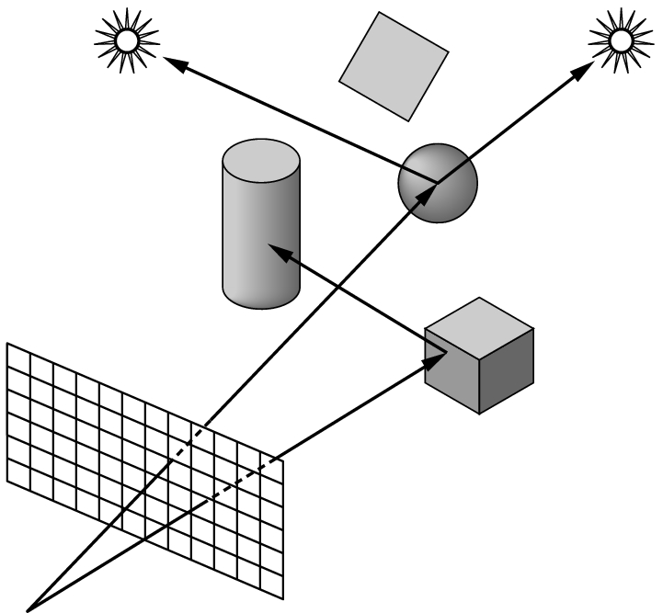
Physical Approaches
Ray tracing: follow rays of light from center of projection until they either are absorbed by objects or go off to infinity
Can handle global effects
Multiple reflections
Translucent objects
Slow
Must have whole data base
available at all times
Radiosity: Energy based approach
Very slow

Slide 6
Practical Approach
Process objects one at a time in the order they are generated by the application
Can consider only local lighting
Pipeline architecture
All steps can be implemented in hardware on the graphics card
application
program
display

Slide 7
Vertex Processing
Much of the work in the pipeline is in converting object representations from one coordinate system to another
Object coordinates
Camera (eye) coordinates
Screen coordinates
Every change of coordinates is equivalent to a matrix transformation
Vertex processor also computes vertex colors

Slide 8
Projection
Projection is the process that combines the 3D viewer with the 3D objects to produce the 2D image
Perspective projections: all projectors meet at the center of projection
Parallel projection: projectors are parallel, center of projection is replaced by a direction of projection

Slide 9
Primitive Assembly
Vertices must be collected into geometric objects before clipping and rasterization can take place
Line segments
Polygons
Curves and surfaces

Slide 10
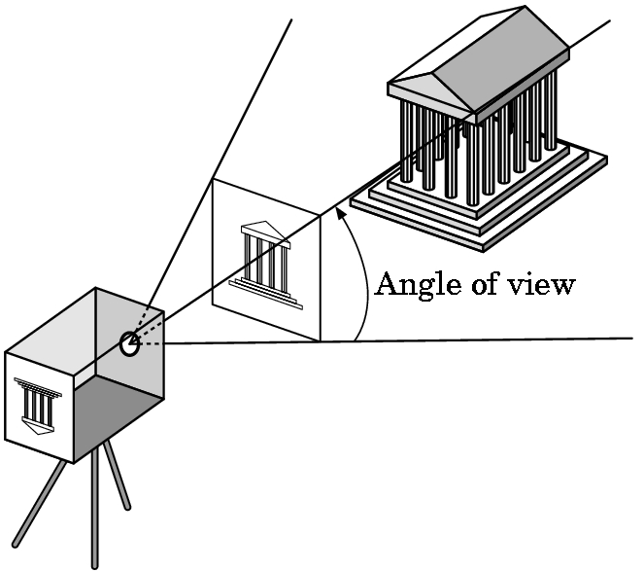
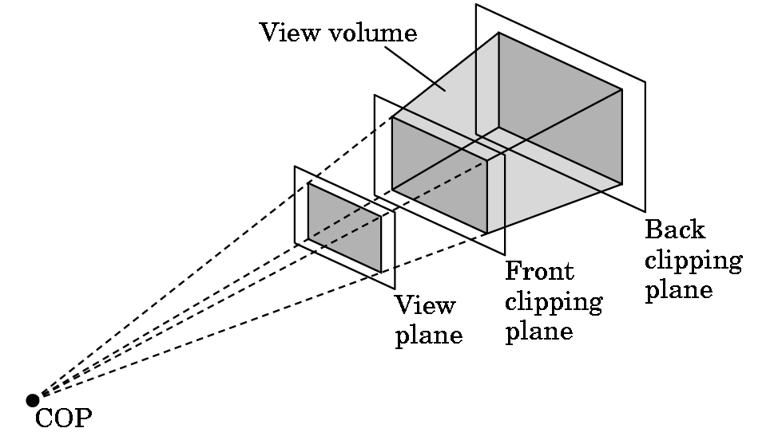
Clipping
Just as a real camera cannot “see” the whole world, the virtual camera can only see part of the world or object space
Objects that are not within this volume are said to be clipped out of the scene

Slide 11
Rasterization
If an object is not clipped out, the appropriate pixels in the frame buffer must be assigned colors
Rasterizer produces a set of fragments for each object
Fragments are “potential pixels”
Have a location in frame bufffer
Color and depth attributes
Vertex attributes are interpolated over objects by the rasterizer

Slide 12
Fragment Processing
Fragments are processed to determine the color of the corresponding pixel in the frame buffer
Colors can be determined by texture mapping or interpolation of vertex colors
Fragments may be blocked by other fragments closer to the camera
Hidden-surface removal

Slide 13
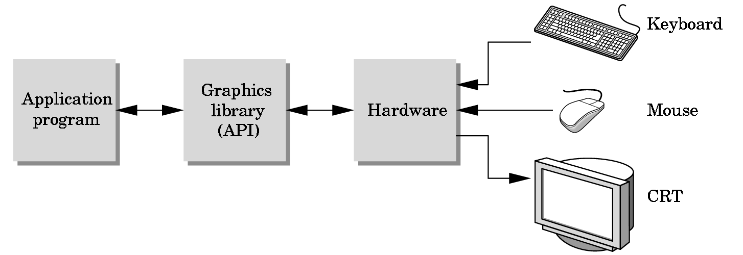
The Programmer’s Interface
Programmer sees the graphics system through a software interface: the Application Programmer Interface (API)

Slide 14
API Contents
Functions that specify what we need to form an image
Objects
Viewer
Light Source(s)
Materials
Other information
Input from devices such as mouse and keyboard
Capabilities of system

Slide 15
Object Specification
Most APIs support a limited set of primitives including
Points (0D object)
Line segments (1D objects)
Polygons (2D objects)
Some curves and surfaces
Quadrics
Parametric polynomials
All are defined through locations in space or vertices

Slide 16
Example (old style)
type of object
location of vertex
glBegin(GL_POLYGON)
glVertex3f(0.0, 0.0, 0.0);
glVertex3f(0.0, 1.0, 0.0);
glVertex3f(0.0, 0.0, 1.0);
glEnd( );
end of object definition

Slide 17
Example (GPU based)
Put geometric data in an array
Send array to GPU
Tell GPU to render as triangle
var points = [
vec3(0.0, 0.0, 0.0),
vec3(0.0, 1.0, 0.0),
vec3(0.0, 0.0, 1.0),
];

Slide 18
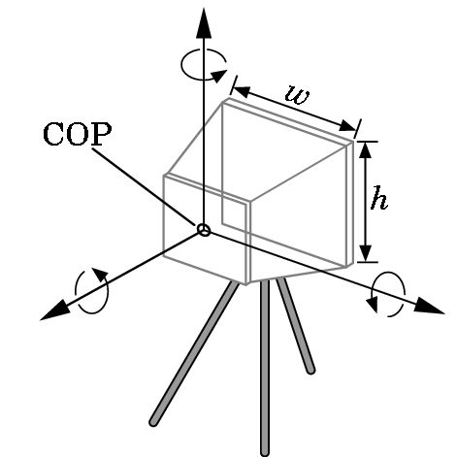
Camera Specification
Six degrees of freedom
Position of center of lens
Orientation
Lens
Film size
Orientation of film plane

Slide 19
Lights and Materials
Types of lights
Point sources vs distributed sources
Spot lights
Near and far sources
Color properties
Material properties
Absorption: color properties
Scattering
Diffuse
Specular

Slide 20
Introduction to Computer Graphics with WebGL
Ed Angel
Professor Emeritus of Computer Science
Founding Director, Arts, Research, Technology and Science Laboratory
University of New Mexico

Slide 21
Programming with WebGL Part 1: Background
Ed Angel
Professor Emeritus of Computer Science
University of New Mexico

Slide 22
Objectives
Development of the OpenGL API
OpenGL Architecture
OpenGL as a state machine
OpenGL as a data flow machine
Functions
Types
Formats
Simple program

Slide 23
Early History of APIs
IFIPS (1973) formed two committees to come up with a standard graphics API
Graphical Kernel System (GKS)
2D but contained good workstation model
Core
Both 2D and 3D
GKS adopted as IS0 and later ANSI standard (1980s)
GKS not easily extended to 3D (GKS-3D)
Far behind hardware development

Slide 24
PHIGS and X
Programmers Hierarchical Graphics System (PHIGS)
Arose from CAD community
Database model with retained graphics (structures)
X Window System
DEC/MIT effort
Client-server architecture with graphics
PEX combined the two
Not easy to use (all the defects of each)

Slide 25
SGI and GL
Silicon Graphics (SGI) revolutionized the graphics workstation by implementing the pipeline in hardware (1982)
To access the system, application programmers used a library called GL
With GL, it was relatively simple to program three dimensional interactive applications

Slide 26
OpenGL
The success of GL lead to OpenGL (1992), a platform-independent API that was
Easy to use
Close enough to the hardware to get excellent performance
Focus on rendering
Omitted windowing and input to avoid window system dependencies

Slide 27
OpenGL Evolution
Originally controlled by an Architectural Review Board (ARB)
Members included SGI, Microsoft, Nvidia, HP, 3DLabs, IBM,…….
Now Kronos Group
Was relatively stable (through version 2.5)
Backward compatible
Evolution reflected new hardware capabilities
3D texture mapping and texture objects
Vertex and fragment programs
Allows platform specific features through extensions

Slide 28
Modern OpenGL
Performance is achieved by using GPU rather than CPU
Control GPU through programs called shaders
Application’s job is to send data to GPU
GPU does all rendering

Slide 29
Immediate Mode Graphics
Geometry specified by vertices
Locations in space( 2 or 3 dimensional)
Points, lines, circles, polygons, curves, surfaces
Immediate mode
Each time a vertex is specified in application, its location is sent to the GPU
Old style uses glVertex
Creates bottleneck between CPU and GPU
Removed from OpenGL 3.1 and OpenGL ES 2.0

Slide 30
Retained Mode Graphics
Put all vertex attribute data in array
Send array to GPU to be rendered immediately
Almost OK but problem is we would have to send array over each time we need another render of it
Better to send array over and store on GPU for multiple renderings

Slide 31
OpenGL 3.1
Totally shader-based
No default shaders
Each application must provide both a vertex and a fragment shader
No immediate mode
Few state variables
Most 2.5 functions deprecated
Backward compatibility not required
Exists a compatibility extension

Slide 32
Other Versions
OpenGL ES
Embedded systems
Version 1.0 simplified OpenGL 2.1
Version 2.0 simplified OpenGL 3.1
Shader based
WebGL
Javascript implementation of ES 2.0
Supported on newer browsers
OpenGL 4.1, 4.2, …..
Add geometry, tessellation, compute shaders

Slide 33
Introduction to Computer Graphics with WebGL
Ed Angel
Professor Emeritus of Computer Science
Founding Director, Arts, Research, Technology and Science Laboratory
University of New Mexico

Slide 34
Programming with WebGL Part 1: Background
Ed Angel
Professor Emeritus of Computer Science
University of New Mexico

Slide 35
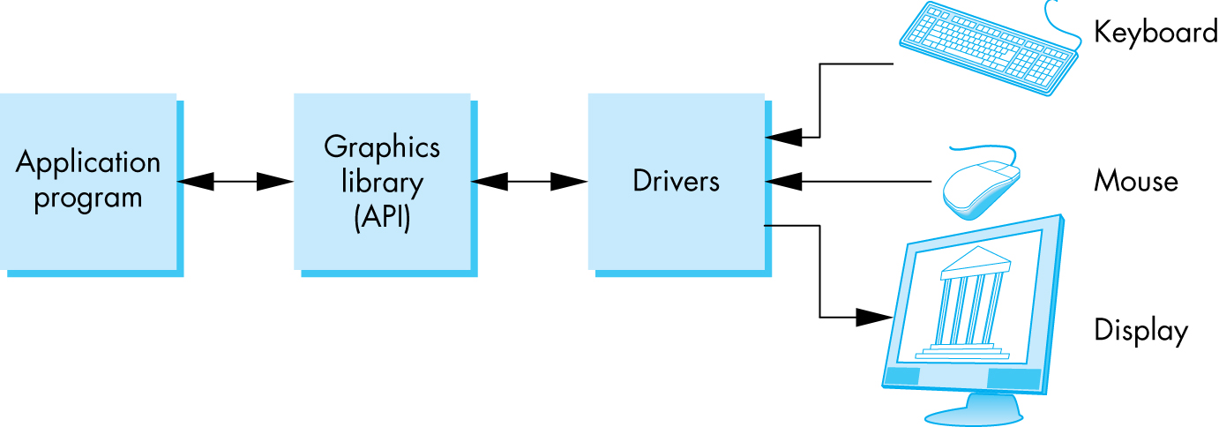
OpenGL Architecture

Slide 36
Software Organization

Slide 37
A OpenGL Simple Program
Generate a square on a solid background

Slide 38
It used to be easy
#include <GL/glut.h>
void mydisplay(){
glClear(GL_COLOR_BUFFER_BIT);
glBegin(GL_QUAD;
glVertex2f(-0.5, -0.5);
glVertex2f(-0,5, 0,5);
glVertex2f(0.5, 0.5);
glVertex2f(0.5, -0.5);
glEnd()
}
int main(int argc, char** argv){
glutCreateWindow("simple");
glutDisplayFunc(mydisplay);
glutMainLoop();
}

Slide 39
What happened?
Most OpenGL functions deprecated
immediate vs retained mode
make use of GPU
Makes heavy use of state variable default values that no longer exist
Viewing
Colors
Window parameters
However, processing loop is the same

Slide 40
Execution in Browser

Slide 41
Event Loop
Remember that the sample program specifies a render function which is a event listener or callback function
Every program should have a render callback
For a static application we need only execute the render function once
In a dynamic application, the render function can call itself recursively but each redrawing of the display must be triggered by an event

Slide 42
Lack of Object Orientation
All versions of OpenGL are not object oriented so that there are multiple functions for a given logical function
Example: sending values to shaders
gl.uniform3f
gl.uniform2i
gl.uniform3dv
Underlying storage mode is the same

Slide 43
WebGL function format
function name
dimension
gl.uniform3f(x,y,z)
x,y,z are variables
belongs to WebGL canvas
gl.uniform3fv(p)
p is an array

Slide 44
WebGL constants
Most constants are defined in the canvas object
In desktop OpenGL, they were in #include files such as gl.h
Examples
desktop OpenGL
glEnable(GL_DEPTH_TEST);
WebGL
gl.enable(gl.DEPTH_TEST)
gl.clear(gl.COLOR_BUFFER_BIT)

Slide 45
WebGL and GLSL
WebGL requires shaders and is based less on a state machine model than a data flow model
Most state variables, attributes and related pre 3.1 OpenGL functions have been deprecated
Action happens in shaders
Job of application is to get data to GPU

Slide 46
GLSL
OpenGL Shading Language
C-like with
Matrix and vector types (2, 3, 4 dimensional)
Overloaded operators
C++ like constructors
Similar to Nvidia’s Cg and Microsoft HLSL
Code sent to shaders as source code
WebGL functions compile, link and get information to shaders

Slide 47
Programming with OpenGL Part 2: Complete Programs
Ed Angel
Professor of Emeritus of Computer Science
University of New Mexico

Slide 48
Objectives
Build a complete first program
Introduce shaders
Introduce a standard program structure
Simple viewing
Two-dimensional viewing as a special case of three-dimensional viewing
Initialization steps and program structure

Slide 49
Square Program

Slide 50
WebGL
Five steps
Describe page (HTML file)
request WebGL Canvas
read in necessary files
Define shaders (HTML file)
could be done with a separate file (browser dependent)
Compute or specify data (JS file)
Send data to GPU (JS file)
Render data (JS file)

Slide 51
square.html
<!DOCTYPE html>
<html>
<head>
<script id="vertex-shader" type="x-shader/x-vertex">
attribute vec4 vPosition;
void main()
{
gl_Position = vPosition;
}
</script>
<script id="fragment-shader" type="x-shader/x-fragment">
precision mediump float;
void main()
{
gl_FragColor = vec4( 1.0, 1.0, 1.0, 1.0 );
}
</script>

Slide 52
Shaders
We assign names to the shaders that we can use in the JS file
These are trivial pass-through (do nothing) shaders that which set the two required built-in variables
gl_Position
gl_FragColor
Note both shaders are full programs
Note vector type vec2
Must set precision in fragment shader

Slide 53
square.html (cont)
<script type="text/javascript" src="../Common/webgl-utils.js"></script>
<script type="text/javascript" src="../Common/initShaders.js"></script>
<script type="text/javascript" src="../Common/MV.js"></script>
<script type="text/javascript" src="square.js"></script>
</head>
<body>
<canvas id="gl-canvas" width="512" height="512">
Oops ... your browser doesn't support the HTML5 canvas element
</canvas>
</body>
</html>

Slide 54
Files
../Common/webgl-utils.js: Standard utilities for setting up WebGL context in Common directory on website
../Common/initShaders.js: contains JS and WebGL code for reading, compiling and linking the shaders
../Common/MV.js: our matrix-vector package
square.js: the application file

Slide 55
square.js
var gl;
var points;
window.onload = function init(){
var canvas = document.getElementById( "gl-canvas" );
gl = WebGLUtils.setupWebGL( canvas );
if ( !gl ) { alert( "WebGL isn't available" );
}
// Four Vertices
var vertices = [
vec2( -0.5, -0.5 ),
vec2( -0.5, 0.5 ),
vec2( 0.5, 0.5 ),
vec2( 0.5, -0.5)
];

Slide 56
Notes
onload: determines where to start execution when all code is loaded
canvas gets WebGL context from HTML file
vertices use vec2 type in MV.js
JS array is not the same as a C or Java array
object with methods
vertices.length // 4
Values in clip coordinates

Slide 57
square.js (cont)
// Configure WebGL
gl.viewport( 0, 0, canvas.width, canvas.height );
gl.clearColor( 0.0, 0.0, 0.0, 1.0 );
// Load shaders and initialize attribute buffers
var program = initShaders( gl, "vertex-shader", "fragment-shader" );
gl.useProgram( program );
// Load the data into the GPU
var bufferId = gl.createBuffer();
gl.bindBuffer( gl.ARRAY_BUFFER, bufferId );
gl.bufferData( gl.ARRAY_BUFFER, flatten(vertices), gl.STATIC_DRAW );
// Associate out shader variables with our data buffer
var vPosition = gl.getAttribLocation( program, "vPosition" );
gl.vertexAttribPointer( vPosition, 2, gl.FLOAT, false, 0, 0 );
gl.enableVertexAttribArray( vPosition );

Slide 58
Notes
initShaders used to load, compile and link shaders to form a program object
Load data onto GPU by creating a vertex buffer object on the GPU
Note use of flatten() to convert JS array to an array of float32’s
Finally we must connect variable in program with variable in shader
need name, type, location in buffer

Slide 59
square.js (cont)
render();
};
function render() {
gl.clear( gl.COLOR_BUFFER_BIT );
gl.drawArrays( gl.TRIANGLE_FAN, 0, 4 );
}
1
2
3
0

Slide 60
Triangles, Fans or Strips
gl.drawArrays( gl.TRIANGLES, 0, 6 ); // 0, 1, 2, 0, 2, 3
gl.drawArrays( gl.TRIANGLE_FAN, 0, 4 ); // 0, 1 , 2, 3
1
2
1
2
0
3
0
3
gl.drawArrays( gl.TRIANGLE_STRIP, 0, 4 ); // 0, 1, 3, 2

Slide 61
Programming with OpenGL Part 2: Complete Programs
Ed Angel
Professor of Emeritus of Computer Science
University of New Mexico

Slide 62
Objectives
Build a complete first program
Introduce shaders
Introduce a standard program structure
Simple viewing
Two-dimensional viewing as a special case of three-dimensional viewing
Initialization steps and program structure

Slide 63
Program Execution
WebGL runs within the browser
complex interaction among the operating system, the window system, the browser and your code (HTML and JS)
Simple model
Start with HTML file
files read in asynchronously
start with onload function
event driven input

Slide 64
Coordinate Systems
The units in points are determined by the application and are called object, world, model or problem coordinates
Viewing specifications usually are also in object coordinates
Eventually pixels will be produced in window coordinates
WebGL also uses some internal representations that usually are not visible to the application but are important in the shaders
Most important is clip coordinates

Slide 65
Coordinate Systems and Shaders
Vertex shader must output in clip coordinates
Input to fragment shader from rasterizer is in window coordinates
Application can provide vertex data in any coordinate system but shader must eventually produce gl_Position in clip coordinates
Simple example uses clip coordinates

Slide 66
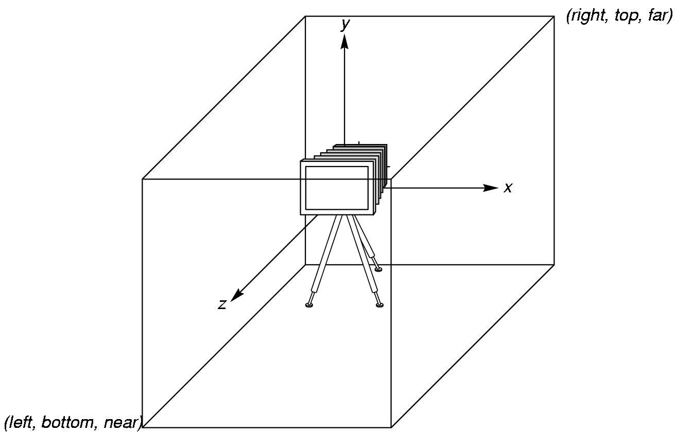
WebGL Camera
WebGL places a camera at the origin in object space pointing in the negative z direction
The default viewing volume
is a box centered at the
origin with sides of
length 2

Slide 67
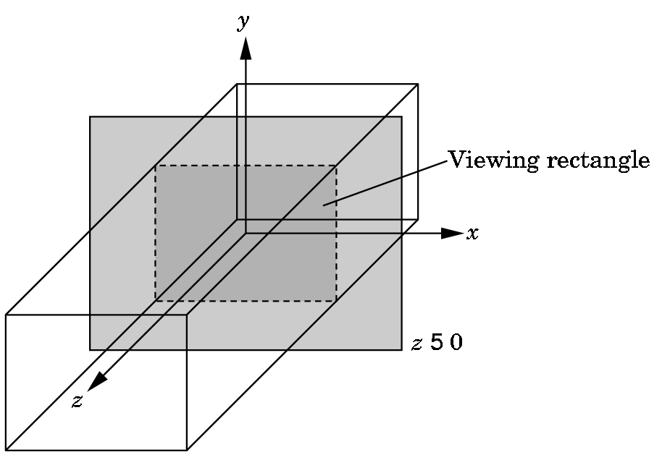
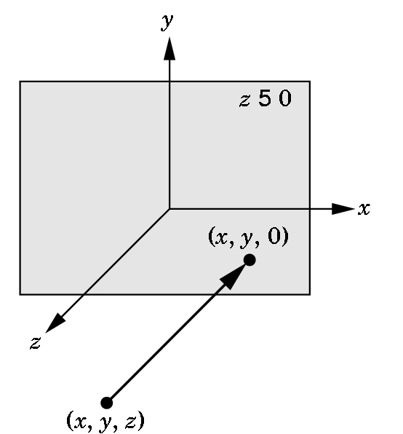
Orthographic Viewing
In the default orthographic view, points are
projected forward along the z axis onto the
plane z=0
z=0
z=0

Slide 68
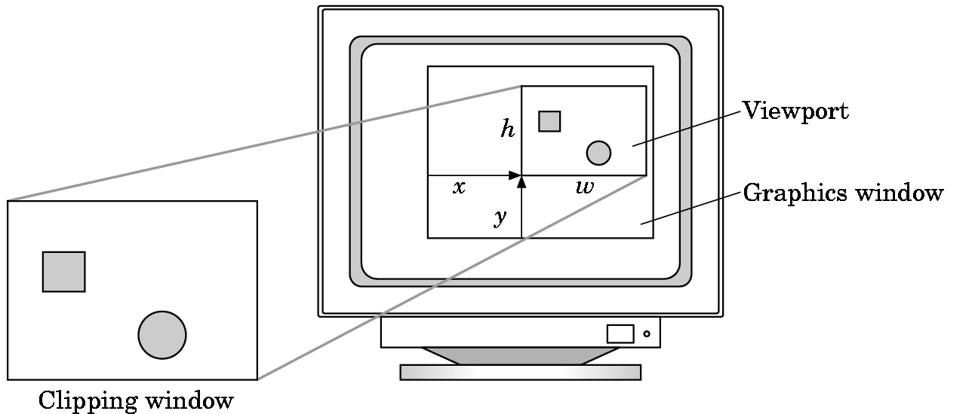
Viewports
Do not have use the entire window for the image: gl.viewport(x,y,w,h)
Values in pixels (window coordinates)

Slide 69
Transformations and Viewing
In WebGL, we usually carry out projection using a projection matrix (transformation) before rasterization
Transformation functions are also used for changes in coordinate systems
Pre 3.1 OpenGL had a set of transformation functions which have been deprecated
Three choices in WebGL
Application code
GLSL functions
MV.js

Slide 70
First Assignment: Tessellation and Twist
Consider rotating a 2D point about the origin
Now let amount of rotation depend on distance from origin giving us twist

Slide 71
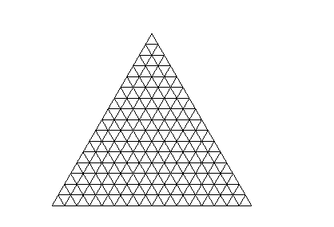
Example
triangle
tessellated triangle
twist without tessellation
twist after tessellation

