Slide 1
Introduction to Computer Graphics with WebGL
Ed Angel
Professor Emeritus of Computer Science
Founding Director, Arts, Research, Technology and Science Laboratory
University of New Mexico

Slide 2
Programming with WebGL Part 3: Shaders
Ed Angel
Professor of Emeritus of Computer Science
University of New Mexico

Slide 3
Objectives
Simple Shaders
Vertex shader
Fragment shaders
Programming shaders with GLSL
Finish first program

Slide 4
Vertex Shader Applications
Moving vertices
Morphing
Wave motion
Fractals
Lighting
More realistic models
Cartoon shaders

Slide 5
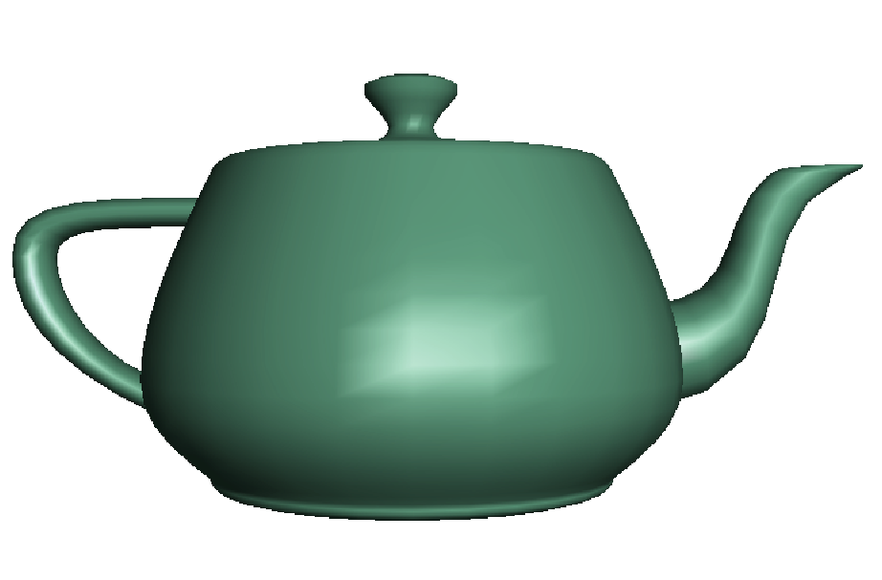
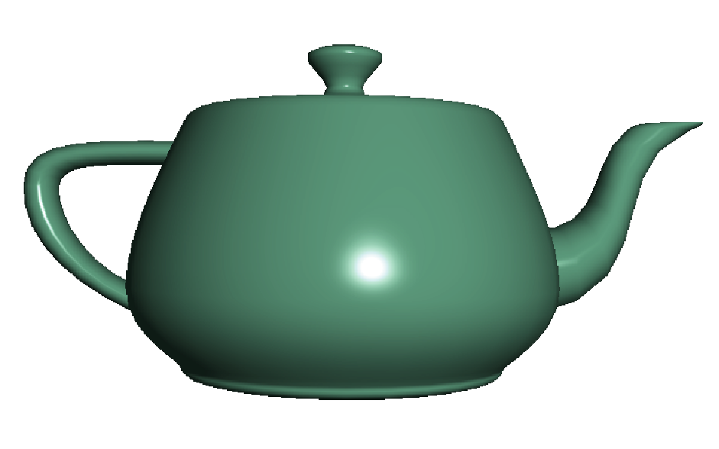
Fragment Shader Applications
Per fragment lighting calculations
per vertex lighting
per fragment lighting

Slide 6
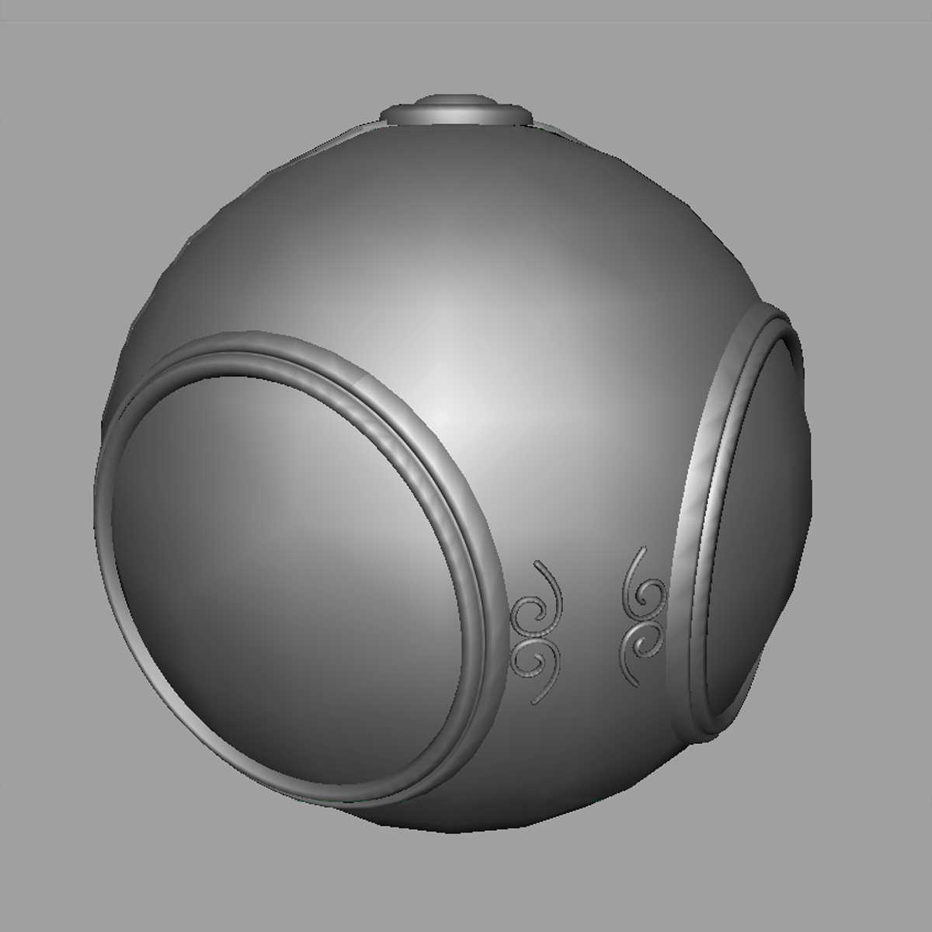
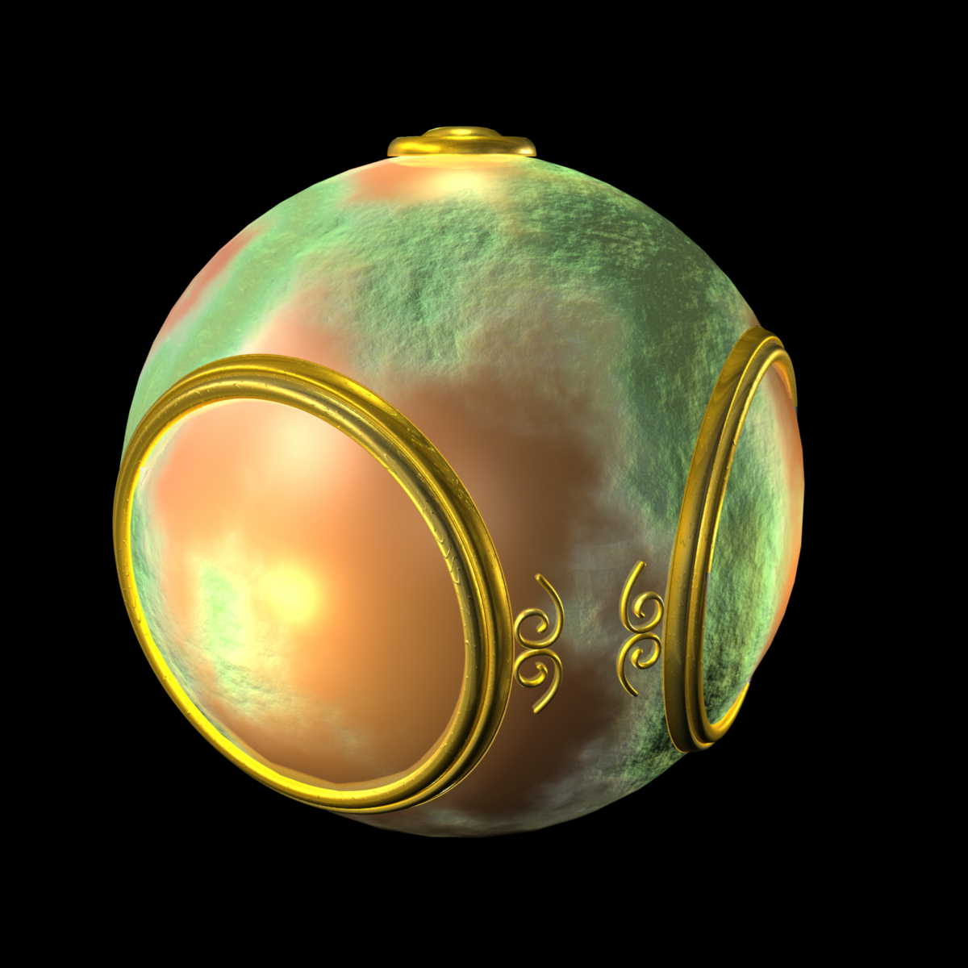
Fragment Shader Applications
Texture mapping
smooth shading
environment
mapping
bump mapping

Slide 7
Writing Shaders
First programmable shaders were programmed in an assembly-like manner
OpenGL extensions added functions for vertex and fragment shaders
Cg (C for graphics) C-like language for programming shaders
Works with both OpenGL and DirectX
Interface to OpenGL complex
OpenGL Shading Language (GLSL)

Slide 8
GLSL
OpenGL Shading Language
Part of OpenGL 2.0 and up
High level C-like language
New data types
Matrices
Vectors
Samplers
As of OpenGL 3.1, application must provide shaders

Slide 9
Simple Vertex Shader
attribute vec4 vPosition;
void main(void)
{
gl_Position = vPosition;
}
input from application
must link to variable in application
built in variable

Slide 10
Execution Model
Vertex data
Shader Program
GPU
Application
Program
Vertex
Shader
Primitive
Assembly
gl.drawArrays
Vertex

Slide 11
Simple Fragment Program
precision mediump float;
void main(void)
{
gl_FragColor = vec4(1.0, 0.0, 0.0, 1.0);
}

Slide 12
Execution Model
Application
Shader Program
Rasterizer
Fragment
Shader
Frame Buffer
Fragment
Fragment
Color

Slide 13
Introduction to Computer Graphics with WebGL
Ed Angel
Professor Emeritus of Computer Science
Founding Director, Arts, Research, Technology and Science Laboratory
University of New Mexico

Slide 14
Programming with WebGL Part 3: Shaders
Ed Angel
Professor of Emeritus of Computer Science
University of New Mexico

Slide 15
Data Types
C types: int, float, bool
Vectors:
float vec2, vec3, vec4
Also int (ivec) and boolean (bvec)
Matrices: mat2, mat3, mat4
Stored by columns
Standard referencing m[row][column]
C++ style constructors
vec3 a =vec3(1.0, 2.0, 3.0)
vec2 b = vec2(a)

Slide 16
No Pointers
There are no pointers in GLSL
We can use C structs which
can be copied back from functions
Because matrices and vectors are basic types they can be passed into and output from GLSL functions, e.g.
mat3 func(mat3 a)
variables passed by copying

Slide 17
Qualifiers
GLSL has many of the same qualifiers such as const as C/C++
Need others due to the nature of the execution model
Variables can change
Once per primitive
Once per vertex
Once per fragment
At any time in the application
Vertex attributes are interpolated by the rasterizer into fragment attributes

Slide 18
Attribute Qualifier
Attribute-qualified variables can change at most once per vertex
There are a few built in variables such as gl_Position but most have been deprecated
User defined (in application program)
attribute float temperature
attribute vec3 velocity
recent versions of GLSL use in and out qualifiers to get to and from shaders

Slide 19
Uniform Qualified
Variables that are constant for an entire primitive
Can be changed in application and sent to shaders
Cannot be changed in shader
Used to pass information to shader such as the time or a bounding box of a primitive or transformation matrices

Slide 20
Varying Qualified
Variables that are passed from vertex shader to fragment shader
Automatically interpolated by the rasterizer
With WebGL, GLSL uses the varying qualifier in both shaders
varying vec4 color;
More recent versions of WebGL use out in vertex shader and in in the fragment shader
out vec4 color; //vertex shader
in vec4 color; // fragment shader

Slide 21
Our Naming Convention
attributes passed to vertex shader have names beginning with v (vPosition, vColor) in both the application and the shader
Note that these are different entities with the same name
Varying variables begin with f (fColor) in both shaders
must have same name
Uniform variables are unadorned and can have the same name in application and shaders

Slide 22
Example: Vertex Shader
attribute vec4 vColor;
varying vec4 fColor; //out vec4 fColor;
void main()
{
gl_Position = vPosition;
fColor = vColor;
}

Slide 23
Corresponding Fragment Shader
precision mediump float;
varying vec4 fColor; //in vec4 fColor;
void main()
{
gl_FragColor = fColor;
}

Slide 24
Sending Colors from Application
var cBuffer = gl.createBuffer();
gl.bindBuffer( gl.ARRAY_BUFFER, cBuffer );
gl.bufferData( gl.ARRAY_BUFFER, flatten(colors),
gl.STATIC_DRAW );
var vColor = gl.getAttribLocation( program, "vColor" );
gl.vertexAttribPointer( vColor, 3, gl.FLOAT, false, 0, 0 );
gl.enableVertexAttribArray( vColor );

Slide 25
Sending a Uniform Variable
// in application
vec4 color = vec4(1.0, 0.0, 0.0, 1.0);
colorLoc = gl.getUniformLocation( program, ”color" );
gl.uniform4f( colorLoc, color);
// in fragment shader (similar in vertex shader)
uniform vec4 color;
void main()
{
gl_FragColor = color;
}

Slide 26
Operators and Functions
Standard C functions
Trigonometric
Arithmetic
Normalize, reflect, length
Overloading of vector and matrix types
mat4 a;
vec4 b, c, d;
c = b*a; // a column vector stored as a 1d array
d = a*b; // a row vector stored as a 1d array

Slide 27
Swizzling and Selection
Can refer to array elements by element using [] or selection (.) operator with
x, y, z, w
r, g, b, a
s, t, p, q
a[2], a.b, a.z, a.p are the same
Swizzling operator lets us manipulate components
vec4 a, b;
a.yz = vec2(1.0, 2.0, 3.0, 4.0);
b = a.yxzw;

Slide 28
Introduction to Computer Graphics with WebGL
Ed Angel
Professor Emeritus of Computer Science
Founding Director, Arts, Research, Technology and Science Laboratory
University of New Mexico

Slide 29
Programming with WebGL Part 4: Color and Attributes
Ed Angel
Professor of Emeritus of Computer Science
University of New Mexico

Slide 30
Objectives
Expanding primitive set
Adding color
Vertex attributes

Slide 31
WebGLPrimitives
GL_POINTS
GL_LINES
GL_LINE_STRIP
GL_LINE_LOOP
GL_TRIANGLES
GL_TRIANGLE_STRIP
GL_TRIANGLE_FAN

Slide 32
Polygon Issues
WebGL will only display triangles
Simple: edges cannot cross
Convex: All points on line segment between two points in a polygon are also in the polygon
Flat: all vertices are in the same plane
Application program must tessellate a polygon into triangles (triangulation)
OpenGL 4.1 contains a tessellator but not WebGL
nonconvex polygon
nonsimple polygon

Slide 33
Polygon Testing
Conceptually simple to test for simplicity and convexity
Time consuming
Earlier versions assumed both and left testing to the application
Present version only renders triangles
Need algorithm to triangulate an arbitrary polygon

Slide 34
Good and Bad Triangles
Long thin triangles render badly
Equilateral triangles render well
Maximize minimum angle
Delaunay triangulation for unstructured points

Slide 35
Triangularization
Convex polygon
Start with abc, remove b, then acd, ….
d
c
b
a

Slide 36
Non-convex (concave)

Slide 37
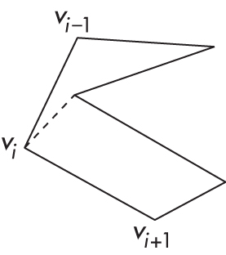
Recursive Division
Find leftmost vertex and split

Slide 38
Attributes
Attributes determine the appearance of objects
Color (points, lines, polygons)
Size and width (points, lines)
Stipple pattern (lines, polygons)
Polygon mode
Display as filled: solid color or stipple pattern
Display edges
Display vertices
Only a few (gl_PointSize) are supported by WebGL functions

Slide 39
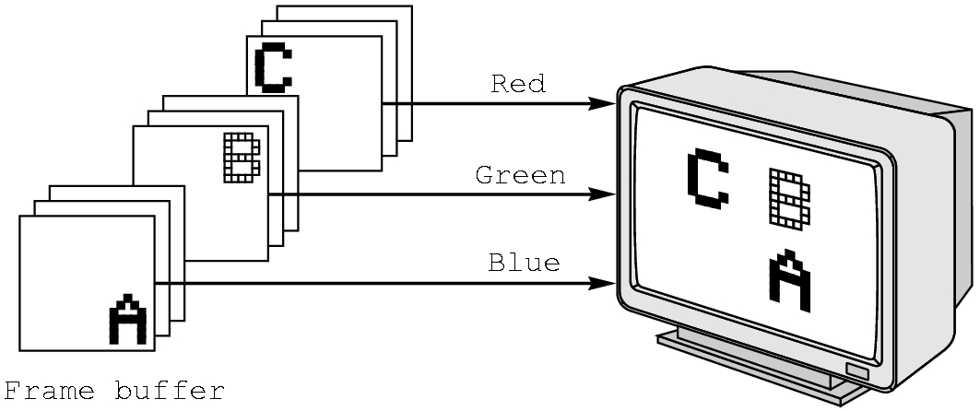
RGB color
Each color component is stored separately in the frame buffer
Usually 8 bits per component in buffer
Color values can range from 0.0 (none) to 1.0 (all) using floats or over the range from 0 to 255 using unsigned bytes

Slide 40
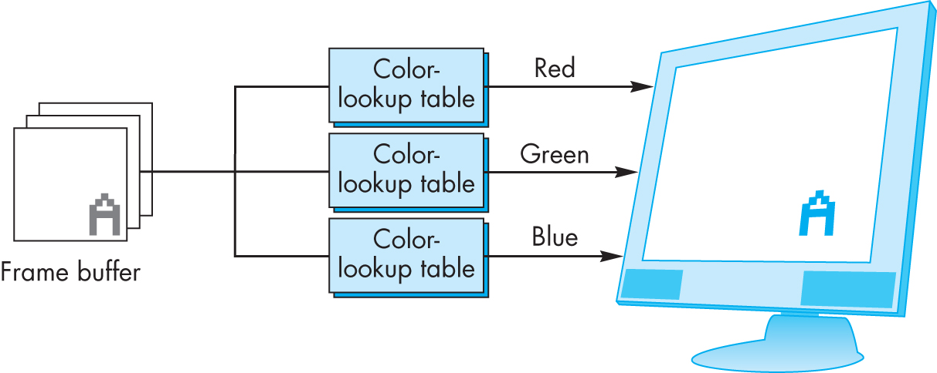
Indexed Color
Colors are indices into tables of RGB values
Requires less memory
indices usually 8 bits
not as important now
Memory inexpensive
Need more colors for shading

Slide 41
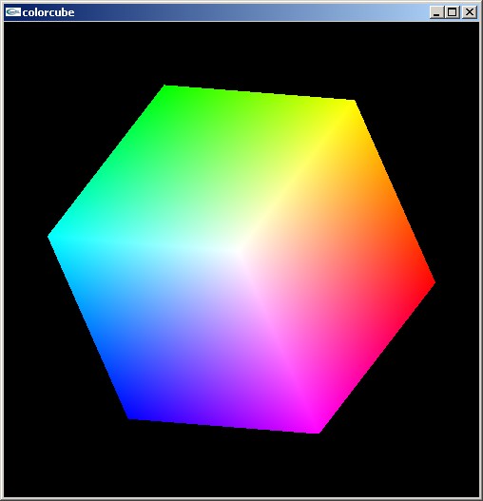
Smooth Color
Default is smooth shading
Rasterizer interpolates vertex colors across visible polygons
Alternative is flat shading
Color of first vertex
determines fill color
Handle in shader

Slide 42
Setting Colors
Colors are ultimately set in the fragment shader but can be determined in either shader or in the application
Application color: pass to vertex shader as a uniform variable or as a vertex attribute
Vertex shader color: pass to fragment shader as varying variable
Fragment color: can alter via shader code

