Slide 1
Building Models
Ed Angel
Professor Emeritus of Computer Science
University of New Mexico

Slide 2
Objectives
Introduce simple data structures for building polygonal models
Vertex lists
Edge lists

Slide 3
Representing a Mesh
Consider a mesh
There are 8 nodes and 12 edges
5 interior polygons
6 interior (shared) edges
Each vertex has a location v_{i} = (x_{i} y_{i} z_{i})
e₂
v₅
v₆
e₃
e₉
e₈
v₈
v₄
e₁
e₁₁
e₁₀
e₇
v₇
e₄
v₁
v₂
e₁₂
e₆
v₃
e₅

Slide 4
Simple Representation
Define each polygon by the geometric locations of its vertices
Leads to WebGL code such as
Inefficient and unstructured
Consider moving a vertex to a new location
Must search for all occurrences
vertex.push(vec3(x1, y1, z1));
vertex.push(vec3(x6, y6, z6));
vertex.push(vec3(x7, y7, z7));

Slide 5
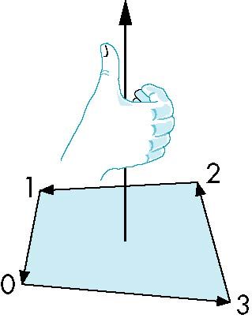
Inward and Outward Facing Polygons
The order {v₁, v₆, v₇} and {v₆, v₇, v₁} are equivalent in that the same polygon will be rendered by OpenGL but the order {v₁, v₇, v₆} is different
The first two describe outwardly
facing polygons
Use the right-hand rule =
counter-clockwise encirclement
of outward-pointing normal
OpenGL can treat inward and
outward facing polygons differently

Slide 6
Geometry vs Topology
Generally it is a good idea to look for data structures that separate the geometry from the topology
Geometry: locations of the vertices
Topology: organization of the vertices and edges
Example: a polygon is an ordered list of vertices with an edge connecting successive pairs of vertices and the last to the first
Topology holds even if geometry changes

Slide 7
Vertex Lists
Put the geometry in an array
Use pointers from the vertices into this array
Introduce a polygon list
x₁ y₁ z₁
x₂ y₂ z₂
x₃ y₃ z₃
x₄ y₄ z₄
x₅ y₅ z_{5.}
x₆ y₆ z₆
x₇ y₇ z₇
x₈ y₈ z₈
v₁
v₇
v₆
P1
P2
P3
P4
P5
v₈
v₅
v₆
topology
geometry

Slide 8
Shared Edges
Vertex lists will draw filled polygons correctly but if we draw the polygon by its edges, shared edges are drawn twice
Can store mesh by edge list

Slide 9
Edge List
e₂
v₅
x₁ y₁ z₁
x₂ y₂ z₂
x₃ y₃ z₃
x₄ y₄ z₄
x₅ y₅ z_{5.}
x₆ y₆ z₆
x₇ y₇ z₇
x₈ y₈ z₈
v₆
e₃
e1
e2
e3
e4
e5
e6
e7
e8
e9
v1
v6
e₉
e₈
v₈
e₁
e₁₁
e₁₀
e₇
v₇
e₄
v₁
v₂
e₁₂
e₆
v₃
e₅
Note polygons are
not represented

Slide 10
Draw cube from faces
var colorCube( )
{
quad(0,3,2,1);
quad(2,3,7,6);
quad(0,4,7,3);
quad(1,2,6,5);
quad(4,5,6,7);
quad(0,1,5,4);
}
5
6
2
1
7
4
0
3

Slide 11
Introduction to Computer Graphics with WebGL
Ed Angel
Professor Emeritus of Computer Science
Founding Director, Arts, Research, Technology and Science Laboratory
University of New Mexico

Slide 12
The Rotating Square
Ed Angel
Professor Emeritus of Computer Science
University of New Mexico

Slide 13
Objectives
Put everything together to display rotating cube
Two methods of display
by arrays
by elements

Slide 14
Modeling a Cube
Define global array for vertices
var vertices = [
vec3( -0.5, -0.5, 0.5 ),
vec3( -0.5, 0.5, 0.5 ),
vec3( 0.5, 0.5, 0.5 ),
vec3( 0.5, -0.5, 0.5 ),
vec3( -0.5, -0.5, -0.5 ),
vec3( -0.5, 0.5, -0.5 ),
vec3( 0.5, 0.5, -0.5 ),
vec3( 0.5, -0.5, -0.5 )
];

Slide 15
Colors
Define global array for colors
var vertexColors = [
[ 0.0, 0.0, 0.0, 1.0 ], // black
[ 1.0, 0.0, 0.0, 1.0 ], // red
[ 1.0, 1.0, 0.0, 1.0 ], // yellow
[ 0.0, 1.0, 0.0, 1.0 ], // green
[ 0.0, 0.0, 1.0, 1.0 ], // blue
[ 1.0, 0.0, 1.0, 1.0 ], // magenta
[ 0.0, 1.0, 1.0, 1.0 ], // cyan
[ 1.0, 1.0, 1.0, 1.0 ] // white
];

Slide 16
Draw cube from faces
function colorCube( )
{
quad(0,3,2,1);
quad(2,3,7,6);
quad(0,4,7,3);
quad(1,2,6,5);
quad(4,5,6,7);
quad(0,1,5,4);
}
5
6
2
1
7
4
0
3
Note that vertices are ordered so that
we obtain correct outward facing normals
Each quad generates two triangles

Slide 17
Initialization
var canvas, gl;
var numVertices = 36;
var points = [];
var colors = [];
window.onload = function init(){
canvas = document.getElementById( "gl-canvas" );
gl = WebGLUtils.setupWebGL( canvas );
colorCube();
gl.viewport( 0, 0, canvas.width, canvas.height );
gl.clearColor( 1.0, 1.0, 1.0, 1.0 );
gl.enable(gl.DEPTH_TEST);
// rest of initialization and html file
// same as previous examples

Slide 18
The quad Function
Put position and color data for two triangles from a list of indices into the array vertices
var quad(a, b, c, d)
{
var indices = [ a, b, c, a, c, d ];
for ( var i = 0; i < indices.length; ++i ) {
points.push( vertices[indices[i]]);
colors.push( vertexColors[indices[i]] );
// for solid colored faces use
//colors.push(vertexColors[a]);
}
}

Slide 19
Render Function
function render(){
gl.clear( gl.COLOR_BUFFER_BIT |gl.DEPTH_BUFFER_BIT);
gl.drawArrays( gl.TRIANGLES, 0, numVertices );
requestAnimFrame( render );
}

Slide 20
Mapping indices to faces
var indices = [
1,0,3,
3,2,1,
2,3,7,
7,6,2,
3,0,4,
4,7,3,
6,5,1,
1,2,6,
4,5,6,
6,7,4,
5,4,0,
0,1,5
];

Slide 21
Rendering by Elements
Send indices to GPU
Render by elements
Even more efficient if we use triangle strips or triangle fans
var iBuffer = gl.createBuffer();
gl.bindBuffer(gl.ELEMENT_ARRAY_BUFFER, iBuffer);
gl.bufferData(gl.ELEMENT_ARRAY_BUFFER,
new Uint8Array(indices), gl.STATIC_DRAW);
gl.drawElements( gl.TRIANGLES, numVertices,
gl.UNSIGNED_BYTE, 0 );

Slide 22
Adding Buttons for Rotation
var xAxis = 0;
var yAxis = 1;
var zAxis = 2;
var axis = 0;
var theta = [ 0, 0, 0 ];
var thetaLoc;
document.getElementById( "xButton" ).onclick = function () { axis = xAxis; }; document.getElementById( "yButton" ).onclick = function () { axis = yAxis; }; document.getElementById( "zButton" ).onclick = function () { axis = zAxis; };

Slide 23
Render Function
function render(){
gl.clear( gl.COLOR_BUFFER_BIT |gl.DEPTH_BUFFER_BIT);
theta[axis] += 2.0;
gl.uniform3fv(thetaLoc, theta);
gl.drawArrays( gl.TRIANGLES, 0, numVertices );
requestAnimFrame( render );
}

Slide 24
Introduction to Computer Graphics with WebGL
Ed Angel
Professor Emeritus of Computer Science
Founding Director, Arts, Research, Technology and Science Laboratory
University of New Mexico

Slide 25
Classical Viewing
Ed Angel
Professor Emeritus of Computer Science
University of New Mexico

Slide 26
Objectives
Introduce the classical views
Compare and contrast image formation by computer with how images have been formed by architects, artists, and engineers
Learn the benefits and drawbacks of each type of view

Slide 27
Classical Viewing
Viewing requires three basic elements
One or more objects
A viewer with a projection surface
Projectors that go from the object(s) to the projection surface
Classical views are based on the relationship among these elements
The viewer picks up the object and orients it how she would like to see it
Each object is assumed to constructed from flat principal faces
Buildings, polyhedra, manufactured objects

Slide 28
Planar Geometric Projections
Standard projections project onto a plane
Projectors are lines that either
converge at a center of projection
are parallel
Such projections preserve lines
but not necessarily angles
Nonplanar projections are needed for applications such as map construction

Slide 29
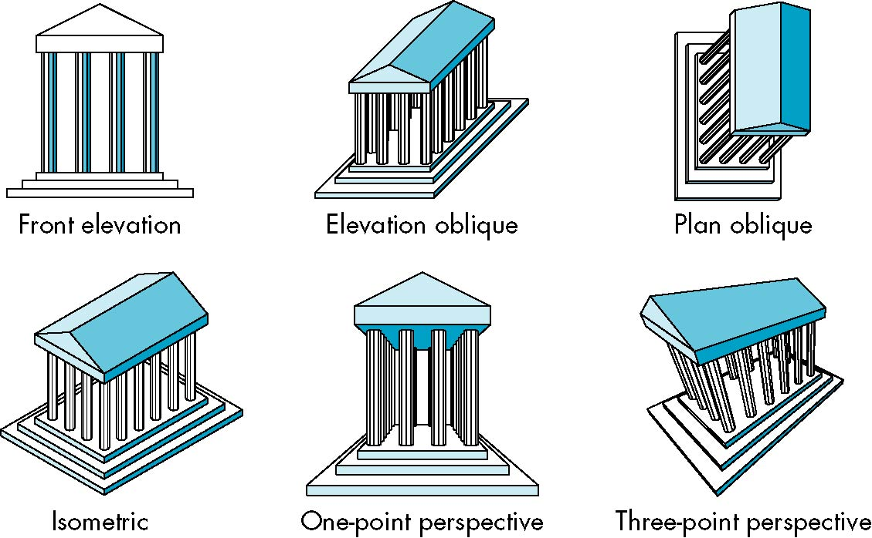
Classical Projections

Slide 30
Perspective vs Parallel
Computer graphics treats all projections the same and implements them with a single pipeline
Classical viewing developed different techniques for drawing each type of projection
Fundamental distinction is between parallel and perspective viewing even though mathematically parallel viewing is the limit of perspective viewing

Slide 31
Taxonomy of Planar Geometric Projections
planar geometric projections
parallel
perspective
1 point
2 point
3 point
multiview
orthographic
axonometric
oblique
isometric
dimetric
trimetric

Slide 32
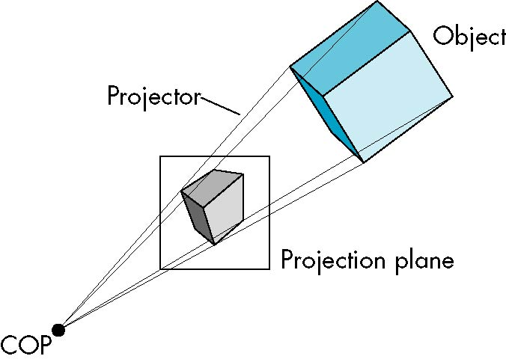
Perspective Projection

Slide 33
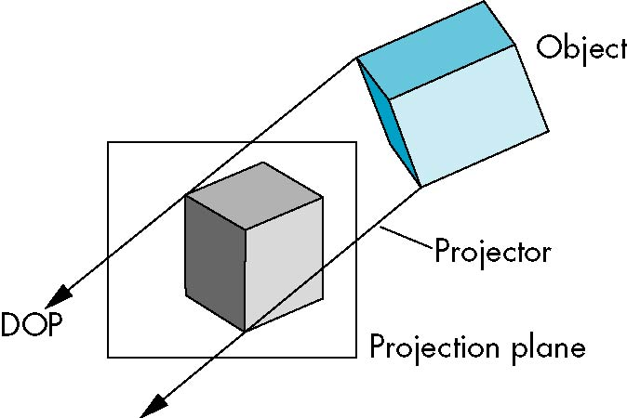
Parallel Projection

Slide 34
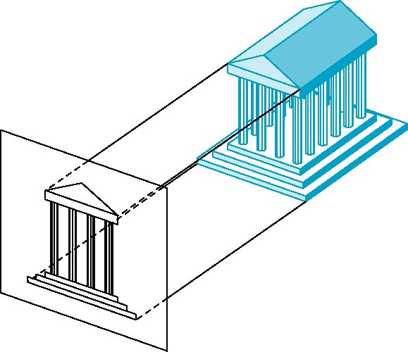
Orthographic Projection
Projectors are orthogonal to projection surface

Slide 35
Multiview Orthographic Projection
Projection plane parallel to principal face
Usually form front, top, side views
isometric (not multiview
orthographic view)
front
in CAD and architecture,
we often display three
multiviews plus isometric
side
top

Slide 36
Advantages and Disadvantages
Preserves both distances and angles
Shapes preserved
Can be used for measurements
Building plans
Manuals
Cannot see what object really looks like because many surfaces hidden from view
Often we add the isometric

Slide 37
Axonometric Projections
Allow projection plane to move relative to object
classify by how many angles of
a corner of a projected cube are
the same
none: trimetric
two: dimetric
three: isometric
θ ₁
θ ₂
θ ₃

Slide 38
Types of Axonometric Projections

Slide 39
Advantages and Disadvantages
Lines are scaled (foreshortened) but can find scaling factors
Lines preserved but angles are not
Projection of a circle in a plane not parallel to the projection plane is an ellipse
Can see three principal faces of a box-like object
Some optical illusions possible
Parallel lines appear to diverge
Does not look real because far objects are scaled the same as near objects
Used in CAD applications

Slide 40
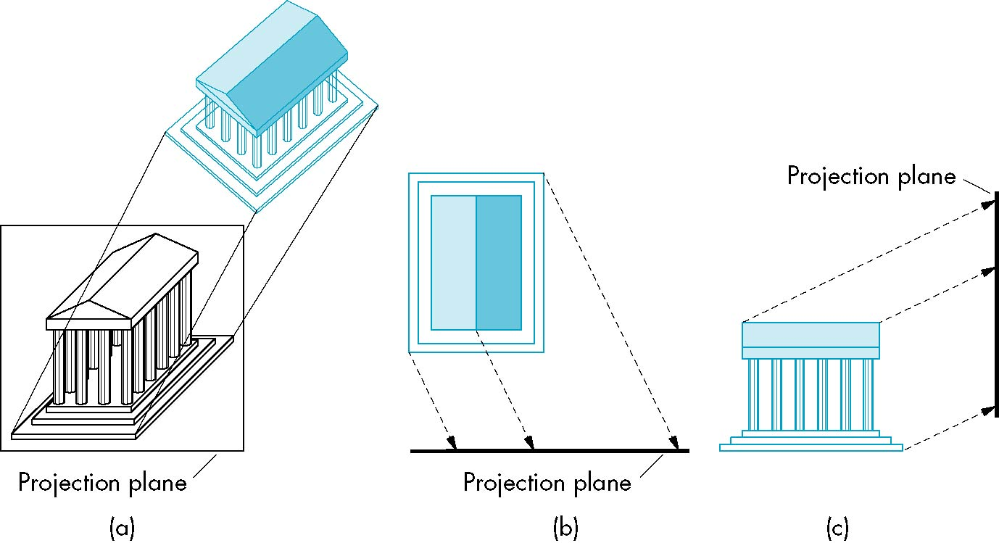
Oblique Projection
Arbitrary relationship between projectors and projection plane

Slide 41
Advantages and Disadvantages
Can pick the angles to emphasize a particular face
Architecture: plan oblique, elevation oblique
Angles in faces parallel to projection plane are preserved while we can still see “around” side
In physical world, cannot create with simple camera; possible with bellows camera or special lens (architectural)

Slide 42
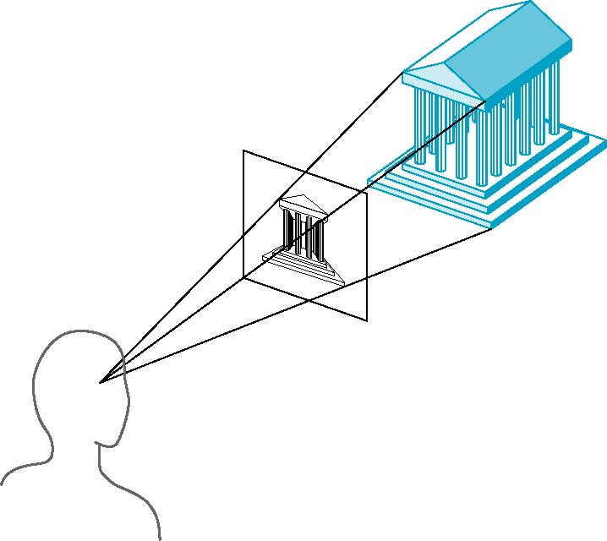
Perspective Projection
Projectors coverge at center of projection

Slide 43
Vanishing Points
Parallel lines (not parallel to the projection plan) on the object converge at a single point in the projection (the vanishing point)
Drawing simple perspectives by hand uses these vanishing point(s)
vanishing point

Slide 44
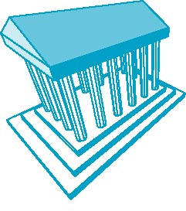
Three-Point Perspective
No principal face parallel to projection plane
Three vanishing points for cube

Slide 45
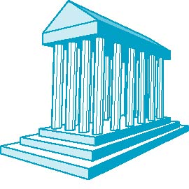
Two-Point Perspective
On principal direction parallel to projection plane
Two vanishing points for cube

Slide 46
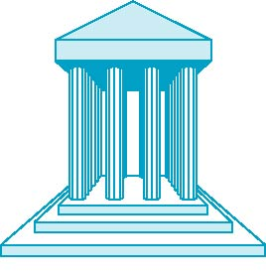
One-Point Perspective
One principal face parallel to projection plane
One vanishing point for cube

Slide 47
Advantages and Disadvantages
Objects further from viewer are projected smaller than the same sized objects closer to the viewer (diminution)
Looks realistic
Equal distances along a line are not projected into equal distances (nonuniform foreshortening)
Angles preserved only in planes parallel to the projection plane
More difficult to construct by hand than parallel projections (but not more difficult by computer)

Slide 48
Introduction to Computer Graphics with WebGL
Ed Angel
Professor Emeritus of Computer Science
Founding Director, Arts, Research, Technology and Science Laboratory
University of New Mexico

Slide 49
Computer Viewing Positioning the Camera
Ed Angel
Professor Emeritus of Computer Science
University of New Mexico

Slide 50
Objectives
Introduce the mathematics of projection
Introduce WebGL viewing functions in MV.js
Look at alternate viewing APIs

Slide 51
From the Beginning
In the beginning:
fixed function pipeline
Model-View and Projection Transformation
Predefined frames: model, object, camera, clip, ndc, window
After deprecation
pipeline with programmable shaders
no transformations
clip, ndc window frames
MV.js reintroduces original capabilities

Slide 52
Computer Viewing
There are three aspects of the viewing process, all of which are implemented in the pipeline,
Positioning the camera
Setting the model-view matrix
Selecting a lens
Setting the projection matrix
Clipping
Setting the view volume

Slide 53
The WebGL Camera
In WebGL, initially the object and camera frames are the same
Default model-view matrix is an identity
The camera is located at origin and points in the negative z direction
WebGL also specifies a default view volume that is a cube with sides of length 2 centered at the origin
Default projection matrix is an identity

Slide 54
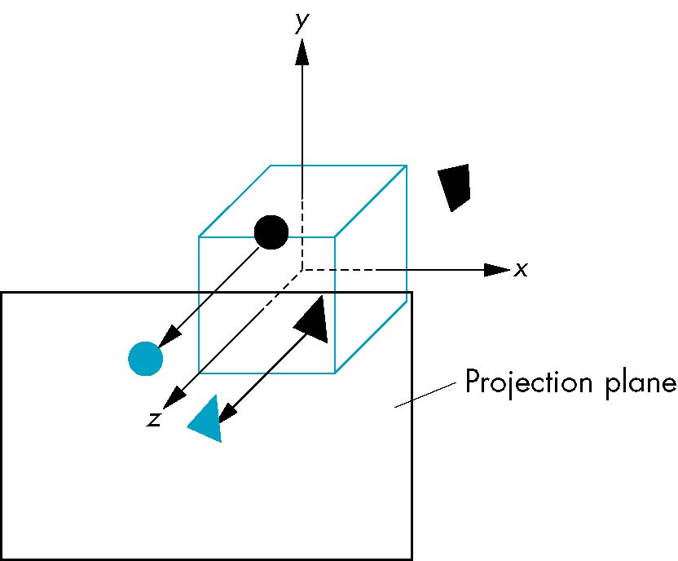
Default Projection
Default projection is orthogonal
clipped out
2
z=0

Slide 55
Moving the Camera Frame
If we want to visualize objects with both positive and negative z values we can either
Move the camera in the positive z direction
Translate the camera frame
Move the objects in the negative z direction
Translate the world frame
Both of these views are equivalent and are determined by the model-view matrix
Want a translation (translate(0.0,0.0,-d);)
d > 0

Slide 56
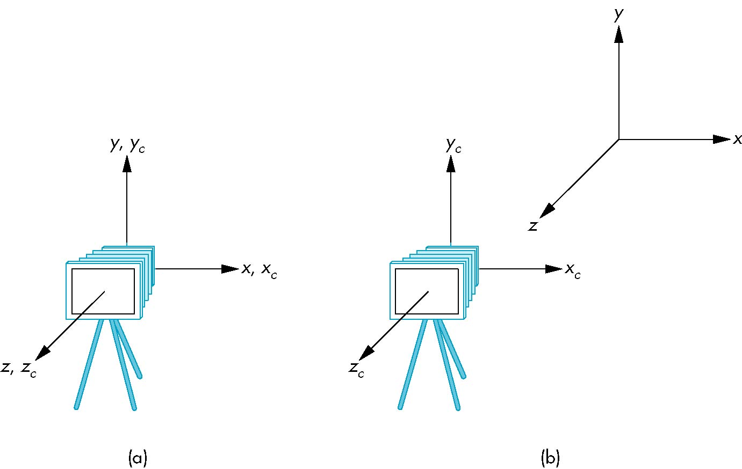
Moving Camera back from Origin
frames after translation by –d
d > 0
default frames

Slide 57
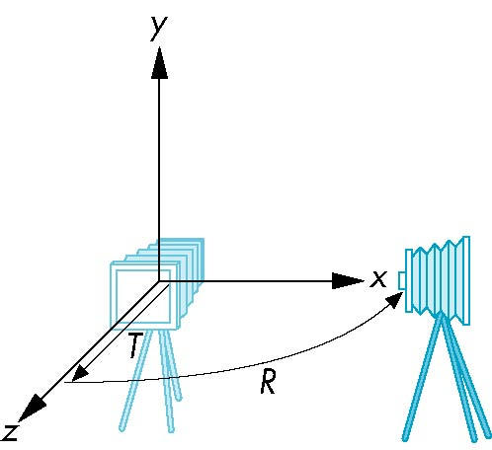
Moving the Camera
We can move the camera to any desired position by a sequence of rotations and translations
Example: side view
Rotate the camera
Move it away from origin
Model-view matrix C = TR

Slide 58
WebGL code
Remember that last transformation specified is first to be applied
// Using MV.js
var t = translate (0.0, 0.0, -d);
var ry = rotateY(90.0);
var m = mult(t, ry);
or
var m = mult(translate (0.0, 0.0, -d),
rotateY(90.0););

Slide 59
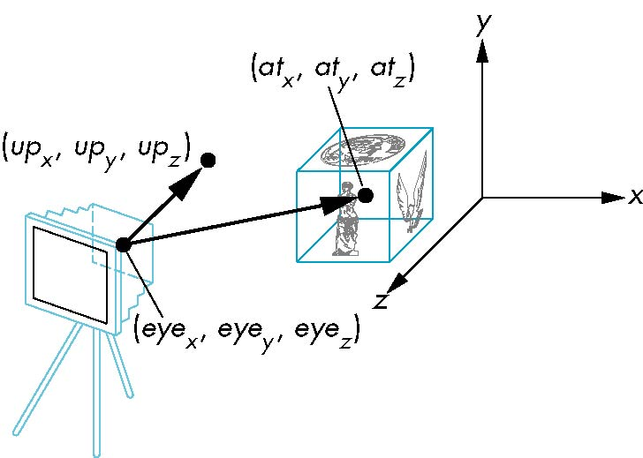
lookAt
LookAt(eye, at, up)

Slide 60
The lookAt Function
The GLU library contained the function gluLookAt to form the required modelview matrix through a simple interface
Note the need for setting an up direction
Replaced by lookAt() in MV.js
Can concatenate with modeling transformations
Example: isometric view of cube aligned with axes
var eye = vec3(1.0, 1.0, 1.0);
var at = vec3(0.0, 0.0, 0.0);
var up = vec3(0.0, 1.0, 0.0);
var mv = LookAt(eye, at, up);

Slide 61
Other Viewing APIs
The LookAt function is only one possible API for positioning the camera
Others include
View reference point, view plane normal, view up (PHIGS, GKS-3D)
Yaw, pitch, roll
Elevation, azimuth, twist
Direction angles

Slide 62
Introduction to Computer Graphics with WebGL
Ed Angel
Professor Emeritus of Computer Science
Founding Director, Arts, Research, Technology and Science Laboratory
University of New Mexico

Slide 63
Computer Viewing Projection
Ed Angel
Professor Emeritus of Computer Science
University of New Mexico

Slide 64
Objectives
Introduce the mathematics of projection
Add WebGL projection functions in MV.js

Slide 65
Projections and Normalization
The default projection in the eye (camera) frame is orthogonal
For points within the default view volume
Most graphics systems use view normalization
All other views are converted to the default view by transformations that determine the projection matrix
Allows use of the same pipeline for all views
x_{p} = x
y_{p} = y
z_{p} = 0

Slide 66
Homogeneous Coordinate Representation
default orthographic projection
x_{p} = x
y_{p} = y
z_{p} = 0
w_{p} = 1
p_{p} = Mp
M =
In practice, we can let M = I and set
the z term to zero later

Slide 67
Simple Perspective
Center of projection at the origin
Projection plane z = d, d < 0

Slide 68
Perspective Equations
Consider top and side views
x_{p} =
y_{p} =
z_{p} = d

Slide 69
Homogeneous Coordinate Form
consider q = Mp where
M =
q =
⇒ p =

Slide 70
Perspective Division
However w ≠ 1, so we must divide by w to return from homogeneous coordinates
This perspective division yields
the desired perspective equations
We will consider the corresponding clipping volume with mat.h functions that are equivalent to deprecated OpenGL functions
x_{p} =
y_{p} =
z_{p} = d

Slide 71
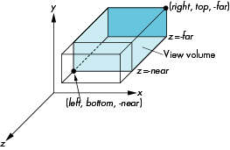
WebGL Orthogonal Viewing
ortho(left,right,bottom,top,near,far)
near and far measured from camera

Slide 72
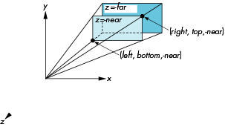
WebGL Perspective
frustum(left,right,bottom,top,near,far)

Slide 73
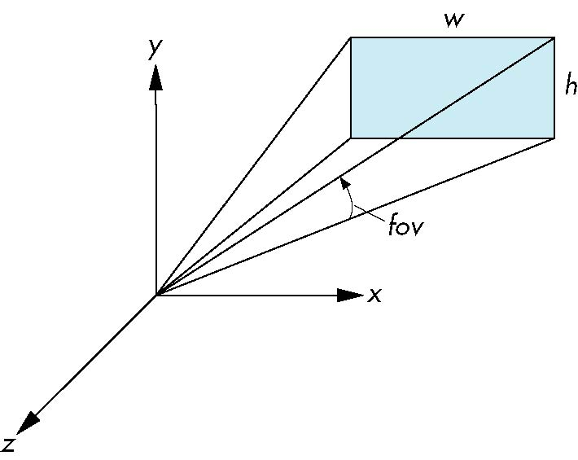
Using Field of View
With frustum it is often difficult to get the desired view
perpective(fovy, aspect, near, far) often provides a better interface
front plane
aspect = w/h

Slide 74
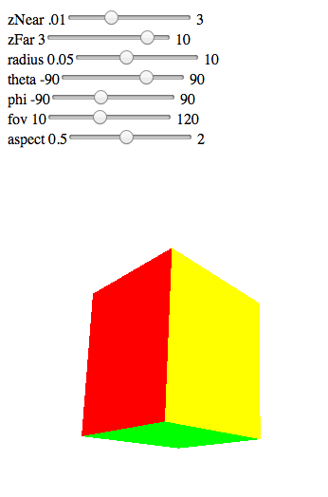
Computing Matrices
Compute in JS file, send to vertex shader with gl.uniformMatrix4fv
Dynamic: update in render() or shader

Slide 75
perspective2.js
var render = function(){
gl.clear( gl.COLOR_BUFFER_BIT | gl.DEPTH_BUFFER_BIT);
eye = vec3(radius*Math.sin(theta)*Math.cos(phi),
radius*Math.sin(theta)*Math.sin(phi), radius*Math.cos(theta));
modelViewMatrix = lookAt(eye, at , up);
projectionMatrix = perspective(fovy, aspect, near, far);
gl.uniformMatrix4fv( modelViewMatrixLoc, false,
flatten(modelViewMatrix) );
gl.uniformMatrix4fv( projectionMatrixLoc, false,
flatten(projectionMatrix) );
gl.drawArrays( gl.TRIANGLES, 0, NumVertices );
requestAnimFrame(render);
}

Slide 76
vertex shader
attribute vec4 vPosition;
attribute vec4 vColor;
varying vec4 fColor;
uniform mat4 modelViewMatrix;
uniform mat4 projectionMatrix;
void main() {
gl_Position = projectionMatrix*modelViewMatrix*vPosition;
fColor = vColor;
}

