Slide 1
Introduction to Computer Graphics with WebGL
Ed Angel
Professor Emeritus of Computer Science
Founding Director, Arts, Research, Technology and Science Laboratory
University of New Mexico

Slide 2
Orthogonal Projection Matrices
Ed Angel
Professor Emeritus of Computer Science
University of New Mexico

Slide 3
Objectives
Derive the projection matrices used for standard orthogonal projections
Introduce oblique projections
Introduce projection normalization

Slide 4
Normalization
Rather than derive a different projection matrix for each type of projection, we can convert all projections to orthogonal projections with the default view volume
This strategy allows us to use standard transformations in the pipeline and makes for efficient clipping

Slide 5
Pipeline View
modelview
transformation
projection
transformation
perspective
division
4D → 3D
nonsingular
clipping
projection
3D → 2D
against default cube

Slide 6
Notes
We stay in four-dimensional homogeneous coordinates through both the modelview and projection transformations
Both these transformations are nonsingular
Default to identity matrices (orthogonal view)
Normalization lets us clip against simple cube regardless of type of projection
Delay final projection until end
Important for hidden-surface removal to retain depth information as long as possible

Slide 7
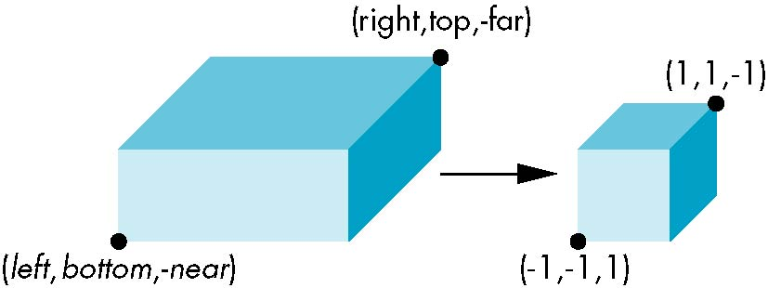
Orthogonal Normalization
ortho(left,right,bottom,top,near,far)
normalization ⇒ find transformation to convert
specified clipping volume to default

Slide 8
Orthogonal Matrix
Two steps
Move center to origin
T(-(left+right)/2, -(bottom+top)/2,(near+far)/2))
Scale to have sides of length 2
S(2/(left-right),2/(top-bottom),2/(near-far))
P = ST =

Slide 9
Final Projection
Set z =0
Equivalent to the homogeneous coordinate transformation
Hence, general orthogonal projection in 4D is
M_{orth} =
P = M_{orth}ST

Slide 10
Oblique Projections
The OpenGL projection functions cannot produce general parallel projections such as
However if we look at the example of the cube it appears that the cube has been sheared
Oblique Projection = Shear + Orthogonal Projection

Slide 11
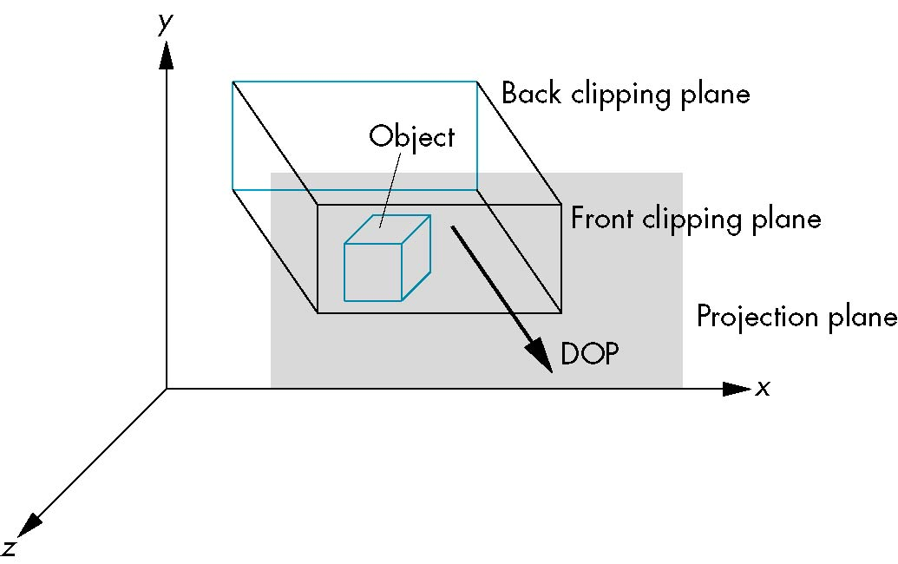
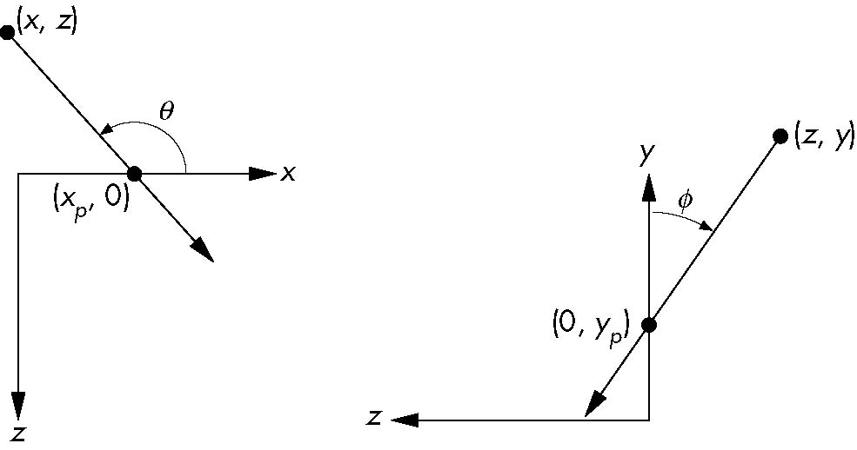
General Shear
top view
side view

Slide 12
Shear Matrix
xy shear (z values unchanged)
Projection matrix
General case:
H(θ,φ) =
P = M_{orth} H(θ,φ)
P = M_{orth} STH(θ,φ)

Slide 13
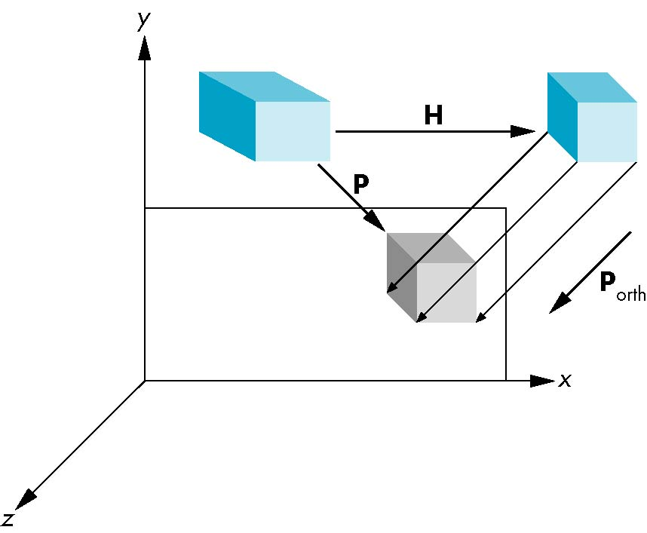
Equivalency

Slide 14
Effect on Clipping
The projection matrix P = STH transforms the original clipping volume to the default clipping volume
object
top view
z = 1
DOP
DOP
x = -1
x = 1
far plane
z = -1
clipping
volume
near plane
distorted object
(projects correctly)

Slide 15
Introduction to Computer Graphics with WebGL
Ed Angel
Professor Emeritus of Computer Science
Founding Director, Arts, Research, Technology and Science Laboratory
University of New Mexico

Slide 16
Perspective Projection Matrices
Ed Angel
Professor Emeritus of Computer Science
University of New Mexico

Slide 17
Objectives
Derive the perspective projection matrices used for standard WebGL projections

Slide 18
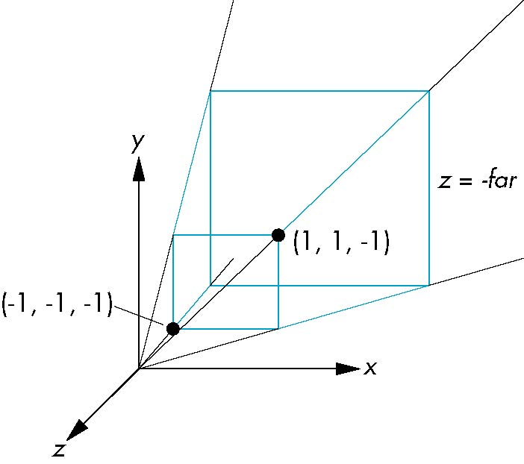
Simple Perspective
Consider a simple perspective with the COP at the origin, the near clipping plane at z = -1, and a 90 degree field of view determined by the planes
x = ±z, y = ±z

Slide 19
Perspective Matrices
Simple projection matrix in homogeneous coordinates
Note that this matrix is independent of the far clipping plane
M =

Slide 20
Generalization
N =
after perspective division, the point (x, y, z, 1) goes to
x’’ = x/z
y’’ = y/z
Z’’ = -(α+β/z)
which projects orthogonally to the desired point
regardless of α and β

Slide 21
Picking α and β
If we pick
α =
β =
the near plane is mapped to z = -1
the far plane is mapped to z =1
and the sides are mapped to x = ± 1, y = ± 1
Hence the new clipping volume is the default clipping volume

Slide 22
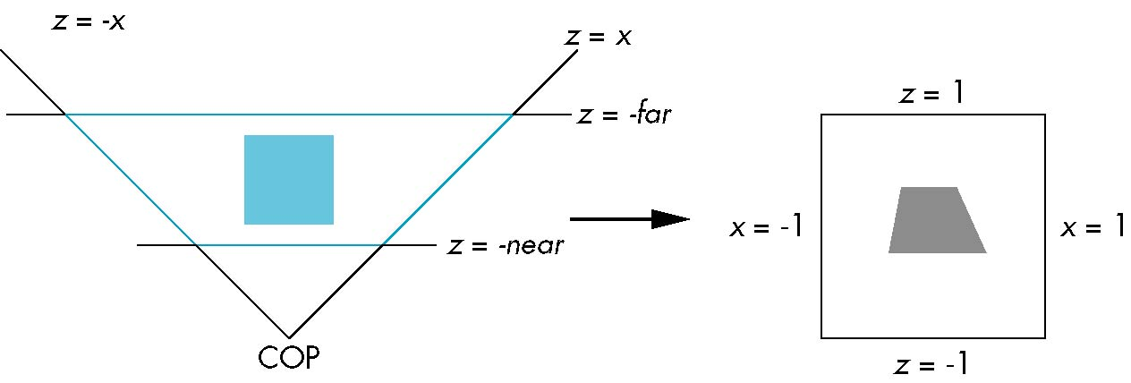
Normalization Transformation
distorted object
projects correctly
original clipping
volume
original object
new clipping
volume

Slide 23
Normalization and Hidden-Surface Removal
Although our selection of the form of the perspective matrices may appear somewhat arbitrary, it was chosen so that if z₁ > z₂ in the original clipping volume then the for the transformed points z₁’ > z₂’
Thus hidden surface removal works if we first apply the normalization transformation
However, the formula z’’ = -(α+β/z) implies that the distances are distorted by the normalization which can cause numerical problems especially if the near distance is small

Slide 24
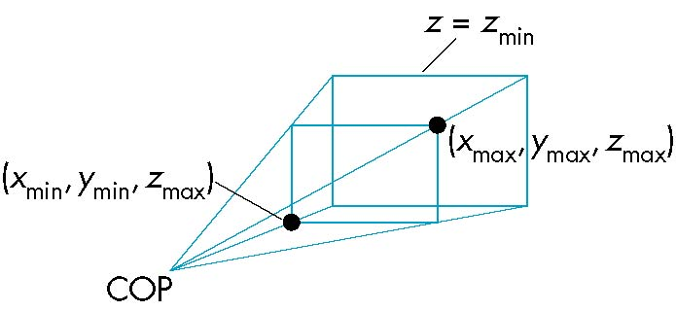
WebGL Perspective
gl.frustum allows for an unsymmetric viewing frustum (although gl.perspective does not)

Slide 25
OpenGL Perspective Matrix
The normalization in Frustum requires an initial shear to form a right viewing pyramid, followed by a scaling to get the normalized perspective volume. Finally, the perspective matrix results in needing only a final orthogonal transformation
P = NSH
our previously defined
perspective matrix
shear and scale

Slide 26
Why do we do it this way?
Normalization allows for a single pipeline for both perspective and orthogonal viewing
We stay in four dimensional homogeneous coordinates as long as possible to retain three-dimensional information needed for hidden-surface removal and shading
We simplify clipping

Slide 27
Perspective Matrices
frustum
perspective

Slide 28
Introduction to Computer Graphics with WebGL
Ed Angel
Professor Emeritus of Computer Science
Founding Director, Arts, Research, Technology and Science Laboratory
University of New Mexico

Slide 29
Meshes
Ed Angel
Professor Emeritus of Computer Science
University of New Mexico

Slide 30
Objective
Introduce techniques for displaying polygonal meshes

Slide 31
Meshes
Polygonal meshes are the standard method for defining and displaying surfaces
Approximations to curved surfaces
Directly from CAD packages
Subdivision
Most common are quadrilateral and triangular meshes
Triangle strips and fans

Slide 32
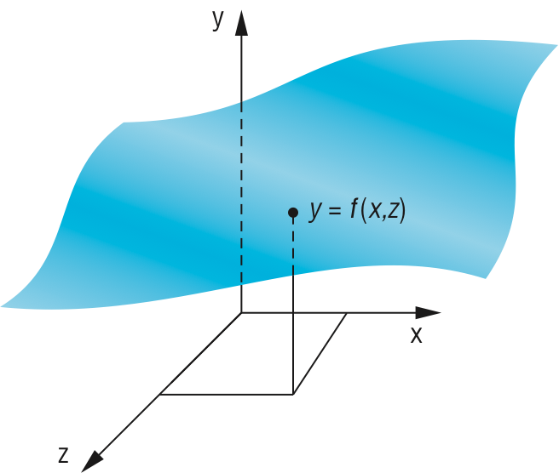
Height Fields
For each (x, z) there is a unique y
Sampling leads to an array of y values
Display as quadrilateral or triangular mesh using strips

Slide 33
Honolulu Plot Using Line Strips

Slide 34
Plot 3D
Old 2D method uses fact that data are ordered and we can render front to back
Regard each plane of constant z as a flat surface that can block (parts of) planes behind it
Can proceed iteratively maintaining a visible top and visible bottom
Lots of little line intersections
Lots of code but avoids all 3D

Slide 35
Lines on Back and Hidden Faces
sombrero or Mexican hat function (sin πr)/(πr)

Slide 36
Using Polygons
We can use four adjacent data points to form a quadrilateral and thus two triangles which can be shaded
But what if we want to see the grid?
We can display each quadrilateral twice
First as two filled white triangles
Second as a black line loop

Slide 37
Hat Using Triangles and Lines

Slide 38
Polygon Offset
Even though we draw the polygon first followed by the lines, small numerical errors cause some of fragments on the line to be display behind the corresponding fragment on the triangle
Polygon offset (gl.polygonOffset) moves fragments slight away from camera
Apply to triangle rendering

Slide 39
Hat with Polygon Offset

Slide 40
Other Mesh Issues
How do we construct a mesh from disparate data (unstructured points)
Technologies such as laser scans can produced tens of millions of such points
Chapter 12: Delaunay triangulation
Can we use one triangle strip for an entire 2D mesh?
Mesh simplification

Slide 41
Introduction to Computer Graphics with WebGL
Ed Angel
Professor Emeritus of Computer Science
Founding Director, Arts, Research, Technology and Science Laboratory
University of New Mexico

Slide 42
Shadows
Ed Angel
Professor Emeritus of Computer Science
University of New Mexico

Slide 43
Objectives
Introduce Shadow Algorithms
Projective Shadows
Shadow Maps
Shadow Volumes

Slide 44
Flashlight in the Eye Graphics
When do we not see shadows in a real scene?
When the only light source is a point source at the eye or center of projection
Shadows are behind objects and not visible
Shadows are a global rendering issue
Is a surface visible from a source
May be obscured by other objects

Slide 45
Shadows in Pipeline Renders
Note that shadows are generated automatically by a ray tracers
feeler rays will detect if no light reaches a point
need all objects to be available
Pipeline renderers work an object at a time so shadows are not automatic
can use some tricks: projective shadows
multi-rendering: shadow maps and shadow volumes

Slide 46
Projective Shadows
Oldest methods
Used in flight simulators to provide visual clues
Projection of a polygon is a polygon called a shadow polygon
Given a point light source and a polygon, the vertices of the shadow polygon are the projections of the original polygon’s vertices from a point source onto a surface

Slide 47
Shadow Polygon

Slide 48
Computing Shadow Vertex
Source at (x_{l}, y_{l}, z_{l})
Vertex at (x, y, z)
Consider simple case of shadow projected onto ground at (x_{p}, 0, z_{p})
Translate source to origin with T(-x_{l}, -y_{l}, -z_{l})
Perspective projection
Translate back

Slide 49
Shadow Process
Put two identical triangles and their colors on GPU (black for shadow triangle)
Compute two model view matrices as uniforms
Send model view matrix for original triangle
Render original triangle
Send second model view matrix
Render shadow triangle
Note shadow triangle undergoes two transformations
Note hidden surface removal takes care of depth issues

Slide 50
Generalized Shadows
Approach was OK for shadows on a single flat surface
Note with geometry shader we can have the shader create the second triangle
Cannot handle shadows on general objects
Exist a variety of other methods based on same basic idea
We’ll pursue methods based on projective textures

Slide 51
Image Based Lighting
We can project a texture onto the surface in which case the are treating the texture as a “slide projector”
This technique the basis of projective textures and image based lighting
Supported in desktop OpenGL and GLSL through four dimensional texture coordinates
Not yet in WebGL

Slide 52
Shadow Maps
If we render a scene from a light source, the depth buffer will contain the distances from the source to nearest lit fragment.
We can store these depths in a texture called a depth map or shadow map
Note that although we don’t care about the image in the shadow map, if we render with some light, anything lit is not in shadow.
Form a shadow map for each source

Slide 53
Shadow Mapping

Slide 54
Final Rendering
During the final rendering we compare the distance from the fragment to the light source with the distance in the shadow map
If the depth in the shadow map is less than the distance from the fragment to the source the fragment is in shadow (from this source)
Otherwise we use the rendered color

Slide 55
Implementation
Requires multiple renderings
We will look at render-to-texture later
gives us a method to save the results of a rendering as a texture
almost all work done in the shaders

Slide 56
Shadow Volumes
light source
far clipping plane
shadow volume
near clipping plane
COP

Slide 57
Introduction to Computer Graphics with WebGL
Ed Angel
Professor Emeritus of Computer Science
Founding Director, Arts, Research, Technology and Science Laboratory
University of New Mexico

Slide 58
Lighting and Shading I
Ed Angel
Professor Emeritus of Computer Science
University of New Mexico

Slide 59
Objectives
Learn to shade objects so their images appear three-dimensional
Introduce the types of light-material interactions
Build a simple reflection model---the Phong model--- that can be used with real time graphics hardware

Slide 60
Why we need shading
Suppose we build a model of a sphere using many polygons and color it with glColor. We get something like
But we want

Slide 61
Shading
Why does the image of a real sphere look like
Light-material interactions cause each point to have a different color or shade
Need to consider
Light sources
Material properties
Location of viewer
Surface orientation

Slide 62
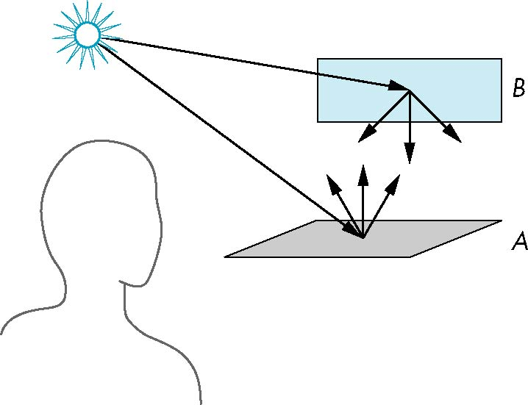
Scattering
Light strikes A
Some scattered
Some absorbed
Some of scattered light strikes B
Some scattered
Some absorbed
Some of this scattered
light strikes A
and so on

Slide 63
Rendering Equation
The infinite scattering and absorption of light can be described by the rendering equation
Cannot be solved in general
Ray tracing is a special case for perfectly reflecting surfaces
Rendering equation is global and includes
Shadows
Multiple scattering from object to object

Slide 64
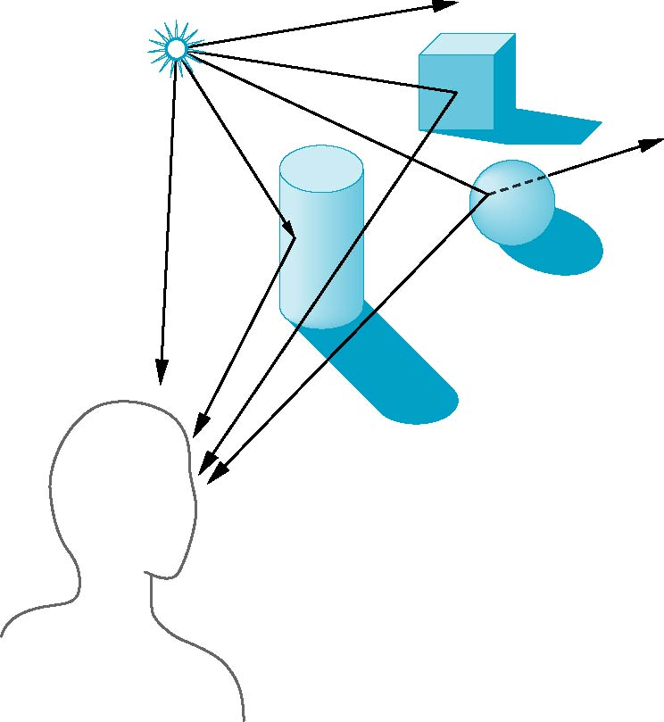
Global Effects
shadow
multiple reflection
translucent surface

Slide 65
Local vs Global Rendering
Correct shading requires a global calculation involving all objects and light sources
Incompatible with pipeline model which shades each polygon independently (local rendering)
However, in computer graphics, especially real time graphics, we are happy if things “look right”
Exist many techniques for approximating global effects

Slide 66
Light-Material Interaction
Light that strikes an object is partially absorbed and partially scattered (reflected)
The amount reflected determines the color and brightness of the object
A surface appears red under white light because the red component of the light is reflected and the rest is absorbed
The reflected light is scattered in a manner that depends on the smoothness and orientation of the surface

Slide 67
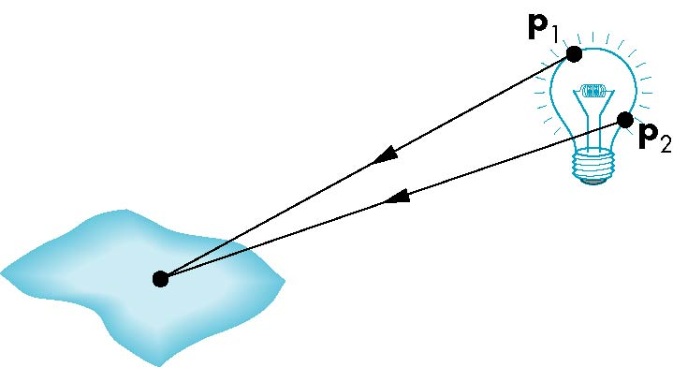
Light Sources
General light sources are difficult to work with because we must integrate light coming from all points on the source

Slide 68
Simple Light Sources
Point source
Model with position and color
Distant source = infinite distance away (parallel)
Spotlight
Restrict light from ideal point source
Ambient light
Same amount of light everywhere in scene
Can model contribution of many sources and reflecting surfaces

Slide 69
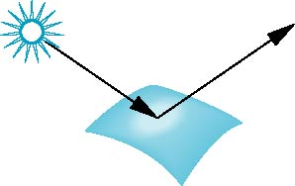
Surface Types
The smoother a surface, the more reflected light is concentrated in the direction a perfect mirror would reflected the light
A very rough surface scatters light in all directions
smooth surface
rough surface

Slide 70
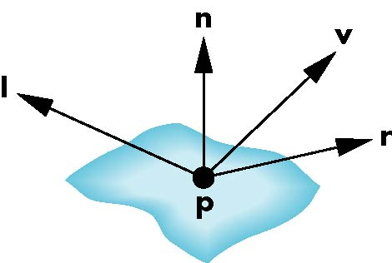
Phong Model
A simple model that can be computed rapidly
Has three components
Diffuse
Specular
Ambient
Uses four vectors
To source
To viewer
Normal
Perfect reflector

Slide 71
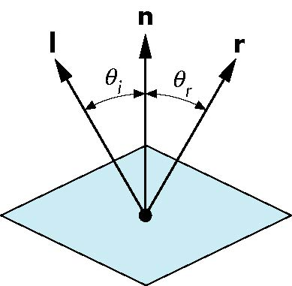
Ideal Reflector
Normal is determined by local orientation
Angle of incidence = angle of relection
The three vectors must be coplanar
r = 2 (l · n ) n - l

Slide 72
Lambertian Surface
Perfectly diffuse reflector
Light scattered equally in all directions
Amount of light reflected is proportional to the vertical component of incoming light
reflected light ~cos θ_{i}
cos θ_{i} = l · n if vectors normalized
There are also three coefficients, k_{r}, k_{b}, k_{g} that show how much of each color component is reflected

Slide 73
Specular Surfaces
Most surfaces are neither ideal diffusers nor perfectly specular (ideal reflectors)
Smooth surfaces show specular highlights due to incoming light being reflected in directions concentrated close to the direction of a perfect reflection
specular
highlight

Slide 74
Modeling Specular Relections
Phong proposed using a term that dropped off as the angle between the viewer and the ideal reflection increased
I_{r} ~ k_{s} I cos^{α}φ
φ
reflected
intensity
shininess coef
incoming intensity
absorption coef

Slide 75
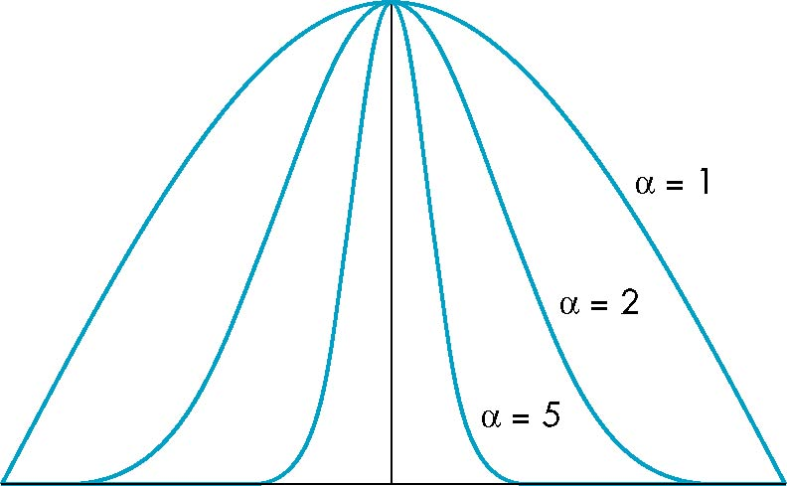
The Shininess Coefficient
Values of α between 100 and 200 correspond to metals
Values between 5 and 10 give surface that look like plastic
cos^{α} φ
-90
φ
90

