Slide 1
Introduction to Computer Graphics with WebGL
Ed Angel
Professor Emeritus of Computer Science
Founding Director, Arts, Research, Technology and Science Laboratory
University of New Mexico

Slide 2
Texture Mapping
Ed Angel
Professor Emeritus of Computer Science
University of New Mexico

Slide 3
Objectives
Introduce Mapping Methods
Texture Mapping
Environment Mapping
Bump Mapping
Consider basic strategies
Forward vs backward mapping
Point sampling vs area averaging

Slide 4
The Limits of Geometric Modeling
Although graphics cards can render over 10 million polygons per second, that number is insufficient for many phenomena
Clouds
Grass
Terrain
Skin

Slide 5
Modeling an Orange
Consider the problem of modeling an orange (the fruit)
Start with an orange-colored sphere
Too simple
Replace sphere with a more complex shape
Does not capture surface characteristics (small dimples)
Takes too many polygons to model all the dimples

Slide 6
Modeling an Orange (2)
Take a picture of a real orange, scan it, and “paste” onto simple geometric model
This process is known as texture mapping
Still might not be sufficient because resulting surface will be smooth
Need to change local shape
Bump mapping

Slide 7
Three Types of Mapping
Texture Mapping
Uses images to fill inside of polygons
Environment (reflection mapping)
Uses a picture of the environment for texture maps
Allows simulation of highly specular surfaces
Bump mapping
Emulates altering normal vectors during the rendering process

Slide 8
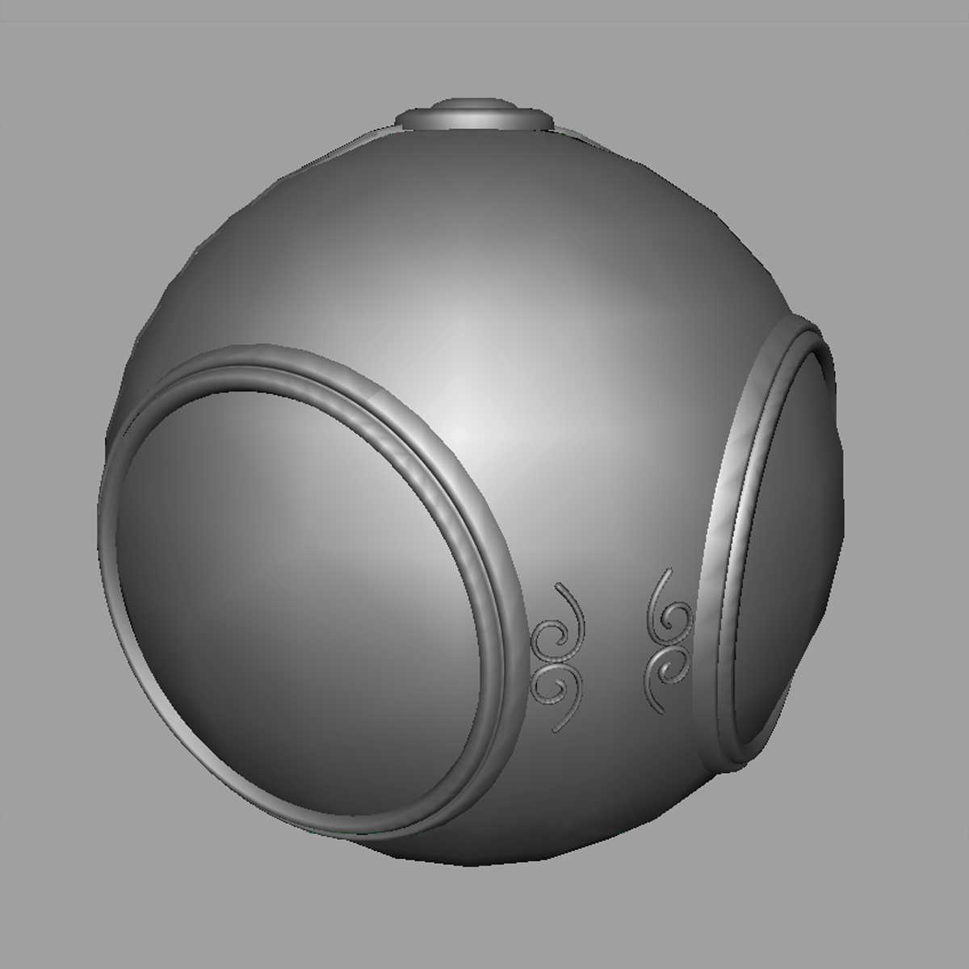
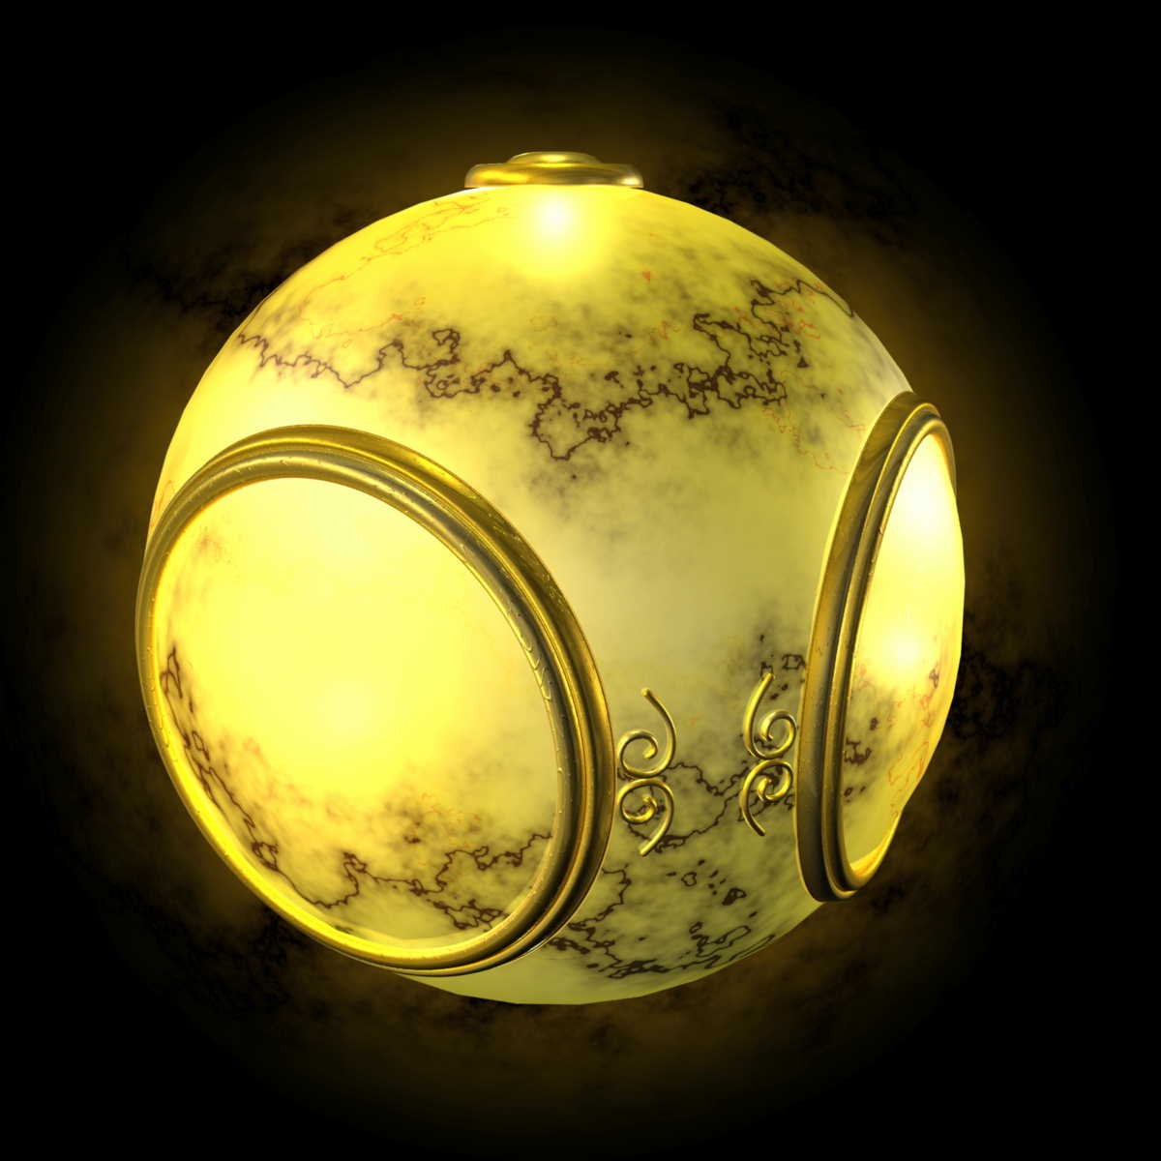
Texture Mapping
geometric model
texture mapped

Slide 9
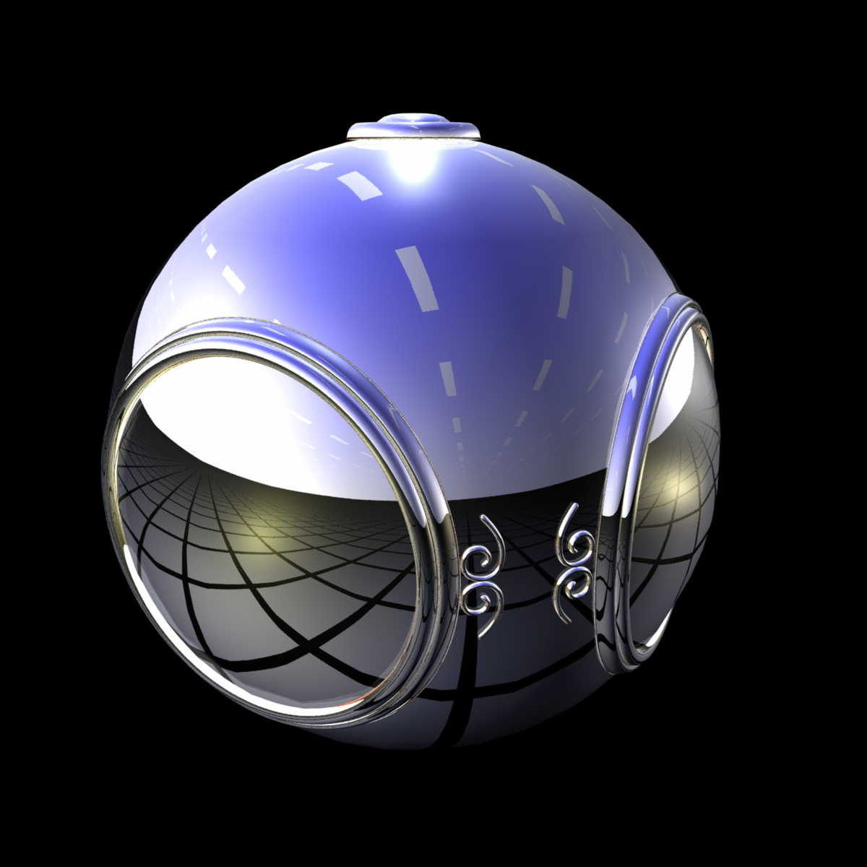
Environment Mapping

Slide 10
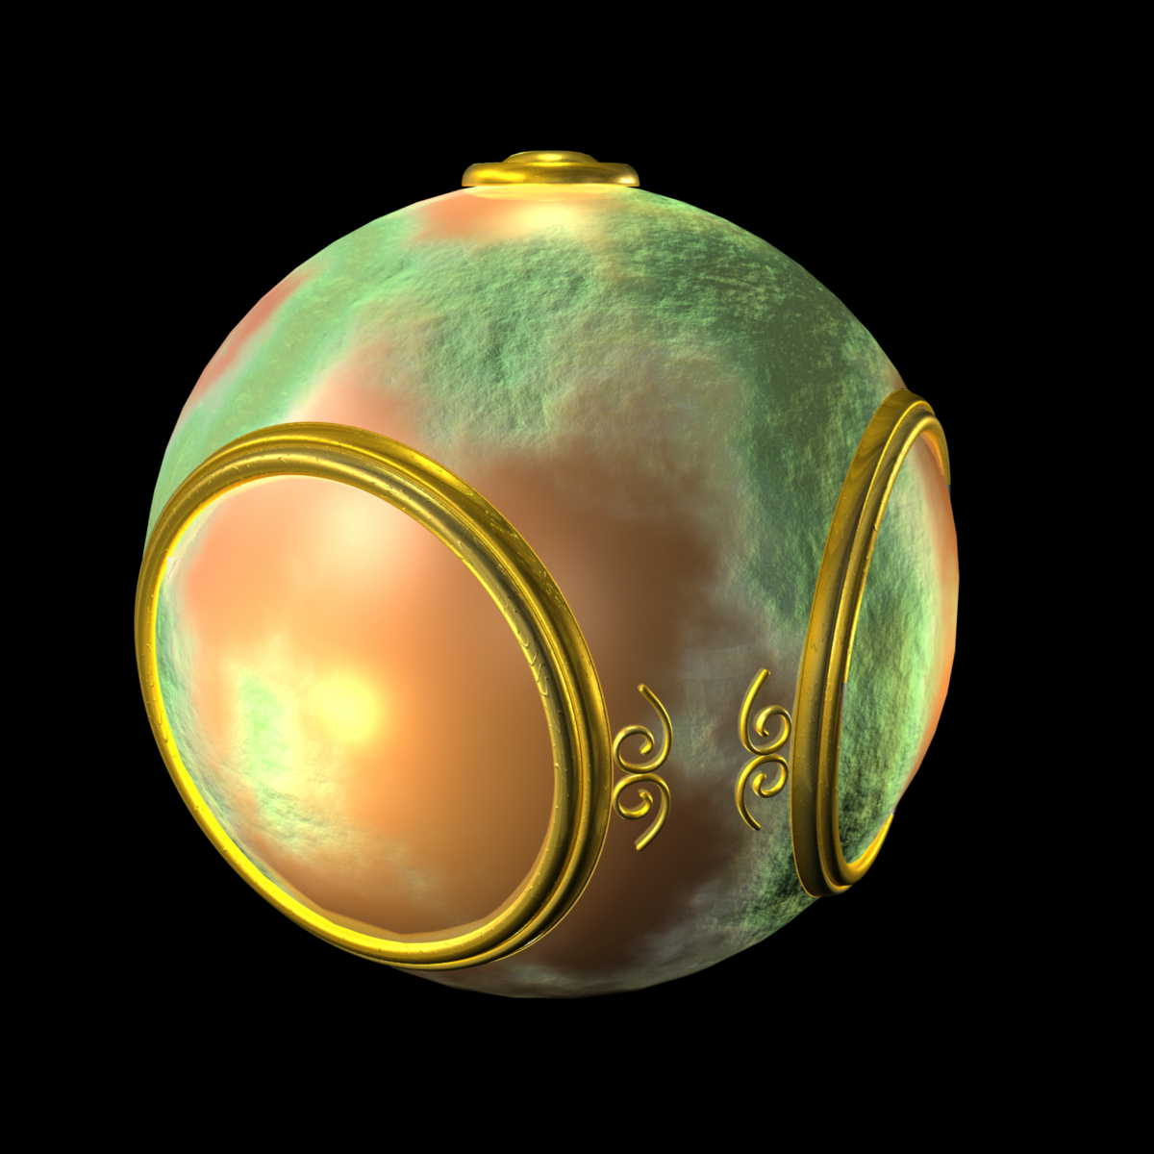
Bump Mapping

Slide 11
Where does mapping take place?
Mapping techniques are implemented at the end of the rendering pipeline
Very efficient because few polygons make it past the clipper

Slide 12
Introduction to Computer Graphics with WebGL
Ed Angel
Professor Emeritus of Computer Science
Founding Director, Arts, Research, Technology and Science Laboratory
University of New Mexico

Slide 13
Texture Mapping
Ed Angel
Professor Emeritus of Computer Science
University of New Mexico

Slide 14
Objectives
Basic mapping strategies
Forward vs backward mapping
Point sampling vs area averaging

Slide 15
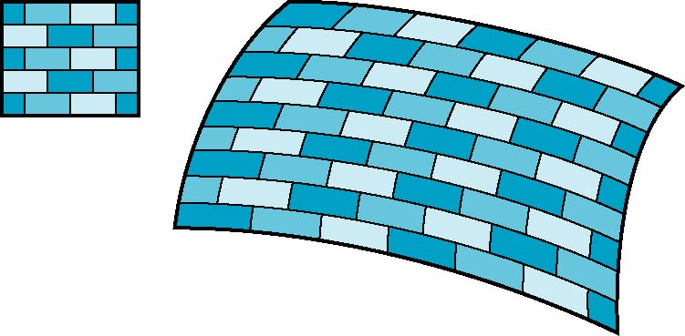
Is it simple?
Although the idea is simple---map an image to a surface---there are 3 or 4 coordinate systems involved
2D image
3D surface

Slide 16
Coordinate Systems
Parametric coordinates
May be used to model curves and surfaces
Texture coordinates
Used to identify points in the image to be mapped
Object or World Coordinates
Conceptually, where the mapping takes place
Window Coordinates
Where the final image is really produced

Slide 17
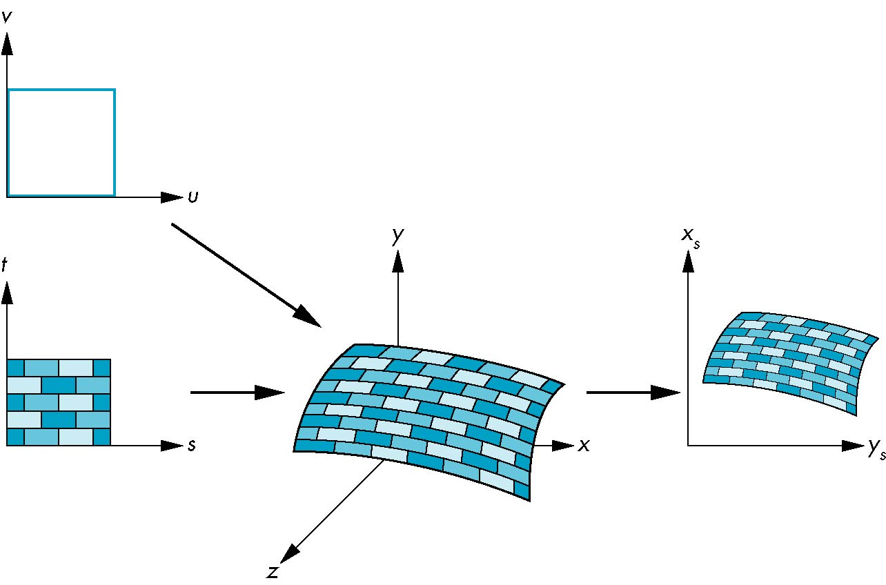
Texture Mapping
parametric coordinates
texture coordinates
window coordinates
world coordinates

Slide 18
Mapping Functions
Basic problem is how to find the maps
Consider mapping from texture coordinates to a point a surface
Appear to need three functions
x = x(s,t)
y = y(s,t)
z = z(s,t)
But we really want
to go the other way
(x,y,z)
t
s

Slide 19
Backward Mapping
We really want to go backwards
Given a pixel, we want to know to which point on an object it corresponds
Given a point on an object, we want to know to which point in the texture it corresponds
Need a map of the form
s = s(x,y,z)
t = t(x,y,z)
Such functions are difficult to find in general

Slide 20
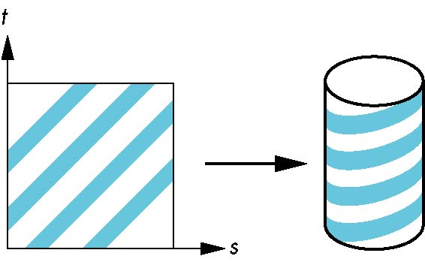
Two-part mapping
One solution to the mapping problem is to first map the texture to a simple intermediate surface
Example: map to cylinder

Slide 21
Cylindrical Mapping
parametric cylinder
x = r cos 2π u
y = r sin 2πu
z = v/h
maps rectangle in u,v space to cylinder
of radius r and height h in world coordinates
s = u
t = v
maps from texture space

Slide 22
Spherical Map
We can use a parametric sphere
x = r cos 2πu
y = r sin 2πu cos 2πv
z = r sin 2πu sin 2πv
in a similar manner to the cylinder
but have to decide where to put
the distortion
Spheres are used in environmental maps

Slide 23
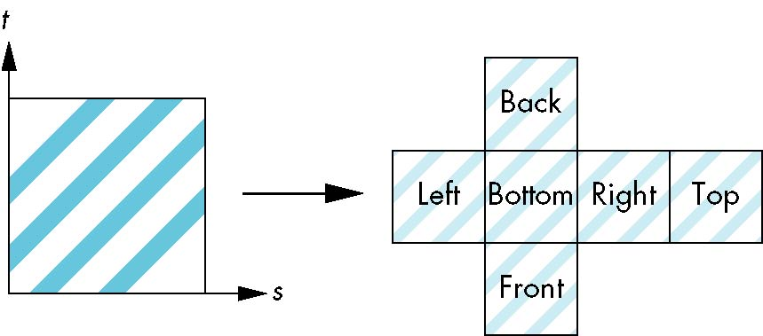
Box Mapping
Easy to use with simple orthographic projection
Also used in environment maps

Slide 24
Second Mapping
Map from intermediate object to actual object
Normals from intermediate to actual
Normals from actual to intermediate
Vectors from center of intermediate
actual
intermediate

Slide 25
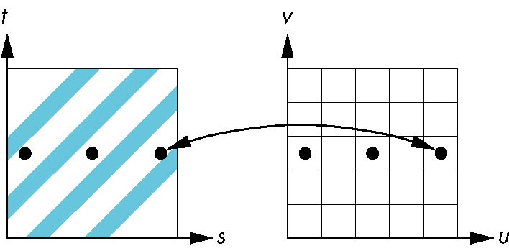
Aliasing
Point sampling of the texture can lead to aliasing errors
miss blue stripes
point samples in u,v
(or x,y,z) space
point samples in texture space

Slide 26
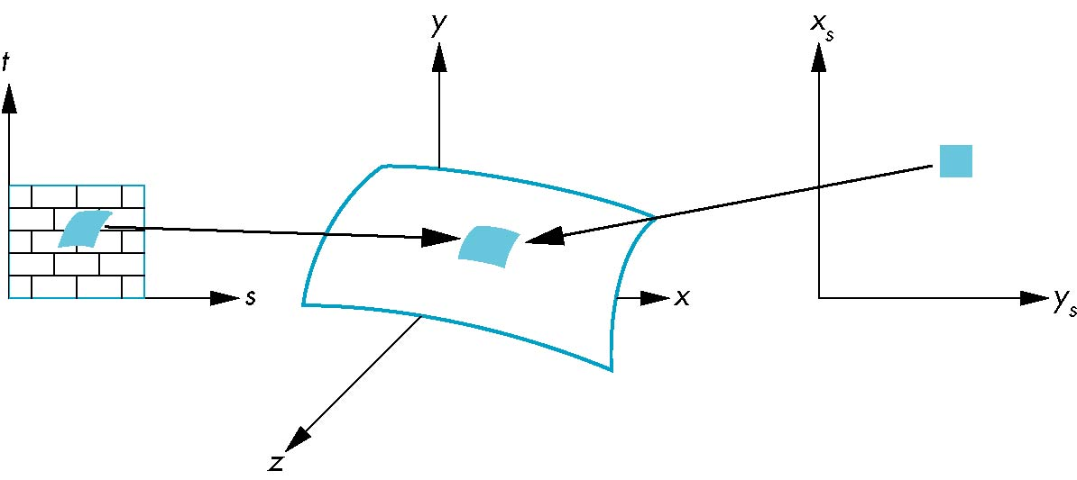
Area Averaging
A better but slower option is to use area averaging
pixel
preimage
Note that preimage of pixel is curved

Slide 27
Introduction to Computer Graphics with WebGL
Ed Angel
Professor Emeritus of Computer Science
Founding Director, Arts, Research, Technology and Science Laboratory
University of New Mexico

Slide 28
WebGL Texture Mapping I
Ed Angel
Professor Emeritus of Computer Science
University of New Mexico

Slide 29
Objectives
Introduce WebGL texture mapping
two-dimensional texture maps
assigning texture coordinates
forming texture images

Slide 30
Basic Stragegy
Three steps to applying a texture
specify the texture
read or generate image
assign to texture
enable texturing
assign texture coordinates to vertices
Proper mapping function is left to application
specify texture parameters
wrapping, filtering

Slide 31
Texture Mapping
y
z
x
geometry
display
t
image
s

Slide 32
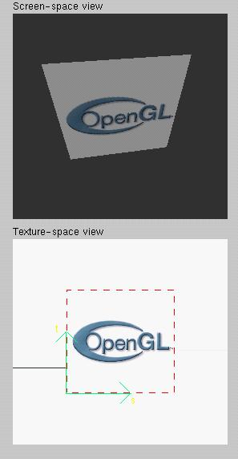
Texture Example
The texture (below) is a 256 x 256 image that has been mapped to a rectangular polygon which is viewed in perspective

Slide 33
Texture Mapping and the WebGL Pipeline
Images and geometry flow through separate pipelines that join during fragment processing
“complex” textures do not affect geometric complexity
vertices
geometry pipeline
fragmentprocessor
image
texel pipeline

Slide 34
Specifying a Texture Image
Define a texture image from an array of texels (texture elements) in CPU memory
Use an image in a standard format such as JPEG
Scanned image
Generate by application code
WebGL supports only 2 dimensional texture maps
no need to enable as in desktop OpenGL
desktop OpenGL supports 1-4 dimensional texture maps

Slide 35
Define Image as a Texture
glTexImage2D( target, level, components, w, h, border, format, type, texels );
target: type of texture, e.g. GL_TEXTURE_2D
level: used for mipmapping (discussed later)
components: elements per texel
w, h: width and height of texels in pixels
border: used for smoothing (discussed later)
format and type: describe texels
texels: pointer to texel array
glTexImage2D(GL_TEXTURE_2D, 0, 3, 512, 512, 0, GL_RGB, GL_UNSIGNED_BYTE, my_texels);

Slide 36
A Checkerboard Image
var image1 = new Uint8Array(4*texSize*texSize);
for ( var i = 0; i < texSize; i++ ) {
for ( var j = 0; j <texSize; j++ ) {
var patchx = Math.floor(i/(texSize/numChecks));
var patchy = Math.floor(j/(texSize/numChecks));
if(patchx%2 ^ patchy%2) c = 255;
else c = 0;
//c = 255*(((i & 0x8) == 0) ^ ((j & 0x8) == 0))
image1[4*i*texSize+4*j] = c;
image1[4*i*texSize+4*j+1] = c;
image1[4*i*texSize+4*j+2] = c;
image1[4*i*texSize+4*j+3] = 255;
}
}

Slide 37
Using a GIF image
// specify image in JS file
var image = new Image();
image.onload = function() {
configureTexture( image );
}
image.src = "SA2011_black.gif”
// or specify image in HTML file with <img> tag
// <img id = "texImage" src = "SA2011_black.gif"></img>
var image = document.getElementById("texImage”) window.onload = configureTexture( image );

Slide 38
Mapping a Texture
Based on parametric texture coordinates
Specify as a 2D vertex attribute
Texture Space
Object Space
t
1, 1
(s, t) = (0.2, 0.8)
0, 1
A
a
c
(0.4, 0.2)
b
B
C
0, 0
1, 0
s
(0.8, 0.4)

Slide 39
Cube Example
var texCoord = [
vec2(0, 0),
vec2(0, 1),
vec2(1, 1),
vec2(1, 0)
];
function quad(a, b, c, d) {
pointsArray.push(vertices[a]);
colorsArray.push(vertexColors[a]);
texCoordsArray.push(texCoord[0]);
pointsArray.push(vertices[b]);
colorsArray.push(vertexColors[a]);
texCoordsArray.push(texCoord[1]);
// etc

Slide 40
Interpolation
WebGL uses interpolation to find proper texels from specified texture coordinates
Can be distortions
texture stretched
over trapezoid
showing effects of
bilinear interpolation
good selection
of tex coordinates
poor selection
of tex coordinates

Slide 41
Introduction to Computer Graphics with WebGL
Ed Angel
Professor Emeritus of Computer Science
Founding Director, Arts, Research, Technology and Science Laboratory
University of New Mexico

Slide 42
WebGL Texture Mapping II
Ed Angel
Professor Emeritus of Computer Science
University of New Mexico

Slide 43
Objectives
Introduce the WebGL texture functions and options
texture objects
texture parameters
example code

Slide 44
Using Texture Objects
specify textures in texture objects
set texture filter
set texture function
set texture wrap mode
set optional perspective correction hint
bind texture object
enable texturing
supply texture coordinates for vertex
coordinates can also be generated

Slide 45
Texture Parameters
WebGL has a variety of parameters that determine how texture is applied
Wrapping parameters determine what happens if s and t are outside the (0,1) range
Filter modes allow us to use area averaging instead of point samples
Mipmapping allows us to use textures at multiple resolutions
Environment parameters determine how texture mapping interacts with shading

Slide 46
Wrapping Mode
Clamping: if s,t > 1 use 1, if s,t <0 use 0
Wrapping: use s,t modulo 1
gl.texParameteri(gl.TEXTURE_2D, gl.TEXTURE_WRAP_S, gl.CLAMP )
gl.texParameteri( gl.TEXTURE_2D, gl.TEXTURE_WRAP_T, gl.REPEAT )
t
s
gl.REPEAT
wrapping
gl.CLAMP
wrapping
texture

Slide 47
Magnification and Minification
More than one texel can cover a pixel (minification) or
more than one pixel can cover a texel (magnification)
Can use point sampling (nearest texel) or linear filtering
( 2 x 2 filter) to obtain texture values
Texture
Polygon
Texture
Polygon
Magnification
Minification

Slide 48
Filter Modes
Modes determined by
gl.texParameteri( target, type, mode )
gl.texParameteri(gl.TEXTURE_2D, gl.TEXURE_MAG_FILTER,
GL_NEAREST);
gl.texParameteri(gl.TEXTURE_2D, gl.TEXURE_MIN_FILTER,
gl.LINEAR);

Slide 49
Mipmapped Textures
Mipmapping allows for prefiltered texture maps of decreasing resolutions
Lessens interpolation errors for smaller textured objects
Declare mipmap level during texture definition
gl.texImage2D(gl.TEXTURE_*D, level, … )

Slide 50
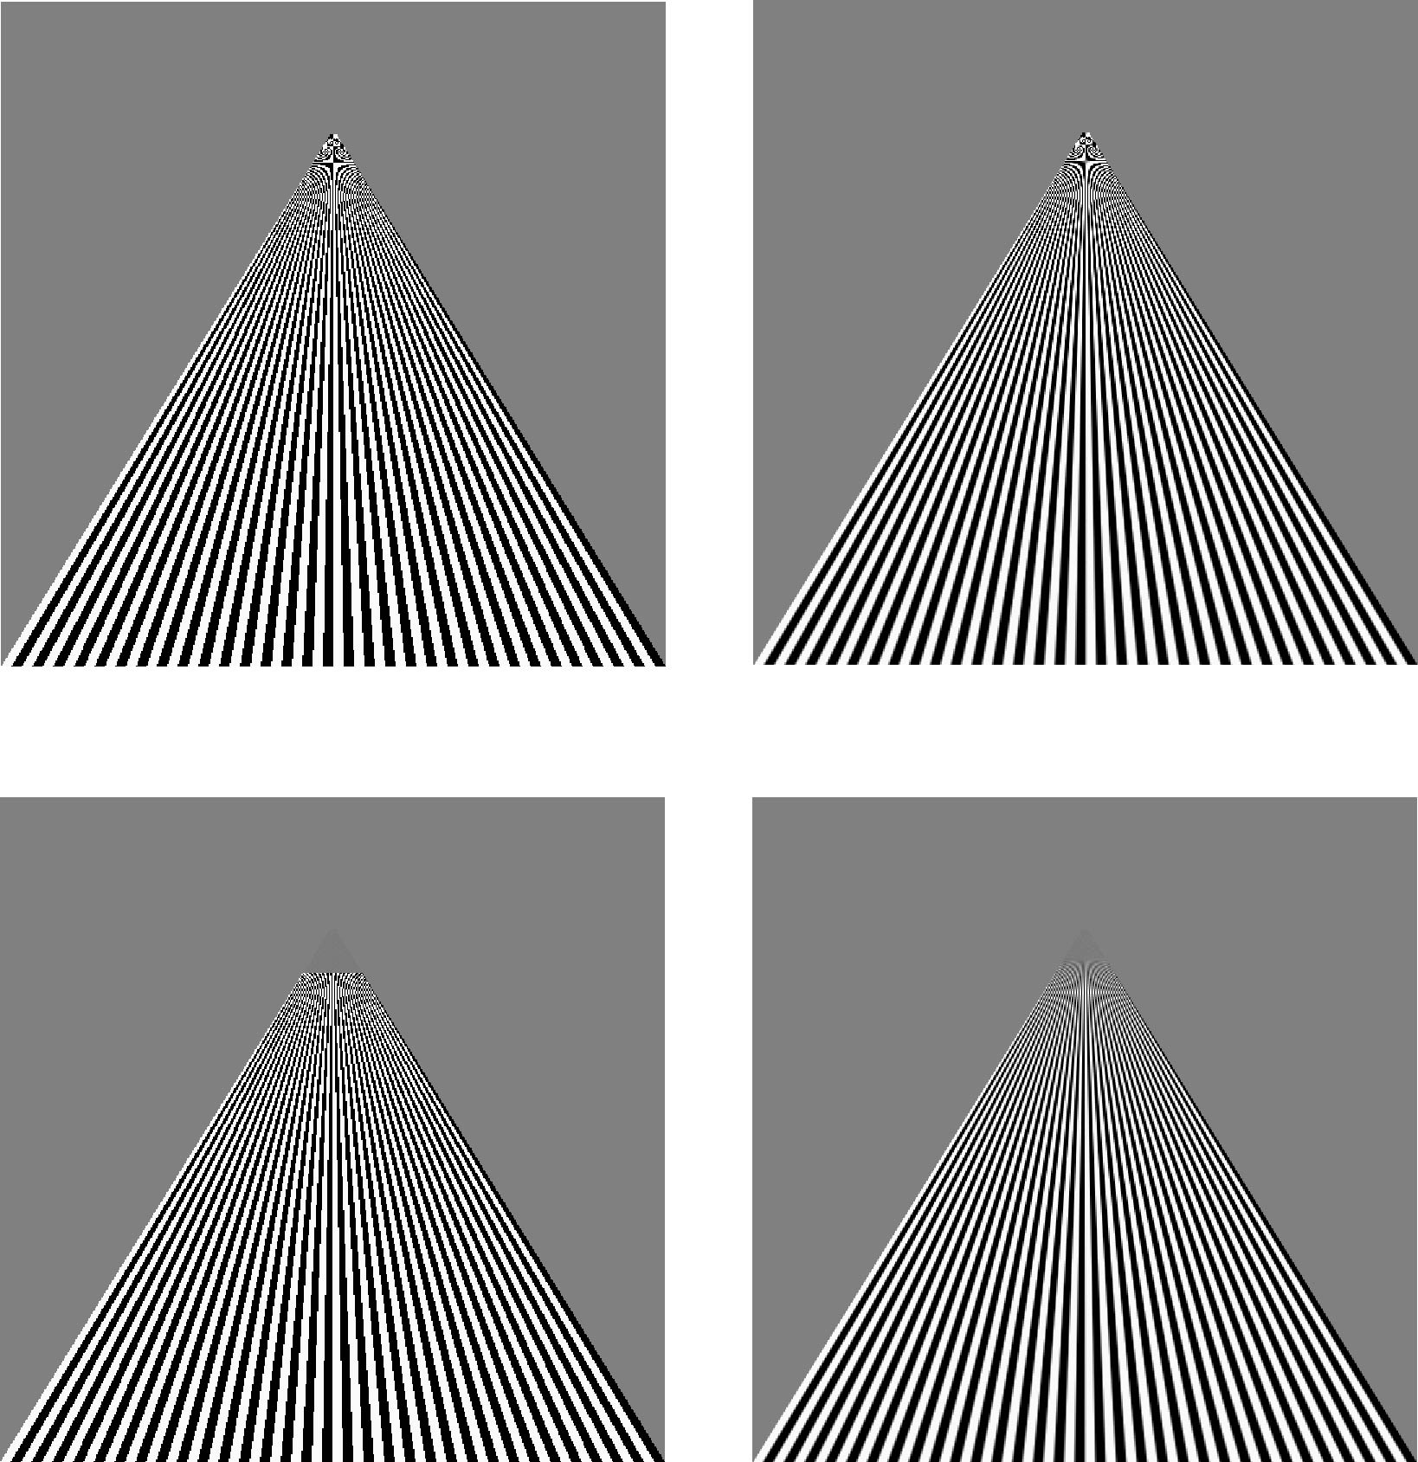
Example
point
sampling
linear
filtering
mipmapped
point
sampling
mipmapped
linear
filtering

Slide 51
Applying Textures
Texture can be applied in many ways
texture fully determines color
modulated with a computed color
blended with and environmental color
Fixed function pipeline has a function glTexEnv to set mode
deprecated
can get all desired functionality via fragment shader
Can also use multiple texture units

Slide 52
Other Texture Features
Environment Maps
Start with image of environment through a wide angle lens
Can be either a real scanned image or an image created in OpenGL
Use this texture to generate a spherical map
Alternative is to use a cube map
Multitexturing
Apply a sequence of textures through cascaded texture units

Slide 53
Applying Textures
Textures are applied during fragments shading by a sampler
Samplers return a texture color from a texture object
varying vec4 color; //color from rasterizer
varying vec2 texCoord; //texture coordinate from rasterizer
uniform sampler2D texture; //texture object from application
void main() {
gl_FragColor = color * texture2D( texture, texCoord );
}

Slide 54
Vertex Shader
Usually vertex shader will output texture coordinates to be rasterized
Must do all other standard tasks too
Compute vertex position
Compute vertex color if needed
attribute vec4 vPosition; //vertex position in object coordinates
attribute vec4 vColor; //vertex color from application
attribute vec2 vTexCoord; //texture coordinate from application
varying vec4 color; //output color to be interpolated
varying vec2 texCoord; //output tex coordinate to be interpolated

Slide 55
A Checkerboard Image
var image1 = new Uint8Array(4*texSize*texSize);
for ( var i = 0; i < texSize; i++ ) {
for ( var j = 0; j <texSize; j++ ) {
var patchx = Math.floor(i/(texSize/numChecks));
var patchy = Math.floor(j/(texSize/numChecks));
if(patchx%2 ^ patchy%2) c = 255;
else c = 0;
//c = 255*(((i & 0x8) == 0) ^ ((j & 0x8) == 0))
image1[4*i*texSize+4*j] = c;
image1[4*i*texSize+4*j+1] = c;
image1[4*i*texSize+4*j+2] = c;
image1[4*i*texSize+4*j+3] = 255;
}
}

Slide 56
Cube Example
var texCoord = [
vec2(0, 0),
vec2(0, 1),
vec2(1, 1),
vec2(1, 0)
];
function quad(a, b, c, d) {
pointsArray.push(vertices[a]);
colorsArray.push(vertexColors[a]);
texCoordsArray.push(texCoord[0]);
pointsArray.push(vertices[b]);
colorsArray.push(vertexColors[a]);
texCoordsArray.push(texCoord[1]);
// etc

Slide 57
Texture Object
function configureTexture( image ) {
var texture = gl.createTexture();
gl.bindTexture( gl.TEXTURE_2D, texture );
gl.pixelStorei(gl.UNPACK_FLIP_Y_WEBGL, true);
gl.texImage2D( gl.TEXTURE_2D, 0, gl.RGB,
gl.RGB, gl.UNSIGNED_BYTE, image );
gl.generateMipmap( gl.TEXTURE_2D );
gl.texParameteri( gl.TEXTURE_2D, gl.TEXTURE_MIN_FILTER,
gl.NEAREST_MIPMAP_LINEAR );
gl.texParameteri( gl.TEXTURE_2D, gl.TEXTURE_MAG_FILTER,
gl.NEAREST );
gl.activeTexture(gl.TEXTURE0);
gl.uniform1i(gl.getUniformLocation(program, "texture"), 0);
}

Slide 58
Linking with Shaders
var vTexCoord = gl.getAttribLocation( program, "vTexCoord" );
gl.enableVertexAttribArray( vTexCoord );
gl.vertexAttribPointer( vTexCoord, 2, gl.FLOAT, false, 0, 0);
// Set the value of the fragment shader texture sampler variable
// ("texture") to the the appropriate texture unit. In this case,
// zero for GL_TEXTURE0 which was previously set by calling
// gl.activeTexture().
gl.uniform1i( glGetUniformLocation(program, "texture"), 0 );

