Slide 1
Introduction to Computer Graphics with WebGL
Ed Angel
Professor Emeritus of Computer Science
Founding Director, Arts, Research, Technology and Science Laboratory
University of New Mexico

Slide 2
Reflection and Environment Maps
Ed Angel
Professor Emeritus of Computer Science
University of New Mexico

Slide 3
Objectives
Texture Mapping Applications
Reflection (Environment) Maps
Cube Maps
Spherical Maps
Bump Maps

Slide 4
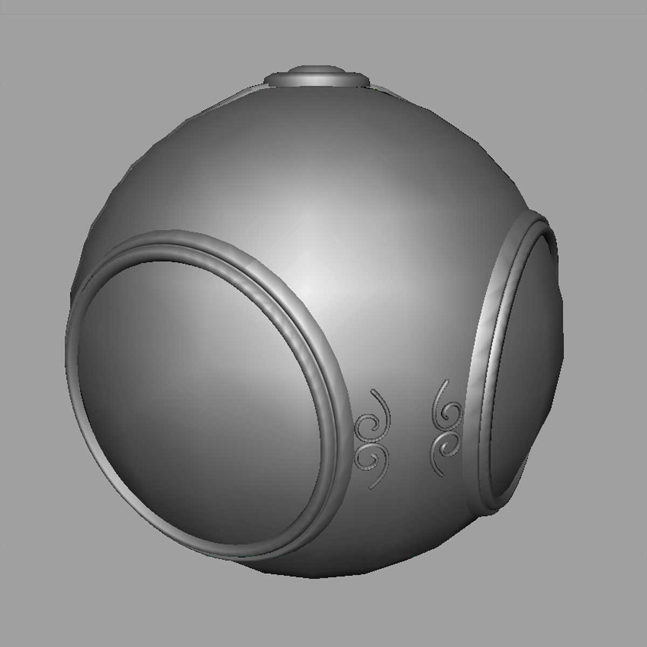
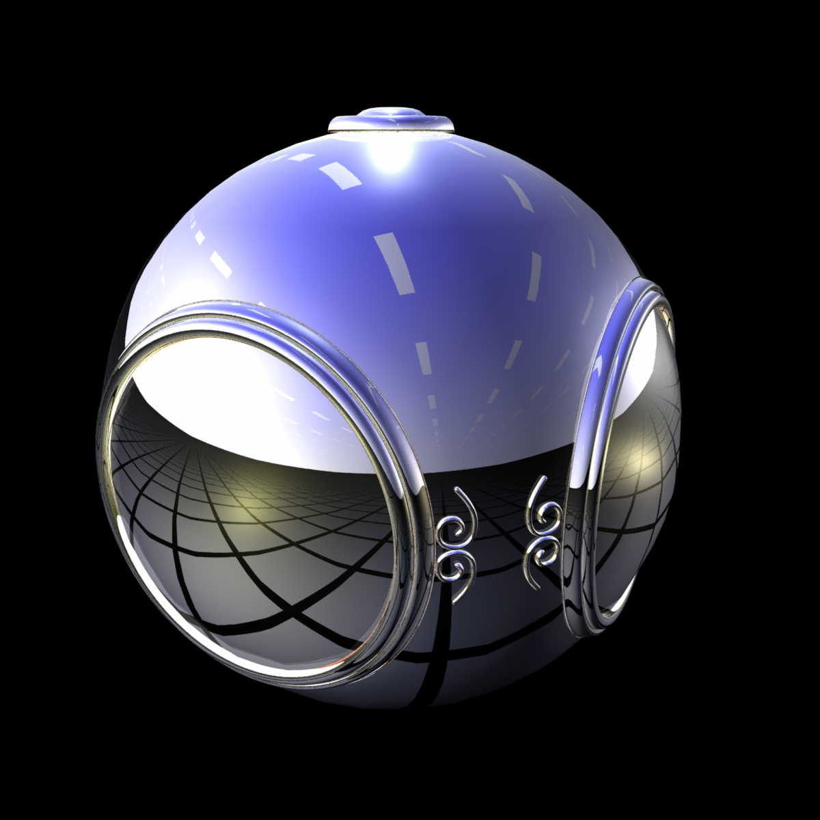
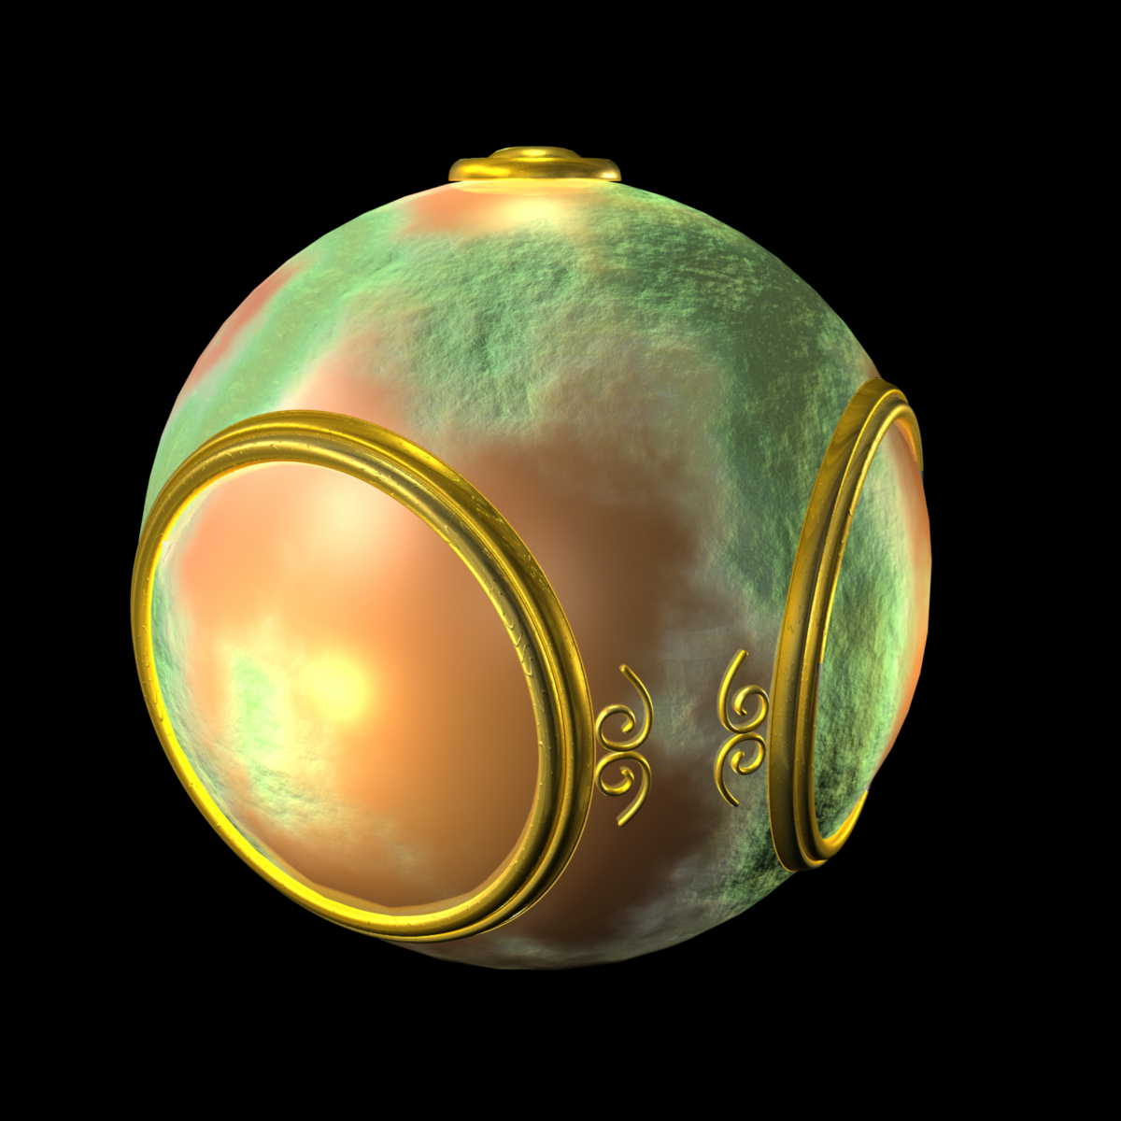
Mapping Variations
smooth shading
environment
mapping
bump mapping

Slide 5
Environment Mapping
Environmental (reflection) mapping is way to create the appearance of highly reflective surfaces without ray tracing which requires global calculations
Introduced in movies such as The Abyss and Terminator 2
Prevalent in video games
It is a form of texture mapping

Slide 6
Reflecting the Environment
N
V
R

Slide 7
Mapping to a Sphere
N
V
R

Slide 8
Hemisphere Map as a Texture
If we map all objects to hemisphere, we cannot tell if they are on the sphere or anywhere else along the reflector
Use the map on the sphere as a texture that can be mapped onto the object
Can use other surfaces as the intermediate
Cube maps
Cylinder maps

Slide 9
Cube Map

Slide 10
Indexing into Cube Map
Compute R = 2(N·V)N-V
Object at origin
Use largest magnitude component of R to determine face of cube
Other two components give texture coordinates
V
R

Slide 11
OpenGL Implementation
WebGL supports only cube maps
desktop OpenGL also supports sphere maps
First must form map
Use images from a real camera
Form images with WebGL
Texture map it to object

Slide 12
Cube Maps
We can form a cube map texture by defining six 2D texture maps that correspond to the sides of a box
Supported by WebGL through cubemap sampler
vec4 texColor = textureCube(mycube, texcoord);
Texture coordinates must be 3D
usually are given by the vertex location so we don’t need compute separate tex coords

Slide 13
Environment Maps with Shaders
Environment maps are usually computed in world coordinates which can differ from object coordinates because of the modeling matrix
May have to keep track of modeling matrix and pass it to the shaders as a uniform variable
Can also use reflection map or refraction map for effects such as simulating water

Slide 14
Issues
Must assume environment is very far from object (equivalent to the difference between near and distant lights)
Object cannot be concave (no self reflections possible)
No reflections between objects
Need a reflection map for each object
Need a new map if viewer moves

Slide 15
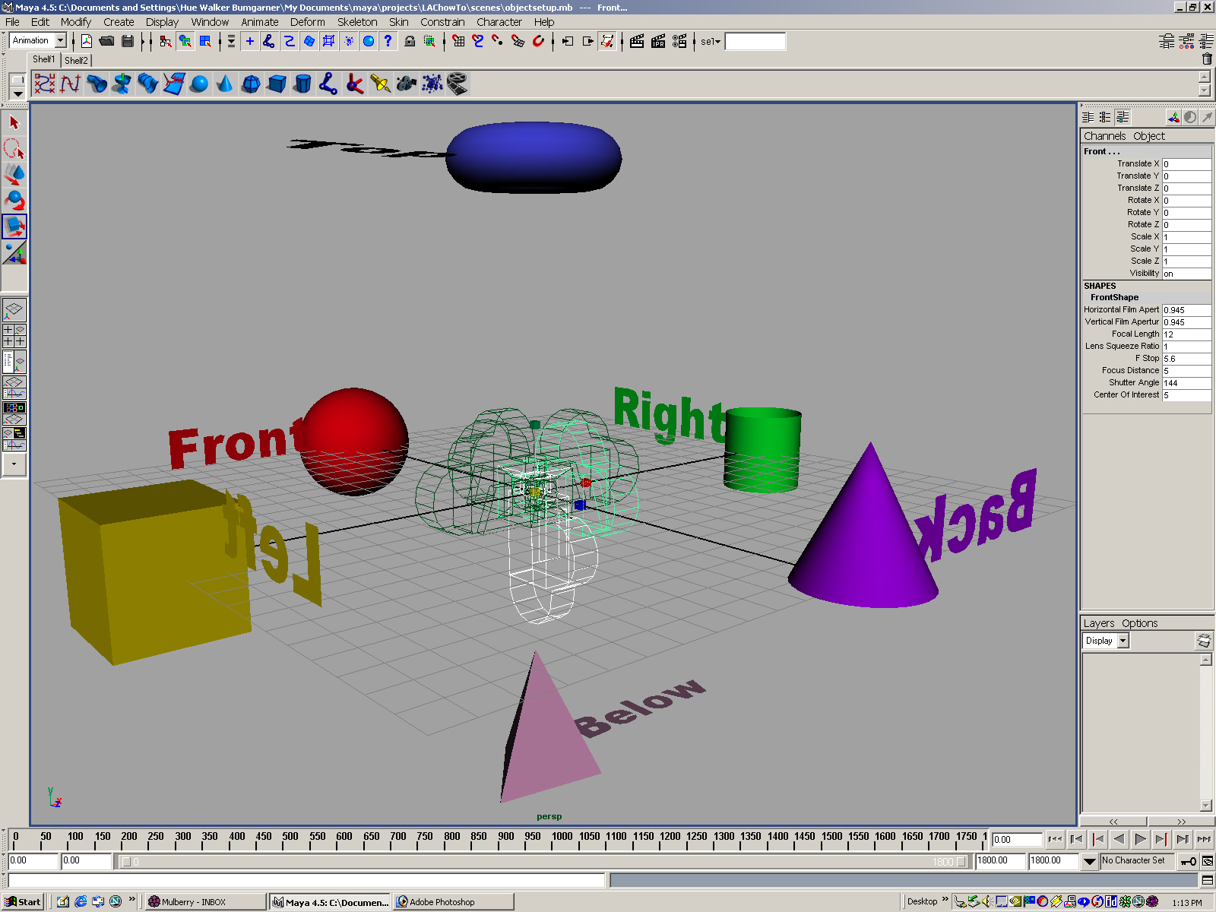
Forming Cube Map
Use six cameras, each with a 90 degree angle of view

Slide 16
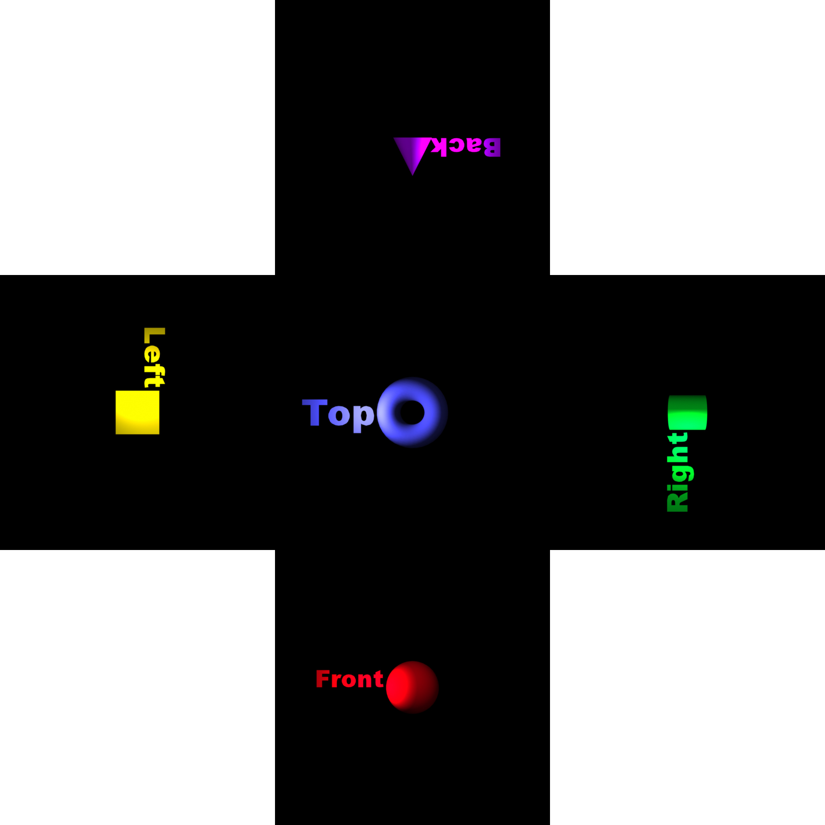
vs Cube Image

Slide 17
Doing it in WebGL
gl.textureMap2D(
gl.TEXTURE_CUBE_MAP_POSITIVE_X,
level, rows, columns, border, gl.RGBA,
gl.UNSIGNED_BYTE, image1)
Same for other five images
Make one texture object out of the six images

Slide 18
Example
Consider rotating cube inside a cube that reflects the color of the walls
Each wall is a solid color (red, green, blue, cyan, magenta, yellow)
Each face of room can be a texture of one texel
var red = new Uint8Array([255, 0, 0, 255]);
var green = new Uint8Array([0, 255, 0, 255]);
var blue = new Uint8Array([0, 0, 255, 255]);
var cyan = new Uint8Array([0, 255, 255, 255]);
var magenta = new Uint8Array([255, 0, 255, 255]);
var yellow = new Uint8Array([255, 255, 0, 255]);

Slide 19
Texture Object
cubeMap = gl.createTexture();
gl.bindTexture(gl.TEXTURE_CUBE_MAP, cubeMap);
gl.texImage2D(gl.TEXTURE_CUBE_MAP_POSITIVE_X, 0, gl.RGBA,
1, 1, 0, gl.RGBA,gl.UNSIGNED_BYTE, red);
gl.texImage2D(gl.TEXTURE_CUBE_MAP_NEGATIVE_X, 0, gl.RGBA,
1, 1, 0, gl.RGBA,gl.UNSIGNED_BYTE, green);
gl.texImage2D(gl.TEXTURE_CUBE_MAP_POSITIVE_Y, 0, gl.RGBA,
1, 1, 0, gl.RGBA,gl.UNSIGNED_BYTE, blue);
gl.texImage2D(gl.TEXTURE_CUBE_MAP_NEGATIVE_Y, 0, gl.RGBA,
1, 1, 0, gl.RGBA,gl.UNSIGNED_BYTE, cyan);
gl.texImage2D(gl.TEXTURE_CUBE_MAP_POSITIVE_Z, 0, gl.RGBA,
1, 1, 0, gl.RGBA,gl.UNSIGNED_BYTE, yellow);
gl.texImage2D(gl.TEXTURE_CUBE_MAP_NEGATIVE_Z, 0, gl.RGBA,
1, 1, 0, gl.RGBA,gl.UNSIGNED_BYTE, magenta);
gl.activeTexture( gl.TEXTURE0 );
gl.uniform1i(gl.getUniformLocation(program, "texMap"),0);

Slide 20
Vertex Shader
varying vec3 R;
attribute vec4 vPosition;
attribute vec4 vNormal;
uniform mat4 modelViewMatrix;
uniform mat4 projectionMatrix;
uniform vec3 theta;
void main(){
vec3 angles = radians( theta );
// compute rotation matrices rx, ry, rz here
mat4 ModelViewMatrix = modelViewMatrix*rz*ry*rx;
gl_Position = projectionMatrix*ModelViewMatrix*vPosition;
vec4 eyePos = ModelViewMatrix*vPosition;
vec4 N = ModelViewMatrix*vNormal;
R = reflect(eyePos.xyz, N.xyz); }

Slide 21
Fragment Shader
precision mediump float;
varying vec3 R;
uniform samplerCube texMap;
void main()
{
vec4 texColor = textureCube(texMap, R);
gl_FragColor = texColor;
}

Slide 22
Sphere Mapping
Original environmental mapping technique proposed by Blinn and Newell based in using lines of longitude and latitude to map parametric variables to texture coordinates
OpenGL supports sphere mapping which requires a circular texture map equivalent to an image taken with a fisheye lens

Slide 23
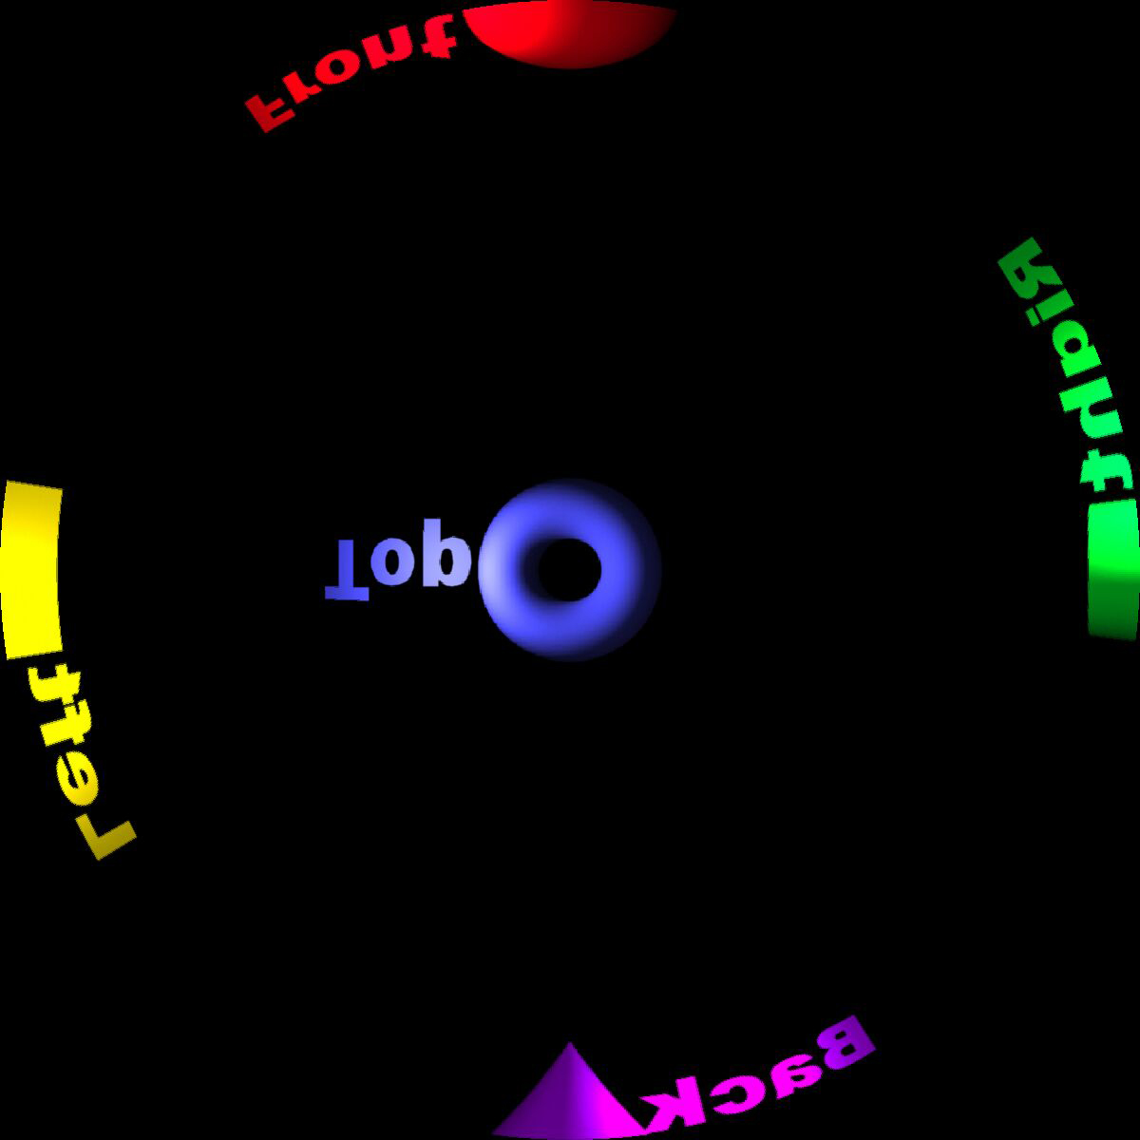
Sphere Map

Slide 24
Introduction to Computer Graphics with WebGL
Ed Angel
Professor Emeritus of Computer Science
Founding Director, Arts, Research, Technology and Science Laboratory
University of New Mexico

Slide 25
Bump Maps
Ed Angel
Professor Emeritus of Computer Science
University of New Mexico

Slide 26
Objectives
Introduce bump mapping

Slide 27
Modeling an Orange
Consider modeling an orange
Texture map a photo of an orange onto a surface
Captures dimples
Will not be correct if we move viewer or light
We have shades of dimples rather than their correct orientation
Ideally we need to perturb normal across surface of object and compute a new color at each interior point

Slide 28
Bump Mapping (Blinn)
Consider a smooth surface
n
p

Slide 29
Rougher Version
n’
p’
p

Slide 30
Tangent Plane
p_{v}
n
p_{u}

Slide 31
Equations
p(u,v) = [x(u,v), y(u,v), z(u,v)]^{T}
p_{u}=[ ∂x/ ∂u, ∂y/ ∂u, ∂z/ ∂u]^{T}
p_{v}=[ ∂x/ ∂v, ∂y/ ∂v, ∂z/ ∂v]^{T}
n = (p_{u} × p_{v} ) / | p_{u} × p_{v} |

Slide 32
Displacement Function
p’ = p + d(u,v) n
d(u,v) is the bump or displacement function
|d(u,v)| << 1

Slide 33
Perturbed Normal
n’ = p’_{u} × p’_{v}
p’_{u} = p_{u} + (∂d/∂u)n + d(u,v)n_{u}
p’_{v} = p_{v} + (∂d/∂v)n + d(u,v)n_{v}
If d is small, we can neglect last term

Slide 34
Approximating the Normal
n’ = p’_{u} × p’_{v}
≈ n + (∂d/∂u)n × p_{v} + (∂d/∂v)n × p_{u}
The vectors n × p_{v} and n × p_{u} lie
in the tangent plane
Hence the normal is displaced in the tangent plane
Must precompute the arrays ∂d/ ∂u and ∂d/ ∂v
Finally,we perturb the normal during shading

Slide 35
Image Processing
Suppose that we start with a function d(u,v)
We can sample it to form an array D=[d_{ij}]
Then ∂d/ ∂u ≈ d_{ij} – d_{i-1,j}
and ∂d/ ∂v ≈ d_{ij} – d_{i,j-1}
Embossing: multipass approach using floating point buffer

Slide 36
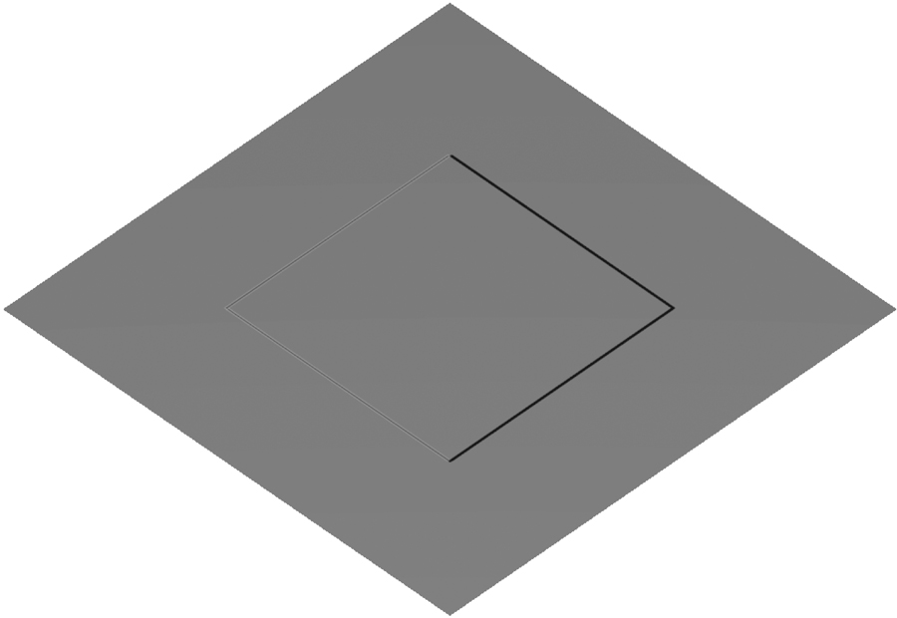
Example
Single Polygon and a Rotating Light Source

Slide 37
How to do this?
The problem is that we want to apply the perturbation at all points on the surface
Cannot solve by vertex lighting (unless polygons are very small)
Really want to apply to every fragment
Can’t do that in fixed function pipeline
But can do with a fragment program!!
See bumpmap.html and bumpmap.js

