Slide 1
Introduction to Computer Graphics with WebGL
Ed Angel
Professor Emeritus of Computer Science
Founding Director, Arts, Research, Technology and Science Laboratory
University of New Mexico

Slide 2
Compositing and Blending
Ed Angel
Professor Emeritus of Computer Science
University of New Mexico

Slide 3
Objectives
Learn to use the A component in RGBA color for
Blending for translucent surfaces
Compositing images
Antialiasing

Slide 4
Opacity and Transparency
Opaque surfaces permit no light to pass through
Transparent surfaces permit all light to pass
Translucent surfaces pass some light
translucency = 1 – opacity (α)
opaque surface α =1

Slide 5
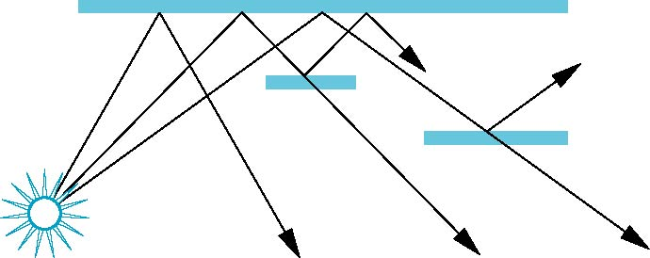
Physical Models
Dealing with translucency in a physically correct manner is difficult due to
the complexity of the internal interactions of light and matter
Using a pipeline renderer

Slide 6
Writing Model
Use A component of RGBA (or RGBα) color to store opacity
During rendering we can expand our writing model to use RGBA values
blend
source blending factor
source
component
destination
component
destination blending
factor
Color Buffer

Slide 7
Blending Equation
We can define source and destination blending factors for each RGBA component
s = [s_{r}, s_{g}, s_{b}, s_{α}]
d = [d_{r}, d_{g}, d_{b}, d_{α}]
Suppose that the source and destination colors are
b = [b_{r}, b_{g}, b_{b}, b_{α}]
c = [c_{r}, c_{g}, c_{b}, c_{α}]
Blend as
c’ = [b_{r} s_{r}+ c_{r} d_{r}, b_{g} s_{g}+ c_{g} d_{g} , b_{b} s_{b}+ c_{b} d_{b} , b_{α} s_{α}+ c_{α} d_{α} ]

Slide 8
OpenGL Blending and Compositing
Must enable blending and pick source and destination factors
gl.enable(gl.BLEND)
gl.blendFunc(source_factor,
destination_factor)
Only certain factors supported
gl.ZERO, gl.ONE
gl.SRC_ALPHA, gl.ONE_MINUS_SRC_ALPHA
gl.DST_ALPHA, gl.ONE_MINUS_DST_ALPHA
See Redbook for complete list

Slide 9
Example
Suppose that we start with the opaque background color (R₀,G₀,B₀,1)
This color becomes the initial destination color
We now want to blend in a translucent polygon with color (R₁,G₁,B₁,α₁)
Select GL_SRC_ALPHA and GL_ONE_MINUS_SRC_ALPHA as the source and destination blending factors
R’₁ = α₁ R₁ +(1- α₁) R_{0,} ……
Note this formula is correct if polygon is either opaque or transparent

Slide 10
Clamping and Accuracy
All the components (RGBA) are clamped and stay in the range (0,1)
However, in a typical system, RGBA values are only stored to 8 bits
Can easily loose accuracy if we add many components together
Example: add together n images
Divide all color components by n to avoid clamping
Blend with source factor = 1, destination factor = 1
But division by n loses bits

Slide 11
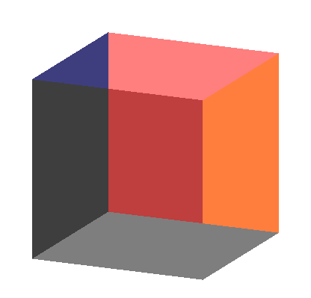
Order Dependency
Is this image correct?
Probably not
Polygons are rendered
in the order they pass
down the pipeline
Blending functions
are order dependent

Slide 12
Opaque and Translucent Polygons
Suppose that we have a group of polygons some of which are opaque and some translucent
How do we use hidden-surface removal?
Opaque polygons block all polygons behind them and affect the depth buffer
Translucent polygons should not affect depth buffer
Render with gl.depthMask(false) which makes depth buffer read-only
Sort polygons first to remove order dependency

Slide 13
Fog
We can composite with a fixed color and have the blending factors depend on depth
Simulates a fog effect
Blend source color C_{s} and fog color C_{f} by
C_{s}’=f C_{s} + (1-f) C_{f}
f is the fog factor
Exponential
Gaussian
Linear (depth cueing)
Deprecated but can recreate

Slide 14
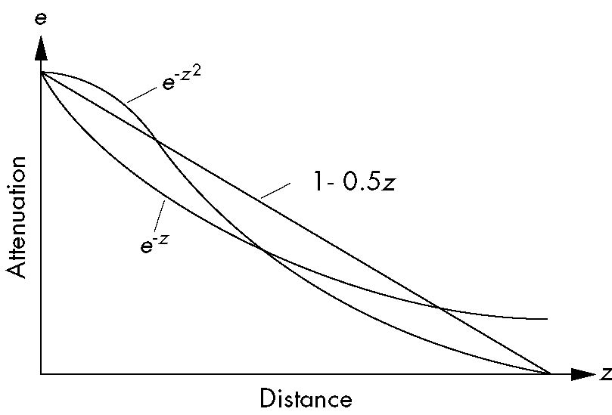
Fog Functions

Slide 15
Compositing and HTML
In desktop OpenGL, the A component has no effect unless blending is enabled
In WebGL, an A other than 1.0 has an effect because WebGL works with the HTML5 Canvas element
A = 0.5 will cut the RGB values by ½ when the pixel is displayed
Allows other applications to be blended into the canvas along with the graphics

Slide 16
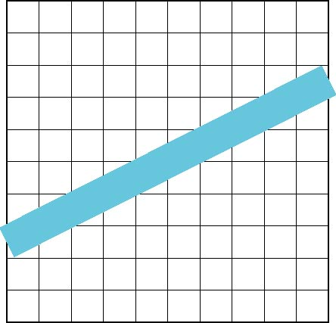
Line Aliasing
Ideal raster line is one pixel wide
All line segments, other than vertical and horizontal segments, partially cover pixels
Simple algorithms color
only whole pixels
Lead to the “jaggies”
or aliasing
Similar issue for polygons

Slide 17
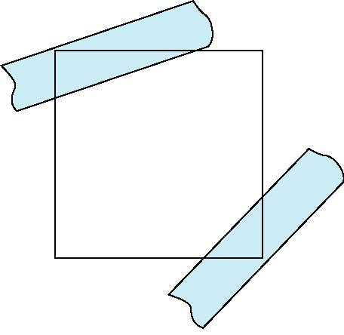
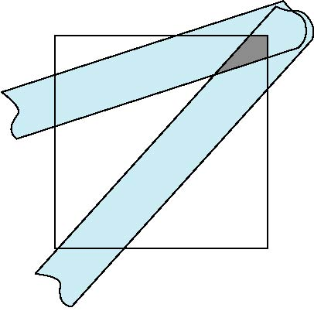
Antialiasing
Can try to color a pixel by adding a fraction of its color to the frame buffer
Fraction depends on percentage of pixel covered by fragment
Fraction depends on whether there is overlap
no overlap
overlap

Slide 18
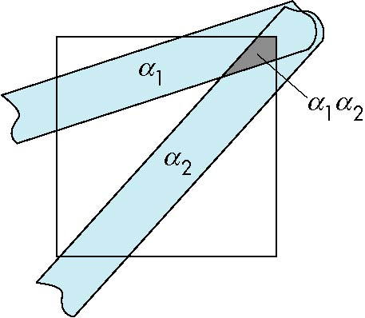
Area Averaging
Use average area α₁+α₂-α₁α₂ as blending factor

Slide 19
OpenGL Antialiasing
Not (yet) supported in WebGL
Can enable separately for points, lines, or polygons
Note most hardware will automatically antialias
glEnable(GL_POINT_SMOOTH);
glEnable(GL_LINE_SMOOTH);
glEnable(GL_POLYGON_SMOOTH);
glEnable(GL_BLEND);
glBlendFunc(GL_SRC_ALPHA, GL_ONE_MINUS_SRC_ALPHA);

Slide 20
Introduction to Computer Graphics with WebGL
Ed Angel
Professor Emeritus of Computer Science
Founding Director, Arts, Research, Technology and Science Laboratory
University of New Mexico

Slide 21
Imaging Applications
Ed Angel
Professor Emeritus of Computer Science
University of New Mexico

Slide 22
Objectives
Use the fragment shader to do image processing
Image filtering
Pseudo Color
Use multiple textures
matrix operations
Introduce GPGPU

Slide 23
Accumulation Techniques
Compositing and blending are limited by resolution of the frame buffer
Typically 8 bits per color component
The accumulation buffer was a high resolution buffer (16 or more bits per component) that avoided this problem
Could write into it or read from it with a scale factor
Slower than direct compositing into the frame buffer
Now deprecated but can do techniques with floating point frame buffers

Slide 24
Multirendering
Composite multiple images
Image Filtering (convolution)
add shifted and scaled versions of an image
Whole scene antialiasing
move primitives a little for each render
Depth of Field
move viewer a little for each render keeping one plane unchanged
Motion effects

Slide 25
Fragment Shaders and Images
Suppose that we send a rectangle (two triangles) to the vertex shader and render it with an n x m texture map
Suppose that in addition we use an n x m canvas
There is now a one-to-one correspondence between each texel and each fragment
Hence we can regard fragment operations as imaging operations on the texture map

Slide 26
GPGPU
Looking back at these examples, we can note that the only purpose of the geometry is to trigger the execution of the imaging operations in the fragment shader
Consequently, we can look at what we have done as large matrix operations rather than graphics operations
Leads to the field of General Purpose Computing with a GPU (GPGPU)

Slide 27
Examples
Add two matrices
Multiply two matrices
Fast Fourier Transform
Uses speed and parallelism of GPU
But how do we get out results?
Floating point frame buffers
OpenCL (WebCL)
Compute shaders

Slide 28
Using Multiple Texels
Suppose we have a 1024 x 1024 texture in the texture object “image”
sampler2D(image, vec2(x,y)) returns the the value of the texture at (x,y)
sampler2D(image, vec2(x+1.0/1024.0), y); returns the value of the texel to the right of (x,y)
We can use any combination of texels surrounding (x, y) in the fragment shader

Slide 29
Image Enhancer
precision mediump float;
varying vec2 fTexCoord;
uniform sampler2D texture;
void main()
{
float d = 1.0/256.0; //spacing between texels
float x = fTexCoord.x;
float y = fTexCoord.y;
gl_FragColor = 10.0*abs( texture2D( texture, vec2(x+d, y))
- texture2D( texture, vec2(x-d, y)))
+10.0*abs( texture2D( texture, vec2(x, y+d))
- texture2D( texture, vec2(x, y-d)));
gl_FragColor.w = 1.0;
}

Slide 30
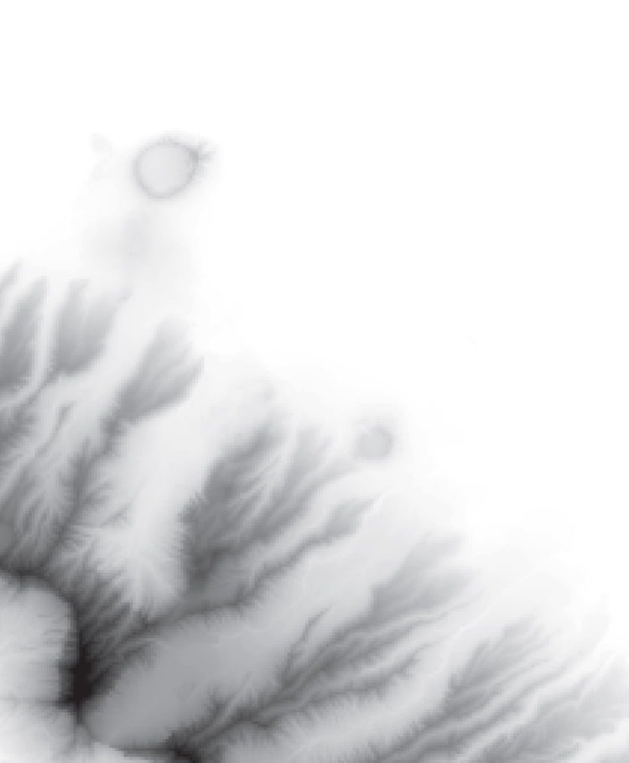
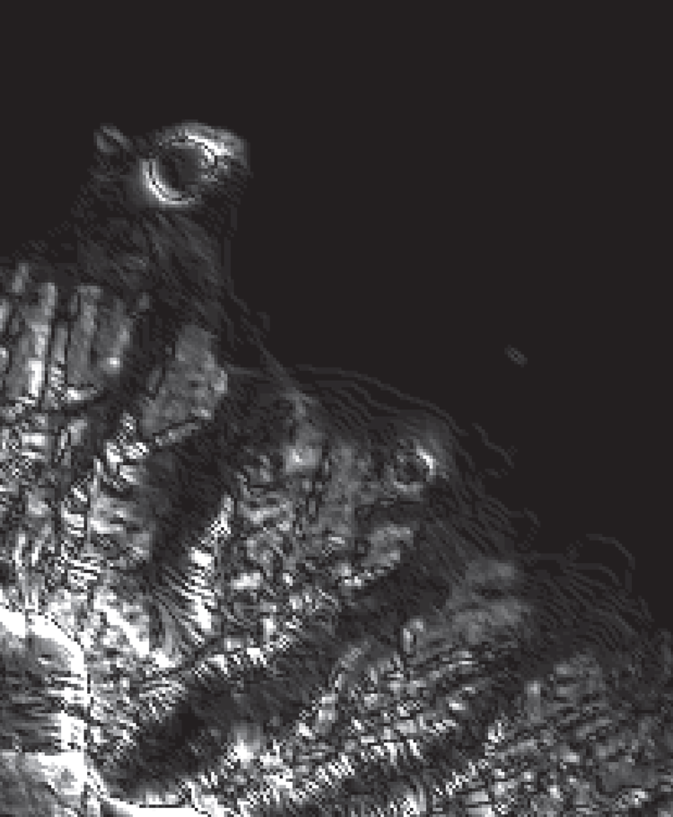
Honolulu Image
original
enhanced

Slide 31
Sobel Edge Detector
Nonlinear
Find approximate gradient at each point
Compute smoothed finite difference approximations to x and y components separately
Display magnitude of approximate gradient
Simple with fragment shader

Slide 32
Sobel Edge Detector
vec4 gx = 3.0*texture2D( texture, vec2(x+d, y))
+ texture2D( texture, vec2(x+d, y+d))
+ texture2D( texture, vec2(x+d, y-d))
- 3.0*texture2D( texture, vec2(x-d, y))
- texture2D( texture, vec2(x-d, y+d))
- texture2D( texture, vec2(x-d, y-d));
vec4 gy = 3.0*texture2D( texture, vec2(x, y+d))
+ texture2D( texture, vec2(x+d, y+d))
+ texture2D( texture, vec2(x-d, y+d))
- 3.0*texture2D( texture, vec2(x, y-d))
- texture2D( texture, vec2(x+d, y-d))
- texture2D( texture, vec2(x-d, y-d));
gl_FragColor = vec4(sqrt(gx*gx + gy*gy), 1.0);
gl_FragColor.w = 1.0;

Slide 33
Sobel Edge Detector

Slide 34
Using Multiple Textures
Example: matrix addition
Create two samplers, texture1 and texture2, that contain the data
In fragment shader
gl_FragColor =
sampler2D(texture1, vec2(x, y)) +sampler2D(texture2, vec2(x,y));

Slide 35
Using 4 Way Parallelism
Recent GPUs and graphics cards support textures up to 8K x 8K
For scalar imaging, we can do twice as well using all four color components

Slide 36
Indexed and Pseudo Color
Display luminance (2D) image as texture map
Treat pixel value as independent variable for separate functions for each color component
void main(){
vec4 color = texture2D(texture, fTexCoord);
if(color.g<0.5) color.g = 2.0*color.g;
else color.g = 2.0 - 2.0*color.g;
color.b = 1.0-color.b;
gl_FragColor = color;
}

Slide 37
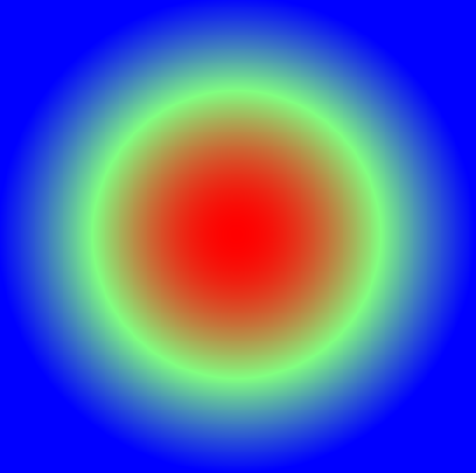
Top View of 2D Sinc

Slide 38
The Next Step
Need more storage for most GPGPU calculations
Example: filtering
Example: iteration
Need shared memory
Solution: Use texture memory and off-screen rendering

Slide 39
Introduction to Computer Graphics with WebGL
Ed Angel
Professor Emeritus of Computer Science
Founding Director, Arts, Research, Technology and Science Laboratory
University of New Mexico

Slide 40
Computing the Mandelbrot Set
Ed Angel
Professor Emeritus of Computer Science
University of New Mexico

Slide 41
Objectives
Introduce the most famous fractal object
more about fractal curves and surfaces later
Imaging calculation
Must compute value for each pixel on display
Shows power of fragment processing

Slide 42
Sierpinski Gasket
Rule based:
Repeat n times. As n →∞
Area→0
Perimeter →∞
Not a normal geometric object
More about fractal curves and surfaces later

Slide 43
Complex Arithmetic
Complex number defined by two scalars
z = x + jy
j² = -1
Addition and Subtraction
z₁+z₂ = x₁ + x₂ +j(y₁+y₂)
z₁*z₂ = x₁*x₂-y₁*y₂ + j(x₁*y₂+x₂*y₁)
Magnitude
|z|² = x² + y²

Slide 44
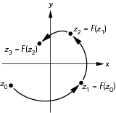
Iteration in the Complex Plane

Slide 45
Mandelbrot Set
iterate on z_{k+1}=z_{k}²+c
with z₀ = 0 + j0
Two cases as k →∞
|z_{k} |→∞
|z_{k} | remains finite
If for a given c, |z_{k} | remains finite, then c belongs to the Mandelbrot set

Slide 46
Computing the Mandelbrot Set
Pick a rectangular region
Map each pixel to a value in this region
Do an iterative calculation for each pixel
If magnitude is greater than 2, we know sequence will diverge and point does not belong to the set
Stop after a fixed number of iterations
Points with small magnitudes should be in set
Color each point based on its magnitude

Slide 47
Mandelbrot Set

Slide 48
Exploring the Mandelbrot Set
Most interesting parts are centered near
(-0.5, 0.0)
Really interesting parts are where we are uncertain if points are in or out of the set
Repeated magnification these regions reveals complex and beautiful patterns
We use color maps to enhance the detail

Slide 49
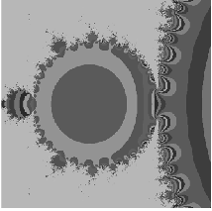
Mandelbrot Set

Slide 50
Computing in the JS File I
Form a texture map of the set and map to a rectangle
var height = 0.5;
// size of window in complex plane
var width = 0.5;var cx = -0.5;
// center of window in complex plane
var cy = 0.5;var max = 100;
// number of interations per point
var n = 512;
var m =512;
var texImage = new Uint8Array(4*n*m);

Slide 51
Computing in JS File II
for ( var i = 0; i < n; i++ )
for ( var j = 0; j < m; j++ ) {
var x = i * ( width / (n - 1) ) + cx - width / 2;
var y = j * ( height / ( m - 1 ) ) + cy - height / 2;
var c = [ 0.0, 0.0 ];
var p = [ x, y ];
for ( var k = 0; k < max; k++ ) {
// compute c = c^2 + p
c = [c[0]*c[0]-c[1]*c[1], 2*c[0]*c[1]];
c = [c[0]+p[0], c[1]+p[1]];
v = c[0]*c[0]+c[1]*c[1];
if ( v > 4.0 ) break; /* assume not in set if mag > 2 */
}

Slide 52
Computing in JS File III
// assign gray level to point based on its magnitude */
if ( v > 1.0 ) v = 1.0; /* clamp if > 1 */
texImage[4*i*m+4*j] = 255*v;
texImage[4*i*m+4*j+1] =
255*( 0.5* (Math.sin( v*Math.PI/180 ) + 1.0));
texImage[4*i*m+4*j+2] = 255*(1.0 - v);
texImage[4*i*m+4*j+3] = 255;
}
Set up two triangles to define a rectangle
Set up texture object with the set as data
Render the triangles

Slide 53
Example

Slide 54
Fragment Shader
Our first implementation is incredibly inefficient and makes no use of the power of the fragment shader
Note the calculation is “embarrassingly parallel”
computation for the color of each fragment is completely independent
Why not have each fragment compute membership for itself?
Each fragment would then determine its own color

Slide 55
Interactive Program
JS file sends window parameters obtained from sliders to the fragment shader as uniforms
Only geometry is a rectangle
No need for a texture map since shader will work on individual pixels

Slide 56
Fragment Shader I
precision mediump float;
uniform float cx;
uniform float cy;
uniform float scale;
float height;
float width;
void main() {
const int max = 100; /* number of iterations per point */
const float PI = 3.14159;
float n = 1000.0;
float m = 1000.0;

Slide 57
Fragment Shader II
float v;
float x = gl_FragCoord.x /(n*scale) + cx - 1.0 / (2.0*scale);
float y = gl_FragCoord.y/(m*scale) + cy - 1.0 / (2.0*scale);
float ax=0.0, ay=0.0;
float bx, by;
for ( int k = 0; k < max; k++ ) {
// compute c = c^2 + p
bx = ax*ax-ay*ay;
by = 2.0*ax*ay;
ax = bx+x;
ay = by+y;
v = ax*ax+ay*ay;
if ( v > 4.0 ) break; // assume not in set if mag > 2
}

Slide 58
Fragment Shader
// assign gray level to point based on its magnitude //
// clamp if > 1
v = min(v, 1.0);
gl_FragColor.r = v;
gl_FragColor.g = 0.5* sin( 3.0*PI*v) + 1.0;
gl_FragColor.b = 1.0-v;
gl_FragColor.b = 0.5* cos( 19.0*PI*v) + 1.0;
gl_FragColor.a = 1.0;
}

Slide 59
Analysis
This implementation will use as many fragment processors as are available concurrently
Note that if an iteration ends early, the GPU will use that processor to work on another fragment
Note also the absence of loops over x and y
Still not using the full parallelism since we are really computing a luminance image

