Slide 1
Introduction to Computer Graphics with WebGL
Ed Angel
Professor Emeritus of Computer Science
Founding Director, Arts, Research, Technology and Science Laboratory
University of New Mexico

Slide 2
Clipping
Ed Angel
Professor Emeritus of Computer Science
University of New Mexico

Slide 3
Objectives
Clipping lines
First of implementation algorithms
Clipping polygons (next lecture)
Focus on pipeline plus a few classic algorithms

Slide 4
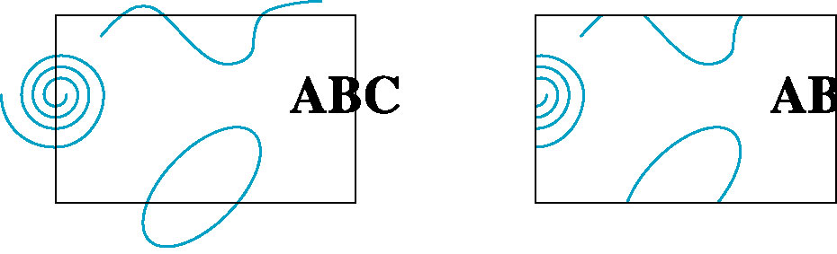
Clipping
2D against clipping window
3D against clipping volume
Easy for line segments polygons
Hard for curves and text
Convert to lines and polygons first

Slide 5
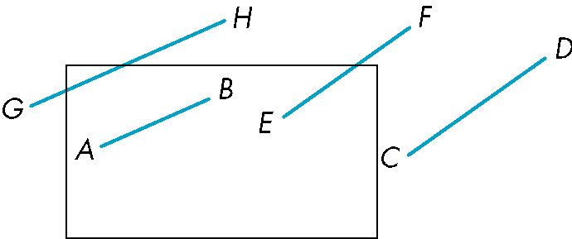
Clipping 2D Line Segments
Brute force approach: compute intersections with all sides of clipping window
Inefficient: one division per intersection

Slide 6
Cohen-Sutherland Algorithm
Idea: eliminate as many cases as possible without computing intersections
Start with four lines that determine the sides of the clipping window
y = y_{max}
x = x_{min}
x = x_{max}
y = y_{min}

Slide 7
The Cases
Case 1: both endpoints of line segment inside all four lines
Draw (accept) line segment as is
Case 2: both endpoints outside all lines and on same side of a line
Discard (reject) the line segment
y = y_{max}
x = x_{min}
x = x_{max}
y = y_{min}

Slide 8
The Cases
Case 3: One endpoint inside, one outside
Must do at least one intersection
Case 4: Both outside
May have part inside
Must do at least one intersection
y = y_{max}
x = x_{min}
x = x_{max}

Slide 9
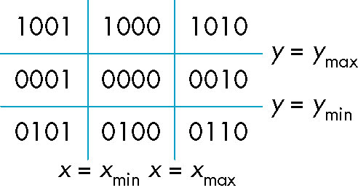
Defining Outcodes
For each endpoint, define an outcode
Outcodes divide space into 9 regions
Computation of outcode requires at most 4 subtractions
b₀b₁b₂b₃
b₀ = 1 if y > y_{max}, 0 otherwise
b₁ = 1 if y < y_{min}, 0 otherwise
b₂ = 1 if x > x_{max}, 0 otherwise
b₃ = 1 if x < x_{min}, 0 otherwise

Slide 10
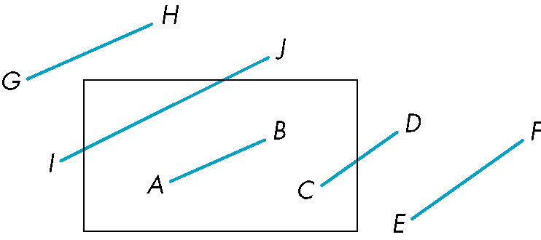
Using Outcodes
Consider the 5 cases below
AB: outcode(A) = outcode(B) = 0
Accept line segment

Slide 11
Using Outcodes
CD: outcode (C) = 0, outcode(D) ≠ 0
Compute intersection
Location of 1 in outcode(D) determines which edge to intersect with
Note if there were a segment from A to a point in a region with 2 ones in outcode, we might have to do two interesections

Slide 12
Using Outcodes
EF: outcode(E) logically ANDed with outcode(F) (bitwise) ≠ 0
Both outcodes have a 1 bit in the same place
Line segment is outside of corresponding side of clipping window
reject

Slide 13
Using Outcodes
GH and IJ: same outcodes, neither zero but logical AND yields zero
Shorten line segment by intersecting with one of sides of window
Compute outcode of intersection (new endpoint of shortened line segment)
Reexecute algorithm

Slide 14
Efficiency
In many applications, the clipping window is small relative to the size of the entire data base
Most line segments are outside one or more side of the window and can be eliminated based on their outcodes
Inefficiency when code has to be reexecuted for line segments that must be shortened in more than one step

Slide 15
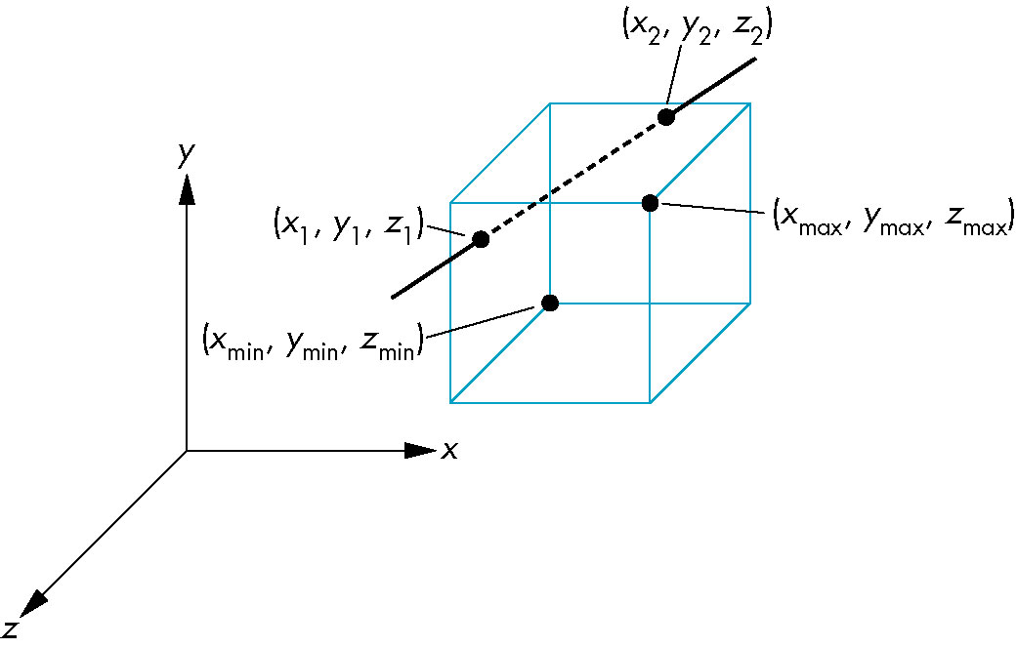
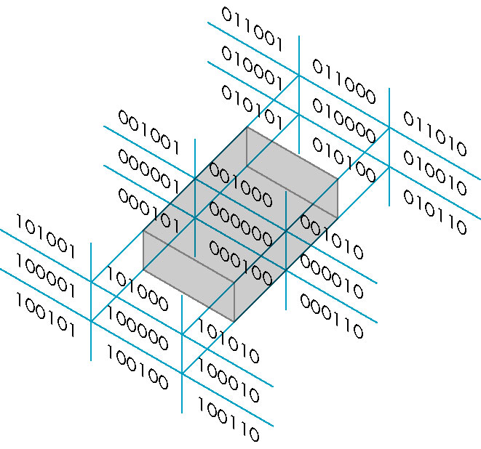
Cohen Sutherland in 3D
Use 6-bit outcodes
When needed, clip line segment against planes

Slide 16
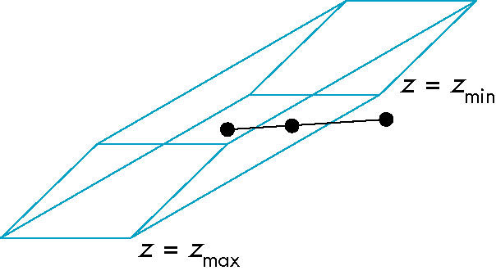
Clipping and Normalization
General clipping in 3D requires intersection of line segments against arbitrary plane
Example: oblique view

Slide 17
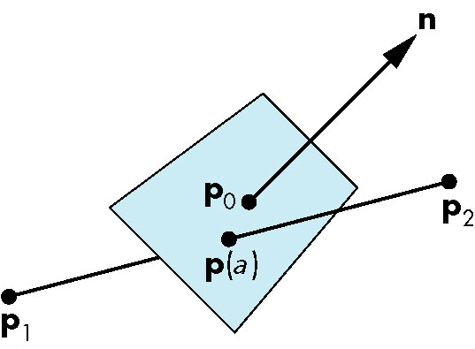
Plane-Line Intersections

Slide 18
Normalized Form
top view
before normalization
after normalization
Normalization is part of viewing (pre clipping)
but after normalization, we clip against sides of
right parallelepiped
Typical intersection calculation now requires only
a floating point subtraction, e.g. is x > x_{max} ?

Slide 19
Introduction to Computer Graphics with WebGL
Ed Angel
Professor Emeritus of Computer Science
Founding Director, Arts, Research, Technology and Science Laboratory
University of New Mexico

Slide 20
Polygon Rendering
Ed Angel
Professor Emeritus of Computer Science
University of New Mexico

Slide 21
Objectives
Introduce clipping algorithms for polygons
Survey hidden-surface algorithms

Slide 22
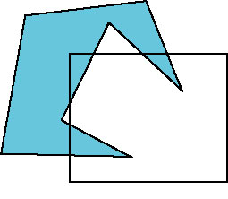
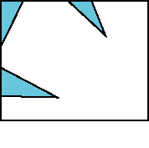
Polygon Clipping
Not as simple as line segment clipping
Clipping a line segment yields at most one line segment
Clipping a polygon can yield multiple polygons
However, clipping a convex polygon can yield at most one other polygon

Slide 23
Tessellation and Convexity
One strategy is to replace nonconvex (concave) polygons with a set of triangular polygons (a tessellation)
Also makes fill easier
Tessellation through tesselllation shaders

Slide 24
Clipping as a Black Box
Can consider line segment clipping as a process that takes in two vertices and produces either no vertices or the vertices of a clipped line segment

Slide 25
Pipeline Clipping of Line Segments
Clipping against each side of window is independent of other sides
Can use four independent clippers in a pipeline

Slide 26
Pipeline Clipping of Polygons
Three dimensions: add front and back clippers
Strategy used in SGI Geometry Engine
Small increase in latency

Slide 27
Bounding Boxes
Rather than doing clipping on a complex polygon, we can use an axis-aligned bounding box or extent
Smallest rectangle aligned with axes that encloses the polygon
Simple to compute: max and min of x and y

Slide 28
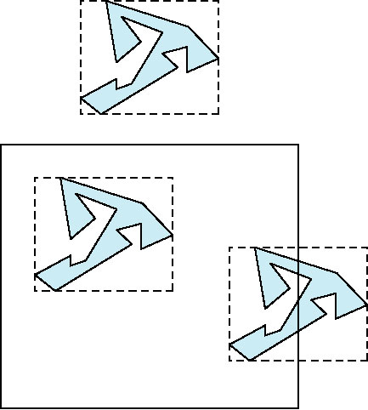
Bounding boxes
Can usually determine accept/reject based only on bounding box
reject
accept
requires detailed
clipping

Slide 29
Clipping and Visibility
Clipping has much in common with hidden-surface removal
In both cases, we are trying to remove objects that are not visible to the camera
Often we can use visibility or occlusion testing early in the process to eliminate as many polygons as possible before going through the entire pipeline

Slide 30
Hidden Surface Removal
Object-space approach: use pairwise testing between polygons (objects)
Worst case complexity O(n²) for n polygons
partially obscuring
can draw independently

Slide 31
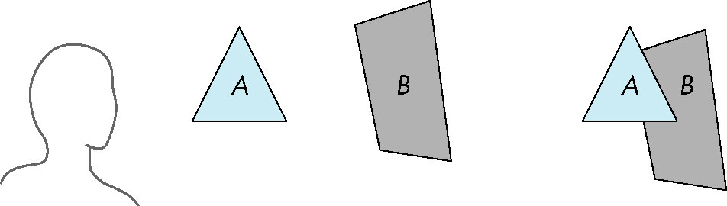
Painter’s Algorithm
Render polygons a back to front order so that polygons behind others are simply painted over
B behind A as seen by viewer
Fill B then A

Slide 32
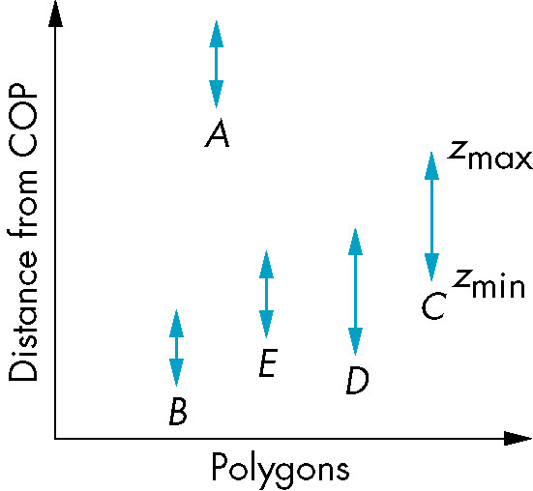
Depth Sort
Requires ordering of polygons first
O(n log n) calculation for ordering
Not every polygon is either in front or behind all other polygons
Order polygons and deal with
easy cases first, harder later
Polygons sorted by
distance from COP

Slide 33
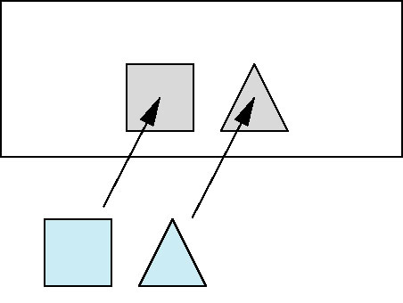
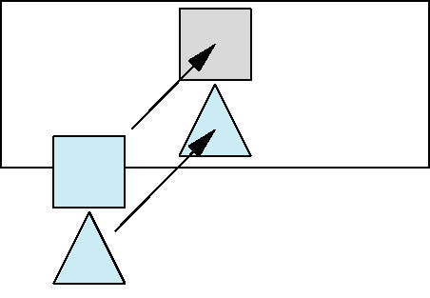
Easy Cases
A lies behind all other polygons
Can render
Polygons overlap in z but not in either x or y
Can render independently

Slide 34
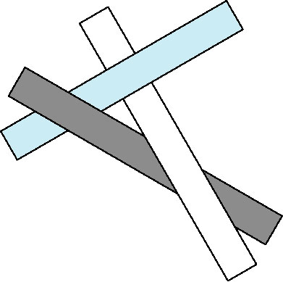
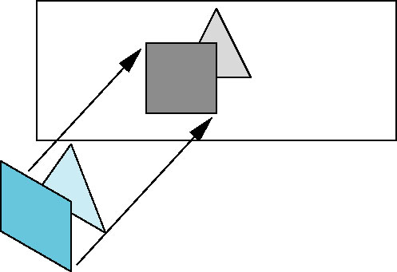
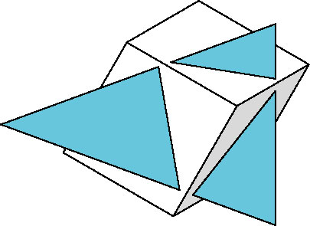
Hard Cases
cyclic overlap
Overlap in all directions
but can one is fully on
one side of the other
penetration

Slide 35
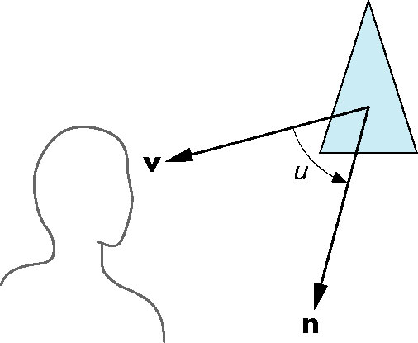
Back-Face Removal (Culling)
face is visible iff 90 ≥ θ ≥ -90
equivalently cos θ ≥ 0
or v • n ≥ 0
θ
plane of face has form ax + by +cz +d =0
but after normalization n = ( 0 0 1 0)^{T}
need only test the sign of c
In OpenGL we can simply enable culling
but may not work correctly if we have nonconvex objects

Slide 36
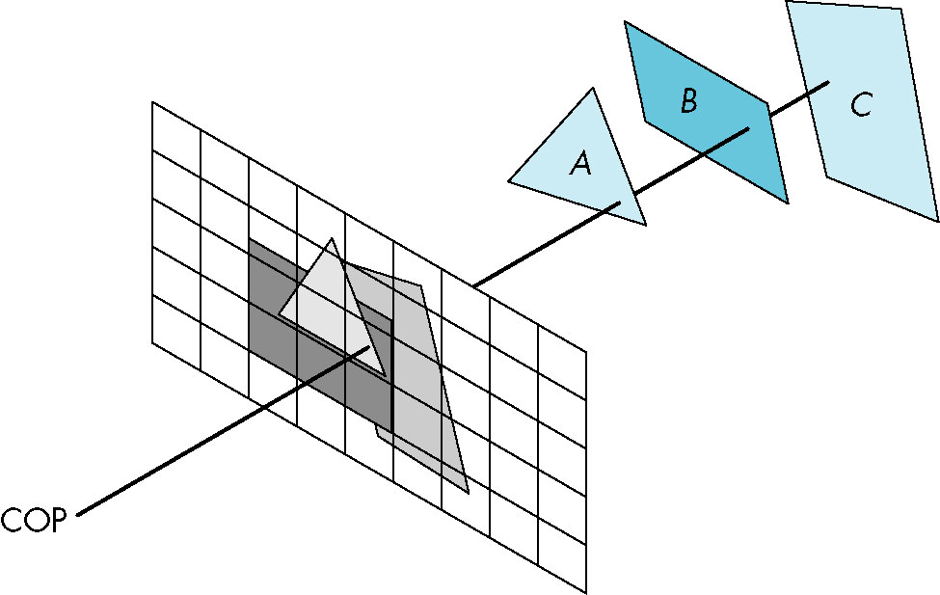
Image Space Approach
Look at each projector (nm for an n x m frame buffer) and find closest of k polygons
Complexity O(nmk)
Ray tracing
z-buffer

Slide 37
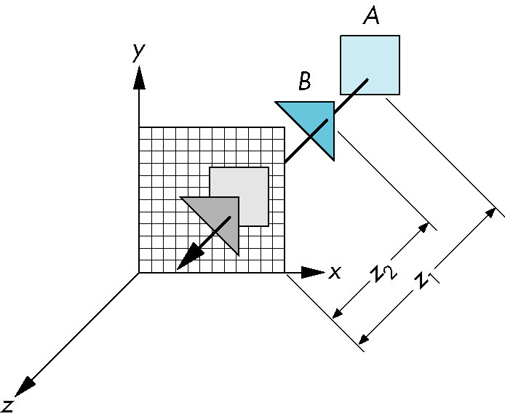
z-Buffer Algorithm
Use a buffer called the z or depth buffer to store the depth of the closest object at each pixel found so far
As we render each polygon, compare the depth of each pixel to depth in z buffer
If less, place shade of pixel in color buffer and update z buffer

Slide 38
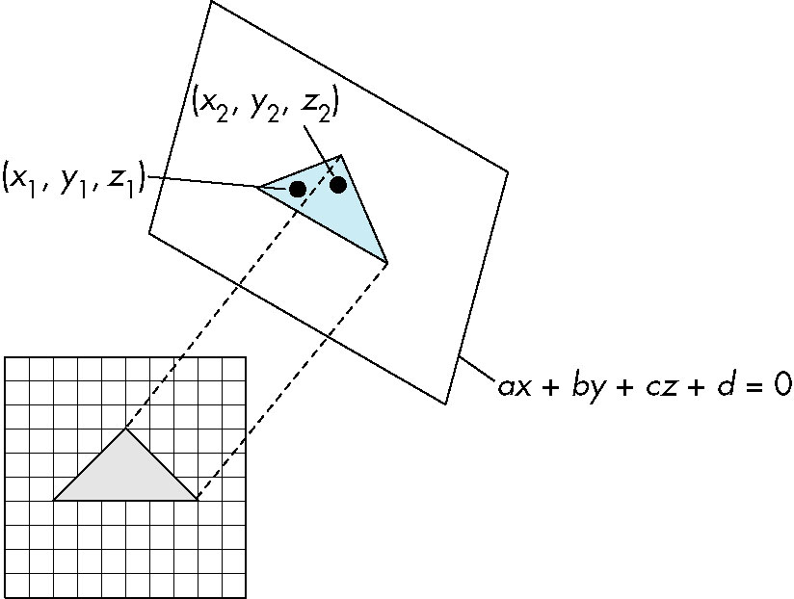
Efficiency
If we work scan line by scan line as we move across a scan line, the depth changes satisfy aΔx+bΔy+cΔz=0
Along scan line
Δy = 0
Δz = - Δx
In screen space Δx = 1

Slide 39
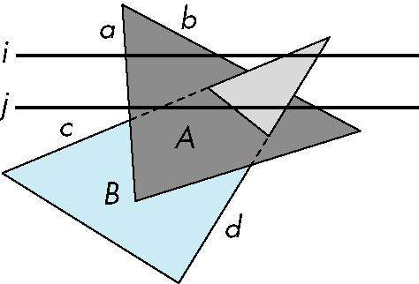
Scan-Line Algorithm
Can combine shading and hsr through scan line algorithm
scan line i: no need for depth
information, can only be in no
or one polygon
scan line j: need depth
information only when in
more than one polygon

Slide 40
Implementation
Need a data structure to store
Flag for each polygon (inside/outside)
Incremental structure for scan lines that stores which edges are encountered
Parameters for planes

Slide 41
Visibility Testing
In many realtime applications, such as games, we want to eliminate as many objects as possible within the application
Reduce burden on pipeline
Reduce traffic on bus
Partition space with Binary Spatial Partition (BSP) Tree

Slide 42
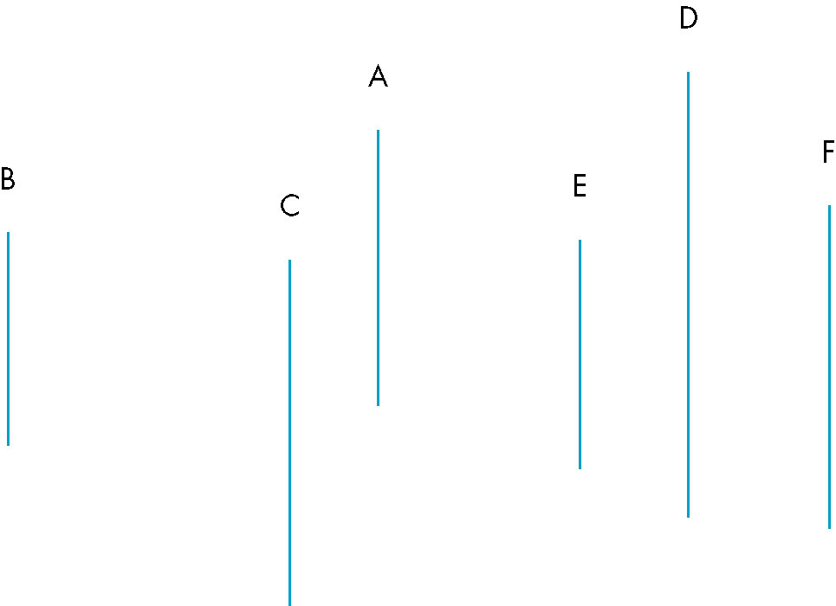
Simple Example
consider 6 parallel polygons
top view
The plane of A separates B and C from D, E and F

Slide 43
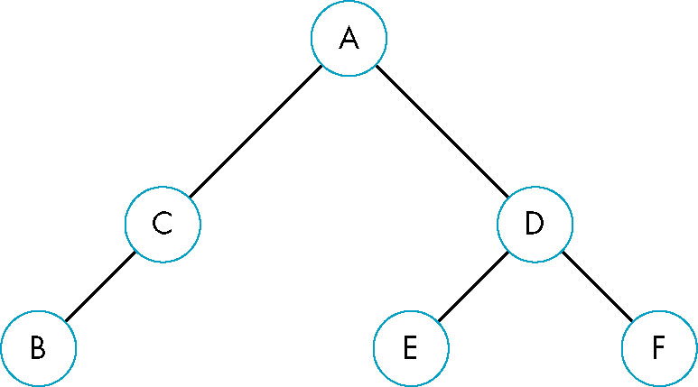
BSP Tree
Can continue recursively
Plane of C separates B from A
Plane of D separates E and F
Can put this information in a BSP tree
Use for visibility and occlusion testing

Slide 44
Introduction to Computer Graphics with WebGL
Ed Angel
Professor Emeritus of Computer Science
Founding Director, Arts, Research, Technology and Science Laboratory
University of New Mexico

Slide 45
Rasterization
Ed Angel
Professor Emeritus of Computer Science
University of New Mexico

Slide 46
Objectives
Survey Line Drawing Algorithms
DDA
Bresenham’s Algorithm
Aliasing and Antialiasing

Slide 47
Rasterization
Rasterization (scan conversion)
Determine which pixels that are inside primitive specified by a set of vertices
Produces a set of fragments
Fragments have a location (pixel location) and other attributes such color and texture coordinates that are determined by interpolating values at vertices
Pixel colors determined later using color, texture, and other vertex properties

Slide 48
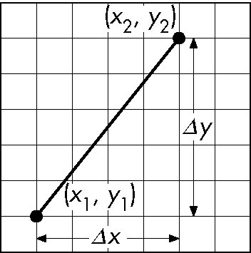
Scan Conversion of Line Segments
Start with line segment in window coordinates with integer values for endpoints
Assume implementation has a write_pixel function
y = mx + h

Slide 49
DDA Algorithm
Digital Differential Analyzer
DDA was a mechanical device for numerical solution of differential equations
Line y=mx+ h satisfies differential equation
dy/dx = m = Δy/Δx = y₂-y₁/x₂-x₁
Along scan line Δx = 1
For(x=x1; x<=x2,ix++) {
y+=m;
write_pixel(x, round(y), line_color)
}

Slide 50
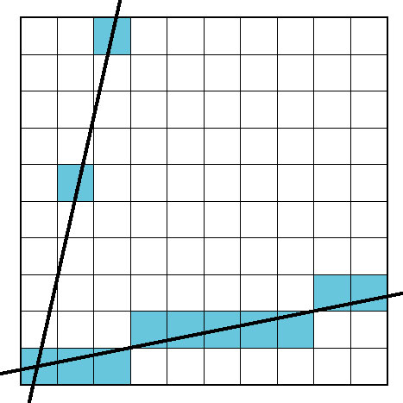
Problem
DDA = for each x plot pixel at closest y
Problems for steep lines

Slide 51
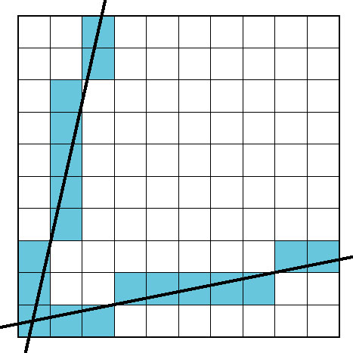
Using Symmetry
Use for 1 ≥ m ≥ 0
For m > 1, swap role of x and y
For each y, plot closest x

Slide 52
Bresenham’s Algorithm
DDA requires one floating point addition per step
We can eliminate all fp through Bresenham’s algorithm
Consider only 1 ≥ m ≥ 0
Other cases by symmetry
Assume pixel centers are at half integers
If we start at a pixel that has been written, there are only two candidates for the next pixel to be written into the frame buffer

Slide 53
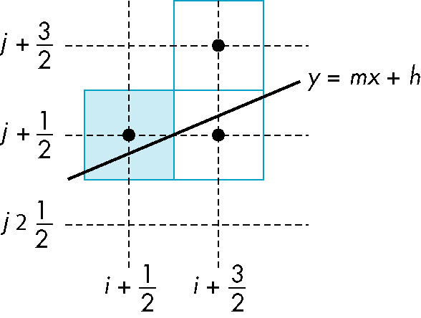
Candidate Pixels
1 ≥ m ≥ 0
candidates
last pixel
Note that line could have
passed through any
part of this pixel

Slide 54
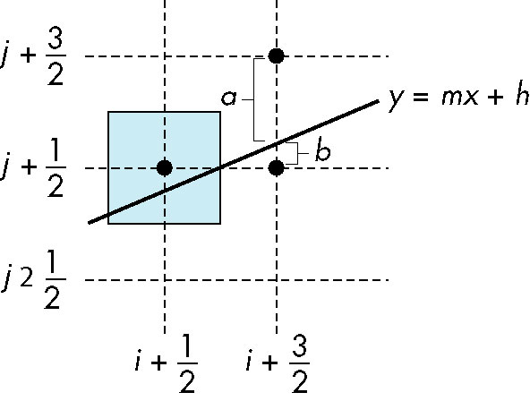
Decision Variable
d = Δx(b-a)
d is an integer
d > 0 use upper pixel
d < 0 use lower pixel
-

Slide 55
Incremental Form
More efficient if we look at d_{k}, the value of the decision variable at x = k
d_{k+1}= d_{k} –2Δy, if d_{k} <0
d_{k+1}= d_{k} –2(Δy- Δx), otherwise
For each x, we need do only an integer
addition and a test
Single instruction on graphics chips

Slide 56
Polygon Scan Conversion
Scan Conversion = Fill
How to tell inside from outside
Convex easy
Nonsimple difficult
Odd even test
Count edge crossings
Winding number
odd-even fill

Slide 57
Winding Number
Count clockwise encirclements of point
Alternate definition of inside: inside if winding number ≠ 0
winding number = 1
winding number = 2

Slide 58
Filling in the Frame Buffer
Fill at end of pipeline
Convex Polygons only
Nonconvex polygons assumed to have been tessellated
Shades (colors) have been computed for vertices (Gouraud shading)
Combine with z-buffer algorithm
March across scan lines interpolating shades
Incremental work small

Slide 59
Using Interpolation
C₁ C₂ C₃ specified by glColor or by vertex shading
C₄ determined by interpolating between C₁ and C₂
C₅ determined by interpolating between C₂ and C₃
interpolate between C₄ and C₅ along span
C₁
C₄
C₂
scan line
C₅
span
C₃

Slide 60
Flood Fill
Fill can be done recursively if we know a seed point located inside (WHITE)
Scan convert edges into buffer in edge/inside color (BLACK)
flood_fill(int x, int y) {
if(read_pixel(x,y)= = WHITE) {
write_pixel(x,y,BLACK);
flood_fill(x-1, y);
flood_fill(x+1, y);
flood_fill(x, y+1);
flood_fill(x, y-1);
} }

Slide 61
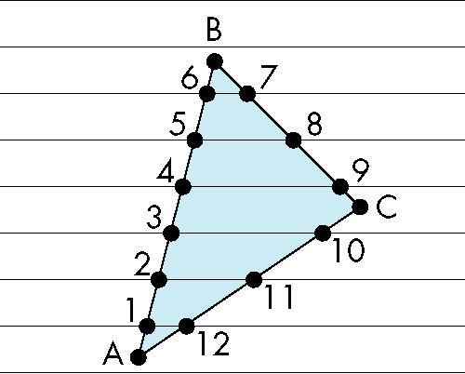
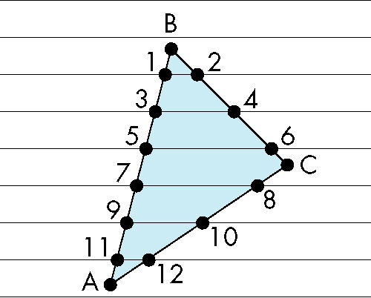
Scan Line Fill
Can also fill by maintaining a data structure of all intersections of polygons with scan lines
Sort by scan line
Fill each span
vertex order generated
by vertex list
desired order

Slide 62
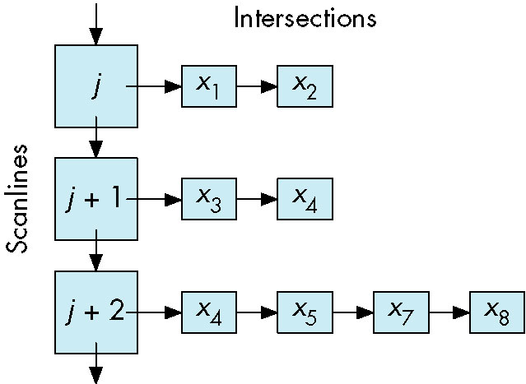
Data Structure

Slide 63
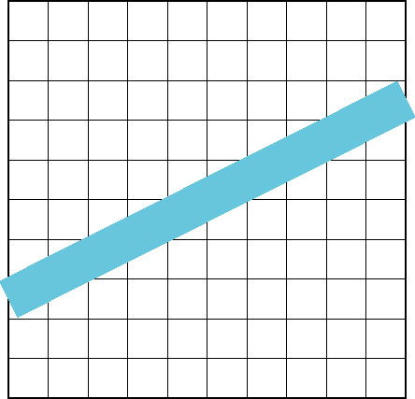
Aliasing
Ideal rasterized line should be 1 pixel wide
Choosing best y for each x (or visa versa) produces aliased raster lines

Slide 64
Antialiasing by Area Averaging
Color multiple pixels for each x depending on coverage by ideal line
original
antialiased
magnified

Slide 65
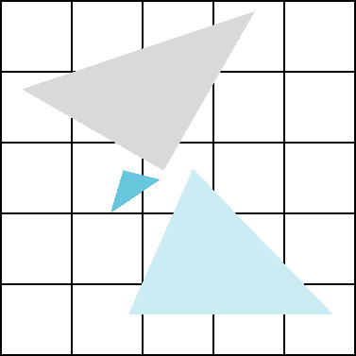
Polygon Aliasing
Aliasing problems can be serious for polygons
Jaggedness of edges
Small polygons neglected
Need compositing so color
of one polygon does not
totally determine color of
pixel
All three polygons should contribute to color

Slide 66
Introduction to Computer Graphics with WebGL
Ed Angel
Professor Emeritus of Computer Science
Founding Director, Arts, Research, Technology and Science Laboratory
University of New Mexico

Slide 67
Display Issues
Ed Angel
Professor Emeritus of Computer Science
University of New Mexico

Slide 68
Objectives
Consider perceptual issues related to displays
Introduce chromaticity space
Color systems
Color transformations
Standard Color Systems

Slide 69
No Display Can Be Perfect
An analog display device such as a CRT takes digital input (pixels) and outputs a small spot of color
A Digital display such as a LCD display outputs discrete spots
The eye merges (filters) these spots
Sampling theory shows this process cannot be done perfectly

Slide 70
Perception Review
Light is the part of the electromagnetic spectrum between ~350-750 nm
A color C(λ) is a distribution of energies within this range
The human visual system has three types of cones on the retina, each with its own spectral sensitivity
Consequently, only three values, the tristimulus values, are “seen” by the brain

Slide 71
Tristimulus Values
The human visual center has three cones with sensitivity curves S₁(λ), S₂(λ), and S₃(λ)
For a color C(λ), the cones output the tristimulus values
C(λ)
optic nerve
T₁, T₂, T₃
cones

Slide 72
Three Color Theory
Any two colors with the same tristimulus values are perceived to be identical
Thus a display (CRT, LCD, film) must only produce the correct tristimulus values to match a color
Is this possible? Not always
Different primaries (different sensitivity curves) in different systems

Slide 73
The Problem
The sensitivity curves of the human are not the same as those of physical devices
Human: curves centered in blue, green, and green-yellow
CRT: RGB
Print media: CMY or CMYK
Which colors can we match and, if we cannot match, how close can we come?

Slide 74
Representing Colors
Consider a color C(λ)
It generates tristimulus values T₁, T₂, T₃
Write C = (T₁, T₂, T₃ )
Conventionally,we assume 1≥ T₁, T₂, T₃ ≥ 0 because there is a maximum brightness we can produce and energy is nonnegative
C is a point in color solid
1
C
T₂
T₁
T₃
1
1

Slide 75
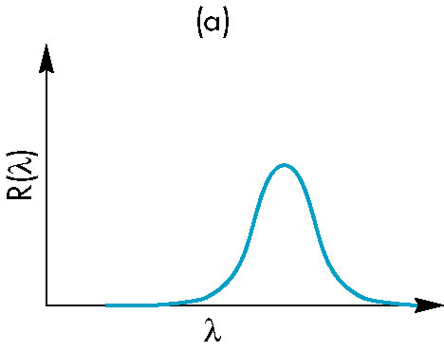
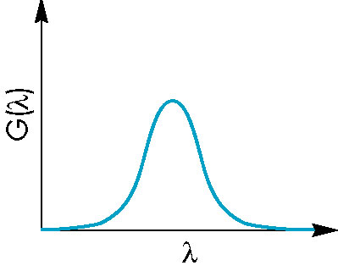
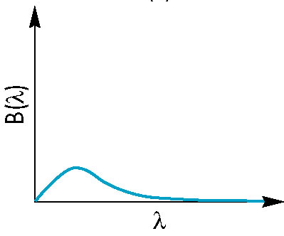
Producing Colors
Consider a device such as a CRT with RGB primaries and sensitivity curves
Tristimulus values

Slide 76
Matching
This T₁, T₂, T₃ is dependent on the particular device
If we use another device, we will get different values and these values will not match those of the human cone curves
Need a way of matching and a way of normalizing

Slide 77
Color Systems
Various color systems are used
Based on real primaries:
NTSC RGB
UVW
CMYK
HLS
Theoretical
XYZ
Prefer to separate brightness (luminance) from color (chromatic) information
Reduce to two dimensions

Slide 78
Tristimulus Coordinates
For any set of primaries, define
Note

Slide 79
Maxwell Triangle
1
color solid
T₁ + T₂+T₃ =1
1
1
Project onto 2D: chromaticity space
1
t₁ + t₂ =1
t₁
possible colors
t₂
1

Slide 80
NTSC RGB
r+g+b=1
1
g
r+g=1
r
1

Slide 81
Producing Other Colors
However colors producible on one system (its color gamut) is not necessarily producible on any other
Not that if we produce all the pure spectral colors in the 350-750 nm range, we can produce all others by adding spectral colors
With real systems (CRT, film), we cannot produce the pure spectral colors
We can project the color solid of each system into chromaticity space (of some system) to see how close we can get

Slide 82
Color Gamuts
600 nm
spectral colors
printer colors
producible color on
CRT but not on printer
CRT colors
unproducible
color
750 nm
producible color on
both CRT and printer
350 nm

Slide 83
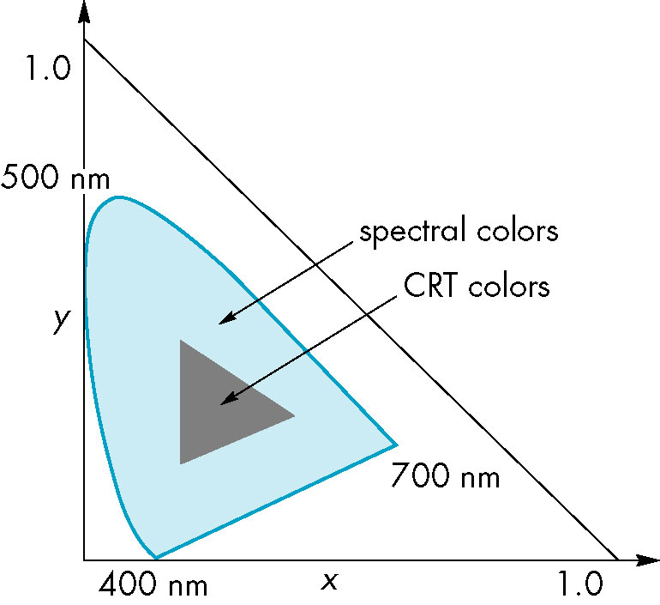
XYZ
Reference system in which all visible pure spectral colors can be produced
Theoretical systems as
there are no corresponding
physical primaries
Standard reference system

Slide 84
Color Systems
Most correspond to real primaries
National Television Systems Committee (NTSC) RGB matches phosphors in CRTs
Film both additive (RGB) and subtractive (CMY) for positive and negative film
Print industry CMYK (K = black)
K used to produce sharp crisp blacks
Example: ink jet printers

Slide 85
Color Transformations
Each additive color system is a linear transformation of another
G’
G
C = (T₁, T₂, T₃) = (T’₁, T’₂, T’₃)
R’
in R’G’B’system
B
R
B’
in RGB system

Slide 86
RGB, CMY, CMYK
Assuming 1 is max of a primary
C = 1 – R
M = 1 – G
Y = 1 – B
Convert CMY to CMYK by
K = min(C, M, Y)
C’ = C – K
M’ = M – K
Y’ = Y - K

Slide 87
Color Matrix
Exists a 3 x 3 matrix to convert from representation in one system to representation in another
Example: XYZ to NTSC RGB
find in colorimetry references
Can take a color in XYZ and find out if it is producible by transforming and then checking if resulting tristimulus values lie in (0,1)

Slide 88
YIQ
NTSC Transmission Colors
Here Y is the luminance
Arose from need to separate brightness from chromatic information in TV broadcasting
Note luminance shows high green sensitivity

Slide 89
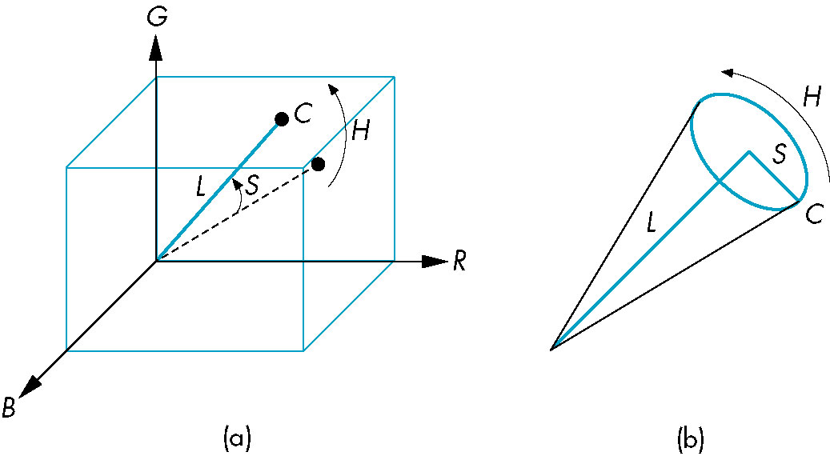
Other Color Systems
UVW: equal numerical errors are closer to equal perceptual errors
HLS: perceptual color (hue, saturation, lightness)
Polar representation of color space
Single and double cone versions

Slide 90
Gamma
Intensity vs CRT voltage is nonlinear
I = cV^{γ}
Can use a lookup table to correct
Human brightness response is logarithmic
Equal steps in gray levels are not perceived equally
Can use lookup table
CRTs cannot produce a full black
Limits contrast ratio

Slide 91
sRGB
Standard for Internet
Adjust colors to match standard gamma of panels
match gamma over most of the range
enhance less bright colors
OpenGL (soon WebGL?) can input sRGB and convert to RGB for processing and then back to sRGB

