Slide 1
Introduction to Computer Graphics with WebGL
Ed Angel
Professor Emeritus of Computer Science
Founding Director, Arts, Research, Technology and Science Laboratory
University of New Mexico

Slide 2
Global Rendering
Ed Angel
Professor Emeritus of Computer Science
University of New Mexico

Slide 3
Introduction
WebGL is based on a pipeline model in which primitives are rendered one at time
No shadows (except by tricks or multiple renderings)
No multiple reflections
Global approaches based on the rendering equation
Ray tracing
Radiosity
Photon mapping
Path Tracing

Slide 4
The Rendering Equation
Use physical reasoning based on conservation of energy
Within a closed environment, the energy entering a surface must equal the energy leaving
Energy leaving in a given direction depends on the energy arriving from all directions

Slide 5
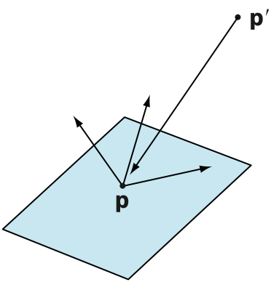
Rendering Equation (Kajia)
intensity from p arriving at p’
emission from p arriving at p’
occlusion term = 0 or 1/r²
bidirectional reflection distribution function (BRDF)
contribution from reflections from all other points

Slide 6
BRDF
The BRDF characterizes the material
Generalization of reflection coefficient
General case requires is a 9 variable function at given frequency
position
direction of three vectors
Special cases lead to familiar methods

Slide 7
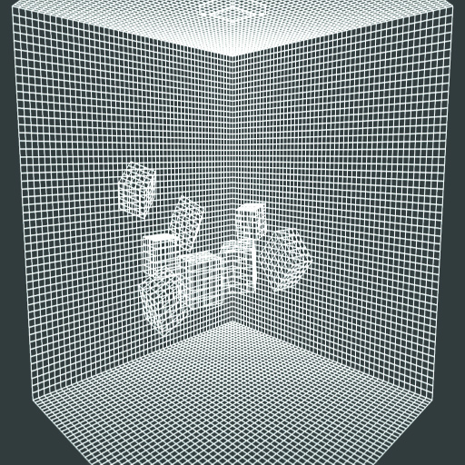
Radiosity
Assume all surfaces are perfectly diffuse
Light is scattered equally in all directions
Divide space into small patches

Slide 8
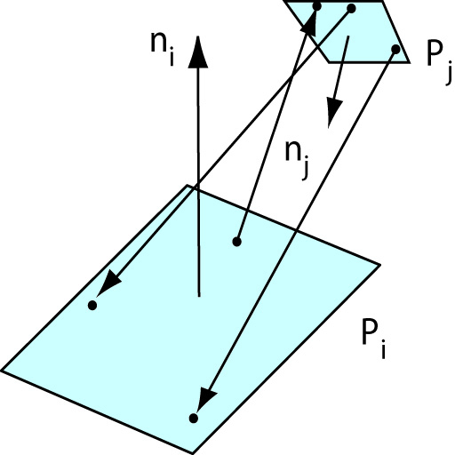
Form Factors
Need to compute the form factor between each pair of patches which describes effect of light from one patch onto the other

Slide 9
Radiosity Rendering
Once the form factors are computer each patch is a small diffuse patch
Final render now uses only diffuse term
As long as geometry is unchanges, subsequent renderings use same form factors

Slide 10
Monte Carlo Methods
Rendering equation cannot be solved analytically
One approach to take a probabilistic (Monte Carlo) approach
Ray tracing
Photon mapping
Path tracing

Slide 11
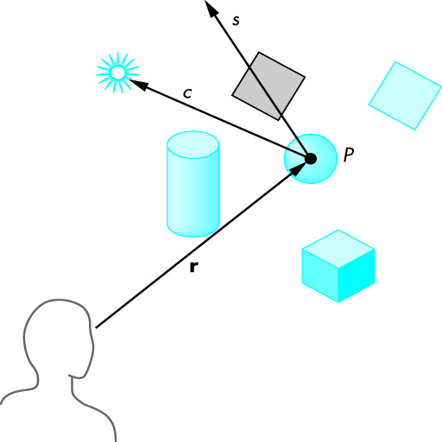
Ray Tracing
Follow rays of light from a point source
Can account for reflection and transmission

Slide 12
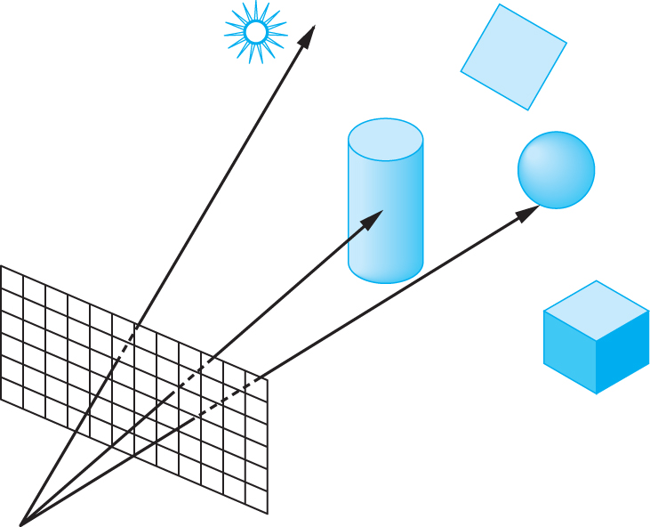
Ray Casting
Only rays that reach the eye matter
Reverse direction and cast rays
Need at least one ray per pixel

Slide 13
Path Tracing

Slide 14
Adding Rays
Basic limitation of ray tracing is the number of rays we can trace
Add more rays
multitisampling
stochastically
adaptively

Slide 15
Photon Mapping
Instead of tracing rays trace photons
Send out stream of photons
When photons strike surface, they can be
absorbed
go off in multiple directions
Total number of photons limited by compute time required
Off line and stochastic

Slide 16
Introduction to Computer Graphics with WebGL
Ed Angel
Professor Emeritus of Computer Science
Founding Director, Arts, Research, Technology and Science Laboratory
University of New Mexico

Slide 17
Ray Tracing
Ed Angel
Professor Emeritus of Computer Science
University of New Mexico

Slide 18
Objectives
Develop a basic recursive ray tracer
Computer intersections for quadrics and polygons

Slide 19
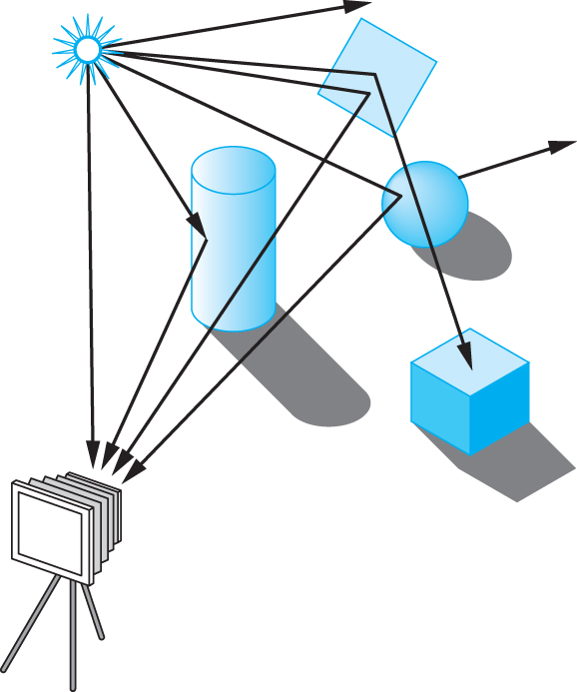
Ray Tracing
Follow rays of light from a point source
Can account for reflection and transmission

Slide 20
Computation
Should be able to handle all physical interactions
Ray tracing paradigm is not computational
Most rays do not affect what we see
Scattering produces many (infinite) additional rays
Alternative: ray casting

Slide 21
Ray Casting
Only rays that reach the eye matter
Reverse direction and cast rays
Need at least one ray per pixel

Slide 22
Ray Casting Quadrics
Ray casting has become the standard way to visualize quadrics which are implicit surfaces in CSG systems
Constructive Solid Geometry
Primitives are solids
Build objects with set operations
Union, intersection, set difference

Slide 23
Ray Casting a Sphere
Ray is parametric
Sphere is quadric
Resulting equation is a scalar quadratic equation which gives entry and exit points of ray (or no solution if ray misses)

Slide 24
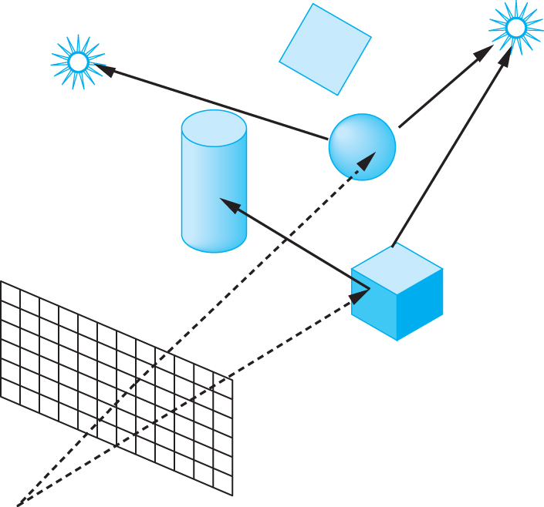
Shadow Rays
Even if a point is visible, it will not be lit unless we can see a light source from that point
Cast shadow or feeler rays

Slide 25
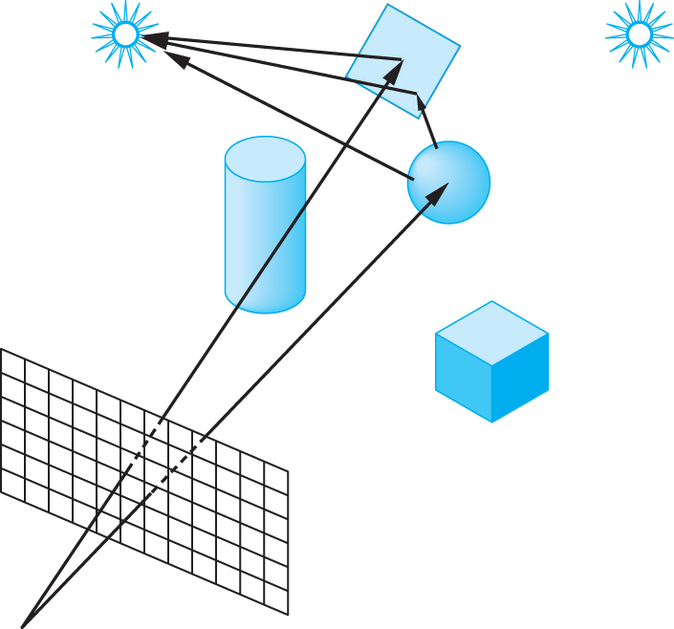
Reflection
Must follow shadow rays off reflecting or transmitting surfaces
Process is recursive

Slide 26
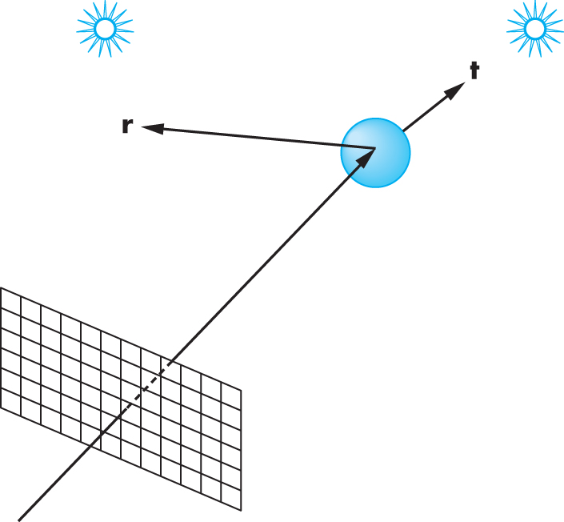
Reflection and Transmission

Slide 27
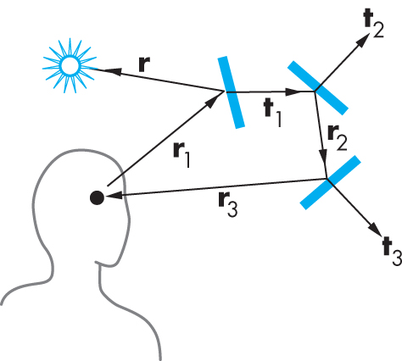
Ray Trees

Slide 28
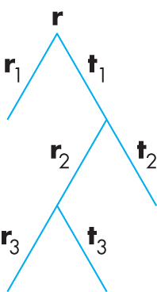
Ray Tree

Slide 29
Diffuse Surfaces
Theoretically the scattering at each point of intersection generates an infinite number of new rays that should be traced
In practice, we only trace the transmitted and reflected rays but use the modified Phong model to compute shade at point of intersection
Radiosity works best for perfectly diffuse (Lambertian) surfaces

Slide 30
Building a Ray Tracer
Best expressed recursively
Can remove recursion later
Image based approach
For each ray …….
Find intersection with closest surface
Need whole object database available
Complexity of calculation limits object types
Compute lighting at surface
Trace reflected and transmitted rays

Slide 31
When to stop
Some light will be absorbed at each intersection
Track amount left
Ignore rays that go off to infinity
Put large sphere around problem
Count steps

Slide 32
Recursive Ray Tracer
color c = trace(point p, vector d, int step)
{
color local, reflected,
transmitted;
point q;
normal n;
if(step > max)
return(background_color);

Slide 33
Recursive Ray Tracer
q = intersect(p, d, status);
if(status==light_source) return(light_source_color);
if(status==no_intersection) return(background_color);
n = normal(q);
r = reflect(q, n);
t = transmit(q,n);

Slide 34
Recursive Ray Tracer
local = phong(q, n, r);
reflected = trace(q, r, step+1);
transmitted = trace(q,t, step+1);
return(local+reflected+
transmitted);

Slide 35
Computing Intersections
Implicit Objects
Quadrics
Planes
Polyhedra
Parametric Surfaces

Slide 36
Implicit Surfaces
Ray from p₀ in direction d
p(t) = p₀ +t d
General implicit surface
f(p) = 0
Solve scalar equation
f(p(t)) = 0
General case requires numerical methods

Slide 37
Quadrics
General quadric can be written as
p^{T}Ap + b^{T}p +c = 0
Substitute equation of ray
p(t) = p₀ +t d
to get quadratic equation

Slide 38
Sphere
(p – p_{c}) • (p – p_{c}) – r² = 0
p(t) = p₀ +t d
p₀ • p₀ t²+ 2 p₀ • (d – p₀) t + (d – p₀) • (d – p₀)
– r² = 0

Slide 39
Planes
p • n + c = 0
p(t) = p₀ +t d
t = -(p₀ • n + c)/ d • n

Slide 40
Polyhedra
Generally we want to intersect with closed convex objects such as polygons and polyhedra rather than planes
Hence we have to worry about inside/outside testing
For convex objects such as polyhedra there are some fast tests

Slide 41
Ray Tracing Polyhedra
If ray enters an object, it must enter a front facing polygon and leave a back facing polygon
Polyhedron is formed by intersection of planes
Ray enters at furthest intersection with front facing planes
Ray leaves at closest intersection with back facing planes
If entry is further away than exit, ray must miss the polyhedron

