Slide 1
Protection and security

Slide 2
Protection and Security
Security: Preventing the access from external agents.
  To authenticate the system users to protect the integrity of the information stored in the system.
Protection: Preventing the access of internal users from accessing resources that they are not allowed to.
  To control the access of programs, processes or users to the resources provided within a computer system.
Protection and security are related but different concepts of OS’s.

Slide 3
Goals of Protection
Protection problem stems from multiprogramming OS’s
  untrustworthy users can safely share common resources, such as memory, files.
Protection
  Prevent violation of access restriction by a user
  Distinguish between authorized and unauthorized usage
  Provide a mechanism for the enforcement of the policies governing resource use
    Some are fixed during the design of the system
    Some are set by the management of the system
    Others are defined by the users of the system

Slide 4
Principles of Protection
Guiding principle – principle of least privilege
  Programs, users and systems should be given just enough privileges to perform their tasks
Ask:
  What is the lowest set of privileges allowable for this user’s tasks?
  How long are the privileges required?
If you hire a gardener,
  grant them access to your yard – not your bedroom.
  grant them access for the time they’re working

Slide 5
Domain of Protection
Operating system consists of a collection of objects, hardware or software
  Files, directories, hardware, ..
    A file can be readable but not writable..
Each object has a unique name and can be accessed through a well-defined set of operations.
    A CPU can only be executed on
    Memory can be read or written
    CD-ROM can only be read
Protection problem - ensure that each object is accessed correctly and only by those processes that are allowed to do so.

Slide 6
Domain Structure
A protection domain specifies the resources that the process may access.
Each domain defines
  a set of objects and
  the types of operations that may be invoked on each object.
Domain = {set of access-rights}
access-right = <object-name, set of rights>
right = read, write, execute …

Slide 7
Domain structure
Domain1 = { <file-A, {read, write, execute}>,
<file-B, {read, execute}>,
<page-2, {read}>,
< printer-1, {print}>}
P1
Domain2 = { <file-A, {read, write}>,
<file-B, {read, execute}>,
<page-1, {read, execute}>,
< printer-1, {print}>}
P2
Domains need not be disjoint.
Both P1 and P2 processes can print on printer-1.
Only P1 can execute file-A.
Only P2 can read page-1.

Slide 8
Domain Structure - static/dynamic
Associations between a process and a domain can be
  Static
    Fixed at the time of creation of the process
    May need to provide more rights than needed at the run time
  Dynamic
    A process can switch from one domain to another
    The content of the domain can also be changed
P1
Domain1 = { <file-A, {read, write, execute}>,
< printer-1, {print}>}

Slide 9
Domain Structure - static/dynamic
Associations between a process and a domain can be
  Static
    Fixed at the time of creation of the process
    May need to provide more rights than needed at the run time
  Dynamic
    A process can switch from one domain to another
P1
Domain1 = { <file-A, {read, write, execute}>,
< printer-1, {print}>}
Domain2 = { <file-A, {read, write}>,
<file-B, {read, execute}>,
}

Slide 10
Domain Structure - static/dynamic
Associations between a process and a domain can be
  Static
    Fixed at the time of creation of the process
    May need to provide more rights than needed at the run time
  Dynamic
    A process can switch from one domain to another
    The content of the domain can also be changed
P1
Domain1 = { <file-A, {read, write, execute}>,
< printer-1, {print}>}
Domain2 = { <file-A, {read, write}>,
<file-B, {read, execute}>,
< printer-1, {print}>}

Slide 11
Domain design
Each user may be a domain.
  Access rights depends on the identity of the user.
  Domain switching occurs when the user is changed.
Each process may be a domain.
  Access rights depends on the identity of the process.
  Domain switching corresponds to one process sending a message to another process, and then waiting for a response.
Each procedure may be a domain.
  the set of objects that can be accessed corresponds to the local variables defined within the procedure.
  Domain switching occurs when a procedure call is made
    As an example, user and kernel modes define a dual domain system where the processes that run in kernel mode have the right to execute privileged instructions.
    But we also need to protect users from each other!

Slide 12
Domain Implementation (UNIX)
A domain is associated with the user through uid (user id) and guid (group id)
  Switching domain = changing user identification temporarily
Domain switch accomplished via file system.
  Each file is associated with
    An owner identification
    a domain bit (known as the setuid bit).
Consider the case where user (with user-id = A) starts executing a file owned by B.
  When the setuid bit is off
    the user-id of the process is set to A.
  When the setuid bit is on,
    the user-id of the process is set to B.

Slide 13
setuid bit – how passwd works
How does the passwd program work
  When executed by the user, the process runs in the user’s domain
    Cannot modify the /etc/passwd file!
  Solution: passwd program has its setuid bit set, that allows it to run with root access
    Modify /etc/passwd file

Slide 14
Model of Protection: Access Matrix
View protection as a matrix
  Rows represent domains
  Columns represent objects
Access(i, j) is the set of operations that
  a process executing in Domain_{i} can invoke on Object_{j}
 | O1 | O2 | O3 | O5
D1 | read, write, execute, owner | read | access | read, write
D2 | read, execute, switch(obi) | read, write, owner | access | read, write
D3 |  |  | Read, write, access, owner | read
D4 |  |  | access | read, write, owner
D5 |  |  | access | read, write
D6 |  |  | access | read

Slide 15
Access Matrix - dynamic protection
Can be expanded to dynamic protection.
  Operations to add, delete access rights.
  Special access rights:
    owner of O_{i}
    copy op from O_{i} to O_{j}
    control – D_{i} can modify D_{j} access rights
    switch – switch from domain D_{i} to D_{j}

Slide 16
Example:
A Unix ls -l output and content of /etc/group
Access matrix:
-rwsr-x--- obi jedi useforce
-rw-r----- luke jedi 3po.man
drwx--x--x darth sith ds.plan
-rw-rw-r-- han free mf.jpeg
jedi:x:yoda,obi,luke
sith:x:emperor,vader,doku
free:x:han,lea,obi,luke
robot:x:r2d3,3po
 | useforce | 3po.man | ds.plan | mf.jpeg
obi | read, write, execute, owner | read | access | read, write
luke | read, execute, switch(obi) | read, write, owner | access | read, write
darth |  |  | Read, write, access, owner | read
han |  |  | access | read, write, owner
Lea |  |  | access | read, write
r2d2 |  |  | access | read

Slide 17
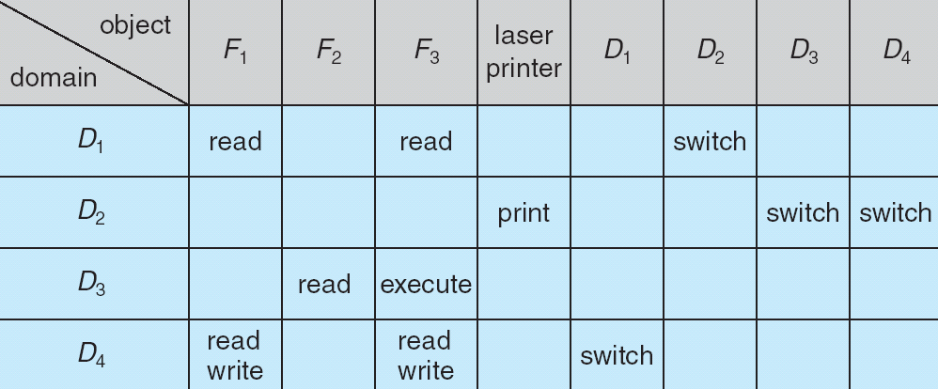
Switching between domains
  A process executing in D₂ can switch to domain D₃ or D₄
  A process executing in D₄ can switch to D₁
Linux sudo implements a domain switch controlled in /etc/sudoers
Allowing controlled change to the contents of the access-matrix entries requires three additional operations: copy , owner , and control .

Slide 18
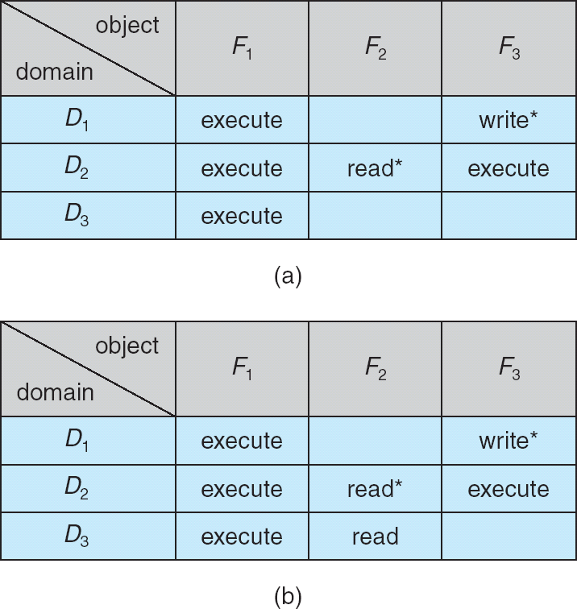
Access Matrix with Copy Rights
The ability to copy an access right from one domain (or row) of the access matrix to another is denoted by an asterisk (*) appended to the access right.
A process in D₂ can copy the read operation into any entry associated with file F₂
Example:
SQL GRANT with “GRANT OPTION”:
GRANT INSERT,DELETE ON TABLE mytable WITH GRANT OPTION;

Slide 19
Access Matrix with Copy Rights
  Two possible variants:
    A right is copied from access (I,j) to access (k,j); it is then removed from access (i,j); this action is a transfer of a right, rather than a copy.
    Propagation of the copy right may be limited. That is, when the right R* is copied from access (i,j) to access (k,j), only the right R (not R*) is created. A process executing in domain cannot further copy the right R.

Slide 20
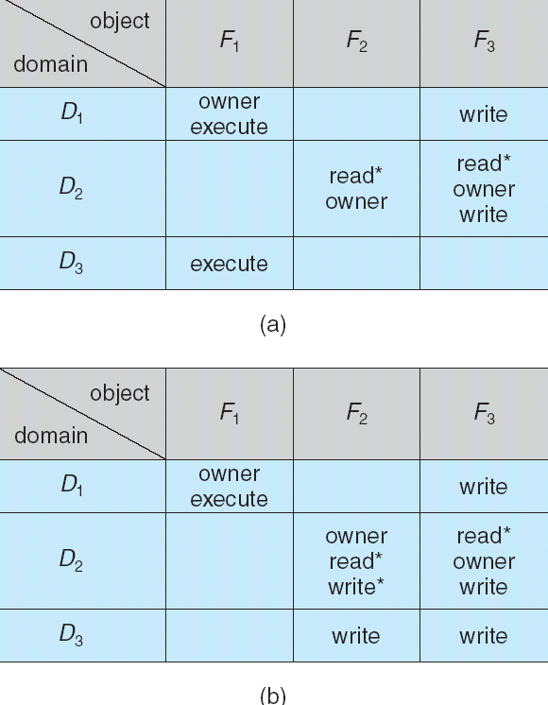
Access Matrix With Owner Rights
Owner rights should allow the addition of new rights and removal of some rights.
Unix implements
chmod() system call to update access matrix by owner.

Slide 21
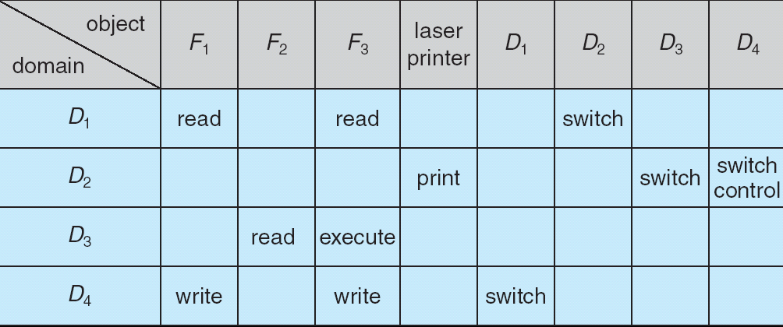
Access Matrix With Control Rights
  D₂ can modify D₄ row.
  For example: Unix root has control right on all other domains
  The copy and owner rights provide us with a mechanism to limit the propagation of access rights.
    However, they do not give us the appropriate tools for preventing the propagation (or disclosure) of information
  The problem of guaranteeing that no information initially held in an object can migrate outside of its execution environment is called
    the confinement problem.

Slide 22
Implementation of Access Matrix
How can the access matrix be implemented effectively?
The matrix will be sparse; that is, most of the entries will be empty.
  Global table
  Access lists for Objects
  Capability lists for Domains
  A Lock-Key Mechanism

Slide 23
Global Table
A global table consisting of
  <domain, object, rights-set> triples
D1 | O1 | read, write, execute, owner
D1 | O2 | read, write
D1 | … | …
D2 | O1 | read, execute, switch(obi)
D2 | O2 | read, write, owner
D2 | … | ….

Slide 24
Global Table – pros and cons
Simplest implementation
The table is usually large and cannot be kept in memory
Does not take into account special groupings of objects or domains
  If everyone can read a particular object, it must have a separate entry in every domain
D1 | O1 | read, write, execute, owner
D1 | O2 | read, write
D1 | … | …
D2 | O1 | read, execute, switch(obi)
D2 | O2 | read, write, owner
D2 | … | ….

Slide 25
Access Lists for Objects
For each object store <domain, rights-set>, which define all domains with a nonempty set of access rights for that object.
  can be extended easily to define a list plus a default set of access rights.
Object1
D1 | read, write, execute, owner
D2 | read, execute, switch(obi)
Object2
D1 | read, write
D2 | read, write, owner

Slide 26
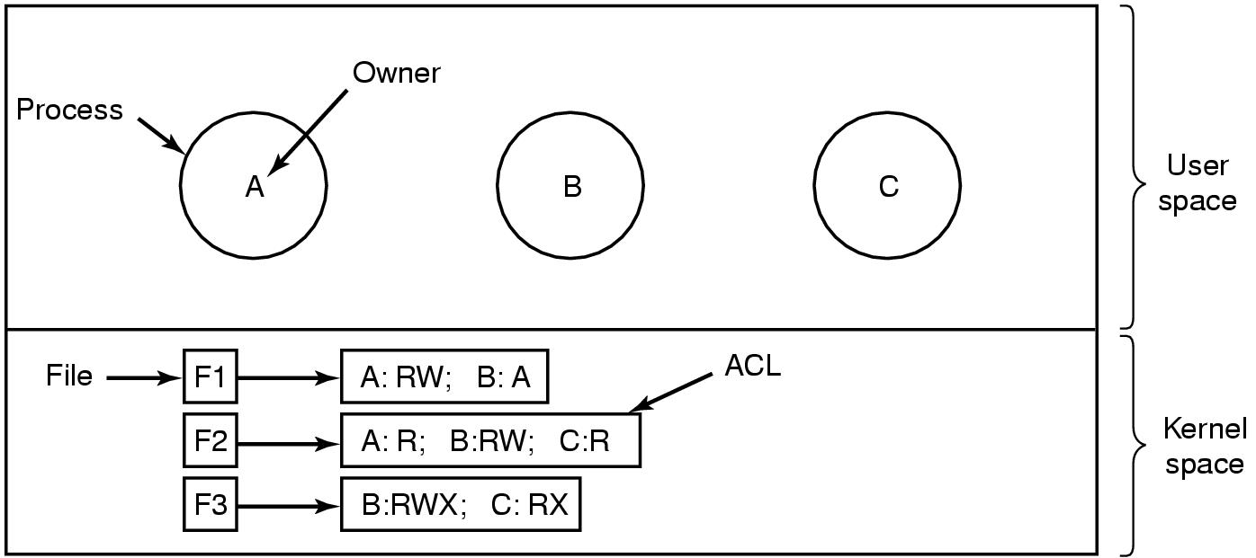
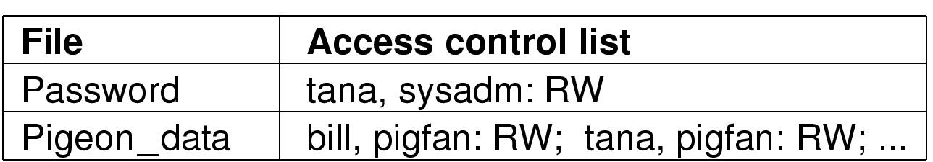
Access Lists for Objects - example
For each object store <domain, rights-set>, which define all domains with a nonempty set of access rights for that object.
  can be extended easily to define a list plus a default set of access rights.
Domain: User = {A,B,C}
Object: File = {F1, F2, F3}
Rights: {R, W, X}

Slide 27
Capability Lists for Domains
A capability list for a domain is a list of objects together with the operations allowed on those objects.
    The capability list is associated with a domain, but it is never directly accessible to a process executing in that domain.
    Rather, the capability list is itself a protected object, maintained by the operating system and accessed by the user only indirectly.
Domain1
O1 | read, write, execute, owner
O2 | read, execute, switch(obi)
Domain2
D1 | read, write
D2 | read, write, owner

Slide 28
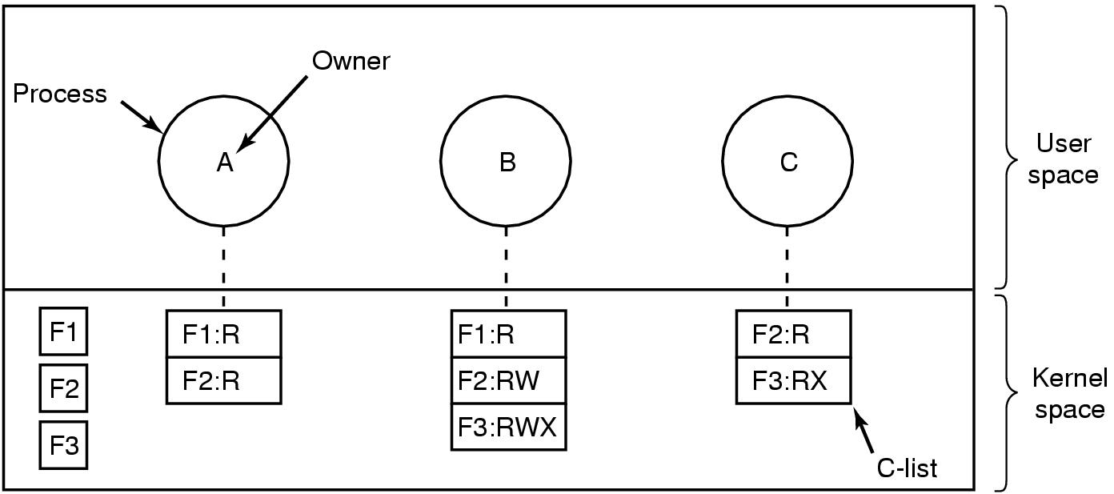
Capability Lists for Domains - example
A capability list for a domain is a list of objects together with the operations allowed on those objects.
    The capability list is associated with a domain, but it is never directly accessible to a process executing in that domain.
    Rather, the capability list is itself a protected object, maintained by the operating system and accessed by the user only indirectly.
Domain: User = {A,B,C}
Object: File = {F1, F2, F3}
Rights: {R, W, X}

Slide 29
Lock-Key Mechanism
The lock–key scheme is a compromise between access lists and capability lists.
    Each object has a list of unique bit patterns, called locks.
    Similarly, each domain has a list of unique bit patterns, called keys.
    A process executing in a domain can access an object only if that domain has a key that matches one of the locks of the object.
The list of keys for a domain must be managed by the OS on behalf of the domain.
Users are not allowed to examine or modify the list of keys (or locks) directly.

Slide 30
Access lists vs. Capability lists vs. Lock-key
Access lists correspond directly to the needs of the users.
    When a user creates an object, she can specify which domains can access the object, as well as the operations allowed.
Capability lists do not correspond directly to the needs of the users; they are useful, however, for localizing information for a given process.
    The process attempting access must present a capability for that access.
The lock–key mechanism is a compromise between these two schemes.
    The mechanism can be both effective and flexible, depending on the length of the keys.
    The keys can be passed freely from domain to domain.

Slide 31
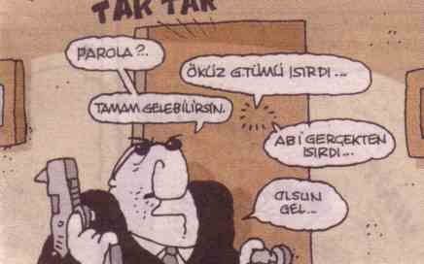
Authentication
Crucial part of OS security.
If a request is really done by a
user/host that it claims.
Host authentication:
Mostly relates to network requests.
Out of scope for this course.
User authentication: done when user starts a session or asks a privileged operation.
Authentication factors:
  Something (only) you know (password, pin code, TCKN?)
  Something you have (id card, credit card, cell phone, smart card)
  Something you are (finger, retina, blood, DNA sample…)

Slide 32
Password Authentication
Relies on only user knows a common passphrase.
User password is compared against the information stored on system.
  A match results in success.
Password is the critical part of security.
  Protecting password database is crucial.
Bad idea: storing passwords in plain.
  If protection of password database is compromised security of system collapses.
  Privileged users can see content. Use it for other systems
Solution use cryptography.
Hash/digest functions: map a string of bytes into a fixed string where:
  Given the result, original string cannot be computed
  Small change in input string ends up extensive changes in result, no correlation can be found.
  Having two input strings result in same has value is extremely unlikely.

Slide 33
Password Authentication
User passwords are stored in database as crypto hashed values.
With cryptohash() function, authentication becomes:
  Input “uname” and plain password “ppass” from user
  Calculate cpass = cryptohash(ppass)
  Check password database for an entry username==uname and password == cpass
No cryptohash’(cpass) function giving ppass is defined.
POSIX define crypt(key, salt) functions for password test:
strcmp(crypt(ppass, cpass), cpass) == 0
/etc/shadow is used as password store in a standalone Unix/Linux system
Not a perfect solution, vulnerable to:
  Dictionary attacks: Test all possible passwords from a dictionary
  Social engineering attacks: Learn information from user, birthday, team he is supporting etc.
  Key-loggers intercepting user input and reporting to third parties.

Slide 34
Encrypted Passwords
How can the system store a password securely yet allow its use for authentication when the user presents her password?
  Keep a list of user:encrypted_password pairs
    Used to be visible
  There is a function that encrypts passwords
    Not even the root can see your passwords
  But open to cracking through guessing:
    Get the password file,
    Guess passwords using different combinations
    Find the matches
A sample line from /etc/passwd
owner:Ejrt3EJUnh5Ms:510:102:Some free text:/home/subdir/owner:/bin/bash

Slide 35
One Time Passwords (OTP)
Major problem in password authentication is its lifetime.
  A user can use same password for year.
  Frequent changes of password/pin code is required.
OTP uses cryptography to generate dynamic passwords as user is authenticated or by time.
Sequence based:
OTP_{t} = otpgen(secret, OPT_{t-1})
Time based:
OTP_{t} = otpgen(secret, time of day)
User cannot compute otpgen so either it is precomputed or s/he is given a device to generate OTP’s as needed:
  OTP token devices / cell phone applications
OTPs turn into “something you have” factor authentication

Slide 36
Third Party Authentication
As implementing password or OTP based authentication per target system gets complicated, authentication may need to be centralized.
User asking for authentication is sent to authentication services on network.
User authenticates him/herself in server, gets a ticket.
Ticket is given back to the original system to finish authentication.
Cryptography makes sure ticket is coming from the trusted service.
Protocols and services exists like kerberos, Openid, Oauth

Slide 37
Multi-factor Authentication
High security systems and software requires at least two factor in authentication:
  password + mobile SMS
  Credit card + pin code
  Retina scan + id card
Something you have and something you are requires hardware devices to implement
  Fingerprint scanners
  Retina scanners
  Smart cards + readers
  Mobile phones
  SIM cards

Slide 38
Other Uses of Cryptography in OS
Cryptographic hash functions/digests:
  Integrity of data. If a file (i.e. a system binary) has changed in system. For example a virus.
  Software package authentication.
Symmetric cryptography:
  Data privacy.
  Encrypted content (disk, files, messages)
Public key cryptography:
  Integrity of data (message signing and verification)
  Authentication (electronic certificates)
  Encryption (encryption without shared key)
  Key exchange

Slide 39
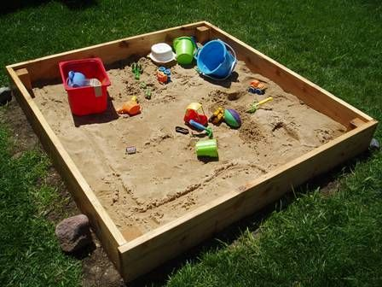
Sandboxing
A sandbox is a security mechanism for separating running programs. It is often used to execute untested code, or untrusted programs from unverified third-parties, suppliers, untrusted users and untrusted websites.
The sandbox typically provides a tightly controlled set of resources for guest programs to run in, such as scratch space on disk and memory. Network access, the ability to inspect the host system or read from input devices are usually disallowed or heavily restricted. In this sense, sandboxes are a specific example of virtualization.

Slide 40
Sandboxing
A sandbox is a security mechanism for separating running programs.
often used to execute untested code, or untrusted programs.
Typically provides a tightly controlled set of resources for guest programs to run in, such as scratch space on disk and memory.
Network access, the ability to inspect the host system or read from input devices are usually disallowed or heavily restricted.
In this sense, sandboxes are a specific example of virtualization.

Slide 41

Sandboxing examples
Applets are self-contained programs that run in a virtual machine or scripting language interpreter
A jail is a set of resource limits imposed on programs by the operating system kernel.
  include I/O bandwidth caps, disk quotas, network-access restrictions and a restricted filesystem namespace
Virtual machines emulate a complete host computer, on which a conventional operating system may boot and run as on actual hardware.
Applications for iOS and Android are sandboxed.
  Only able to access files inside their own respective storage areas, and cannot change system settings.

Slide 42
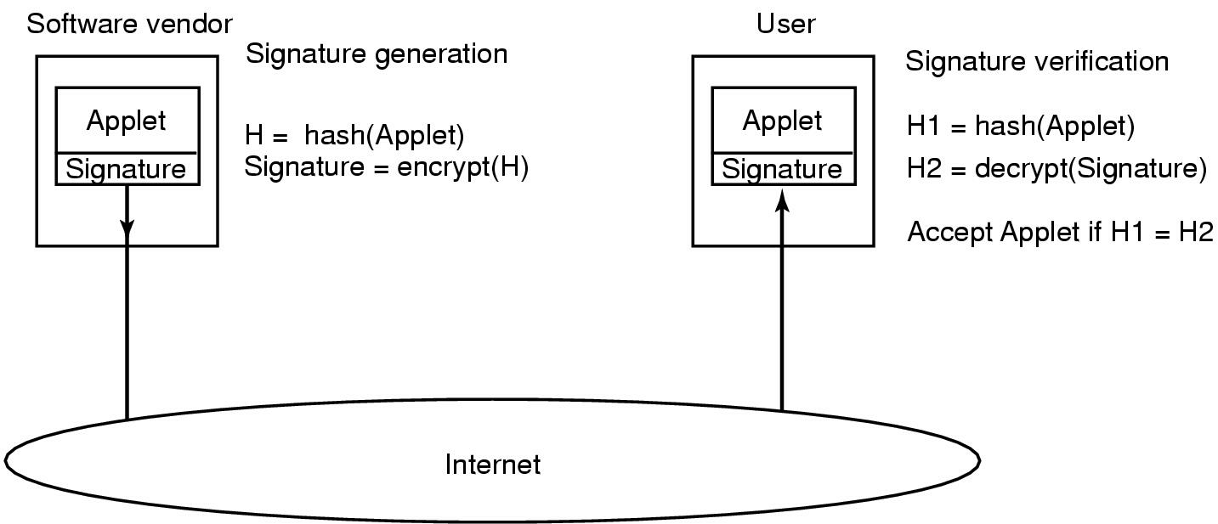
Code Signing and Mobile Code
How code signing works

