Slide 1
CS 412 Intro. to Data Mining
Chapter 3. Data Preprocessing
Qi Li Computer Science, Univ. Illinois at Urbana-Champaign, 2018

Slide 2
Chapter 3: Data Preprocessing
Data Preprocessing: An Overview
Data Cleaning
Data Integration
Data Reduction and Transformation
Dimensionality Reduction
Summary

Slide 3
What is Data Preprocessing? — Major Tasks
Data cleaning
  Handle missing data, smooth noisy data, identify or remove outliers, and resolve inconsistencies
Data integration
  Integration of multiple databases, data cubes, or files
Data reduction
  Dimensionality reduction
  Numerosity reduction
  Data compression
Data transformation and data discretization
  Normalization
  Concept hierarchy generation

Slide 4
Why Preprocess the Data? — Data Quality Issues
Measures for data quality: A multidimensional view
  Accuracy: correct or wrong, accurate or not
  Completeness: not recorded, unavailable, …
  Consistency: some modified but some not, dangling, …
  Timeliness: timely update?
  Believability: how trustable the data are correct?
  Interpretability: how easily the data can be understood?

Slide 5
Chapter 3: Data Preprocessing
Data Preprocessing: An Overview
Data Cleaning
Data Integration
Data Reduction and Transformation
Dimensionality Reduction
Summary

Slide 6
Data Cleaning
Data in the Real World Is Dirty: Lots of potentially incorrect data, e.g., instrument faulty, human or computer error, and transmission error
  Incomplete: lacking attribute values, lacking certain attributes of interest, or containing only aggregate data
    e.g., Occupation = “ ” (missing data)
  Noisy: containing noise, errors, or outliers
    e.g., Salary = “−10” (an error)
  Inconsistent: containing discrepancies in codes or names, e.g.,
    Age = “42”, Birthday = “03/07/2010”
    Was rating “1, 2, 3”, now rating “A, B, C”
    discrepancy between duplicate records
  Intentional (e.g., disguised missing data)
    Jan. 1 as everyone’s birthday?

Slide 7
Incomplete (Missing) Data
Data is not always available
  E.g., many tuples have no recorded value for several attributes, such as customer income in sales data
Missing data may be due to
  Equipment malfunction
  Inconsistent with other recorded data and thus deleted
  Data were not entered due to misunderstanding
  Certain data may not be considered important at the time of entry
  Did not register history or changes of the data
Missing data may need to be inferred

Slide 8
How to Handle Missing Data?
Ignore the tuple: usually done when class label is missing (when doing classification)—not effective when the % of missing values per attribute varies considerably
Fill in the missing value manually: tedious + infeasible?
Fill in it automatically with
  a global constant : e.g., “unknown”, a new class?!
  the attribute mean
  the attribute mean for all samples belonging to the same class: smarter
  the most probable value: inference-based such as Bayesian formula or decision tree

Slide 9
Noisy Data
Noise: random error or variance in a measured variable
Incorrect attribute values may be due to
  Faulty data collection instruments
  Data entry problems
  Data transmission problems
  Technology limitation
  Inconsistency in naming convention
Other data problems
  Duplicate records
  Incomplete data
  Inconsistent data
Notes:
9

Slide 10
How to Handle Noisy Data?
Binning
  First sort data and partition into (equal-frequency) bins
  Then one can smooth by bin means, smooth by bin median, smooth by bin boundaries, etc.
Regression
  Smooth by fitting the data into regression functions
Clustering
  Detect and remove outliers
Semi-supervised: Combined computer and human inspection
  Detect suspicious values and check by human (e.g., deal with possible outliers)
Notes:
Enrich using data integration research!!

Slide 11
Data Cleaning as a Process
Data discrepancy detection
  Use metadata (e.g., domain, range, dependency, distribution)
  Check field overloading
  Check uniqueness rule, consecutive rule and null rule
  Use commercial tools
    Data scrubbing: use simple domain knowledge (e.g., postal code, spell-check) to detect errors and make corrections
    Data auditing: by analyzing data to discover rules and relationship to detect violators (e.g., correlation and clustering to find outliers)
Data migration and integration
  Data migration tools: allow transformations to be specified
  ETL (Extraction/Transformation/Loading) tools: allow users to specify transformations through a graphical user interface
Integration of the two processes
  Iterative and interactive (e.g., Potter’s Wheels)

Slide 12
Chapter 3: Data Preprocessing
Data Preprocessing: An Overview
Data Cleaning
Data Integration
Data Reduction and Transformation
Dimensionality Reduction
Summary

Slide 13
Data Integration
Data integration
  Combining data from multiple sources into a coherent store
Why data integration?
  Help reduce/avoid noise
  Get a more complete picture
  Improve mining speed and quality
Schema integration:
  e.g., A.cust-id ≡ B.cust-#
  Integrate metadata from different sources
Entity identification:
  Identify real world entities from multiple data sources, e.g., Bill Clinton = William Clinton
Notes:
Should ask students to do some survey on data integration. -JH

Slide 14
Handling Noise in Data Integration
Detecting data value conflicts
  For the same real world entity, attribute values from different sources are different
  Possible reasons: no reason, different representations, different scales, e.g., metric vs. British units
Resolving conflict information
  Take the mean/median/mode/max/min
  Take the most recent
  Truth finding: consider the source quality
Data cleaning + data integration

Slide 15
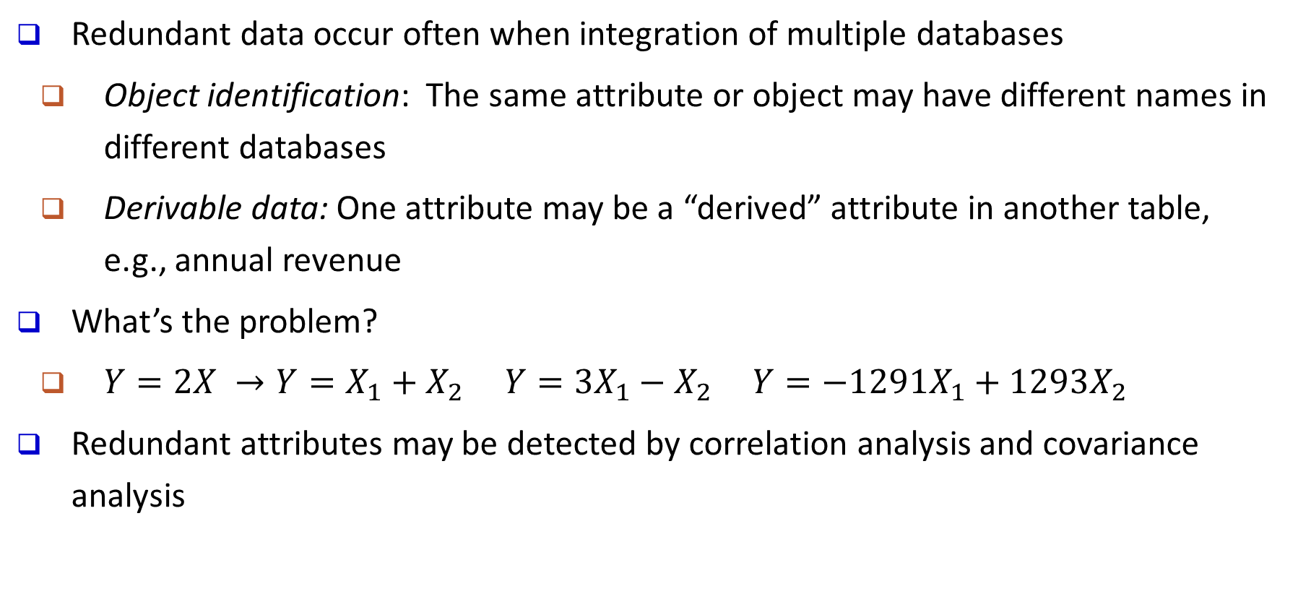
Handling Redundancy in Data Integration
Redundant data occur often when integration of multiple databases
  Object identification: The same attribute or object may have different names in different databases
  Derivable data: One attribute may be a “derived” attribute in another table, e.g., annual revenue
What’s the problem?
  $Y=2X →Y=X_{1}+X_{2} Y=3X_{1}−X_{2} Y=−1291X_{1}+1293X_{2}$
Redundant attributes may be detected by correlation analysis and covariance analysis

Slide 16
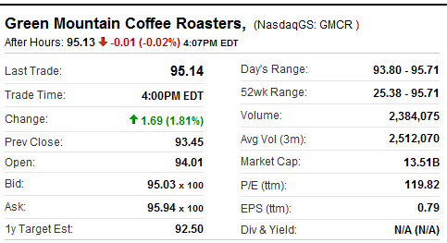
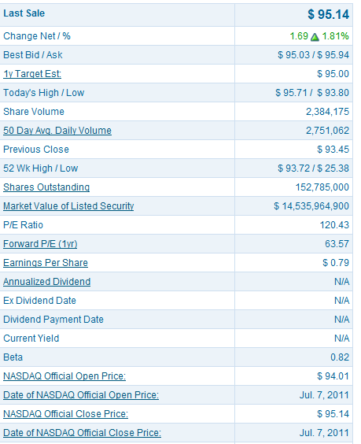
Example: stock market
Yahoo! Finance
Day’s Range: 93.80-95.71
Nasdaq
52wk Range: 25.38-95.71
52 Wk: 25.38-93.72

Slide 17
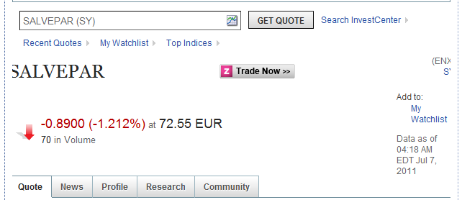
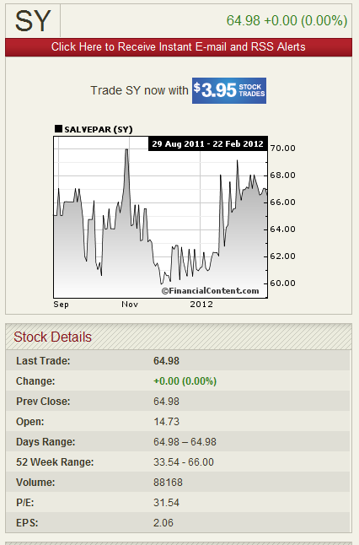
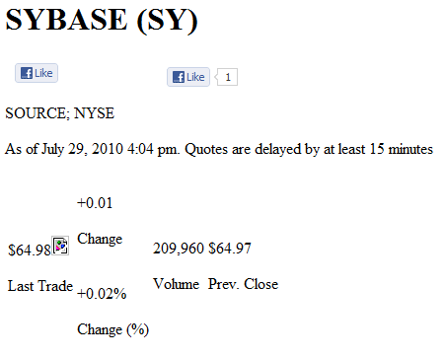
Example: stock market

Slide 18

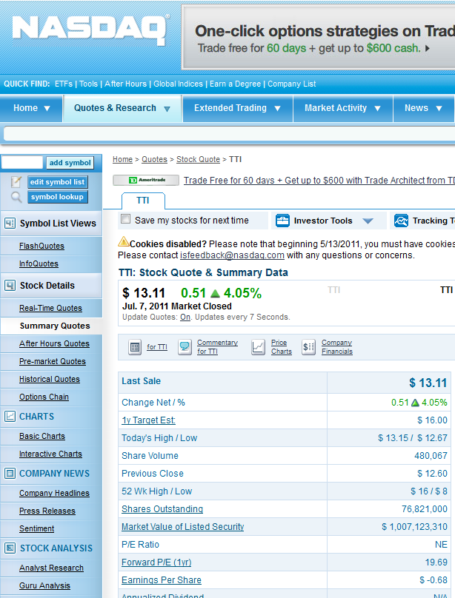
Example: stock market
76.82B
76,821,000

Slide 19
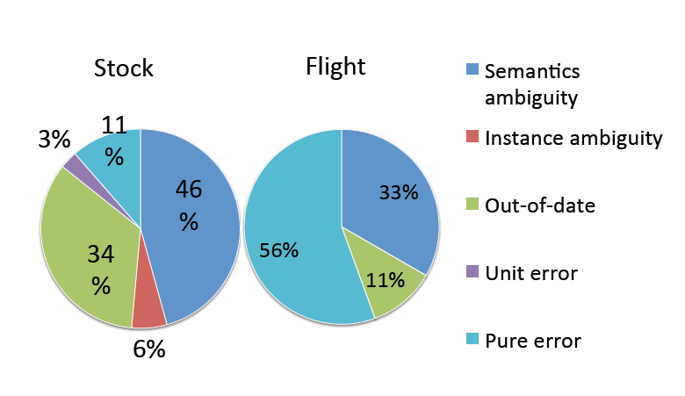
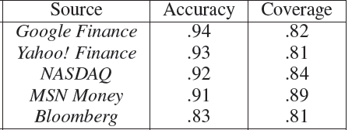
Example: stock market
Xian Li, Xin Luna Dong, Kenneth Lyons, Weiyi Meng, and Divesh Srivastava. Truth finding on the Deep Web: Is the problem solved? In VLDB, 2013.

Slide 20
Chapter 3: Data Preprocessing
Data Preprocessing: An Overview
Data Cleaning
Data Integration
Data Reduction and Transformation
Dimensionality Reduction
Summary

Slide 21
Data Reduction
Data reduction:
  Obtain a reduced representation of the data set
    much smaller in volume but yet produces almost the same analytical results
Why data reduction?—A database/data warehouse may store terabytes of data
  Complex analysis may take a very long time to run on the complete data set
Methods for data reduction (also data size reduction or numerosity reduction)
  Regression and Log-Linear Models
  Histograms, clustering, sampling
  Data cube aggregation
  Data compression
Notes:
MK 09/09/05: Wiki has dimensionality reduction as feature extraction (PCA) and feature subset selection. It states both wavelet transforms and PCA as forms of data compression. It does not have any pages for "numerosity reduction". We claim there are many different ways to organize data reduction strategies, which is true, so this presentation below should be OK. Let’s discuss.

Slide 22
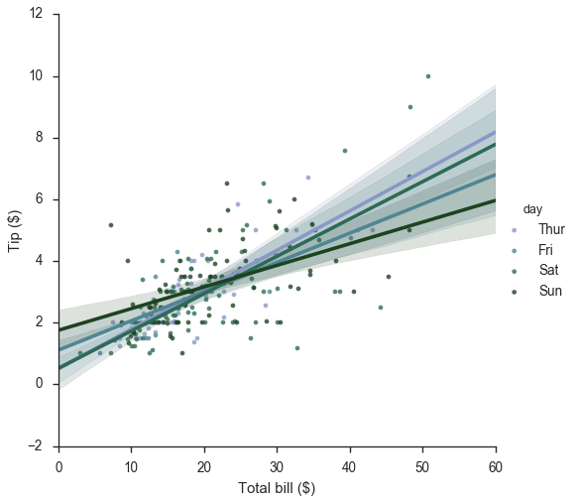
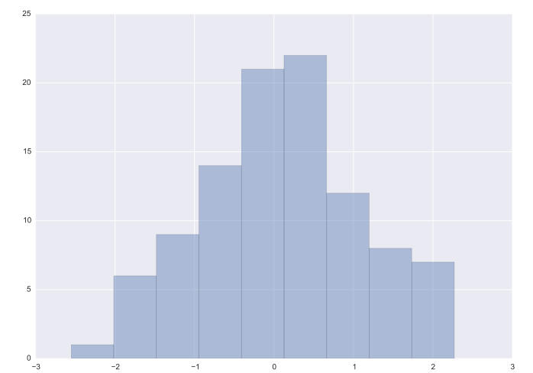
Data Reduction: Parametric vs. Non-Parametric Methods
Reduce data volume by choosing alternative, smaller forms of data representation
Parametric methods (e.g., regression)
  Assume the data fits some model, estimate model parameters, store only the parameters, and discard the data (except possible outliers)
  Ex.: Log-linear models—obtain value at a point in m-D space as the product on appropriate marginal subspaces
Non-parametric methods
  Do not assume models
  Major families: histograms, clustering, sampling, …
tip vs. bill
Clustering on the Raw Data
Stratified Sampling
Histogram

Slide 23
Parametric Data Reduction: Regression Analysis
Regression analysis: A collective name for techniques for the modeling and analysis of numerical data consisting of values of a dependent variable (also called response variable or measurement) and of one or more independent variables (also known as explanatory variables or predictors)
The parameters are estimated so as to give a "best fit" of the data
Most commonly the best fit is evaluated by using the least squares method, but other criteria have also been used
y
Y₁
Y₁’
y = x + 1
X₁
x
Used for prediction (including forecasting of time-series data), inference, hypothesis testing, and modeling of causal relationships

Slide 24
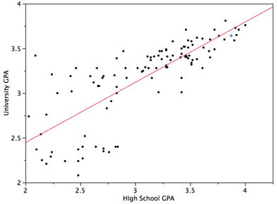
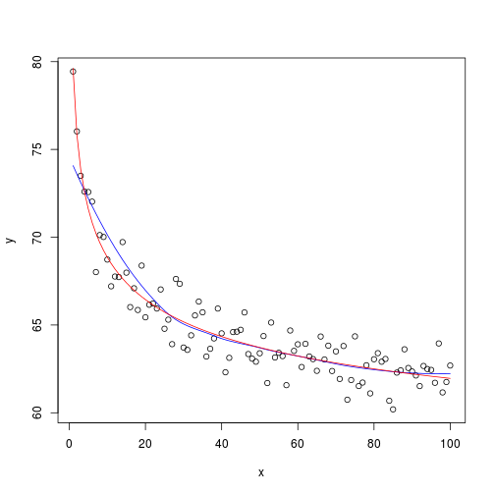
Linear and Multiple Regression
Linear regression: Y = w X + b
  Data modeled to fit a straight line
  Often uses the least-square method to fit the line
  Two regression coefficients, w and b, specify the line and are to be estimated by using the data at hand
  Using the least squares criterion to the known values of Y₁, Y₂, …, X₁, X₂, ….
Nonlinear regression:
  Data are modeled by a function which is a nonlinear combination of the model parameters and depends on one or more independent variables
  The data are fitted by a method of successive approximations

Slide 25
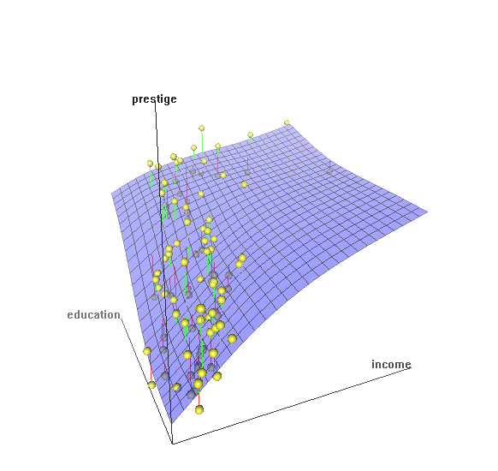
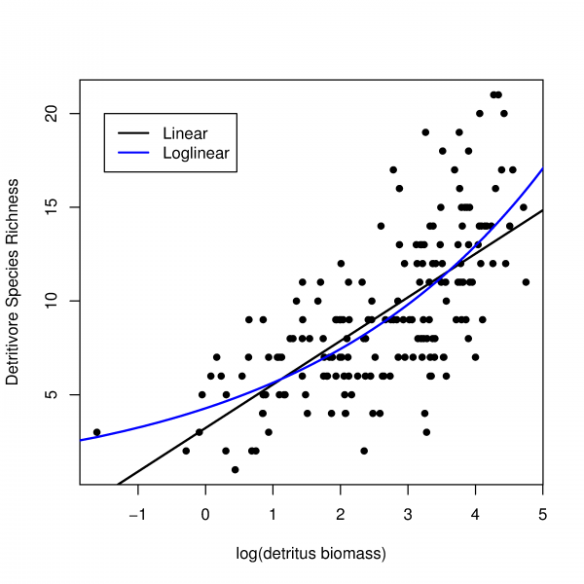
Multiple Regression and Log-Linear Models
Multiple regression: Y = b₀ + b₁ X₁ + b₂ X₂
  Allows a response variable Y to be modeled as a linear function of multidimensional feature vector
  Many nonlinear functions can be transformed into the above
Log-linear model:
  A math model that takes the form of a function whose logarithm is a linear combination of the parameters of the model, which makes it possible to apply (possibly multivariate) linear regression
  Estimate the probability of each point (tuple) in a multi-dimen. space for a set of discretized attributes, based on a smaller subset of dimensional combinations
  Useful for dimensionality reduction and data smoothing

Slide 26
Histogram Analysis
Divide data into buckets and store average (sum) for each bucket
Partitioning rules:
  Equal-width: equal bucket range
  Equal-frequency (or equal-depth)
Notes:
Removed 09/09/10: V-optimal: with the least histogram variance (weighted sum of the original values that each bucket represents)

Slide 27
Clustering
Partition data set into clusters based on similarity, and store cluster representation (e.g., centroid and diameter) only
Can be very effective if data is clustered but not if data is “smeared”
Can have hierarchical clustering and be stored in multi-dimensional index tree structures
There are many choices of clustering definitions and clustering algorithms
Cluster analysis will be studied in depth in Chapter 10

Slide 28
Sampling
Sampling: obtaining a small sample s to represent the whole data set N
Allow a mining algorithm to run in complexity that is potentially sub-linear to the size of the data
Key principle: Choose a representative subset of the data
  Simple random sampling may have very poor performance in the presence of skew
  Develop adaptive sampling methods, e.g., stratified sampling:
Note: Sampling may not reduce database I/Os (page at a time)

Slide 29
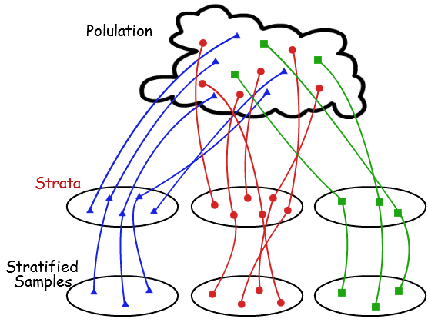
Types of Sampling
Simple random sampling: equal probability of selecting any particular item
Sampling without replacement
  Once an object is selected, it is removed from the population
Sampling with replacement
  A selected object is not removed from the population
Stratified sampling
  Partition (or cluster) the data set, and draw samples from each partition (proportionally, i.e., approximately the same percentage of the data)
Raw Data
SRSWOR
(simple random
sample without
replacement)
SRSWR
Stratified sampling

Slide 30
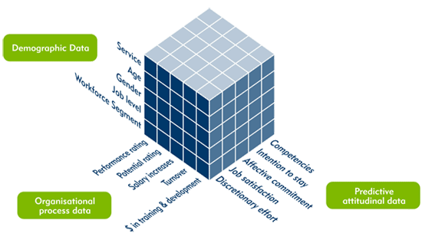
Data Cube Aggregation
The lowest level of a data cube (base cuboid)
  The aggregated data for an individual entity of interest
  E.g., a customer in a phone calling data warehouse
Multiple levels of aggregation in data cubes
  Further reduce the size of data to deal with
Reference appropriate levels
  Use the smallest representation which is enough to solve the task
Queries regarding aggregated information should be answered using data cube, when possible
Notes:
30

Slide 31
Data Compression
String compression
  There are extensive theories and well-tuned algorithms
  Typically lossless, but only limited manipulation is possible without expansion
Audio/video compression
  Typically lossy compression, with progressive refinement
  Sometimes small fragments of signal can be reconstructed without reconstructing the whole
Time sequence is not audio
  Typically short and vary slowly with time
Data reduction and dimensionality reduction may also be considered as forms of data compression
Original Data
Compressed
Data
lossless
Original Data
Approximated
lossy
Lossy vs. lossless compression
Notes:
31
PCA and Wavelet are forms of data compression also.

Slide 32
Data Transformation
A function that maps the entire set of values of a given attribute to a new set of replacement values s.t. each old value can be identified with one of the new values
Methods
  Smoothing: Remove noise from data
  Attribute/feature construction
    New attributes constructed from the given ones
  Aggregation: Summarization, data cube construction
  Normalization: Scaled to fall within a smaller, specified range
    min-max normalization
    z-score normalization
    normalization by decimal scaling
  Discretization: Concept hierarchy climbing
Notes:
32

Slide 33
Normalization
Min-max normalization: to [new_min_{A}, new_max_{A}]
  Ex. Let income range $12,000 to $98,000 normalized to [0.0, 1.0]
      Then $73,000 is mapped to
Z-score normalization (μ: mean, σ: standard deviation):
  Ex. Let μ = 54,000, σ = 16,000. Then
Normalization by decimal scaling
Z-score: The distance between the raw score and the population mean in the unit of the standard deviation
Where j is the smallest integer such that Max(|ν’|) < 1

Slide 34
Discretization
Three types of attributes
  Nominal—values from an unordered set, e.g., color, profession
  Ordinal—values from an ordered set, e.g., military or academic rank
  Numeric—real numbers, e.g., integer or real numbers
Discretization: Divide the range of a continuous attribute into intervals
  Interval labels can then be used to replace actual data values
  Reduce data size by discretization
  Supervised vs. unsupervised
  Split (top-down) vs. merge (bottom-up)
  Discretization can be performed recursively on an attribute
  Prepare for further analysis, e.g., classification
Notes:
08.09.12 MK: Slide moved here from Ch. 3. Added examples.

Slide 35
Data Discretization Methods
Binning
  Top-down split, unsupervised
Histogram analysis
  Top-down split, unsupervised
Clustering analysis
  Unsupervised, top-down split or bottom-up merge
Decision-tree analysis
  Supervised, top-down split
Correlation (e.g., χ²) analysis
  Unsupervised, bottom-up merge
Note: All the methods can be applied recursively
Notes:
35

Slide 36
Simple Discretization: Binning
Equal-width (distance) partitioning
  Divides the range into N intervals of equal size: uniform grid
  if A and B are the lowest and highest values of the attribute, the width of intervals will be: W = (B –A)/N.
  The most straightforward, but outliers may dominate presentation
  Skewed data is not handled well
Equal-depth (frequency) partitioning
  Divides the range into N intervals, each containing approximately same number of samples
  Good data scaling
  Managing categorical attributes can be tricky

Slide 37
Example: Binning Methods for Data Smoothing
Sorted data for price (in dollars): 4, 8, 9, 15, 21, 21, 24, 25, 26, 28, 29, 34
* Partition into equal-frequency (equal-depth) bins:
- Bin 1: 4, 8, 9, 15
- Bin 2: 21, 21, 24, 25
- Bin 3: 26, 28, 29, 34
* Smoothing by bin means:
- Bin 1: 9, 9, 9, 9
- Bin 2: 23, 23, 23, 23
- Bin 3: 29, 29, 29, 29
* Smoothing by bin boundaries:
- Bin 1: 4, 4, 4, 15
- Bin 2: 21, 21, 25, 25
- Bin 3: 26, 26, 26, 34

Slide 38
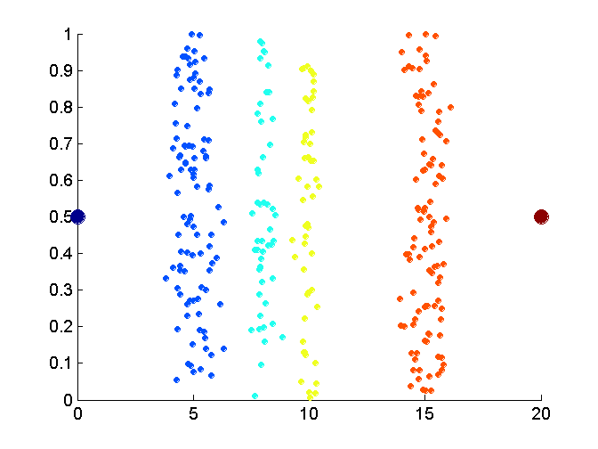
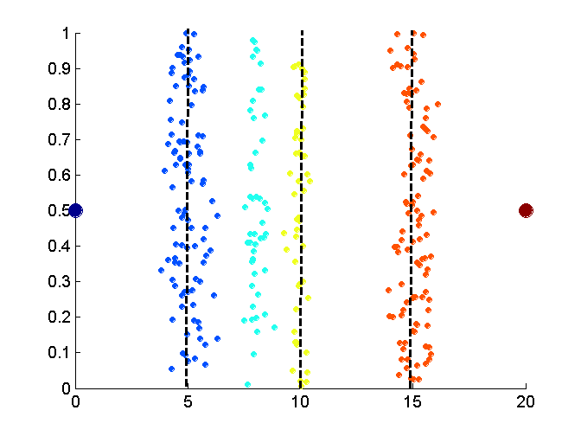
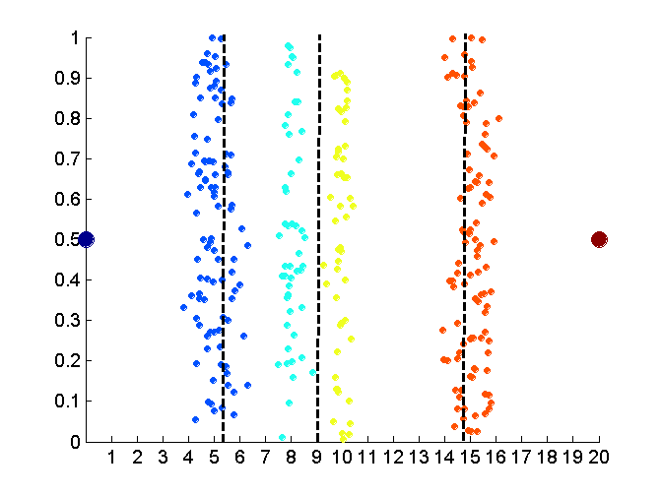
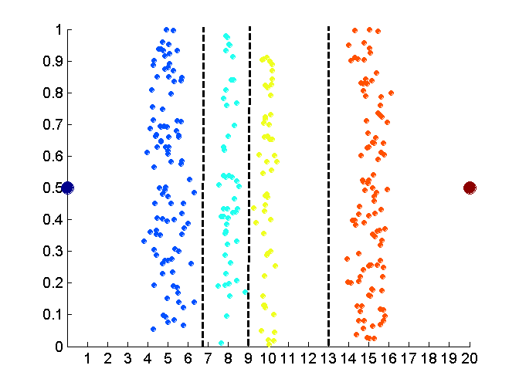
Discretization Without Supervision: Binning vs. Clustering
Data
Equal width (distance) binning
Equal depth (frequency) (binning)
K-means clustering leads to better results
Notes:
38

Slide 39
Discretization by Classification & Correlation Analysis
Classification (e.g., decision tree analysis)
  Supervised: Given class labels, e.g., cancerous vs. benign
  Using entropy to determine split point (discretization point)
  Top-down, recursive split
  Details to be covered in Chapter “Classification”
Correlation analysis (e.g., Chi-merge: χ²-based discretization)
  Supervised: use class information
  Bottom-up merge: Find the best neighboring intervals (those having similar distributions of classes, i.e., low χ² values) to merge
  Merge performed recursively, until a predefined stopping condition
Notes:
39

Slide 40
Concept Hierarchy Generation
Concept hierarchy organizes concepts (i.e., attribute values) hierarchically and is usually associated with each dimension in a data warehouse
Concept hierarchies facilitate drilling and rolling in data warehouses to view data in multiple granularity
Concept hierarchy formation: Recursively reduce the data by collecting and replacing low level concepts (such as numeric values for age) by higher level concepts (such as youth, adult, or senior)
Concept hierarchies can be explicitly specified by domain experts and/or data warehouse designers
Concept hierarchy can be automatically formed for both numeric and nominal data—For numeric data, use discretization methods shown

Slide 41
Concept Hierarchy Generation for Nominal Data
Specification of a partial/total ordering of attributes explicitly at the schema level by users or experts
  street < city < state < country
Specification of a hierarchy for a set of values by explicit data grouping
  {Urbana, Champaign, Chicago} < Illinois
Specification of only a partial set of attributes
  E.g., only street < city, not others
Automatic generation of hierarchies (or attribute levels) by the analysis of the number of distinct values
  E.g., for a set of attributes: {street, city, state, country}
Notes:
Should we briefly introduce ontology? Ontology has been used extensively in bio-medical data warehouses. -- JP
We should introduce this part using 1-2 slides -JH

Slide 42
Automatic Concept Hierarchy Generation
Some hierarchies can be automatically generated based on the analysis of the number of distinct values per attribute in the data set
  The attribute with the most distinct values is placed at the lowest level of the hierarchy
  Exceptions, e.g., weekday, month, quarter, year
country
15 distinct values
province_or_ state
365 distinct values
city
3567 distinct values
street
674,339 distinct values

Slide 43
Chapter 3: Data Preprocessing
Data Preprocessing: An Overview
Data Cleaning
Data Integration
Data Reduction and Transformation
Dimensionality Reduction
Summary

Slide 44
Dimensionality Reduction
Curse of dimensionality
  When dimensionality increases, data becomes increasingly sparse
  Density and distance between points, which is critical to clustering, outlier analysis, becomes less meaningful
  The possible combinations of subspaces will grow exponentially
Dimensionality reduction
  Reducing the number of random variables under consideration, via obtaining a set of principal variables
Advantages of dimensionality reduction
  Avoid the curse of dimensionality
  Help eliminate irrelevant features and reduce noise
  Reduce time and space required in data mining
  Allow easier visualization
Notes:
44
JH: put SVD at clustering high-D reduction.

Slide 45
Dimensionality Reduction Techniques
Dimensionality reduction methodologies
  Feature selection: Find a subset of the original variables (or features, attributes)
  Feature extraction: Transform the data in the high-dimensional space to a space of fewer dimensions
Some typical dimensionality methods
  Principal Component Analysis
  Supervised and nonlinear techniques
    Feature subset selection
    Feature creation
Notes:
45
JH: put SVD at clustering high-D reduction.

Slide 46
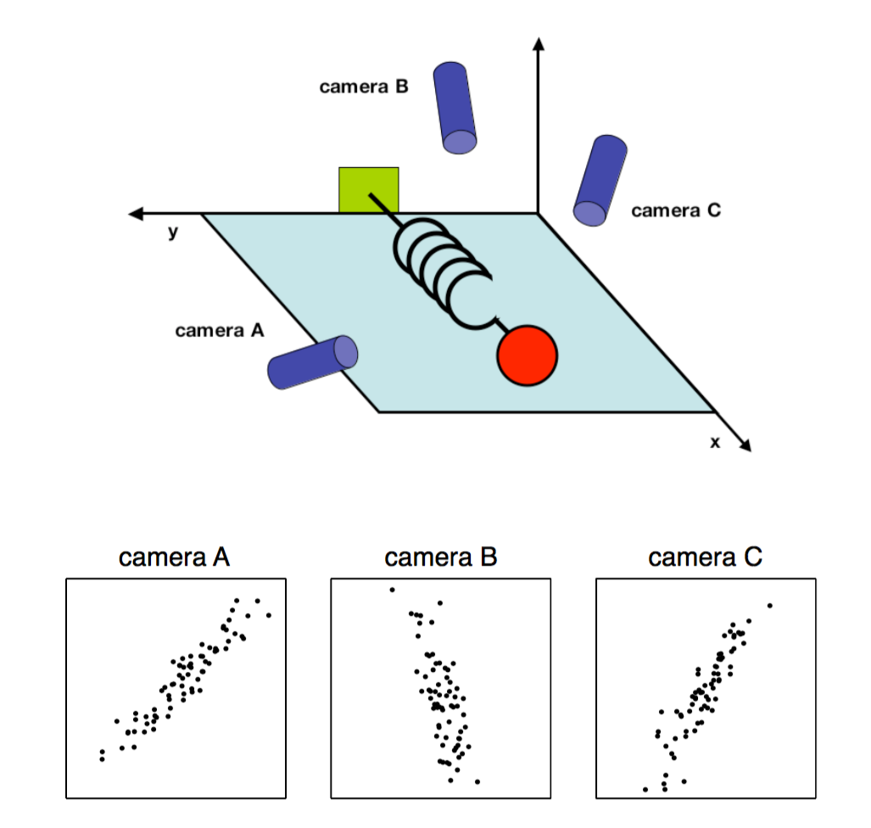
Principal Component Analysis (PCA)
PCA: A statistical procedure that uses an orthogonal transformation to convert a set of observations of possibly correlated variables into a set of values of linearly uncorrelated variables called principal components
The original data are projected onto a much smaller space, resulting in dimensionality reduction
Method: Find the eigenvectors of the covariance matrix, and these eigenvectors define the new space
Ball travels in a straight line. Data from three cameras contain much redundancy

Slide 47
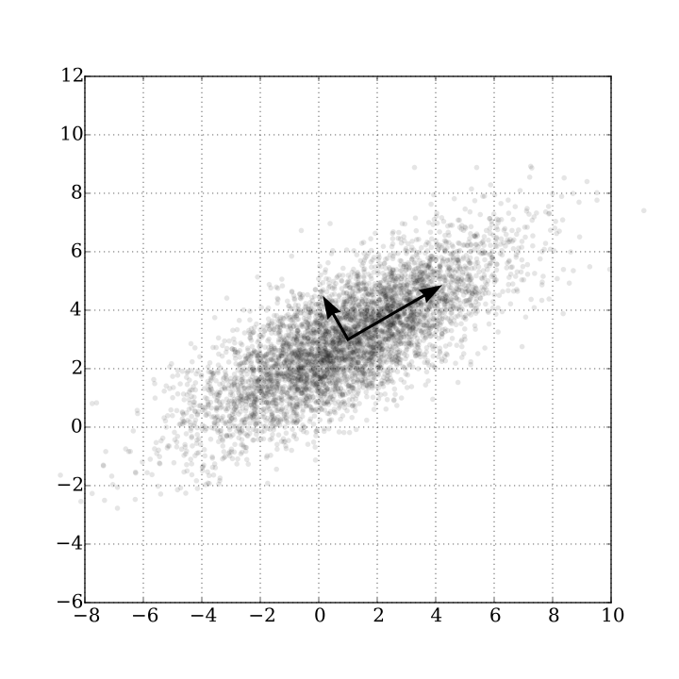
Principal Component Analysis (Method)
Given N data vectors from n-dimensions, find k ≤ n orthogonal vectors (principal components) best used to represent data
  Normalize input data: Each attribute falls within the same range
  Compute k orthonormal (unit) vectors, i.e., principal components
  Each input data (vector) is a linear combination of the k principal component vectors
  The principal components are sorted in order of decreasing “significance” or strength
  Since the components are sorted, the size of the data can be reduced by eliminating the weak components, i.e., those with low variance (i.e., using the strongest principal components, to reconstruct a good approximation of the original data)
Works for numeric data only
Ack. Wikipedia: Principal Component Analysis

Slide 48
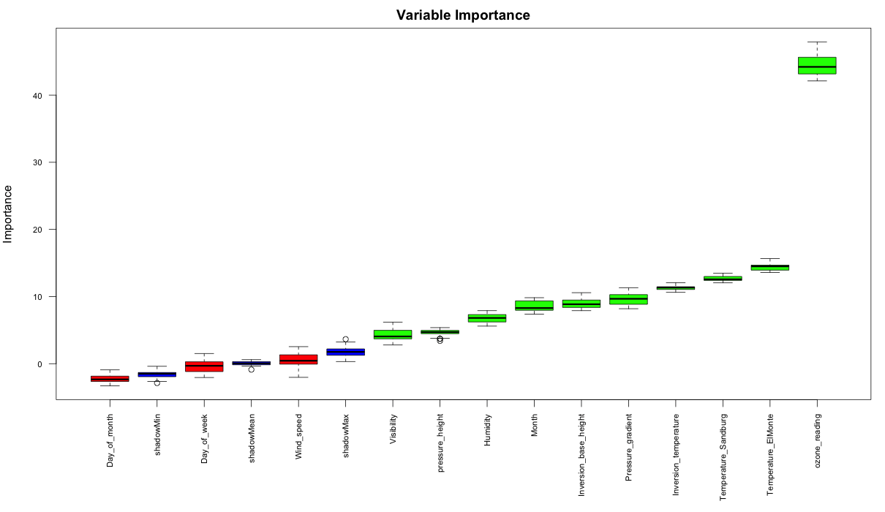
Attribute Subset Selection
Another way to reduce dimensionality of data
Redundant attributes
  Duplicate much or all of the information contained in one or more other attributes
    E.g., purchase price of a product and the amount of sales tax paid
Irrelevant attributes
  Contain no information that is useful for the data mining task at hand
    Ex. A student’s ID is often irrelevant to the task of predicting his/her GPA

Slide 49
Heuristic Search in Attribute Selection
There are 2^{d} possible attribute combinations of d attributes
Typical heuristic attribute selection methods:
  Best single attribute under the attribute independence assumption: choose by significance tests
  Best step-wise feature selection:
    The best single-attribute is picked first
    Then next best attribute condition to the first, ...
  Step-wise attribute elimination:
    Repeatedly eliminate the worst attribute
  Best combined attribute selection and elimination
  Optimal branch and bound:
    Use attribute elimination and backtracking

Slide 50
Attribute Creation (Feature Generation)
Create new attributes (features) that can capture the important information in a data set more effectively than the original ones
Three general methodologies
  Attribute extraction
    Domain-specific
  Mapping data to new space (see: data reduction)
    E.g., Fourier transformation, wavelet transformation, manifold approaches (not covered)
  Attribute construction
    Combining features (see: discriminative frequent patterns in Chapter on “Advanced Classification”)
    Data discretization
Notes:
50

Slide 51
Summary
Data quality: accuracy, completeness, consistency, timeliness, believability, interpretability
Data cleaning: e.g. missing/noisy values, outliers
Data integration from multiple sources:
  Entity identification problem; Remove redundancies; Detect inconsistencies
Data reduction, data transformation and data discretization
  Numerosity reduction; Data compression
  Normalization; Concept hierarchy generation
Dimensionality reduction

Slide 52
References
D. P. Ballou and G. K. Tayi. Enhancing data quality in data warehouse environments. Comm. of ACM, 42:73-78, 1999
T. Dasu and T. Johnson. Exploratory Data Mining and Data Cleaning. John Wiley, 2003
T. Dasu, T. Johnson, S. Muthukrishnan, V. Shkapenyuk. Mining Database Structure; Or, How to Build a Data Quality Browser. SIGMOD’02
H. V. Jagadish et al., Special Issue on Data Reduction Techniques. Bulletin of the Technical Committee on Data Engineering, 20(4), Dec. 1997
D. Pyle. Data Preparation for Data Mining. Morgan Kaufmann, 1999
E. Rahm and H. H. Do. Data Cleaning: Problems and Current Approaches. IEEE Bulletin of the Technical Committee on Data Engineering. Vol.23, No.4
V. Raman and J. Hellerstein. Potters Wheel: An Interactive Framework for Data Cleaning and Transformation, VLDB’2001
T. Redman. Data Quality: Management and Technology. Bantam Books, 1992
R. Wang, V. Storey, and C. Firth. A framework for analysis of data quality research. IEEE Trans. Knowledge and Data Engineering, 7:623-640, 1995
Notes:
MK 08.11.02: This needs to be updated to reflect changes.

Slide 53
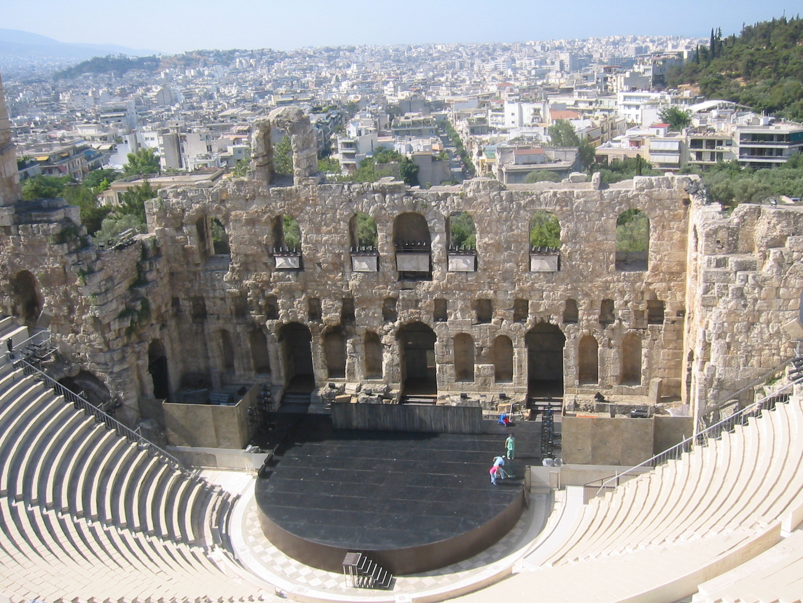
Notes:
Theatre of Dionysus is a Amphitheater in Athens, Greece.

