Slide 1
CS 412 Intro. to Data Mining
Chapter 6. Mining Frequent Patterns, Association and Correlations: Basic Concepts and Methods
Qi Li, Computer Science, Univ. Illinois at Urbana-Champaign, 2018

Slide 2
Chapter 6: Mining Frequent Patterns, Association and Correlations: Basic Concepts and Methods
Basic Concepts
Efficient Pattern Mining Methods
Pattern Evaluation
Summary

Slide 3
Pattern Discovery: Basic Concepts
What Is Pattern Discovery? Why Is It Important?
Basic Concepts: Frequent Patterns and Association Rules
Compressed Representation: Closed Patterns and Max-Patterns

Slide 4
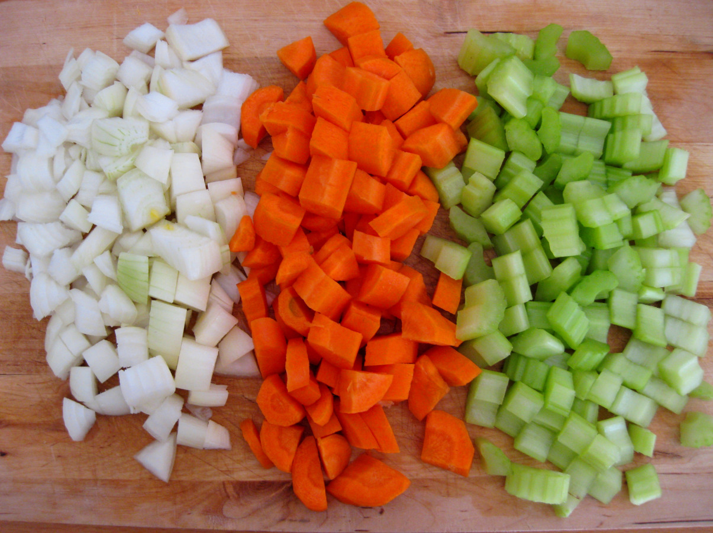
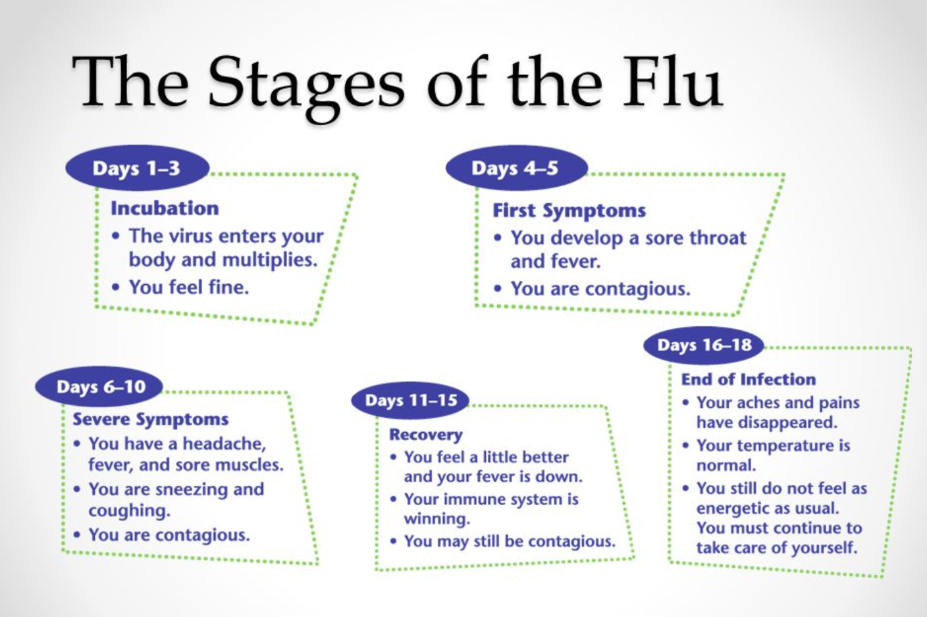
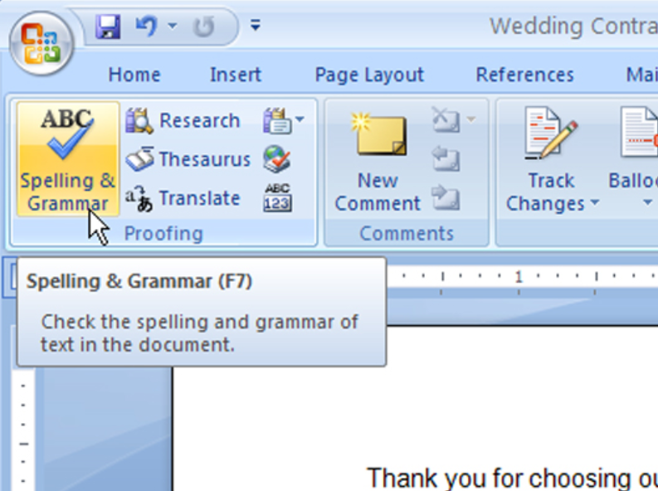
What are Patterns?
What are patterns?
Patterns: A set of items, subsequences, or substructures that occur frequently together (or strongly correlated) in a data set
Patterns represent intrinsic and important properties of datasets
Frequent item set
Frequent sequences
Frequent structures
Notes:
https://culinspiration.files.wordpress.com/2010/03/img_3955.jpg
http://slideplayer.com/slide/6292417/21/images/65/The+Stages+of+the+Flu.jpg

Slide 5
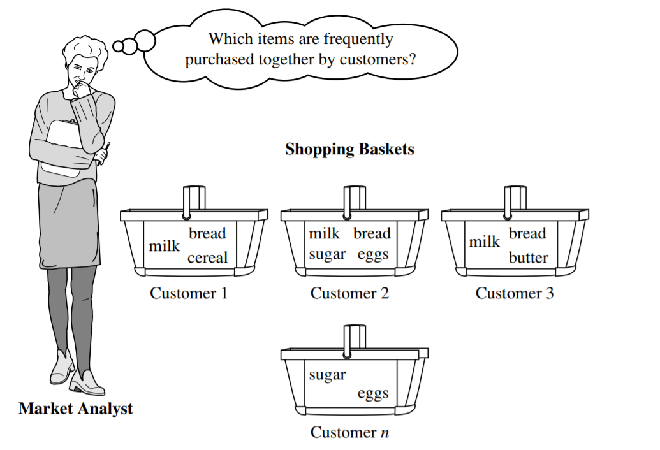
What Is Pattern Discovery?
Pattern discovery: Uncovering patterns from massive data sets
It can answer questions such as:
What products were often purchased together?
What are the subsequent purchases after buying an iPad?

Slide 6
Pattern Discovery: Why Is It Important?
Finding inherent regularities in a data set:
spatiotemporal, multimedia, time-series, and stream data
Foundation for many essential data mining tasks
Association, correlation, and causality analysis
Mining sequential, structural (e.g., sub-graph) patterns
Classification: Discriminative pattern-based analysis
Cluster analysis: Pattern-based subspace clustering
Broad applications
Market basket analysis, cross-marketing, catalog design, sale campaign analysis, Web log analysis, biological sequence analysis
Notes:
Reorder the content to make it more logical

Slide 7
Basic Concepts: Transactional Database
Transactional Database (TDB)
Each transaction is associated with an identifier, called a TID.
Tid | Items bought
1 | Beer, Nuts, Diaper
2 | Beer, Coffee, Diaper
3 | Beer, Diaper, Eggs
4 | Nuts, Eggs, Milk
5 | Nuts, Coffee, Diaper, Eggs, Milk
Notes:
Introduce transactional database and transaction identifier, also revise the number (10,20,30,40,50) to (1,2,3,4,5)

Slide 8

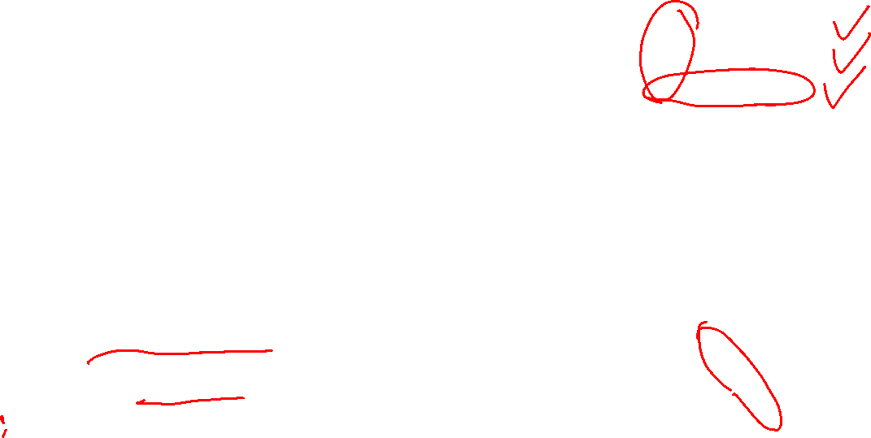
Basic Concepts: k-Itemsets and Their Supports
Itemset: A set of one or more items
k-itemset: An itemset containing k items:
X = {x₁, …, x_{k}}
Ex. {Beer, Nuts, Diaper} is a 3-itemset
(absolute) support (count)
sup{X} = occurrences of an itemset X
Ex. sup{Beer} = 3
Ex. sup{Diaper} = 4
Ex. sup{Beer, Diaper} = 3
Ex. sup{Beer, Eggs} = 1
Tid | Items bought
1 | Beer, Nuts, Diaper
2 | Beer, Coffee, Diaper
3 | Beer, Diaper, Eggs
4 | Nuts, Eggs, Milk
5 | Nuts, Coffee, Diaper, Eggs, Milk
(relative) support
s{X} = The fraction of transactions that contains X (i.e., the probability that a transaction contains X)
Ex. s{Beer} = 3/5 = 60%
Ex. s{Diaper} = 4/5 = 80%
Ex. s{Beer, Eggs} = 1/5 = 20%

Slide 9
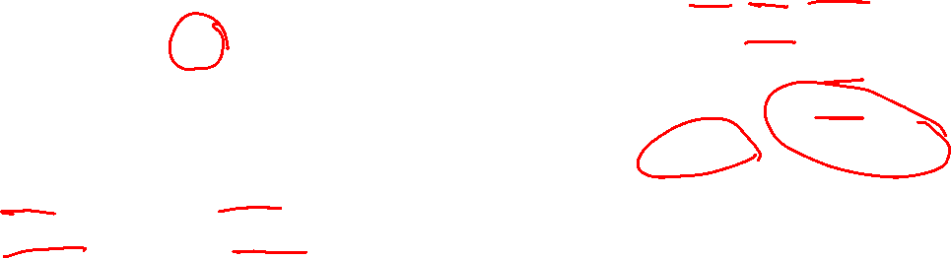
Basic Concepts: Frequent Itemsets (Patterns)
An itemset (or a pattern) X is frequent if the support of X is no less than a minsup threshold σ
Let σ = 50% (σ: minsup threshold)
For the given 5-transaction dataset
All the frequent 1-itemsets:
Beer: 3/5 (60%); Nuts: 3/5 (60%)
Diaper: 4/5 (80%); Eggs: 3/5 (60%)
All the frequent 2-itemsets:
{Beer, Diaper}: 3/5 (60%)
All the frequent 3-itemsets?
None
Tid | Items bought
1 | Beer, Nuts, Diaper
2 | Beer, Coffee, Diaper
3 | Beer, Diaper, Eggs
4 | Nuts, Eggs, Milk
5 | Nuts, Coffee, Diaper, Eggs, Milk
Why do these itemsets (shown on the left) form the complete set of frequent k-itemsets (patterns) for any k?
Observation: We may need an efficient method to mine a complete set of frequent patterns

Slide 10
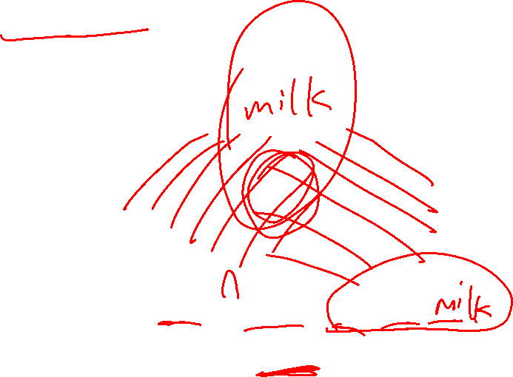
From Frequent Itemsets to Association Rules
Comparing with itemsets, association rules can be more telling
Ex. Diaper → Beer
Buying diapers may likely lead to buying beers
Containing both
Containing diaper
{Beer} ∪ {Diaper}
Beer
Diaper
Containing beer
{Beer} ∪ {Diaper} = {Beer, Diaper}
Note: X ∪ Y: the union of two itemsets
The set contains both X and Y
Notes:
First introduce the union of two itemsets

Slide 11
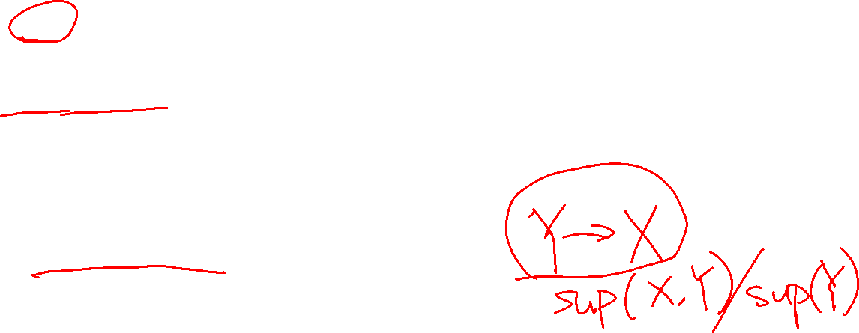
Association Rules
How do we compute the strength of an association rule X Y (Both X and Y are itemsets)?
We first compute the following two metrics, s and c.
Support
Ex. s{Diaper, Beer} = 3/5 = 0.6 (i.e., 60%)
Confidence of
The conditional probability that a transaction containing X also contains Y
c = sup(X → Y) / sup(X)
Ex. c = sup{Diaper, Beer}/sup{Diaper} = ¾ = 0.75
→
Tid | Items bought
1 | Beer, Nuts, Diaper
2 | Beer, Coffee, Diaper
3 | Beer, Diaper, Eggs
4 | Nuts, Eggs, Milk
5 | Nuts, Coffee, Diaper, Eggs, Milk
of X ∪ Y
X → Y
In pattern analysis, we are often interested in those rules that dominates the database, and these two metrics ensure the popularity and correlation of X and Y.
Notes:
Give the insight of why support and confidence is important in association rules

Slide 12
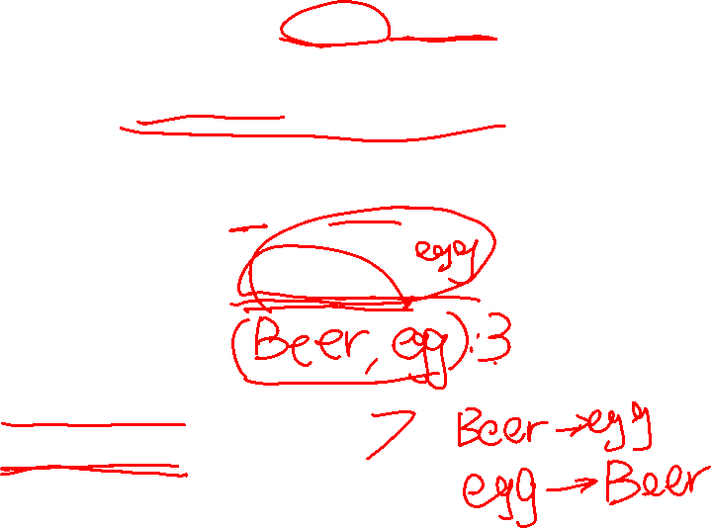
Mining Frequent Itemsets and Association Rules
Association rule mining
Given two thresholds: minsup, minconf
Find all of the rules, X → Y (s, c)
such that, s ≥ minsup and c ≥ minconf
Tid | Items bought
1 | Beer, Nuts, Diaper
2 | Beer, Coffee, Diaper
3 | Beer, Diaper, Eggs
4 | Nuts, Eggs, Milk
5 | Nuts, Coffee, Diaper, Eggs, Milk
Let minsup = 50%
Freq. 1-itemsets: Beer: 3, Nuts: 3, Diaper: 4, Eggs: 3
Freq. 2-itemsets: {Beer, Diaper}: 3
Let minconf = 50%
Beer → Diaper (60%, 100%)
Diaper → Beer (60%, 75%)
Observations:
Mining association rules and mining frequent patterns are very close problems
Scalable methods are needed for mining large datasets
(Q: Are these all rules?)

Slide 13

Challenge: There Are Too Many Frequent Patterns!
A long pattern contains a combinatorial number of sub-patterns
How many frequent itemsets does the following TDB₁ contain (minsup = 1)?
TDB_{1:} T₁: {a₁, …, a₅₀}; T₂: {a₁, …, a₁₀₀}
Let’s have a try
1-itemsets: {a₁}: 2, {a₂}: 2, …, {a₅₀}: 2, {a₅₁}: 1, …, {a₁₀₀}: 1,
2-itemsets: {a₁, a₂}: 2, …, {a₁, a₅₀}: 2, {a₁, a₅₁}: 1 …, …, {a₉₉, a₁₀₀}: 1,
…, …, …, …
99-itemsets: {a₁, a₂, …, a₉₉}: 1, …, {a₂, a₃, …, a₁₀₀}: 1
100-itemset: {a₁, a₂, …, a₁₀₀}: 1
The total number of frequent itemsets:
A too huge set for any one to compute or store!

Slide 14
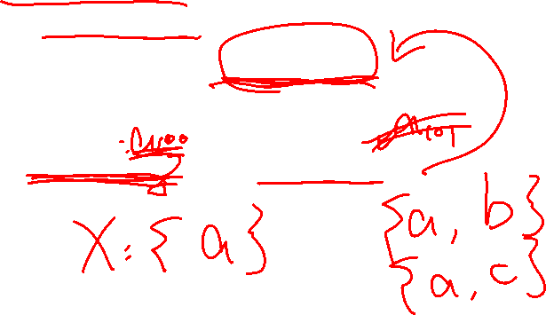
Expressing Patterns in Compressed Form
How to reduce the redundancy of the list of all the frequent itemsets?
If {a₁, …, a₉₉} and {a₁, …, a₁₀₀} have the same support in the database, then we don't need to list both of them
Solution 1: Closed patterns: A pattern (itemset) X is closed if X is frequent, and there exists no super-pattern Y כ X, with the same support as X
Ex. TDB₁: T₁: {a₁, …, a₅₀}; T₂: {a₁, …, a₁₀₀}
Suppose minsup = 1. How many closed patterns does TDB₁ contain?
Two: P₁: “{a₁, …, a₅₀}: 2”; P₂: “{a₁, …, a₁₀₀}: 1”
Notes:
Give the insight of solution 1 : a subset with the same support is no need

Slide 15
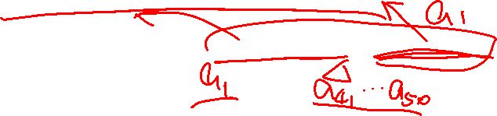
Expressing Patterns in Compressed Form: Closed Patterns
Closed pattern is a lossless compression of frequent patterns
Reduces the # of patterns but does not lose the support information!
Given
You will still be able to say: “{a₂, …, a₄₀}: 2”, “{a₅, a₅₁}: 1”
P₁: “{a₁, …, a₅₀}: 2”; P₂: “{a₁, …, a₁₀₀}: 1”

Slide 16
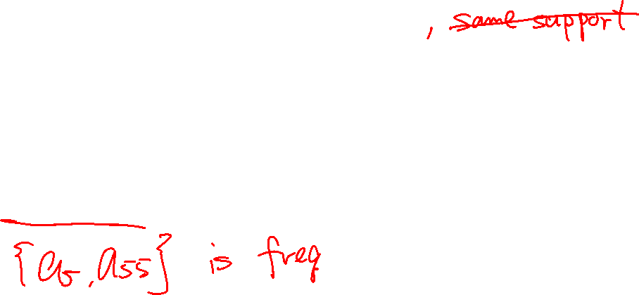
Expressing Patterns in Compressed Form: Max-Patterns
Solution 2: Max-patterns: A pattern X is a max-pattern if X is frequent and there exists no frequent super-pattern Y כ X
Difference from close-patterns?
Do not care the real support of the sub-patterns of a max-pattern
Let Transaction DB TDB₁: T₁: {a₁, …, a₅₀}; T₂: {a₁, …, a₁₀₀}
Suppose minsup = 1. How many max-patterns does TDB₁ contain?
One: P: “{a₁, …, a₁₀₀}: 1”

Slide 17
Expressing Patterns in Compressed Form: Max-Patterns
Max-pattern is a lossy compression!
We only know a subset of the max-pattern P, {a₁, …, a₄₀} , is frequent
But we do not know the real support of {a₁, …, a₄₀}, …, any more!
Thus in many applications, mining close-patterns is more desirable than mining max-patterns

Slide 18
Chapter 6: Mining Frequent Patterns, Association and Correlations: Basic Concepts and Methods
Basic Concepts
Efficient Pattern Mining Methods
Pattern Evaluation
Summary

Slide 19
Efficient Pattern Mining Methods
The Downward Closure Property of Frequent Patterns
The Apriori Algorithm
Extensions or Improvements of Apriori
Mining Frequent Patterns by Exploring Vertical Data Format
FPGrowth: A Frequent Pattern-Growth Approach
Mining Closed Patterns

Slide 20
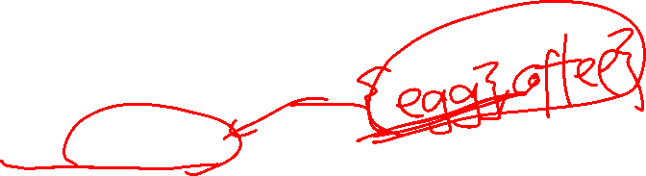
The Downward Closure Property of Frequent Patterns
Observation: From TDB_{1:} T₁: {a₁, …, a₅₀}; T₂: {a₁, …, a₁₀₀}
We get a frequent itemset: {a₁, …, a₅₀}
Also, its subsets are all frequent: {a₁}, {a₂}, …, {a₅₀}, {a₁, a₂}, …, {a₁, …, a₄₉}, …
There must be some hidden relationships among frequent patterns!
The downward closure (also called “Apriori”) property of frequent patterns
If {beer, diaper, nuts} is frequent, so is {beer, diaper}
Every transaction containing {beer, diaper, nuts} also contains {beer, diaper}
Apriori: Any subset of a frequent itemset must be frequent
Efficient mining methodology
If any subset of an itemset S is infrequent, then there is no chance for S to be frequent—why do we even have to consider S!?
A sharp knife for pruning!

Slide 21
Apriori Pruning and Scalable Mining Methods
Apriori pruning principle: If there is any itemset which is infrequent, its superset should not even be generated! (Agrawal & Srikant @VLDB’94, Mannila, et al. @ KDD’ 94)
Scalable mining Methods: Three major approaches
Level-wise, join-based approach: Apriori (Agrawal & Srikant@VLDB’94)
Vertical data format approach: Eclat (Zaki, Parthasarathy, Ogihara, Li @KDD’97)
Frequent pattern projection and growth: FPgrowth (Han, Pei, Yin @SIGMOD’00)

Slide 22
Apriori: A Candidate Generation & Test Approach
Outline of Apriori (level-wise, candidate generation and test)
Initially, scan DB once to get frequent 1-itemset
Repeat
Generate length-(k+1) candidate itemsets from length-k frequent itemsets
Test the candidates against DB to find frequent (k+1)-itemsets
Set k := k +1
Until no frequent or candidate set can be generated
Return all the frequent itemsets derived

Slide 23
The Apriori Algorithm (Pseudo-Code)
C_{k}: Candidate itemset of size k
F_{k} : Frequent itemset of size k
K := 1;
F_{k} := {frequent items}; // frequent 1-itemset
While (F_{k} != ∅) do { // when F_{k} is non-empty
C_{k+1} := candidates generated from F_{k}; // candidate generation
Derive F_{k+1} by counting candidates in C_{k+1} with respect to TDB at minsup;
k := k + 1
}
return ∪_{k} F_{k} // return F_{k} generated at each level

Slide 24
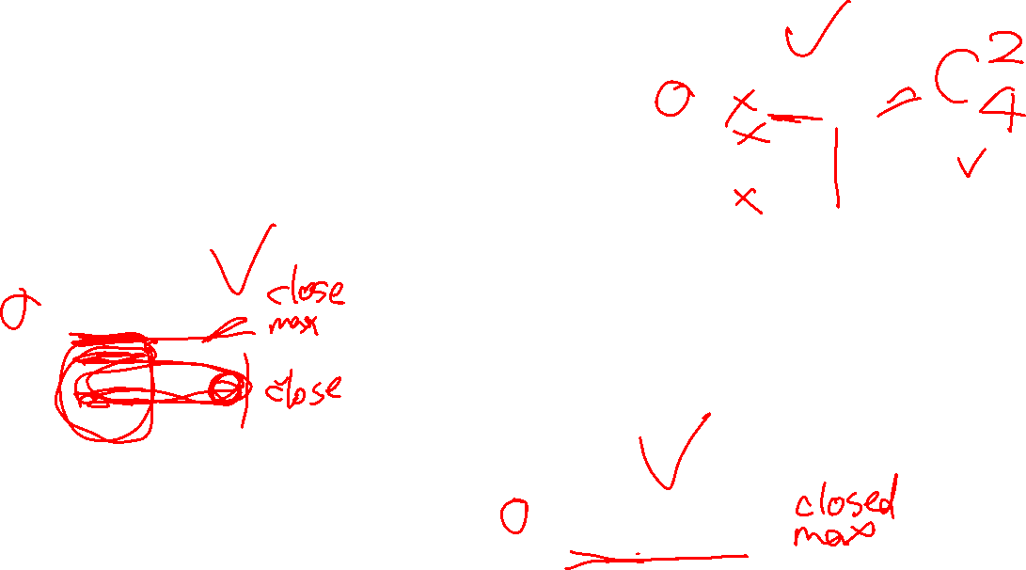
The Apriori Algorithm—An Example
Database TDB
minsup = 2
Itemset | sup
{A} | 2
{B} | 3
{C} | 3
{D} | 1
{E} | 3
F₁
Itemset | sup
{A} | 2
{B} | 3
{C} | 3
{E} | 3
Tid | Items
10 | A, C, D
20 | B, C, E
30 | A, B, C, E
40 | B, E
C₁
1st scan
C₂
C₂
Itemset | sup
{A, B} | 1
{A, C} | 2
{A, E} | 1
{B, C} | 2
{B, E} | 3
{C, E} | 2
Itemset
{A, B}
{A, C}
{A, E}
{B, C}
{B, E}
{C, E}
F₂
Itemset | sup
{A, C} | 2
{B, C} | 2
{B, E} | 3
{C, E} | 2
2nd scan
C₃
Itemset
{B, C, E}
3rd scan
F₃
Itemset | sup
{B, C, E} | 2

Slide 25
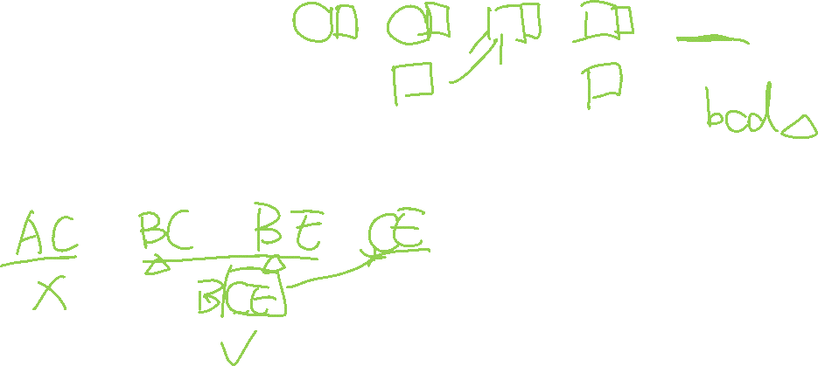
Apriori: Implementation Tricks
How to generate candidates?
Step 1: self-joining F_{k}
Step 2: pruning
Example of candidate-generation
F₃ = {abc, abd, acd, ace, bcd}
Self-joining: F₃*F₃
abcd from abc and abd
acde from acd and ace
Pruning:
acde is removed because ade is not in F₃
C₄ = {abcd}
self-join
self-join
abc | abd | acd | ace | bcd
abcd
acde
pruned

Slide 26
Candidate Generation: An SQL Implementation
self-join
self-join
Suppose the items in F_{k-1} are listed
in an order
Step 1: self-joining F_{k-1}
insert into C_{k}
select p.item₁, p.item₂, …, p.item_{k-1}, q.item_{k-1}
from F_{k-1} as p, F_{k-1} as q
where p.item₁= q.item₁, …, p.item_{k-2} = q.item_{k-2}, p.item_{k-1} < q.item_{k-1}
Step 2: pruning
for all itemsets c in C_{k} do
for all (k-1)-subsets s of c do
if (s is not in F_{k-1}) then delete c from C_{k}
abc | abd | acd | ace | bcd
abcd
acde
pruned

Slide 27
Candidate Generation (Pseudo-Code)
Suppose the items in F_{k-1} are listed in an order
// Step 1: Joining
for each p in F_{k-1}
for each q in F_{k-1}
if p.item₁= q.item₁, …, p.item_{k-2} = q.item_{k-2}, p.item_{k-1} < q.item_{k-1} {
c = join(p, q)
// Step 2: pruning
if has_infrequent_subset(c, F_{k-1})
continue // prune
else add c to C_{k}
}
self-join
self-join
zabc | zabd | acd | ace | bcd
zabcd
acde

Slide 28

Apriori: Improvements and Alternatives
Reduce passes of transaction database scans
Partitioning (e.g., Savasere, et al., 1995)
Dynamic itemset counting (Brin, et al., 1997)
Shrink the number of candidates
Hashing (e.g., DHP: Park, et al., 1995)
Pruning by support lower bounding (e.g., Bayardo 1998)
Sampling (e.g., Toivonen, 1996)
Exploring special data structures
Tree projection (Agarwal, et al., 2001)
H-miner (Pei, et al., 2001)
Hypecube decomposition (e.g., LCM: Uno, et al., 2004)
To be discussed in subsequent slides
To be discussed in subsequent slides

Slide 29
Partitioning: Scan Database Only Twice
Theorem: Any itemset that is potentially frequent in TDB must be frequent in at least one of the partitions of TDB
Here is the proof!
+
TDB₂
+
. . .
+
TDB_{k}
= TDB
TDB₁
sup₁(X) < σ|TDB₁|
sup₂(X) < σ|TDB₂|
. . .
sup_{k}(X) < σ|TDB_{k}|
sup(X) < σ|TDB|

Slide 30
Partitioning: Scan Database Only Twice
Method: Scan DB twice (A. Savasere, E. Omiecinski and S. Navathe, VLDB’95)
Scan 1: Partition database so that each partition can fit in main memory (why?)
Mine local frequent patterns in this partition
Scan 2: Consolidate global frequent patterns
Find global frequent itemset candidates (those frequent in at least one partition)
Find the true frequency of those candidates, by scanning TDB_{i} one more time

Slide 31
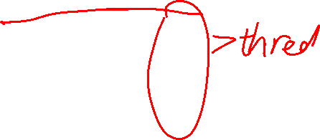
Direct Hashing and Pruning (DHP)
DHP (Direct Hashing and Pruning): (J. Park, M. Chen, and P. Yu, SIGMOD’95)
Hashing: Different itemsets may have the same hash value: v = hash(itemset)
1st scan: When counting the 1-itemset, hash 2-itemset to calculate the bucket count
Observation: A k-itemset cannot be frequent if its corresponding hashing bucket count is below the minsup threshold
Example: At the 1st scan of TDB, count 1-itemset, and
Hash 2-itemsets in the transaction to its bucket
{ab, ad, ce}
{bd, be, de}
…
At the end of the first scan,
if minsup = 80, remove ab, ad, ce, since count{ab, ad, ce} < 80
Itemsets | Count
{ab, ad, ce} | 35
{bd, be, de} | 298
…… | …
{yz, qs, wt} | 58
Hash Table

Slide 32
Exploring Vertical Data Format: ECLAT
ECLAT (Equivalence Class Transformation): A depth-first search algorithm using set intersection [Zaki et al. @KDD’97]
Tid-List: List of transaction-ids containing an itemset
Vertical format: t(e) = {T₁₀, T₂₀, T₃₀}; t(a) = {T_{10,} T₂₀}; t(ae) = {T_{10,} T₂₀}
Properties of Tid-Lists
t(X) = t(Y): X and Y always happen together (e.g., t(ac} = t(d})
t(X) ⊂ t(Y): transaction having X always has Y (e.g., t(ac) ⊂ t(ce))
Deriving frequent patterns based on vertical intersections
Using diffset to accelerate mining
Only keep track of differences of tids
t(e) = {T₁₀, T₂₀, T₃₀}, t(ce) = {T₁₀, T₃₀} → Diffset (ce, e) = {T₂₀}
A transaction DB in Horizontal Data Format
Tid | Itemset
10 | a, c, d, e
20 | a, b, e
30 | b, c, e
The transaction DB in Vertical Data Format
Item | TidList
a | 10, 20
b | 20, 30
c | 10, 30
d | 10
e | 10, 20, 30

Slide 33

Why Mining Frequent Patterns by Pattern Growth?
Apriori: A breadth-first search mining algorithm
First find the complete set of frequent k-itemsets
Then derive frequent (k+1)-itemset candidates
Scan DB again to find true frequent (k+1)-itemsets

Slide 34
Why Mining Frequent Patterns by Pattern Growth?
Motivation for a different mining methodology
Can we develop a depth-first search mining algorithm?
For a frequent itemset ρ, can subsequent search be confined to only those transactions that containing ρ?
Such thinking leads to a frequent pattern growth approach:
FPGrowth (J. Han, J. Pei, Y. Yin, “Mining Frequent Patterns without Candidate Generation,” SIGMOD 2000)

Slide 35
Prerequisite: Find frequent 1-itemset
TID | Items in the Transaction
100 | {f, a, c, d, g, i, m, p}
200 | {a, b, c, f, l, m, o}
300 | {b, f, h, j, o, w}
400 | {b, c, k, s, p}
500 | {a, f, c, e, l, p, m, n}
Scan DB once, find single item frequent pattern:
Sort frequent items in frequency descending order, f-list
Let min_support = 3
f:4, a:3, c:4, b:3, m:3, p:3
F-list = f-c-a-b-m-p

Slide 36
Example: Construct FP-tree from a Transaction DB
TID | Items in the Transaction | Ordered, frequent itemlist
100 | {f, a, c, d, g, i, m, p} | f, c, a, m, p
200 | {a, b, c, f, l, m, o} | f, c, a, b, m
300 | {b, f, h, j, o, w} | f, b
400 | {b, c, k, s, p} | c, b, p
500 | {a, f, c, e, l, p, m, n} | f, c, a, m, p
Scan DB again, find the ordered frequent itemlist for each transaction

Slide 37
Example: Construct FP-tree from a Transaction DB
TID | Items in the Transaction | Ordered, frequent itemlist
100 | {f, a, c, d, g, i, m, p} | f, c, a, m, p
200 | {a, b, c, f, l, m, o} | f, c, a, b, m
300 | {b, f, h, j, o, w} | f, b
400 | {b, c, k, s, p} | c, b, p
500 | {a, f, c, e, l, p, m, n} | f, c, a, m, p
After inserting the 1st frequent
Itemlist: “f, c, a, m, p”
{}
Header Table
f:1
Item | Frequency | header
f | 4
c | 4
a | 3
b | 3
m | 3
p | 3
c:1
For each transaction, insert the ordered frequent itemlist into an FP-tree, with shared sub-branches merged, counts accumulated
a:1
m:1
p:1

Slide 38
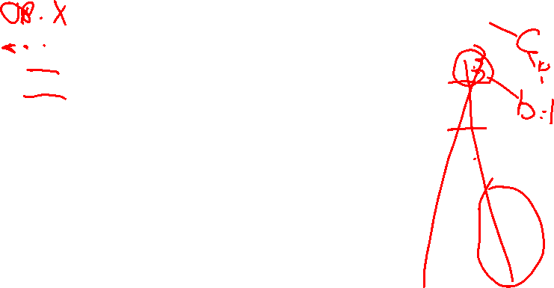
Example: Construct FP-tree from a Transaction DB
TID | Items in the Transaction | Ordered, frequent itemlist
100 | {f, a, c, d, g, i, m, p} | f, c, a, m, p
200 | {a, b, c, f, l, m, o} | f, c, a, b, m
300 | {b, f, h, j, o, w} | f, b
400 | {b, c, k, s, p} | c, b, p
500 | {a, f, c, e, l, p, m, n} | f, c, a, m, p
After inserting the 2nd frequent
itemlist “f, c, a, b, m”
{}
Header Table
Item | Frequency | header
f | 4
c | 4
a | 3
b | 3
m | 3
p | 3
f:2
c:2
4. For each transaction, insert the ordered frequent itemlist into an FP-tree, with shared sub-branches merged, counts accumulated
a:2
m:1
b:1
p:1
m:1

Slide 39
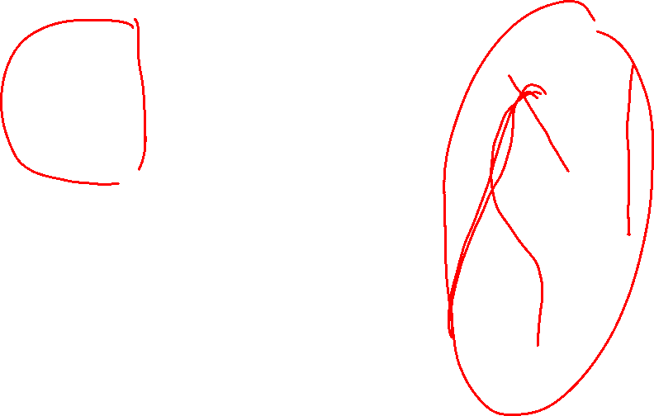
Example: Construct FP-tree from a Transaction DB
TID | Items in the Transaction | Ordered, frequent itemlist
100 | {f, a, c, d, g, i, m, p} | f, c, a, m, p
200 | {a, b, c, f, l, m, o} | f, c, a, b, m
300 | {b, f, h, j, o, w} | f, b
400 | {b, c, k, s, p} | c, b, p
500 | {a, f, c, e, l, p, m, n} | f, c, a, m, p
After inserting all the frequent itemlists
{}
Header Table
Item | Frequency | header
f | 4
c | 4
a | 3
b | 3
m | 3
p | 3
f:4
c:1
c:3
b:1
b:1
4. For each transaction, insert the ordered frequent itemlist into an FP-tree, with shared sub-branches merged, counts accumulated
a:3
p:1
m:2
b:1
p:2
m:1

Slide 40

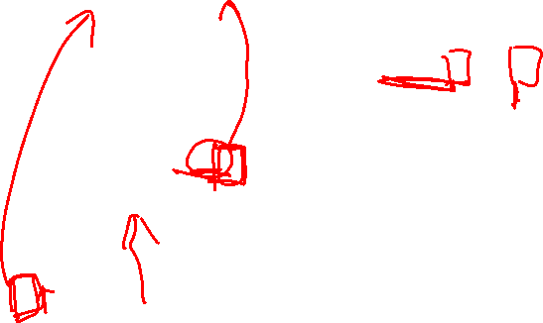
Mining FP-Tree: Divide and Conquer Based on Patterns and Data
Pattern mining can be partitioned according to current patterns
We start to calculate the conditional database from bottom to top (from the least frequent item)
Conditional database: the database under the condition that p exists
p’s conditional database (Patterns containing p): fcam:2, cb:1
{}
min_support = 3
Conditional database of each pattern
Item | Frequency | Header
f | 4
c | 4
a | 3
b | 3
m | 3
p | 3
f:4
c:1
Item Conditional database
p fcam:2, cb:1
c:3
b:1
b:1
a:3
p:1
m:2
b:1
p:2
m:1

Slide 41
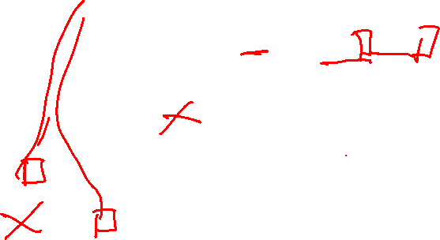
Mining FP-Tree: Divide and Conquer Based on Patterns and Data
p’s conditional database (Patterns containing p): fcam:2, cb:1
After calculating p’s conditional database, we calculate m’s conditional database
{}
min_support = 3
Conditional database of each pattern
Item | Frequency | Header
f | 4
c | 4
a | 3
b | 3
m | 3
p | 3
f:4
c:1
Item Conditional database
m fca:2, fcab:1
p fcam:2, cb:1
c:3
b:1
b:1
a:3
p:1
m:2
b:1
p:2
m:1

Slide 42
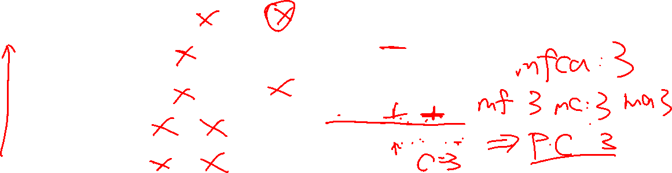
Mining FP-Tree: Divide and Conquer Based on Patterns and Data
Repeat and calculate the conditional database of b, a, and c
Since f is the most frequent item, we don’t need to compute its conditional dataset
{}
min_support = 3
Conditional database of each pattern
Item | Frequency | Header
f | 4
c | 4
a | 3
b | 3
m | 3
p | 3
f:4
c:1
Item Conditional database
c f:3
a fc:3
b fca:1, f:1, c:1
m fca:2, fcab:1
p fcam:2, cb:1
c:3
b:1
b:1
a:3
p:1
m:2
b:1
p:2
m:1

Slide 43
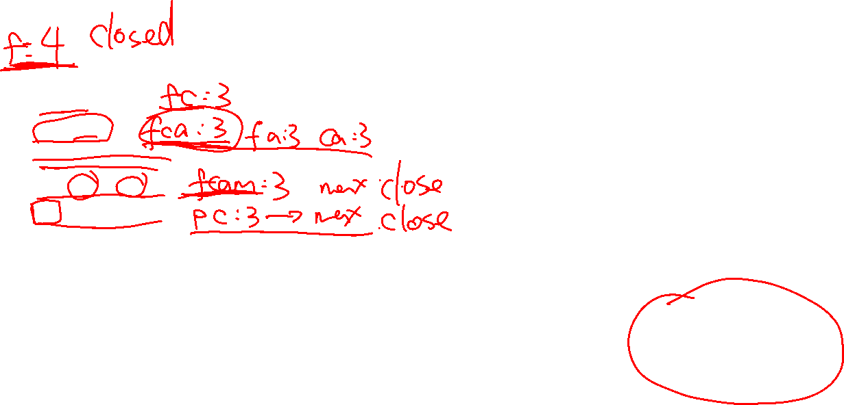
Mine Each Conditional Database Recursively
min_support = 3
For each conditional database
Mine single-item patterns
Construct its FP-tree & mine it
Conditional Data Bases
item cond. data base
c f:3
a fc:3
b fca:1, f:1, c:1
m fca:2, fcab:1
p fcam:2, cb:1
e.g., mining m’s FP-tree
{}
{}
{}
{}
f:3
f:3
f:3
f:3
c:3
c:3
cm’s FP-tree
cam’s FP-tree
a:3
am’s FP-tree
m’s FP-tree
Actually, for single branch FP-tree, all the frequent patterns can be generated in one shot
m: 3
fm: 3, cm: 3, am: 3
fcm: 3, fam:3, cam: 3
fcam: 3

Slide 44
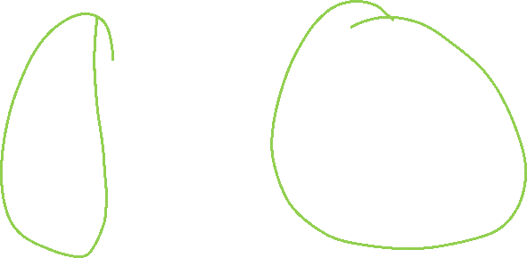
A Special Case: Single Prefix Path in FP-tree
Suppose a (conditional) FP-tree T has a shared single prefix-path P
Mining can be decomposed into two parts
Reduction of the single prefix path into one node
Concatenation of the mining results of the two parts
{}
a₁:n₁
a₂:n₂
r₁
{}
a₃:n₃

a₁:n₁
+
r₁
=
b₁:m₁
c₁:k₁
c₁:k₁
a₂:n₂
b₁:m₁
a₃:n₃
c₂:k₂
c₃:k₃
c₂:k₂
c₃:k₃

Slide 45
FPGrowth: Mining Frequent Patterns by Pattern Growth
Essence of frequent pattern growth (FPGrowth) methodology
Find frequent single items and partition the database based on each such single item pattern
Recursively grow frequent patterns by doing the above for each partitioned database (also called the pattern’s conditional database)
To facilitate efficient processing, an efficient data structure, FP-tree, can be constructed

Slide 46
FPGrowth: Mining Frequent Patterns by Pattern Growth
Mining becomes
Recursively construct and mine (conditional) FP-trees
Until the resulting FP-tree is empty, or until it contains only one path—single path will generate all the combinations of its sub-paths, each of which is a frequent pattern

Slide 47
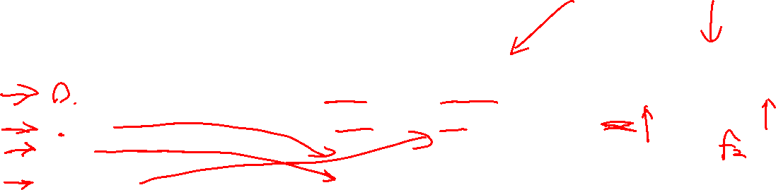
Scaling FP-growth by Item-Based Data Projection
What if FP-tree cannot fit in memory?—Do not construct FP-tree
“Project” the database based on frequent single items
Construct & mine FP-tree for each projected DB
Parallel projection vs. partition projection
Parallel projection: Project the DB on each frequent item
Space costly, all partitions can be processed in parallel
Partition projection: Partition the DB in order
Passing the unprocessed parts to subsequent partitions
Trans. DB
Parallel projection
Partition projection
f₂ f₃ f₄ g h
f₃ f₄ i j
f₂ f₄ k
f₁ f₃ h
…
f₄-proj. DB
f₃-proj. DB
f₄-proj. DB
f₃-proj. DB
Assume only f’s are frequent & the frequent item ordering is: f₁-f₂-f₃-f₄
f₂ f₃
f₃
f₂
…
f₂
f₁
…
f₂ f₃
f₃
f₂
…
f₁
…
f₂ will be projected to f₃-proj. DB only when processing f₄-proj. DB

Slide 48
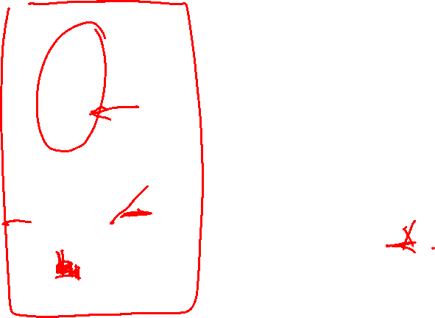
CLOSET+: Mining Closed Itemsets by Pattern-Growth
{}
Efficient, direct mining of closed itemsets
Intuition:
If an FP-tree contains a single branch as shown left
“a₁,a₂, a₃” should be merged
Itemset merging: If Y appears in every occurrence of X, then Y is merged with X
d-proj. db: {acef, acf} → acfd-proj. db: {e}
Final closed itemset: acfd:2
There are many other tricks developed
For details, see J. Wang, et al,, “CLOSET+: Searching for the Best Strategies for Mining Frequent Closed Itemsets”, KDD'03
TID | Items
1 | acdef
2 | abe
3 | cefg
4 | acdf
a₁:n₁
a₂:n₁
a₃:n₁
Let minsupport = 2
a:3, c:3, d:2, e:3, f:3
b₁:m₁
c₁:k₁
F-List: a-c-e-f-d
c₂:k₂
c₃:k₃

Slide 49
Chapter 6: Mining Frequent Patterns, Association and Correlations: Basic Concepts and Methods
Basic Concepts
Efficient Pattern Mining Methods
Pattern Evaluation
Summary

Slide 50
Pattern Evaluation
Limitation of the Support-Confidence Framework
Interestingness Measures: Lift and χ²
Null-Invariant Measures
Comparison of Interestingness Measures

Slide 51
How to Judge if a Rule/Pattern Is Interesting?
Pattern-mining will generate a large set of patterns/rules
Not all the generated patterns/rules are interesting
Interestingness measures: Objective vs. subjective
Objective interestingness measures
Support, confidence, correlation, …
Subjective interestingness measures:
Different users may judge interestingness differently
Let a user specify
Query-based: Relevant to a user’s particular request
Judge against one’s knowledge-base
unexpected, freshness, timeliness

Slide 52
Limitation of the Support-Confidence Framework
Be careful!
Are s and c interesting in association rules: “A ⇒ B” [s, c]?
Example: Suppose one school may have the following statistics on # of students who may play basketball and/or eat cereal:
Association rule mining may generate the following:
play-basketball ⇒ eat-cereal [40%, 66.7%] (higher s & c)
But this strong association rule is misleading: The overall % of students eating cereal is 75% > 66.7%, a more telling rule:
¬ play-basketball ⇒ eat-cereal [35%, 87.5%] (high s & c)
 | play-basketball | not play-basketball | sum (row)
eat-cereal | 400 | 350 | 750
not eat-cereal | 200 | 50 | 250
sum(col.) | 600 | 400 | 1000
2-way contingency table

Slide 53
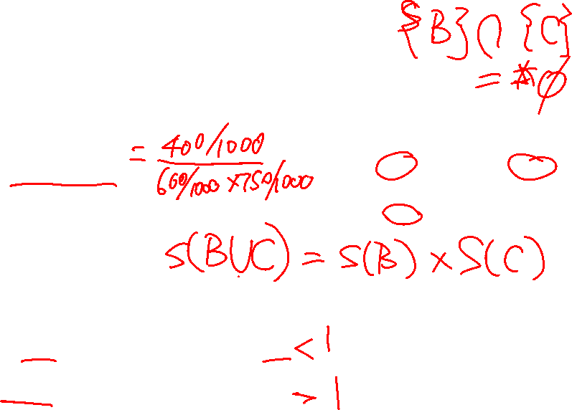
Interestingness Measure: Lift
Measure of dependent/correlated events: lift
Lift is more telling than s & c
 | B | ¬B | ∑_{row}
C | 400 | 350 | 750
¬C | 200 | 50 | 250
∑_{col.} | 600 | 400 | 1000
Lift(B, C) may tell how B and C are correlated
Lift(B, C) = 1: B and C are independent
> 1: positively correlated
< 1: negatively correlated
For our example,
Thus, B and C are negatively correlated since lift(B, C) < 1;
B and ¬C are positively correlated since lift(B, ¬C) > 1

Slide 54
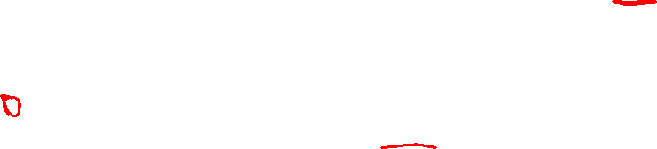
Interestingness Measure: χ²
Another measure to test correlated events: χ²
 | B | ¬B | ∑_{row}
C | 400 (450) | 350 (300) | 750
¬C | 200 (150) | 50 (100) | 250
∑_{col} | 600 | 400 | 1000
For the table on the right,
Lookup χ² distribution table => B, C are correlated
χ²-test shows B and C are negatively correlated since the expected value is 450 but the observed is only 400
Thus, χ² is also more telling than the support-confidence framework
Expected value
Observed value

Slide 55

Lift and χ² : Are They Always Good Measures?
Null transactions: Transactions that contain neither B nor C
Let’s examine the new dataset D
BC (100) is much rarer than B¬C (1000) and ¬BC (1000), but there are many ¬B¬C (100000)
Unlikely B & C will happen together!
But, Lift(B, C) = 8.44 >> 1 (Lift shows B and C are strongly positively correlated!)
χ² = 670: Observed(BC) >> expected value (11.85)
Too many null transactions may “spoil the soup”!
 | B | ¬B | ∑_{row}
C | 100 | 1000 | 1100
¬C | 1000 | 100000 | 101000
∑_{col.} | 1100 | 101000 | 102100
null transactions
Contingency table with expected values added
 | B | ¬B | ∑_{row}
C | 100 (11.85) | 1000 | 1100
¬C | 1000 (988.15) | 100000 | 101000
∑_{col.} | 1100 | 101000 | 102100

Slide 56
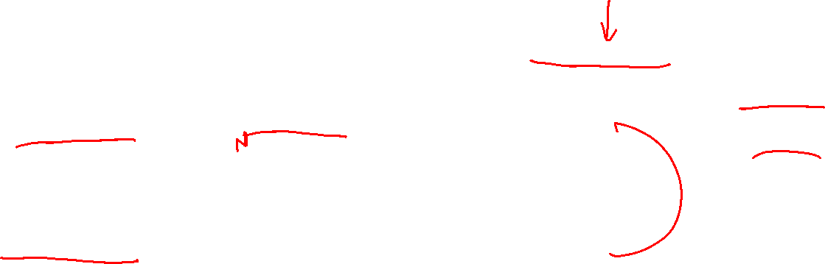
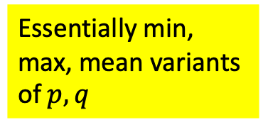

Interestingness Measures & Null-Invariance
Null invariance: Value does not change with the # of null-transactions
A few interestingness measures: Some are null invariant
Let
$$p=\frac{s\left(A∪B\right)}{s\left(A\right)}=P\left(B | A\right)$$
$$q=\frac{s\left(A∪B\right)}{s\left(B\right)}=P(A|B)$$
$p, q$ are null invariant
Essentially min, max, mean variants of $p, q$

Slide 57
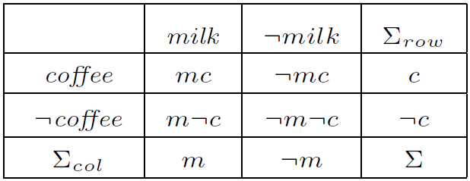
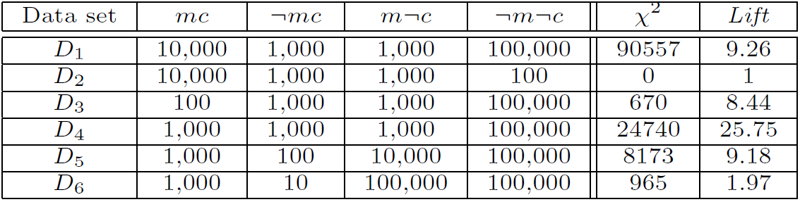

Null Invariance: An Important Property
Why is null invariance crucial for the analysis of massive transaction data?
Many transactions may contain neither milk nor coffee!
Lift and χ² are not null-invariant: not good to evaluate data that contain too many or too few null transactions!
Many measures are not null-invariant!
milk vs. coffee contingency table

Slide 58
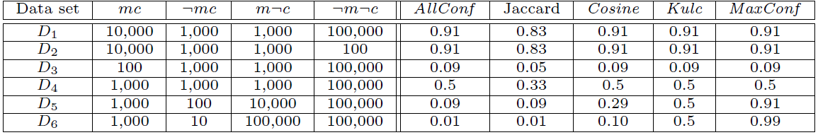
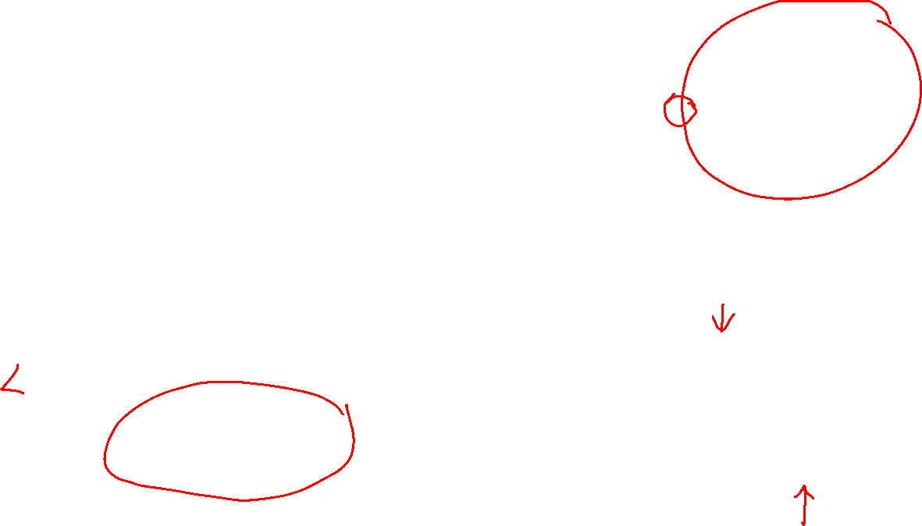
Comparison of Null-Invariant Measures
Not all null-invariant measures are created equal
Which one is better?
D₄—D₆ differentiate the null-invariant measures
Kulc (Kulczynski 1927) holds firm and is in balance of both directional implications
2-variable contingency table
All 5 are null-invariant

Slide 59

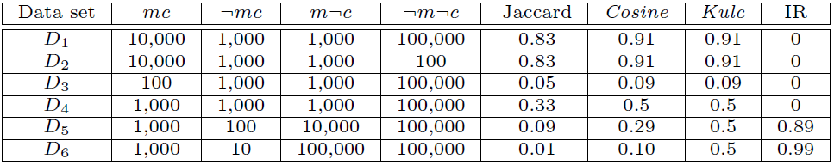
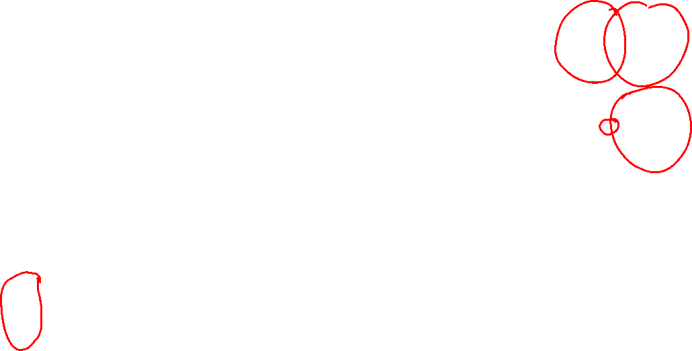
Imbalance Ratio with Kulczynski Measure
IR (Imbalance Ratio): measure the imbalance of two itemsets A and B in rule implications:
Kulczynski and Imbalance Ratio (IR) together present a clear picture for all the three datasets D₄ through D₆
D₄ is neutral & balanced; D₅ is neutral but imbalanced
D₆ is neutral but very imbalanced

Slide 60
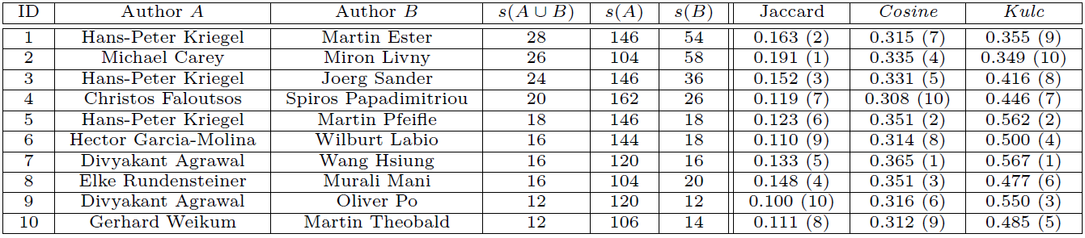
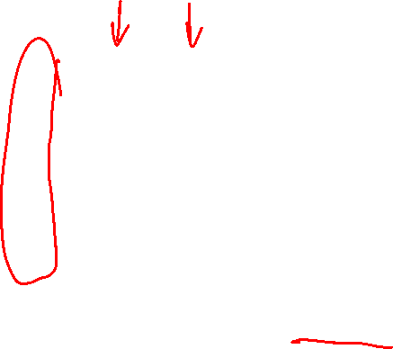
Example: Analysis of DBLP Coauthor Relationships
DBLP: Computer science research publication bibliographic database
> 3.8 million entries on authors, paper, venue, year, and other information
Advisor-advisee relation: Kulc: high, Jaccard: low, cosine: middle
Which pairs of authors are strongly related?
Use Kulc to find Advisor-advisee, close collaborators

Slide 61
What Measures to Choose for Effective Pattern Evaluation?
Null value cases are predominant in many large datasets
Neither milk nor coffee is in most of the baskets; neither Mike nor Jim is an author in most of the papers; ……
Null-invariance is an important property
Lift, χ² and cosine are good measures if null transactions are not predominant
Otherwise, Kulczynski + Imbalance Ratio should be used to judge the interestingness of a pattern

Slide 62
What Measures to Choose for Effective Pattern Evaluation?
Exercise: Mining research collaborations from research bibliographic data
Find a group of frequent collaborators from research bibliographic data (e.g., DBLP)
Can you find the likely advisor-advisee relationship and during which years such a relationship happened?
Ref.: C. Wang, J. Han, Y. Jia, J. Tang, D. Zhang, Y. Yu, and J. Guo, "Mining Advisor-Advisee Relationships from Research Publication Networks", KDD'10

Slide 63
Chapter 6: Mining Frequent Patterns, Association and Correlations: Basic Concepts and Methods
Basic Concepts
Efficient Pattern Mining Methods
Pattern Evaluation
Summary

Slide 64
Summary
Basic Concepts
What Is Pattern Discovery? Why Is It Important?
Basic Concepts: Frequent Patterns and Association Rules
Compressed Representation: Closed Patterns and Max-Patterns
Efficient Pattern Mining Methods
The Downward Closure Property of Frequent Patterns
The Apriori Algorithm
Extensions or Improvements of Apriori
Mining Frequent Patterns by Exploring Vertical Data Format
FPGrowth: A Frequent Pattern-Growth Approach
Mining Closed Patterns
Pattern Evaluation
Interestingness Measures in Pattern Mining
Interestingness Measures: Lift and χ²
Null-Invariant Measures
Comparison of Interestingness Measures

Slide 65
Recommended Readings (Basic Concepts)
R. Agrawal, T. Imielinski, and A. Swami, “Mining association rules between sets of items in large databases”, in Proc. of SIGMOD'93
R. J. Bayardo, “Efficiently mining long patterns from databases”, in Proc. of SIGMOD'98
N. Pasquier, Y. Bastide, R. Taouil, and L. Lakhal, “Discovering frequent closed itemsets for association rules”, in Proc. of ICDT'99
J. Han, H. Cheng, D. Xin, and X. Yan, “Frequent Pattern Mining: Current Status and Future Directions”, Data Mining and Knowledge Discovery, 15(1): 55-86, 2007

Slide 66
Recommended Readings (Efficient Pattern Mining Methods)
R. Agrawal and R. Srikant, “Fast algorithms for mining association rules”, VLDB'94
A. Savasere, E. Omiecinski, and S. Navathe, “An efficient algorithm for mining association rules in large databases”, VLDB'95
J. S. Park, M. S. Chen, and P. S. Yu, “An effective hash-based algorithm for mining association rules”, SIGMOD'95
S. Sarawagi, S. Thomas, and R. Agrawal, “Integrating association rule mining with relational database systems: Alternatives and implications”, SIGMOD'98
M. J. Zaki, S. Parthasarathy, M. Ogihara, and W. Li, “Parallel algorithm for discovery of association rules”, Data Mining and Knowledge Discovery, 1997
J. Han, J. Pei, and Y. Yin, “Mining frequent patterns without candidate generation”, SIGMOD’00
M. J. Zaki and Hsiao, “CHARM: An Efficient Algorithm for Closed Itemset Mining”, SDM'02
J. Wang, J. Han, and J. Pei, “CLOSET+: Searching for the Best Strategies for Mining Frequent Closed Itemsets”, KDD'03
C. C. Aggarwal, M.A., Bhuiyan, M. A. Hasan, “Frequent Pattern Mining Algorithms: A Survey”, in Aggarwal and Han (eds.): Frequent Pattern Mining, Springer, 2014

Slide 67
Recommended Readings (Pattern Evaluation)
C. C. Aggarwal and P. S. Yu. A New Framework for Itemset Generation. PODS’98
S. Brin, R. Motwani, and C. Silverstein. Beyond market basket: Generalizing association rules to correlations. SIGMOD'97
M. Klemettinen, H. Mannila, P. Ronkainen, H. Toivonen, and A. I. Verkamo. Finding interesting rules from large sets of discovered association rules. CIKM'94
E. Omiecinski. Alternative Interest Measures for Mining Associations. TKDE’03
P.-N. Tan, V. Kumar, and J. Srivastava. Selecting the Right Interestingness Measure for Association Patterns. KDD'02
T. Wu, Y. Chen and J. Han, Re-Examination of Interestingness Measures in Pattern Mining: A Unified Framework, Data Mining and Knowledge Discovery, 21(3):371-397, 2010

Slide 68


