Slide 1
CS 412 Intro. to Data Mining
Chapter 9. Classification: Advanced Methods
Qi Li, Computer Science, Univ. Illinois at Urbana-Champaign, 2018

Slide 2
Chapter 9. Classification: Advanced Methods
Ensemble Methods: Increasing the Accuracy
Bayesian Belief Networks
Support Vector Machines
Neural Networks and Deep Learning
Pattern-Based Classification
Lazy Learners and K-Nearest Neighbors
Other Classification Methods
Summary
Notes:
2

Slide 3
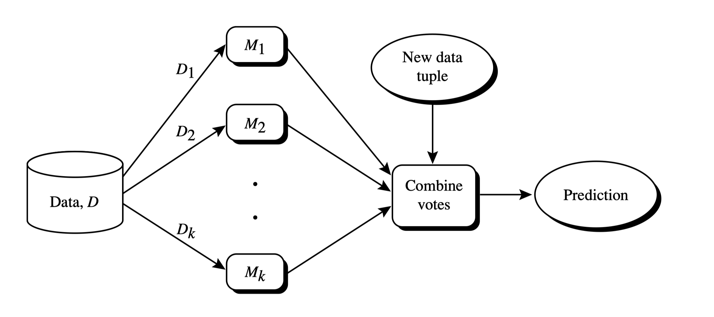
Ensemble Methods: Increasing the Accuracy
Ensemble methods
  Use a combination of models to increase accuracy
  Combine a series of k learned models, M₁, M₂, …, M_{k}, with the aim of creating an improved model M*

Slide 4
Ensemble Methods: Increasing the Accuracy
What are the requirements to generate an improved model?
  Example: majority voting
 | x₁ | x₂ | x₃
M₁ | ✓ | ✓ | ✗
M₂ | ✗ | ✓ | ✓
M₃ | ✓ | ✗ | ✓
Voting Ensemble | ✓ | ✓ | ✓
 | x₁ | x₂ | x₃
M₁ | ✓ | ✓ | ✗
M₂ | ✓ | ✓ | ✗
M₃ | ✓ | ✓ | ✗
Voting Ensemble | ✓ | ✓ | ✗
 | x₁ | x₂ | x₃
M₁ | ✓ | ✗ | ✗
M₂ | ✗ | ✓ | ✗
M₃ | ✗ | ✗ | ✓
Voting Ensemble | ✗ | ✗ | ✗
Base model performance
Ensemble performance
Case 1:
Ensemble has positive effect
Case 2:
Ensemble has no effect
Case 3:
Ensemble has negative effect
Base models should be
  Accurate
  Diverse

Slide 5
Ensemble Methods: Increasing the Accuracy
Popular ensemble methods
  Bagging: Trains each model using a subset of the training set, and models learned in parallel
  Boosting: Trains each new model instance to emphasize the training instances that previous models mis-classified, and models learned in order
Bagging
Boosting

Slide 6
Bagging: Bootstrap Aggregation
Analogy: Diagnosis based on multiple doctors’ majority vote
Training
  For i = 1 to k
    create bootstrap sample, D_{i}, by sampling D with replacement;
    use D_{i} and the learning scheme to derive a model, M_{i} ;
Classification: classify an unknown sample X
  let each of the k models classify X and return the majority vote
Prediction:
  To predict continuous variables, use average prediction instead of vote

Slide 7
Random Forest: Basic Concepts
Random Forest (first proposed by L. Breiman in 2001)
  Bagging with decision trees as base models
  Data bagging
    Use a subset of training data by sampling with replacement for each tree
  Feature bagging
    At each node use a random selection of attributes as candidates and split by the best attribute among them
  During classification, each tree votes and the most popular class is returned
Advantage of decision trees – more diversity

Slide 8
Random Forest
Two Methods to construct Random Forest:
  Forest-RI (random input selection): Randomly select, at each node, F attributes as candidates for the split at the node. The CART methodology is used to grow the trees to maximum size
  Forest-RC (random linear combinations): Creates new attributes (or features) that are a linear combination of the existing attributes (reduces the correlation between individual classifiers)
Comparable in accuracy to Adaboost, but more robust to errors and outliers
Insensitive to the number of attributes selected for consideration at each split, and faster than typical bagging or boosting

Slide 9
Boosting
Analogy: Consult several doctors, based on a combination of weighted diagnoses—weight assigned based on the previous diagnosis accuracy
How boosting works?
  A series of k classifiers are iteratively learned
  After a classifier M_{i} is learned, set the subsequent classifier, M_{i+1}, to pay more attention to the training tuples that were misclassified by M_{i}
  The final M* combines the votes of each individual classifier, where the weight of each classifier's vote is a function of its accuracy
Boosting algorithm can be extended for numeric prediction

Slide 10
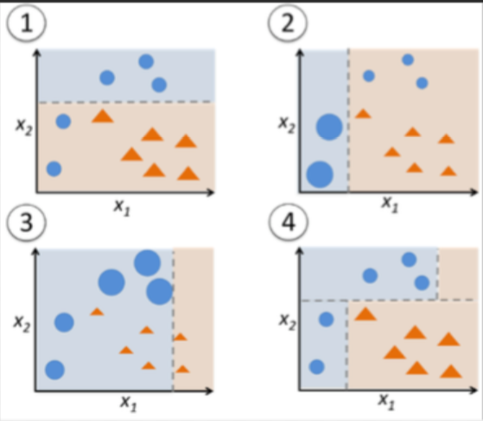
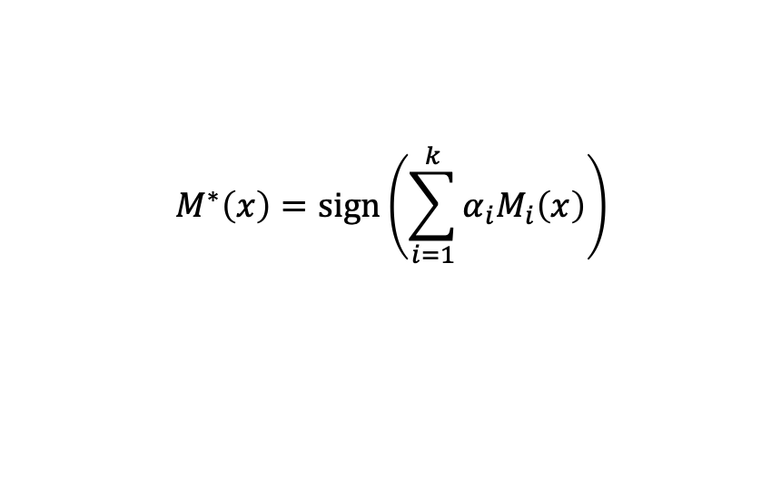
Adaboost (Freund and Schapire, 1997)
3. Update weights based on current model
1. Assign initial weights to each training tuple
{w_{n}⁽¹⁾}
{w_{n}⁽²⁾}
{w_{n}^{(k)}}
…
2. Train base classifier on weighted dataset
M₁
M₂
…
M_{k}
4. After base classifiers are trained, they are combined to give the final classifier
Two ‘weighting’ strategy:
Assign weights to each training example
Sample dataset based on weight distribution
$$M^{∗}\left(x\right)=sign\left(\sum_{i=1}^{k}{α_{i}M_{i}\left(x\right)}\right)$$

Slide 11
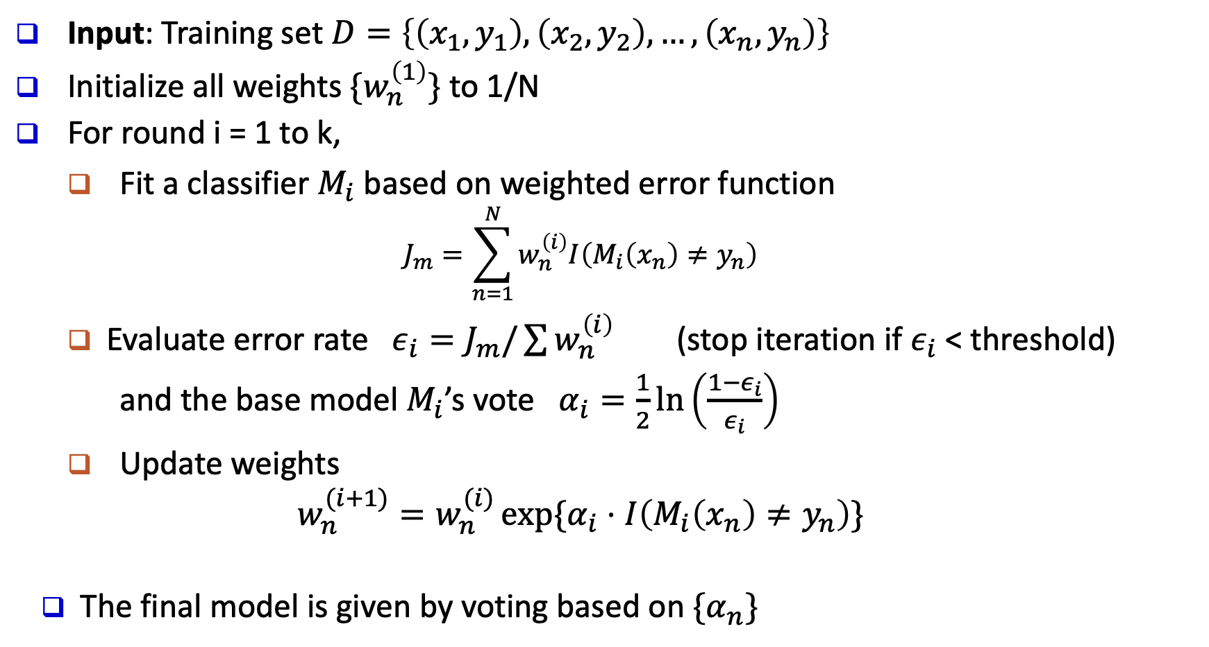
Adaboost (Freund and Schapire, 1997)
Input: Training set $D=\left\{\left(x_{1},y_{1}\right), \left(x_{2},y_{2}\right), …, \left(x_{n},y_{n}\right)\right\}$
Initialize all weights $\{w_{n}^{\left(1\right)}\}$ to 1/N
For round i = 1 to k,
  Fit a classifier $M_{i}$ based on weighted error function
  $$J_{m}=\sum_{n=1}^{N}{w_{n}^{\left(i\right)}I\left(M_{i}\left(x_{n}\right)≠y_{n}\right)}$$
  Evaluate error rate $ε_{i}=J_{m}/\sum{w_{n}^{\left(i\right)}}$ (stop iteration if $ε_{i}$ < threshold)
  and the base model $M_{i}$’s vote $α_{i}=\frac{1}{2}\ln\left(\frac{1−ε_{i}}{ε_{i}}\right)$
  Update weights
  $$w_{n}^{(i+1)}=w_{n}^{(i)}\exp{\{α_{i}⋅I\left(M_{i}\left(x_{n}\right)≠y_{n}\right)\}}$$
The final model is given by voting based on $\{α_{n}\}$

Slide 12
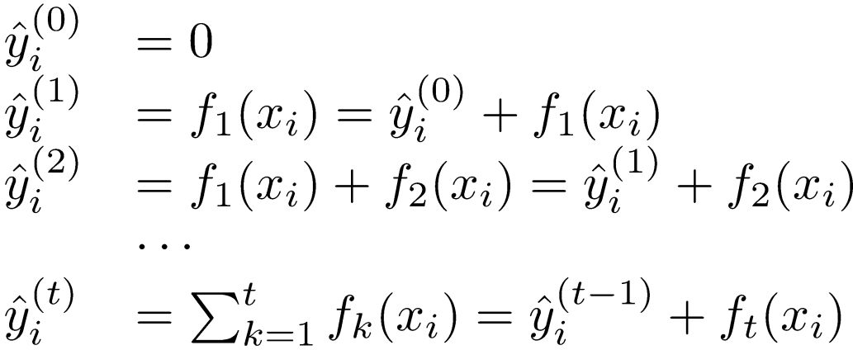
Gradient Boosting
Operates on:
  A differentiable loss function
  A weak learner to make predictions (usually trees)
  An additive model to add weak learners to minimize the loss function
Each time adds an additional weak learner
Scalable implementation: XGBoost
Previous model
New weak learner

Slide 13
Ensemble Methods Recap
Random forest and XGBoost are the most commonly used algorithms for tabular data
Pros
  Good performance for tabular data, requires no data scaling
  Can scale to large datasets
  Can handle missing data to some extent
Cons
  Can overfit to training data if not tuned properly
  Lack of interpretability (compared to decision trees)

Slide 14
Chapter 9. Classification: Advanced Methods
Ensemble Methods: Increasing the Accuracy
Bayesian Belief Networks
Support Vector Machines
Neural Networks and Deep Learning
Pattern-Based Classification
Lazy Learners and K-Nearest Neighbors
Other Classification Methods
Summary
Notes:
14

Slide 15
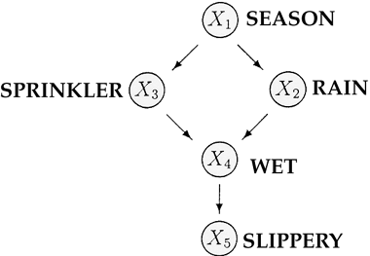
From Naïve Bayes to Bayesian Networks
Naïve Bayes classifiers assume that the value of a particular feature is independent of the value of any other feature, given the class variable
  This assumption is often too simple to model the real world well
Bayesian network (or Bayes network, belief network, Bayesian model or probabilistic directed acyclic graphical model) is a probabilistic graphical model
  Represented by a set of random variables and their conditional dependencies via a directed acyclic graph (DAG)
  E.g. Given symptoms, the network can be used to compute the probabilities of the presence of various diseases

Slide 16

Bayesian Belief Networks
Bayesian belief network (or Bayesian network, probabilistic network):
  Allows class conditional independencies between subsets of variables
Two components:
  A directed acyclic graph (called a structure)
  A set of conditional probability tables (CPTs)
Nodes: random variables Links: dependency
Family History
Smoker
B
B
Not Bayesian networks
Lung Cancer
Emphysema
A
C
A
C
Positive
X-Ray
Dyspnea
directed acyclic graphical model
directed cyclic graphical model
$p\left(A, B, C\right)=p$(B)$∙p(A|B)∙$p(C|A, B)
Notes:
16

Slide 17
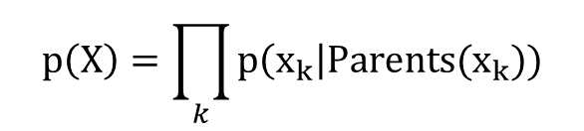
A Bayesian Network and Its CPTs
Conditional Probability Tables (CPT)
Fire | Smoke | Θ_{s|f}
True | True | .90
False | True | .01
Fire (F)
Tampering (T)
Fire | Tampering | Alarm | Θ_{a|f,t}
True | True | True | .5
True | False | True | .99
False | True | True | .85
False | False | True | .0001
Smoke (S)
Alarm (A)
CPT shows the conditional probability for each possible combination of its parents:
$$p\left(X\right)=\prod_{k}{p\left(x_{k}\right|Parents(x_{k}))}$$
$p\left(F, S ,A, T\right)=p$(F)$∙p(T)∙$p(S|F) $∙p(A|F, T)$

Slide 18
Training Bayesian Networks: Several Scenarios
Scenario 1: Given both the network structure and all variables observable: compute only the CPT entries
Scenario 2: Network structure known, some variables hidden: gradient descent (greedy hill-climbing) method, i.e., search for a solution along the steepest descent of a criterion function
  Weights are initialized to random probability values
  At each iteration, it moves towards what appears to be the best solution at the moment, without backtracking
  Weights are updated at each iteration & converge to local optimum

Slide 19
Training Bayesian Networks: Several Scenarios
Scenario 3: Network structure unknown, all variables observable: search through the model space to reconstruct network topology
Scenario 4: Unknown structure, all hidden variables: No good algorithms known for this purpose
D. Heckerman. A Tutorial on Learning with Bayesian Networks. In Learning in Graphical Models, M. Jordan, ed. MIT Press, 1999

Slide 20
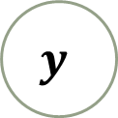


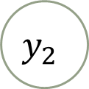


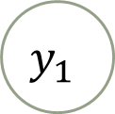

Probabilistic Graphic Model: Plate Notations
Represent variables that repeat in a graphical model
Variables
  A solid (or shaded) circle means the corresponding variable is observed; otherwise it is hidden
Dependency among variables:
  A Directed Acyclic Graphical (DAG) model
Using plate notation instead of flat notation
A
B
$$x$$
$$x$$
$$y_{1}$$
$$y_{2}$$
$$⋯$$
$$y_{N}$$
$$y$$
$$N$$
Flat notation
Plate notation

Slide 21
An Example of Plate Notation
Flat notation
Grade for (course0, student a)
Difficulty for Course 0
Plate notation
Grade for (course0, student b)
Difficulty for Course 1
Difficulty
Grade for (course1, student a)
#Courses
Intelligence for student a
Grade
Grade for (course1, student b)
#Grades
Intelligence
Intelligence for student b
#Students
Grade for (course1, student c)
Intelligence for student c

Slide 22
Chapter 9. Classification: Advanced Methods
Ensemble Methods: Increasing the Accuracy
Bayesian Belief Networks
Support Vector Machines
Neural Networks and Deep Learning
Pattern-Based Classification
Lazy Learners and K-Nearest Neighbors
Other Classification Methods
Summary
Notes:
22

Slide 23
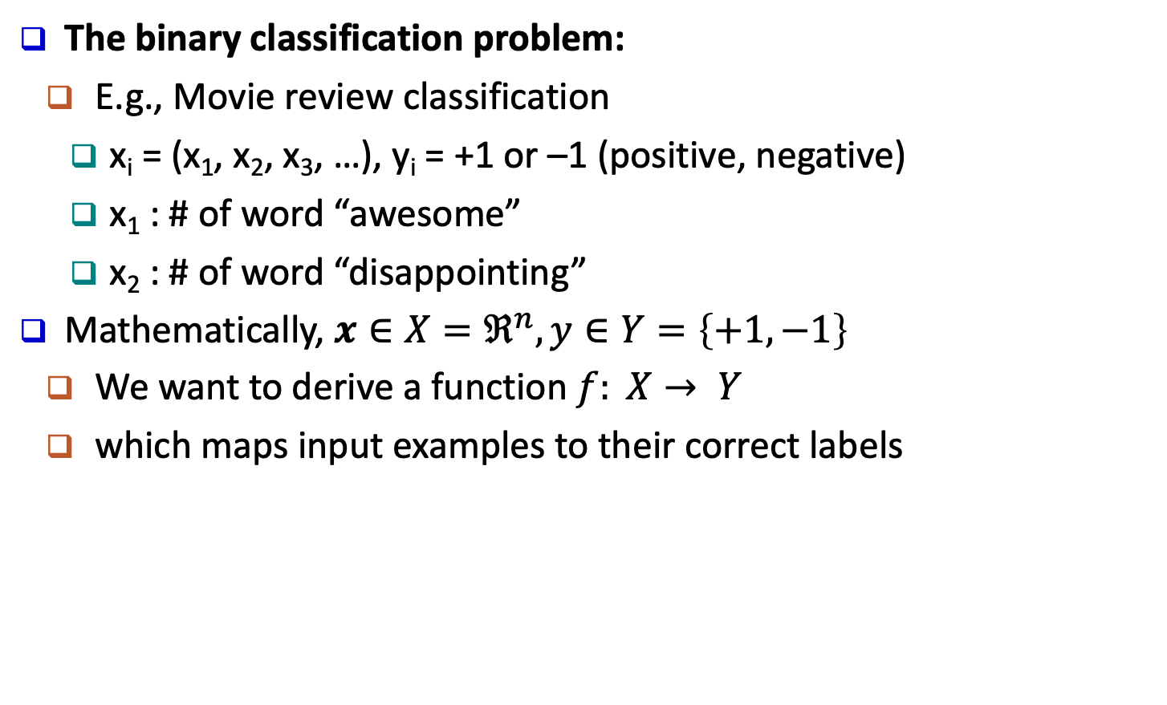
Classification: A Mathematical Mapping
The binary classification problem:
  E.g., Movie review classification
    x_{i} = (x₁, x₂, x₃, …), y_{i} = +1 or –1 (positive, negative)
    x₁ : # of word “awesome”
    x₂ : # of word “disappointing”
Mathematically, $x∈X=ℜ^{n},y∈Y=\left\{+1,−1\right\}$
  We want to derive a function $f: X→ Y$
  which maps input examples to their correct labels
Notes:
23

Slide 24
SVM—Support Vector Machines
linear and nonlinear
  Vapnik and colleagues (1992)—groundwork from Vapnik & Chervonenkis’ statistical learning theory in 1960s
It uses a nonlinear mapping to transform the original training data into a higher dimension
With the new dimension, it searches for the linear optimal separating hyperplane (i.e., “decision boundary”)
With an appropriate nonlinear mapping to a sufficiently high dimension, data from two classes can always be separated by a hyperplane
SVM finds this hyperplane using support vectors (“essential” training tuples) and margins (defined by the support vectors)

Slide 25
SVM—General Philosophy
Learning a max-margin classifier
  From the infinite set of lines (hyperplanes) separating two classes
  Find the one which separates two classes with the largest margin
  i.e. a maximum marginal hyperplane (MMH)

Slide 26
SVM—When Data Is Linearly Separable
Linearly Separable
Linearly Inseparable
The simplest case: When data is linearly separable
  Data sets whose classes can be separated exactly by linear decision surfaces are said to be linearly separable

Slide 27
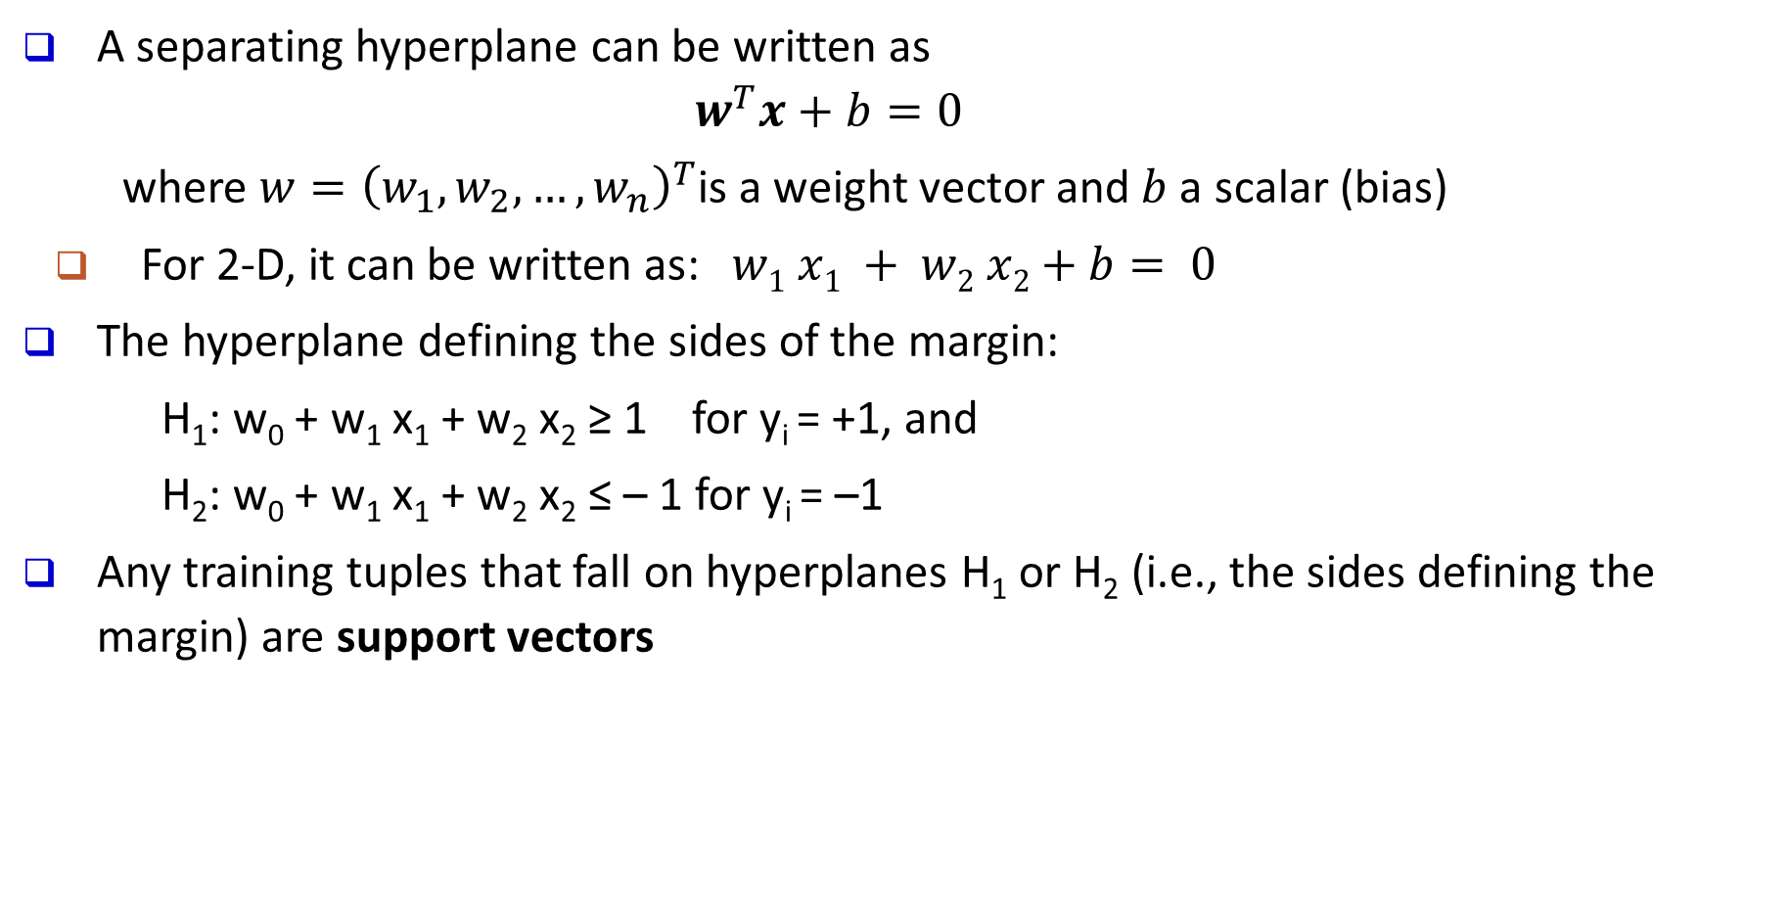
Linear SVM for Linearly Separable Data
A separating hyperplane can be written as
        $$w^{T}x+b=0$$
      where $w={\left(w_{1},w_{2},…,w_{n}\right)}^{T}$is a weight vector and $b$ a scalar (bias)
  For 2-D, it can be written as: $w1 x1 + w2 x2+b= 0$
The hyperplane defining the sides of the margin:
        H₁: w₀ + w₁ x₁ + w₂ x₂ ≥ 1 for y_{i} = +1, and
        H₂: w₀ + w₁ x₁ + w₂ x₂ ≤ – 1 for y_{i} = –1
Any training tuples that fall on hyperplanes H₁ or H₂ (i.e., the sides defining the margin) are support vectors
Model parameters to learn
Notes:
Objective function: "Minimize {\displaystyle \|{\vec {w}}\|} subject to {\displaystyle y_{i}({\vec {w}}\cdot {\vec {x}}_{i}-b)\geq 1,} for {\displaystyle i=1,\,\ldots ,\,n}"

Slide 28
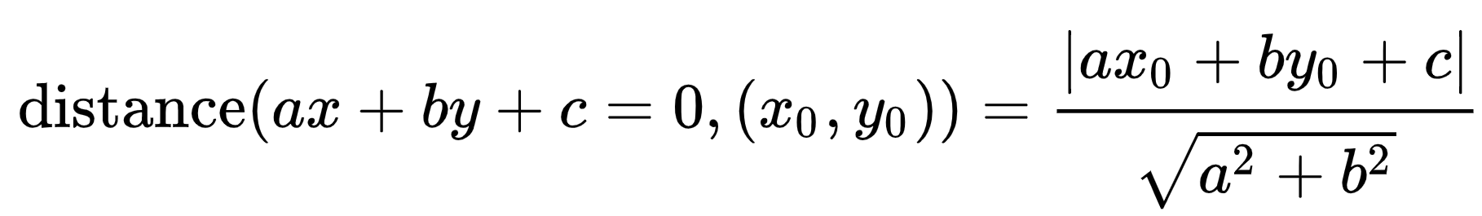
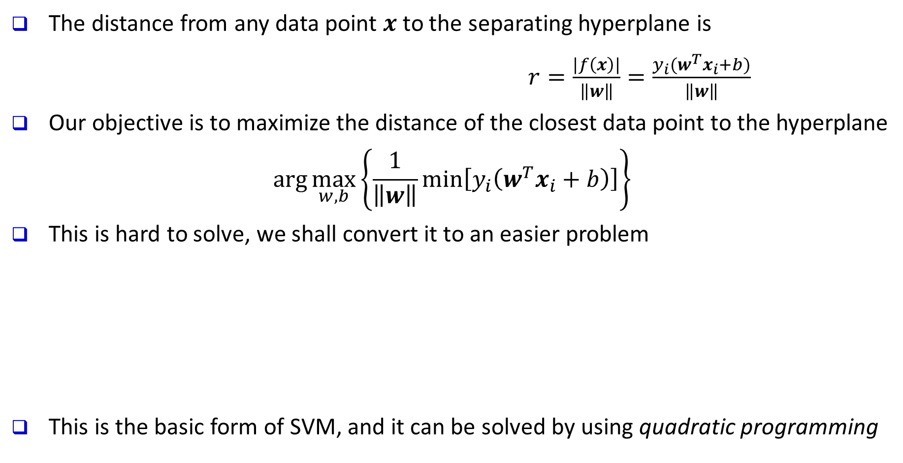
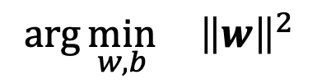
Linear SVM for Linearly Separable Data
The distance from any data point $x$ to the separating hyperplane is
$r=\frac{|f\left(x\right)|}{\left\|w\right\|}=\frac{y_{i}(w^{T}x_{i}+b)}{\left\|w\right\|}$
Our objective is to maximize the distance of the closest data point to the hyperplane
$$\arg{\max_{w,b}\left\{\frac{1}{\left\|w\right\|}\min\left[y_{i}\left(w^{T}x_{i}+b\right)\right]\right\}}$$
This is hard to solve, we shall convert it to an easier problem
This is the basic form of SVM, and it can be solved by using quadratic programming
$$\arg{\min_{w,b}{ {\left\|w\right\|}^{2}}}$$
$${s.t. y}_{i}\left(w^{T}x_{i}+b\right)≥1, i=1,2,…,n$$
Notes:
Objective function: "Minimize {\displaystyle \|{\vec {w}}\|} subject to {\displaystyle y_{i}({\vec {w}}\cdot {\vec {x}}_{i}-b)\geq 1,} for {\displaystyle i=1,\,\ldots ,\,n}"

Slide 29






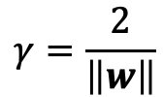
Linear SVM for Linearly Separable Data
$$x_{2}$$
$w^{T}x_{i}+b=0$
The data points closest to the separating hyperplane are called support vectors
$w^{T}x_{i}+b=1$
$w^{T}x_{i}+b=−1$
$$γ=\frac{2}{\left\|w\right\|}$$
“Margin”
$$0$$
$$x_{1}$$

Slide 30
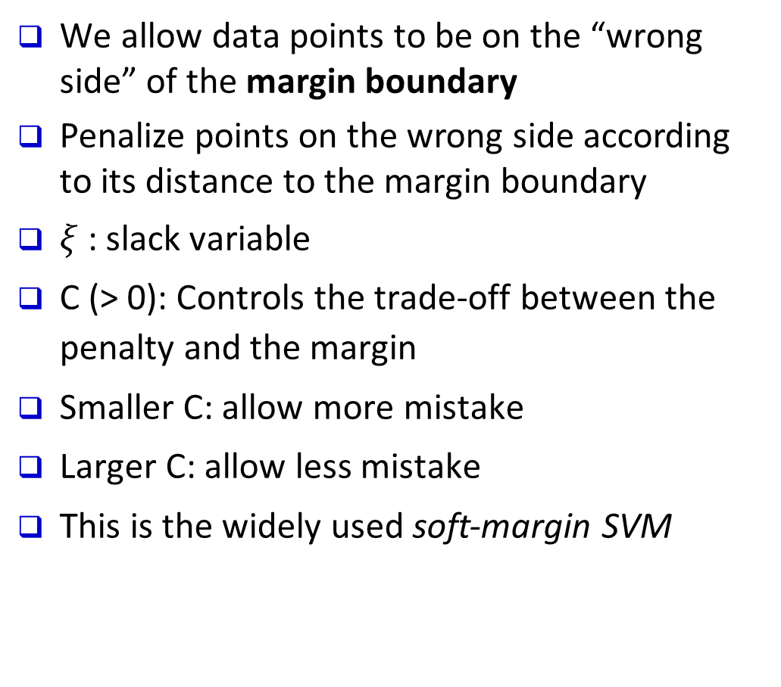




SVM for Linearly Inseparable Data
We allow data points to be on the “wrong side” of the margin boundary
Penalize points on the wrong side according to its distance to the margin boundary
$ξ$: slack variable
C (> 0): Controls the trade-off between the penalty and the margin
Smaller C: allow more mistake
Larger C: allow less mistake
This is the widely used soft-margin SVM
$$ξ>1$$
$$ξ=0$$
$$ξ<1$$
$$ξ=1$$

Slide 31
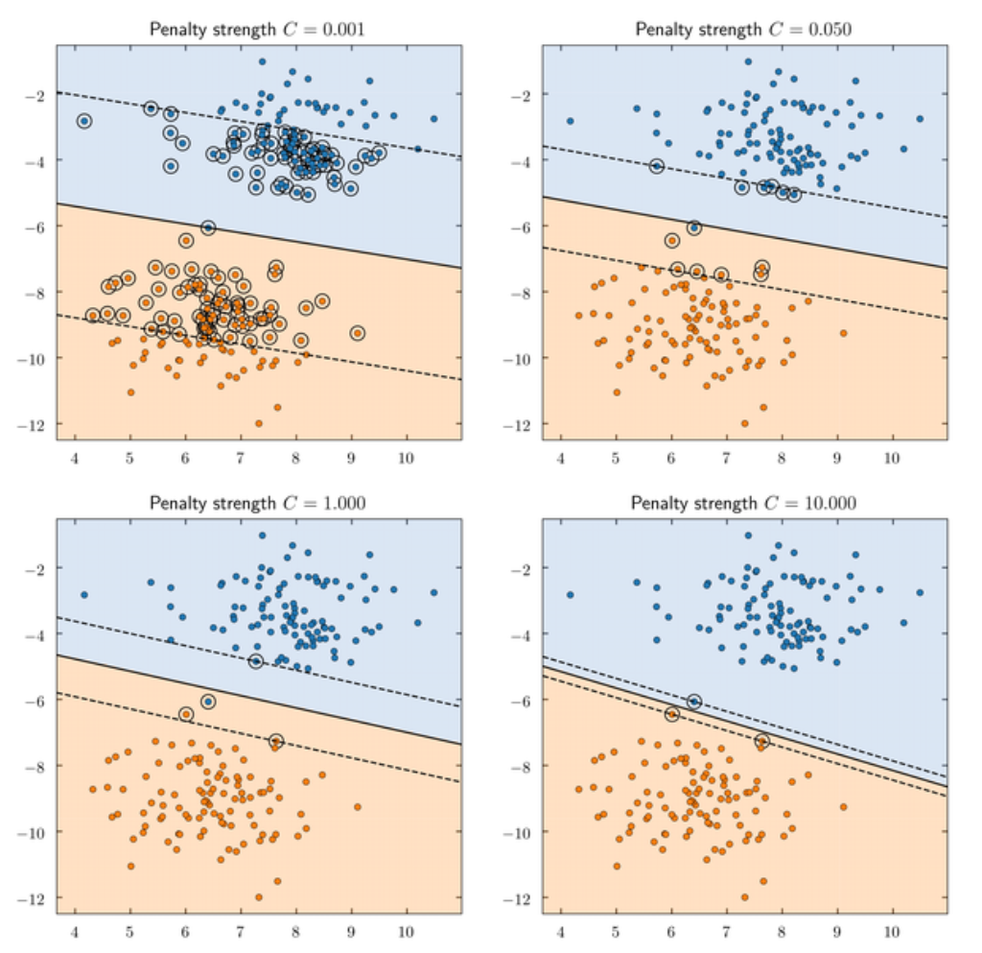
Effect of slack variable
https://www.quora.com/What-is-the-purpose-for-using-slack-variable-in-SVM

Slide 32

SVM for Linearly Inseparable Data
Alternatively, for linearly inseparable data, we can map them to a higher dimensional space
We search for a linear separating hyperplane in the new space
  Example: The XOR problem
$$x⟼φ(x)$$

Slide 33
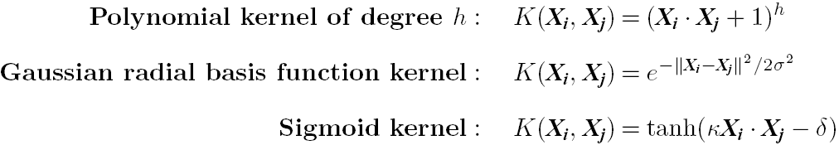
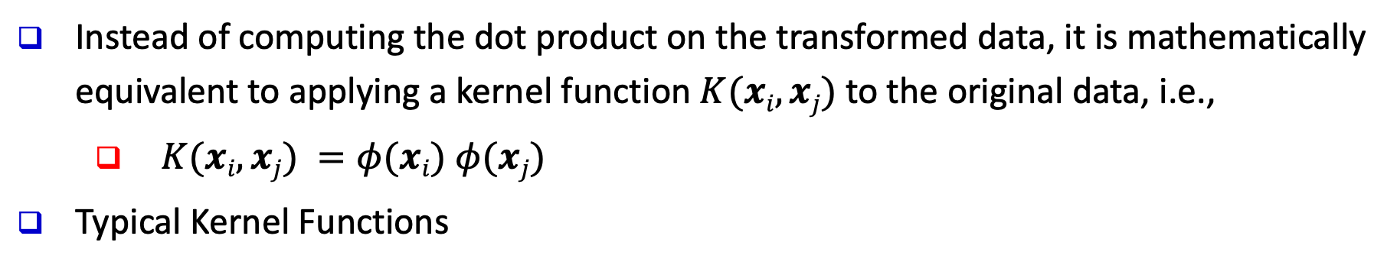
Kernel Functions for Nonlinear Classification
Instead of computing the dot product on the transformed data, it is mathematically equivalent to applying a kernel function $K(xi, xj)$to the original data, i.e.,
      $K(xi, xj) =φ(xi) φ(xj)$
Typical Kernel Functions
SVMs can efficiently perform a non-linear classification using kernel functions, implicitly mapping their inputs into high-dimensional feature spaces
https://www.youtube.com/watch?time_continue=42&v=3liCbRZPrZA
http://crsouza.com/2010/03/17/kernel-functions-for-machine-learning-applications/

Slide 34
Multi-class Classification with SVM
One-vs-Rest
Requires N classifiers
N classes
One-vs-One
Requires N(N - 1)/2 classifiers

Slide 35
Is SVM Scalable on Massive Data?
SVM is effective on high dimensional data
  The complexity of trained classifier is characterized by the # of support vectors rather than the dimensionality of the data
  The support vectors are the essential or critical training examples—they lie closest to the decision boundary (MMH)
  Thus, an SVM with a small number of support vectors can have good generalization, even when the dimensionality of the data is high
SVM is not scalable to the # of data objects in terms of training time and memory usage
  Scaling SVM by a hierarchical micro-clustering approach
    H. Yu, J. Yang, and J. Han, “Classifying Large Data Sets Using SVM with Hierarchical Clusters”, KDD'03

Slide 36
SVM: Applications
Features: training can be slow but accuracy is high owing to their ability to model complex nonlinear decision boundaries (margin maximization)
Used for: classification and numeric prediction
  SVM can also be used for classifying multiple (> 2) classes and for regression analysis (with additional parameters)
Applications:
  handwritten digit recognition, object recognition, speaker identification, benchmarking time-series prediction tests

Slide 37
SVM Recap
Pros
  Elegant mathematical formulation, guaranteed global optimal with optimization
  Trains well on small data sets
  Flexibility through kernel functions
  Conformity with semi-supervised training
Cons
  Not naturally scalable to large data sets

Slide 38
SVM Related Links
SVM Website: http://www.kernel-machines.org/
Representative implementations
  LIBSVM: an efficient implementation of SVM, multi-class classifications, nu-SVM, one-class SVM, including also various interfaces with java, python, etc.
  SVM-light: simpler but performance is not better than LIBSVM, support only binary classification and only in C
  SVM-torch: another recent implementation also written in C

Slide 39
Chapter 9. Classification: Advanced Methods
Ensemble Methods: Increasing the Accuracy
Bayesian Belief Networks
Support Vector Machines
Neural Networks and Deep Learning
Pattern-Based Classification
Lazy Learners and K-Nearest Neighbors
Other Classification Methods
Summary
Notes:
39

Slide 40
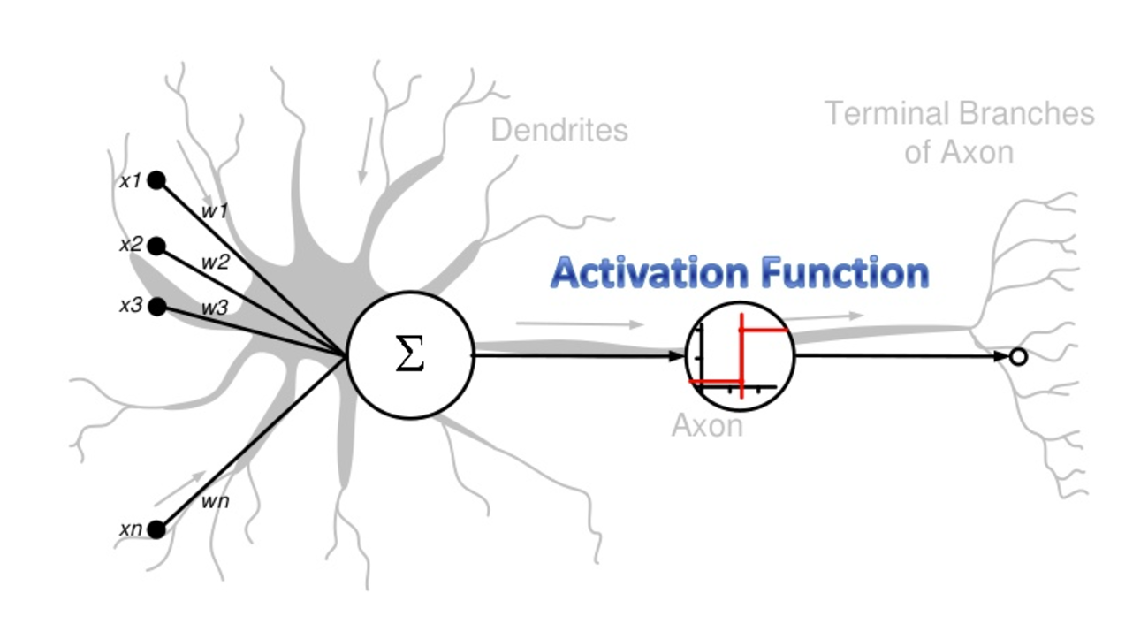
Neural Network for Classification
Started by psychologists and neurobiologists to develop and test computational analogues of neurons
A neural network: A set of connected input/output units where each connection has a weight associated with it
  During the learning phase, the network learns by adjusting the weights so as to be able to predict the correct class label of the input tuples
Artificial Neural Networks as an analogy of Biological Neural Networks

Slide 41

Perceptron: Predecessor of a Neural Network
$$\hat{y}=f\left(W^{T}x\right)=f(∑W_{i}x_{i}+b)$$
Activation Function
Adding non-linearity to the model
Weights
Bias
A measure of how easy it is to get the perceptron to output a 1
Computes a weighted sum of inputs
Invented in 1957 by Frank Rosenblatt. The original perceptron model does not have a non-linear activation function
Notes:
41
More on activation functions: https://medium.com/the-theory-of-everything/understanding-activation-functions-in-neural-networks-9491262884e0

Slide 42
Perceptron: Predecessor of a Neural Network
Examples of activation functions
Notes:
42
More on activation functions: https://medium.com/the-theory-of-everything/understanding-activation-functions-in-neural-networks-9491262884e0

Slide 43
Multilayer Perceptron (MLP)
Stacking multiple layers of perceptrons (adding hidden layers) makes a multilayer perceptron (MLP)
MLP can engage in sophisticated decision making, where perceptrons fail
  E.g. XOR problem
Try it: http://playground.tensorflow.org
Notes:
43
Neural network playground
http://playground.tensorflow.org

Slide 44


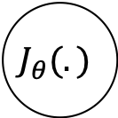
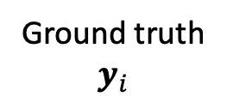
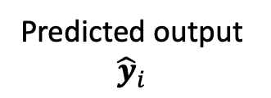
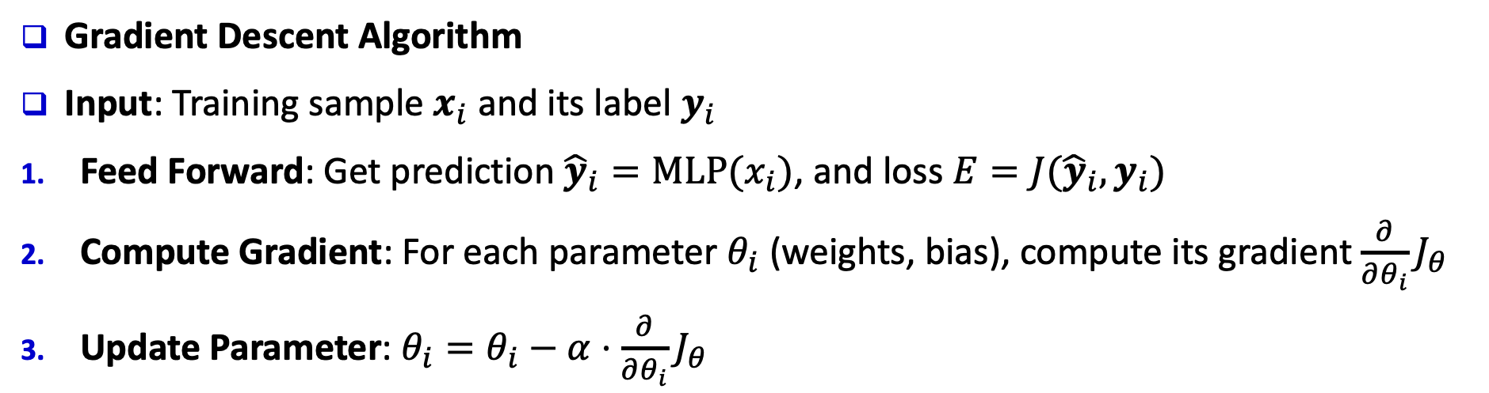
Learning NN Parameters
Loss (error) function
Predicted output ${\hat{y}}_{i}$
$$J_{θ}(.)$$
Ground truth
$$y_{i}$$
Input $x_{i}$
Multilayer Network
Loss $E$
Update Parameters
Gradient Descent Algorithm
Input: Training sample $x_{i}$ and its label $y_{i}$
Feed Forward: Get prediction ${\hat{y}}_{i}=MLP(x_{i})$, and loss $E=J({\hat{y}}_{i},y_{i})$
Compute Gradient: For each parameter $θ_{i}$ (weights, bias), compute its gradient $\frac{∂}{∂θ_{i}}J_{θ}$
Update Parameter: $θ_{i}=θ_{i}−α⋅\frac{∂}{∂θ_{i}}J_{θ}$
Explained later
Notes:
44

Slide 45
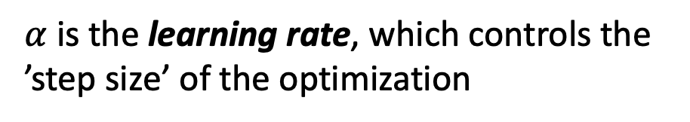
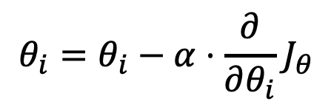
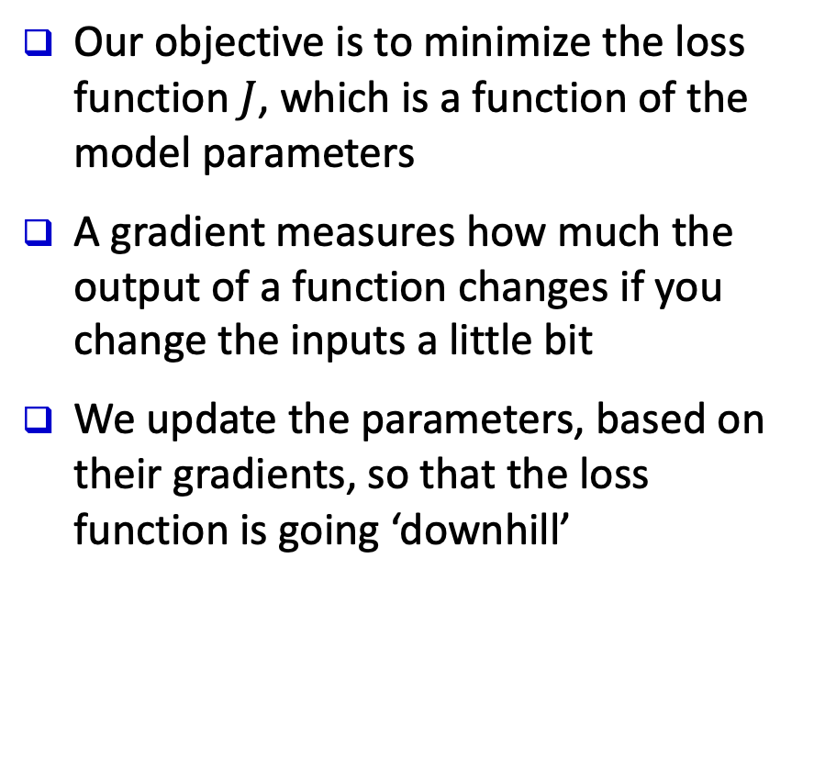
Empirical Explanation of Gradient Descent
Our objective is to minimize the loss function $J$, which is a function of the model parameters
A gradient measures how much the output of a function changes if you change the inputs a little bit
We update the parameters, based on their gradients, so that the loss function is going ‘downhill’
$$θ_{i}=θ_{i}−α⋅\frac{∂}{∂θ_{i}}J_{θ}$$
$α$ is the learning rate, which controls the ’step size’ of the optimization
Notes:
45

Slide 46
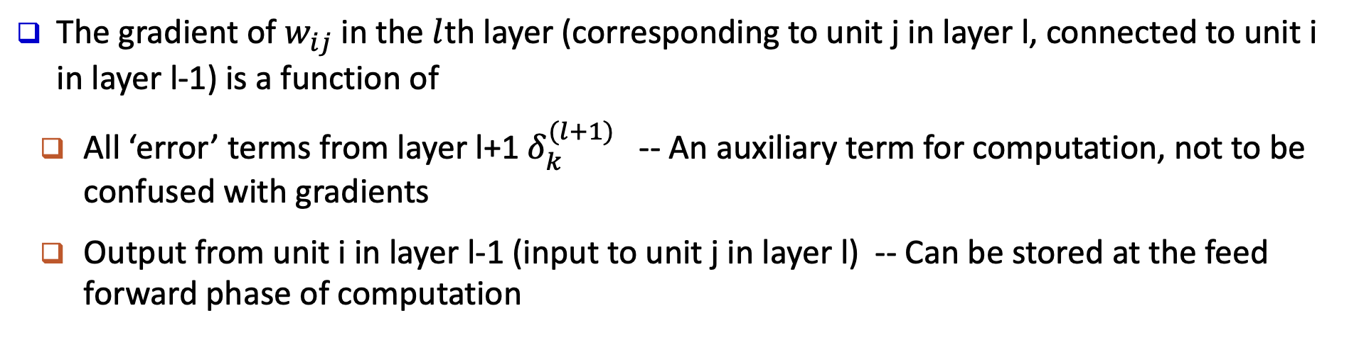





Gradient Computation: Backpropagation
$$δ_{1}^{(l+1)}$$
$$δ_{j}^{(l)}$$
$$δ_{2}^{(l+1)}$$
…
…
$$o_{i}$$
$$δ_{3}^{(l+1)}$$
…
…
The gradient of $w_{ij}$ in the $l$th layer (corresponding to unit j in layer l, connected to unit i in layer l-1) is a function of
  All ‘error’ terms from layer l+1 $δ_{k}^{(l+1)}$ -- An auxiliary term for computation, not to be confused with gradients
  Output from unit i in layer l-1 (input to unit j in layer l) -- Can be stored at the feed forward phase of computation
Notes:
46

Slide 47
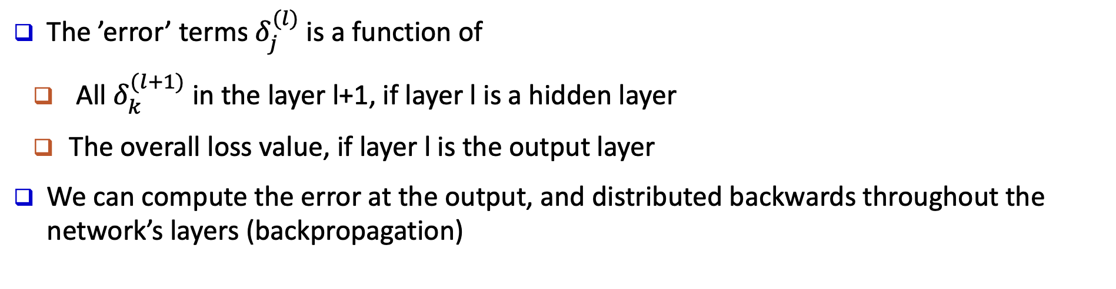
Gradient Computation: Backpropagation
$$δ_{1}^{(l+1)}$$
$$δ_{j}^{(l)}$$
$$δ_{2}^{(l+1)}$$
…
…
$$o_{i}$$
$$δ_{3}^{(l+1)}$$
…
…
The ’error’ terms $δ_{j}^{(l)}$ is a function of
  All $δ_{k}^{(l+1)}$ in the layer l+1, if layer l is a hidden layer
  The overall loss value, if layer l is the output layer
We can compute the error at the output, and distributed backwards throughout the network’s layers (backpropagation)
Notes:
47

Slide 48
From Neural Networks to Deep Learning
Deep Learning refers to training (deep) neural networks with many layers
  More neurons, more layers
  More complex ways to connect layers
Deep Learning has some major advantages, making it popular
  Tremendous improvement of performance in many tasks
    Image recognition, natural language processing, AI game playing…
  Requires no (or less) feature engineering, making end-to-end models possible
Several factors lead to deep learning’s success
  Very large data sets
  Massive amounts of computation power (GPU acceleration)
  Advanced neural network structures and tricks
    Convolutional neural networks, recurrent neural networks, …
    Dropout, ReLU, residual connection, … (not covered)
Notes:
48

Slide 49
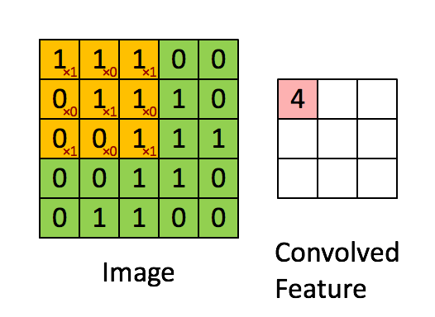
Convolutional Neural Networks (CNN)
What is convolution?
1D Convolution
2D Convolution
The outputs are computed by sliding a kernel (of weights) on the inputs, and computing weighted sum locally
Notes:
49
More on convolutional neural networks
http://cs231n.github.io/convolutional-networks/

Slide 50
CNN Motivation
Why not deep MLP?
  Deep multilayer perceptrons are computationally expensive, and hard to train.
    Long training time, slow convergence, local minima
Motivations of convolution
  Sparse interactions
  Parameter sharing
  Equivariant representations
The properties of CNNs are well aligned with properties of many forms of data (e.g. images, text), making them very successful
Notes:
50
More on convolutional neural networks
http://cs231n.github.io/convolutional-networks/

Slide 51
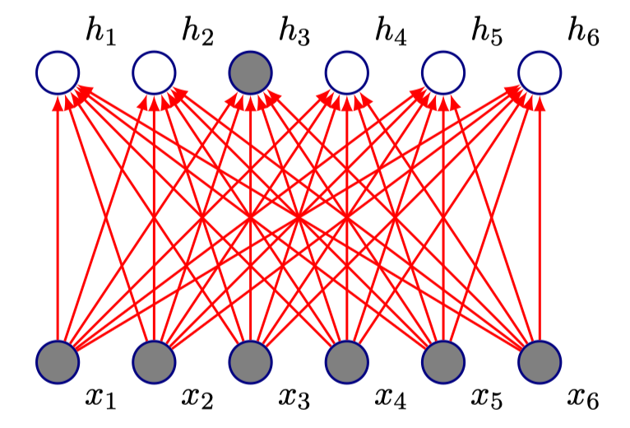
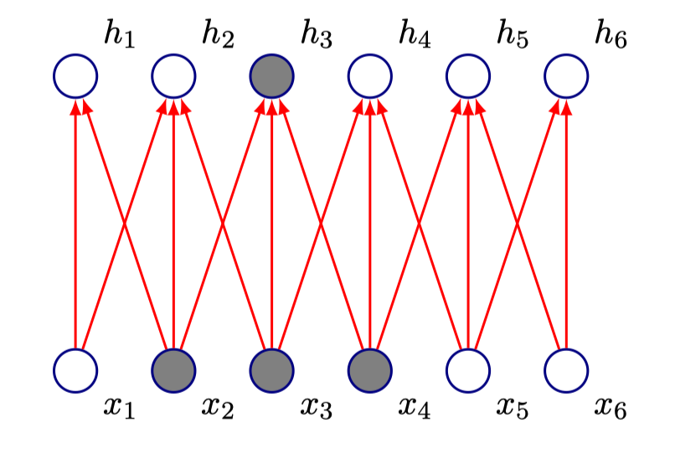
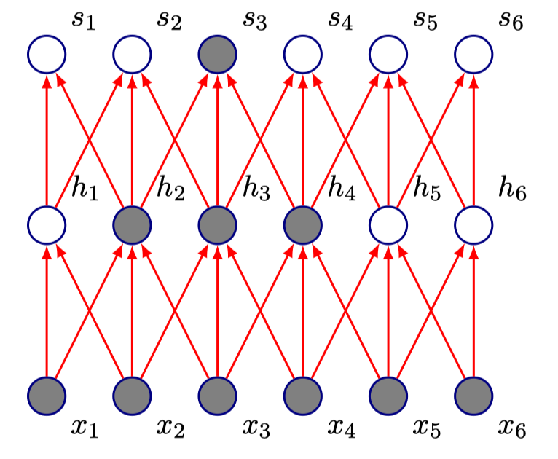
CNN Motivation
Motivations of convolution
  Sparse interactions
    E.g. 1D convolution with kernel size 3
    Units in deeper layers still connect to a wide range of inputs
MLP
CNN
Notes:
51
More on convolutional neural networks
http://cs231n.github.io/convolutional-networks/

Slide 52
CNN Motivation
Motivations of convolution
  Parameter sharing
    Each kernel is used on all locations of input
    Reduce #parameters
  Equivariance
    Same input at different location gives same output
    E.g. a cat at the upper right corner and at the lower left corner of an image, will produce the same outputs
    E.g. “University of Illinois” at the start of the sentence and at the end of the sentence produce the same outputs
Notes:
52
More on convolutional neural networks
http://cs231n.github.io/convolutional-networks/

Slide 53
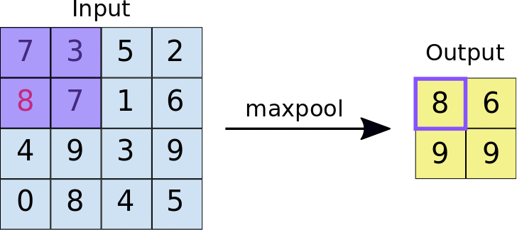
CNN: Pooling Layer
Pooling (Subsampling)
  Pool hidden units in the same neighborhood
    Introduces invariance to local translations
    Reduces the number of hidden units in hidden layer
Notes:
53
More on convolutional neural networks
http://cs231n.github.io/convolutional-networks/

Slide 54
CNN for Image Recognition: Example
An example CNN for hand written digit recognition
Notes:
54

Slide 55
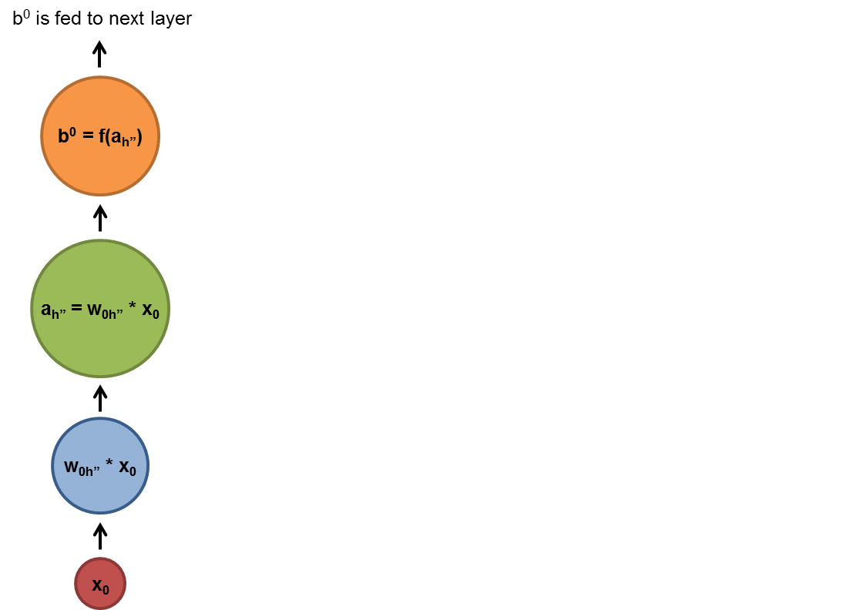
Recurrent Neural Networks
Handling sequences with Recurrent Neural Networks (RNN)
  At each time step, the input and the previous hidden state are fed into the network
Notes:
55

Slide 56

Recurrent Neural Networks: General Concepts
Modeling the time dimension: by creating cycles in the network (thus “recurrent”)
  Adding feedback loops connected to past decisions
  Long-term dependencies: Use hidden states to preserve sequential information
RNNs are trained to generate sequences: Output at each timestamp is based on both the current input and the inputs at all previous timestamps
  Compute a gradient with the algorithm BPTT (backpropagation through time)
Major obstacles of RNN: Vanishing and Exploding Gradients
  When the gradient becomes too large or too small, it is difficult to model long-range dependencies (10 timestamps or more)
  Solution: Use a variant of RNN: LSTM (1997, by Hochreiter and Schmidthuber)
Notes:
56
https://deeplearning4j.org/lstm.html

Slide 57
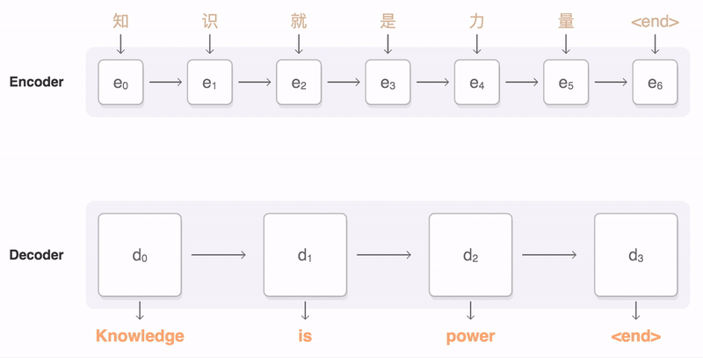
RNN for Machine Translation: Example
Notes:
57
Do we really need this example???

Slide 58
Deep Learning Recap
Pros
  Very good performance on certain tasks, for certain types of data
    Images: image recognition, segmentation, …
    Text (sometimes): machine translation, language modeling,…
    …
  Requires very little feature engineering
  Good generalization
    E.g. models trained on ImageNet dataset for classification can help tasks such as segmentation
Cons
  Requires huge amounts of computation power
  Black box model
  Hard to tune the architecture and hyperparameters for new tasks

Slide 59
Chapter 9. Classification: Advanced Methods
Ensemble Methods: Increasing the Accuracy
Bayesian Belief Networks
Support Vector Machines
Neural Networks and Deep Learning
Pattern-Based Classification
Lazy Learners and K-Nearest Neighbors
Other Classification Methods
Summary
Notes:
59

Slide 60
Using IF-THEN Rules for Classification
Represent the knowledge in the form of IF-THEN rules
  R₁: IF age = youth AND student = yes THEN buys_computer = yes
Assessment of a rule: coverage and accuracy
  coverage(R₁) = ratio of tuples covered by the condition of R₁ (THEN-part is not important for this)
  accuracy(R₁) = ratio of tuples correctly classified by R₁ in the covered ones (both IF-part and THEN-part counts)
If more than one rule are triggered, need conflict resolution
  Size ordering: assign the highest priority to the triggering rules that has the “toughest” requirement (i.e., with the most attribute tests)
  Class-based ordering: decreasing order of prevalence or misclassification cost per class
  Rule-based ordering (decision list): rules are organized into one long priority list, according to some measure of rule quality or by experts

Slide 61
Rule Extraction from a Decision Tree
Rules are easier to understand than large trees
One rule is created for each path from the root to a leaf
Each attribute-value pair along a path forms a conjunction: the leaf holds the class prediction
Rules are mutually exclusive and exhaustive
age?
<=30
31..40
>40
student?
credit rating?
yes
no
yes
excellent
fair
no
yes
no
yes
Example: Rule extraction from our buys_computer decision-tree
  IF age = young AND student = no THEN buys_computer = no
  IF age = young AND student = yes THEN buys_computer = yes
  IF age = mid-age THEN buys_computer = yes
  IF age = old AND credit_rating = excellent THEN buys_computer = no
  IF age = old AND credit_rating = fair THEN buys_computer = yes

Slide 62
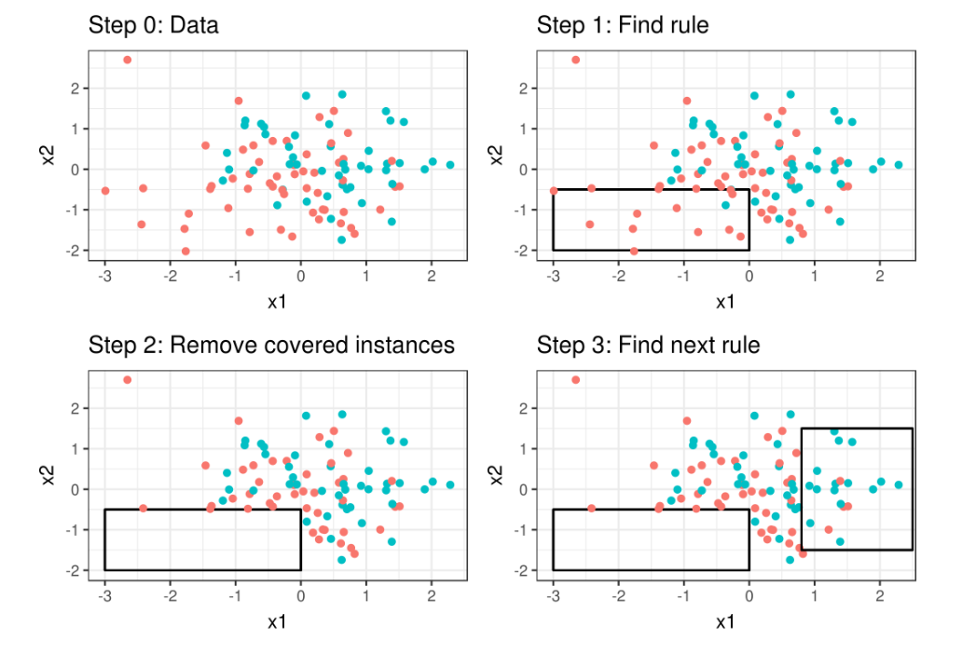
Rule Induction: Sequential Covering Method
Sequential covering algorithm: Extracts rules directly from training data
Rules are learned sequentially, each for a given class C_{i} will cover many tuples of C_{i} but none (or few) of the tuples of other classes
Comp. w. decision-tree induction: learning a set of rules simultaneously
Step 0: Start with an empty list of rules.

Slide 63
Rule Induction: Sequential Covering Method
Sequential covering algorithm: Extracts rules directly from training data
Rules are learned sequentially, each for a given class C_{i} will cover many tuples of C_{i} but none (or few) of the tuples of other classes
Comp. w. decision-tree induction: learning a set of rules simultaneously
Step 1: Learn a rule r.

Slide 64
Rule Induction: Sequential Covering Method
Sequential covering algorithm: Extracts rules directly from training data
Rules are learned sequentially, each for a given class C_{i} will cover many tuples of C_{i} but none (or few) of the tuples of other classes
Comp. w. decision-tree induction: learning a set of rules simultaneously
Step 2: The tuples covered by the rules are
removed.

Slide 65
Rule Induction: Sequential Covering Method
Sequential covering algorithm: Extracts rules directly from training data
Rules are learned sequentially, each for a given class C_{i} will cover many tuples of C_{i} but none (or few) of the tuples of other classes
Comp. w. decision-tree induction: learning a set of rules simultaneously
Step 3: Repeat the process on the remaining
  tuples until termination condition, e.g., when
  no more training examples or when the quality
  of a rule returned is below a threshold.

Slide 66
Pattern-Based Classification, Why?
Frequent Pattern
Mining
Pattern-Based
Classification
Classification
Pattern-based classification: An integration of both themes
Why pattern-based classification?
  Feature construction
    Higher order; compact; discriminative
    E.g., single word → phrase (Apple pie, Apple i-pad)
  Complex data modeling
    Graphs (no predefined feature vectors)
    Sequences
    Semi-structured/unstructured Data
Notes:
Single feature is not enough
Complex data is difficult
Background

Slide 67
CBA: Classification Based on Associations
CBA [Liu, Hsu and Ma, KDD’98]
Method
  Mine high-confidence, high-support class association rules
  LHS: conjunctions of attribute-value pairs); RHS: class labels
          p₁ ^ p₂ … ^ p_{l} → “A_{class-label} = C” (confidence, support)
  Rank rules in descending order of confidence and support
  Classification: Apply the first rule that matches a test case; o.w. apply the default rule
  Effectiveness: Often found more accurate than some traditional classification methods, such as C4.5
  Why? — Exploring high confident associations among multiple attributes may overcome some constraints introduced by some classifiers that consider only one attribute at a time

Slide 68
Chapter 9. Classification: Advanced Methods
Ensemble Methods: Increasing the Accuracy
Bayesian Belief Networks
Support Vector Machines
Neural Networks and Deep Learning
Pattern-Based Classification
Lazy Learners and K-Nearest Neighbors
Other Classification Methods
Summary
Notes:
68

Slide 69
Lazy vs. Eager Learning
Lazy vs. eager learning
  Lazy learning (e.g., instance-based learning): Simply stores training data (or only minor processing) and waits until it is given a test tuple
  Eager learning (the above discussed methods): Given a set of training tuples, constructs a classification model before receiving new (e.g., test) data to classify
Lazy: less time in training but more time in predicting
Accuracy
  Lazy method effectively uses a richer hypothesis space since it uses many local linear functions to form an implicit global approximation to the target function
  Eager: must commit to a single hypothesis that covers the entire instance space

Slide 70
Lazy Learner: Instance-Based Methods
Instance-based learning:
  Store training examples and delay the processing (“lazy evaluation”) until a new instance must be classified
Typical approaches
  k-nearest neighbor approach
    Instances represented as points in a Euclidean space.
  Locally weighted regression
    Constructs local approximation
  Case-based reasoning
    Uses symbolic representations and knowledge-based inference

Slide 71
The k-Nearest Neighbor Algorithm
All instances correspond to points in the n-D space
The nearest neighbor are defined in terms of Euclidean distance, dist(X₁, X₂)
Target function could be discrete- or real- valued
For discrete-valued, k-NN returns the most common value among the k training examples nearest to x_{q}
Vonoroi diagram: the decision surface induced by 1-NN for a typical set of training examples
_
.
.
_
_
+
_
.
.
+
.
_
x_{q}
+
_
.
+

Slide 72

Discussion on the k-NN Algorithm
k-NN for real-valued prediction for a given unknown tuple
  Returns the mean values of the k nearest neighbors
Distance-weighted nearest neighbor algorithm
  Weight the contribution of each of the k neighbors according to their distance to the query x_{q}
    Give greater weight to closer neighbors
Robust to noisy data by averaging k-nearest neighbors
Curse of dimensionality: distance between neighbors could be dominated by irrelevant attributes
  To overcome it, axes stretch or elimination of the least relevant attributes
$$w=\frac{1}{d(x_{q},x_{i})^{2}}$$

Slide 73
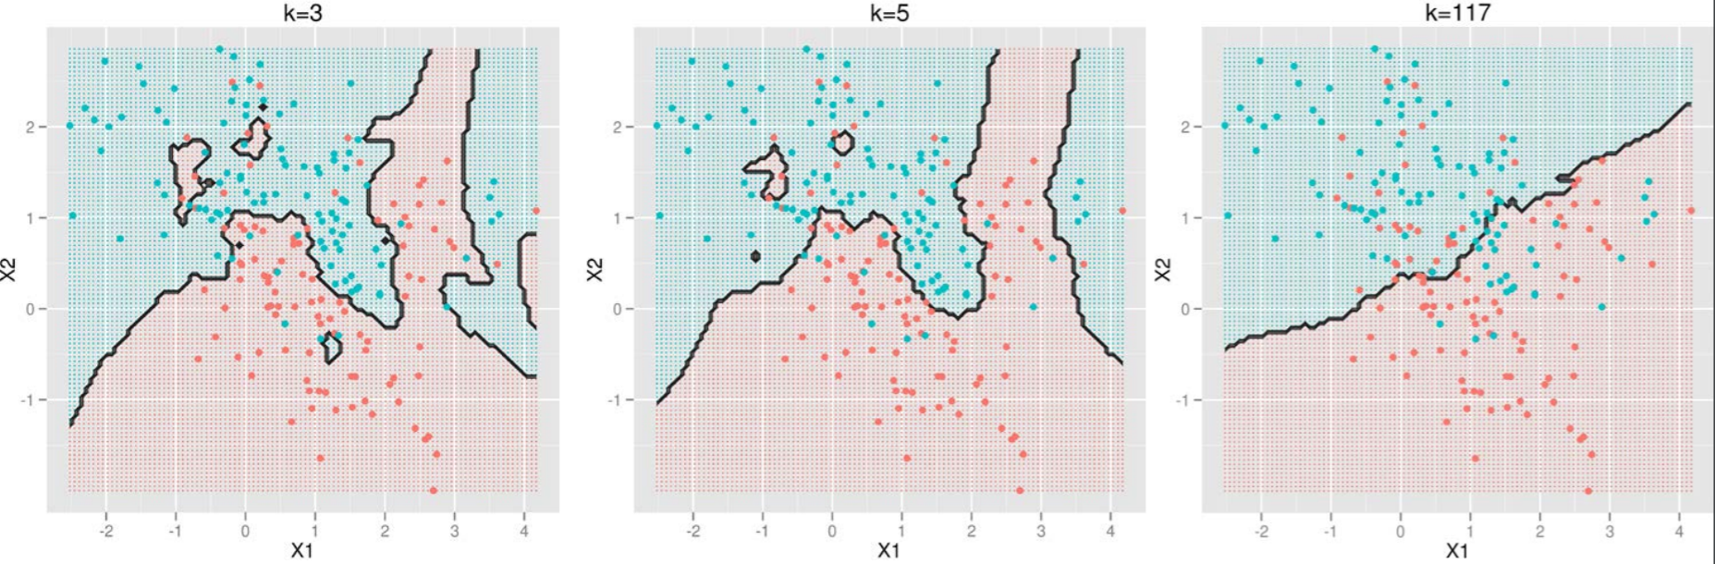
Selection of k for kNN
The number of neighbors k
  Small k: overfitting (high var., low bias)
  Big k: bringing too many irrelevant points (high bias, low var.)
http://scott.fortmann-roe.com/docs/BiasVariance.html

Slide 74
Case-Based Reasoning (CBR)
CBR: Uses a database of problem solutions to solve new problems
Store symbolic description (tuples or cases)—not points in a Euclidean space
Applications: Customer-service (product-related diagnosis), legal ruling
Methodology
  Instances represented by rich symbolic descriptions (e.g., function graphs)
  Search for similar cases, multiple retrieved cases may be combined
  Tight coupling between case retrieval, knowledge-based reasoning, and problem solving
Challenges
  Find a good similarity metric
  Indexing based on syntactic similarity measure, and when failure, backtracking, and adapting to additional cases

Slide 75
Chapter 9. Classification: Advanced Methods
Ensemble Methods: Increasing the Accuracy
Bayesian Belief Networks
Support Vector Machines
Neural Networks and Deep Learning
Pattern-Based Classification
Lazy Learners and K-Nearest Neighbors
Other Classification Methods
Summary
Notes:
75

Slide 76
Genetic Algorithms (GA)
Genetic Algorithm: based on an analogy to biological evolution
An initial population is created consisting of randomly generated rules
  Each rule is represented by a string of bits
  E.g., if A₁ and ¬A₂ then C₂ can be encoded as 100
  If an attribute has k > 2 values, k bits can be used
Based on the notion of survival of the fittest, a new population is formed to consist of the fittest rules and their offspring
The fitness of a rule is represented by its classification accuracy on a set of training examples
Offspring are generated by crossover and mutation
The process continues until a population P evolves when each rule in P satisfies a pre-specified threshold
Slow but easily parallelizable

Slide 77
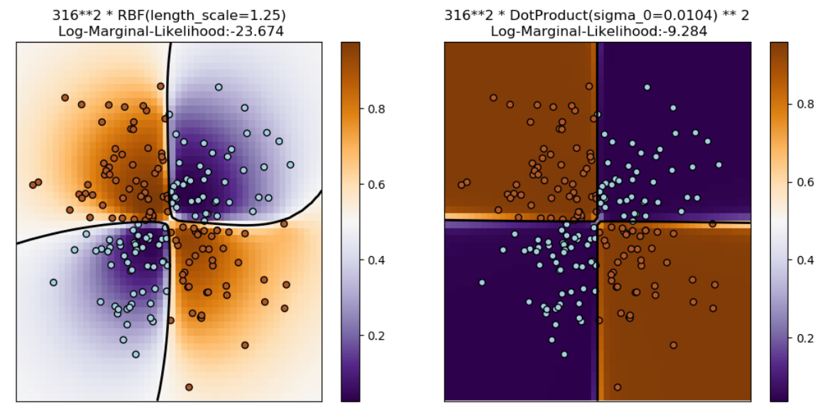
Gaussian Process
Lazy learning
Probabilistic prediction

Slide 78
Chapter 9. Classification: Advanced Methods
Ensemble Methods: Increasing the Accuracy
Bayesian Belief Networks
Support Vector Machines
Neural Networks and Deep Learning
Pattern-Based Classification
Lazy Learners and K-Nearest Neighbors
Other Classification Methods
Summary
Notes:
78

Slide 79
Summary
Bayesian belief network (probabilistic networks)
Support Vector Machine (SVM)
Neural networks and Deep Learning
Pattern-Based classification
Other classification methods
  lazy learners (KNN, case-based reasoning)

Slide 80
References (1)
C. M. Bishop, Neural Networks for Pattern Recognition. Oxford University Press, 1995
C. M. Bishop, Pattern Recognition and Machine Learning. Springer, 2006
L. Breiman, J. Friedman, R. Olshen, and C. Stone. Classification and Regression Trees. Wadsworth International Group, 1984
C. J. C. Burges. A Tutorial on Support Vector Machines for Pattern Recognition. Data Mining and Knowledge Discovery, 2(2): 121-168, 1998
N. Cristianini and J. Shawe-Taylor, Introduction to Support Vector Machines and Other Kernel-Based Learning Methods, Cambridge University Press, 2000
H. Yu, J. Yang, and J. Han. Classifying large data sets using SVM with hierarchical clusters. KDD'03
A. J. Dobson. An Introduction to Generalized Linear Models. Chapman & Hall, 1990
R. O. Duda, P. E. Hart, and D. G. Stork. Pattern Classification, 2ed. John Wiley, 2001
T. Hastie, R. Tibshirani, and J. Friedman. The Elements of Statistical Learning: Data Mining, Inference, and Prediction. Springer-Verlag, 2001
S. Haykin, Neural Networks and Learning Machines, Prentice Hall, 2008
D. Heckerman, D. Geiger, and D. M. Chickering. Learning Bayesian networks: The combination of knowledge and statistical data. Machine Learning, 1995

Slide 81
References (2): Rule and Pattern-Based Classification
H. Cheng, X. Yan, J. Han & C.-W. Hsu, Discriminative Frequent Pattern Analysis for Effective Classification, ICDE'07
H. Cheng, X. Yan, J. Han & P. S. Yu, Direct Discriminative Pattern Mining for Effective Classification, ICDE’08
W. Cohen. Fast effective rule induction. ICML'95
G. Cong, K. Tan, A. Tung & X. Xu. Mining Top-k Covering Rule Groups for Gene Expression Data, SIGMOD’05
M. Deshpande, M. Kuramochi, N. Wale & G. Karypis. Frequent Substructure-based Approaches for Classifying Chemical Compounds, TKDE’05
G. Dong & J. Li. Efficient Mining of Emerging Patterns: Discovering Trends and Differences, KDD’99
W. Fan, K. Zhang, H. Cheng, J. Gao, X. Yan, J. Han, P. S. Yu & O. Verscheure. Direct Mining of Discriminative and Essential Graphical and Itemset Features via Model-based Search Tree, KDD’08
W. Li, J. Han & J. Pei. CMAR: Accurate and Efficient Classification based on Multiple Class-association Rules, ICDM’01
B. Liu, W. Hsu & Y. Ma. Integrating Classification and Association Rule Mining, KDD’98
J. R. Quinlan and R. M. Cameron-Jones. FOIL: A midterm report. ECML’93
Jingbo Shang, Wenzhu Tong, Jian Peng, and Jiawei Han, "DPClass: An Effective but Concise Discriminative Patterns-Based Classification Framework", SDM’16
J. Wang and G. Karypis. HARMONY: Efficiently Mining the Best Rules for Classification, SDM’05
X. Yin & J. Han. CPAR: Classification Based on Predictive Association Rules, SDM’03

Slide 82
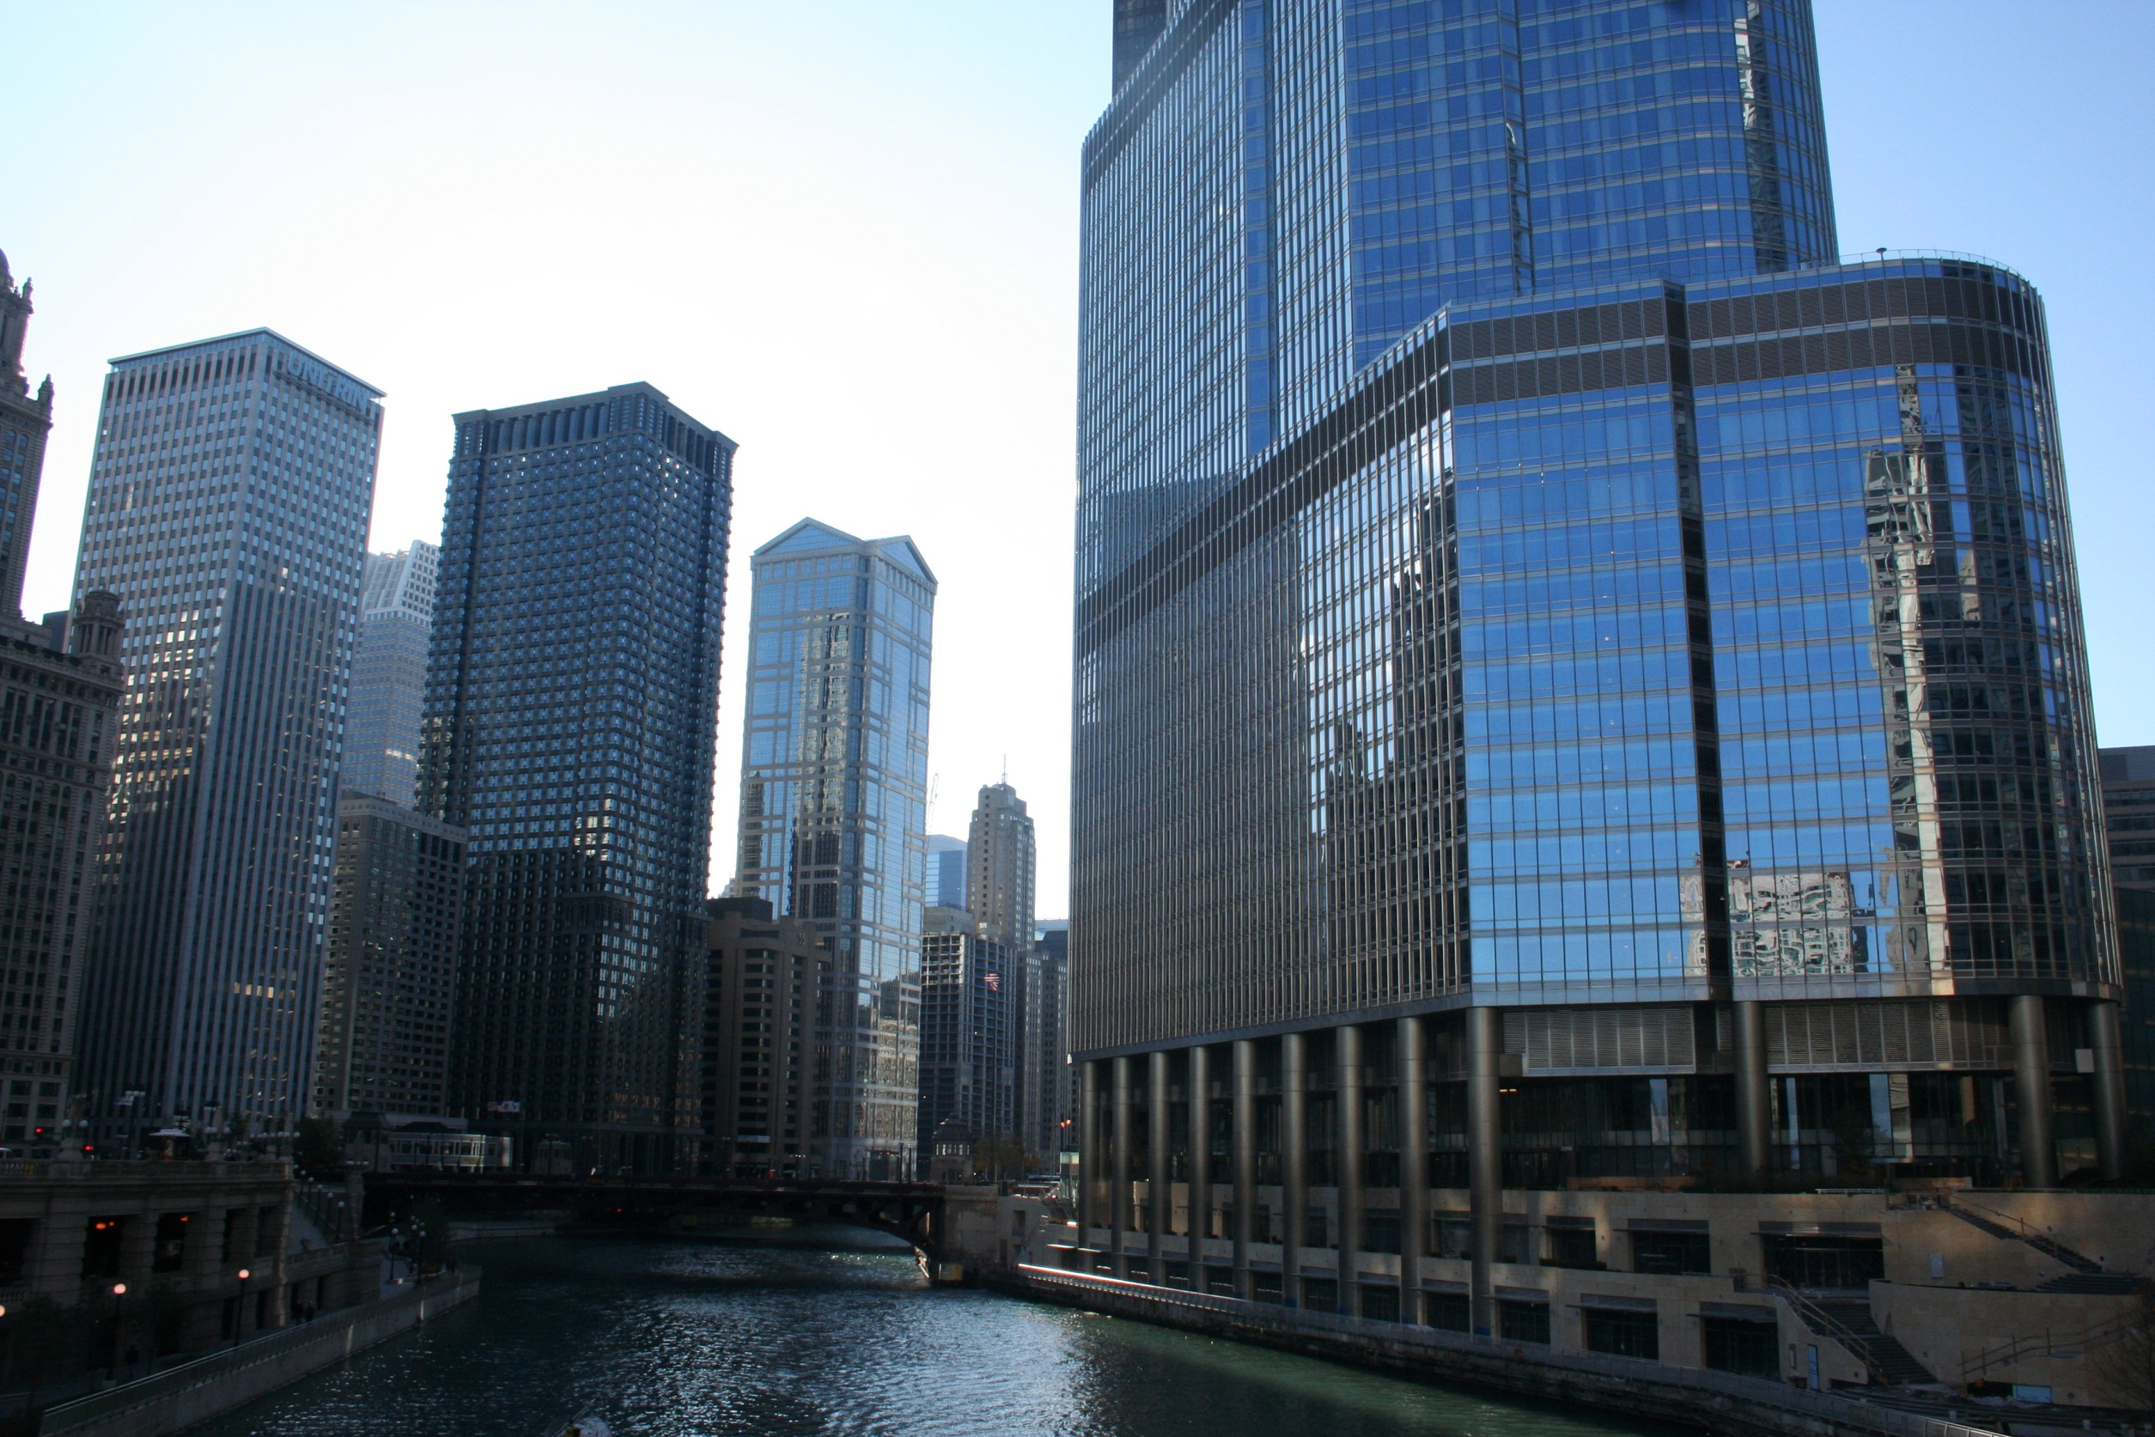

Slide 83
Other Regression-Based Models
Generalized linear model:
  Foundation on which linear regression can be applied to modeling categorical response variables
  Variance of y is a function of the mean value of y, not a constant
  Logistic regression: models the prob. of some event occurring as a linear function of a set of predictor variables
  Poisson regression: models the data that exhibit a Poisson distribution
Log-linear models: (for categorical data)
  Approximate discrete multidimensional prob. distributions
  Also useful for data compression and smoothing
Regression trees and model trees
  Trees to predict continuous values rather than class labels
Notes:
83

Slide 84
Regression Trees and Model Trees
Regression tree: proposed in CART system (Breiman et al. 1984)
  CART: Classification And Regression Trees
  Each leaf stores a continuous-valued prediction
  It is the average value of the predicted attribute for the training tuples that reach the leaf
Model tree: proposed by Quinlan (1992)
  Each leaf holds a regression model—a multivariate linear equation for the predicted attribute
  A more general case than regression tree
Regression and model trees tend to be more accurate than linear regression when the data are not represented well by a simple linear model

Slide 85
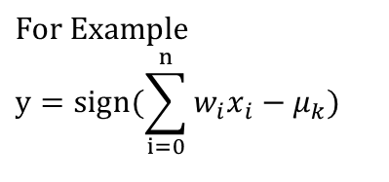
Neuron: A Hidden/Output Layer Unit
bias
μ_{k}
x₀
w₀
x₁
w₁
∑
f
output y
x_{n}
w_{n}
$$\text{For} \text{Example} \\ y=\text{sign}(\sum_{i=0}^{n}{w_{i}x_{i}}−μ_{k})$$
Input
vector x
weight
vector w
weighted
sum
Activation
function
An n-dimensional input vector x is mapped into variable y by means of the scalar product and a nonlinear function mapping
The inputs to unit are outputs from the previous layer. They are multiplied by their corresponding weights to form a weighted sum, which is added to the bias associated with unit. Then a nonlinear activation function is applied to it.
Notes:
85
MK Oct 2009: I removed “neuron = perceptron” from title since we do not use that term in the book.

Slide 86
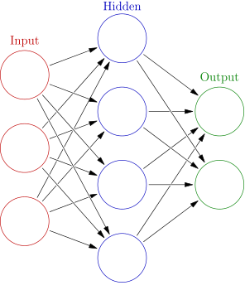

A Multi-Layer Feed-Forward Neural Network
Output vector
$$w_{j}^{(k+1)}=w_{j}^{(k)}+λ(y_{i}−{\hat{y}}_{i}^{(k)})x_{ij}$$
Output layer
Hidden layer
w_{ij}
Input layer
Input vector: X
Notes:
MK: Note – different notation than used in book. Will have to standardize notation.

Slide 87
Sequential Covering Algorithm
while (enough target tuples left)
  generate a rule
  remove positive target tuples satisfying this rule
To generate a rule
  while(true)
  find the best predicate p
  if foil-gain(p) > threshold then add p to current rule
  else break
Examples covered
by Rule 2
A3=1
Examples covered
by Rule 1
A3=1&&A1=2
Examples covered
by Rule 3
A3=1&&A1=2
&&A8=5
Positive examples
Positive examples
Negative examples
Rule Generation

Slide 88
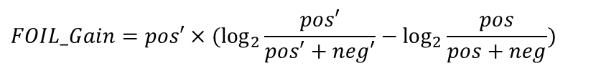
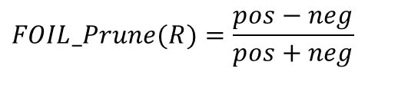
How to Learn-One-Rule?
Start with the most general rule possible: condition = empty
Adding new attributes by adopting a greedy depth-first strategy
  Picks the one that most improves the rule quality
Rule-Quality measures: consider both coverage and accuracy
  Foil-gain (in FOIL & RIPPER): assesses info_gain by extending condition
    favors rules that have high accuracy and cover many positive tuples
Rule pruning based on an independent set of test tuples
    Pos/neg are # of positive/negative tuples covered by R
    If FOIL_Prune is higher for the pruned version of R, prune R
$$FOIL_Gain=pos′×(\log_{2}{\frac{pos′}{pos′+neg′}}−\log_{2}{\frac{pos}{pos+neg}})$$
$$FOIL_Prune(R)=\frac{pos−neg}{pos+neg}$$

Slide 89
Defining a Network Topology
Decide the network topology
  Specify # of units in the input layer, # of hidden layers (if > 1), # of units in each hidden layer, and # of units in the output layer
Normalize the input values for each attribute measured in the training tuples to [0.0—1.0]
One input unit per domain value, each initialized to 0
Output, if for classification and more than two classes, one output unit per class is used
Once a network has been trained and its accuracy is unacceptable, repeat the training process with a different network topology or a different set of initial weights

Slide 90
Error-Correcting Codes for Multiclass Classification
Originally designed to correct errors during data transmission for communication tasks by exploring data redundancy
Example
  A 7-bit codeword associated with classes 1-4
Class | Error-Corr. Codeword
C₁ | 1 | 1 | 1 | 1 | 1 | 1 | 1
C₂ | 0 | 0 | 0 | 0 | 1 | 1 | 1
C₃ | 0 | 0 | 1 | 1 | 0 | 0 | 1
C₄ | 0 | 1 | 0 | 1 | 0 | 1 | 0
  Given a unknown tuple X, the 7-trained classifiers output: 0001010
  Hamming distance: # of different bits between two codewords
  H(X, C₁) = 5, by checking # of bits between [1111111] & [0001010]
  H(X, C₂) = 3, H(X, C₃) = 3, H(X, C₄) = 1, thus C₄ as the label for X
Error-correcting codes can correct up to (h ̶ 1)/2 1-bit error, where h is the minimum Hamming distance between any two codewords
If we use 1-bit per class, it is equiv. to one-vs.-all approach, the code are insufficient to self-correct
When selecting error-correcting codes, there should be good row-wise and col.-wise separation between the codewords

Slide 91
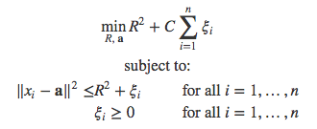
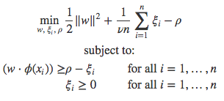
One-class SVM
Is the test data alike or not like the training data?
  Outlier detection, Novelty detection, etc.
Method 1: Separate all data points from the origin and maximize the distance from this hyperplane to the origin. It learns a binary function that captures regions where the data training reside.
Method 2: Obtains a spherical boundary around the data, with the volume of this hypersphere minimized. The sphere is characterized by a center a and a radius R>0.
Notes:
http://rvlasveld.github.io/blog/2013/07/12/introduction-to-one-class-support-vector-machines/
http://papers.nips.cc/paper/1723-support-vector-method-for-novelty-detection.pdf
https://link.springer.com/article/10.1023/B:MACH.0000008084.60811.49

Slide 92
How Are Bayesian Networks Constructed?
Subjective construction: Identification of (direct) causal structure
  People are quite good at identifying direct causes from a given set of variables & whether the set contains all relevant direct causes
  Markovian assumption: Each variable becomes independent of its non-effects once its direct causes are known
    E.g., S ← F → A ← T, path S → A is blocked once we know F → A
  HMM (Hidden Markov Model): often used to model dynamic systems whose states are not observable, yet their outputs are
F
T
S
A

Slide 93
How Are Bayesian Networks Constructed?
Synthesis from other specifications
  E.g., from a formal system design: block diagrams & info flow
Learning from data (e.g., from medical records or student admission record)
  Learn parameters give its structure or learn both structure and params
  Maximum likelihood principle: favors Bayesian networks that maximize the probability of observing the given data set
F
T
S
A

Slide 94
Linear SVM for Linearly Separable Data
A separating hyperplane can be written as
        $$w^{T}x+b=0$$
      where $w={\left(w_{1},w_{2},…,w_{n}\right)}^{T}$is a weight vector and $b$ a scalar (bias)
  For 2-D, it can be written as: $w1 x1 + w2 x2+b= 0$
The distance from any data point $x$ to the separating hyperplane is
$$r=\frac{|f\left(x\right)|}{\left\|w\right\|}=\frac{y_{i}(w^{T}x_{i}+b)}{\left\|w\right\|}$$
Our objective is to maximize the distance of the closest data point to the hyperplane
$$\arg{\max_{w,b}\left\{\frac{1}{\left\|w\right\|}\min\left[y_{i}\left(w^{T}x_{i}+b\right)\right]\right\}}$$
This is hard to solve, we shall convert it to an easier problem
Model parameters to learn
Notes:
Objective function: "Minimize {\displaystyle \|{\vec {w}}\|} subject to {\displaystyle y_{i}({\vec {w}}\cdot {\vec {x}}_{i}-b)\geq 1,} for {\displaystyle i=1,\,\ldots ,\,n}"

Slide 95
Linear SVM for Linearly Separable Data
If we rescale the model parameters $w→κw,b→κb$, the distance from any data point to the hyperplane is not going to change
We can set $y_{i}\left(w^{T}x_{i}+b\right)=1$ for the closest data point to the hyperplane, then all the data points will satisfy the constraint
$$y_{i}\left(w^{T}x_{i}+b\right)≥1$$
We will then maximize${\left\|w\right\|}^{−1}$ subject to this constraint. This is equivalent to minimizing ${\left\|w\right\|}^{2}$
This is the basic form of SVM, and it can be solved by using quadratic programming
$$\arg{\min_{w,b}{ {\left\|w\right\|}^{2}}}$$
$${s.t. y}_{i}\left(w^{T}x_{i}+b\right)≥1, i=1,2,…,n$$
Notes:
Objective function: "Minimize {\displaystyle \|{\vec {w}}\|} subject to {\displaystyle y_{i}({\vec {w}}\cdot {\vec {x}}_{i}-b)\geq 1,} for {\displaystyle i=1,\,\ldots ,\,n}"

Slide 96
Linear SVM for Linearly Separable Data
$$x_{2}$$
$w^{T}x_{i}+b=0$
The data points closest to the separating hyperplane are called support vectors
$w^{T}x_{i}+b=1$
$w^{T}x_{i}+b=−1$
$$γ=\frac{2}{\left\|w\right\|}$$
“Margin”
$$0$$
$$x_{1}$$

Slide 97
SVM for Linearly Inseparable Data
We allow data points to be on the “wrong side” of the margin boundary
Penalize points on the wrong side according to its distance to the margin boundary
We define slack variables
$ξ_{i}=\left\{\begin{aligned}&0, correct side \\ &\left|y_{i}−f\left(x_{i}\right)\right|, wrong side\end{aligned}\right.$
$=\max\left(0, 1−y_{i}\left(w^{T}x_{i}+b\right)\right)$
$$ξ>1$$
$$ξ=0$$
$$ξ<1$$
$$ξ=1$$
Original constraint: $y_{i}\left(w^{T}x_{i}+b\right)≥1$
Updated constraint: $y_{i}\left(w^{T}x_{i}+b\right)≥1−ξ_{i}$

Slide 98
SVM for Linearly Inseparable Data
Using the updated constraint, our objective becomes
C > 0 controls the trade-off between the slack variable penalty and the margin
Limit C → ∞, we will recover the earlier support vector machine for separable data.
This is the widely used soft-margin SVM
$\arg{\min_{w,b}{ {\left\|w\right\|}^{2}}+C\sum{ξ_{i}}}$
$${s.t. y}_{i}\left(w^{T}x_{i}+b\right)≥1−ξ_{i},$$
$ξ_{i}≥0, i=1,2,…,n$

Slide 99
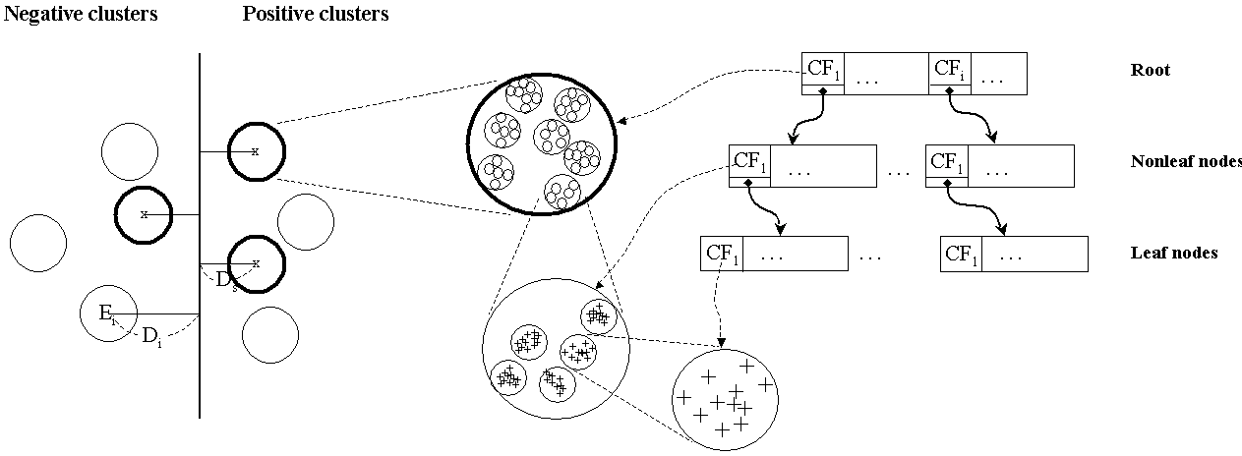
Scaling SVM by Hierarchical Micro-Clustering
Construct two CF-trees (i.e., statistical summary of the data) from positive and negative data sets independently (with one scan of the data set)
Micro-clustering: Hierarchical indexing structure
  Provide finer samples closer to the boundary and coarser samples farther from the boundary

Slide 100
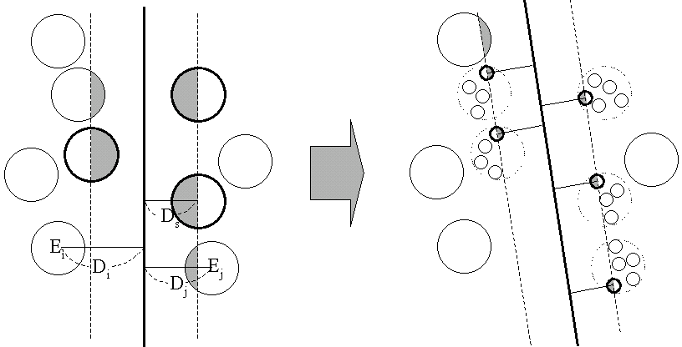
Selective Declustering: Ensure High Accuracy
De-cluster only the cluster E_{i} such that
  D_{i} – R_{i} < D_{s}, where D_{i} is the distance from the boundary to the center point of E_{i} and R_{i} is the radius of E_{i}
  Decluster only the cluster whose subclusters have possibilities to be the support cluster of the boundary
    “Support cluster”: The cluster whose centroid is a support vector

Slide 101

Accuracy and Scalability on Synthetic Dataset
Experiments on large synthetic data sets shows better accuracy than random sampling approaches and far more scalable than the original SVM algorithm

Slide 102

Sigmoid Neurons
A many-layer network of perceptrons can engage in sophisticated decision making
Instead of assigning weights of the edges by a person, we can devise learning algorithms that can automatically tune the weights and biases of a network of artificial neurons
Use sigmoid neuron instead of perceptron: Output is not 0/1 but a sigmoid function: σ(w●x + b) , i.e.,
The smoothness of σ means that small changes in the Δw_{j} weights and in the Δb bias will produce a small change Δ_{output} in the output from the neuron
Sigmoid function:
This shape is a smoothed out version of a step function
i.e., Δ_{output} is a linear function of the changes Δw_{j} and Δb

Slide 103
Architecture of a (Feed-Forward) Neural Network (NN)
Input layer
  The inputs to NN correspond to the attributes measured for each training tuple
  Inputs are fed simultaneously into the units making up the input layer
Hidden layer(s)
  Inputs are weighted and fed simultaneously to a hidden layer
  The number of hidden layers is arbitrary
Output layer
  The weighted outputs of the last hidden layer are input to units making up the output layer, which emits the network's prediction

Slide 104
Neural Network Architecture: Feed-Forward vs. Recurrent
Feed-Forward Neural Network: Typical neural network architecture
  The output from one layer is used as input to the next layer (no loops)
  Information is always fed forward, never fed back
  From a statistical point of view, networks perform nonlinear regression
  Given enough hidden units and enough training samples, they can closely approximate any function
Recurrent neural network: Feedback loops are possible (cascade of neurons firing)
  Some neurons fire for some limited duration of time, before becoming quiescent
  That firing can stimulate other neurons, which may fire a little while later, also for a limited duration, which causes still more neurons to fire, and so on
  Loops do not cause problems since a neuron's output only affects its input at some later time, not instantaneously

Slide 105
Learning with Gradient Descent
A quadratic cost (objective) function C (or mean square error, MSE)
      where w: the collection of all weights in the network, b: all the biases, n: the total # of training inputs, a: the vector of outputs from the network when x is input
Goal of training a network: Find weights and biases which minimize the cost C(w, b)
That is, choose Δv₁ and Δv₂ to make ΔC negative; i.e., the ball is rolling down into the valley:
The change ΔC in C by a small change in v, Δv:
    where C is the gradient vector:

Slide 106
Stochastic Gradient Descent
Gradient descent can be viewed as a way of taking small steps in the direction which does the most to immediately decrease C
To compute gradient ∇C, we need to compute the gradients ∇C_{x} separately for each training input, x, and then average them: slow when the # of training inputs is large
Stochastic gradient descent (SGD): Speed up learning
  Computing for a small sample of randomly chosen training inputs and averaging over them, we can quickly get a good estimate of the true gradient
  Method: Randomly pick out a small number (mini-batch) m of randomly chosen training inputs. Provided the sample size is large enough, we expect that the average value will be roughly equal to the average over all, that is,
Stochastic gradient descent in neural networks:
  Pick out a randomly chosen minibatch of training inputs and train with them; then pick out another minibatch, until inputs exhausted—complete an epoch of training
  Then we start over with a new training epoch

Slide 107
Backpropagation for Fast Gradient Computation
Backpropagation: Reset weights on the “front” neural units and this is sometimes done in combination with training where the correct result is known
Iteratively process a set of training tuples & compare the network’s prediction with the actual known target value
For each training tuple, the weights are modified to minimize the mean squared error between the network's prediction and the actual target value
Modifications are made in the “backwards” direction
  From the output layer, through each hidden layer
      back to the first hidden layer, hence “backpropagation”
Steps
  Initialize weights to small random numbers, associated with biases
  Propagate the inputs forward (by applying activation function)
  Backpropagate the error (by updating weights and biases)
    Terminating condition (when error is very small, etc.)

Slide 108
More on Backpropagation
With backpropagation, we distribute the “blame” backward through the network
  Each hidden node sending input to the current node is somewhat “responsible” for some portion of the error in each neuron to which it has forward connection
Local minima and backpropagation
  Backpropagation can be stuck at local minima
  But in practice it generally performs well
Is backpropagation too slow?
  Historically, backpropagation has been considered slow
  Recent advances in computer power through parallelism and GPUs (graphics processing units) have reduced time substantially for training neural networks

Slide 109
From Neural Networks to Deep Learning
Train networks with many layers (vs. shallow nets with just a couple of layers)
  More neurons than previous networks
  More complex ways to connect layers
  Tremendous computing power to train networks
  Automatic feature extraction
Multiple layers work to build an improved feature space
  Analogy: Signals passing through regions of the visual cortex
    Example: For face recognition: edge → nose → face, layer-by-layer
Popular Deep Learning Frameworks for Classification
  Deep Feedforward Neural Networks
  Convolutional Neural Networks
  Recurrent Neural Networks
Notes:
109

Slide 110
Deep (Feed Forward) Neural Networks
How multiple layers work to build an improved feature space?
  First layer learns 1st order features (e.g., edges, …)
  2nd layer learns higher order features (combinations of first layer features, combinations of edges, etc.)
  In Deep Belief Networks (DBNs), layers often learn in an unsupervised mode and discover general features of the input space—serving multiple tasks related to the unsupervised instances (image recognition, etc.)
  Then final layer features are fed into supervised layer(s)
    And entire network is often subsequently tuned using supervised training of the entire net, using the initial weightings learned in the unsupervised phase
  Could also do fully supervised versions (back-propagation)

Slide 111

Convolutional Neural Networks: General Architecture
Learn high-order features in the data via convolutions
  Well suited to object recognition with images (e.g., computer vision)
  Build position- and (somewhat) rotation-invariant features from raw image data
CNN leverages learnable visual filters and globally shared local features
  Specifics: high dimensional, 2D topology of pixels, invariance to translations, etc.
High-level general CNN architecture
  Input layer
  Feature-extraction layers (Convolution—ReLU—Pool)
  Classification layers
CNN properties
  Local connectivity
  Parameter sharing
  Subsampling
ReLU: Rectified Linear Unit
Notes:
111
Larret et al 2009 from nyu http://cs231n.github.io/convolutional-networks/

Slide 112


Convolutional Neural Networks: Local Connectivity
Local Connectivity
  Receptive fields: Each hidden unit is connected only to a sub-region of the image
    Manageable number of parameters
    Efficient computation of pre-activation
  Spatial arrangements
    Depth: Number of filters
    Stride: how to slide the filter
    Zero-padding: deal with the border
Notes:
112
Larret et al 2009 from nyu
http://cs231n.github.io/convolutional-networks/

Slide 113


Convolutional Neural Networks: Parameter Sharing
Parameter sharing
  Discrete convolution: share matrix of parameters across certain units
    Reduces even more the number of parameters
    Extract the same feature at every position
Notes:
113
Larret et al 2009 from nyu
http://cs231n.github.io/convolutional-networks/

Slide 114


Convolutional Neural Networks: Subsampling
Subsampling
  Pooling: pool hidden units in the same neighborhood
    Introduces invariance to local translations
    Reduces the number of hidden units in hidden layer
Notes:
114
Larret et al 2009 from nyu
http://cs231n.github.io/convolutional-networks/

Slide 115
Recurrent Neural Networks: General Concepts
Modeling the time dimension: by creating cycles in the network (thus “recurrent”)
  Adding feedback loops connected to past decisions
  Long-term dependencies: Use hidden states to preserve sequential information
RNNs are trained to generate sequences: Output at each timestamp is based on both the current input and the inputs at all previous timestamps
  Compute a gradient with the algorithm BPTT (backpropagation through time)
Major obstacles of RNN: Vanishing and Exploding Gradients
  When the gradient becomes too large or too small, it is difficult to model long-range dependencies (10 timestamps or more)
  Solution: Use a variant of RNN: LSTM (1997, by Hochreiter and Schmidthuber)
Notes:
115
https://deeplearning4j.org/lstm.html

Slide 116

LSTM: One Variant of Recurrent Neural Network
Critical components of LSTM
  Memory cells
  3 Gates (input, forget, output)
Use gated cells to
  Write, store, forget information
When both gates are closed
  The contents of the memory cell will remain unmodified
The gating structure allows information to be retained across many timestamps
  Also allows gradient to flow across many timestampls
By back-propagating errors and adjusting weights, to learn what to store, and when to allow reads, writes and erasures
Applications: Handling sequence and time series data
  E.g., NLP, video analysis, image captioning, robotics control
Notes:
116
https://deeplearning4j.org/lstm.html

Slide 117

Difficulties of Training and Improvements
Vanishing gradient problem: Saturated units block gradient propagation
  Need better optimization (than SGD)
Overfitting: high variance/low bias situation
  Better regularization (than L1, L2 norm)
    Unsupervised pre-training
    Statistical dropout
    Other popular approaches
      Batch normalization, residual networks, highway networks, attention, etc.
Pre-training of stacked autoencoders
Notes:
117

Slide 118
Pattern-Based Classification on Graphs
Inactive
Frequent subgraphs
Use frequent patterns as features for classification
g₁
Active
g₁ | g₂ | Class
1 | 1 | 0
0 | 0 | 1
1 | 1 | 0
Mining
Transform
g₂
min_sup=2
Inactive
Inactive
Notes:
Related work
Major ones: good and problems: not confined to rule-based, most discriminative features, any classifier
Accurate
Emerging patterns
2 slides

Slide 119
Associative or Pattern-Based Classification
Data: Transactions, microarray data, … → Patterns or association rules
Classification Methods (Some interesting work):
  CBA [Liu, Hsu & Ma, KDD’98]: Use high-conf., high-support class association rules to build classifiers
  Emerging patterns [Dong & Li, KDD’99]: Patterns whose support changes significantly between the two classes
  CMAR [Li, Han & Pei, ICDM’01]: Multiple rules in prediction
  CPAR [Yin & Han, SDM’03]: Beam search on multiple prediction rules
  RCBT [Cong et al., SIGMOD’05]: Build classifier based on mining top-k covering rule groups with row enumeration (for high-dimensional data)
  Lazy classifier [Veloso, Meira & Zaki, ICDM’06]: For a test t, project training data D on t, mine rules from D_{t} , predict on the best rule
  Discriminative pattern-based classification [Cheng et al., ICDE’07]
To be discussed here
To be discussed here
To be discussed here

Slide 120
CMAR: Classification Based on Multiple Association Rules
Rule pruning whenever a rule is inserted into the tree
  Given two rules, R₁ and R₂, if the antecedent of R₁ is more general than that of R₂ and conf(R₁) ≥ conf(R₂), then prune R₂
  Prunes rules for which the rule antecedent and class label are not positively correlated, based on the χ² test of statistical significance
Classification based on generated/pruned rules
  If only one rule satisfies tuple X, assign the class label of the rule
  If a rule set S satisfies X
    Divide S into groups according to class labels
    Use a weighted χ² measure to find the strongest group of rules, based on the statistical correlation of rules within a group
    Assign X the class label of the strongest group
CMAR improves model construction efficiency and classification accuracy

Slide 121
Discriminative Pattern-Based Classification
Discriminative patterns as features for classification [Cheng et al., ICDE’07]
Principle: Mining discriminative frequent patterns as high-quality features and then apply any classifier
Framework (PatClass)
  Feature construction by frequent itemset mining
  Feature selection (e.g., using Maximal Marginal Relevance (MMR))
    Select discriminative features (i.e., that are relevant but minimally similar to the previously selected ones)
    Remove redundant or closely correlated features
  Model learning
    Apply a general classifier, such as SVM or C4.5, to build a classification model

Slide 122
On the Power of Discriminative Patterns
K-itemsets are often more informative than single features (1-itemsets) in classification
Computation on real datasets shows: The discriminative power of k-itemsets (for k > 1 but often ≤ 10) is higher than that of single features
(a) Austral
(b) Cleve
(c) Sonar
Information Gain vs. Pattern Length

Slide 123
Information Gain vs. Pattern Frequency
Computation on real datasets shows: Pattern frequency (but not too frequent) is strongly tied with the discriminative power (information gain)
Information gain upper bound monotonically increases with pattern frequency
Info Gain
Info Gain
Info Gain
Frequency
Frequency
Low support,
low info gain
Frequency
(a) Austral
(b) Breast
(c) Sonar
Notes:
Some conclusion
Info gain introduction

Slide 124
Mining Concise Set of Discriminative Patterns
Frequent pattern mining, then getting discriminative patterns: Expensive, large model
Frequent Patterns
10⁴~10⁶
Data
Mining
Filtering
Discriminative
Patterns
DDPMine [Cheng et al., ICDE’08]: Direct mining of discriminative patterns: Efficient
Transform
Direct Mining
Data
FP-tree
Discriminative
Patterns
Still generates 10²~10³ patterns
DPClass [Shang et al, SDM’16]: A better solution—Efficient, effective, and generating a very limited number of (such as only 20 or so) patterns
Notes:
philosophy

Slide 125

DPClass: Discriminative Pattern-based Classification
Input: A feature table for training data
Adopt every prefix path in an (extremely) random forest as a candidate pattern
  The split points of continuous variables are automatically chosen by random forest → No discretization!
Run top-k (e.g., top-20) pattern selection based on training data
Train a generalized linear model (e.g., logistic regression) based on “bag-of-patterns” representations of training data
Notes:
philosophy

Slide 126

Explanatory Discriminative Patterns: Generation
Example: For each patient, we have several uniformly sampled features as follows
The positive label of the hypo-disease will be given when at least one of the following rules holds
  Training: ${10}^{5}$ random patients + $0.1\%$ noise
  Flip the binary labels with 0.1% probability
Testing: $5×{10}^{4}$ random patients in test
Features | Age | Gender | Lab Test 1 (LT1) | Lab Test 2(LT2)
Values | Positive Integers | Male or Female | A, B, O, AB | Real value in [0, 1]
Features | Age | Gender | Lab Test 1 (LT1) | Lab Test 2(LT2)
Rule 1 | > 18 | Male | AB | >= 0.6
Rule 2 | > 18 | Female | O | >= 0.5
Rule 3 | <= 18 |  |  | >= 0.9

Slide 127
Explanatory Discriminative Patterns: Evaluation
Features | Age | Gender | Lab Test 1 (LT1) | Lab Test 2(LT2)
Rule 1 | > 18 | Male | AB | >= 0.6
Rule 2 | > 18 | Female | O | >= 0.5
Rule 3 | <= 18 |  |  | >= 0.9
Ground Truth:
Top-3 Discriminative Patterns for each model:
  DPClass (perfect):
    (age > 18) and (gender = Female) and (LT1 = O) and (LT2 ≥ 0.496)
    (age ≤ 18) and (LT2 ≥ 0.900)
    (age > 18) and (gender = Male) and (LT1 = AB) and (LT2 ≥ 0.601)
  DDPMine (poor):
    (LT2 > 0.8)
    (gender = Male) and (LT1 = AB) and (LT2 ≥ 0.6) and (LT2 < 0.8)
    (gender = Female) and (LT1 = O) and (LT2 ≥ 0.6) and (LT2 < 0.8)

Slide 128
A Comparison on Classification Accuracy
DPClass: Discriminative & frequent at the same time, then select top-k
Two methods on pattern selection
  Forward vs. LASSO
  In comparison with DDPMine and Random Forest, DPClass maintains high accuracy
 | Dataset | DPClass (Forward) | DPClass (LASSO) | DDPMine | Random Forest
low- dimensional data | adult | 85.66% | 84.33% | 83.42% | 85.45%
 | hypo | 99.58% | 99.28% | 92.69% | 97.22%
 | sick | 98.35% | 98.87% | 93.82% | 94.03%
 | crx | 89.35% | 87.96% | 87.96% | 89.35%
 | sonar | 85.29% | 83.82% | 73.53% | 83.82%
 | chess | 92.25% | 92.05% | 90.04% | 94.22%
high- dimensional data | namao | 97.17% | 96.94% | 96.83% | 97.86%
 | musk | 95.92% | 95.71% | 93.29% | 96.60%
 | madelon | 74.50% | 76.00% | 59.84% | 56.50%

