Slide 1
CS 412 Intro. to Data Mining
Chapter 10. Cluster Analysis: Basic Concepts and Methods
Qi Li, Computer Science, Univ. Illinois at Urbana-Champaign, 2018

Slide 2
Chapter 10. Cluster Analysis: Basic Concepts and Methods
Cluster Analysis: An Introduction
Partitioning Methods
Hierarchical Methods
Gaussian Mixture Models and E-M algorithm
Density- and Grid-Based Methods
Spectral Clustering
Evaluation of Clustering
Summary
Notes:
2

Slide 3
Cluster Analysis: An Introduction
What Is Cluster Analysis?
Applications of Cluster Analysis
Cluster Analysis: Requirements and Challenges
Cluster Analysis: A Multi-Dimensional Categorization
An Overview of Typical Clustering Methodologies
An Overview of Clustering Different Types of Data
An Overview of User Insights and Clustering

Slide 4
What Is Cluster Analysis?
What is a cluster?
A cluster is a collection of data objects which are
Similar (or related) to one another within the same group (i.e., cluster)
Dissimilar (or unrelated) to the objects in other groups (i.e., clusters)
Cluster analysis (or clustering, data segmentation, …)
Given a set of data points, partition them into a set of groups (i.e., clusters) which are as similar as possible
Cluster analysis is unsupervised learning (i.e., no predefined classes)
This contrasts with classification (i.e., supervised learning)
Typical ways to use/apply cluster analysis
As a stand-alone tool to get insight into data distribution, or
As a preprocessing (or intermediate) step for other algorithms

Slide 5
What Is Good Clustering?
A good clustering method will produce high quality clusters which should have
High intra-class similarity: Cohesive within clusters
Low inter-class similarity: Distinctive between clusters
Quality function
There is usually a separate “quality” function that measures the “goodness” of a cluster
It is hard to define “similar enough” or “good enough”
The answer is typically highly subjective
There exist many similarity measures and/or functions for different applications
Similarity measure is critical for cluster analysis

Slide 6
Cluster Analysis: Applications
A key intermediate step for other data mining tasks
Generating a compact summary of data for classification, pattern discovery, hypothesis generation and testing, etc.
Outlier detection: Outliers—those “far away” from any cluster
Data summarization, compression, and reduction
Ex. Image processing: Vector quantization
Collaborative filtering, recommendation systems, or customer segmentation
Find like-minded users or similar products
Dynamic trend detection
Clustering stream data and detecting trends and patterns
Multimedia data analysis, biological data analysis and social network analysis
Ex. Clustering images or video/audio clips, gene/protein sequences, etc.

Slide 7
Considerations for Cluster Analysis
Partitioning criteria
Single level vs. hierarchical partitioning (often, multi-level hierarchical partitioning is desirable, e.g., grouping topical terms)
Separation of clusters
Exclusive (e.g., one customer belongs to only one region) vs. non-exclusive (e.g., one document may belong to more than one class)
Similarity measure
Distance-based (e.g., Euclidean, road network, vector) vs. connectivity-based (e.g., density or contiguity)
Clustering space
Full space (often when low dimensional) vs. subspaces (often in high-dimensional clustering)

Slide 8
Requirements and Challenges
Quality
Ability to deal with different types of attributes: Numerical, categorical, text, multimedia, networks, and mixture of multiple types
Discovery of clusters with arbitrary shape
Ability to deal with noisy data
Scalability
Clustering all the data instead of only on samples
High dimensionality
Incremental or stream clustering and insensitivity to input order
Constraint-based clustering
User-given preferences or constraints; domain knowledge; user queries
Interpretability and usability
The final generated clusters should be semantically meaningful and useful

Slide 9
Chapter 10. Cluster Analysis: Basic Concepts and Methods
Cluster Analysis: An Introduction
Partitioning Methods
Hierarchical Methods
Gaussian Mixture Models and E-M algorithm
Density- and Grid-Based Methods
Spectral Clustering
Evaluation of Clustering
Summary
Notes:
9

Slide 10
Partitioning-Based Clustering Methods
Basic Concepts of Partitioning Algorithms
The K-Means Clustering Method
Initialization of K-Means Clustering
The K-Medoids Clustering Method
The K-Medians and K-Modes Clustering Methods
The Kernel K-Means Clustering Method

Slide 11
Partitioning Algorithms: Basic Concepts
Partitioning method: Discovering the groupings in the data by optimizing a specific objective function and iteratively improving the quality of partitions
K-partitioning method: Partitioning a dataset D of n objects into a set of K clusters so that an objective function is optimized (e.g., the sum of squared distances is minimized, where c_{k} is the centroid or medoid of cluster C_{k})
A typical objective function: Sum of Squared Errors (SSE)
Problem definition: Given K, find a partition of K clusters that optimizes the chosen partitioning criterion
Global optimal: Needs to exhaustively enumerate all partitions
Heuristic methods (i.e., greedy algorithms): K-Means, K-Medians, K-Medoids, etc.

Slide 12
The K-Means Clustering Method
K-Means (MacQueen’67, Lloyd’57/’82)
Each cluster is represented by the center of the cluster
Given K, the number of clusters, the K-Means clustering algorithm is outlined as follows
Select K points as initial centroids
Repeat
Form K clusters by assigning each point to its closest centroid
Re-compute the centroids (i.e., mean point) of each cluster
Until convergence criterion is satisfied
Different kinds of measures can be used
Manhattan distance (L₁ norm), Euclidean distance (L₂ norm), Cosine similarity

Slide 13
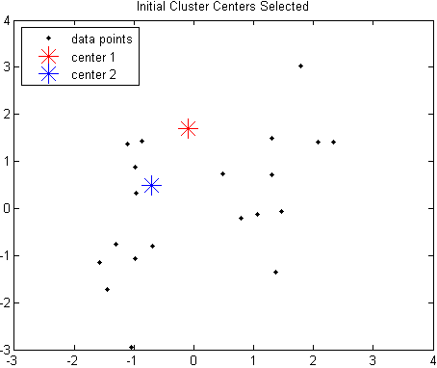
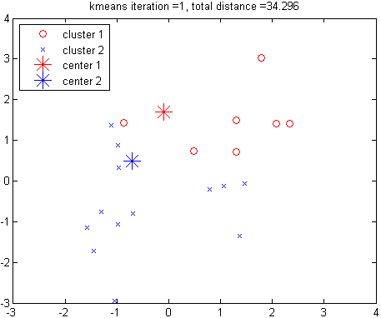
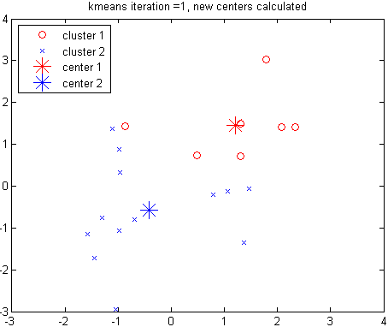
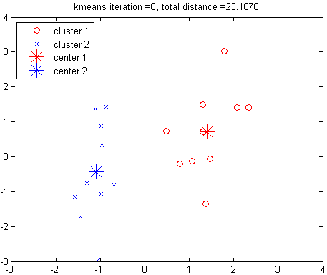
Example: K-Means Clustering
Assign points to clusters
Recompute cluster centers
The original data points & randomly select K = 2 centroids
Redo point assignment
Execution of the K-Means Clustering Algorithm
Select K points as initial centroids
Repeat
Form K clusters by assigning each point to its closest centroid
Re-compute the centroids (i.e., mean point) of each cluster
Until convergence criterion is satisfied

Slide 14
Discussion on the K-Means Method
Efficiency: O(tKn) where n: # of objects, K: # of clusters, and t: # of iterations
Normally, K, t << n; thus, an efficient method
K-means clustering often terminates at a local optimal
Initialization can be important to find high-quality clusters
Need to specify K, the number of clusters, in advance
There are ways to automatically determine the “best” K
In practice, one often runs a range of values and selected the “best” K value
Sensitive to noisy data and outliers
Variations: Using K-medians, K-medoids, etc.
K-means is applicable only to objects in a continuous n-dimensional space
Using the K-modes for categorical data
Not suitable to discover clusters with non-convex shapes
Using density-based clustering, kernel K-means, etc.

Slide 15
Variations of K-Means
There are many variants of the K-Means method, varying in different aspects
Choosing better initial centroid estimates
K-means++, Intelligent K-Means, Genetic K-Means
Choosing different representative prototypes for the clusters
K-Medoids, K-Medians, K-Modes
Applying feature transformation techniques
Weighted K-Means, Kernel K-Means
To be discussed in this lecture
To be discussed in this lecture
To be discussed in this lecture

Slide 16
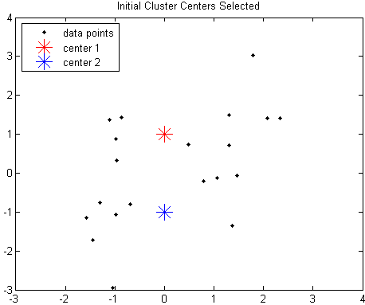
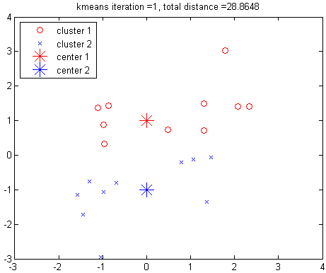
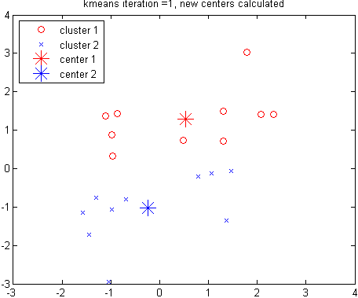
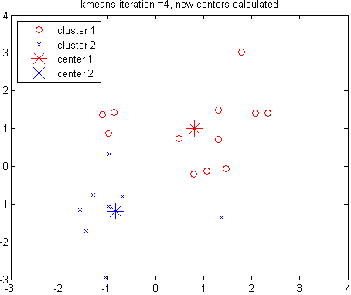
Poor Initialization in K-Means May Lead to Poor Clustering
Assign points to clusters
Recompute cluster centers
Another random selection of k centroids for the same data points
Rerun of the K-Means using another random K seeds
This run of K-Means generates a poor quality clustering

Slide 17
Initialization of K-Means: Problem and Solution
Different initializations may generate rather different clustering results (some could be far from optimal)
Original proposal (MacQueen’67): Select K seeds randomly
Need to run the algorithm multiple times using different seeds
There are many methods proposed for better initialization of k seeds
K-Means++ (Arthur & Vassilvitskii’07):
The first centroid is selected at random
The next centroid selected is the one that is farthest from the currently selected (selection is based on a weighted probability score)
The selection continues until K centroids are obtained

Slide 18
Handling Outliers: From K-Means to K-Medoids
The K-Means algorithm is sensitive to outliers!—since an object with an extremely large value may substantially distort the distribution of the data
K-Medoids: Instead of taking the mean value of the object in a cluster as a reference point, medoids can be used, which is the most centrally located object in a cluster
The K-Medoids clustering algorithm:
Select K points as the initial representative objects (i.e., as initial K medoids)
Repeat
Assigning each point to the cluster with the closest medoid
Randomly select a non-representative object o_{i}
Compute the total cost S of swapping the medoid m with o_{i}
If S < 0, then swap m with o_{i} to form the new set of medoids
Until convergence criterion is satisfied

Slide 19
PAM: A Typical K-Medoids Algorithm
10
9
8
Arbitrary choose K object as initial medoids
Assign each remaining object to nearest medoids
7
6
5
4
3
2
1
0
0
1
2
3
4
5
6
7
8
9
10
K = 2
Randomly select a non-medoid object,O_{ramdom}
Select initial K medoids randomly
Repeat
Object re-assignment
Swap medoid m with o_{i} if it improves the clustering quality
Until convergence criterion is satisfied
10
Compute total cost of swapping
10
Swapping O and O_{ramdom}
If quality is improved
9
9
8
8
7
7
6
6
5
5
4
4
3
3
2
2
1
1
0
0
1
2
3
4
5
6
7
8
9
10
0
0
1
2
3
4
5
6
7
8
9
10
Notes:
19

Slide 20
Discussion on K-Medoids Clustering
K-Medoids Clustering: Find representative objects (medoids) in clusters
PAM (Partitioning Around Medoids: Kaufmann & Rousseeuw 1987)
Starts from an initial set of medoids, and
Iteratively replaces one of the medoids by one of the non-medoids if it improves the total sum of the squared errors (SSE) of the resulting clustering
PAM works effectively for small data sets but does not scale well for large data sets (due to the computational complexity)
Computational complexity: PAM: O(K(n − K)²) (quite expensive!)
Efficiency improvements on PAM
CLARA (Kaufmann & Rousseeuw, 1990):
PAM on samples; O(Ks² + K(n − K)), s is the sample size
CLARANS (Ng & Han, 1994): Randomized re-sampling, ensuring efficiency + quality

Slide 21
K-Medians: Handling Outliers by Computing Medians
Medians are less sensitive to outliers than means
Think of the median salary vs. mean salary of a large firm when adding a few top executives!
K-Medians: Instead of taking the mean value of the object in a cluster as a reference point, medians are used (L₁-norm as the distance measure)
The criterion function for the K-Medians algorithm:
The K-Medians clustering algorithm:
Select K points as the initial representative objects (i.e., as initial K medians)
Repeat
Assign every point to its nearest median
Re-compute the median using the median of each individual feature
Until convergence criterion is satisfied

Slide 22
K-Modes: Clustering Categorical Data
K-Means cannot handle non-numerical (categorical) data
Mapping categorical value to 1/0 cannot generate quality clusters
K-Modes: An extension to K-Means by replacing means of clusters with modes
Mode: The value that appears most often in a set of data values
Dissimilarity measure between object X and the center of a cluster Z
Φ(x_{j}, z_{j}) = 1 – n_{j}^{r}/n_{l} when x_{j} = z_{j} ; 1 when x_{j} ǂ z_{j}
where z_{j} is the categorical value of attribute j in Z_{l}, n_{l} is the number of objects in cluster l, and n_{j}^{r} is the number of objects whose attribute value is r
This dissimilarity measure (distance function) is frequency-based
Algorithm is still based on iterative object cluster assignment and centroid update
A fuzzy K-Modes method is proposed to calculate a fuzzy cluster membership value for each object to each cluster
A mixture of categorical and numerical data: Using a K-Prototype method

Slide 23
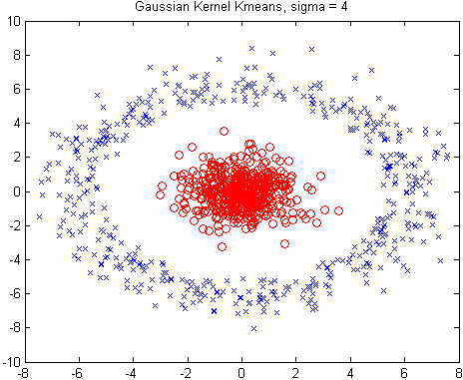
Kernel K-Means Clustering
Kernel K-Means can be used to detect non-convex clusters
A region is convex if it contains all the line segments connecting any pair of its points. Otherwise, it is concave
K-Means can only detect clusters that are linearly separable
Idea: Project data onto the high-dimensional kernel space, and then perform K-Means clustering
Map data points in the input space onto a high-dimensional feature space using the kernel function
Perform K-Means on the mapped feature space
Computational complexity is higher than K-Means
Need to compute and store n x n kernel matrix generated from the kernel function on the original data, where n is the number of points
Spectral clustering can be considered as a variant of Kernel K-Means clustering

Slide 24
Kernel Functions and Kernel K-Means Clustering
Typical kernel functions:
Polynomial kernel of degree h: K(X_{i}, X_{j}) = (X_{i}∙X_{j} + 1)^{h}
Gaussian radial basis function (RBF) kernel: K(X_{i}, X_{j}) =
Sigmoid kernel: K(X_{i}, X_{j}) = tanh(κX_{i}∙X_{j} −δ)
The formula for kernel matrix K for any two points x_{i}, x_{j} є C_{k} is
The SSE criterion of kernel K-means:
The formula for the cluster centroid:
Clustering can be performed without the actual individual projections φ(x_{i}) and φ(x_{j}) for the data points x_{i}, x_{j} є C_{k}

Slide 25
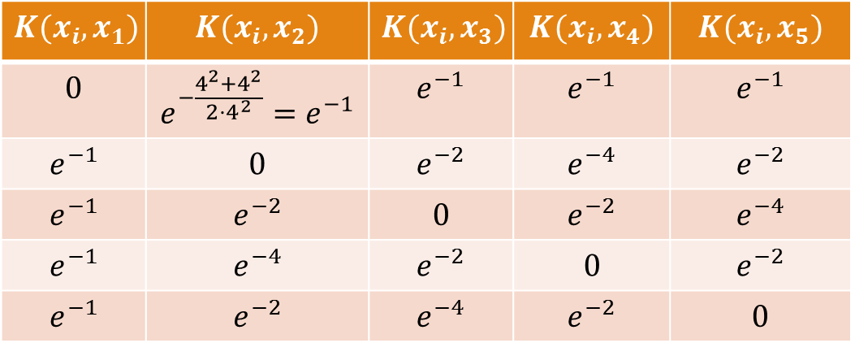
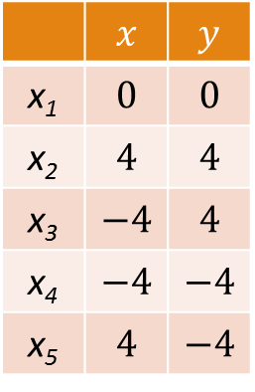
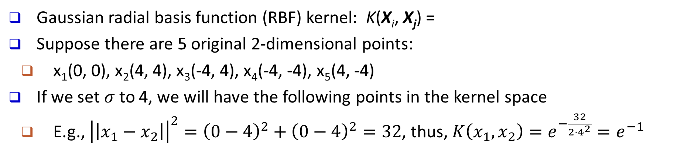

Example: Kernel Functions and Kernel K-Means Clustering
Gaussian radial basis function (RBF) kernel: K(X_{i}, X_{j}) =
Suppose there are 5 original 2-dimensional points:
x₁(0, 0), x₂(4, 4), x₃(-4, 4), x₄(-4, -4), x₅(4, -4)
If we set $σ$ to 4, we will have the following points in the kernel space
E.g., ${\left|\left|x_{1}−x_{2}\right|\right|}^{2}={\left(0−4\right)}^{2}+{\left(0−4\right)}^{2}=32$, thus, $K\left(x_{1},x_{2}\right)=e^{−\frac{32}{2⋅4^{2}}}=e^{−1}$
Original Space
RBF Kernel Space ($σ=4$)
 | $$x$$ | $$y$$
x₁ | $$0$$ | $$0$$
x₂ | $$4$$ | $$4$$
x₃ | $$−4$$ | $$4$$
x₄ | $$−4$$ | $$−4$$
x₅ | $$4$$ | $$−4$$
$$K(x_{i},x_{1})$$ | $$K(x_{i},x_{2})$$ | $$K(x_{i},x_{3})$$ | $$K(x_{i},x_{4})$$ | $$K(x_{i},x_{5})$$
$$0$$ | $$e^{−\frac{4^{2}+4^{2}}{2⋅4^{2}}}=e^{−1}$$ | $$e^{−1}$$ | $$e^{−1}$$ | $$e^{−1}$$
$$e^{−1}$$ | $$0$$ | $$e^{−2}$$ | $$e^{−4}$$ | $$e^{−2}$$
$$e^{−1}$$ | $$e^{−2}$$ | $$0$$ | $$e^{−2}$$ | $$e^{−4}$$
$$e^{−1}$$ | $$e^{−4}$$ | $$e^{−2}$$ | $$0$$ | $$e^{−2}$$
$$e^{−1}$$ | $$e^{−2}$$ | $$e^{−4}$$ | $$e^{−2}$$ | $$0$$

Slide 26

Kernel k-means
Minimize sum of squared error:
Kernel k-means:
k-means:
Replace with $φ(x)$
www.cse.msu.edu/~cse802/Kernel k-means&Spectral_Clustering.pptx

Slide 27
Kernel k-means
Cluster centers:
Substitute for centers:
www.cse.msu.edu/~cse802/Kernel k-means&Spectral_Clustering.pptx

Slide 28
Kernel k-means
Use kernel trick:
Optimization problem:
K is the n x n kernel matrix, U is the optimal normalized cluster membership matrix
www.cse.msu.edu/~cse802/Kernel k-means&Spectral_Clustering.pptx
Notes:
Questions?

Slide 29
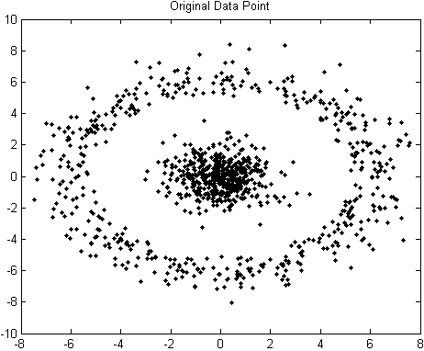
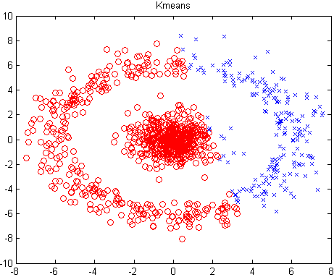
Example: Kernel K-Means Clustering
The original data set
The result of K-Means clustering
The result of Gaussian Kernel K-Means clustering
The above data set cannot generate quality clusters by K-Means since it contains non-convex clusters
Gaussian RBF Kernel transformation maps data to a kernel matrix K for any two points x_{i}, x_{j}: and Gaussian kernel: K(X_{i}, X_{j}) =
K-Means clustering is conducted on the mapped data, generating quality clusters

Slide 30
Chapter 10. Cluster Analysis: Basic Concepts and Methods
Cluster Analysis: An Introduction
Partitioning Methods
Hierarchical Methods
Gaussian Mixture Models and E-M algorithm
Density- and Grid-Based Methods
Spectral Clustering
Evaluation of Clustering
Summary
Notes:
30

Slide 31
Hierarchical Clustering Methods
Basic Concepts of Hierarchical Algorithms
Agglomerative Clustering Algorithms
Divisive Clustering Algorithms
Extensions to Hierarchical Clustering

Slide 32
Hierarchical Clustering: Basic Concepts
Hierarchical clustering
Generate a clustering hierarchy (drawn as a dendrogram)
Not required to specify K, the number of clusters
More deterministic
No iterative refinement
Two categories of algorithms:
Step 0
Step 1
Step 2
Step 3
Step 4
agglomerative
(AGNES)
a
a b
b
a b c d e
c
c d e
d
d e
e
divisive
(DIANA)
Step 4
Step 3
Step 2
Step 1
Step 0
Agglomerative: Start with singleton clusters, continuously merge two clusters at a time to build a bottom-up hierarchy of clusters
Divisive: Start with a huge macro-cluster, split it continuously into two groups, generating a top-down hierarchy of clusters

Slide 33
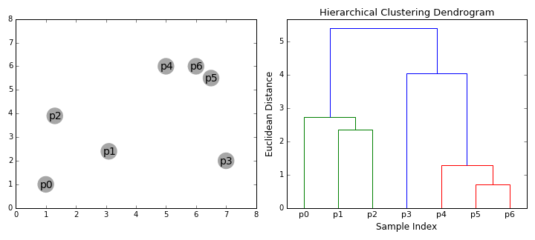
Dendrogram: Shows How Clusters are Merged
Dendrogram: Decompose a set of data objects into a tree of clusters by multi-level nested partitioning
A clustering of the data objects is obtained by cutting the dendrogram at the desired level, then each connected component forms a cluster
Hierarchical clustering generates a dendrogram (a hierarchy of clusters)

Slide 34
Agglomerative Clustering Algorithm
AGNES (AGglomerative NESting) (Kaufmann and Rousseeuw, 1990)
Use the single-link method and the dissimilarity matrix
Continuously merge nodes that have the least dissimilarity
Eventually all nodes belong to the same cluster
Agglomerative clustering varies on different similarity measures among clusters
Single link (nearest neighbor)
Complete link (diameter)
Average link (group average)
Centroid link (centroid similarity)
X
X

Slide 35
Single Link vs. Complete Link in Hierarchical Clustering
Single link (nearest neighbor)
The similarity between two clusters is the similarity between their most similar (nearest neighbor) members
Local similarity-based: Emphasizing more on close regions, ignoring the overall structure of the cluster
Capable of clustering non-elliptical shaped group of objects
Sensitive to noise and outliers
Complete link (diameter)
The similarity between two clusters is the similarity between their most dissimilar members
Merge two clusters to form one with the smallest diameter
Nonlocal in behavior, obtaining compact shaped clusters
Sensitive to outliers
X
X
X
X

Slide 36
Agglomerative Clustering: Average vs. Centroid Links
Agglomerative clustering with average link
Average link: The average distance between an element in one cluster and an element in the other (i.e., all pairs in two clusters)
Expensive to compute
Agglomerative clustering with centroid link
Centroid link: The distance between the centroids of two clusters
Group Averaged Agglomerative Clustering (GAAC)
Let two clusters C_{a} and C_{b} be merged into C_{aUb}. The new centroid is:
N_{a} is the cardinality of cluster C_{a}, and c_{a} is the centroid of C_{a}
The similarity measure for GAAC is the average of their distances
X
X
C_{a}: N_{a}
C_{b}: N_{b}
X
X
Agglomerative clustering with Ward’s criterion
Ward’s criterion: The increase in the value of the SSE criterion for the clustering obtained by merging them into C_{a} U C_{b}:

Slide 37
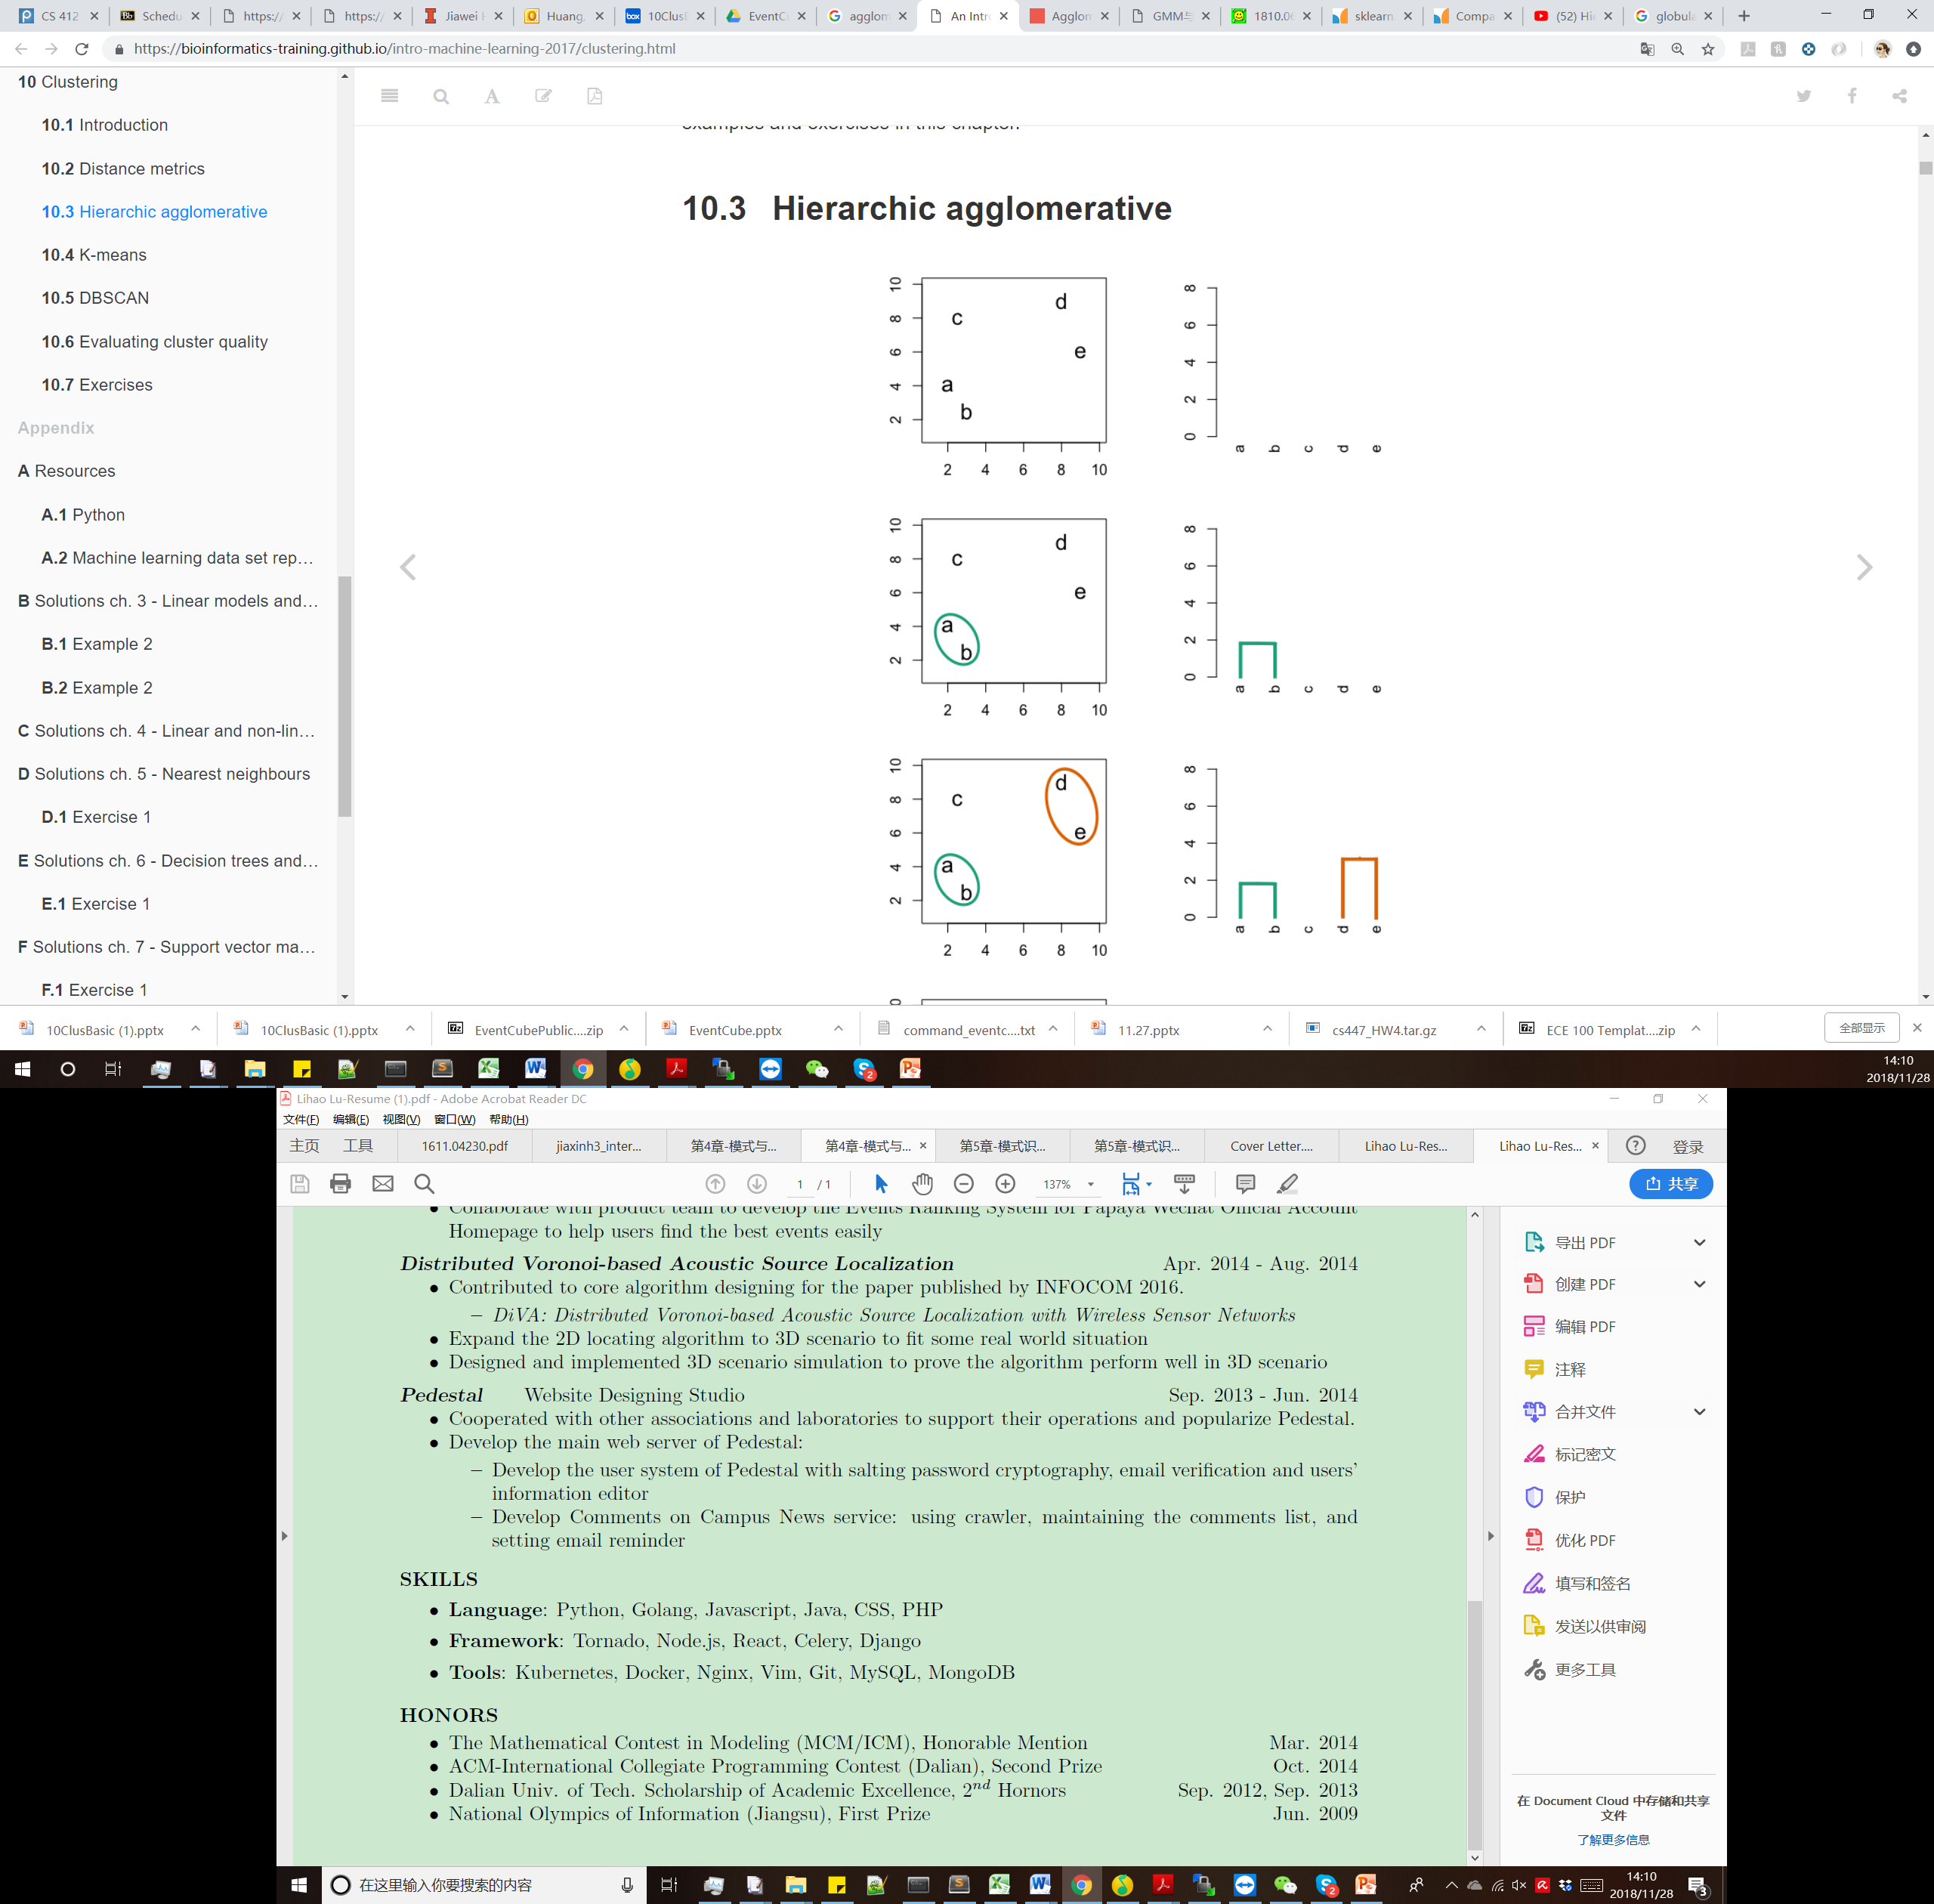
Agglomerative Clustering: Example of Single Link
2-D Data points
a(2,4)
b(3,2)
c(2,8)
d(8,9)
e(9,6)
Distance Matrix
 | a | b | c | d | e
a | 0
b | 2.2 | 0
c | 4 | 6.1 | 0
d | 7.8 | 8.6 | 6.1 | 0
e | 7.3 | 7.2 | 7.3 | 3.2 | 0

Slide 38
Agglomerative Clustering: Example of Single Link
2-D Data points
Update distance
Distance((a,b), c) = min(Distance(a,c), Distance(b,c)) = min(4, 6.1)=4
Distance((a,b), d) = min(Distance(a,d), Distance(b,d)) = min(7.8, 8.6)=7.8
Distance((a,b), e) = min(Distance(a,e), Distance(b,e)) = min(7.3, 7.2)=7.2
Distance Matrix
 | a,b | c | d | e
a,b | 0
c | 4 | 0
d | 7.8 | 6.1 | 0
e | 7.2 | 7.3 | 3.2 | 0
 | a | b | c | d | e
a | 0
b | 2.2 | 0
c | 4 | 6.1 | 0
d | 7.8 | 8.6 | 6.1 | 0
e | 7.3 | 7.2 | 7.3 | 3.2 | 0

Slide 39
Agglomerative Clustering: Example of Single Link
2-D Data points
Update distance
Distance((d,e), (a,b)) = min(Distance(d,(a,b)), Distance(e,(a,b)) = 7.2
Distance((d,e), c) = min(Distance(d,c), Distance(e,c)) = 6.1
Distance Matrix
 | a,b | c | d,e
a,b | 0
c | 4 | 0
d,e | 7.2 | 6.1 | 0
 | a,b | c | d | e
a,b | 0
c | 4 | 0
d | 7.8 | 6.1 | 0
e | 7.2 | 7.3 | 3.2 | 0
 | a,b | c | d | e
a,b | 0
c | 4 | 0
d | 7.8 | 6.1 | 0
e | 7.2 | 7.3 | 3.2 | 0

Slide 40
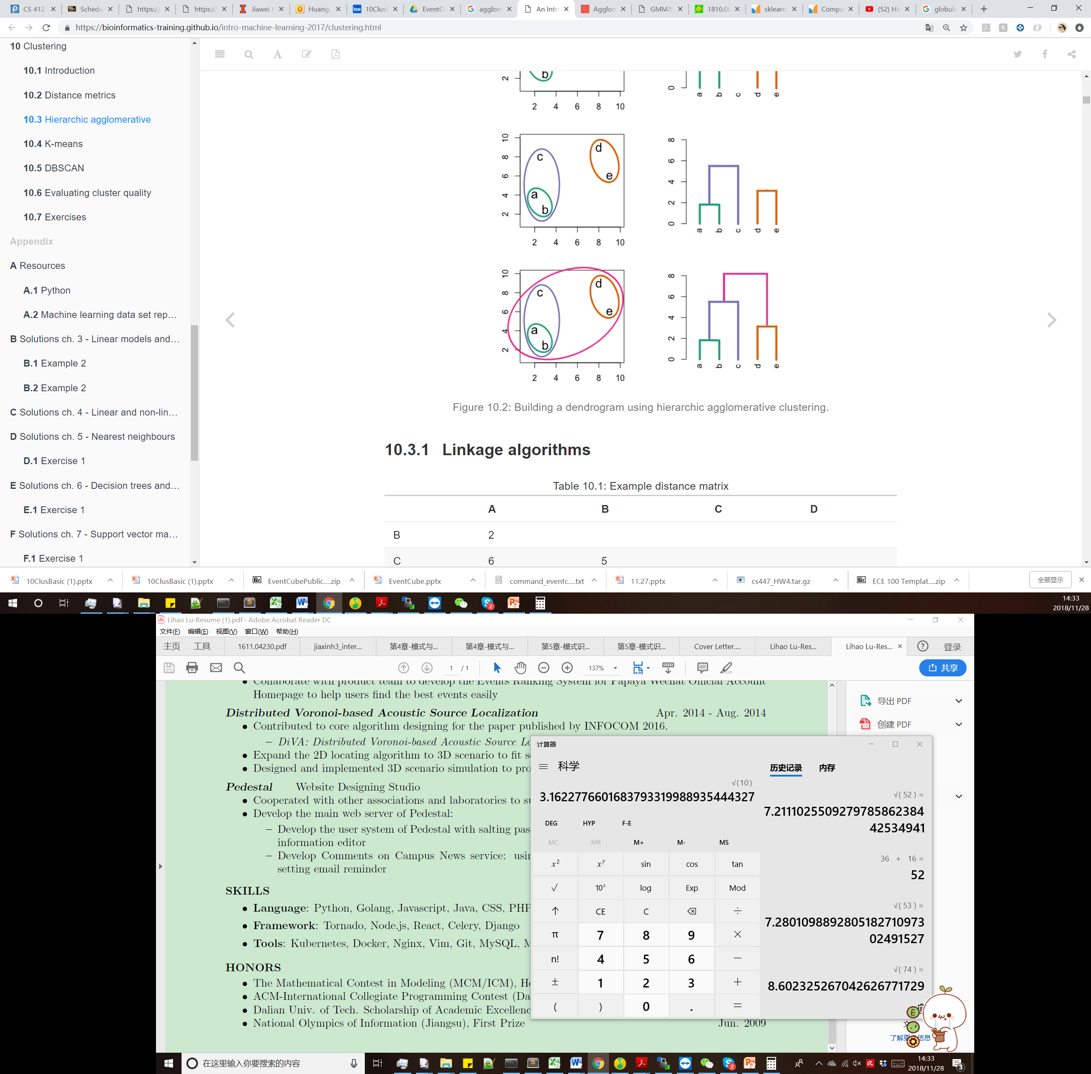
Agglomerative Clustering: Example of Single Link
2-D Data points
Update distance
Distance((d,e), (c,(a,b)))= min(Distance((d,e),(a,b)), Distance((d,e),c) = 6.1
Distance Matrix
 | a,b | c | d,e
a,b | 0
c | 4 | 0
d,e | 7.2 | 6.1 | 0
 | a,b,c | d,e
a,b,c | 0
d,e | 6.1 | 0

Slide 41
Agglomerative Clustering: Example of Single Link
2-D Data points
Distance Matrix
 | a,b,c,d,e
a,b,c,d,e | 0

Slide 42
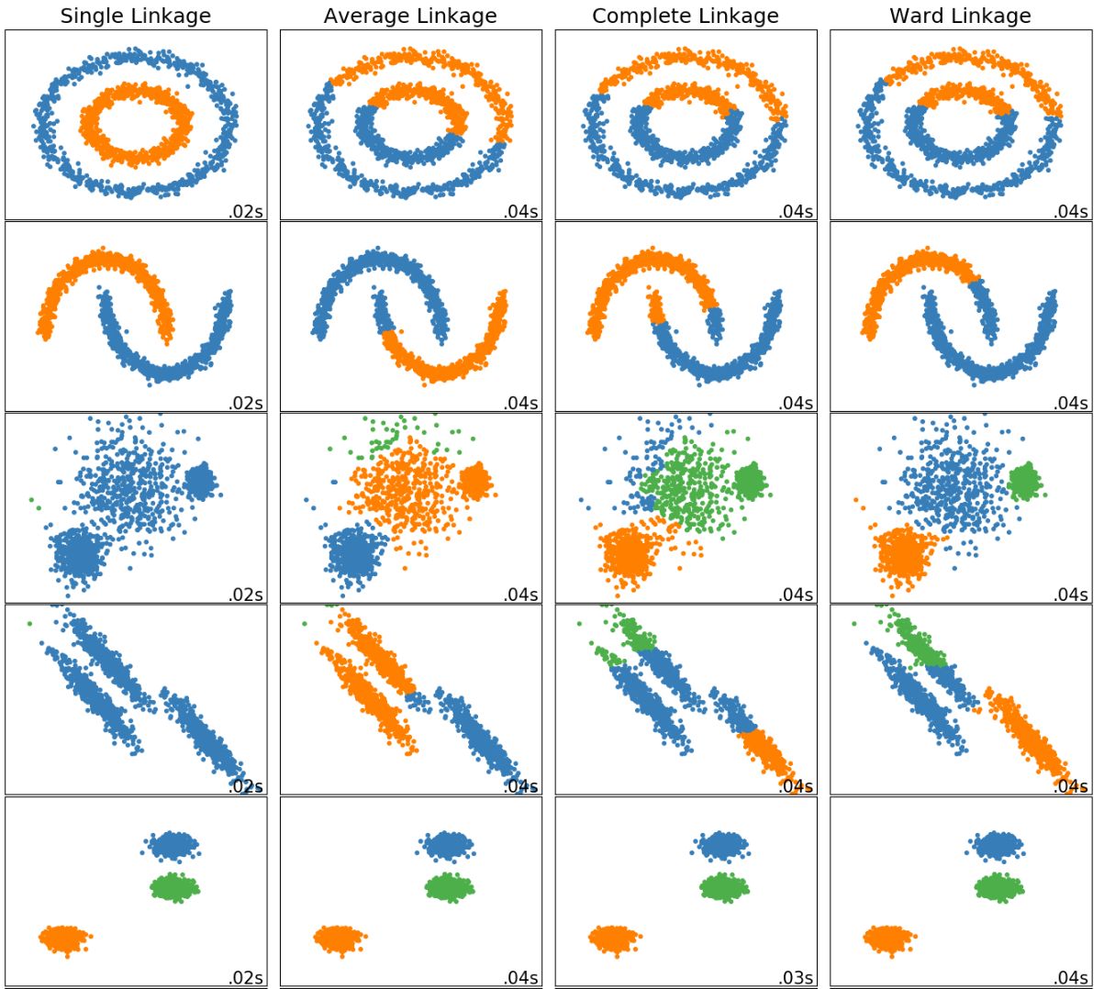
Comparison of different linkage methods
Single Link
Average Link
Complete Link
Ward Link
Observations:
Single link performs well on non-globular data, but it performs poorly in the presence of noise.
Average and Complete Linkage performs well on globular data, but have mixed results otherwise.
Ward is the most effective method for noisy data.

Slide 43
Divisive Clustering
DIANA (Divisive Analysis) (Kaufmann and Rousseeuw,1990)
Implemented in some statistical analysis packages, e.g., Splus
Inverse order of AGNES: Eventually each node forms a cluster on its own
Divisive clustering is a top-down approach
The process starts at the root with all the points as one cluster
It recursively splits the higher level clusters to build the dendrogram
Can be considered as a global approach
More efficient when compared with agglomerative clustering

Slide 44
More on Algorithm Design for Divisive Clustering
Choosing which cluster to split
Check the sums of squared errors of the clusters and choose the one with the largest value
Splitting criterion: Determining how to split
One may use Ward’s criterion to chase for greater reduction in the difference in the SSE criterion as a result of a split
For categorical data, Gini-index can be used
Handling the noise
Use a threshold to determine the termination criterion (do not generate clusters that are too small because they contain mainly noises)

Slide 45
Extensions to Hierarchical Clustering
Major weaknesses of hierarchical clustering methods
Can never undo what was done previously
Do not scale well
Time complexity of at least O(n²), where n is the number of total objects
Other hierarchical clustering algorithms
BIRCH (1996): Use CF-tree and incrementally adjust the quality of sub-clusters
CURE (1998): Represent a cluster using a set of well-scattered representative points
CHAMELEON (1999): Use graph partitioning methods on the K-nearest neighbor graph of the data

Slide 46
Chapter 10. Cluster Analysis: Basic Concepts and Methods
Cluster Analysis: An Introduction
Partitioning Methods
Hierarchical Methods
Gaussian Mixture Models and E-M algorithm
Density- and Grid-Based Methods
Evaluation of Clustering
Summary
Notes:
46

Slide 47
Hard Clustering Can Be Difficult

Slide 48

Soft Clustering
Every object i is assigned to one cluster j with a probability
$P\left(z_{i}=j\right)∈\left[0,1\right]$ and $Σ_{j}P\left(z_{i}=j\right)=1$
Where $z_{i}$ is a hidden variable of which cluster $x_{i}$ belongs to.

Slide 49
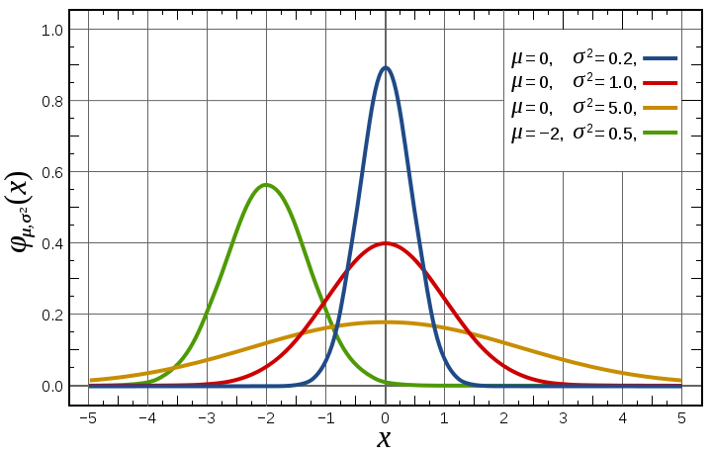
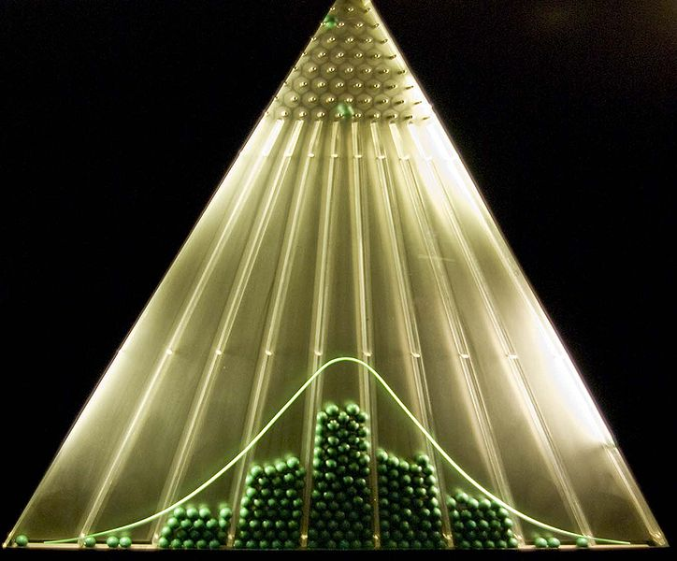
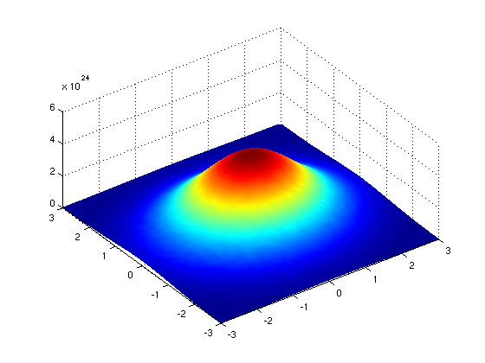
Gaussian Distribution
1-d Gaussian
Bean machine: drop ball with pins
2-d Gaussian
From wikipedia and http://home.dei.polimi.it

Slide 50
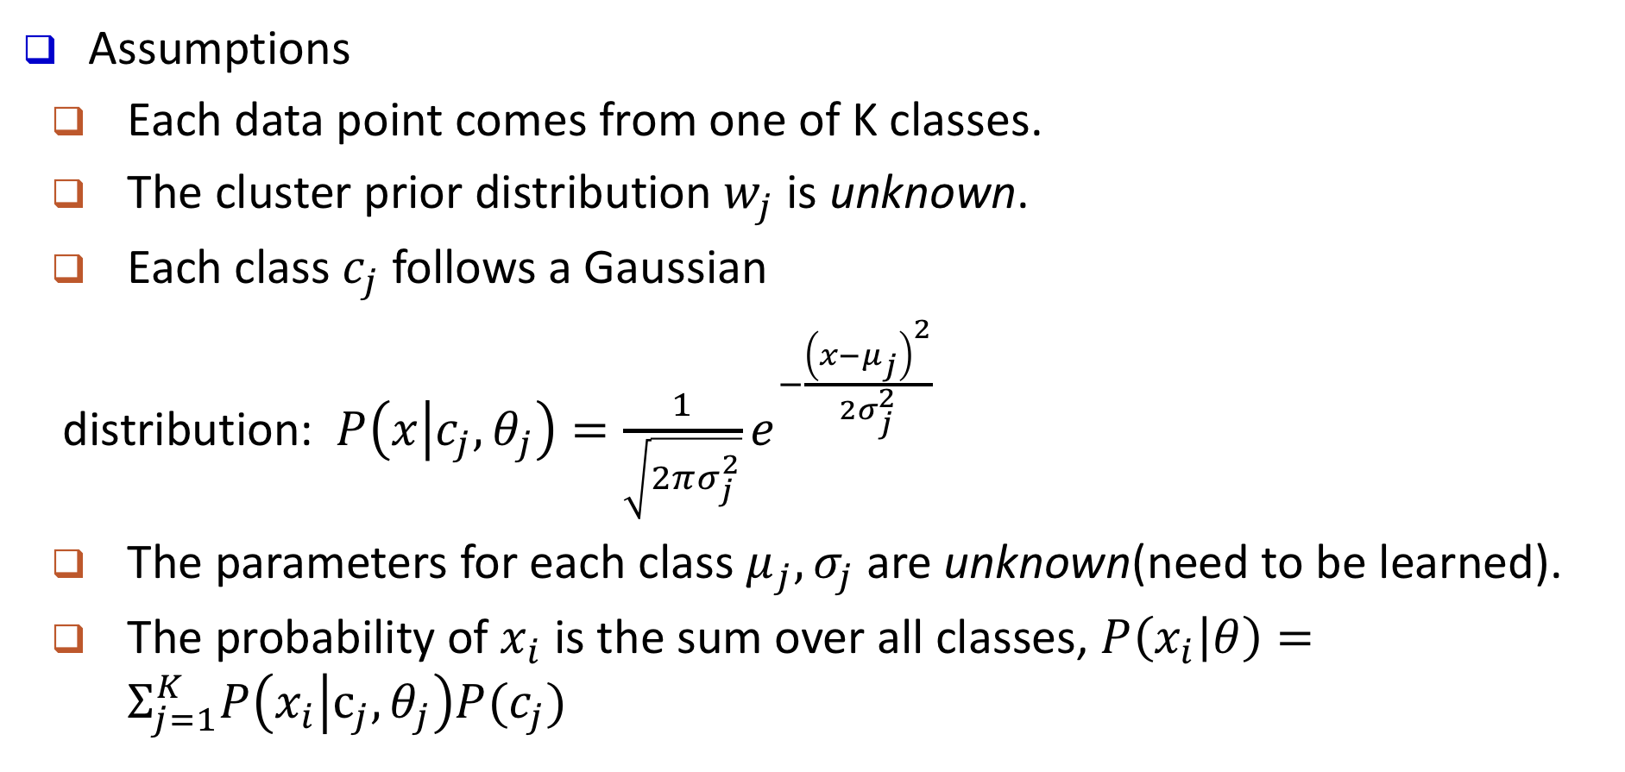
Gaussian Mixture Model
Assumptions
Each data point comes from one of K classes.
The cluster prior distribution $w_{j}$ is unknown.
Each class $c_{j}$ follows a Gaussian
distribution: $P\left(x | c_{j},θ_{j}\right)=\frac{1}{\sqrt{2πσ_{j}^{2}}}e^{−\frac{{\left(x−μ_{j}\right)}^{2}}{2σ_{j}^{2}}}$
The parameters for each class $μ_{j}, σ_{j}$ are unknown(need to be learned).
The probability of $x_{i}$ is the sum over all classes, $P\left(x_{i} | θ\right)=Σ_{j=1}^{K}P\left(x_{i} | c_{j},θ_{j}\right)P(c_{j})$

Slide 51
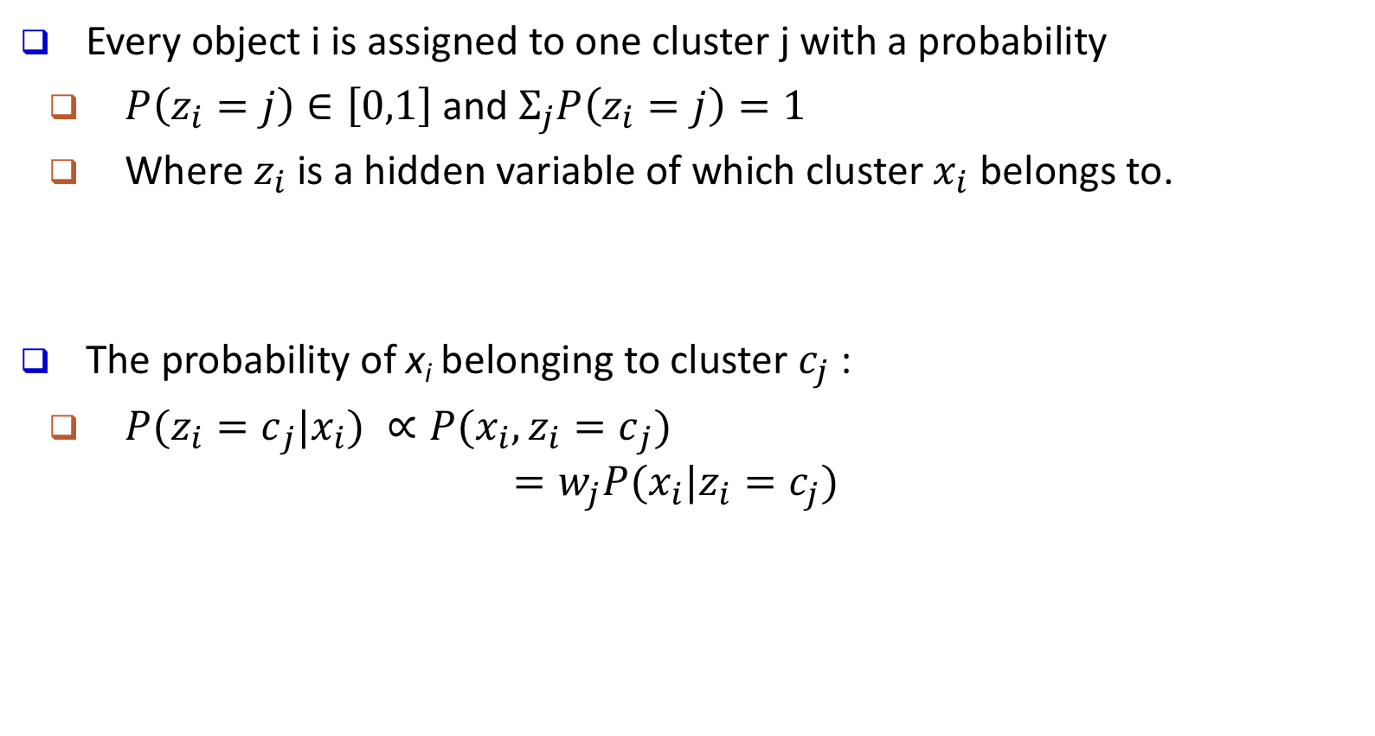
Soft Clustering with Gaussian Mixture Model
Every object i is assigned to one cluster j with a probability
$P\left(z_{i}=j\right)∈\left[0,1\right]$ and $Σ_{j}P\left(z_{i}=j\right)=1$
Where $z_{i}$ is a hidden variable of which cluster $x_{i}$ belongs to.
The probability of x_{i} belonging to cluster $c_{j}$ :
${{P(z_{i}=c}_{j}|x_{i}) ∝P(x_{i}, z_{i}=c}_{j})$
$$=w_{j}P(x_{i}|z_{i}=c_{j})$$
Assume the parameters of the GMM have been learned
Cluster prior probabilities
Probability density function of each cluster

Slide 52
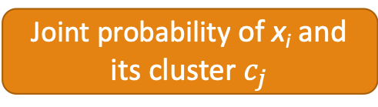
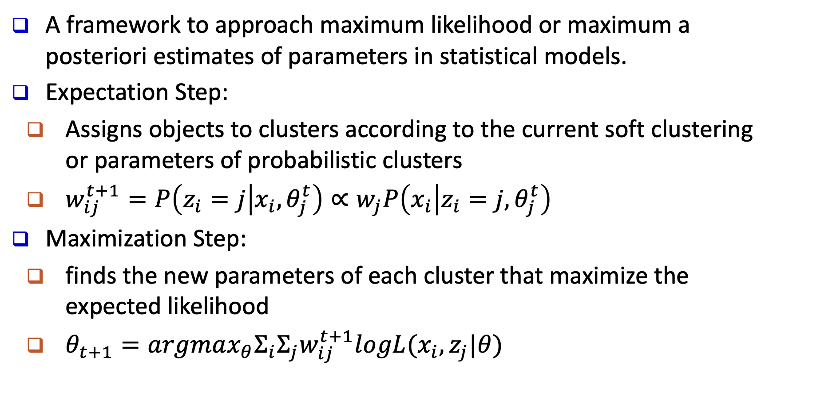
The E-M(Expectation Maximization) Algorithm​
A framework to approach maximum likelihood or maximum a posteriori estimates of parameters in statistical models.​
Expectation Step:​
Assigns objects to clusters according to the current soft clustering or parameters of probabilistic clusters​
$w_{ij}^{t+1}=P\left(z_{i}=j | x_{i},θ_{j}^{t}\right)∝w_{j}P\left(x_{i} | z_{i}=j,θ_{j}^{t}\right)$
Maximization Step:
finds the new parameters of each cluster that maximize the expected likelihood
$θ_{t+1}=argmax_{θ}Σ_{i}Σ_{j}w_{ij}^{t+1}logL(x_{i},z_{j}|θ)$
Joint probability of x_{i} and its cluster $c_{j}$

Slide 53
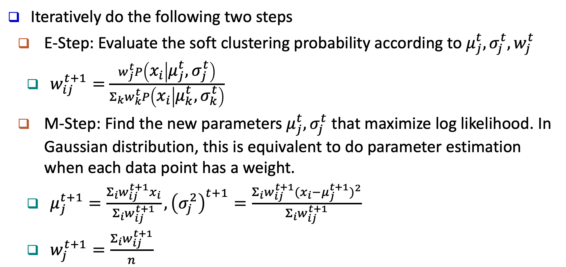
Example: Applying E-M algorithm to 1-D GMM
Iteratively do the following two steps
E-Step: Evaluate the soft clustering probability according to $μ_{j}^{t},σ_{j}^{t},w_{j}^{t}$
$w_{ij}^{t+1}=$ $\frac{w_{j}^{t}P\left(x_{i} | μ_{j}^{t}{,σ}_{j}^{t}\right)}{Σ_{k}w_{k}^{t}P\left(x_{i} | μ_{k}^{t}{,σ}_{k}^{t}\right)}$
M-Step: Find the new parameters $μ_{j}^{t},σ_{j}^{t}$ that maximize log likelihood. In Gaussian distribution, this is equivalent to do parameter estimation when each data point has a weight.
$μ_{j}^{t+1}=\frac{Σ_{i}w_{ij}^{t+1}x_{i}}{Σ_{i}w_{ij}^{t+1}}, {\left(σ_{j}^{2}\right)}^{t+1}=\frac{Σ_{i}w_{ij}^{t+1}{{(x}_{i}−μ_{j}^{t+1})}^{2}}{Σ_{i}w_{ij}^{t+1}}$
$w_{j}^{t+1}=\frac{Σ_{i}w_{ij}^{t+1}}{n}$
Weighted average means and variance

Slide 54
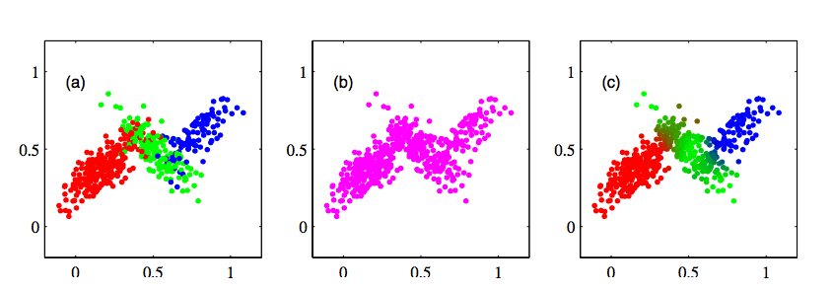
Gaussian Mixture Model
Example of applying Gaussian Mixture Model
We can use E-M algorithm to learn the parameters.
The data points belong to three classes. Each class follows a Gaussian distribution.
We hide the class information.
Class information inferred by GMM.

Slide 55
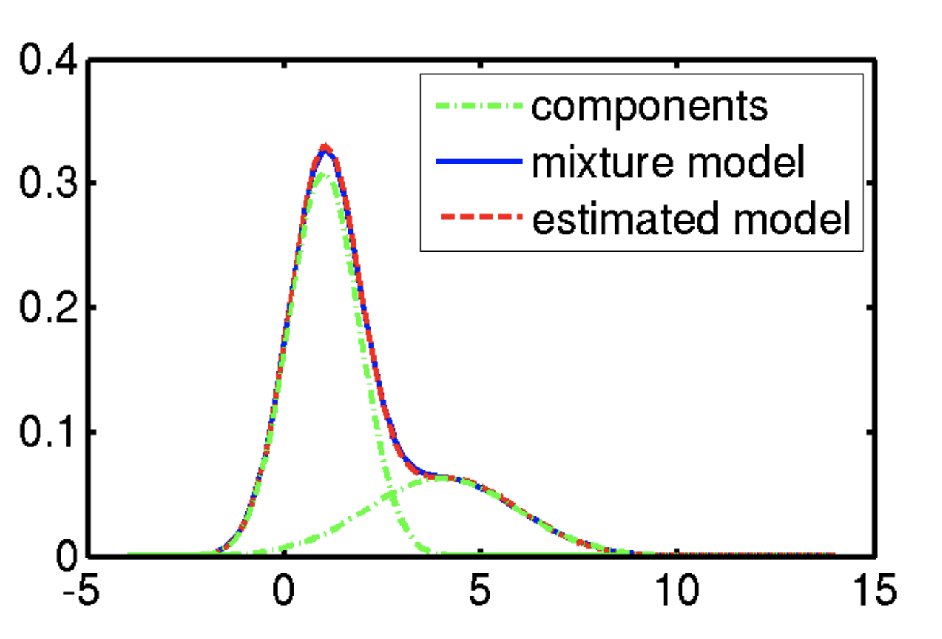
Example: Applying E-M algorithm to 1-D GMM

Slide 56
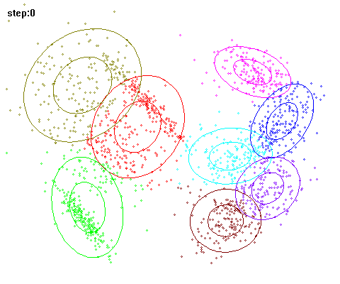
EM for Learning 2D Gaussian Mixture Model

Slide 57
Gaussian Mixture Model – Strength and Weakness
Advantages
Mixture models are more general than partitioning: different densities and sizes of clusters
Clusters can be characterized by a small number of parameters
The results satisfy the statistical assumptions of generative models
Disadvantages
Converge to local optimal
Computationally more expensive
Hard to estimate the number of clusters
Can only deal with spherical clusters
Overcome it by running multi-times w. random initialization

Slide 58
Chapter 10. Cluster Analysis: Basic Concepts and Methods
Cluster Analysis: An Introduction
Partitioning Methods
Hierarchical Methods
Gaussian Mixture Models and E-M algorithm
Density-Based Methods
Evaluation of Clustering
Summary
Notes:
58

Slide 59
Density-Based Clustering
Clustering based on density (a local criterion), such as densely-connected points
Main Advantages
Discover clusters of arbitrary shape
Handle noise

Slide 60
Representative Density-Based Clustering Methods
Several interesting studies:
DBSCAN: Ester, et al. (KDD’96)
OPTICS: Ankerst, et al (SIGMOD’99)
DENCLUE: Hinneburg & D. Keim (KDD’98)
CLIQUE: Agrawal, et al. (SIGMOD’98) (also, grid-based)
To be covered in this lecture

Slide 61
DBSCAN: High-Level Idea
DBSCAN
Discovers clusters of arbitrary shape: Density-Based Spatial Clustering of Applications with Noise
A density-based notion of cluster
A cluster is defined as a maximal set of density-connected points

Slide 62
DBSCAN: Core Concepts
DBSCAN: A cluster is defined as a maximal set of density-connected points
Two parameters:
Eps (ε): Maximum radius of the neighborhood
MinPts: Minimum number of points in the
Eps-neighborhood of a point
The Eps(ε)-neighborhood of a point q:
N_{Eps}(q): {p belongs to D | dist(p, q) ≤ Eps}
p
MinPts = 5
Eps = 1 cm
q
Outlier
Outlier/noise: not in a cluster
Border
Core point: dense neighborhood
Core
Border point: in cluster but neighborhood is not dense

Slide 63
DBSCAN: Density-Reachable and Density-Connected
Directly density-reachable:
A point p is directly density-reachable from a point q w.r.t. Eps (ε), MinPts if
p belongs to N_{Eps}(q)
core point condition: |N_{Eps} (q)| ≥ MinPts
Density-reachable:
A point p is density-reachable from a point q w.r.t. Eps, MinPts if there is a chain of points p₁, …, p_{n}, p₁ = q, p_{n} = p such that p_{i+1} is directly density-reachable from p_{i}
Density-connected:
A point p is density-connected to a point q w.r.t. Eps, MinPts if there is a point o such that both p and q are density-reachable from o w.r.t. Eps and MinPts
p
MinPts = 5
Eps = 1 cm
q
p
p₂
q
p
q
o

Slide 64
DBSCAN: The Algorithm
Algorithm
Arbitrarily select a point p
Retrieve all points density-reachable
from p w.r.t. Eps and MinPts
If p is a core point, a cluster is formed
If p is a border point, no points are density-reachable from p, and DBSCAN visits the next point of the database
Continue the process until all of the points have been processed
Outlier
Outlier/noise: not in a cluster
Border
Core point: dense neighborhood
Core
Border point: in cluster but neighborhood is not dense
Computational complexity
If a spatial index is used, the computational complexity of DBSCAN is O(nlogn), where n is the number of database objects
Otherwise, the complexity is O(n²)

Slide 65
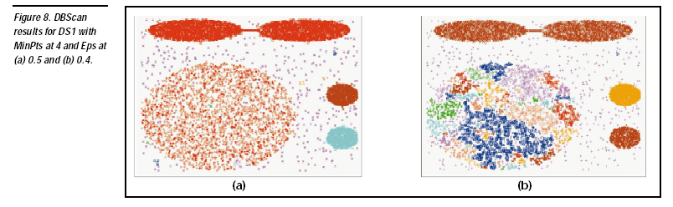

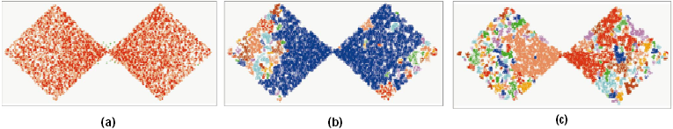
DBSCAN Is Sensitive to the Setting of Parameters
Ack. Figures from G. Karypis, E.-H. Han, and V. Kumar, COMPUTER, 32(8), 1999

Slide 66
Chapter 10. Cluster Analysis: Basic Concepts and Methods
Cluster Analysis: An Introduction
Partitioning Methods
Hierarchical Methods
Gaussian Mixture Models and E-M algorithm
Density- and Grid-Based Methods
Evaluation of Clustering
Summary
Notes:
66

Slide 67
Grid-Based Clustering Methods
Grid-Based Clustering: Explore multi-resolution grid data structure in clustering
Partition the data space into a finite number of cells to form a grid structure
Find clusters (dense regions) from the cells in the grid structure

Slide 68
CLIQUE: Grid-Based Subspace Clustering
CLIQUE (Clustering In QUEst) (Agrawal, Gehrke, Gunopulos, Raghavan: SIGMOD’98)
CLIQUE is a density-based and grid-based subspace clustering algorithm
Grid-based: It discretizes the data space through a grid and estimates the density by counting the number of points in a grid cell
Density-based: A cluster is a maximal set of connected dense units in a subspace
A unit is dense if the fraction of total data points contained in the unit exceeds the input model parameter
Subspace clustering: A subspace cluster is a set of neighboring dense cells in an arbitrary subspace. It also discovers some minimal descriptions of the clusters
It automatically identifies subspaces of a high dimensional data space that allow better clustering than original space using the Apriori principle

Slide 69
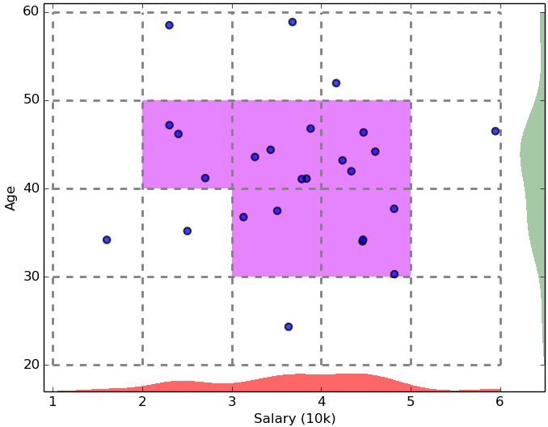
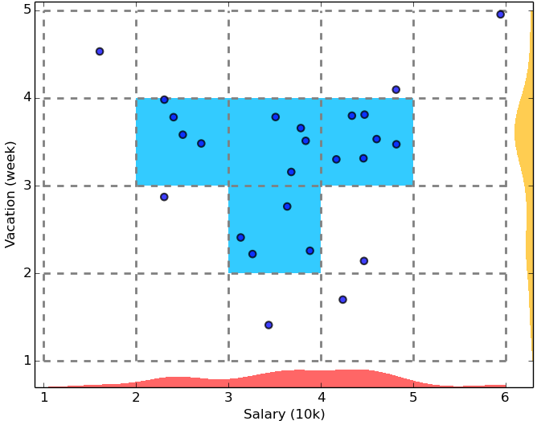
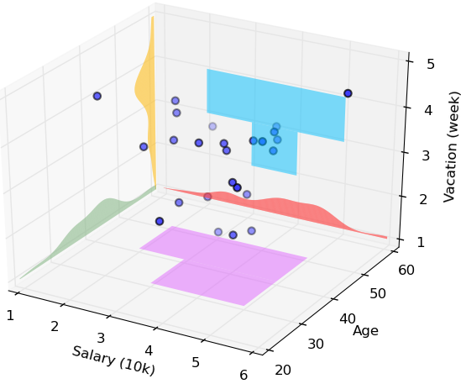
CLIQUE: SubSpace Clustering with Aprori Pruning
Start at 1-D space and discretize numerical intervals in each axis into grid
Find dense regions (clusters) in each subspace and generate their minimal descriptions
Use the dense regions to find promising candidates in 2-D space based on the Apriori principle
Repeat the above in level-wise manner in higher dimensional subspaces

Slide 70
Major Steps of the CLIQUE Algorithm
Identify subspaces that contain clusters
Partition the data space and find the number of points that lie inside each cell of the partition
Identify the subspaces that contain clusters using the Apriori principle
Identify clusters
Determine dense units in all subspaces of interests
Determine connected dense units in all subspaces of interests
Generate minimal descriptions for the clusters
Determine maximal regions that cover a cluster of connected dense units for each cluster

Slide 71
Additional Comments on CLIQUE
Strengths
Automatically finds subspaces of the highest dimensionality as long as high density clusters exist in those subspaces
Insensitive to the order of records in input and does not presume some canonical data distribution
Scales linearly with the size of input and has good scalability as the number of dimensions in the data increases
Weaknesses
As in all grid-based clustering approaches, the quality of the results crucially depends on the appropriate choice of the number and width of the partitions and grid cells

Slide 72
Chapter 10. Cluster Analysis: Basic Concepts and Methods
Cluster Analysis: An Introduction
Partitioning Methods
Hierarchical Methods
Gaussian Mixture Models and E-M algorithm
Density- and Grid-Based Methods
Evaluation of Clustering
Summary
Notes:
72

Slide 73
Clustering Validation
Clustering Validation: Basic Concepts
External Measures for Clustering Validation
I: Matching-Based Measures
II: Entropy-Based Measures
III: Pairwise Measures
Internal Measures for Clustering Validation
Relative Measures
Cluster Stability
Clustering Tendency

Slide 74
Clustering Validation and Assessment
Major issues on clustering validation and assessment
Clustering evaluation
Evaluating the goodness of the clustering
Clustering stability
To understand the sensitivity of the clustering result to various algorithm parameters, e.g., # of clusters
Clustering tendency
Assess the suitability of clustering, i.e., whether the data has any inherent grouping structure

Slide 75
Clustering Validation
Clustering Validation: Basic Concepts
External Measures for Clustering Validation
I: Matching-Based Measures
II: Entropy-Based Measures
III: Pairwise Measures
Internal Measures for Clustering Validation
Relative Measures
Cluster Stability
Clustering Tendency

Slide 76
Measuring Clustering Quality
Clustering Evaluation: Evaluating the goodness of clustering results
No commonly recognized best suitable measure in practice
Three categorization of measures: External, internal, and relative
External: Supervised, employ criteria not inherent to the dataset
Compare a clustering against prior or expert-specified knowledge (i.e., the ground truth) using certain clustering quality measure
Internal: Unsupervised, criteria derived from data itself
Evaluate the goodness of a clustering by considering how well the clusters are separated and how compact the clusters are, e.g., silhouette coefficient
Relative: Directly compare different clusterings, usually those obtained via different parameter settings for the same algorithm

Slide 77
Commonly Used External Measures
Matching-based measures
Purity, maximum matching, F-measure
Entropy-Based Measures
Conditional entropy
Normalized mutual information (NMI)
Pairwise measures
Four possibilities: True positive (TP), FN, FP, TN
Jaccard coefficient, Rand statistic, Fowlkes-Mallow measure
Ground truth partitioning T₁
T₂
Cluster C₁
Cluster C₂

Slide 78
Matching-Based Measures (I): Purity vs. Maximum Matching
Purity: Quantifies the extent that cluster C_{i} contains points only from one (ground truth) partition:
Total purity of clustering C:
Perfect clustering if purity = 1 and r = k (the number of clusters obtained is the same as that in the ground truth)
Ex. 1 (green or orange): purity₁ = 30/50; purity₂ = 20/25; purity₃ = 25/25; purity = (30 + 20 + 25)/100 = 0.75
Two clusters may share the same majority partition
Ground Truth T₁
T₂
T₃
Cluster C₁
C₂
C₃
C\T | T₁ | T₂ | T₃ | Sum
C₁ | 0 | 20 | 30 | 50
C₂ | 0 | 20 | 5 | 25
C₃ | 25 | 0 | 0 | 25
m_{j} | 25 | 40 | 35 | 100
Maximum matching: Only one cluster can match one partition
Match: Pairwise matching, weight w(e_{ij}) = n_{ij}
Maximum weight matching:
Ex2. (green) match = purity = 0.75; (orange) match = 0.65 > 0.6
C\T | T₁ | T₂ | T₃ | Sum
C₁ | 0 | 30 | 20 | 50
C₂ | 0 | 20 | 5 | 25
C₃ | 25 | 0 | 0 | 25
m_{j} | 25 | 50 | 25 | 100

Slide 79
Matching-Based Measures (II): F-Measure
Precision: The fraction of points in C_{i} from the majority partition (i.e., the same as purity), where j_{i} is the partition that contains the maximum # of points from C_{i}
Ex. For the green table
prec₁ = 30/50; prec₂ = 20/25; prec₃ = 25/25
Recall: The fraction of point in partition shared in common with cluster C_{i}, where
Ex. For the green table
recall₁ = 30/35; recall₂ = 20/40; recall₃ = 25/25
F-measure for C_{i}: The harmonic means of prec_{i} and recall_{i}:
F-measure for clustering C: average of all clusters:
Ex. For the green table
F₁ = 60/85; F₂ = 40/65; F₃ = 1; F = 0.774
Ground Truth T₁
T₂
T₃
Cluster C₁
C₂
C₃
C\T | T₁ | T₂ | T₃ | Sum
C₁ | 0 | 20 | 30 | 50
C₂ | 0 | 20 | 5 | 25
C₃ | 25 | 0 | 0 | 25
m_{j} | 25 | 40 | 35 | 100

Slide 80
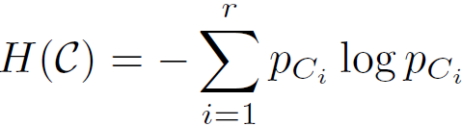
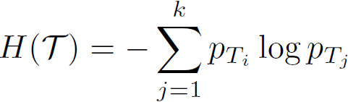
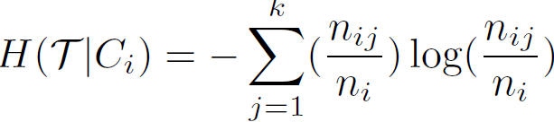
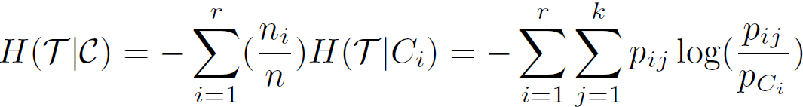

Entropy-Based Measures (I): Conditional Entropy
Entropy of clustering C:
Entropy of partitioning T:
Entropy of T with respect to cluster C_{i}:
Conditional entropy of T with respect to
clustering C:
The more a cluster’s members are split into different partitions, the higher the conditional entropy
For a perfect clustering, the conditional entropy value is 0
Ground Truth T₁
T₂
T₃
Cluster C₁
C₂
C₃

Slide 81

Entropy-Based Measures (II): Normalized Mutual Information (NMI)
Mutual information:
Quantifies the amount of shared info between
the clustering C and partitioning T
Measures the dependency between the observed joint probability p_{ij} of C and T, and the expected joint probability p_{Ci} . p_{Tj} under the independence assumption
When C and T are independent, p_{ij} = p_{Ci} . p_{Tj}, I(C, T) = 0.
Normalized mutual information (NMI)
Value range of NMI: [0,1]. Value close to 1 indicates a good clustering
Ground Truth T₁
T₂
T₃
Cluster C₁
C₂
C₃

Slide 82
Pairwise Measures: Four Possibilities for Truth Assignment
Four possibilities based on the agreement between cluster label and partition label
TP: true positive—Two points x_{i} and x_{j} belong to the same partition T , and they also in the same cluster C
where y_{i}: the true partition label , and : the cluster label for point x_{i}
FN: false negative:
FP: false positive
TN: true negative
Calculate the four measures:
Ground Truth T₁
T₂
T₃
Cluster C₁
C₂
C₃
Total # of pairs of points

Slide 83
Pairwise Measures: Jaccard Coefficient and Rand Statistic
Jaccard coefficient: Fraction of true positive point pairs, but after ignoring the true negatives (thus asymmetric)
Jaccard = TP/(TP + FN + FP) [i.e., denominator ignores TN]
Perfect clustering: Jaccard = 1
Rand Statistic:
Rand = (TP + TN)/N
Symmetric; perfect clustering: Rand = 1
Fowlkes-Mallow Measure:
Geometric mean of precision and recall
Using the above formulas, one can calculate all the measures for the green table (leave as an exercise)
Ground Truth T₁
T₂
T₃
Cluster C₁
C₂
C₃
C\T | T₁ | T₂ | T₃ | Sum
C₁ | 0 | 20 | 30 | 50
C₂ | 0 | 20 | 5 | 25
C₃ | 25 | 0 | 0 | 25
m_{j} | 25 | 40 | 35 | 100

Slide 84
Clustering Validation
Clustering Validation: Basic Concepts
External Measures for Clustering Validation
I: Matching-Based Measures
II: Entropy-Based Measures
III: Pairwise Measures
Internal Measures for Clustering Validation
Relative Measures
Cluster Stability
Clustering Tendency

Slide 85
Internal Measures (I): BetaCV Measure
A trade-off in maximizing intra-cluster compactness and inter-cluster separation
Given a clustering C = {C₁, . . ., C_{k}} with k clusters, cluster C_{i} containing n_{i} = |C_{i}| points
Let W(S, R) be sum of weights on all edges with one vertex in S and the other in R
The sum of all the intra-cluster weights over all clusters:
The sum of all the inter-cluster weights:
The number of distinct intra-cluster edges:
The number of distinct inter-cluster edges:
Beta-CV measure:
The ratio of the mean intra-cluster distance to the mean inter-cluster distance
The smaller, the better the clustering

Slide 86
Internal Measures (II): Normalized Cut
Normalized cut:
where vol(C_{i}) = W(C_{i}, V) is the volume of cluster C_{i}
The higher normalized cut value, the better the clustering

Slide 87
Clustering Validation
Clustering Validation: Basic Concepts
External Measures for Clustering Validation
I: Matching-Based Measures
II: Entropy-Based Measures
III: Pairwise Measures
Internal Measures for Clustering Validation
Relative Measures
Cluster Stability
Clustering Tendency

Slide 88
Relative Measure
Relative measure: Directly compare different clusterings, usually those obtained via different parameter settings for the same algorithm
Silhouette coefficient as an internal measure: Check cluster cohesion and separation
For each point x_{i}, its silhouette coefficient s_{i} is:
where is the mean distance from x_{i} to points in its own cluster
is the mean distance from x_{i} to points in its closest cluster
Silhouette coefficient (SC) is the mean values of s_{i} across all the points:
SC close to +1 implies good clustering
Points are close to their own clusters but far from other clusters
Silhouette coefficient as a relative measure: Estimate the # of clusters in the data
Pick the k value that yields the best clustering, i.e., yielding high values for SC and SC_{i} (1 ≤ i ≤ k)

Slide 89
Clustering Validation
Clustering Validation: Basic Concepts
External Measures for Clustering Validation
I: Matching-Based Measures
II: Entropy-Based Measures
III: Pairwise Measures
Internal Measures for Clustering Validation
Relative Measures
Cluster Stability
Clustering Tendency

Slide 90
Cluster Stability
Clusterings obtained from several datasets sampled from
the same underlying distribution as D should be similar or “stable”
Typical approach:
Find good parameter values for a given clustering algorithm
Example: Find a good value of k, the correct number of clusters
A bootstrapping approach to find the best value of k (judged on stability)
Generate t samples of size n by sampling from D with replacement
For each sample D_{i}, run the same clustering algorithm with k values from 2 to k_{max}
Compare the distance between all pairs of clusterings C_{k}(D_{i}) and C_{k}(D_{j}) via some distance function
Compute the expected pairwise distance for each value of k
The value k* that exhibits the least deviation between the clusterings obtained from the resampled datasets is the best choice for k since it exhibits the most stability

Slide 91
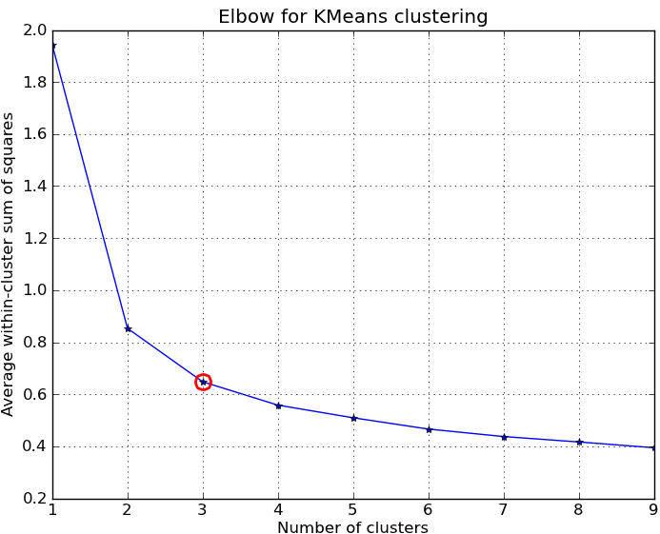
Other Methods for Finding K, the Number of Clusters
Empirical method
# of clusters: for a dataset of n points (e.g., n = 200, k = 10)
Elbow method: Use the turning point in the curve of the sum
of within cluster variance with respect to the # of clusters
Cross validation method
Divide a given data set into m parts
Use m – 1 parts to obtain a clustering model
Use the remaining part to test the quality of the clustering
For example, for each point in the test set, find the closest centroid, and use the sum of squared distance between all points in the test set and the closest centroids to measure how well the model fits the test set
For any k > 0, repeat it m times, compare the overall quality measure w.r.t. different k’s, and find # of clusters that fits the data the best

Slide 92
Clustering Tendency: Whether the Data Contains Inherent Grouping Structure
Assessing the suitability of clustering
(i.e., whether the data has any inherent grouping structure)
Determining clustering tendency or clusterability
A hard task because there are so many different definitions of clusters
E.g., partitioning, hierarchical, density-based, graph-based, etc.
Even fixing cluster type, still hard to define an appropriate null model for a data set
Still, there are some clusterability assessment methods, such as
Spatial histogram: Contrast the histogram of the data with that generated from random samples
Distance distribution: Compare the pairwise point distance from the data with those from the randomly generated samples
Hopkins Statistic: A sparse sampling test for spatial randomness
To be covered here

Slide 93
Clustering Validation
Clustering Validation: Basic Concepts
External Measures for Clustering Validation
I: Matching-Based Measures
II: Entropy-Based Measures
III: Pairwise Measures
Internal Measures for Clustering Validation
Relative Measures
Cluster Stability
Clustering Tendency

Slide 94
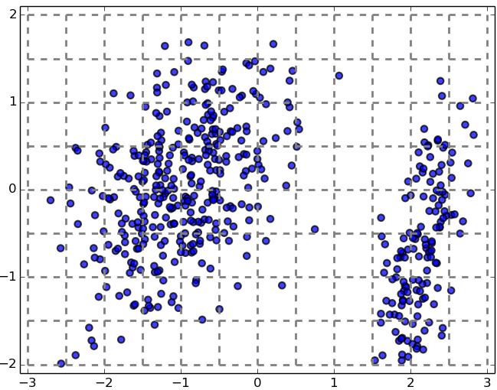
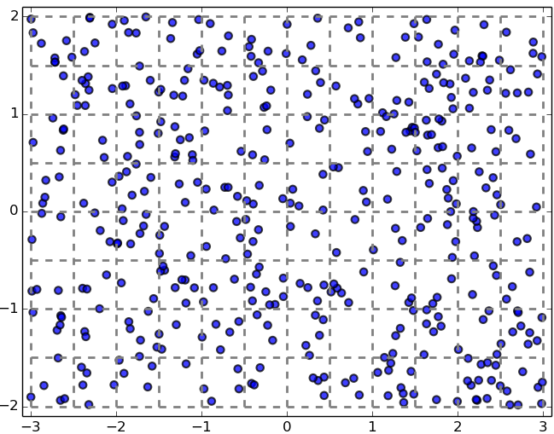
Testing Clustering Tendency: A Spatial Histogram Approach
Spatial Histogram Approach: Contrast the d-dimensional histogram of the input dataset D with the histogram generated from random samples
Dataset D is clusterable if the distributions of two histograms are rather different
Method outline
Divide each dimension into equi-width bins, count how many points lie in each cells, and obtain the empirical joint probability mass function (EPMF)
Do the same for the randomly sampled data
Compute how much they differ using the Kullback-Leibler (KL) divergence value

Slide 95
Chapter 10. Cluster Analysis: Basic Concepts and Methods
Cluster Analysis: An Introduction
Partitioning Methods
Hierarchical Methods
Gaussian Mixture Models and E-M algorithm
Density- and Grid-Based Methods
Evaluation of Clustering
Summary
Notes:
95

Slide 96
Summary
Cluster Analysis: An Introduction
Partitioning Methods
Hierarchical Methods
Density- and Grid-Based Methods
Evaluation of Clustering
Notes:
96

Slide 97
References: (I) Cluster Analysis: An Introduction
Jiawei Han, Micheline Kamber, and Jian Pei. Data Mining: Concepts and Techniques. Morgan Kaufmann, 3rd ed. , 2011 (Chapters 10 & 11)
Charu Aggarwal and Chandran K. Reddy (eds.). Data Clustering: Algorithms and Applications. CRC Press, 2014
Mohammed J. Zaki and Wagner Meira, Jr.. Data Mining and Analysis: Fundamental Concepts and Algorithms. Cambridge University Press, 2014
L. Kaufman and P. J. Rousseeuw, Finding Groups in Data: An Introduction to Cluster Analysis, John Wiley & Sons, 1990
Charu Aggarwal. An Introduction to Clustering Analysis. in Aggarwal and Reddy (eds.). Data Clustering: Algorithms and Applications (Chapter 1). CRC Press, 2014

Slide 98
References: (II) Partitioning Methods
J. MacQueen. Some Methods for Classification and Analysis of Multivariate Observations. In Proc. of the 5th Berkeley Symp. on Mathematical Statistics and Probability, 1967
S. Lloyd. Least Squares Quantization in PCM. IEEE Trans. on Information Theory, 28(2), 1982
A. K. Jain and R. C. Dubes. Algorithms for Clustering Data. Prentice Hall, 1988
R. Ng and J. Han. Efficient and Effective Clustering Method for Spatial Data Mining. VLDB'94
B. Schölkopf, A. Smola, and K. R. Müller. Nonlinear Component Analysis as a Kernel Eigenvalue Problem. Neural computation, 10(5):1299–1319, 1998
I. S. Dhillon, Y. Guan, and B. Kulis. Kernel K-Means: Spectral Clustering and Normalized Cuts. KDD’04
D. Arthur and S. Vassilvitskii. K-means++: The Advantages of Careful Seeding. SODA’07
C. K. Reddy and B. Vinzamuri. A Survey of Partitional and Hierarchical Clustering Algorithms, in (Chap. 4) Aggarwal and Reddy (eds.), Data Clustering: Algorithms and Applications. CRC Press, 2014

Slide 99
References: (III) Hierarchical Methods
A. K. Jain and R. C. Dubes. Algorithms for Clustering Data. Prentice Hall, 1988
L. Kaufman and P. J. Rousseeuw. Finding Groups in Data: An Introduction to Cluster Analysis. John Wiley & Sons, 1990
T. Zhang, R. Ramakrishnan, and M. Livny. BIRCH: An Efficient Data Clustering Method for Very Large Databases. SIGMOD'96
S. Guha, R. Rastogi, and K. Shim. Cure: An Efficient Clustering Algorithm for Large Databases. SIGMOD’98
G. Karypis, E.-H. Han, and V. Kumar. CHAMELEON: A Hierarchical Clustering Algorithm Using Dynamic Modeling. COMPUTER, 32(8): 68-75, 1999.
C. K. Reddy and B. Vinzamuri. A Survey of Partitional and Hierarchical Clustering Algorithms, in (Chap. 4) Aggarwal and Reddy (eds.), Data Clustering: Algorithms and Applications. CRC Press, 2014

Slide 100
References: (IV) Density- and Grid-Based Methods
M. Ester, H.-P. Kriegel, J. Sander, and X. Xu. A Density-Based Algorithm for Discovering Clusters in Large Spatial Databases. KDD'96
W. Wang, J. Yang, R. Muntz, STING: A Statistical Information Grid Approach to Spatial Data Mining, VLDB’97
R. Agrawal, J. Gehrke, D. Gunopulos, and P. Raghavan. Automatic Subspace Clustering of High Dimensional Data for Data Mining Applications. SIGMOD’98
A. Hinneburg and D. A. Keim. An Efficient Approach to Clustering in Large Multimedia Databases with Noise. KDD’98
M. Ankerst, M. M. Breunig, H.-P. Kriegel, and J. Sander. Optics: Ordering Points to Identify the Clustering Structure. SIGMOD’99
M. Ester. Density-Based Clustering. In (Chapter 5) Aggarwal and Reddy (eds.), Data Clustering: Algorithms and Applications . CRC Press. 2014
W. Cheng, W. Wang, and S. Batista. Grid-based Clustering. In (Chapter 6) Aggarwal and Reddy (eds.), Data Clustering: Algorithms and Applications. CRC Press. 2014

Slide 101
References: (IV) Evaluation of Clustering
M. J. Zaki and W. Meira, Jr.. Data Mining and Analysis: Fundamental Concepts and Algorithms. Cambridge University Press, 2014
L. Hubert and P. Arabie. Comparing Partitions. Journal of Classification, 2:193–218, 1985
A. K. Jain and R. C. Dubes. Algorithms for Clustering Data. Printice Hall, 1988
M. Halkidi, Y. Batistakis, and M. Vazirgiannis. On Clustering Validation Techniques. Journal of Intelligent Info. Systems, 17(2-3):107–145, 2001
J. Han, M. Kamber, and J. Pei. Data Mining: Concepts and Techniques. Morgan Kaufmann, 3rd ed. , 2011
H. Xiong and Z. Li. Clustering Validation Measures. in (Chapter 23) C. Aggarwal and C. K. Reddy (eds.), Data Clustering: Algorithms and Applications. CRC Press, 2014

Slide 102


Slide 103
Cluster Analysis: A Multi-Dimensional Categorization
Technique-Centered
Distance-based methods
Density-based and grid-based methods
Probabilistic and generative models
Leveraging dimensionality reduction methods
High-dimensional clustering
Scalable techniques for cluster analysis
Data Type-Centered
Clustering numerical data, categorical data, text data, multimedia data, time-series data, sequences, stream data, networked data, uncertain data
Additional Insight-Centered
Visual insights, semi-supervised, ensemble-based, validation-based

Slide 104
Typical Clustering Methodologies (I)
Distance-based methods
Partitioning algorithms: K-Means, K-Medians, K-Medoids
Hierarchical algorithms: Agglomerative vs. divisive methods
Density-based and grid-based methods
Density-based: Data space is explored at a high-level of granularity and then post-processing to put together dense regions into an arbitrary shape
Grid-based: Individual regions of the data space are formed into a grid-like structure
Probabilistic and generative models: Modeling data from a generative process
Assume a specific form of the generative model (e.g., mixture of Gaussians)
Model parameters are estimated with the Expectation-Maximization (EM) algorithm (using the available dataset, for a maximum likelihood fit)
Then estimate the generative probability of the underlying data points

Slide 105
Typical Clustering Methodologies (II)
High-dimensional clustering
Subspace clustering: Find clusters on various subspaces
Bottom-up, top-down, correlation-based methods vs. δ-cluster methods
Dimensionality reduction: A vertical form (i.e., columns) of clustering
Columns are clustered; may cluster rows and columns together (co-clustering)
Probabilistic latent semantic indexing (PLSI) then LDA: Topic modeling of text data
A cluster (i.e., topic) is associated with a set of words (i.e., dimensions) and a set of documents (i.e., rows) simultaneously
Nonnegative matrix factorization (NMF) (as one kind of co-clustering)
A nonnegative matrix A (e.g., word frequencies in documents) can be approximately factorized two non-negative low rank matrices U and V
Spectral clustering: Use the spectrum of the similarity matrix of the data to perform dimensionality reduction for clustering in fewer dimensions

Slide 106
Clustering Different Types of Data (I)
Numerical data
Most earliest clustering algorithms were designed for numerical data
Categorical data (including binary data)
Discrete data, no natural order (e.g., sex, race, zip-code, and market-basket)
Text data: Popular in social media, Web, and social networks
Features: High-dimensional, sparse, value corresponding to word frequencies
Methods: Combination of k-means and agglomerative; topic modeling; co-clustering
Multimedia data: Image, audio, video (e.g., on Flickr, YouTube)
Multi-modal (often combined with text data)
Contextual: Containing both behavioral and contextual attributes
Images: Position of a pixel represents its context, value represents its behavior
Video and music data: Temporal ordering of records represents its meaning

Slide 107
Clustering Different Types of Data (II)
Time-series data: Sensor data, stock markets, temporal tracking, forecasting, etc.
Data are temporally dependent
Time: contextual attribute; data value: behavioral attribute
Correlation-based online analysis (e.g., online clustering of stock to find stock tickers)
Shape-based offline analysis (e.g., cluster ECG based on overall shapes)
Sequence data: Weblogs, biological sequences, system command sequences
Contextual attribute: Placement (rather than time)
Similarity functions: Hamming distance, edit distance, longest common subsequence
Sequence clustering: Suffix tree; generative model (e.g., Hidden Markov Model)
Stream data:
Real-time, evolution and concept drift, single pass algorithm
Create efficient intermediate representation, e.g., micro-clustering

Slide 108
Clustering Different Types of Data (III)
Graphs and homogeneous networks
Every kind of data can be represented as a graph with similarity values as edges
Methods: Generative models; combinatorial algorithms (graph cuts); spectral methods; non-negative matrix factorization methods
Heterogeneous networks
A network consists of multiple typed nodes and edges (e.g., bibliographical data)
Clustering different typed nodes/links together (e.g., NetClus)
Uncertain data: Noise, approximate values, multiple possible values
Incorporation of probabilistic information will improve the quality of clustering
Big data: Model systems may store and process very big data (e.g., weblogs)
Ex. Google’s MapReduce framework
Use Map function to distribute the computation across different machines
Use Reduce function to aggregate results obtained from the Map step

Slide 109
User Insights and Interactions in Clustering
Visual insights: One picture is worth a thousand words
Human eyes: High-speed processor linking with a rich knowledge-base
A human can provide intuitive insights; HD-eye: visualizing HD clusters
Semi-supervised insights: Passing user’s insights or intention to system
User-seeding: A user provides a number of labeled examples, approximately representing categories of interest
Multi-view and ensemble-based insights
Multi-view clustering: Multiple clusterings represent different perspectives
Multiple clustering results can be ensembled to provide a more robust solution
Validation-based insights: Evaluation of the quality of clusters generated
May use case studies, specific measures, or pre-existing labels

Slide 110
BIRCH (Balanced Iterative Reducing and Clustering Using Hierarchies)
A multiphase clustering algorithm (Zhang, Ramakrishnan & Livny, SIGMOD’96)
Incrementally construct a CF (Clustering Feature) tree, a hierarchical data structure for multiphase clustering
Phase 1: Scan DB to build an initial in-memory CF tree (a multi-level compression of the data that tries to preserve the inherent clustering structure of the data)
Phase 2: Use an arbitrary clustering algorithm to cluster the leaf nodes of the CF-tree
Key idea: Multi-level clustering
Low-level micro-clustering: Reduce complexity and increase scalability
High-level macro-clustering: Leave enough flexibility for high-level clustering
Scales linearly: Find a good clustering with a single scan and improve the quality with a few additional scans

Slide 111
Clustering Feature Vector in BIRCH
Clustering Feature (CF): CF = (N, LS, SS)
N: Number of data points
LS: linear sum of N points:
SS: square sum of N points:
Clustering feature:
Summary of the statistics for a given sub-cluster: the 0-th, 1st, and 2nd moments of the sub-cluster from the statistical point of view
Registers crucial measurements for computing cluster and utilizes storage efficiently
CF = (5, (16,30),(54,190))
(3,4)
(2,6)
(4,5)
(4,7)
(3,8)

Slide 112
Measures of Cluster: Centroid, Radius and Diameter
Centroid:
the “middle” of a cluster
n: number of points in a cluster
is the i-th point in the cluster
Radius: R
Average distance from member objects to the centroid
The square root of average distance from any point of the cluster to its centroid
Diameter: D
Average pairwise distance within a cluster
The square root of average mean squared distance between all pairs of points in the cluster
X

Slide 113
The CF Tree Structure in BIRCH
Incremental insertion of new points (similar to B+-tree)
For each point in the input
Find closest leaf entry
Add point to leaf entry and update CF
If entry diameter > max_diameter
split leaf, and possibly parents
A CF tree has two parameters
Branching factor: Maximum number of children
Maximum diameter of sub-clusters stored at the leaf nodes
Root
B = 7
L = 6
CF₁
CF₂
CF₃
CF₆
child₁
child₂
child₃
child₆
Non-leaf node
CF₁
CF₂
CF₃
CF₅
child₁
child₂
child₃
child₅
Leaf node
Leaf node
prev
CF₁
CF₂
CF₆
next
prev
CF₁
CF₂
CF₄
next
A CF tree: A height-balanced tree that stores the clustering features (CFs)
The non-leaf nodes store sums of the CFs of their children

Slide 114
BIRCH: A Scalable and Flexible Clustering Method
An integration of agglomerative clustering with other (flexible) clustering methods
Low-level micro-clustering
Exploring CP-feature and BIRCH tree structure
Preserving the inherent clustering structure of the data
Higher-level macro-clustering
Provide sufficient flexibility for integration with other clustering methods
Impact to many other clustering methods and applications
Concerns
Sensitive to insertion order of data points
Due to the fixed size of leaf nodes, clusters may not be so natural
Clusters tend to be spherical given the radius and diameter measures

Slide 115
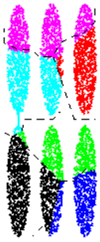
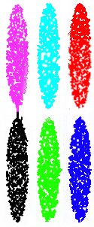
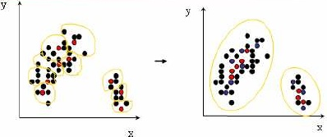
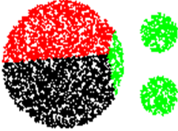
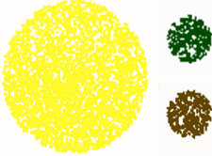
CURE: Clustering Using Representatives
CURE (Clustering Using REpresentatives) (S. Guha, R. Rastogi, and K. Shim, 1998)
Represent a cluster using a set of well-scattered representative points
Cluster distance: Minimum distance between the representative points chosen
This incorporates features of both single link and average link
Shrinking factor α: The points are shrunk towards the centroid by a factor α
Far away points are shrunk more towards the center: More robust to outliers
Choosing scattered points helps CURE capture clusters of arbitrary shapes
Courtesy: Kyuseok Shim@SNU.KR

Slide 116
CHAMELEON: Hierarchical Clustering Using Dynamic Modeling
CHAMELEON: A graph partitioning approach (G. Karypis, E. H. Han, and V. Kumar, 1999)
Measures the similarity based on a dynamic model
Two clusters are merged only if the interconnectivity and closeness (proximity) between two clusters are high relative to the internal interconnectivity of the clusters and closeness of items within the clusters
A graph-based, two-phase algorithm
Use a graph-partitioning algorithm: Cluster objects into a large number of relatively small sub-clusters
Use an agglomerative hierarchical clustering algorithm: Find the genuine clusters by repeatedly combining these sub-clusters

Slide 117
Overall Framework of CHAMELEON
Construct (K-NN)
Sparse Graph
Partition the Graph
Data Set
K-NN Graph: Points p and q are connected if q is among the top-k closest neighbors of p
Merge Partition
Relative interconnectivity: connectivity of c₁ and c₂ over internal connectivity
Relative closeness: closeness of c₁ and c₂ over internal closeness
Final Clusters

Slide 118
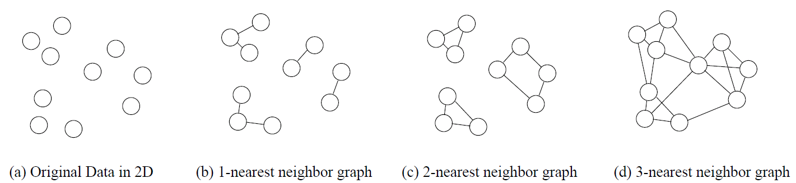
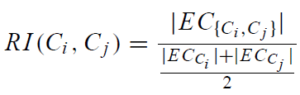
KNN Graphs and Interconnectivity
K-nearest neighbor (KNN) graphs from an original data in 2D:
EC_{{Ci ,Cj } :}The absolute interconnectivity between C_{i} and C_{j}:
The sum of the weight of the edges that connect vertices in C_{i} to vertices in C_{j}
Internal interconnectivity of a cluster C_{i} : The size of its min-cut bisector EC_{Ci} (i.e., the weighted sum of edges that partition the graph into two roughly equal parts)
Relative Interconnectivity (RI):

Slide 119
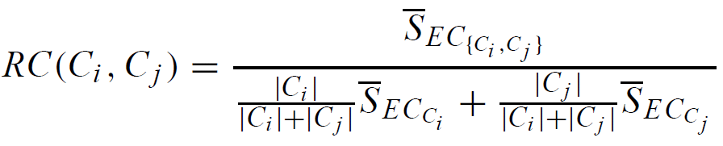



Relative Closeness & Merge of Sub-Clusters
Relative closeness between a pair of clusters C_{i} and C_{j} : The absolute closeness between C_{i} and C_{j} normalized w.r.t. the internal closeness of the two clusters C_{i} and C_{j}
where and are the average weights of the edges that belong to the min-cut bisector of clusters C_{i} and C_{j} , respectively, and is the average weight of the edges that connect vertices in C_{i} to vertices in C_{j}
Merge Sub-Clusters:
Merges only those pairs of clusters whose RI and RC are both above some user-specified thresholds
Merge those maximizing the function that combines RI and RC

Slide 120

CHAMELEON: Clustering Complex Objects
CHAMELEON is capable to generate quality clusters at clustering complex objects

Slide 121
Probabilistic Hierarchical Clustering
Algorithmic hierarchical clustering
Nontrivial to choose a good distance measure
Hard to handle missing attribute values
Optimization goal not clear: heuristic, local search
Probabilistic hierarchical clustering
Use probabilistic models to measure distances between clusters
Generative model: Regard the set of data objects to be clustered as a sample of the underlying data generation mechanism to be analyzed
Easy to understand, same efficiency as algorithmic agglomerative clustering method, can handle partially observed data
In practice, assume the generative models adopt common distribution functions, e.g., Gaussian distribution or Bernoulli distribution, governed by parameters

Slide 122

Generative Model
Given a set of 1-D points X = {x₁, …, x_{n}} for clustering analysis & assuming they are generated by a Gaussian distribution:
The probability that a point x_{i} ∈ X is generated by the model:
The likelihood that X is generated by the model:
The task of learning the generative model: find the parameters μ and σ² such that
the maximum likelihood

Slide 123

Gaussian Distribution
Bean machine: drop ball with pins
1-d Gaussian
2-d Gaussian
From wikipedia and http://home.dei.polimi.it

Slide 124




A Probabilistic Hierarchical Clustering Algorithm
For a set of objects partitioned into m clusters C₁, . . . ,C_{m}, the quality can be measured by,
where P() is the maximum likelihood
If we merge two clusters C_{j1} and C_{j2} into a cluster C_{j1}∪C_{j2}, the change in quality of the overall clustering is
Distance between clusters C₁ and C₂:
If dist(C_{i}, C_{j}) < 0, merge C_{i} and C_{j}

Slide 125
OPTICS: Ordering Points To Identify Clustering Structure
OPTICS (Ankerst, Breunig, Kriegel, and Sander, SIGMOD’99)
DBSCAN is sensitive to parameter setting
An extension: finding clustering structure
Observation: Given a MinPts, density-based clusters w.r.t. a higher density are completely contained in clusters w.r.t. to a lower density
Idea: Higher density points should be processed first—find high-density clusters first
OPTICS stores such a clustering order using two pieces of information:
Core distance and reachability distance
Reachability plot for a dataset
Reachability-distance
undefined
Cluster-order of the objects
Since points belonging to a cluster have a low reachability distance to their nearest neighbor, valleys correspond to clusters
The deeper the valley, the denser the cluster

Slide 126

OPTICS: An Extension from DBSCAN
Core distance of an object p: The smallest value ε such
that the ε-neighborhood of p has at least MinPts objects
Let N_{ε}(p): ε-neighborhood of p
ε is a distance value
Core-distance_{ε, MinPts}(p) = Undefined if card(N_{ε}(p)) < MinPts
MinPts-distance(p), otherwise
Reachability
distance
Reachability distance of object p from core object q is the min. radius value that makes p density-reachable from q
Reachability-distance_{ε, MinPts}(p, q) =
Undefined, if q is not a core object
max(core-distance(q), distance (q, p)), otherwise
Complexity: O(N logN) (if index-based)
where N: # of points
undefined
Cluster-order of the objects

Slide 127


OPTICS: Finding Hierarchically Nested Clustering Structures
OPTICS produces a special cluster-ordering of the data points with respect to its density-based clustering structure
The cluster-ordering contains information equivalent to the density-based clusterings corresponding to a broad range of parameter settings
Good for both automatic and interactive cluster analysis—finding intrinsic, even hierarchically nested clustering structures
Finding nested clustering structures with different parameter settings

