Slide 1
Privacy & Online Speech or “Why does the internet work this way? – a legal perspective”

Slide 2
Privacy - Defining privacy? - What we assume - How the US’s privacy laws work - Why it matters Online speech - Policing speech – private vs. government actors - Communications Decency Act Section 230 - Section 230 and platforms
Outline

Slide 3
we’re not covering data security

Slide 4
Privacy?

Slide 5
- Government is different than the private sector - Our goal is meaningful choice for the person whose information is shared. - We care about the rights of recipients as well as actors.
Privacy Assumptions

Slide 7
Notice & Choice

Slide 8
- Government is different than the private sector - Our goal is meaningful choice for the person whose information is shared. - We care about the rights of recipients as well as actors.
Privacy Assumptions

Slide 9
Communications (ECPA)
General
Kids' data (COPPA)
State laws (CCPA, BIPA)
Healthcare (HIPAA)
Education (FERPA)
Credit reports & background checks (FCRA)
Sector-specific
Notes:
And others – GLBA, other state laws

Slide 11
Notes:
For online consumer data, this translates to notice and choice
Affirmative express consent (flag geolocation)
Just in time notice

Slide 12
Notes:
Report sets out privacy “framework” for all (online & offline) user data
Standard is “reasonably linkable” to individual or device
Emphasis on simplified consumer choice, transparency, privacy by design
Already 6! years old

Slide 13
What do you collect? How do you use it? How and with whom do you share it?
Notice & Choice

Slide 16
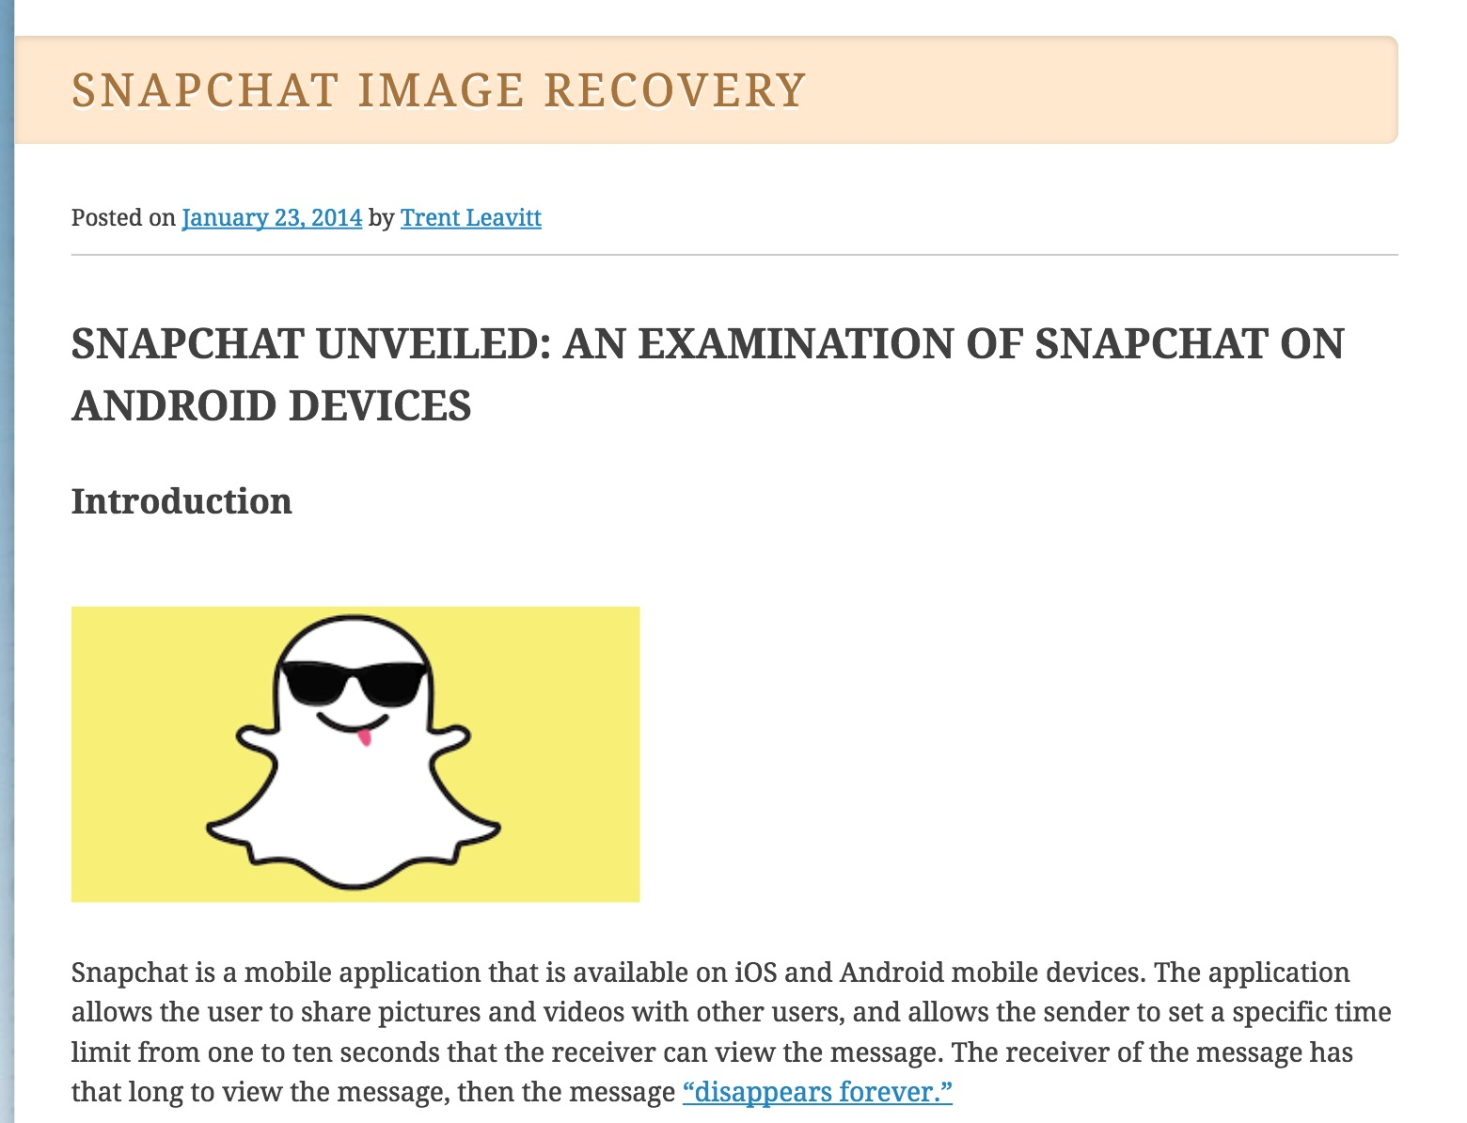

Slide 17
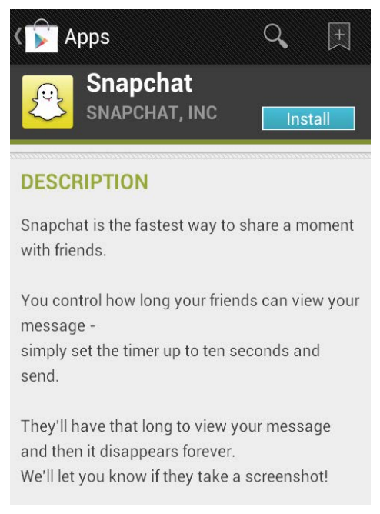

Slide 18
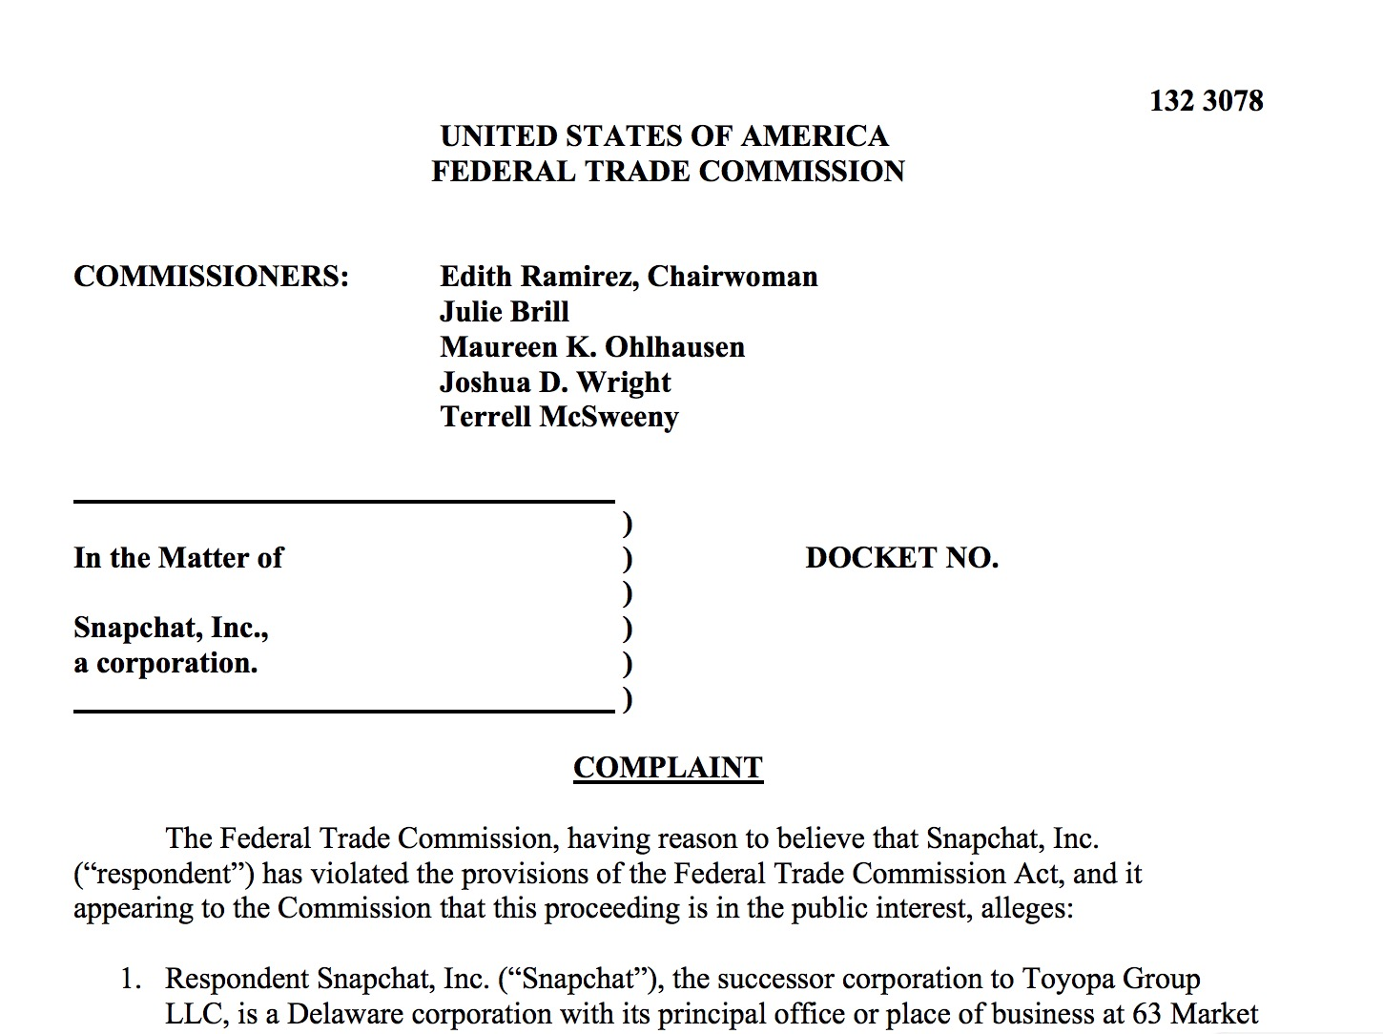

Slide 22
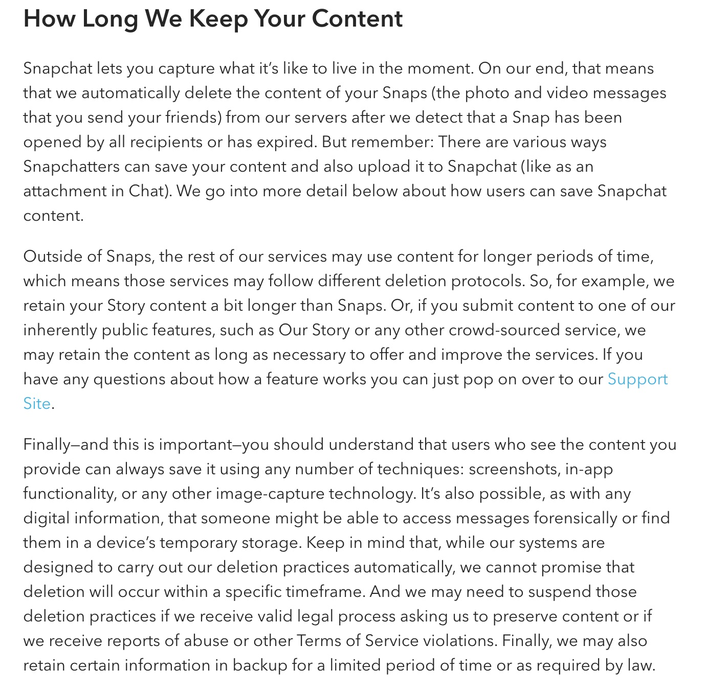

Slide 23
Communications Decency Act

Slide 24
Publisher or distributor??
Public Library
Newspaper ad
Bookstore
Magazine letter to the editor
Neighborhood newsletter
TV news broadcast
TV ad
Newspaper seller
Test:
Publishers are liable for what they publish, but
Distributors must have “actual knowledge” of the unlawful content.
(Smith v. California)

Slide 25
Publisher or distributor??
Public Library
Newspaper ad
Bookstore
Magazine letter to the editor
Neighborhood newsletter
TV news broadcast
TV ad
Newspaper seller
Test:
Publishers are liable for what they publish, but
Distributors must have “actual knowledge” of the unlawful content.
(Smith v. California)

Slide 26
(c) PROTECTION FOR ‘GOOD SAMARITAN’ BLOCKING AND SCREENING OF OFFENSIVE MATERIAL.—
TREATMENT OF PUBLISHER OR SPEAKER.—No provider or user of an interactive computer service shall be treated as the publisher or speaker of any information provided by another information content provider.
CIVIL LIABILITY.—No provider or user of an interactive computer service shall be held liable on account of—
any action voluntarily taken in good faith to restrict access to or availability of material that the provider or user considers to be obscene, lewd, lascivious, filthy, excessively violent, harassing, or otherwise objectionable, whether or not such material is constitutionally protected; or
any action taken to enable or make available to information content providers or others the technical means to restrict access to material described in paragraph (1).

Slide 28
(c) PROTECTION FOR ‘GOOD SAMARITAN’ BLOCKING AND SCREENING OF OFFENSIVE MATERIAL.—
TREATMENT OF PUBLISHER OR SPEAKER.—No provider or user of an interactive computer service shall be treated as the publisher or speaker of any information provided by another information content provider.
CIVIL LIABILITY.—No provider or user of an interactive computer service shall be held liable on account of—
any action voluntarily taken in good faith to restrict access to or availability of material that the provider or user considers to be obscene, lewd, lascivious, filthy, excessively violent, harassing, or otherwise objectionable, whether or not such material is constitutionally protected; or
any action taken to enable or make available to information content providers or others the technical means to restrict access to material described in paragraph (1).

Slide 29
(b) POLICY.—It is the policy of the United States—
to promote the continued development of the Internet and other interactive computer services and other interactive media;
to preserve the vibrant and competitive free market that presently exists for the Internet and other interactive computer services, unfettered by Federal or State regulation;
to encourage the development of technologies which maximize user control over what information is received by individuals, families, and schools who use the Internet and other interactive computer services;
to remove disincentives for the development and utilization of blocking and filtering technologies that empower parents to restrict their children’s access to objectionable or inappropriate online material; and
to ensure vigorous enforcement of Federal criminal laws to deter and punish trafficking in obscenity, stalking, and harassment by means of computer.

Slide 33
