Slide 1
I/O systems
Some of the following slides adapted from Matt Welsh.

Slide 2
I/O systems
The two main jobs of a computer are I/O and processing.
In many cases, the main job is I/O and the processing is merely incidental, e.g.
browse a web page or
edit a file
I/O system provides the means for the computer to interact with the rest of the world.

Slide 3
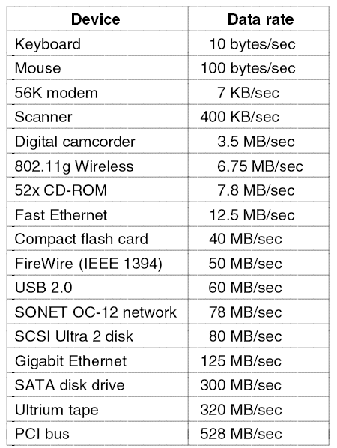
I/O devices in OS
I/O devices vary greatly
Data rate:
may vary by several orders of magnitude
Complexity of control:
exclusive vs. shared devices
Unit of transfer:
stream of bytes vs. block-I/O
Data representations:
character encoding, error codes, parity conventions
Error conditions:
consequences, range of responses
Applications:
impact on resource scheduling, buffering schemes

Slide 4
I/O systems in OS
I/O system in the OS should
abstract away the detailed differences in I/O devices by identifying a few general types,
Provide access to each type through a standardized set of functions—an interface
Provide a modular software structure to support vendor-specific software

Slide 5
I/O system in OS
Users should not be allowed to issue illegal I/O instructions.
All I/O instructions should be priviliged to provide a proper protection.
Note that the kernel cannot simply deny all user access.
Most graphics games and video editing/playback software need direct access to memory-mapped graphics controller memory to speed access.
The kernel may provide a locking mechanism to allow a section of graphics memory to be allocated to a process at a time.

Slide 6
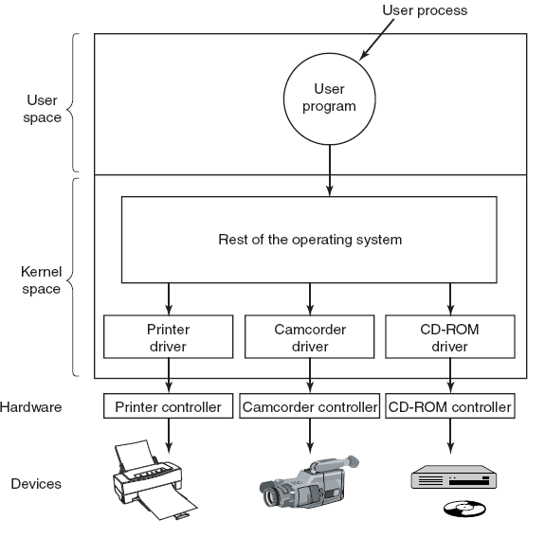
I/O system
Converts the I/O request of the application into low-level commands for the device and send it to the device controller,
Take the response of the I/O device and send it to the application.

Slide 7
Issues related to I/O system
How to access I/O devices in HW?
How to interact with I/O devices?
How are I/O devices categorized?
Character vs. Block

Slide 8
How to access I/O devices in HW?
OS needs to send/receive commands and control to device controller to accomplish I/O.
Device controller* has one or more registers for control and data. (*will be described later)
Processor communicates controller through reading/writing to these registers
How to address these registers?
Memory-based I/O
Port-based I/O
Hybrid I/O

Slide 9
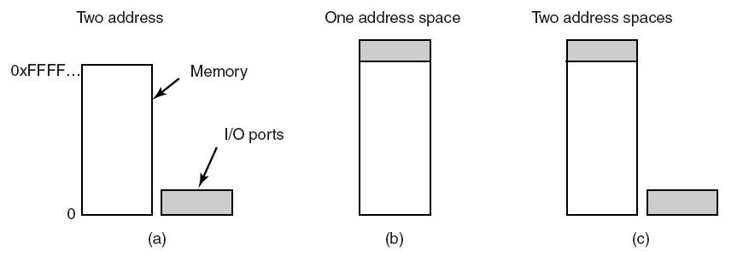
Memory-mapped/ Port-based/Hybrid I/O
How to read/write registers:
Special CPU instructions (IN/OUT)
Memory mapped: Regions of memory is reserved for HW I/O registers. Standard memory instructions update them.
Hybrid: Some controllers mapped to memory, some uses I/O instructions

Slide 10
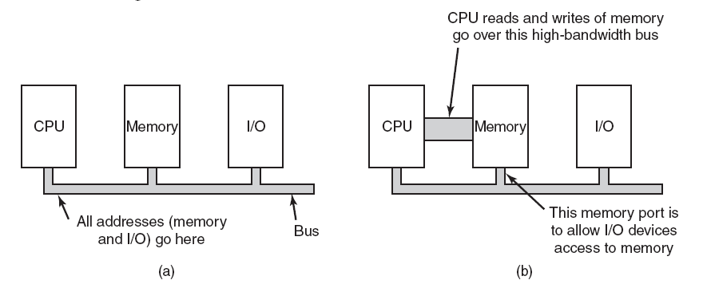
Single Bus and dual bus I/O
Memory mapped I/O has a single address space,
Memory mapped I/O is simpler to implement and use.
Frame buffers, or similar devices, are more suitable for memory mapped I/O.
Port based I/O has two address spaces: one for memory, one for ports.
Dual bus allows parallel read/write of data and devices.

Slide 11
I/O Hardware interfaces
SCSI disk
Memory bus
CPU
PCI bridge/ memory controller
Memory
SCSI disk
Cache
SCSI disk
SCSI bus
Video controller
Network controller
SCSI controller
PCI bus
IDE disk controller
USB interface/
controller
Keyboard
+
USB controller
Mouse
+
USB controller
USB bus
USB ports

Slide 12
I/O Hardware interfaces - Bus
Bus: An interconnection between components (including CPU)
More than one device can be connected
SCSI disk
Memory bus
CPU
PCI bridge/ memory controller
Memory
SCSI disk
Cache
SCSI disk
SCSI bus
Video controller
Network controller
SCSI controller
PCI bus
IDE disk controller
USB interface/
controller
Keyboard
+
USB controller
Mouse
+
USB controller
USB bus
USB ports

Slide 13
I/O Hardware interfaces - Port
Port: An interface for plugging in only one I/O device
SCSI disk
Memory bus
CPU
PCI bridge/ memory controller
Memory
SCSI disk
Cache
SCSI disk
SCSI bus
Video controller
Network controller
SCSI controller
PCI bus
IDE disk controller
USB interface/
controller
Keyboard
+
USB controller
Mouse
+
USB controller
USB bus
USB ports

Slide 14
I/O Hardware interfaces - device controller
Device controller: Connects physical device to system bus/port.
SCSI disk
Memory bus
CPU
PCI bridge/ memory controller
Memory
SCSI disk
Cache
SCSI disk
SCSI bus
Video controller
Network controller
SCSI controller
PCI bus
IDE disk controller
USB interface/
controller
Keyboard
+
USB controller
Mouse
+
USB controller
USB bus
USB ports

Slide 15
Device controllers and device drivers
There is always a device controller and a device driver for each device to communicate with the OS.
Device drivers are software modules that can be plugged into an OS to handle a particular device.
Device controllers works as an interface between a device and a device driver.
A device controller may be able to handle multiple devices.
As an interface its main task is to convert serial bit stream to block of bytes, perform error correction as necessary.
Operating system
device driver
Device
device controller

Slide 16
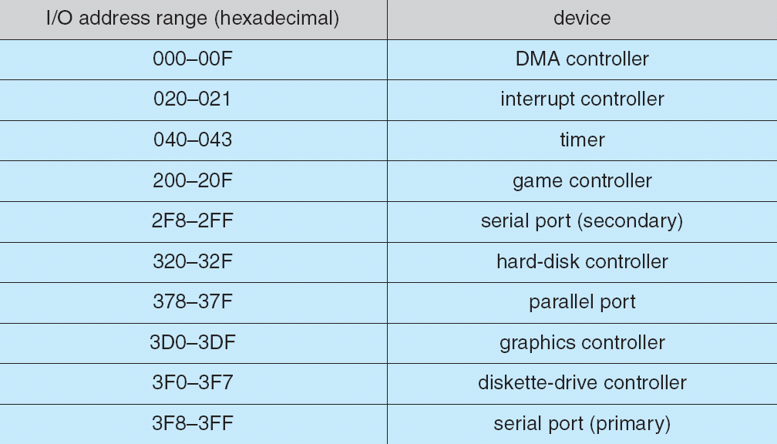
Device I/O port locations on PC (partial)

Slide 17
I/O port registers
status register
Read by the host.
command register
Written by the host
data-in register
Read by the host to get input.
data-out register
Written by the host to send output.
Device
device controller
status
Operating system
device driver
command
data-in
data-out

Slide 18
I/O port registers - status register
status register
Read by the host.
Bits indicate states such as
whether the current command has completed,
whether a byte is available to be read from the data-in register,
whether there has been a device error.
Device
device controller
status
Operating system
device driver
command
data-in
data-out

Slide 19
I/O port registers - command register
command register
Written by the host
The command requested from the device
E.g. read or write for a disk
Device
device controller
status
Operating system
device driver
command
data-in
data-out

Slide 20
I/O port registers - data-in register
data-in register
Read by the host to get input.
E.g. the data read from the disk when the command is read
Device
device controller
status
Operating system
device driver
command
data-in
data-out

Slide 21
I/O port registers - data-out register
data-out register
Written by the host to send output.
E.g. the data to be written on the the disk when the command is write
Device
device controller
status
Operating system
device driver
command
data-in
data-out

Slide 22
I/O device communication
Note that both the device driver and the device controller are running as “separate processes” to access the registers.
Hence need to ensure the atomicity of register updates.
For example, how can the device controller know that the data to be written on the disk is fully copied onto its registers?
Device
device controller
status
Operating system
device driver
command
data-in
data-out

Slide 23
Polling: I/O interfacing in software
/* DEVICE DRIVER CODE */
while (*deviceStatus&BUSY); /* POLL:repeatedly check the busy bit */
*deviceDataOut = data_byte; /* write a byte into the data-out register */
*deviceCommand |= WRITE; /* sets the command as WRITE */
*deviceCommand |= READY; /* sets the command-ready bit */
/* DEVICE CONTROLLER CODE */
while(TRUE){
while (*deviceCommand&READY); /* repeatedly check the command ready bit*/
*deviceStatus = BUSY; /* set the busy bit */
/* …................ */
}
Device
device controller
status
Operating system
device driver
command
data-in
data-out

Slide 24
Polling: I/O interfacing in software
/* DEVICE DRIVER CODE */
while (*deviceStatus&BUSY); /* repeatedly check the busy bit in status */
*deviceDataOut = data_byte; /* write a byte into the data-out register */
*deviceCommand |= WRITE; /* sets the command as WRITE */
*deviceCommand |= READY; /* sets the command-ready bit */
/* DEVICE CONTROLLER CODE */
while(TRUE){
while (*deviceCommand&READY); /* repeatedly check the command ready bit*/
*deviceStatus |= BUSY; /* set the busy bit */
Command = *deviceCommand; /* read the command */
if (Command&WRITE) /* if the command is WRITE */
dataOut = *deviceDataOut; /* read the data put by the OS */
success= WriteToDevice(dataOut); /* do the I/O on the device */
if (success){
*deviceCommand &= !READY; /* clear the command-ready bit */
*deviceStatus &= !ERROR; /* clear the error bit */
*deviceStatus &= !BUSY; /* clear the busy bit */
}else{
*deviceCommand &= !READY; /* clear the command-ready bit */
*deviceStatus |= ERROR; /* SET the error bit */
*deviceStatus &= !BUSY; /* clear the busy bit */
}
}
/* code for other commands */
}

Slide 25
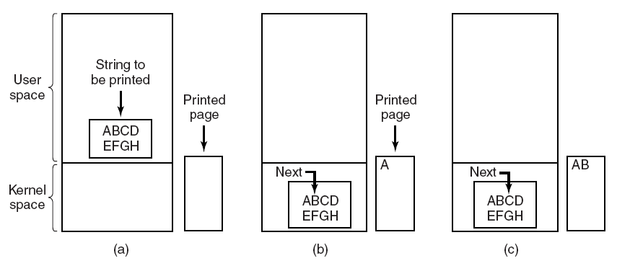
Polling I/O example: Steps in printing a string
Copy the string to be printed into a buffer in the kernel space
Poll the printer and send a character if not busy.
Loop until the end of the string.
Tanenbaum, Modern Operating Systems 3 e, (c) 2008 Prentice-Hall, Inc. All rights reserved. 0-13-6006639

Slide 26
Programmed Polling I/O example: Pseudocode for printing a string
/* p is the kernel buffer */
copyFromUser(buffer, p, count);
/* loop on every character */
for (i=0; i<count; i++){
/* loop until device is ready */
while (*printerStatusRegister != READY);
/* POLLING/BUSY WAITING! */
/* output one char */
*printerDataRegister = p[i];
}
returnToUser();
Polling is essentially busy waiting and wastes CPU time!
Any ideas how to fix it?
Tanenbaum, Modern Operating Systems 3 e, (c) 2008 Prentice-Hall, Inc. All rights reserved. 0-13-6006639

Slide 27
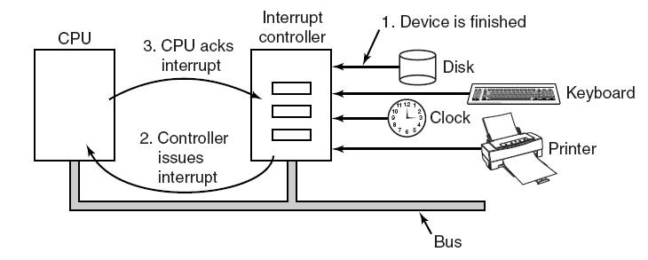
Interrupts - refresher
Interrupts are hardware exceptions.
CPU has an interrupt wire
Connected to an interrupt controller, which in turn is
connected to I/O devices
When one of the devices generate an interrupt signal, the controller informs the CPU
The CPU acknowledges the interrupt and
Jumps to the interrupt service routine (ISR) if needed.

Slide 28
Interrupt-Driven I/O
Use interrupts!
Recall that interrupts are “hardware exceptions” that allow I/O devices to signal the CPU that they need attention!
The device driver initiates the I/O and resume (instead of busy waiting)
When done, the device raises an interrupt to let the CPU (hence OS) know that it’s ready to accept more
The interrupt service routine (handler) sends some more.
Device
device controller
Interrupt
handler
status
Operating system
command
data-in
device driver
data-out

Slide 29
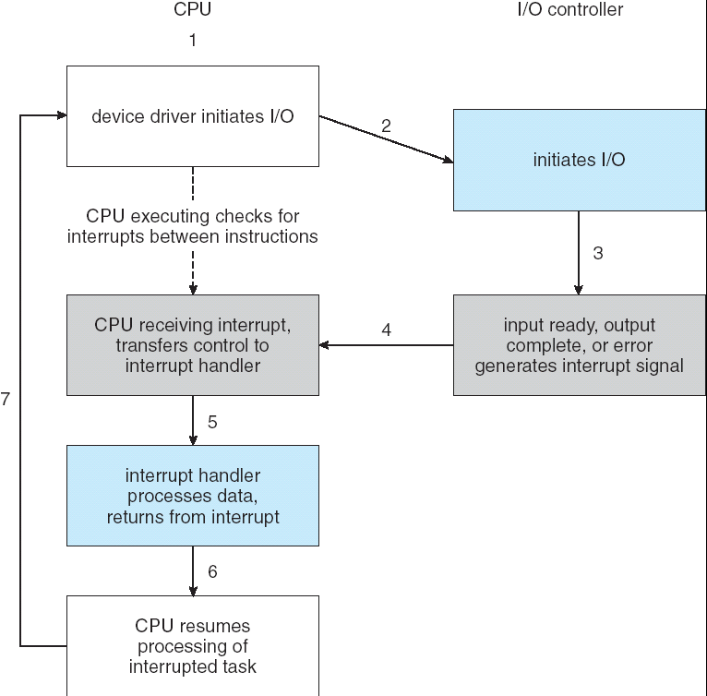
Interrupt Based I/O
CPU is not blocked during I/O. Schedules user tasks.
Upon interrupt:
Current CPU state is saved
Interrupt Service Routine corresponding to device is jumped.
Necessary actions are executed.
Return from Interrupt instruction restores the state prior to the interrupt.
Depending on the architecture a separate stack can be used as ISR context
Task requesting I/O is put into sleep until interrupt handler marks I/O ready and wakes up the task.

Slide 30
Interrupt-Driven I/O
/* Code executed when the print system call is made */
copyFromUser(buffer, p, count);
enableInterrupts();
while (*printerStatusRegister != READY);
*printerDataRegister = p[i];
scheduler();
/* Interrupt Service Routine (ISR) for the printer */
if (count == 0)
unblockUser();
else{
*printerDataRegister = p[i];
count = count -1;
i++;
}
acknowledgeInterrupt();
returnFromInterrupt();
Tanenbaum, Modern Operating Systems 3 e, (c) 2008 Prentice-Hall, Inc. All rights reserved. 0-13-6006639

Slide 31
Interrupt Handler Routine Details
Save registers not already been saved by interrupt hardware.
Set up a context for the interrupt service procedure.
Set up a stack for the interrupt service procedure.
Acknowledge the interrupt controller.
If there is no centralized interrupt controller, reenable interrupts.
Copy the registers from where they were saved to the process table.
Run the interrupt service procedure.
Choose which process to run next.
Set up the MMU context for the process to run next.
Load the new process’ registers, including its PSW.
Start running the new process.

Slide 32
Interrupt servicing: Advanced
Modern interrupt controllers provide
The ability to defer interrupt handling during critical processing
Efficient way to dispatch the proper interrupt handle w/o polling all the devices
Multi-level interrupts, to distinguish low and high priority interrupts
Most CPU’s have two interrupt request lines
Nonmaskable
Reserved for unrecoverable errors
Maskable
Used by device controllers
Can be turned off before the execution of critical instruction sequences

Slide 33
Interrupt servicing: Advanced (cont)
Interrupt mechanism needs
Address: to select a specific interrupt handling routine
Typically an offset in a table called interrupt vector which contains addresses of interrupt handlers
What if there are more devices than the interrupt vector size?
Interrupt chaining
Interrupt priority levels
defer the handling of low-priority interrupts without masking off all interrupts,
and makes it possible for a high-priority interrupt to pre-empt the execution of a low-priority interrupt.

Slide 34
Direct Memory Access (DMA)
For a device that does large transfers, such as a disk drive,
it seems wasteful to use an expensive general-purpose processor to watch status bits and
to feed data into a controller register 1 byte at a time —a process termed programmed I/O
Interrupt-based I/O is not a remedy since, each byte would create a context switch to the Interrupt Handler Routine.
In both polling-based and interrupt-based I/O, all the bytes need to be passed through the CPU and has a lot of overhead
I/O device <-> CPU <-> Memory
It would be nice if we can off-load this mundane task to a special-purpose processor that can move the data from/to I/O device to memory directly!
Direct-memory-access (DMA) controller.

Slide 35
Direct Memory Access
To initiate a DMA transfer, the host writes a DMA command block into memory.
a pointer to the source of a transfer,
a pointer to the destination of the transfer, and
a count of the number of bytes to be transferred.
The CPU writes the address of this command block to the DMA controller, then goes on with other work.
The DMA controller proceeds to operate the memory bus directly,
placing addresses on the bus to perform transfers without the help of the main CPU.
A simple DMA controller is a standard component in PCs, and bus-mastering I/O boards for the PC usually contain their own high-speed DMA hardware

Slide 36
I/O Using DMA
/* Code executed when the print system call is made */
copyFromUser(buffer, p, count);
setupDMAController();
scheduler();
/* Interrupt Service Routine Procedure for the printer */
acknowledgeInterrupt();
unblockUser();
returnFromInterrupt();
Note that the interrupt is generated once per I/O task as opposed to once per byte (in the case of interrupt-based I/O).
Tanenbaum, Modern Operating Systems 3 e, (c) 2008 Prentice-Hall, Inc. All rights reserved. 0-13-6006639

Slide 37
I/O Hardware interfaces
Device driver is told to transfer disk data to buffer at address X
Device driver tells the disk controller to transfer C bytes from disk to buffer at address X
Disk controller initiates DMA transfer
Disk controller sends each byte to DMA controller
DMA controller transfers bytes to buffer X
Incrementing memory address and decrementing C until 0.
When C == 0, DMA interrupts CPU to signal transfer completion.
CPU
PCI bridge/ memory controller
Memory
Cache
Disk
DMA controller
Disk controller
PCI bus

Slide 38
Application I/O Interface
User processes
System Calls |  |  | Kernel (other subsytems)
I/O Subsystem
SCSI Device Driver | Keyboard Device Driver | Mouse Device Driver | … | PCI bus Device Driver | USB bus Device Driver | Graphic Card Device Driver
SCSI Controller | Keyboard Controller | Mouse Controller | … | PCI Controller | USB controller | Graphics Adapter
Kernel
Hardware
Internal or external cabling/connectors
SCSI Devices
Keyboard
Mouse
USB Devices
Screen Devices

Slide 39
Application I/O Interface
OS needs to provide the interface and I/O subsystem from user area down to the HW and the device controller.
Interface and I/O subsystem should:
Cover all different device types
E.g. graphic cards, network interface cards, disk controllers, HCI devices, etc.
Allow addition of new devices.
A vendor introduced a new product, support it.
Provide device driver development interfaces for HW vendors.
Plug and play support for different device types and buses (i.e. PCI, USB).
Dynamic loading of device drivers.
A kernel supporting all possible HW will be huge.
Load device drivers on demand or selectively.

Slide 40
Application I/O Interface
System calls are the basic kernel interface for user applications.
A different set of system calls for each different:
Device vendor?
Device driver?
Device type?
Device class?
Set of system calls should be minimum. A uniform and simple I/O interface is required.
Simple set of device types:
Character devices (character special files)
Block devices (block special files)
Network devices (socket interface)

Slide 41
Application I/O Interface
Unix solution: Use simple file interface:
open/read/write/seek/close/mmap + ioctl (for configuring device)
Handler/Entry point for a device:
a special file on file system which resides traditionally under /dev
All system calls on special files are directed on device drivers.
crw------- 1 root root 10, 1 Mar 21 13:43 /dev/psaux brw-rw---- 1 root disk 8, 16 Mar 21 13:43 /dev/sdb brw-rw---- 1 root disk 8, 17 Mar 21 13:43 /dev/sdb1 brw-rw---- 1 root disk 8, 18 Mar 21 13:43 /dev/sdb2 brw-rw---- 1 root disk 8, 19 Mar 21 13:44 /dev/sdb3 crw--w---- 1 root tty 4, 0 Mar 21 13:43 /dev/tty0 crw------- 1 onur tty 4, 3 May 22 13:35 /dev/tty3
A special file is either a character or a block device.
Each file has a major and minor number
Major number selects device driver code.
Minor number selects between multiple devices handled by same driver.

Slide 42
Device Driver Switch
Major
0
1
..
8
…
struct cdeviceops
Device Driver Code int sd_open(maj,min,…){ ... } int sd_read(maj,min,…){ ... }
int sd_write(maj,min,…) { ... }
int sd_ioctl(maj,min,…){ ... }
…
..
open
read
write
ioctl
…
..
A read on block special file major 8, minor 4 translates: bdevsw[8]->read(8,4,…)

Slide 43
Device drivers
Each I/O device attached to a computer needs some device-specific code for controlling it.
written by device manufacturer
each OS needs its own device drivers
Each device driver supports a specific type or class of I/O devices.
A mouse driver can support different types of mice but cannot be used for a webcam.
The OS defines what a driver does and how it interacts with the rest of the OS.
A device driver has several functions
to accept abstract read and write requests from device-independent software above it and make sure that they are carried out, +
initialization of the device
manage is power requirements and log events

Slide 44
Device driver structure
check whether input parameters are valid
translation from abstract to concrete terms
for a disk driver, converting a block id into head, track, sector and cylinder numbers for the disk's geometry
check if the device is currently in use by checking its status register
if not, insert the request into queue
if the device is not on, turn it on
issue the sequence of commands
after issuing each command, check whether the device is ready to accept the next one
[in most cases] the driver blocks itself until an interrupt comes
[in fewer cases] the driver waits for the completion of the command
the driver is awakened up by the driver to continue its operation
the data and the error information is passed to the device-independent OS I/O software

Slide 45
Device drivers - issues
Note that
an I/O device may complete while the device driver is running and create an interrupt
the interrupt may cause the current driver to run
device drivers must be reentrant,
a running driver has to expect that it will be called a second time before the first call has completed.
Drivers cannot make system calls but are allowed to call some kernel procedures for interaction.

Slide 46
I/O devices - character and block devices
From units of transfer perspective, I/O devices can be divided into two categories:
Block devices − A block device is one with which the driver communicates by sending entire blocks of data.
Hard disks, USB cameras, Disk-On-Key etc.
Character devices − A character device is one with which the driver communicates by sending and receiving single characters.
serial ports, parallel ports, sounds cards etc.

Slide 47
Character vs. Block Devices
Some hardware uses character at a time I/O:
printers, keyboard, mouse, modem, console, etc.
Some hardware has a special block size as the minimum unit:
All disk devices, hard disks, SSD, CD/DVD etc.
A single byte I/O is not possible in block devices.
A single byte update requires:
Read a full block in memory
Update block in memory
Write block back

Slide 48
Block devices
The block-device interface captures all the aspects necessary for accessing disk drives and other block-oriented devices.
read() and write() , and, if it is a random-access device, it has a seek() command to specify which block to transfer next.
Applications normally access such a device through a file-system interface.
The operating system itself, and special applications such as database-management systems, may prefer to access a block device as a simple linear array of blocks (also called raw I/O).
OS device cache is used to accelerate block device operations.
Block based I/O is tightly coupled with paging.
File systems require block devices.

Slide 49
Character devices
A keyboard is an example of a device that is accessed through a character-stream interface.
get() or put() one character.
Character device drivers implements their own buffers and caching internally.
for example, when a user types a backspace, the preceding character is removed from the input stream.
Example devices:
Keyboard, modem, mouse

Slide 50
Character vs. Block Devices
Character and Block device switches are separate.
Interface is also different.
Block devices can combine read and write functions (see I/O scheduling later)
Character vs. Block devices:
Character devices can transfer data 1 byte at a time. Block devices work in block units (i.e. 4K)
Character device devices have buffering and caching internal, block devices use systems page cache.
Block devices can contain file system partitions and swap area.
Block device drivers may implement I/O scheduling algorithms, system call interface support it.

Slide 51
ioctl()
A single function configuration interface for all devices. int ioctl(int fd, unsigned long request, ...);
Types of requests and optional parameter is driver or even vendor specific.
Each driver implements its own set of configuration requests and parameter types.
Devices and drivers change but libc and kernel interface is fixed.

Slide 52
Windows I/O subsystem
Microsoft Windows uses device shortcuts on filesystem to address devices.
Device Access API provides an interface to application programmers to inspect and interact with the devices.
WDK, Windows Device Framework provides user and kernel interfaces for device driver development.

Slide 53
I/O Categorization (OS perspective)
Character stream vs block.
Sequential vs Random access device driver allow seeking to an offset in device
Synchronous vs Asynchronous I/O operation on device driver is synchronized with I/O completion on device controller. Asynchronous I/O returns earlier and report success/failure later.
Buffered vs Direct The reported operation result is completed on buffers or on device controller.
Shareable or Dedicated I/O on each device instance is mutually exclusive. (i.e. printer)
Read only, Write only, Read-write i.e: mouse, printer, hard disk

Slide 54
Kernel I/O System
Kernels provide many services related to I/O:
scheduling,
buffering,
caching,
pooling,
device reservation, and
error handling
built on the hardware and device-driver infrastructure.

Slide 55
I/O scheduling
To schedule a set of I/O requests means to determine a good order in which to execute them.
Operating-system developers implement scheduling by maintaining a queue of requests for each device.
When an application issues a blocking I/O system call, the request is placed on the queue for that device.
The I/O scheduler rearranges the order of the queue to improve the overall system efficiency and the average response time experienced by applications.

Slide 56
I/O Scheduling
I/O is usually slow and some devices have physical characteristics requiring optimizations.
E.g. hard disks: Mechanical devices and delays caused by head movement and rotation.
If I/O is executed in a FIFO strategy, mechanical zigzag movements can overrule the I/O operations.
I/O scheduling gets a set of I/O requests on a device and determines an optimal order and timing to execute the requests on the device.
Scheduling gets complicated where multiple tasks compete for their I/O requests to be handled.

Slide 57
Disk I/O Scheduling
Given multiple outstanding I/O requests, what order to issue them?
Why does it matter?
Major goals of disk scheduling:
Minimize latency for small transfers
Primarily: Avoid long seeks by ordering accesses according to disk head locality
Maximize throughput for large transfers
Large databases and scientific workloads often involve enormous files and datasets
Note that disk block layout (where we place file blocks, directories, file system metadata, etc.) has a large impact on performance

Slide 58
Disk I/O Scheduling
Given multiple outstanding I/O requests, what order to issue them?
FIFO: Just schedule each I/O in the order it arrives
What's wrong with this?
Potentially lots of seek time!
SSTF: Shortest seek time first
Issue I/O with the nearest cylinder to the current one
Favors middle tracks: Head rarely moves to edges of disk
SCAN (or Elevator) Algorithm:
Head has a current direction and current cylinder
Sort I/Os according to the track # in the current direction of the head
If no more I/Os in the current direction, reverse direction
CSCAN Algorithm:
Always move in one direction, “wrap around” to beginning of disk when moving off the end
Reduce variance in seek times, avoid discrimination against the highest and lowest tracks

Slide 59
SCAN example
Current track
Direction

Slide 60
SCAN example
Current track
Direction

Slide 61
SCAN example
Current track
Direction

Slide 62
SCAN example
Current track
Direction

Slide 63
SCAN example
Current track
Direction

Slide 64
SCAN example
Current track
Direction

Slide 65
SCAN example
Current track
Direction

Slide 66
SCAN example
Current track
Direction

Slide 67
SCAN example
Current track
Direction

Slide 68
SCAN example
Current track
Direction

Slide 69
SCAN example
Current track
Direction

Slide 70
SCAN example
Current track
Direction
What is the overhead of the SCAN algorithm?
Count the total amount of seek time to service all I/O requests
In this case, 12 tracks in --> direction
15 tracks for long seek back
5 tracks in <-- direction
Total: 12+15+5 = 32 tracks

Slide 71
Disk Devices
Not all disk devices may require I/O scheduling.
Solid State disks have no moving parts and mechanical delays.
SSD’s have other problems due to the following characteristics:
Block based read only read access, fast, no restriction.
Only empty blocks can be written, slower than read but still fast
Non-empty blocks needs to be erased.
Erasing has to be done in larger units (segments/clusters). i.e. 512byte vs. 32KByte.
Erasing is slow and each segment has a erase cycle limit (i.e. 10000 erases).
Single bit update requires:
Erase a whole segment , write all (32K) content with modified bit.

Slide 72
SSD Drives
Erase/write problem solution:
Write modified blocks on already erased segments
Logical block number and actual block on disk differs.
Keep and internal table for actual block to logical block mapping.
OS asks for logical block content, SDD controller returns actual block content.
Called Wear Leveling or Write Amplification.
FTL: Flash Translation Layer implemented on Flash hardware does the translation. OS does not know about it.
OS based solution: Use a Log Structured File System.

Slide 73
Disk Management
Managing disks on a system gets complicated as space requirement increases by time.
Adding new disks to system, changing failed disks, deleting disks, adjusting partitions with new layout is an issue.
A solution is Logical Volume Management.
A layer in OS maps a group of physical disk partitions into a large contiguous logical volume.
E.g. add 5 4T disks to get a 20T as a single partition.
LVM helps getting OS independent from underlying disk organization.
RAID (Redundant Array of Independent Disks) is another solution which also respects disk failures and efficiency.
Common RAID levels:
0 stripe (distribute I/O requests on two or more disks for efficiency)
1 mirror (execute same I/O on two or more disks for failure recovery)
5 distributed parity (distribute operation on multiple disk with parity, both efficiency and filure recovery)
RAID is best implemented in HW. OS implementation is called Soft RAID

Slide 74
Page Cache
Block device operations are tightly coupled with virtual memory and paging.
Some of the frames are used as page cache and keeps data of block devices in systems.
I/O in a block device:
Search if block is already in page cache (in physical memory):
if found read/write buffer from/to existing frame
Else allocate a frame, read device block into frame, mark frame as caching device-block pair read/write bufffer from/to this frame.
Dirty pages are written on block device periodically.
Accelerates I/O operations significantly, especially file system meta data operations.

Slide 75
File Cache
Page cache idea also couples with memory mapped I/O. mmap()’ed files work in a similar mechanism.
Virtual memory of a process map a page backed as a file (instead of a block device). Changes are updated on memory, cached frames are forced on disk periodically.
VM system keeps track of frames of page and file caches together with other (resident and free) pages.
VM system adapts sizes of file and device cache based on memory state of the system.

Slide 76
Buffering
A buffer is a memory area that stores data while they are transferred between two devices or between a device and an application.
Buffering is done for three reasons.
to cope with a speed mismatch between the producer and consumer of a data stream.
a file is being received via modem for storage on the hard disk
to adapt between devices that have different data-transfer sizes.
networking: messages are typically fragmented during sending and receiving
to support copy semantics for application I/O.
application calls the write() system call, providing a pointer to the buffer and an integer specifying the number of bytes to write.
After the system call returns, what happens if the application changes the contents of the buffer?
When processing write() system call, OS copy the application data into a kernel buffer before returning control to the application.
The disk write is performed from the kernel buffer, so that subsequent changes to the application buffer have no effect.

Slide 77
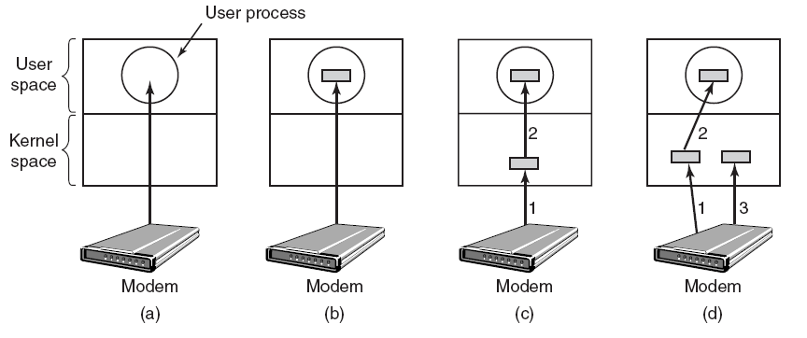
Buffering (1)
(a) Unbuffered input. (b) Buffering in user space. (c) Buffering in the kernel followed by copying to user space.(d) Double buffering in the kernel.
Tanenbaum, Modern Operating Systems 3 e, (c) 2008 Prentice-Hall, Inc. All rights reserved. 0-13-6006639

Slide 78
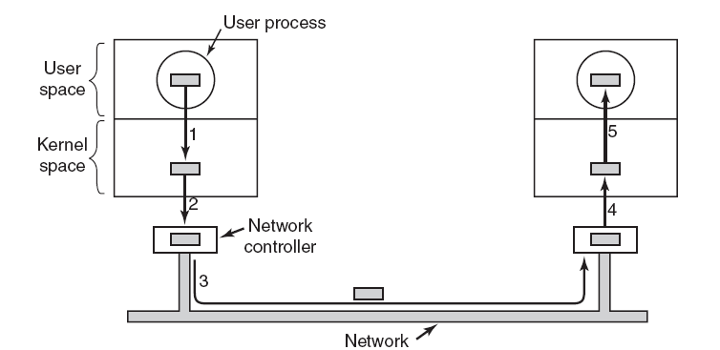
Buffering (2)
Networking may involve many copies of a packet.
Tanenbaum, Modern Operating Systems 3 e, (c) 2008 Prentice-Hall, Inc. All rights reserved. 0-13-6006639

Slide 79
Caching
Caching is done at the I/O level to improve the I/O efficiency.
The difference between a buffer and a cache is that a buffer may hold the only existing copy of a data item, whereas a cache, by definition, just holds a copy on faster storage of an item that resides elsewhere.
Caching and buffering are distinct functions, but sometimes a region of memory can be used for both purposes. For instance, to preserve copy semantics and to enable efficient scheduling of disk I/O, the operating system uses buffers in main memory to hold disk data.

Slide 80
Blocking I/O semantic
When an application issues a blocking system call, the execution of the application is suspended.
The application is moved from the operating system's ready queue to a wait queue.
After the system call completes, the application is moved back to the ready queue.
Easy to understand

Slide 81
Nonblocking I/O semantic
A nonblocking call does not halt the execution of the application for an extended time. Instead, it returns quickly, with a return value that indicates how many bytes were transferred.
E.g. user interface that receives keyboard and mouse input while processing and displaying data on the screen.
An asynchronous call returns immediately, without waiting for the I/O to complete.
The application continues to execute its code.
The completion of the I/O at some future time is communicated to the application,
either through the setting of some variable in the address space of the application,
or through the triggering of a signal or software interrupt
or a call-back routine that is executed outside the linear control flow of the application.

Slide 82
Spooling
A spool is a buffer that holds output for a device, such as a printer, that cannot accept interleaved data streams.
Although a printer can serve only one job at a time, several applications may wish to print their output concurrently, without having their output mixed together.
The operating system solves this problem by intercepting all output to the printer.
Each application's output is spooled to a separate disk file.
When an application finishes printing, the spooling system queues the corresponding spool file for output to the printer.
The spooling system copies the queued spool files to the printer one at a time.
In some operating systems, spooling is managed by a system daemon process.

Slide 83
Error handling
An operating system that uses protected memory can guard against many kinds of hardware and application errors, so that a complete system failure is not the usual result of each minor mechanical glitch.
Devices and I/O transfers can fail in many ways, either for transient reasons, such as a network becoming overloaded, or for “permanent” reasons, such as a disk controller becoming defective.
Operating systems can often compensate effectively for transient failures.
For instance, a disk read() failure results in a read() retry, and a network send() error results in a resend() , if the protocol so specifies.
Unfortunately, if an important component experiences a permanent failure, the operating system is unlikely to recover.

Slide 84
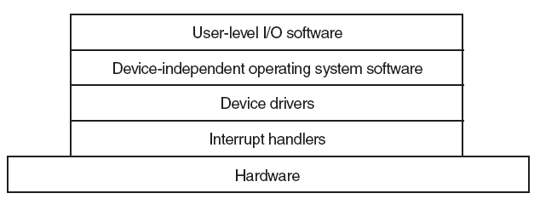
I/O Software Layers
I/O software is typically organized in four layers.
Each layer has a well-defined interface.
Tanenbaum, Modern Operating Systems 3 e, (c) 2008 Prentice-Hall, Inc. All rights reserved. 0-13-6006639

Slide 85
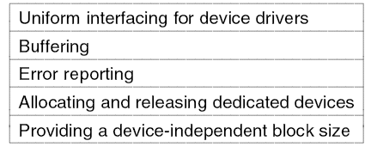
Device-Independent I/O Software
Functions of the device-independent I/O software.
Tanenbaum, Modern Operating Systems 3 e, (c) 2008 Prentice-Hall, Inc. All rights reserved. 0-13-6006639

Slide 86
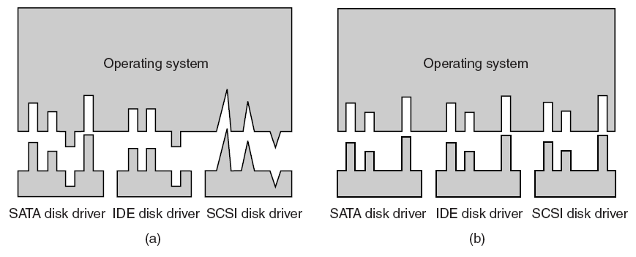
Uniform Interfacing for Device Drivers
(a) Without a standard driver interface. (b) With a standard driver interface.
Tanenbaum, Modern Operating Systems 3 e, (c) 2008 Prentice-Hall, Inc. All rights reserved. 0-13-6006639

Slide 87
Characteristics of I/O devices
Character-stream or block
A character-stream device transfers bytes one by one, whereas a block device transfers a block of bytes as a unit.
Sequential or random-access
A sequential device transfers data in a fixed order determined by the device, whereas the user of a random-access device can instruct the device to seek to any of the available data storage locations.
Synchronous or asynchronous
A synchronous device is one that performs data transfers with predictable response times. An asynchronous device exhibits irregular or unpredictable response times.

Slide 88
Characteristics of I/O devices
Sharable or dedicated
A sharable device can be used concurrently by several processes or threads; a dedicated device cannot.
Speed of operation
Device speeds range from a few bytes per second to a few gigabytes per second.•
Read–write, read only, or write only
Some devices perform both input and output, but others support only one data direction

Slide 89
I/O device trends
New I/O devices and device types emerge everyday
I/O devices vary greatly but exhibits two conflicting trends.
increasing standardization of software and hardware interfaces.
increasingly broad variety of I/O devices.
Software
Device drivers present a uniform device-access interface to the I/O subsystem,
Similar to system calls providing a standard interface between the application and the operating system.

Slide 90
Error Handling
OS is responsible for I/O error handling and recovery.
Some errors may be permanent, some may be due to a transient problem.
OS may sometimes compensate the transient failures by retrying

Slide 91
Interrupt handlers
The driver can start an I/O operation and then block until the I/O is completed and the interrupt occurs
The driver can block itself by doing a down on a semaphore or a wait on a condition variable.
When the interrupt happens, the interrupt routine does whatever it has to do to handle the interrupt and then unblock the driver that started it, by up'ping on the semaphore or notifying the condition variable.
the net effect of the interrupt is to unblock the driver.

Slide 92
I/O spooling
Devices like printers or network based systems require dedicated operations
Spooling keeps a request queue and executes dedicated operations on at a time.
Can be implemented on directory/file system level.
Each application request creates as a separate file under a directory.
A system daemon process controls the device and send requests one at a time.

Slide 93
Widely vary in in their types and characteristics, hence their interfacing within the OS.
I/O-device technology exhibits two conflicting trends.
increasing standardization of software and hardware interfaces.
increasingly broad variety of I/O devices.
Hardware
Ports
Buses
Device controllers
Software
Device drivers present a uniform device-access interface to the I/O subsystem,
Similar to system calls providing a standard interface between the application and the operating system.

Slide 94
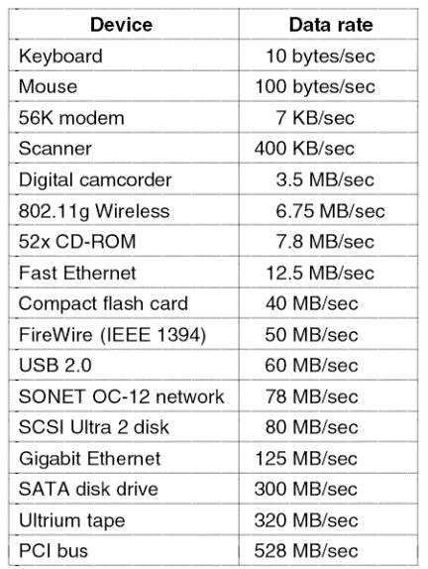
General Categories
Storage devices (disks, tapes,…)
Graphic card and console devices
HCI devices (mouse, keyboard)
Media devices (sound card, camera)
Network Interface Controllers
Printers, modems
Specialized devices

Slide 95
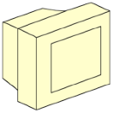
I/O Hardware - Single Bus
Monitor
Keyboard
Floppy drive
Disk drive
CPU
Memory
Video Controller
Keyboard Controller
Floppy Controller
Disk Controller
System bus
All addresses (memory and I/O) go here.
Memory is just another I/O.

Slide 96
I/O Hardware – Dual bus
CPU reads and writes to the memory takes place through this high-speed bus.
SCSI disk
Memory bus
CPU
PCI bridge/ memory controller
Memory
SCSI disk
Cache
SCSI disk
This bridge/controller allows I/O devices to access memory directly w/o going through CPU
SCSI bus
Video controller
Network controller
SCSI controller
PCI bus
IDE disk controller
USB interface/
controller
Keyboard
+
USB controller
Mouse
+
USB controller
USB bus
USB ports

Slide 97
Issues related to I/O system
How to access I/O devices in HW?
How to interact with I/O devices?
Poll based vs. Interrupt based I/O
CPU checks if I/O is complete
An interrupt is generated when I/O is complete
Programmed vs. DMA based I/O
Data is transferred to/from CPU
DMA controller transfers data from device buffer to main memory without CPU intervention
How are I/O devices categorized?
Character vs. Block
Streams of chars (e.g. printer, modem)
Units of blocks (e.g. disks)

