Slide 1
Geometry 1: Perspective model, projective geometry
Introduction to Computer Vision
Ronen Basri
Weizmann Institute of Science

Slide 2
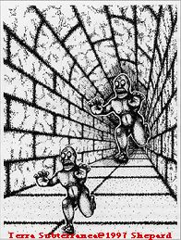
Perspectivity

Slide 3
Material covered
Pinhole camera model, perspective projection
A taste of projective geometry
Homography (planes, camera rotation)
Two view geometry, general case:
Epipolar geometry, the essential matrix
Camera calibration, the fundamental matrix
Stereo vision
3D reconstruction from two views
Multi-view geometry, reconstruction through factorization

Slide 6
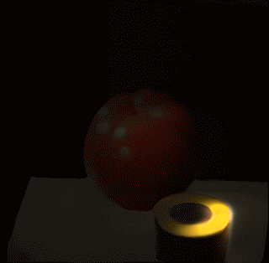
Trillion frames per second
(Velten, Raskar and Bawendi 2011)

Slide 8
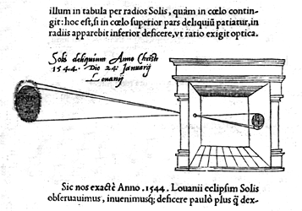
Camera obscura (“dark room”)
"Reinerus Gemma-Frisius, observed an eclipse of the sun at Louvain on January 24, 1544, and later he used this illustration of the event in his book De Radio Astronomica et Geometrica, 1545. It is thought to be the first published illustration of a camera obscura..."
(Hammond, John H., The Camera Obscura, A Chronicle)

Slide 9
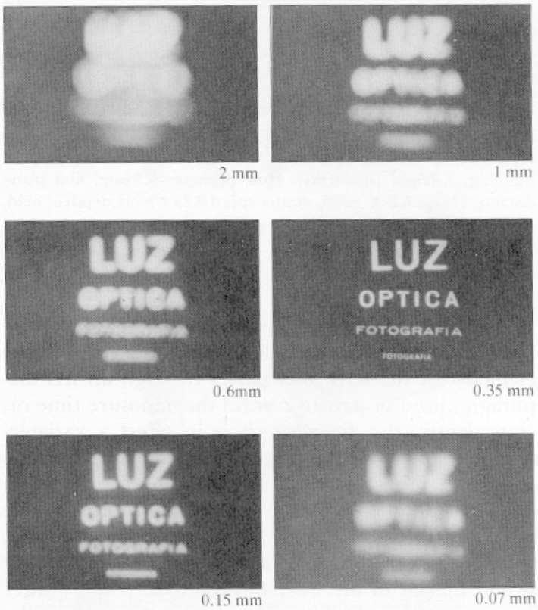
Why not use a pinhole camera?
Pinhole cameras are dark
Pinhole too big – blurry image
Pinhole too small – diffraction

Slide 10
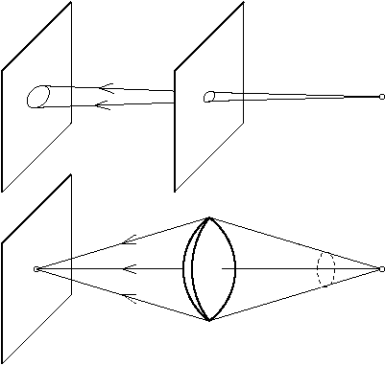
Lenses

Slide 11
Lenses
Lenses collect light from a large hole and direct it to a single point
Overcome the darkness of pinhole cameras
But there is a price
Focus
Radial distortions
Chromatic abberations
…
Pinhole is useful as a geometric model
Perspective: “perspicere” (latine) – to see through

Slide 12
Pinhole camera model

Slide 13
Perspective projection
$$P=\left(X,Y,Z\right)$$
$$p=\left(x,y\right)$$
$$O$$

Slide 14
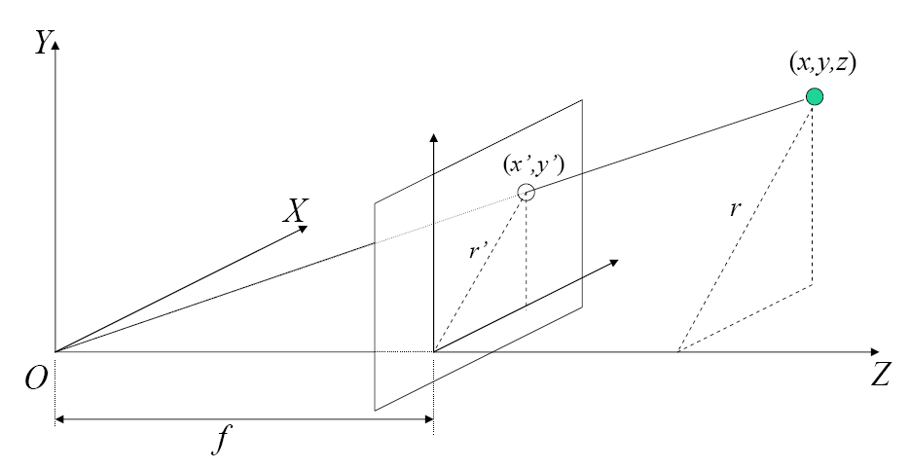
Perspective projection
O – Focal center
π – Image plane
Z – Optical axis
f – Focal length

Slide 15
Perspective projection
$$y$$
$$x$$
$$f$$
$$Y$$
$$X$$
$$Z$$
$$\frac{x}{X}=\frac{y}{Y}=\frac{f}{Z}$$

Slide 16
Perspective projection
Perspective rule
$$x=\frac{fX}{Z} y=\frac{fY}{Z}$$
In homogeneous coordinates
$$\left(\begin{matrix}x \\ y \\ f\end{matrix}\right)=\frac{f}{Z}\left(\begin{matrix}X \\ Y \\ Z\end{matrix}\right)$$

Slide 17
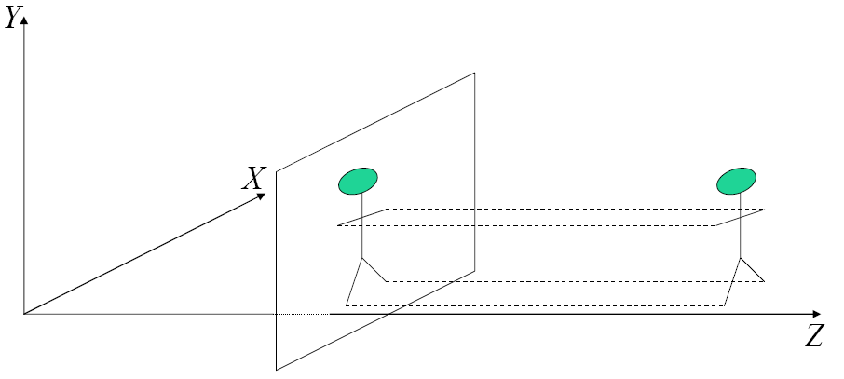
Orthographic projection
When objects are far from the camera
Projection rays are nearly parallel
Camera center at infinity
$$x=X$$
$$y=Y$$

Slide 18
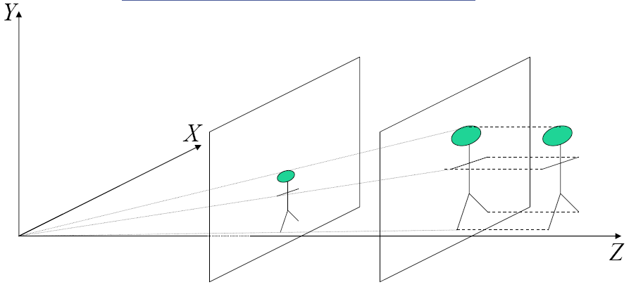
Scaled orthographic
How would a tilted rectangle look like under perspective projection? And under scaled orthography?
$$\begin{matrix}\begin{matrix}x=sX \\ y=sY\end{matrix} & s=\frac{f}{Z_{0}}\end{matrix}$$

Slide 19
Which projection model should I use?
Perspective model is needed
In scenes that contain many depth differences
For accurate 3D reconstruction (stereo, structure from motion)
Scaled orthographic can be used
When objects are small relative to their distance from the camera
Often sufficient for recognition applications

Slide 20
Geometry
Geometry – Greek: earth measurement
Geometry concerns with shape, size, relative positions, and properties of spaces
Euclidean geometry:
Point, line, plane
Incidence
Continuity
Order, “between”
Parallelism
Congruence = invariance: angles, lengths, areas are preserved under rigid transformations

Slide 21
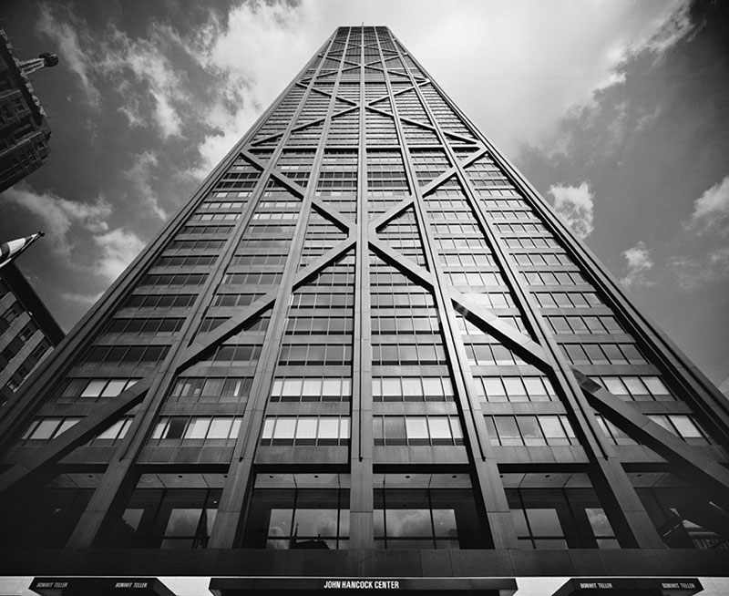
Projective geometry
How does a plane looks after projection? How does perspective distorts geometry?

Slide 22
Plane perspective
Pencil of rays

Slide 23
Plane perspective
Pencil of rays

Slide 24
Projective transformation

Slide 25
Projective transformation
How these change from Eucleadian geometry?
Point, line, plane
Incidence
Continuity
Order, “between”
Parallelism
Congruence
Under projective transformation
A (straight) line transforms to a line and a conic to a conic
But order and parallelism are not preserved
Likewise, angles, lengths and areas are not preserved

Slide 26
Projective coordinates
$ℙ^{2}$ denotes the projective plane
Projective coordinates are homogeneous, so $p=(x,y,1)∈ℙ^{2}$ represents point $(x,y)∈ℝ^{2}$ in the Euclidean plane
A point is identified with a ray through the origin, so $p$ and $αp$ for $α≠0$ represent the same point (note that $α$ can be negative!)
Projective geometry is a geometry of rays
$$z$$
$$y$$
$$z=1$$
$$x$$

Slide 27
Projective line
A line = plane of rays through the origin
$ax+by+cz=0$ -or- $l^{T}p=0$
$l$ is normal to the plane of rays
Equivalent to the Euclidean line $a\frac{x}{z}+b\frac{y}{z}+c=0$
Note that lines and points are dual, so any result on points can be interpreted as a result on lines and vice versa

Slide 28
Intersection and incidence
The intersection of two lines $l_{1}^{T}p=0$ and $l_{2}^{T}p=0$ is $p=l_{1}×l_{2}$
Given two points $p_{1}$ and $p_{2}$, the line through them is defined by $l=p_{1}×p_{2}$

Slide 29
Ideal points
Rays from the origin that are parallel to the $z=1$ plane define ideal points, $p=\left(x,y,0\right)$. These points do not correspond to a Euclidean point
How many ideal points there are?

Slide 30
Line at infinity

Slide 31
Line at infinity
Parallel lines intersect at an ideal point: $l_{1}={(a,b,c) }^{T}$ and $l_{2}={(a,b,c′) }^{T}$ intersect at $p=l_{1}×l_{2}∝(b,−a,0)$
Every set of parallel lines of different orientation intersects at a different point at infinity
The complete set of ideal points is called the line at infinity
The line at infinity is indeed a line = a plane of rays through the origin (the $Z=0$ plane)

Slide 32
Homography
An invertible linear transformation of rays
$$q∝Hp=\left(\begin{matrix}h_{11} & h_{12} & h_{13} \\ h_{21} & h_{22} & h_{23} \\ h_{31} & h_{32} & h_{33}\end{matrix}\right)\left(\begin{matrix}x \\ y \\ 1\end{matrix}\right)$$
$⇔$ non-linear transformation of points
$x^{′}=\frac{h_{11}x+h_{12}y+h_{13}}{h_{31}x+h_{32}y+h_{33}}$, $y^{′}=\frac{h_{21}x+h_{22}y+h_{23}}{h_{31}x+h_{32}y+h_{33}}$
Homography has 8 DOFs (determined up to scale) How many points are needed to determine homography?
Note the difference between homography and epipolar lines (Essential or Fundamental matrices):
$q∝Hp$ vs. $q^{T}Ep=0$

Slide 33
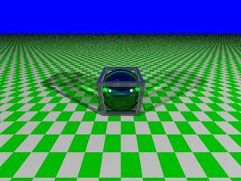
Homography
Homography transforms a line to a line:
$l^{T}p=0$, $q∝Hp ⇒$ ${(H^{−T}l)}^{T}Hp={l′}^{T}q=0$
The line at infinity also maps to a line – the “vanishing line” (aka. the horizon)

Slide 34
Hierarchy of transformations
Rigid | $$\left(\begin{matrix}\cos{θ} & −\sin{θ} & t_{x} \\ \sin{θ} & \cos{θ} & t_{y} \\ 0 & 0 & 1\end{matrix}\right)$$ | Preserves angles, lengths, area, parallelism
Similarity | $$\left(\begin{matrix}a & −b & t_{x} \\ b & a & t_{y} \\ 0 & 0 & 1\end{matrix}\right)$$ | Preserves angles, parallelism
Affine | $$\left(\begin{matrix}a & b & t_{x} \\ c & d & t_{y} \\ 0 & 0 & 1\end{matrix}\right)$$ | Preserves parallelism
Homography | $$\left(\begin{matrix}h_{11} & h_{12} & h_{13} \\ h_{21} & h_{22} & h_{23} \\ h_{31} & h_{32} & h_{33}\end{matrix}\right)$$ | Preserves cross ratio

Slide 35
Camera rotation
Images obtained by rotating the camera about its optical axis are related by homography:
$$Q=RP$$
($t=0$)
imply
$$q∝Rp$$
(Verify that $q$ does not depend on $Z$)

Slide 36
Planar scene
A plane $aX+bY+cZ=d$
In vector notation $n^{T}P=d$
$Q=RP+t$
$\frac{n^{T}P}{d}=1$, so $Q=RP+t\frac{n^{T}P}{d}$
Rearrange, $Q=\left(R+\frac{1}{d}tn^{T}\right)P$
Project, $q∝\left(R+\frac{1}{d}tn^{T}\right)p$
So $q∝Hp$ , with $H=R+\frac{1}{d}tn^{T}$

Slide 37
Summary
 | Homography | Perspective (calibrated) | Perspective (uncalibrated) | Orthographic
Form | $$q∝Hp$$ | $q^{T}Ep=$0 | $q^{T}Fp=$0 | $q^{T}Fp=$0
Properties | One-to-one (group) | Concentric epipolar lines | Concentric epipolar lines | Parallel epipolar lines
DOFs | 8(5) | 8(5) | 8(7) | 4
Eqs/pnt | 2 | 1 | 1 | 1
Minimal configuration | 4 | 5+ (8,linear) | 7+ (8,linear) | 4
Depth | No | Yes, up to scale | Yes, projective structure | Affine structure (third view required for Euclidean structure)

