Slide 1
Geometry 2: Epipolar Lines
Introduction to Computer Vision
Ronen Basri
Weizmann Institute of Science

Slide 2
Material covered
Pinhole camera model, perspective projection
A taste of projective geometry
Homography (planes, camera rotation)
Two view geometry, general case:
Epipolar geometry, the essential matrix
Camera calibration, the fundamental matrix
Stereo vision
3D reconstruction from two views
Multi-view geometry, reconstruction through factorization

Slide 3
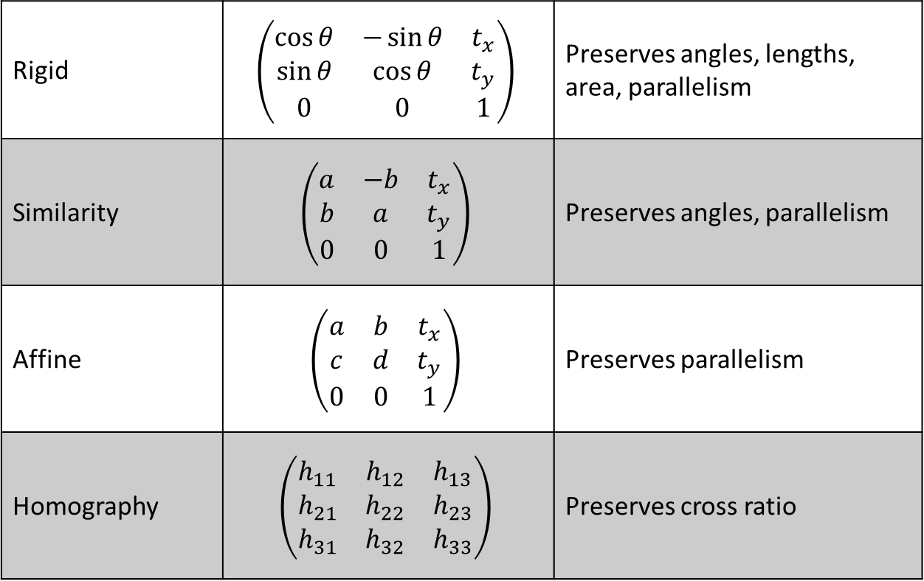
Hierarchy of transformations
Rigid | $$\left(\begin{matrix}\cos{θ} & −\sin{θ} & t_{x} \\ \sin{θ} & \cos{θ} & t_{y} \\ 0 & 0 & 1\end{matrix}\right)$$ | Preserves angles, lengths, area, parallelism
Similarity | $$\left(\begin{matrix}a & −b & t_{x} \\ b & a & t_{y} \\ 0 & 0 & 1\end{matrix}\right)$$ | Preserves angles, parallelism
Affine | $$\left(\begin{matrix}a & b & t_{x} \\ c & d & t_{y} \\ 0 & 0 & 1\end{matrix}\right)$$ | Preserves parallelism
Homography | $$\left(\begin{matrix}h_{11} & h_{12} & h_{13} \\ h_{21} & h_{22} & h_{23} \\ h_{31} & h_{32} & h_{33}\end{matrix}\right)$$ | Preserves cross ratio

Slide 4

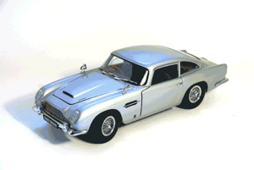
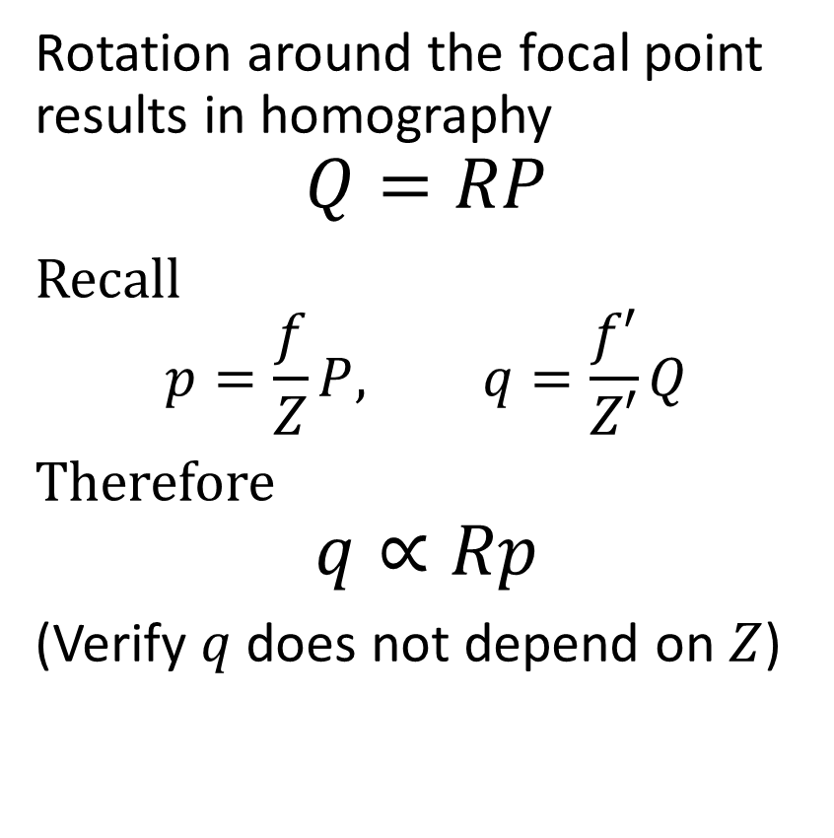
Camera rotation
Rotation around the focal point results in homography
$$Q=RP$$
Recall
$$p=\frac{f}{Z}P, q=\frac{f′}{Z′}Q$$
Therefore
$$q∝Rp$$
(Verify $q$ does not depend on $Z$)

Slide 5
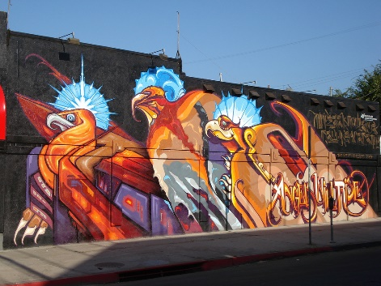

Planar scene
A plane $aX+bY+cZ=d$
In vector notation $n^{T}P=d$
$Q=RP+t$
$\frac{n^{T}P}{d}=1$, so $Q=RP+t\frac{n^{T}P}{d}$
Rearrange, $Q=\left(R+\frac{1}{d}tn^{T}\right)P$
Project, $q∝\left(R+\frac{1}{d}tn^{T}\right)p$
$q∝Hp$, with $H=R+\frac{1}{d}tn^{T}$

Slide 6
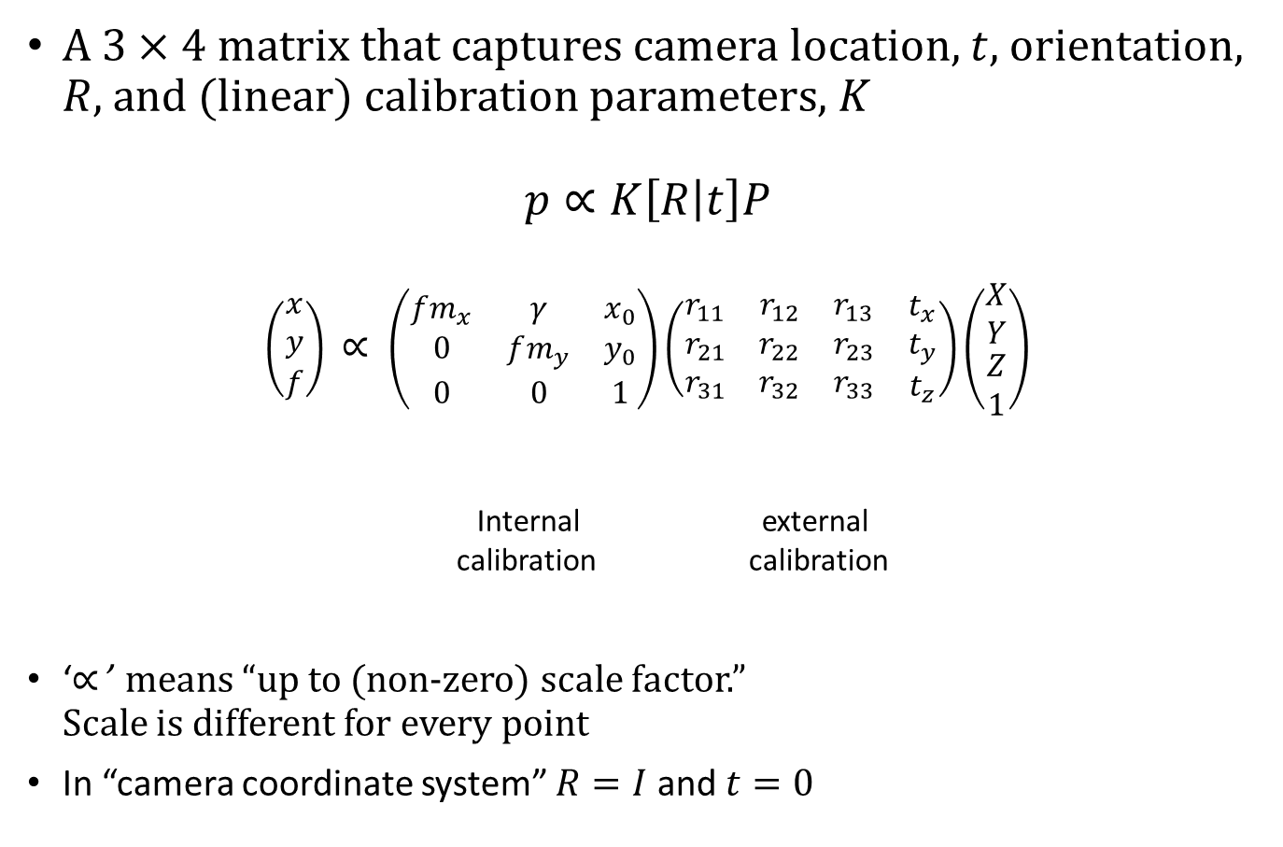
Camera matrix
A $3×4$ matrix that captures camera location, $t$, orientation, $R$, and (linear) calibration parameters, $K$
$$p∝K\left[R | t\right]P$$
$$\left(\begin{matrix}x \\ y \\ f\end{matrix}\right) ∝ \left(\begin{matrix}fm_{x} & γ & x_{0} \\ 0 & fm_{y} & y_{0} \\ 0 & 0 & 1\end{matrix}\right)\left(\begin{matrix}\begin{matrix}r_{11} & r_{12} & r_{13} \\ r_{21} & r_{22} & r_{23} \\ r_{31} & r_{32} & r_{33}\end{matrix} & \begin{matrix}t_{x} \\ t_{y} \\ t_{z}\end{matrix}\end{matrix}\right)\left(\begin{matrix}\begin{matrix}X \\ Y\end{matrix} \\ \begin{matrix}Z \\ 1\end{matrix}\end{matrix}\right)$$
Internal external calibration calibration
‘$∝$’ means “up to (non-zero) scale factor.” Scale is different for every point
In “camera coordinate system” $R=I$ and $t=0$

Slide 7
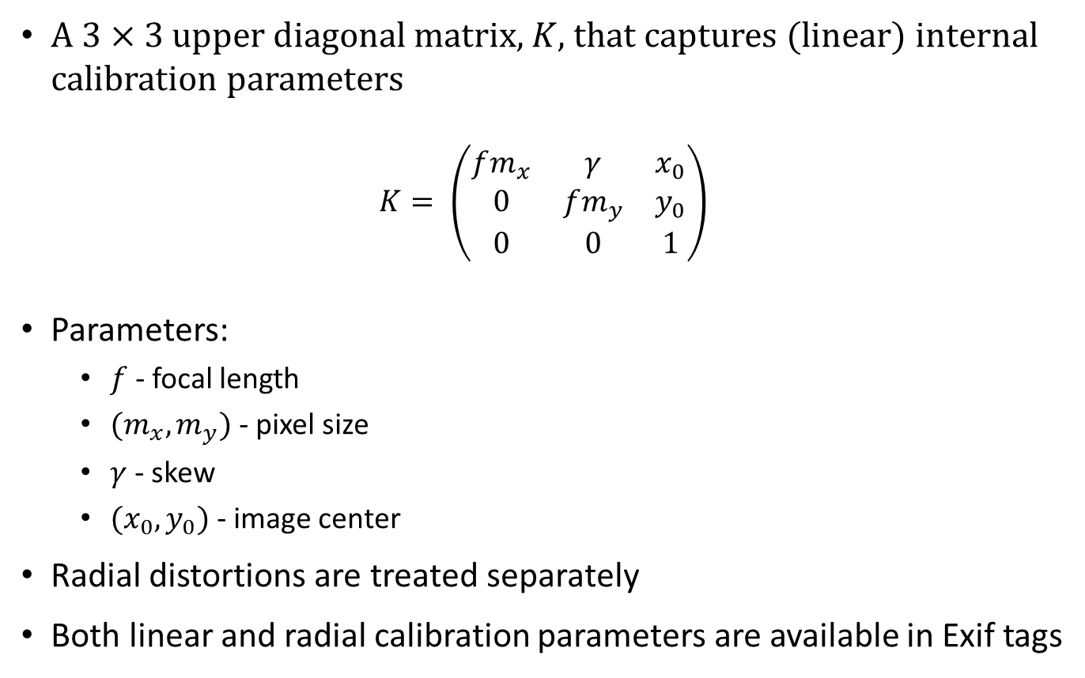
Calibration matrix
A $3×3$ upper diagonal matrix, $K$, that captures (linear) internal calibration parameters
$$K= \left(\begin{matrix}fm_{x} & γ & x_{0} \\ 0 & fm_{y} & y_{0} \\ 0 & 0 & 1\end{matrix}\right)$$
Parameters:
$f$ - focal length
${(m}_{x},m_{y})$ - pixel size
$γ$ - skew
${(x}_{0},y_{0})$ - image center
Radial distortions are treated separately
Both linear and radial calibration parameters are available in Exif tags

Slide 8
Two view geometry
epipolar line

Slide 9



Epipolar plane
Definition:
Epipolar plane: a plane that contains the baseline
$$P$$
epipolar plane
epipolar line
epipolar line
$$O$$
Baseline
$$O’$$

Slide 10


Epipoles
Each epipolar plane produces a pair of epipolar lines
There is a 1-D system of epipolar planes
All epipolar planes contain the baseline
All epipolar lines intersect at the epipole
An epipole is the projection of the right focal center onto the left image (and vice versa)
epipolar lines
epipolar lines
$$O$$
$$O’$$
Baseline

Slide 11
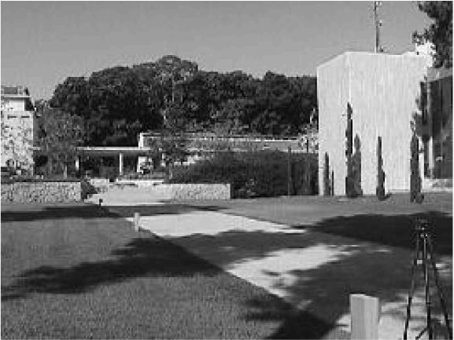
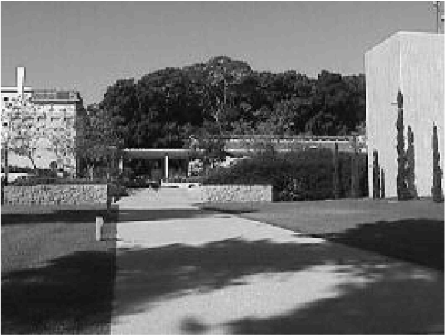
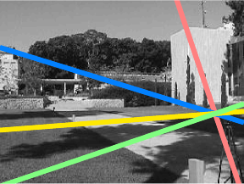
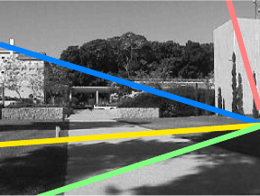

Slide 12

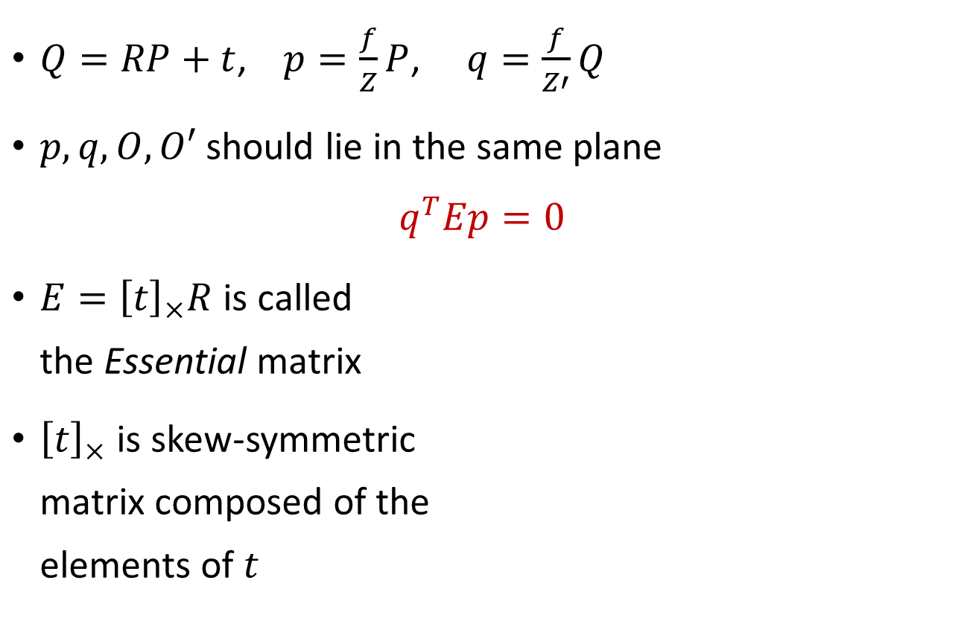




Epipolar constraints: the essential matrix
$Q=RP+t$, $p=\frac{f}{Z}P$, $q=\frac{f}{Z′}Q$
$p,q,O,O′$ should lie in the same plane
$$q^{T}Ep=0$$
$E={\left[t\right]}_{×}R$ is called the Essential matrix
${\left[t\right]}_{×}$ is skew-symmetric matrix composed of the elements of $t$
$$P$$
$$p$$
Epipolar plane
$$q$$
$$O$$
Baseline
$$O’$$

Slide 13
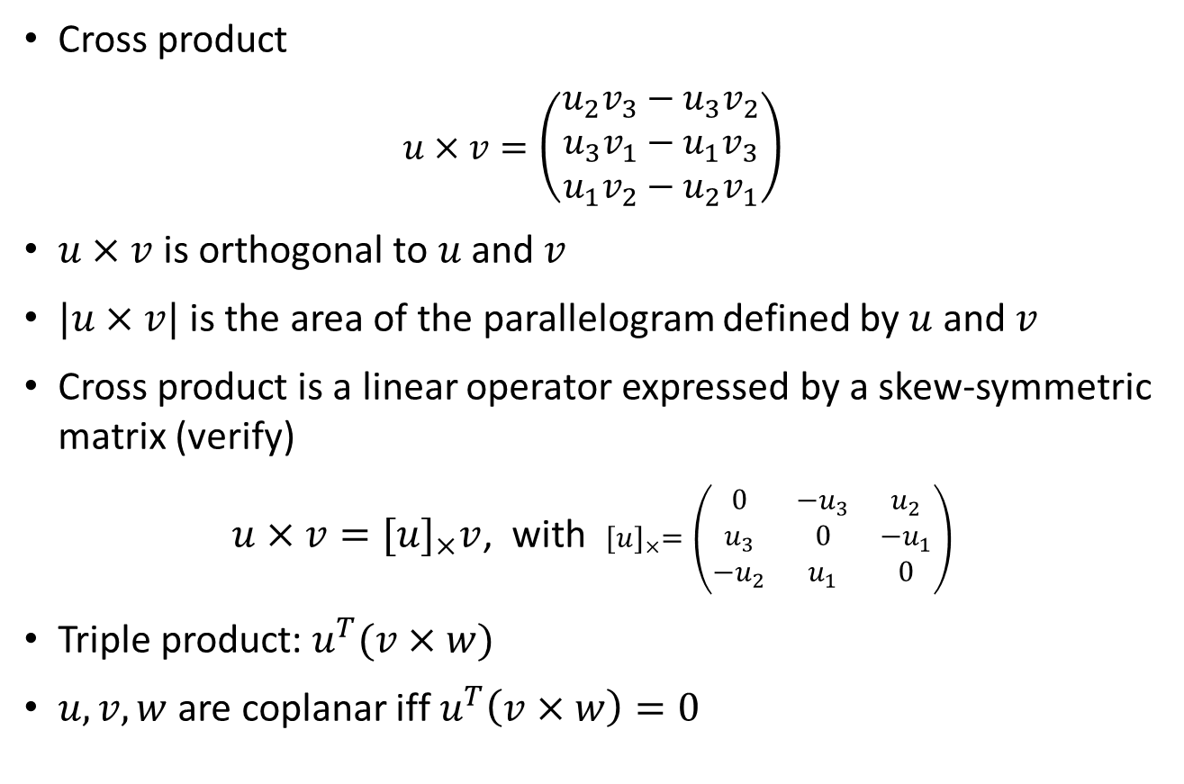
Cross product, triple product
Cross product
$$u×v=\left(\begin{matrix}u_{2}v_{3}−u_{3}v_{2} \\ u_{3}v_{1}−u_{1}v_{3} \\ u_{1}v_{2}−u_{2}v_{1}\end{matrix}\right)$$
$u×v$ is orthogonal to $u$ and $v$
$|u×v|$ is the area of the parallelogram defined by $u$ and $v$
Cross product is a linear operator expressed by a skew-symmetric matrix (verify)
$u×v={[u]}_{×}v$, with ${[u]}_{×}=\left(\begin{matrix}0 & −u_{3} & u_{2} \\ u_{3} & 0 & −u_{1} \\ −u_{2} & u_{1} & 0\end{matrix}\right)$
Triple product: $u^{T}(v×w)$
$u,v,w$ are coplanar iff $u^{T}\left(v×w\right)=0$

Slide 14
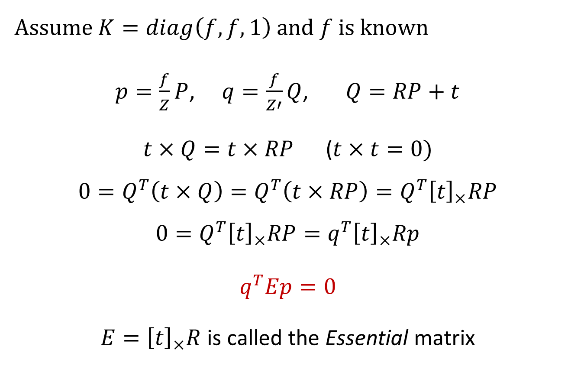
Epipolar constraints: the Essential matrix
Assume $K=diag\left(f,f,1\right)$ and $f$ is known
$p=\frac{f}{Z}P$, $q=\frac{f}{Z′}Q$, $Q=RP+t$
$t×Q=t×RP$ ($t×t=0)$
$$0=Q^{T}\left(t×Q\right)=Q^{T}\left(t×RP\right)=Q^{T}{\left[t\right]}_{×}RP$$
$$0=Q^{T}{\left[t\right]}_{×}RP=q^{T}{\left[t\right]}_{×}Rp$$
$$q^{T}Ep=0$$
$E={\left[t\right]}_{×}R$ is called the Essential matrix

Slide 15
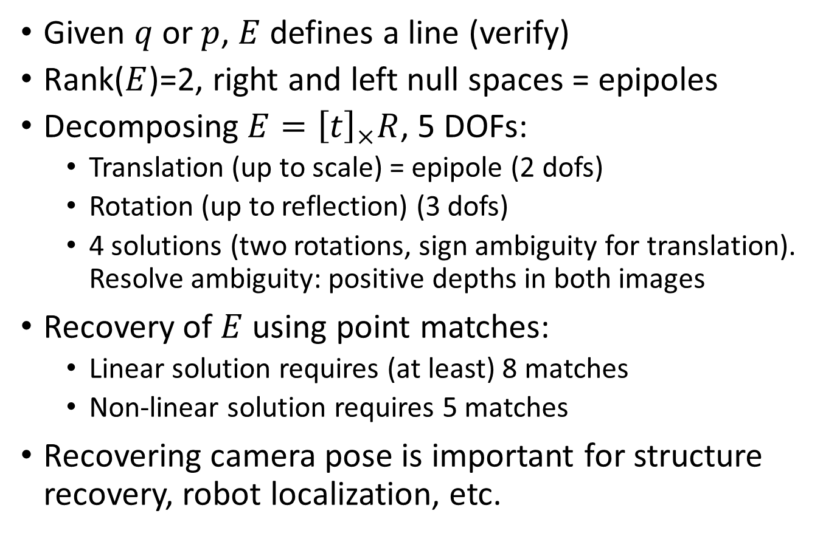

The Essential matrix, $q^{T}Ep=0$
Given $q$ or $p$, $E$ defines a line (verify)
Rank($E$)=2, right and left null spaces = epipoles
Decomposing $E={\left[t\right]}_{×}R$, 5 DOFs:
Translation (up to scale) = epipole (2 dofs)
Rotation (up to reflection) (3 dofs)
4 solutions (two rotations, sign ambiguity for translation). Resolve ambiguity: positive depths in both images
Recovery of $E$ using point matches:
Linear solution requires (at least) 8 matches
Non-linear solution requires 5 matches
Recovering camera pose is important for structure recovery, robot localization, etc.

Slide 16
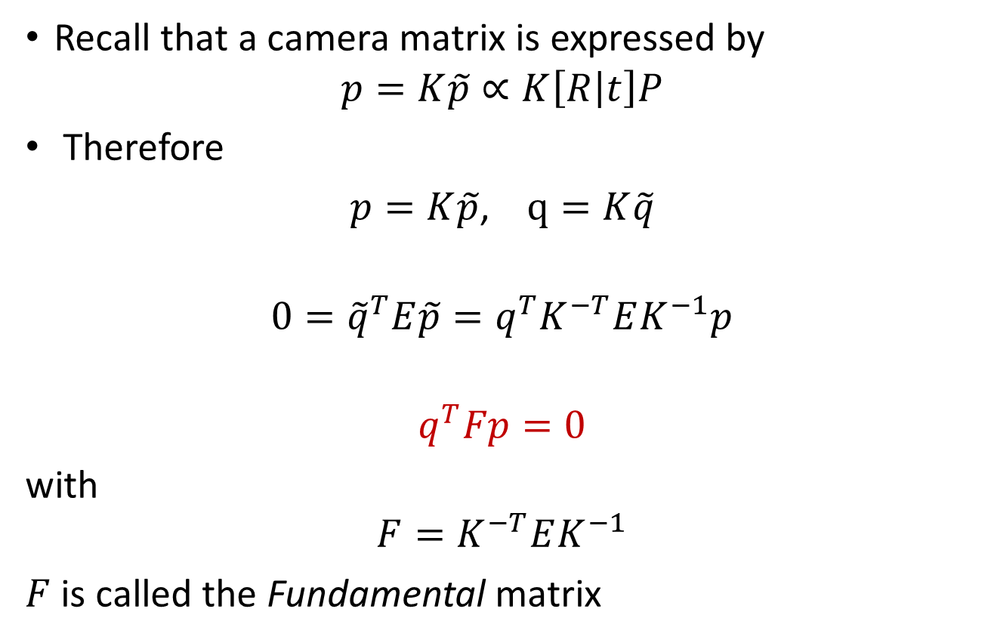
Uncalibrated case: the Fundamental matrix
Recall that a camera matrix is expressed by
$$p=K\tilde{p}∝K\left[R | t\right]P$$
Therefore
$p=K\tilde{p}$, $q=K\tilde{q}$
$$0={\tilde{q}}^{T}E\tilde{p}=q^{T}K^{−T}EK^{−1}p$$
$$q^{T}Fp=0$$
with
$${F=K}^{−T}EK^{−1}$$
$F$ is called the Fundamental matrix

Slide 17
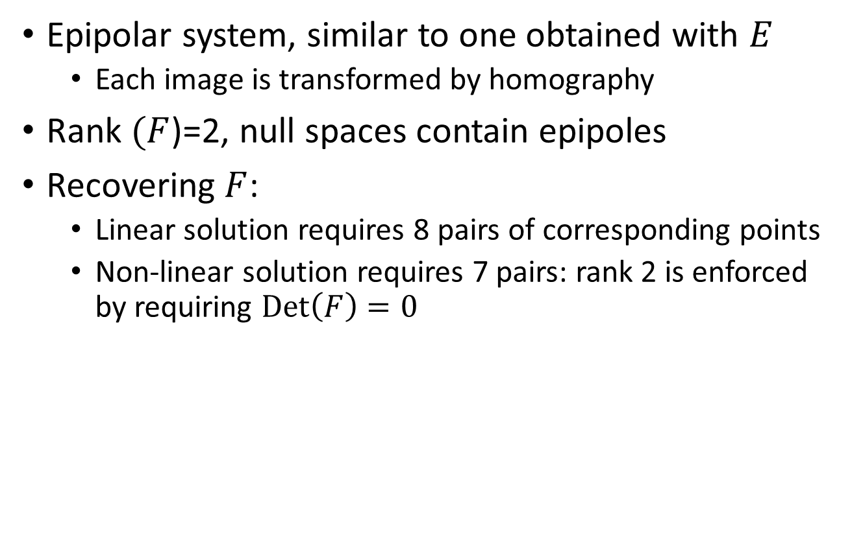

The Fundamental matrix, $q^{T}Fp=0$
Epipolar system, similar to one obtained with $E$
Each image is transformed by homography
Rank $(F$)=2, null spaces contain epipoles
Recovering $F$:
Linear solution requires 8 pairs of corresponding points
Non-linear solution requires 7 pairs: rank 2 is enforced by requiring $Det\left(F\right)=0$

Slide 18
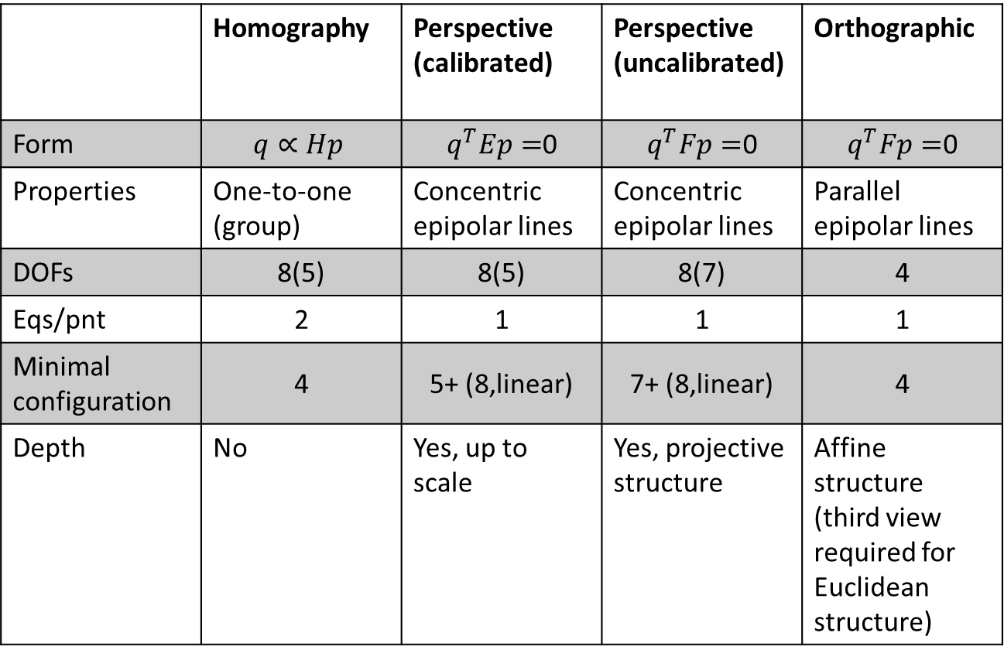
Summary
 | Homography | Perspective (calibrated) | Perspective (uncalibrated) | Orthographic
Form | $$q∝Hp$$ | $q^{T}Ep=$0 | $q^{T}Fp=$0 | $q^{T}Fp=$0
Properties | One-to-one (group) | Concentric epipolar lines | Concentric epipolar lines | Parallel epipolar lines
DOFs | 8(5) | 8(5) | 8(7) | 4
Eqs/pnt | 2 | 1 | 1 | 1
Minimal configuration | 4 | 5+ (8,linear) | 7+ (8,linear) | 4
Depth | No | Yes, up to scale | Yes, projective structure | Affine structure (third view required for Euclidean structure)

Slide 19
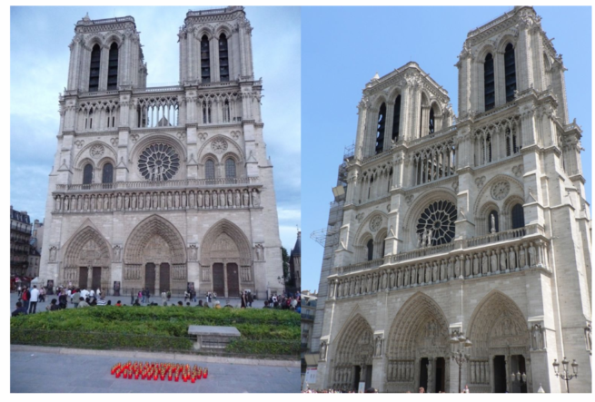
Recovering epipolar constraints

Slide 20
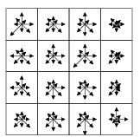
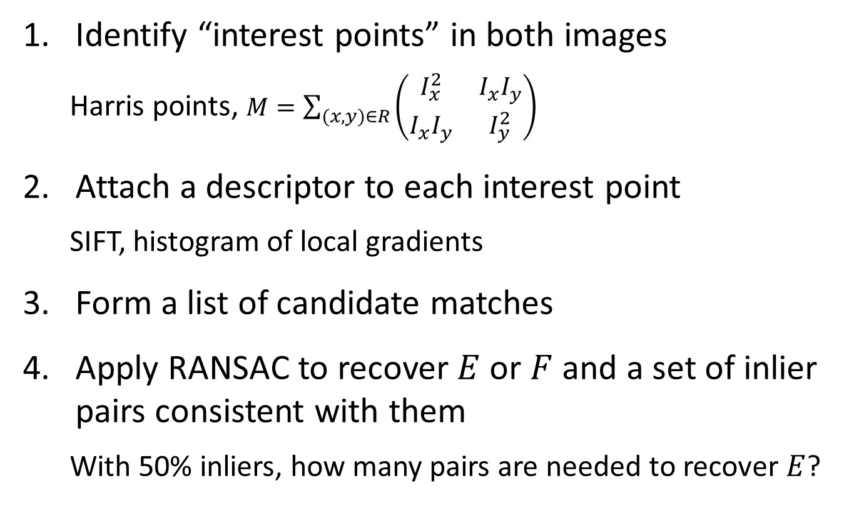
Recovering epipolar constraints: pipeline
Identify “interest points” in both images
Harris points, $M=\sum_{(x,y)∈R}{\left(\begin{matrix}I_{x}^{2} & I_{x}I_{y} \\ I_{x}I_{y} & I_{y}^{2}\end{matrix}\right)}$
Attach a descriptor to each interest point
SIFT, histogram of local gradients
Form a list of candidate matches
Apply RANSAC to recover $E$ or $F$ and a set of inlier pairs consistent with them
With 50% inliers, how many pairs are needed to recover $E$?

Slide 21
SIFT matches

Slide 22
Epipolar lines

Slide 23

Rectification
Homography to make epipolar lines horizontal
O
Baseline
O’
$${q′}^{ T}{H_{l}}^{−T}E{H_{r}}^{−1}q=0$$

Slide 24


Rectification
$$H_{l}$$
$$H_{r}$$
O
Baseline
O’
$${q′}^{ T}{H_{l}}^{−T}E{H_{r}}^{−1}q=0$$

Slide 25
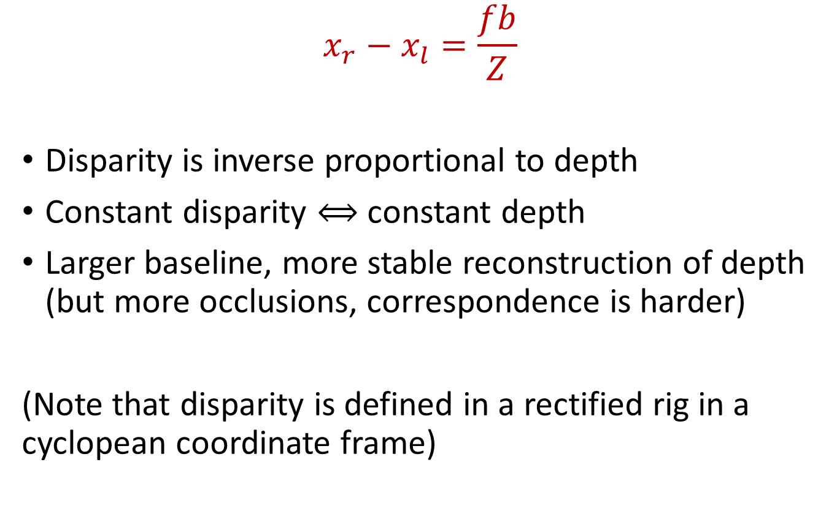
Disparity
$$x_{r}−x_{l}=\frac{fb}{Z}$$
Disparity is inverse proportional to depth
Constant disparity $⟺$ constant depth
Larger baseline, more stable reconstruction of depth (but more occlusions, correspondence is harder)
(Note that disparity is defined in a rectified rig in a cyclopean coordinate frame)

Slide 26
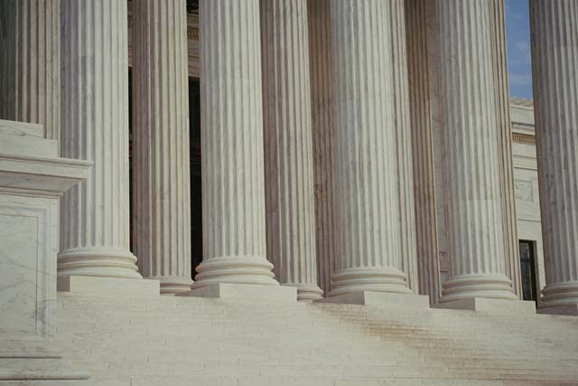
The correspondence problem
Stereo matching is ill-posed:
Matching ambiguity: different regions may look similar

Slide 27
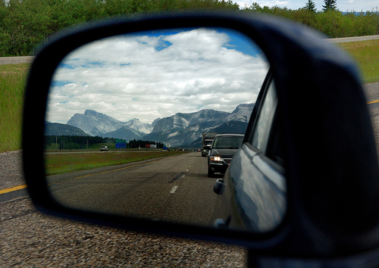
The correspondence problem
Stereo matching is ill-posed:
Matching ambiguity: different regions may look similar
Specular reflectance: multiple depth values

Slide 28


Random dot stereogram
Depth is perceived from a pair of random dot images
Stereo perception is based solely on local information (low level)

Slide 29

Moving random dots

Slide 30
Dynamic programming
Each pair of epipolar lines is compared independently
Local cost, sum of unary term and binary term
Unary term: cost of a single match
Binary term: cost of change of disparity (occlusion)
Analogous to string matching (‘diff’ in Unix)

Slide 31
String matching
Swing → String
S t r i n g
Start
S w i n g
End

Slide 32
String matching
Cost: #substitutions + #insertions + #deletions
S t r i n g
S w i n g

Slide 34
Stereo with dynamic programming
Shortest path in a grid
Diagonals: constant disparity
Moving along the diagonal – pay unary cost (cost of pixel match)
Move sideways – pay binary cost, i.e. disparity change (occlusion, right or left)
Cost prefers fronto-parallel planes. Penalty is paid for tilted planes

Slide 35
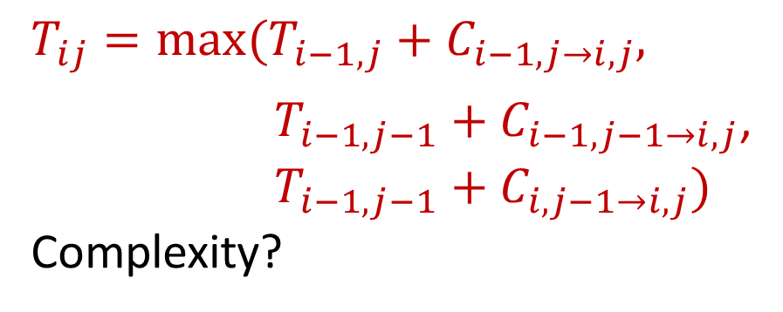
Dynamic programming on a grid
Start
$T_{ij}=\max_{}{(T_{i−1,j}+C_{i−1,j→i,j}, }$
$T_{i−1,j−1}+C_{i−1,j−1→i,j}$,
$T_{i−1,j−1}+C_{i,j−1→i,j})$
Complexity?

Slide 36
Dynamic programming: pros and cons
Advantages:
Simple, efficient
Achieves global optimum
Generally works well

Slide 37
Dynamic programming: pros and cons
Advantages:
Simple, efficient
Achieves global optimum
Generally works well
Disadvantages:
Works separately on each epipolar line, does not enforce smoothness across epipolars
Prefers fronto-parallel planes
Too local? (considers only immediate neighbors)

Slide 38
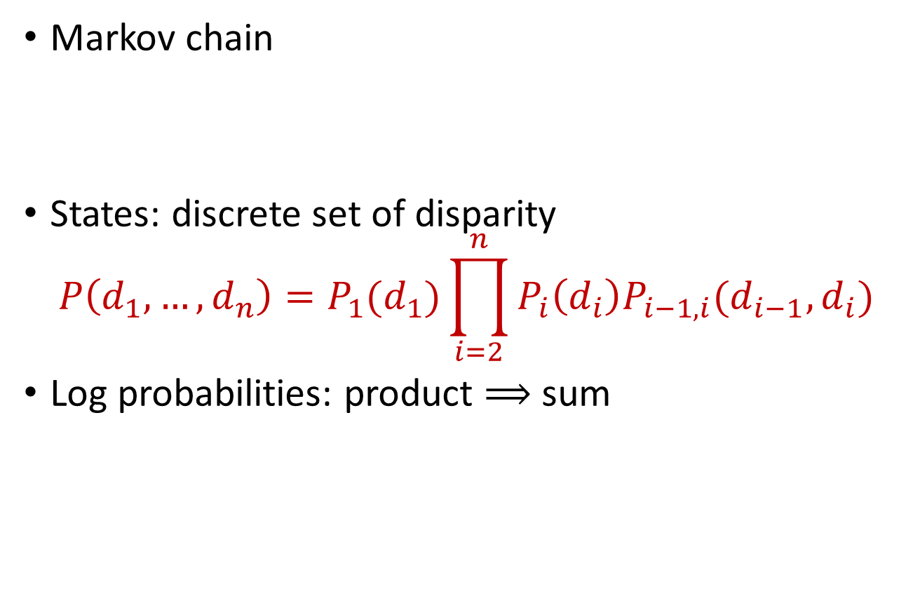
Probability interpretation: the Viterbi algorithm
Markov chain
States: discrete set of disparity
$$P\left(d_{1},…,d_{n}\right)=P_{1}(d_{1})\prod_{i=2}^{n}{P_{i}\left(d_{i}\right)P_{i−1,i}(d_{i−1},d_{i})}$$
Log probabilities: product $⟹$ sum

Slide 39
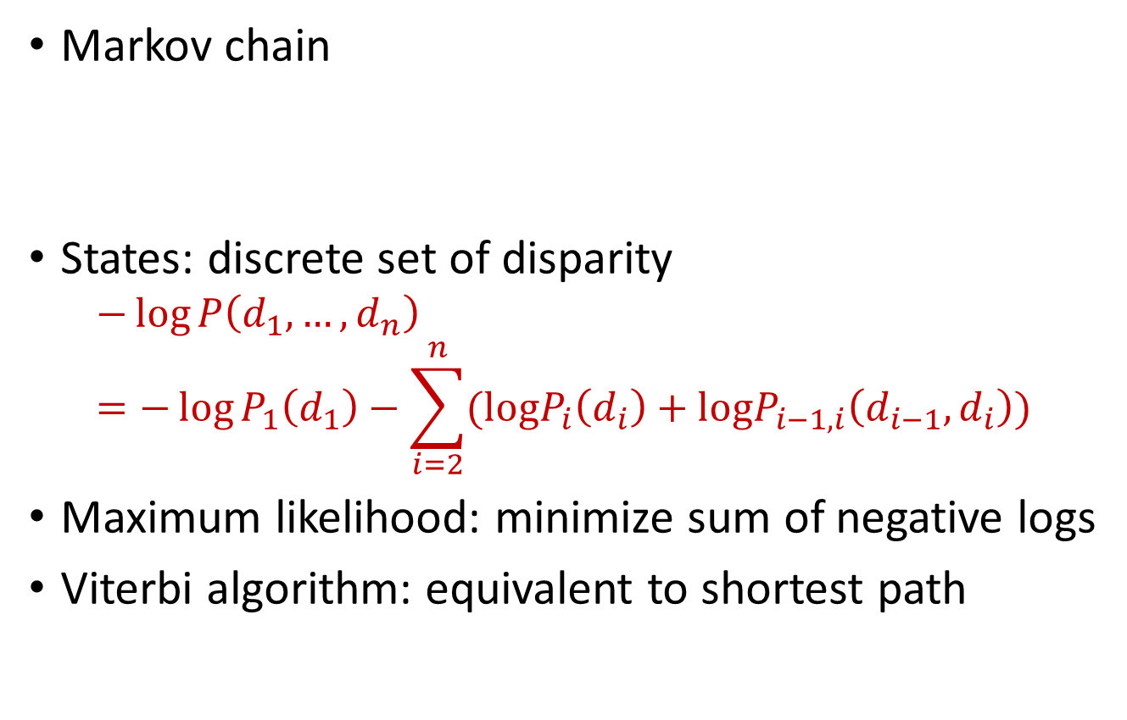
Probability interpretation: the Viterbi algorithm
Markov chain
States: discrete set of disparity
$$−\log{P\left(d_{1},…,d_{n}\right)}=−\log{P_{1}\left(d_{1}\right)}−\sum_{i=2}^{n}{(logP_{i}\left(d_{i}\right)+logP_{i−1,i}\left(d_{i−1},d_{i}\right))}$$
Maximum likelihood: minimize sum of negative logs
Viterbi algorithm: equivalent to shortest path

