Slide 1

Introduction to computer Vision: Deep Learning
Shai Bagon

Slide 2
Overview and motivation for deep learning

Slide 3
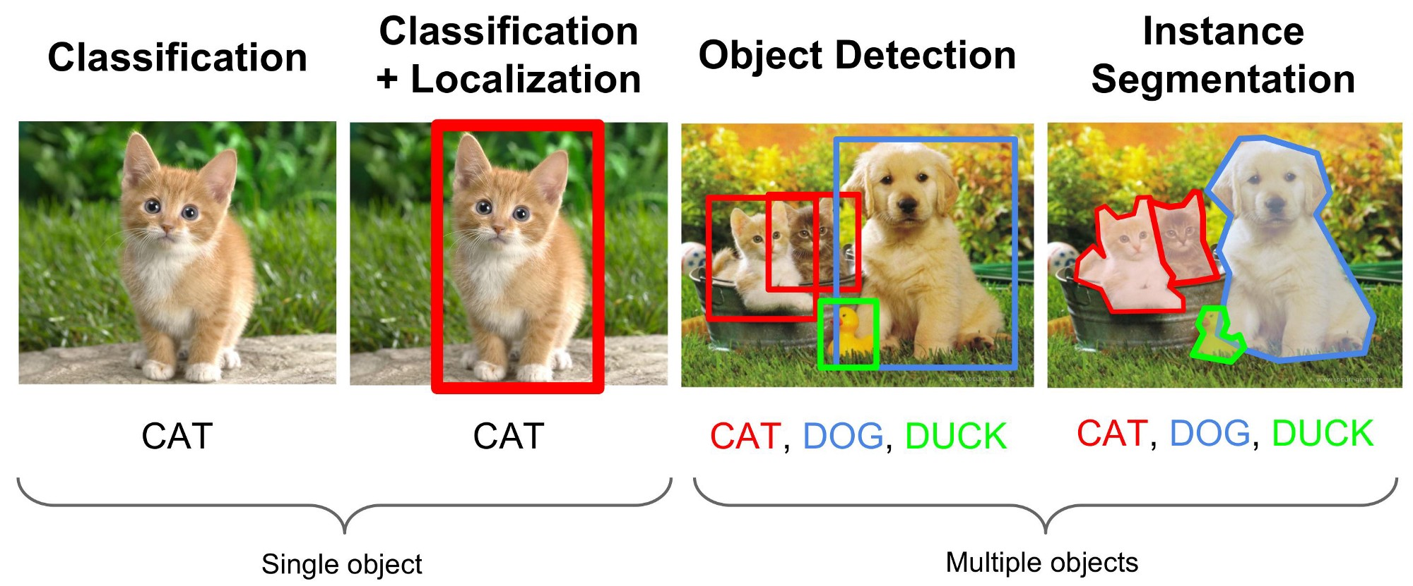
Deep Learning in Computer Vision
Image credit: medium

Slide 4
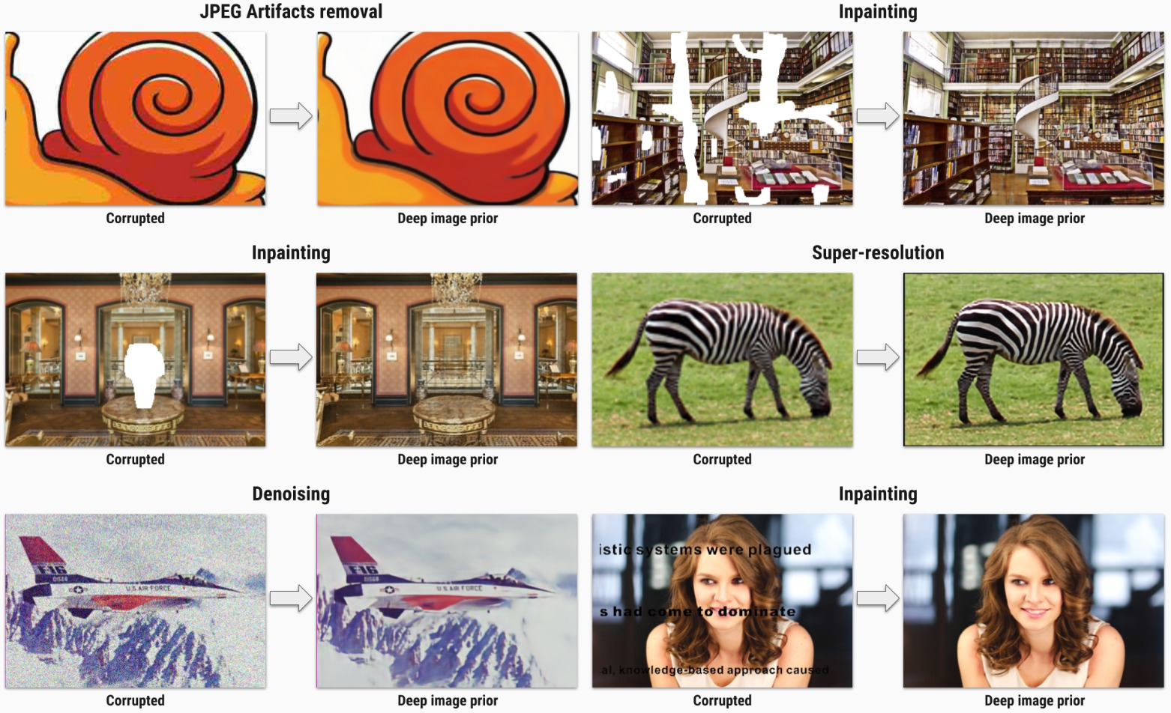
Deep Learning in Computer Vision
“Image enhancement” tasks: denoising, inpainting, super resolution…
Image credit: deep image prior (CVPR 2018)

Slide 5
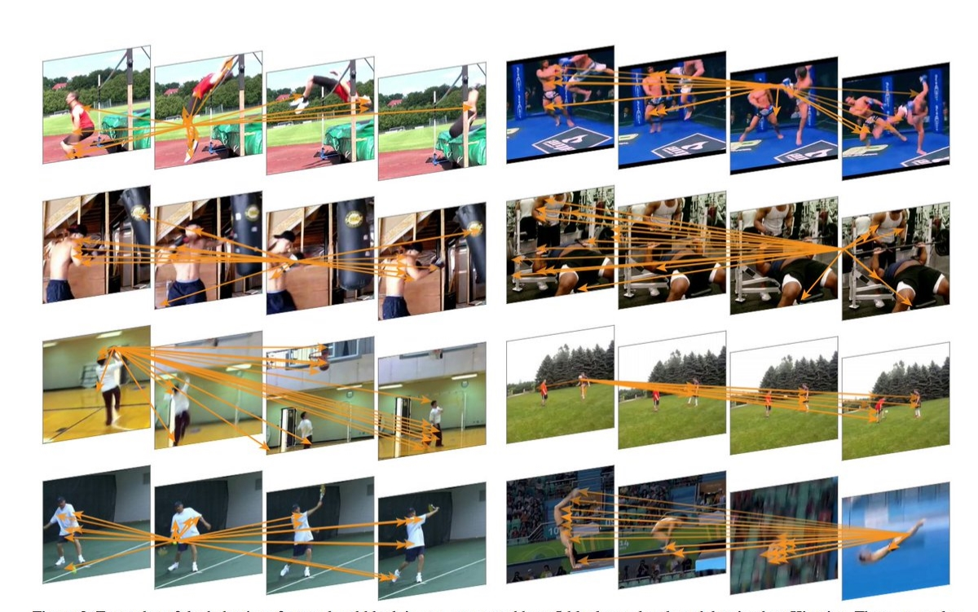
Deep Learning in Computer Vision
Video processing and understanding
Image credit: non-local neural networks (CVPR 2018)

Slide 6
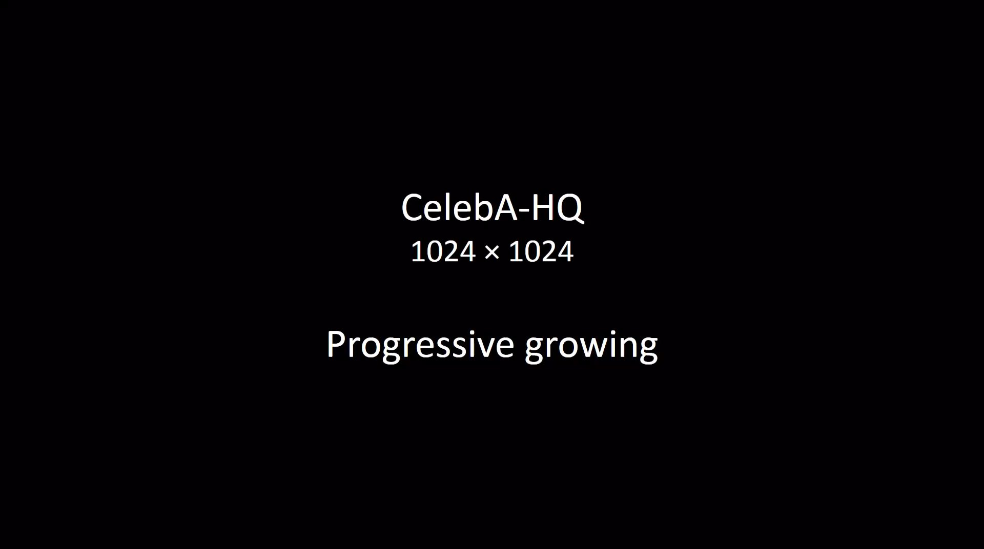
Deep Learning in Computer Vision
Generating images
video credit: Celeb HQ (ICLR 2018)

Slide 7
Deep Learning in Computer Vision
Image classification, object detection, instance segmentation
Image enhancement
Video processing and understanding
Generating new images/videos
…

Slide 8
Deep Learning
Complex systems/tasks
End-to-end training

Slide 9
High level concept of machine learning
From “rule based” programing to “example based” one.

Slide 10
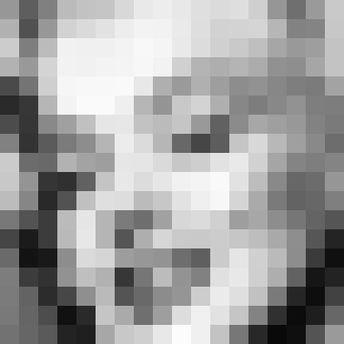
Machine Learning - crash course

Slide 11
Machine Learning - crash course

Slide 12
Machine Learning - crash course
151 | 94 | 128 | 187 | 194 | 197 | 216 | 233 | 237 | 232 | 223 | 219 | 222 | 207 | 150 | 111 | 154 | 201
177 | 81 | 151 | 210 | 218 | 226 | 237 | 243 | 242 | 234 | 222 | 210 | 211 | 213 | 182 | 130 | 132 | 199
204 | 126 | 187 | 241 | 240 | 240 | 243 | 248 | 245 | 233 | 220 | 208 | 201 | 191 | 166 | 153 | 158 | 195
178 | 153 | 212 | 242 | 241 | 243 | 244 | 247 | 242 | 208 | 180 | 174 | 180 | 172 | 145 | 142 | 166 | 195
74 | 116 | 207 | 246 | 248 | 248 | 249 | 232 | 175 | 154 | 176 | 158 | 141 | 146 | 135 | 126 | 123 | 163
42 | 55 | 182 | 243 | 250 | 250 | 239 | 182 | 148 | 200 | 211 | 175 | 135 | 125 | 136 | 146 | 126 | 125
76 | 54 | 137 | 160 | 192 | 230 | 231 | 194 | 187 | 197 | 153 | 97 | 139 | 167 | 159 | 152 | 130 | 122
129 | 51 | 91 | 123 | 141 | 181 | 236 | 219 | 182 | 104 | 70 | 93 | 197 | 216 | 184 | 159 | 137 | 109
203 | 108 | 105 | 178 | 163 | 158 | 230 | 229 | 218 | 199 | 206 | 226 | 233 | 209 | 165 | 132 | 126 | 132
200 | 148 | 53 | 48 | 97 | 196 | 232 | 220 | 230 | 241 | 244 | 249 | 226 | 189 | 137 | 103 | 108 | 150
188 | 134 | 40 | 82 | 192 | 223 | 221 | 187 | 199 | 226 | 239 | 247 | 213 | 170 | 122 | 99 | 103 | 127
120 | 83 | 60 | 187 | 229 | 181 | 123 | 110 | 161 | 215 | 219 | 208 | 158 | 167 | 141 | 118 | 100 | 85
69 | 27 | 60 | 185 | 231 | 181 | 85 | 174 | 214 | 202 | 201 | 204 | 198 | 189 | 169 | 142 | 86 | 36
106 | 19 | 25 | 141 | 218 | 213 | 157 | 151 | 147 | 110 | 95 | 203 | 229 | 208 | 186 | 141 | 59 | 16
125 | 60 | 50 | 146 | 191 | 177 | 55 | 118 | 188 | 147 | 129 | 224 | 232 | 207 | 174 | 98 | 22 | 35
123 | 99 | 44 | 71 | 143 | 186 | 84 | 105 | 140 | 149 | 205 | 235 | 223 | 193 | 122 | 38 | 14 | 66
121 | 101 | 77 | 17 | 42 | 197 | 170 | 111 | 158 | 221 | 240 | 226 | 197 | 131 | 48 | 12 | 30 | 103
114 | 102 | 90 | 35 | 31 | 167 | 200 | 207 | 232 | 252 | 240 | 195 | 119 | 40 | 9 | 15 | 84 | 154

Slide 13
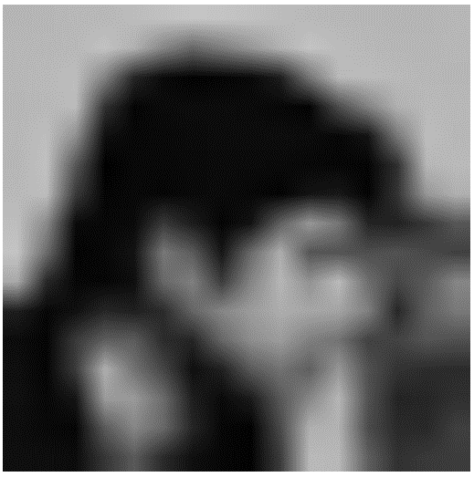
Machine Learning - crash course

Slide 14
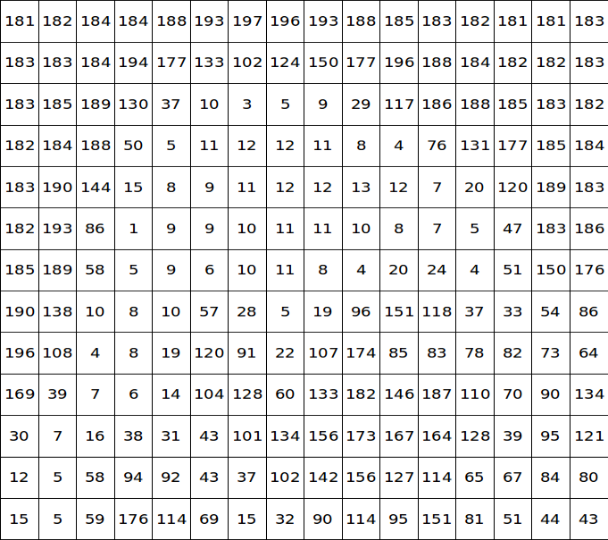
Machine Learning - crash course

Slide 15
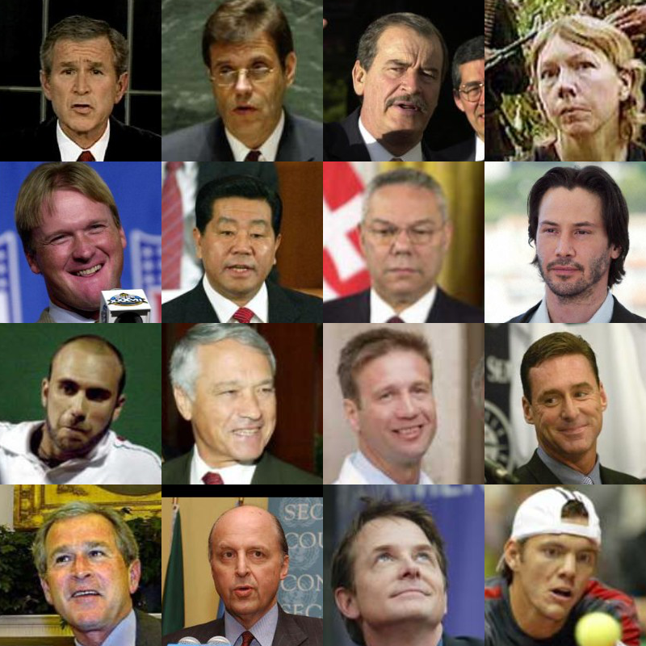
Machine Learning - crash course
Images taken from LFW benchmark

Slide 16
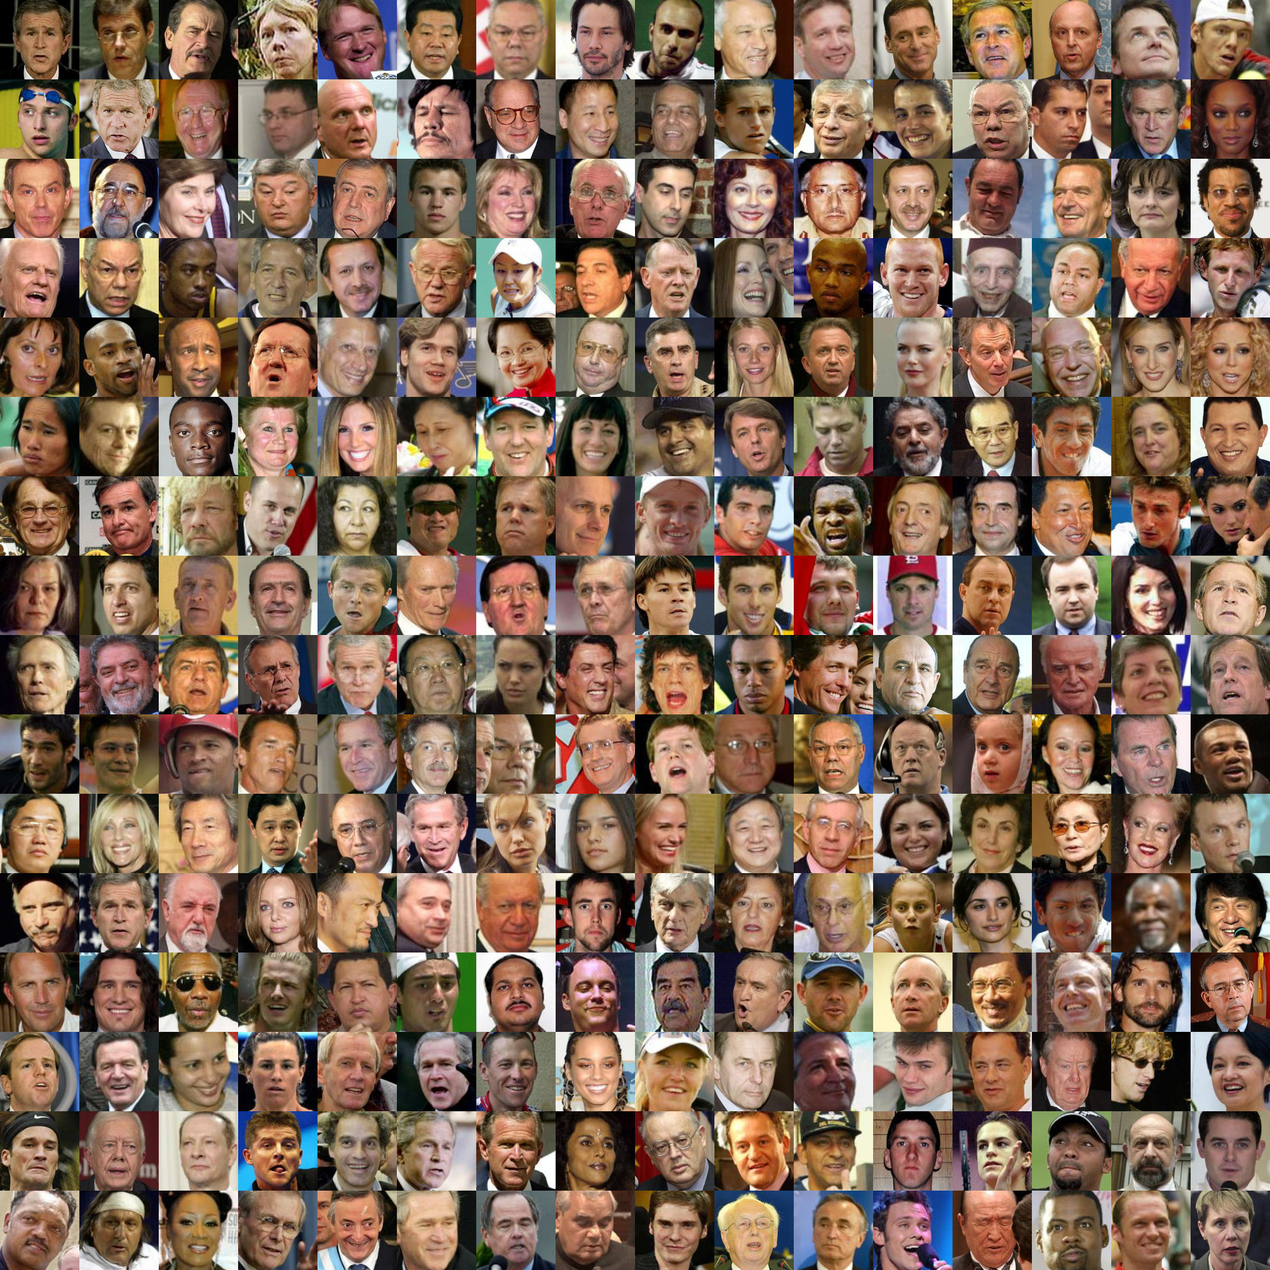
Machine Learning - crash course
Images taken from LFW benchmark

Slide 17

Machine Learning - supervised learning

Slide 18


Machine Learning - supervised learning
$$x_{o}$$

Slide 19
Machine Learning - supervised learning

Slide 20
Machine Learning - supervised learning
$$x_{o}$$

Slide 21

Machine Learning - supervised learning

Slide 22
Machine Learning - supervised learning

Slide 23
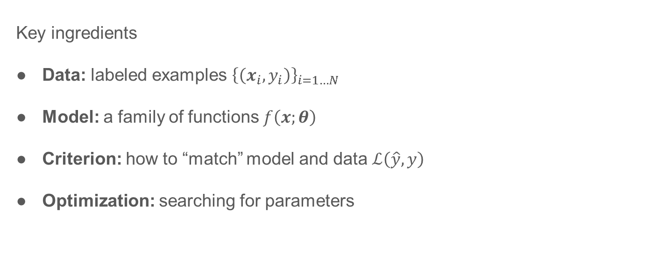
Machine Learning – Supervised Learning
Key ingredients
Data: labeled examples ${\left\{\left(x_{i},y_{i}\right)\right\}}_{i=1…N}$
Model: a family of functions $f\left(x;θ\right)$
Criterion: how to “match” model and data $ℒ\left(\hat{y}, y\right)$
Optimization: searching for parameters

Slide 24
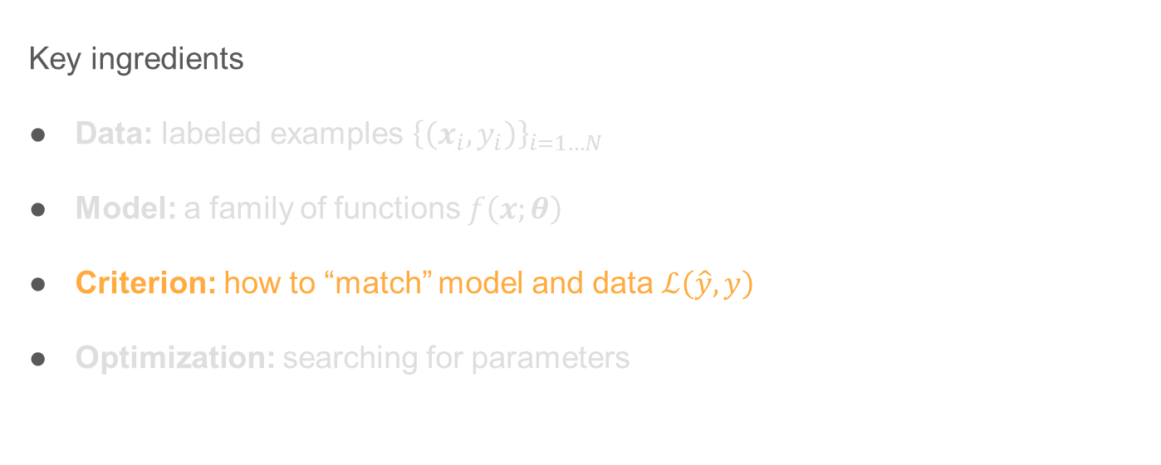
Machine Learning – Supervised Learning
Key ingredients
Data: labeled examples ${\left\{\left(x_{i},y_{i}\right)\right\}}_{i=1…N}$
Model: a family of functions $f\left(x;θ\right)$
Criterion: how to “match” model and data $ℒ\left(\hat{y}, y\right)$
Optimization: searching for parameters

Slide 25
Criterion - Regression

Slide 26
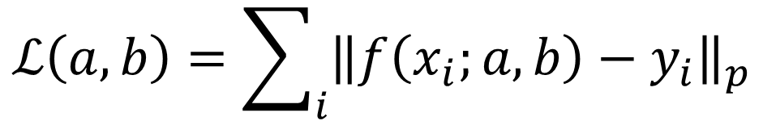



Criterion - Regression
$$ℒ\left(a,b\right)=\sum_{i}{{\left\|f\left(x_{i};a,b\right)−y_{i}\right\|}_{p}}$$
$${\left\|f\left(x_{i};a,b\right)−y_{i}\right\|}_{p}=ℒ\left(\hat{y_{i}},y_{i}\right)$$
$$y_{i}$$
$$x_{i}$$

Slide 27
Criterion - Classification
Face
Not - face

Slide 28


Criterion - Classification
Face
Not - face
$$ℒ\left(\hat{y_{i}}=w^{T}x_{i},y_{i}\right)$$
$$w$$

Slide 29


Criterion - Classification
Face
Not - face
Hinge loss
$$ℒ\left(\hat{y_{i}}=w^{T}x_{i},y_{i}\right)$$
$$ℒ$$
$$w$$
$$w^{T}x_{i}⋅y_{i}$$

Slide 30
Criterion - Classification
Cross-Entropy (on board)

Slide 31
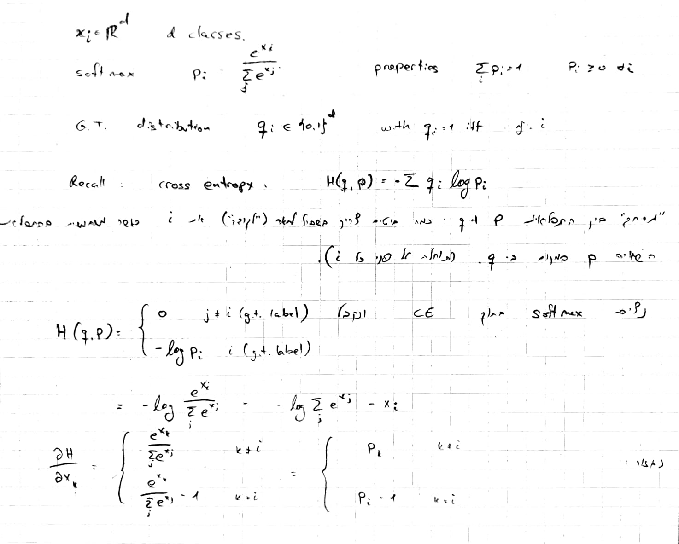
Criterion - Classification
Cross-Entropy (on board)

Slide 32
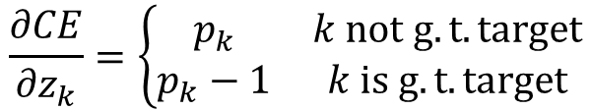


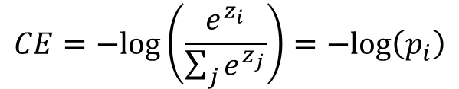
Criterion - Classification
Cross-Entropy
$$ℒ$$
$$CE=−log\left(\frac{e^{z_{i}}}{\sum_{j}{e^{z_{j}}}}\right)=−log\left(p_{i}\right)$$
$$\frac{∂CE}{∂z_{k}}=\left\{\begin{matrix}p_{k} & k not g.t. target \\ p_{k}−1 & k is g.t. target\end{matrix}\right.$$
$$z=w^{T}x$$

Slide 33
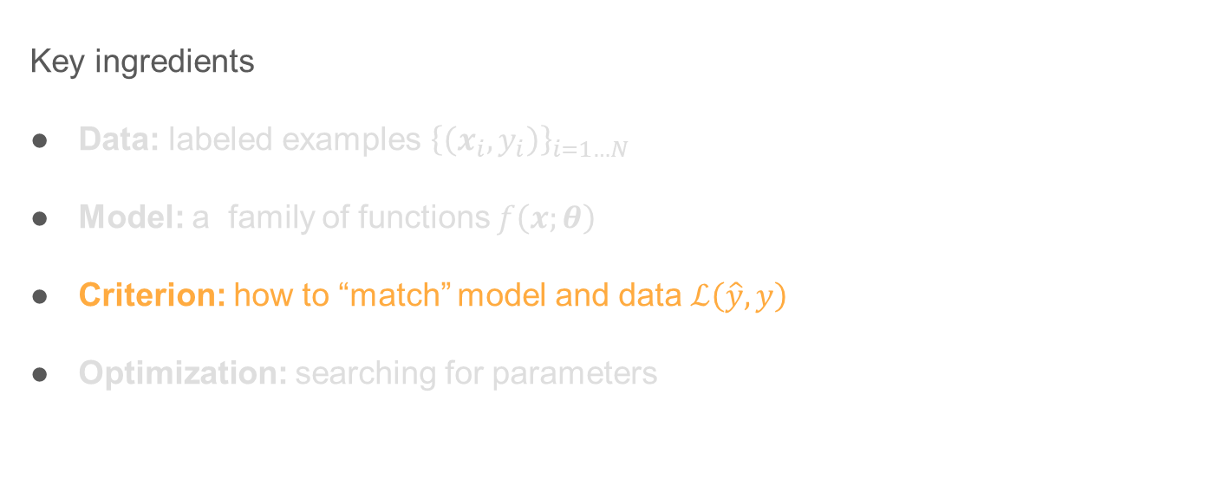
Machine Learning – Supervised Learning
Key ingredients
Data: labeled examples ${\left\{\left(x_{i},y_{i}\right)\right\}}_{i=1…N}$
Model: a family of functions $f\left(x;θ\right)$
Criterion: how to “match” model and data $ℒ\left(\hat{y}, y\right)$
Optimization: searching for parameters

Slide 34
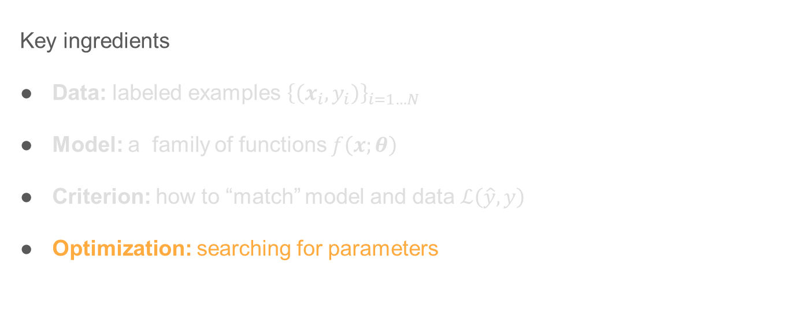
Machine Learning – Supervised Learning
Key ingredients
Data: labeled examples ${\left\{\left(x_{i},y_{i}\right)\right\}}_{i=1…N}$
Model: a family of functions $f\left(x;θ\right)$
Criterion: how to “match” model and data $ℒ\left(\hat{y}, y\right)$
Optimization: searching for parameters

Slide 35
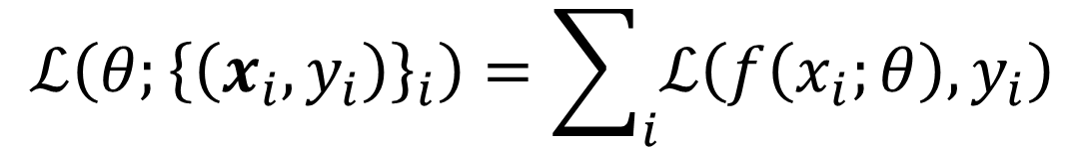


Gradient descent
$$ℒ\left(θ;{\left\{\left(x_{i},y_{i}\right)\right\}}_{i}\right)=\sum_{i}{ℒ\left(f\left(x_{i};θ\right),y_{i}\right)}$$
$$ℒ\left(θ\right)$$
$$θ$$

Slide 36

General approach
Pick random starting point.
$$ℒ\left(θ\right)$$
$$θ$$
$$a_{1}$$

Slide 37

General approach
Compute gradient at point
$$ℒ\left(θ\right)$$
$$∇ℒ(a_{1})$$
$$θ$$
$$a_{1}$$

Slide 38



General approach
Move along parameter space in direction of negative gradient
$η$ = step size = learning rate
$$ℒ\left(θ\right)$$
$$a_{2}=a_{1}−η∇ℒ(a_{1})$$
$$θ$$
$$a_{1}$$
$$a_{2}$$

Slide 39


General approach
Move along parameter space in direction of negative gradient
$η$ = step size = learning rate
$$ℒ\left(θ\right)$$
$$a_{3}=a_{2}−η∇ℒ(a_{2})$$
$$θ$$
$$a_{1}$$
$$a_{2}$$
$$a_{3}$$

Slide 40

General approach
Stop when we don’t move any more.
$$ℒ\left(θ\right)$$
$$a_{3}=a_{2}−η∇ℒ(a_{2})$$
$$θ$$
$$a_{1}$$
$$a_{2}$$
$$a_{3}$$
$$a_{stop}$$

Slide 41
Gradient Descent
Finds optimum of functions
Guaranteed to find global minimum for convex functions.
Non-convex = local minimum
Deep learning = (highly) non convex loss functions
f(x)
x

Slide 42
Machine Learning – Supervised Learning
Key ingredients
Data: labeled examples ${\left\{\left(x_{i},y_{i}\right)\right\}}_{i=1…N}$
Model: a family of functions $f\left(x;θ\right)$
Criterion: how to “match” model and data $ℒ\left(\hat{y}, y\right)$
Optimization: searching for parameters

Slide 43

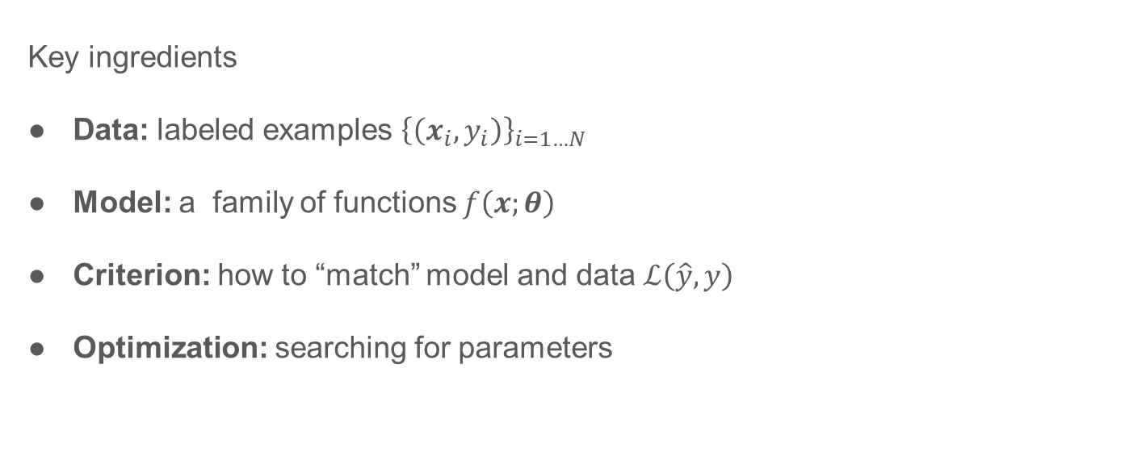
Machine Learning – Supervised Learning
Key ingredients
Data: labeled examples ${\left\{\left(x_{i},y_{i}\right)\right\}}_{i=1…N}$
Model: a family of functions $f\left(x;θ\right)$
Criterion: how to “match” model and data $ℒ\left(\hat{y}, y\right)$
Optimization: searching for parameters

Slide 44
Wrap up “machine learning” high level
Starting with details. Image classification as a “case study”

Slide 45
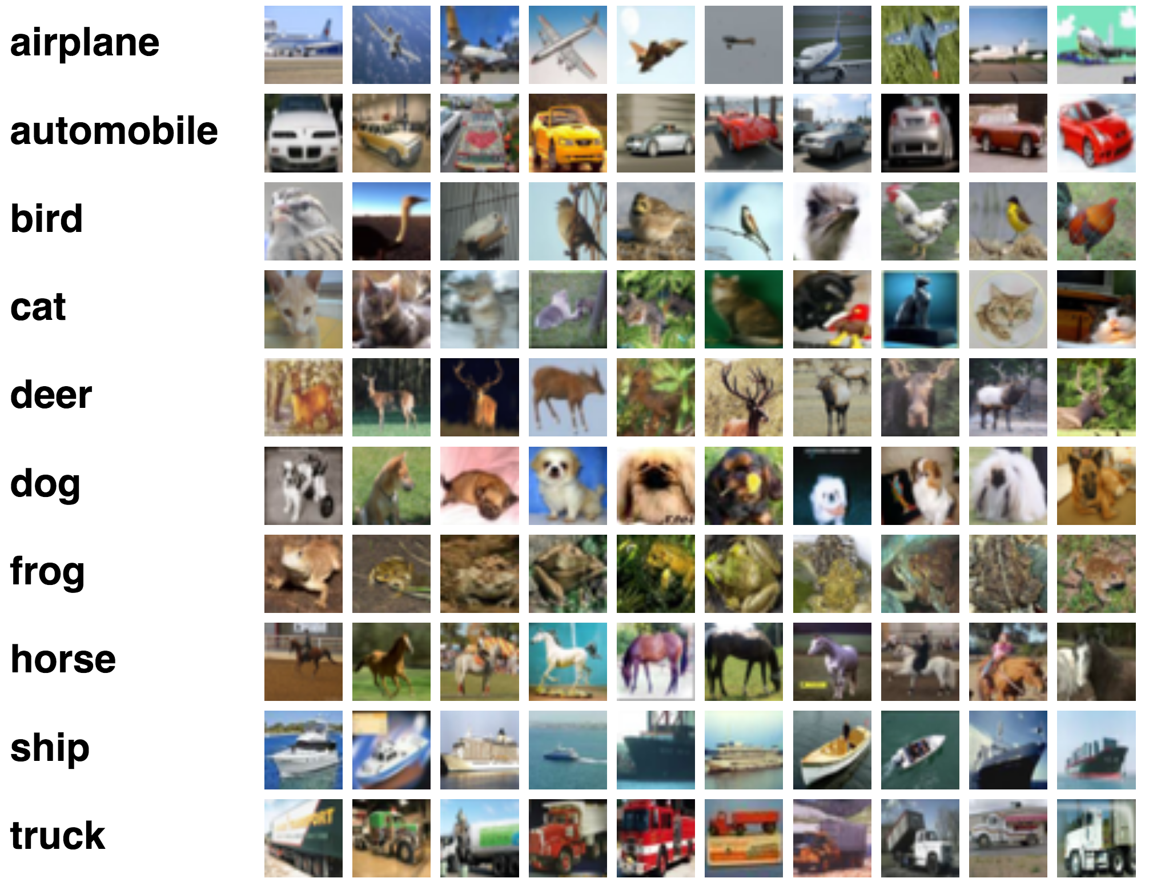
Image Classification
Task: predict dominant object in an image
Imagenet: 1000 classes, 1M training
Goal: accuracy of prediction

Slide 46
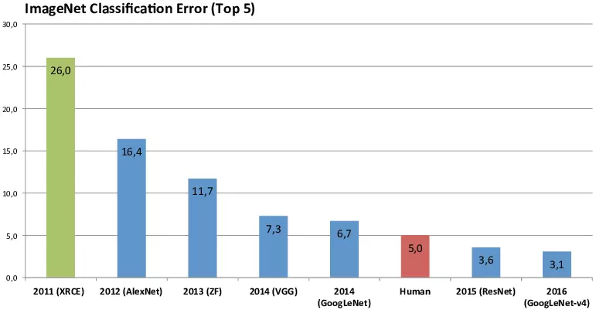
Image classification

Slide 47
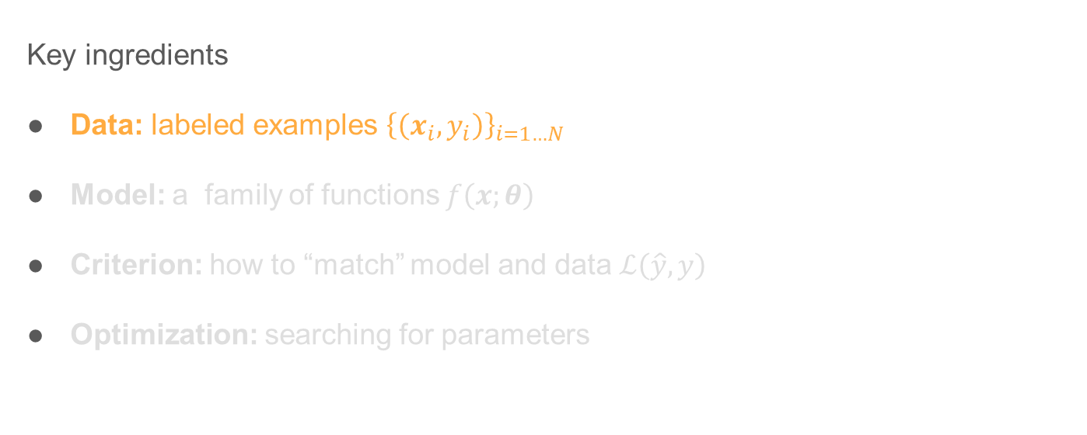
Image Classification
Key ingredients
Data: labeled examples ${\left\{\left(x_{i},y_{i}\right)\right\}}_{i=1…N}$
Model: a family of functions $f\left(x;θ\right)$
Criterion: how to “match” model and data $ℒ\left(\hat{y}, y\right)$
Optimization: searching for parameters

Slide 48
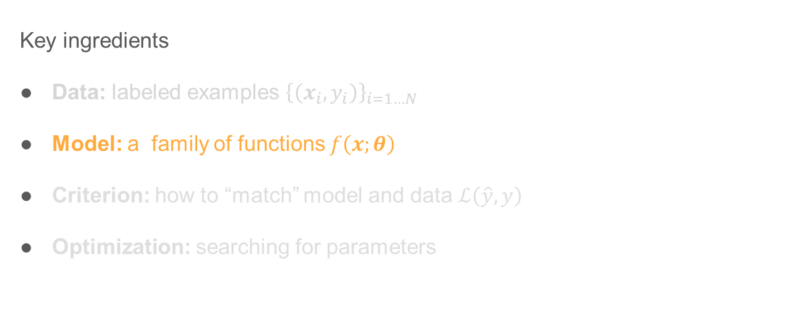
Image Classification
Key ingredients
Data: labeled examples ${\left\{\left(x_{i},y_{i}\right)\right\}}_{i=1…N}$
Model: a family of functions $f\left(x;θ\right)$
Criterion: how to “match” model and data $ℒ\left(\hat{y}, y\right)$
Optimization: searching for parameters

Slide 49
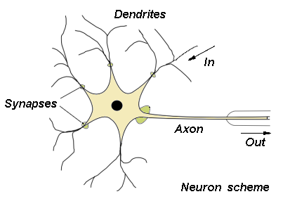
What is “deep net” / “neural network”?
In
Synapses
Axon
Out
Image sources: neuron, perceptron

Slide 50
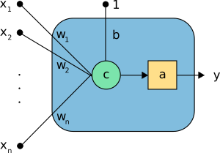
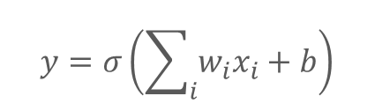


What is “deep net” / “neural network”?
$$y=σ\left(\sum_{i}{w_{i}x_{i}}+b\right)$$
In
Synapses
$$Σ_{i}$$
$$σ$$
Axon
Out
Image sources: neuron, perceptron

Slide 51
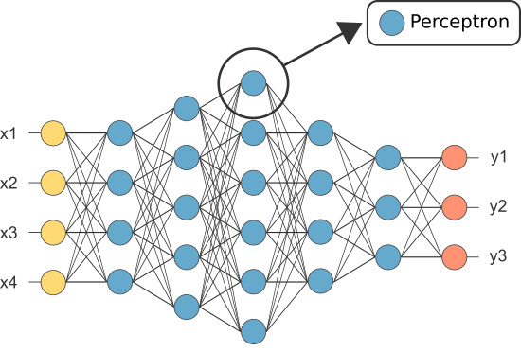
What is “deep net” / “neural network”?
$$y=σ\left(\sum_{i}{w_{i}x_{i}}+b\right)$$
$$Σ_{i}$$
$$σ$$
Image sources: neuron, perceptron

Slide 52
Types of Layers

Slide 53



Fully-Connected Layer
Aka Inner-product, Linear …
Number of parameters: $n_{in}×n_{out}$ (not including the bias)
$$y_{j}=\sum_{i}{w_{ij}x_{i}}+b_{j}$$

Slide 54
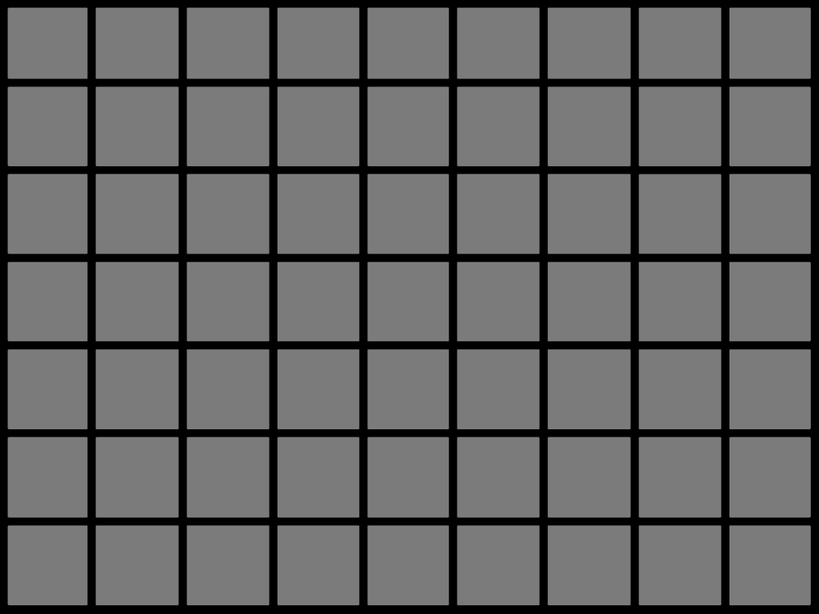
Fully-Connected Layer
Aka Inner-product, Linear …
Number of parameters: $n_{in}×n_{out}$ (not including the bias)
$$y_{j}=\sum_{i}{w_{ij}x_{i}}+b_{j}$$

Slide 55

Fully-Connected Layer
Aka Inner-product, Linear …
Number of parameters: $n_{in}×n_{out}$ (not including the bias)
$$y_{j}=\sum_{i}{w_{ij}x_{i}}+b_{j}$$

Slide 56
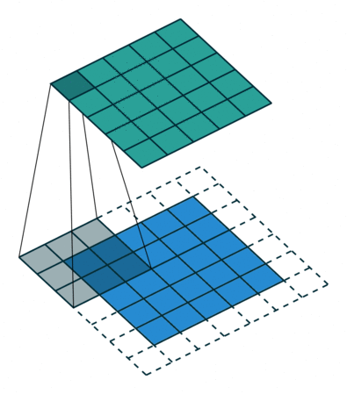

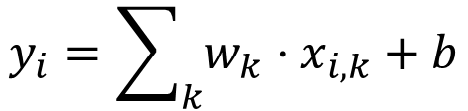
Convolution Layer
$$y_{i}=\sum_{k}{w_{k}⋅x_{i,k}}+b$$
Number of parameters: $k^{2}×c_{in}×c_{out}$
animation source

Slide 57
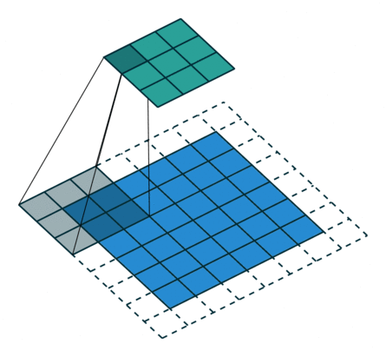
Pooling Layer
Reduce spatial dimensions
Sample pixels
Max / Avg / Fixed …
animation source

Slide 58
Non-Linear Activations

Slide 59
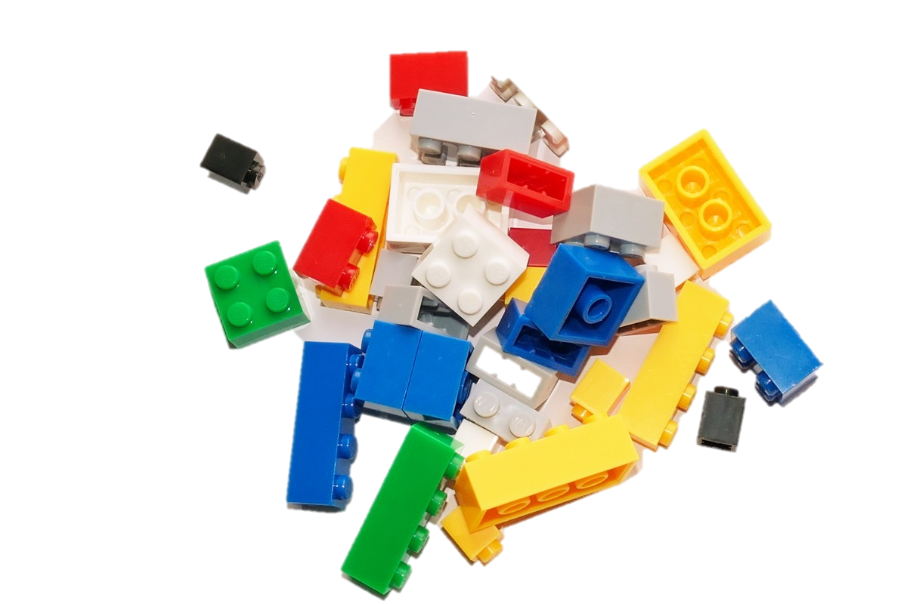

Slide 60
What is the most important thing?
Differentiability!

Slide 61
Landmark Deep Architectures

Slide 62
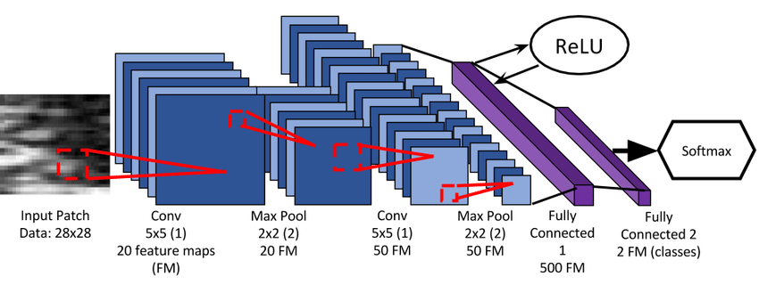
LeNet
LeCun, Yann, Léon Bottou, Yoshua Bengio, and Patrick Haffner Gradient-based learning applied to document recognition (1998).
Image source

Slide 63
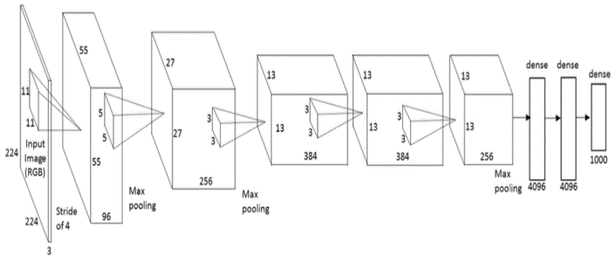
AlexNet
Alex Krizhevsky, Ilya Sutskever, and Geoffrey E. Hinton Imagenet classification with deep convolutional neural networks (NIPS 2012).
Image source

Slide 64
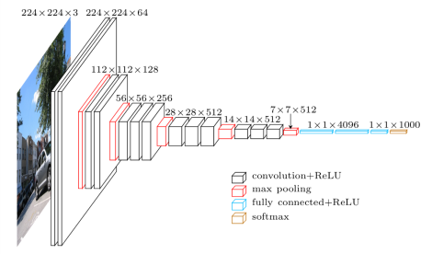
VGG
Simonyan, Karen, and Andrew Zisserman Very deep convolutional networks for large-scale image recognition (2014).
Image source

Slide 65
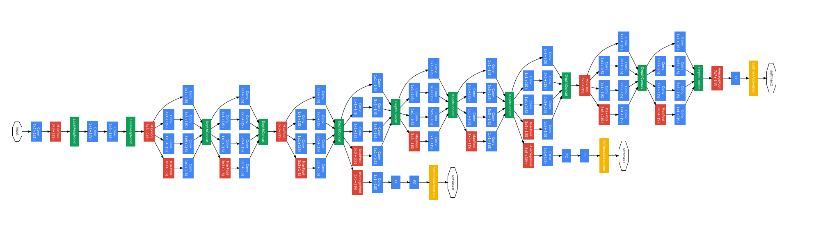
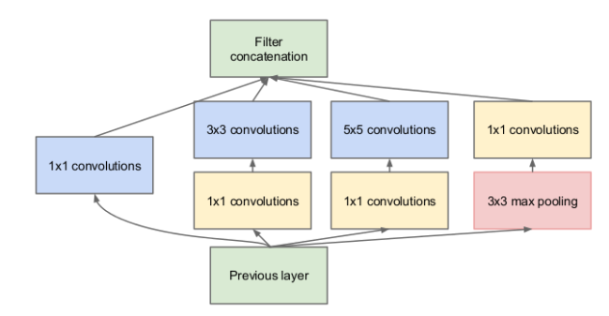
GoogLeNet (Inception)
Szegedy, Christian, Wei Liu, Yangqing Jia, Pierre Sermanet, Scott Reed, Dragomir Anguelov, Dumitru Erhan, Vincent Vanhoucke, and Andrew Rabinovich Going deeper with convolutions (CVPR 2015).
Image source

Slide 66
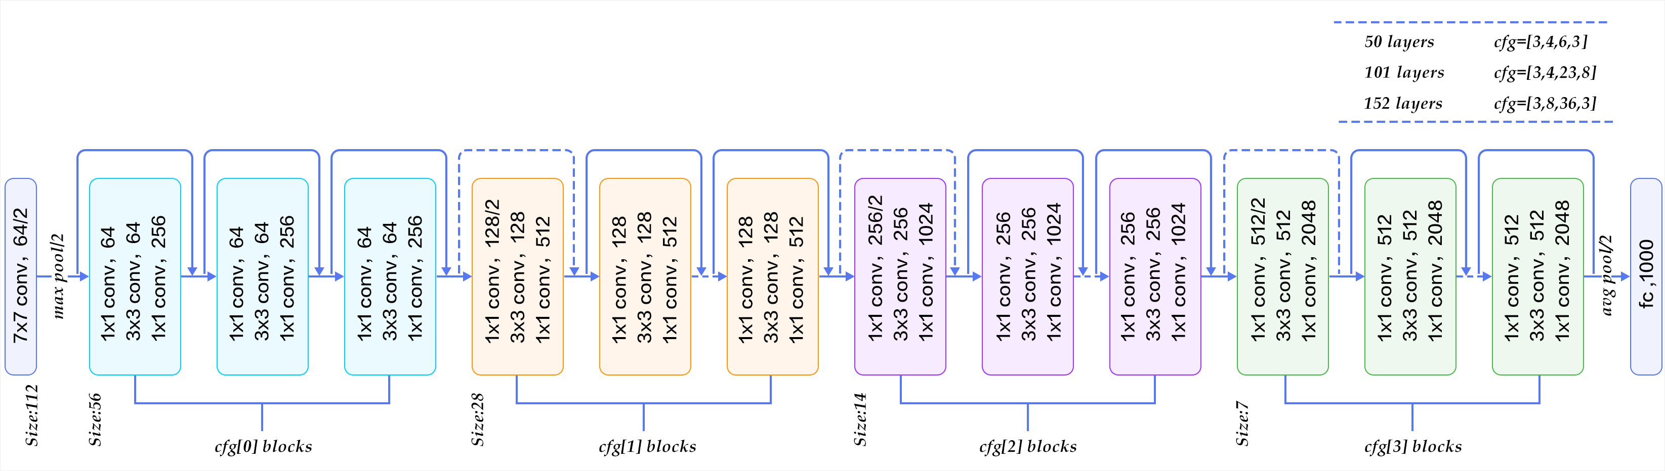
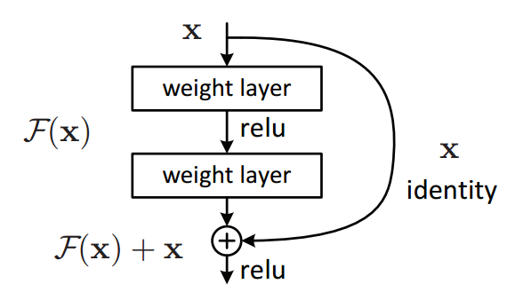
ResNet
He, Kaiming, Xiangyu Zhang, Shaoqing Ren, and Jian Sun Deep residual learning for image recognition (CVPR 2016)
Image source, source

Slide 67
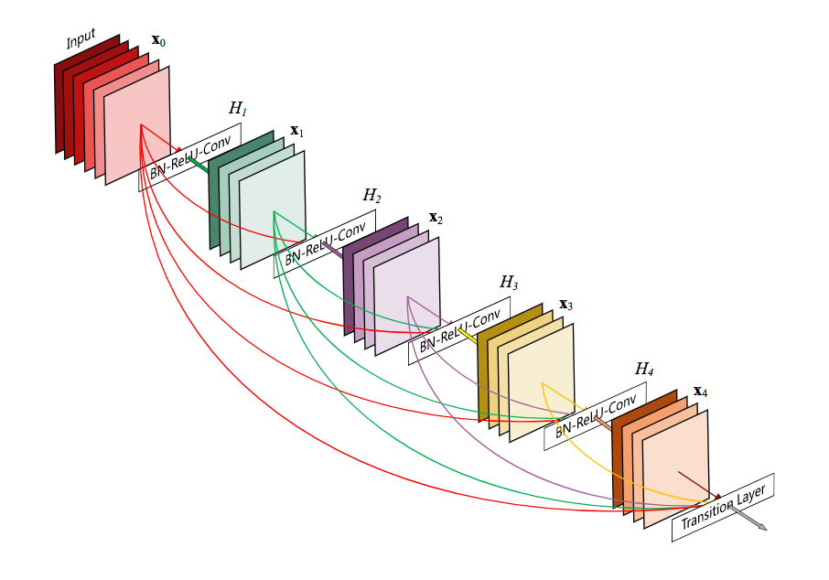
DenseNet
Iandola, Forrest, Matt Moskewicz, Sergey Karayev, Ross Girshick, Trevor Darrell, and Kurt Keutzer Densenet: Implementing efficient convnet descriptor pyramids (2014).
Image source

Slide 68
MobileNet

Slide 69

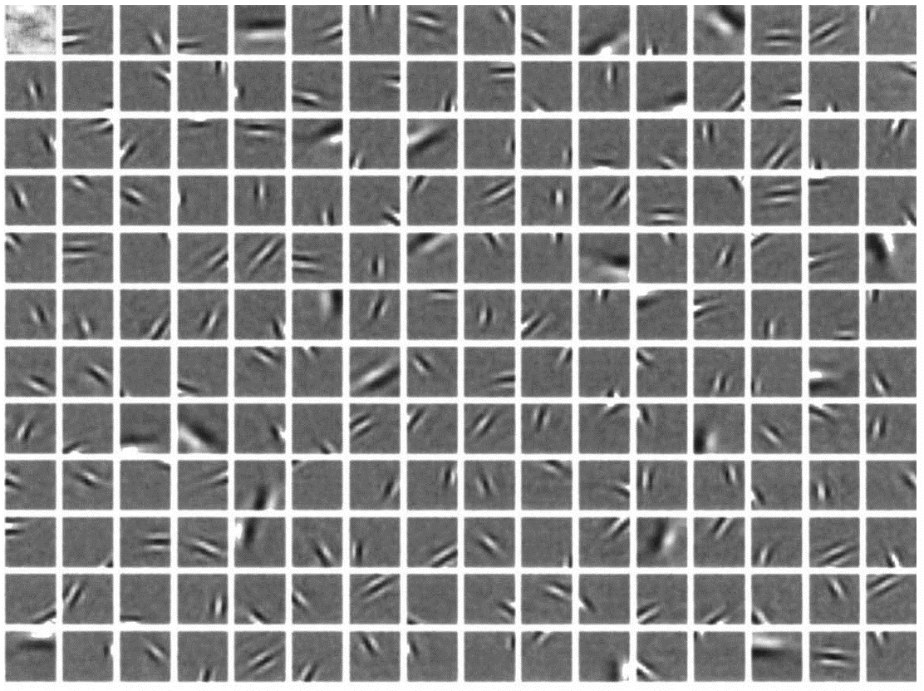
What do Deep Nets Learn?
Inception – conv1
Human V1
Olshausen, Bruno A., and David J. Field Emergence of simple-cell receptive field properties by learning a sparse code for natural images (Nature 1996)

Slide 70
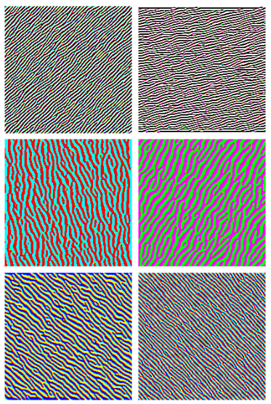
What do Deep Nets Learn?
Inception – conv1
Inception – conv2
Source: distill, appendix

Slide 71
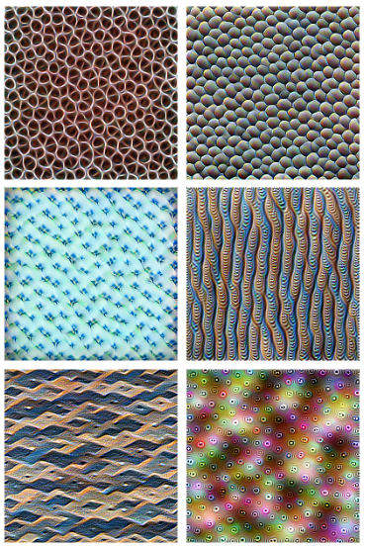
What do Deep Nets Learn?
Inception – mix3a
Inception – conv2
Source: distill, appendix

Slide 72
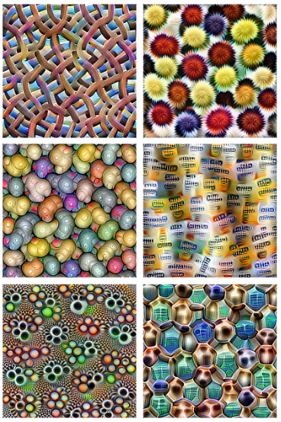
What do Deep Nets Learn?
Inception – mix4a
Inception – mix3a
Source: distill, appendix

Slide 73
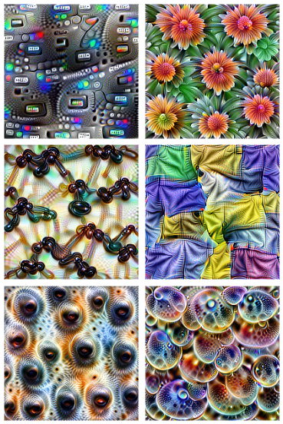
What do Deep Nets Learn?
Inception – mix4a
Inception – mix4b/c
Source: distill, appendix

Slide 74
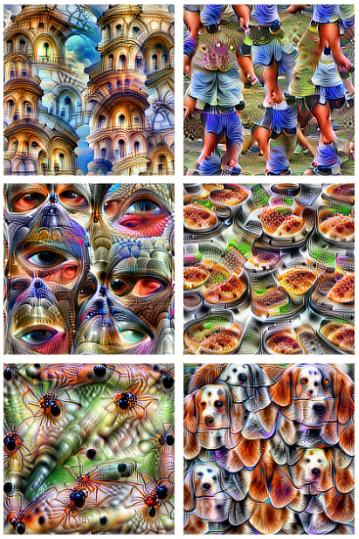
What do Deep Nets Learn?
Inception – mix4d/e
Inception – mix4b/c
Source: distill, appendix

Slide 75
Image Classification
Key ingredients
Data: labeled examples ${\left\{\left(x_{i},y_{i}\right)\right\}}_{i=1…N}$
Model: a family of functions $f\left(x;θ\right)$
Criterion: how to “match” model and data $ℒ\left(\hat{y}, y\right)$
Optimization: searching for parameters

