Slide 1

Introduction to computer Vision: Deep Learning
Shai Bagon

Slide 2
Recap
Supervised learning:
Training examples
Model = deep networks
Criterion = loss function
Optimization = finding the best instance in the “model family” using gradient descent
Layer types
“milestone” architectures

Slide 3
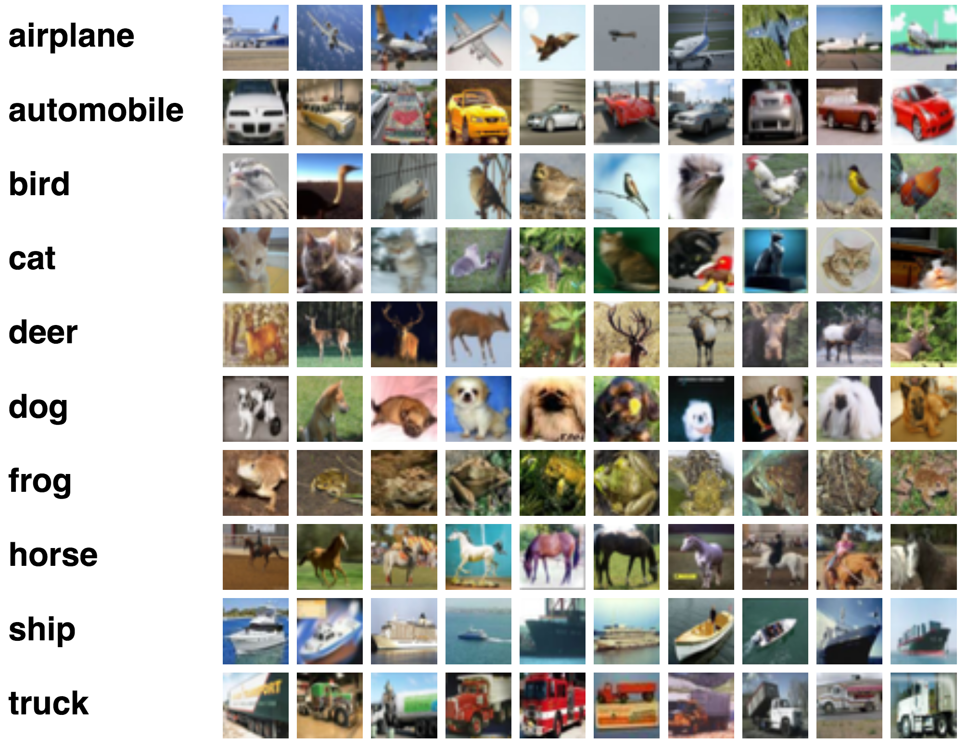
Image Classification
Task: predict dominant object in an image
Imagenet: 1000 classes, 1M training
Goal: accuracy of prediction

Slide 4
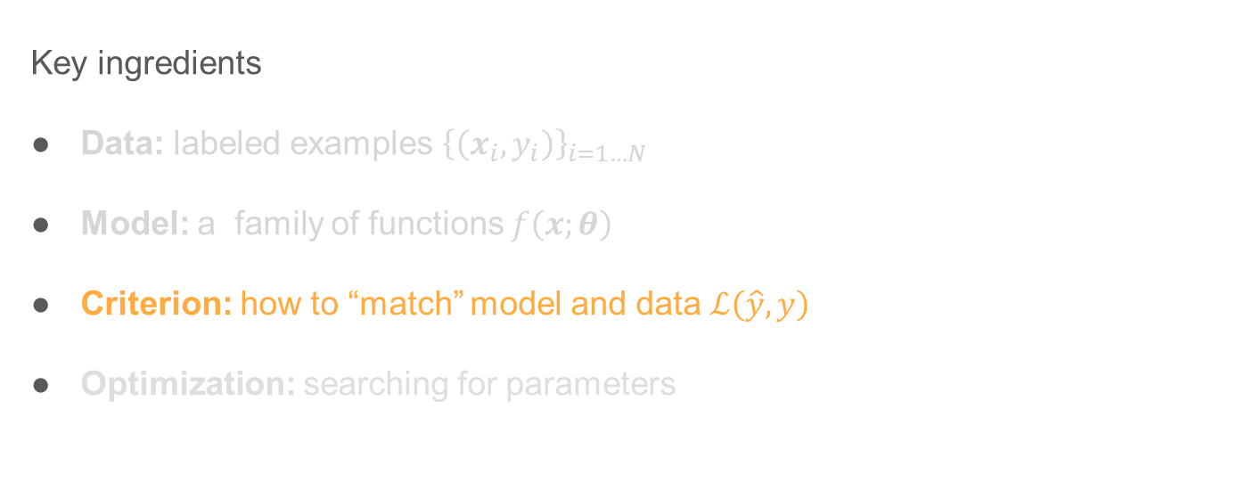
Image Classification
Key ingredients
Data: labeled examples ${\left\{\left(x_{i},y_{i}\right)\right\}}_{i=1…N}$
Model: a family of functions $f\left(x;θ\right)$
Criterion: how to “match” model and data $ℒ\left(\hat{y}, y\right)$
Optimization: searching for parameters

Slide 5


Criterion - Classification
class
Non class
$$ℒ\left(\hat{y_{i}}=w^{T}x_{i},y_{i}\right)$$
$$w$$

Slide 6
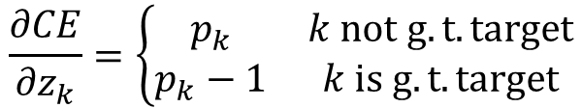


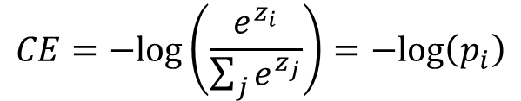
Criterion - Classification
Cross-Entropy loss
$$ℒ$$
$$CE=−log\left(\frac{e^{z_{i}}}{\sum_{j}{e^{z_{j}}}}\right)=−log\left(p_{i}\right)$$
$$\frac{∂CE}{∂z_{k}}=\left\{\begin{matrix}p_{k} & k not g.t. target \\ p_{k}−1 & k is g.t. target\end{matrix}\right.$$
$$z=w^{T}x$$

Slide 7
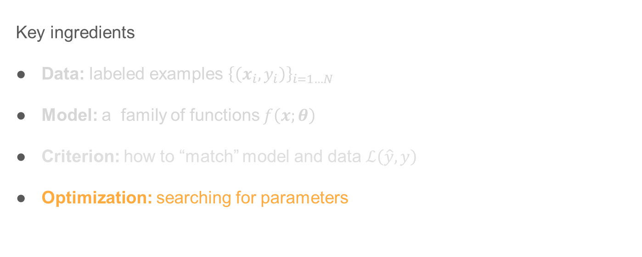
Image Classification
Key ingredients
Data: labeled examples ${\left\{\left(x_{i},y_{i}\right)\right\}}_{i=1…N}$
Model: a family of functions $f\left(x;θ\right)$
Criterion: how to “match” model and data $ℒ\left(\hat{y}, y\right)$
Optimization: searching for parameters

Slide 8







Gradient Descent
$$ℒ\left(θ\right)$$
$$a_{3}=a_{2}−η∇ℒ(a_{2})$$
$$θ$$
$$a_{1}$$
$$a_{2}$$
$$a_{3}$$
$$a_{stop}$$

Slide 9
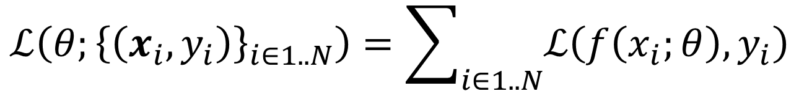
Gradient Descent
$$ℒ\left(θ;{\left\{\left(x_{i},y_{i}\right)\right\}}_{i∈1..N}\right)=\sum_{i∈1..N}{ℒ\left(f\left(x_{i};θ\right),y_{i}\right)}$$

Slide 10
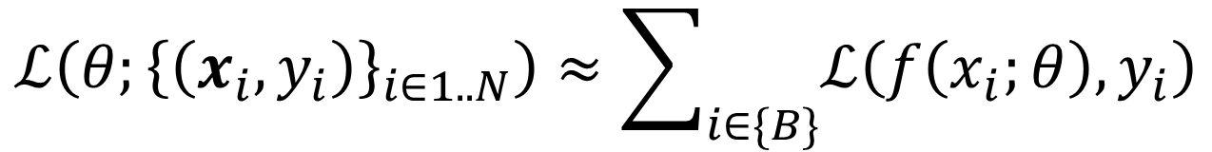
Stochastic Gradient Descent (SGD)
$$ℒ\left(θ;{\left\{\left(x_{i},y_{i}\right)\right\}}_{i∈1..N}\right)≈\sum_{i∈\{B\}}{ℒ\left(f\left(x_{i};θ\right),y_{i}\right)}$$

Slide 11
Stochastic Gradient Descent (SGD)
$$ℒ\left(θ;{\left\{\left(x_{i},y_{i}\right)\right\}}_{i∈1..N}\right)≈\sum_{i∈\{B\}}{ℒ\left(f\left(x_{i};θ\right),y_{i}\right)}$$
Update rule:
$$θ^{t+1}=θ^{t}−η∇ ℒ\left(θ^{t};{\left\{\left(x_{i},y_{i}\right)\right\}}_{i∈\{B\}}\right)$$

Slide 12

Stochastic Gradient Descent (SGD)
Chain rule:
$$f\left(g\left(x, θ_{1}\right);θ_{2}\right)$$
$$\frac{∂f}{∂θ_{1}}=\frac{∂f}{∂g}⋅\frac{∂g}{∂θ_{1}}$$

Slide 13




SGD by Backpropagation
$$x$$
$$f\left(x;θ\right)$$
$$y$$
$$θ$$

Slide 14
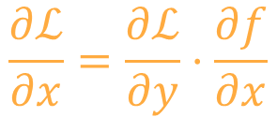

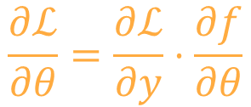
SGD by Backpropagation
$$\frac{∂ℒ}{∂x}=\frac{∂ℒ}{∂y}⋅\frac{∂f}{∂x}$$
$$f\left(x;θ\right)$$
$$\frac{∂ℒ}{∂y}$$
$$x$$
$$y$$
$$θ$$
$$\frac{∂ℒ}{∂θ}=\frac{∂ℒ}{∂y}⋅\frac{∂f}{∂θ}$$

Slide 15


Slide 16






Stochastic Gradient Descent (SGD)
$$traget=0$$
$$y=w_{2}h+b_{2}=w_{2}\left(w_{1}x+b_{1}\right)+b_{2}$$
Let: $$w_{1}=\left[\begin{matrix}1 & −1 \\ −2 & 2\end{matrix}\right], b_{1}=\left[\begin{matrix}−1 \\ 1\end{matrix}\right]$$
$$w_{2}=\left[\begin{matrix}−3 & 4\end{matrix}\right], b_{2}=\left[1\right]$$
$$h$$
$$y$$
$$x$$
$$ℒ$$

Slide 17
Stochastic Gradient Descent (SGD)
$$traget=0$$
$$h$$
$$y$$
$$x$$
$$ℒ$$

Slide 18

Stochastic Gradient Descent (SGD)
$$traget=0$$
Let: $$w_{1}=\left[\begin{matrix}1 & −1 \\ −2 & 2\end{matrix}\right], b_{1}=\left[\begin{matrix}−1 \\ 1\end{matrix}\right]$$
$$w_{2}=\left[\begin{matrix}2 & 1\end{matrix}\right], b_{2}=\left[−2\right]$$
$$ℒ=0.5{\left(y−t\right)}^{2}$$
$$h$$
$$y$$
$$x$$
$$ℒ$$

Slide 19





Forward
$$h=\left[\begin{aligned}−2 \\ 5\end{aligned}\right]$$
$$traget=0$$
Let: $$w_{1}=\left[\begin{matrix}1 & −1 \\ −2 & 2\end{matrix}\right], b_{1}=\left[\begin{matrix}−1 \\ 1\end{matrix}\right]$$
$$w_{2}=\left[\begin{matrix}2 & 1\end{matrix}\right], b_{2}=\left[−2\right]$$
$$ℒ=0.5{\left(y−t\right)}^{2}$$
$$h$$
$$x=\left[\begin{aligned}−1 \\ 2\end{aligned}\right]$$
$$y$$
$$x$$
$$ℒ$$
$$ℒ=0.5$$
$$y=\left[−1\right]$$

Slide 20

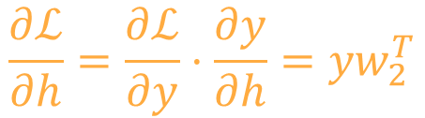
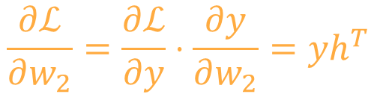

Backward
$$\frac{∂ℒ}{∂w_{2}}=\frac{∂ℒ}{∂y}⋅\frac{∂y}{∂w_{2}}=yh^{T}$$
$$h=\left[\begin{aligned}−2 \\ 5\end{aligned}\right]$$
$$traget=0$$
Let: $$w_{1}=\left[\begin{matrix}1 & −1 \\ −2 & 2\end{matrix}\right], b_{1}=\left[\begin{matrix}−1 \\ 1\end{matrix}\right]$$
$$w_{2}=\left[\begin{matrix}2 & 1\end{matrix}\right], b_{2}=\left[−2\right]$$
$$ℒ=0.5{\left(y−t\right)}^{2}$$
$$x=\left[\begin{aligned}−1 \\ 2\end{aligned}\right]$$
$$ℒ=0.5$$
$$\frac{∂ℒ}{∂y}=y$$
$$y=\left[−1\right]$$
$$\frac{∂ℒ}{∂w_{1}}=\frac{∂ℒ}{∂h}⋅\frac{∂h}{∂w_{1}}$$
$$\frac{∂ℒ}{∂h}=\frac{∂ℒ}{∂y}⋅\frac{∂y}{∂h}=yw_{2}^{T}$$

Slide 21
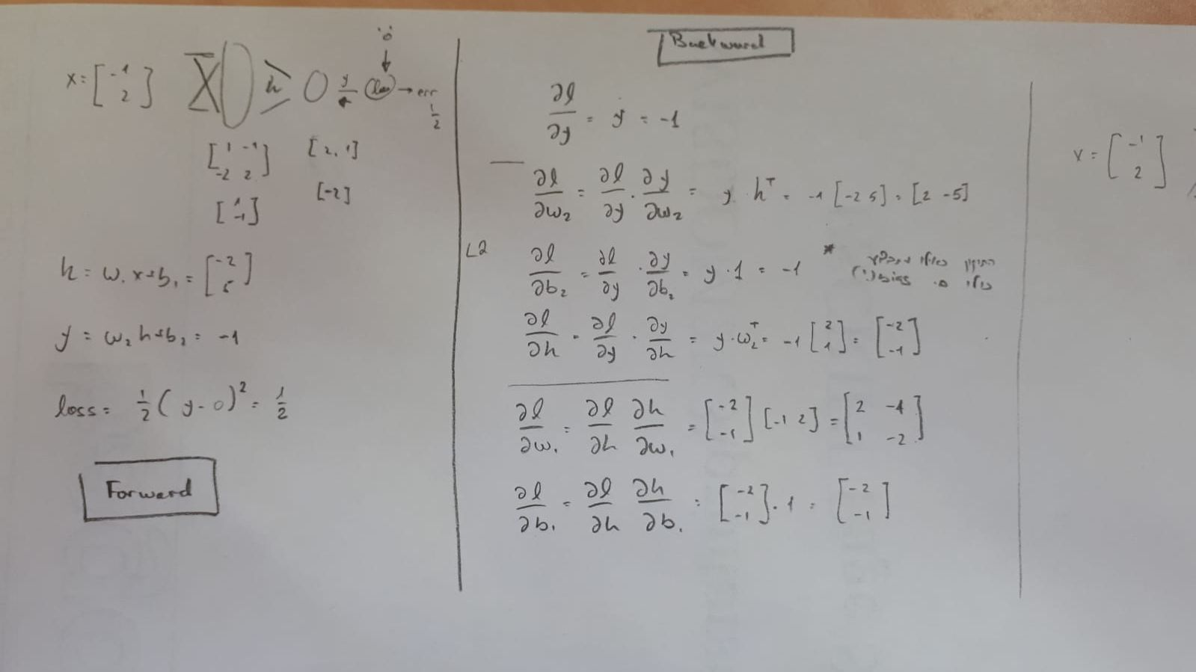

Slide 22
Stochastic Gradient Descent (SGD)
$$ℒ\left(θ;{\left\{\left(x_{i},y_{i}\right)\right\}}_{i∈1..N}\right)≈\sum_{i∈\{B\}}{ℒ\left(f\left(x_{i};θ\right),y_{i}\right)}$$
Update rule:
$$θ^{t+1}=θ^{t}−η∇ ℒ\left(θ^{t};{\left\{\left(x_{i},y_{i}\right)\right\}}_{i∈\{B\}}\right)$$

Slide 23
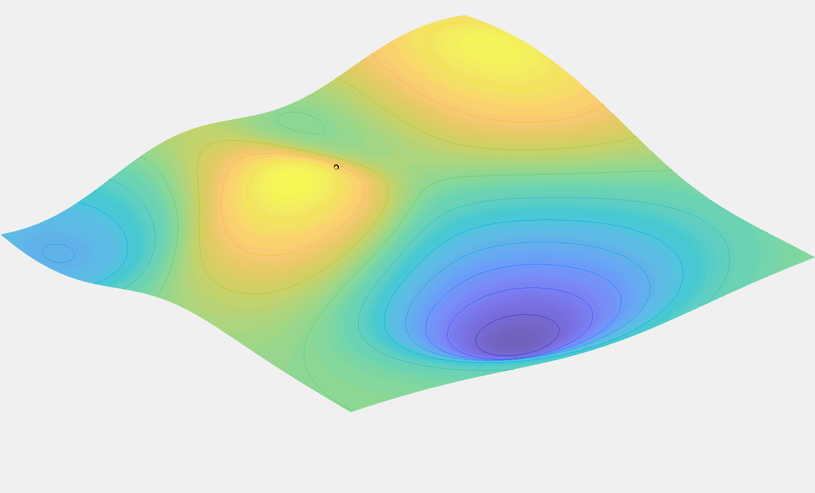

Vanilla SGD
$$θ^{t+1}=θ^{t}−η∇ ℒ\left(θ^{t}\right)$$

Slide 24
Vanilla SGD
$$θ^{t+1}=θ^{t}−η∇ ℒ\left(θ^{t}\right)$$
High learning rate

Slide 25
Vanilla SGD
$$θ^{t+1}=θ^{t}−η∇ ℒ\left(θ^{t}\right)$$
Low learning rate

Slide 26
Vanilla SGD
$$θ^{t+1}=θ^{t}−η∇ ℒ\left(θ^{t}\right)$$
“Ideal” learning rate

Slide 27
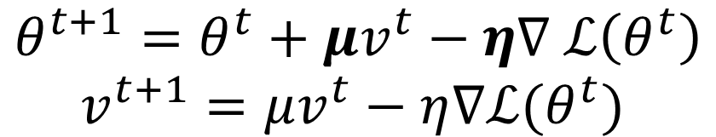
SGD with Momentum
$$θ^{t+1}=θ^{t}+μv^{t}−η∇ ℒ\left(θ^{t}\right)$$
$$v^{t+1}=μv^{t}−η∇ℒ(θ^{t})$$

Slide 28
Other SGD Update Rules
Adagrad: Adjusting the learning rate per parameter
ADAM: Taking into account “velocity” and “acceleration” (2nd order moments)
…
A good review can be found here.

Slide 29
SGD - Remarks
Guarantees?
No!
Starting point?
“dead neurons”
Data normalization / weight initialization

Slide 30
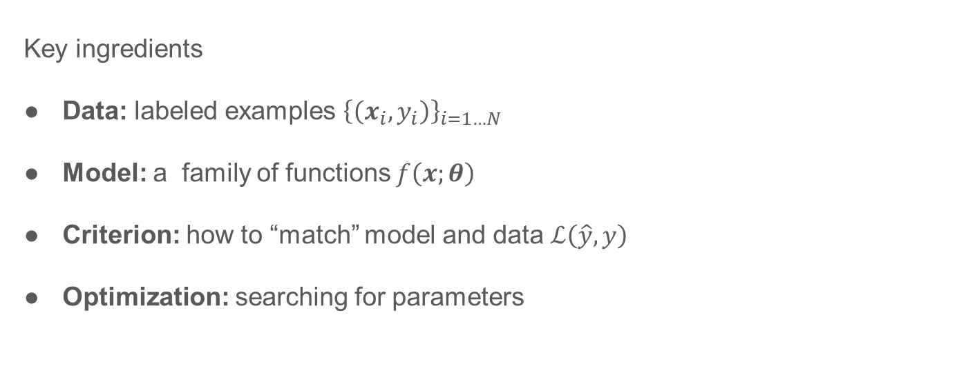
Image Classification
Key ingredients
Data: labeled examples ${\left\{\left(x_{i},y_{i}\right)\right\}}_{i=1…N}$
Model: a family of functions $f\left(x;θ\right)$
Criterion: how to “match” model and data $ℒ\left(\hat{y}, y\right)$
Optimization: searching for parameters

Slide 31




Optimization’s Pitfalls
“Space” of all predictors
“ideal” predictor
All deep networks
Approximation error
Networks of specific architecture
$$θ_{world}^{⋆}$$
$$θ_{training}^{⋆}$$
$$θ_{optimization}^{⋆}$$
Estimation/Generalization error
Optimization error

Slide 32
Optimization’s Pitfalls
“Space” of all predictors
“ideal” predictor
Approximation error
Networks of specific architecture
$$θ_{world}^{⋆}$$
Change Architecture
$$θ_{training}^{⋆}$$
$$θ_{optimization}^{⋆}$$
Estimation/Generalization error
Optimization error
Add more examples
…
Tweak optimization meta parameters

Slide 33

Optimization’s Pitfalls
How to look at the loss-vs-iterations for train/test set?
Overfitting
$$ℒ$$
-- Train loss
-- Test loss
$$t$$

Slide 34

Regularization
$$ℒ\left(θ;X\right)=CE\left(θ;X\right)+λ{\left\|θ\right\|}_{p}$$

Slide 35
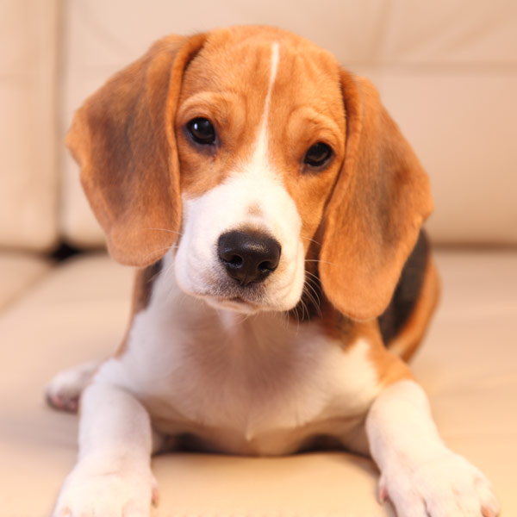

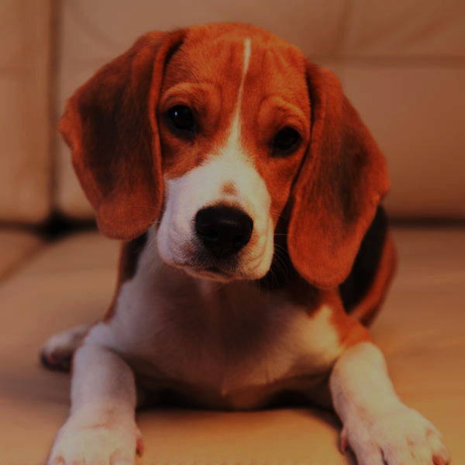
Regularization
Data augmentation
dog

Slide 36
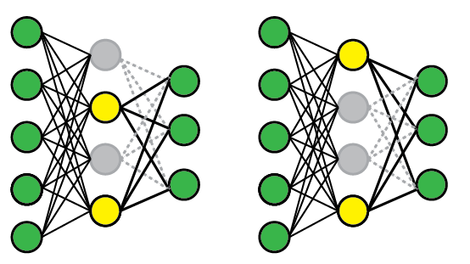
Regularization
Dropout
Image source

Slide 37
Regularization
Early Stopping
$$ℒ$$
-- Train loss
-- Test loss
$$t$$

Slide 38
Optimization’s Pitfalls
Exploding gradients
$$ℒ$$
-- Train loss
-- Test loss
$$t$$

Slide 39
Optimization’s Pitfalls
Vanishing gradients
$$ℒ$$
-- Train loss
-- Test loss
$$t$$

Slide 40




Optimization’s Pitfalls
Covariate shift
$$\frac{∂𝓛}{∂θ}$$
$$x$$
$$y$$

Slide 41
Optimization’s Pitfalls
Batch Norm!
$$x$$
BN
BN
BN
$$y$$

Slide 42
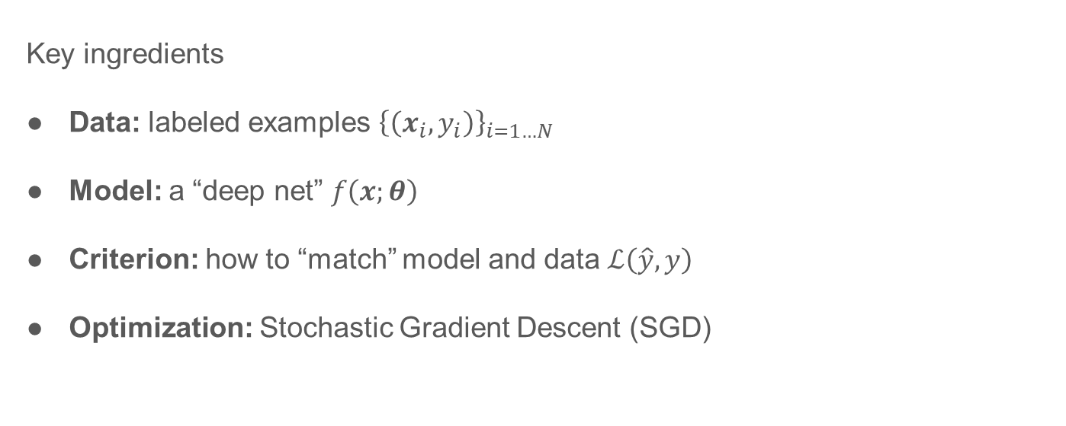
Deep Learning
Key ingredients
Data: labeled examples ${\left\{\left(x_{i},y_{i}\right)\right\}}_{i=1…N}$
Model: a “deep net” $f\left(x;θ\right)$
Criterion: how to “match” model and data $ℒ\left(\hat{y}, y\right)$
Optimization: Stochastic Gradient Descent (SGD)

Slide 43
Additional Reading
How to initialize weights: He, Kaiming, Xiangyu Zhang, Shaoqing Ren, and Jian Sun Delving deep into rectifiers: Surpassing human-level performance on imagenet classification (CVPR 2015)
Convolution “arithmetic”
Simple “playground”

