Slide 1
Introduction to computer Vision: Deep Learning
Shai Bagon

Slide 2
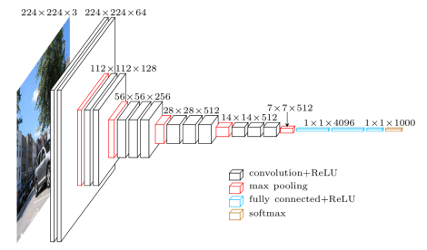
Recap: Deep Learning
Key ingredients
Data: labeled examples ${\left\{\left(x_{i},y_{i}\right)\right\}}_{i=1…N}$
Model: a “deep net” $f\left(x;θ\right)$
Criterion: how to “match” model and data $ℒ\left(\hat{y}, y\right)$
Optimization: Stochastic Gradient Descent (SGD)

Slide 3
Additional Tasks
Object detection
Semantic segmentation

Slide 4
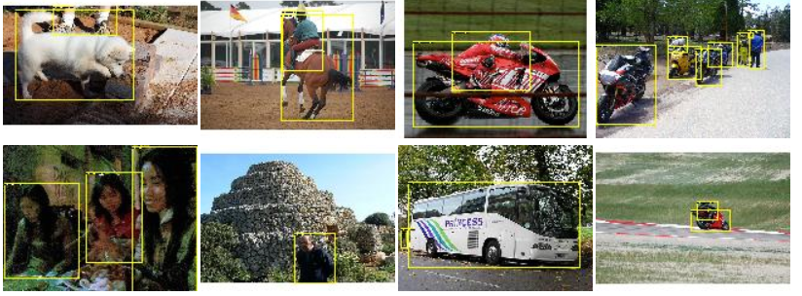
Additional Tasks: Training Data
PASCAL VOC
11.5K labeled images
27.5K instances
20 object categories

Slide 5
Additional Tasks: Training Data
MS COCO
200K labeled images
1.5M instances
80 object categories

Slide 6
Additional Tasks: Metric
Ground Truth
Prediction
$$IoU=\frac{Intersection}{Union}$$

Slide 7
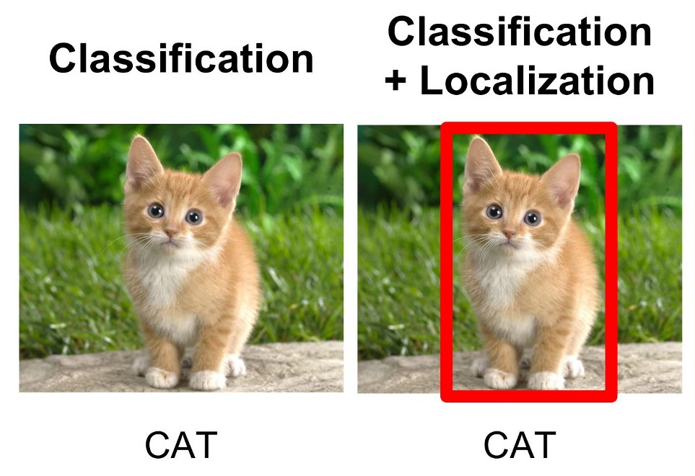
Localization
Image credit: medium

Slide 8
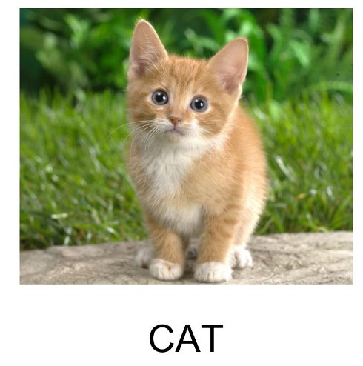
Localization
Deep net (“backbone”)
$${\hat{w}}_{f×4}^{T}x$$
$$ℓ_{1}$$
$$w_{f×1000}^{T}x$$
$$CE$$

Slide 9
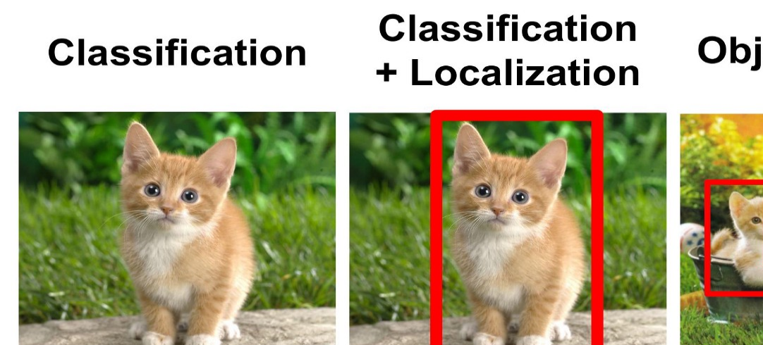
Object Detection
Image credit: medium

Slide 10
Object Detection
Two Stages (R-CNN)
Propose “objects”
Classify each candidate
Single Stage (SSD, Yolo)
Sliding window to classify all candidates

Slide 11
Object Detection
Two Stages (R-CNN)
Propose “objects”
Classify each candidate
Single Stage (SSD, Yolo)
Sliding window to classify all candidates

Slide 12
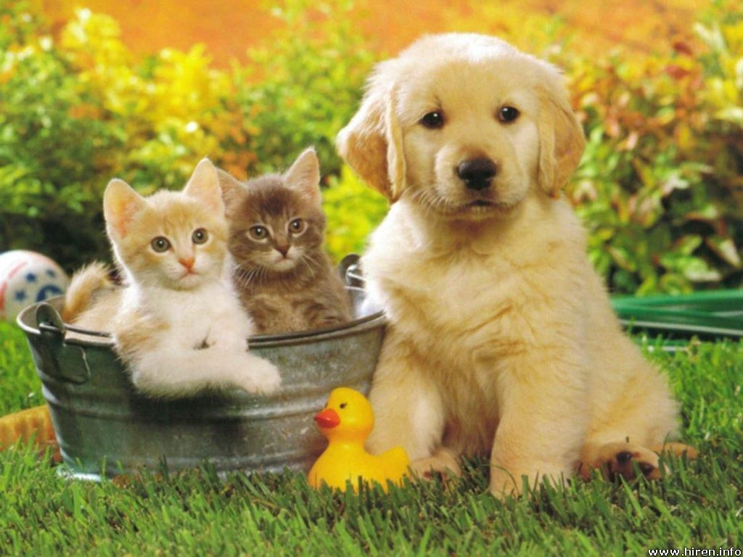
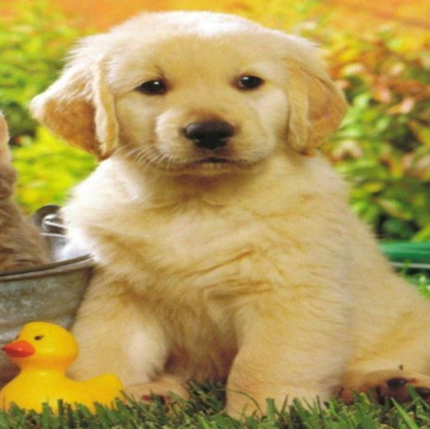
R-CNN
Deep net (“backbone”)
Class / BG
BBox
Propose “object” regions (~2K)
Crop and “warp” each proposed region
“Localize” the object
Drawbacks
Detection in one image = ~2K image classifications
Does not train “end-to-end”
Girshick, Donahue, Darrell and Malik "Rich feature hierarchies for accurate object detection and semantic segmentation" (CVPR 2014)

Slide 13
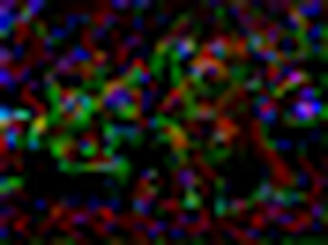
Fast R-CNN
backbone
Class / BG
BBox
Propose “object” regions (~2K)
“ROI Pool” each proposed region
from the feature map
Drawbacks
Detection in one image = ~2K image classifications
Does not train “end-to-end”
Girshick "Fast R-CNN" (ICCV 2015)

Slide 14
Faster R-CNN
RPN: Region Proposal Network
RPN
backbone
Class / BG
BBox
“ROI Pool” each proposed region
from the feature map
Advantages
Accurate
trains “end-to-end”
Ren, He, Girshick, and Sun "Faster r-cnn: Towards real-time object detection with region proposal networks" (NIPS 2015)

Slide 15
RPN: Region Proposal Network
How can a net outputs an arbitrary/varying number of BBoxes?

Slide 16
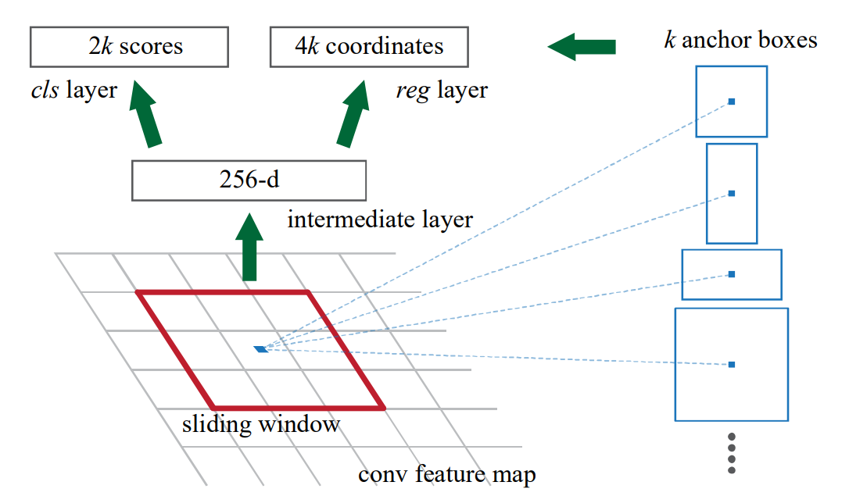
RPN: Region Proposal Network

Slide 17
RPN: Region Proposal Network
Predicting a bounding box $t=\left[t_{x},t_{y},t_{w},t_{h}\right]$: $$t_{x}=\frac{x−x_{a}}{w_{a}}, t_{y}=\frac{y−y_{a}}{h_{a}}, t_{w}=log\left(\frac{w}{w_{a}}\right), t_{h}=log\left(\frac{h}{h_{a}}\right)$$
Recovering the actual BBox from $t=\left[t_{x},t_{y},t_{w},t_{h}\right]$: $$x=w_{a}⋅t_{x}+x_{a}, y=h_{a}⋅t_{y}+y_{a}, w=e^{t_{w}}⋅w_{a}, h=e^{t_{h}}⋅h_{a}$$
The learned “corrections” t are relative to anchor position and scale.
$$\left[x_{a},y_{a},w_{a},h_{a}\right]$$

Slide 18
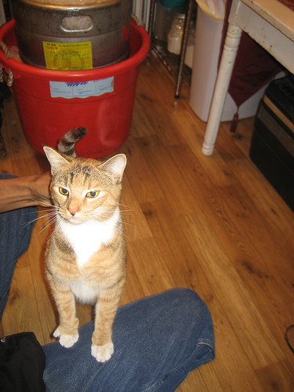
RPN: Region Proposal Network
Training
Assign “object” label to each anchor
IoU of anchor and some GT > 0.7 → “positive”
IoU of anchor and all GT < 0.3 → “negative”
Otherwise → “ignore”
$ℒ\left(\left\{p_{i}\right\},\left\{t_{i}\right\}\right)=\frac{1}{N_{cls}}\sum_{i}{CE\left(p_{i},p_{i}^{⋆}\right)+\frac{1}{N_{reg}}\sum_{i}{p_{i}^{⋆}ℓ_{1}\left(t_{i},t_{i}^{⋆}\right)}}$

Slide 19
Object Detection
Two Stages (R-CNN)
Propose “objects”
Classify each candidate
Single Stage (SSD, Yolo)
Sliding window to classify all candidates

Slide 20
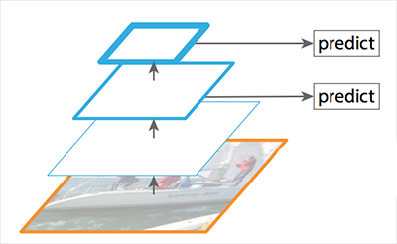
SSD: Single Shot Detector
Why stop at object/non-object in RPN?
Why using only last feature map?
Wei, Anguelov, Erhan, Szegedy, Reed, Fu and Berg “SSD: Single shot multibox detector" (ECCV 2016)

Slide 21
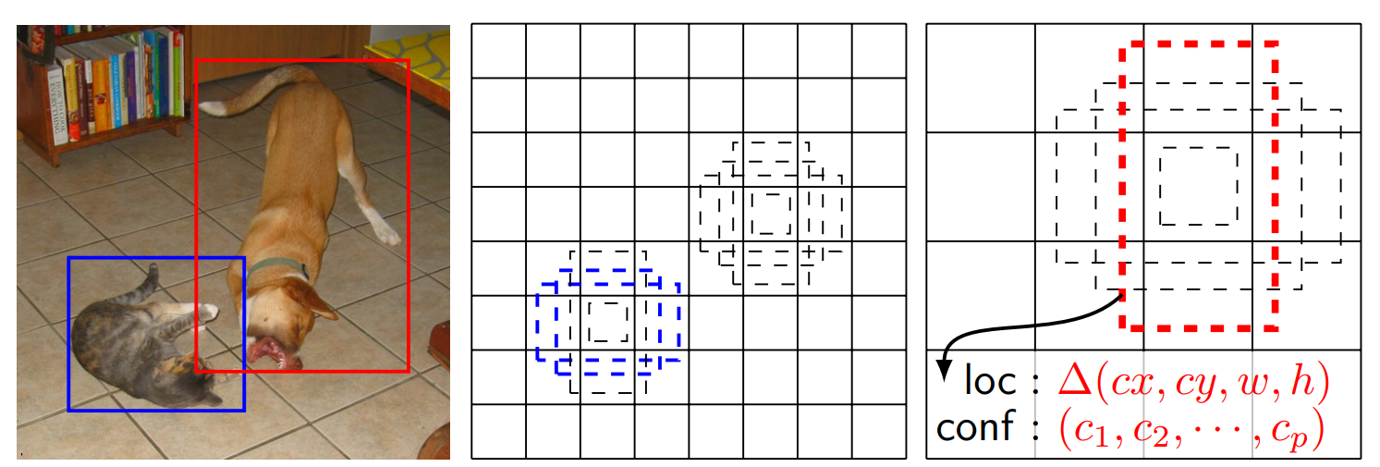
SSD: Single Shot Detector
Anchors are directly classified to object type (+”none”)
Anchors/proposals are extracted from several feature maps
Wei, Anguelov, Erhan, Szegedy, Reed, Fu and Berg “SSD: Single shot multibox detector" (ECCV 2016)

Slide 22
Object Detection
Two Stages (R-CNN)
Propose “objects”
Classify each candidate
Single Stage (SSD, Yolo)
Sliding window to classify all candidates

Slide 23
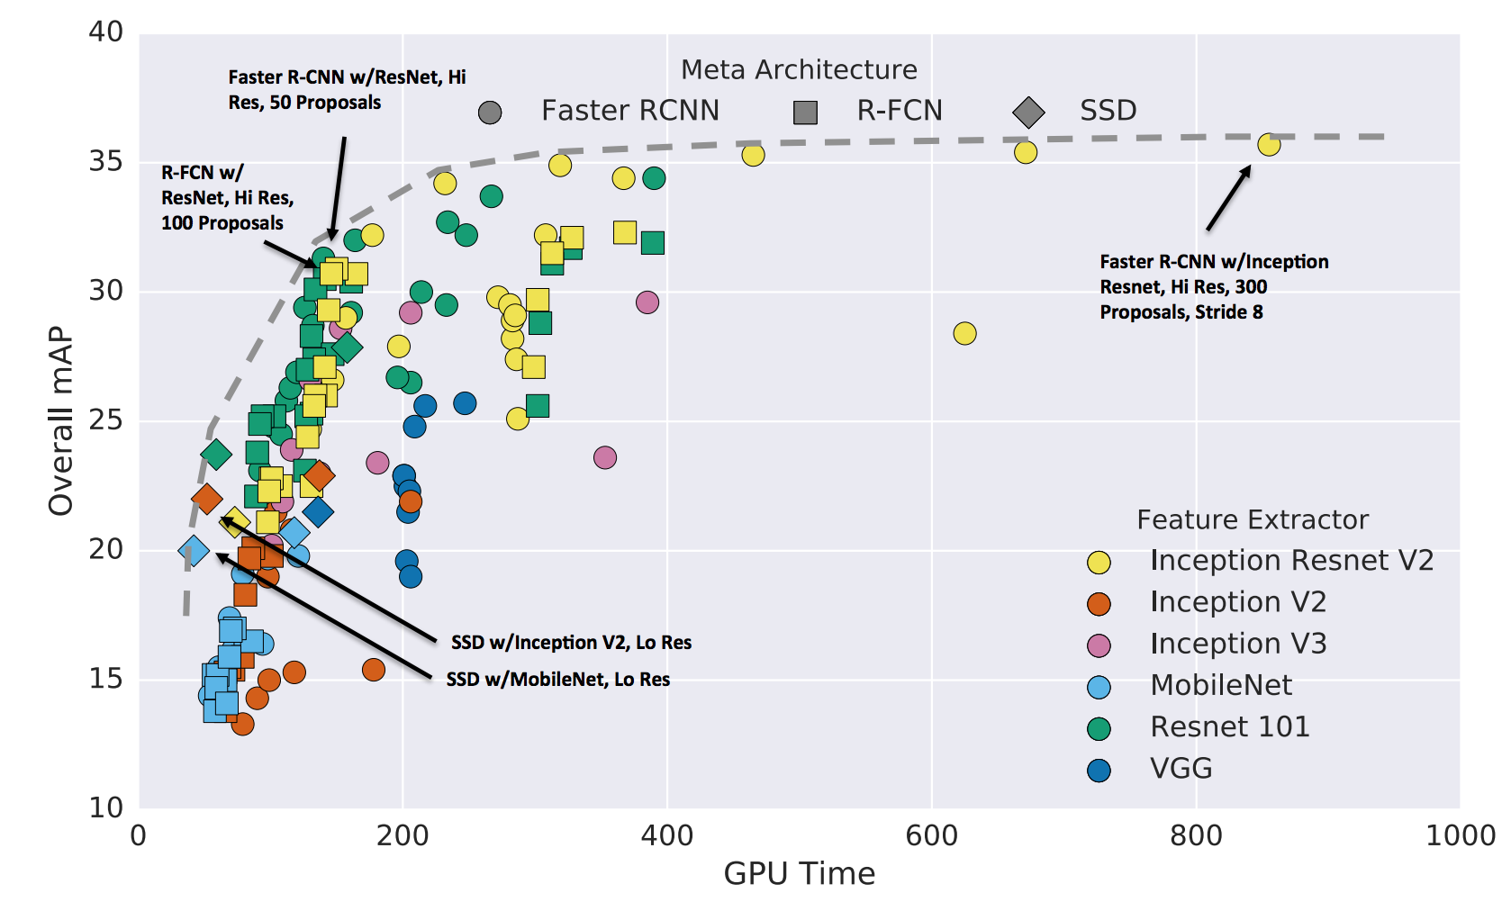
source

Slide 24
Object Detection: Pitfalls and Details
Imbalance
Receptive field
Multiscale

Slide 25
Imbalance
Number of “negative” anchors ~O(10K) Number of “positive” anchors ~O(10)
What happens to CE loss in this case?
$$ℒ=−\frac{1}{N}\sum_{i}{y_{i}log \left(p_{i}\right)}, \frac{∂ℒ}{∂p_{i}}=\left\{\begin{aligned}p_{i,l} if y_{i}≠l \\ p_{i,l}−1 if y_{i}=l\end{aligned}\right.$$
On Board
Loss and gradient are dominated by correctly classified negative examples
Training outcome → constant “negative” prediction.

Slide 26
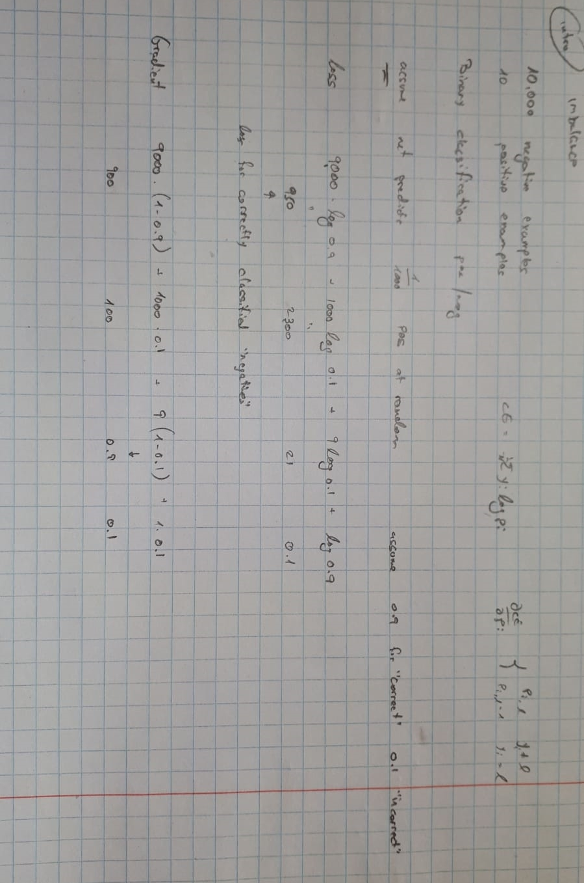

Slide 27
Imbalance – Hard Negative Mining
k
Compute loss for all N anchors
Select top k “hard” examples
Compute gradient for hard k

Slide 28
Imbalance – Focal Loss
Lin,Goyal, Girshick, He, and Dollár Focal loss for dense object detection (PAMI 2018)
Relatively weak gradient
Strong gradient
Non vanishing loss/gradient
$$CE=−y_{i}logp_{i}$$
Vanishing loss/gradient
$$FL=−y_{i}{\left(1−p_{i}\right)}^{γ}logp_{i}$$

Slide 29
Object Detection: Pitfalls and Details
Imbalance
Receptive field
Multiscale

Slide 30
Receptive field
Can we detect 100pix object using “conv1” features?
Kernel size | Stride | Jump | Receptive field
5 | 2
3 | 1
7 | 3

Slide 31
Receptive field
Can we detect 100pix object using “conv1” features?
Kernel size | Stride | Jump | Receptive field
5 | 2 | 2 | 5
3 | 1
7 | 3

Slide 32
Receptive field
Can we detect 100pix object using “conv1” features?
Kernel size | Stride | Jump | Receptive field
5 | 2 | 2 | 5
3 | 1
7 | 3

Slide 33
Receptive field
Can we detect 100pix object using “conv1” features?
Kernel size | Stride | Jump | Receptive field
5 | 2 | 2 | 5
3 | 1 | 2 | 9
7 | 3

Slide 34
Receptive field
Can we detect 100pix object using “conv1” features?
Kernel size | Stride | Jump | Receptive field
5 | 2 | 2 | 5
3 | 1 | 2 | 9
7 | 3

Slide 35
Receptive field
Can we detect 100pix object using “conv1” features?
Kernel size | Stride | Jump | Receptive field
5 | 2 | 2 | 5
3 | 1 | 2 | 9
7 | 3 | 6 | 21
$$j_{out}=j_{in}⋅stride \\ RF_{out}=RF_{in}+\left(kernel−1\right)⋅J_{in}$$

Slide 36
Receptive Field
Additional reading
Receptive field arithmetic
Wenjie, Li, Urtasun and Zemel Understanding the effective receptive field in deep convolutional neural networks (NIPS 2016).

Slide 37
Object Detection: Pitfalls and Details
Imbalance
Receptive field
Multiscale

Slide 38
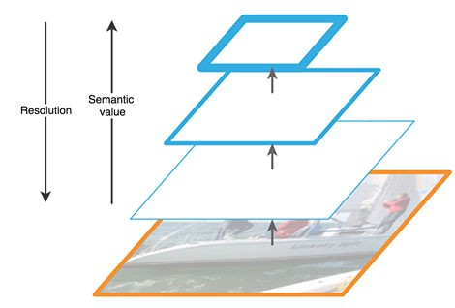
Feature Pyramid Network (FPN)
How to handle multiscale predictions?
Tsung-Yi, Dollár, Girshick, He, Hariharan and Belongie. Feature Pyramid Networks for Object Detection (CVPR 2017)

Slide 39
Feature Pyramid Network (FPN)
How to handle multiscale predictions?
Tsung-Yi, Dollár, Girshick, He, Hariharan and Belongie. Feature Pyramid Networks for Object Detection (CVPR 2017)

Slide 40
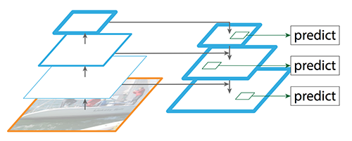
Feature Pyramid Network (FPN)
How to handle multiscale predictions?
Tsung-Yi, Dollár, Girshick, He, Hariharan and Belongie. Feature Pyramid Networks for Object Detection (CVPR 2017)

Slide 41
Object Detection
RPN vs “Single Shot”
Imbalance data
Receptive field
Backbone and multiscale

Slide 42
Additional Tasks
Object detection
Semantic segmentation

Slide 43
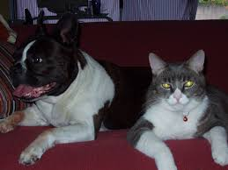
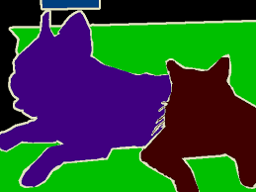
Semantic Segmentation
Deep Net

Slide 44
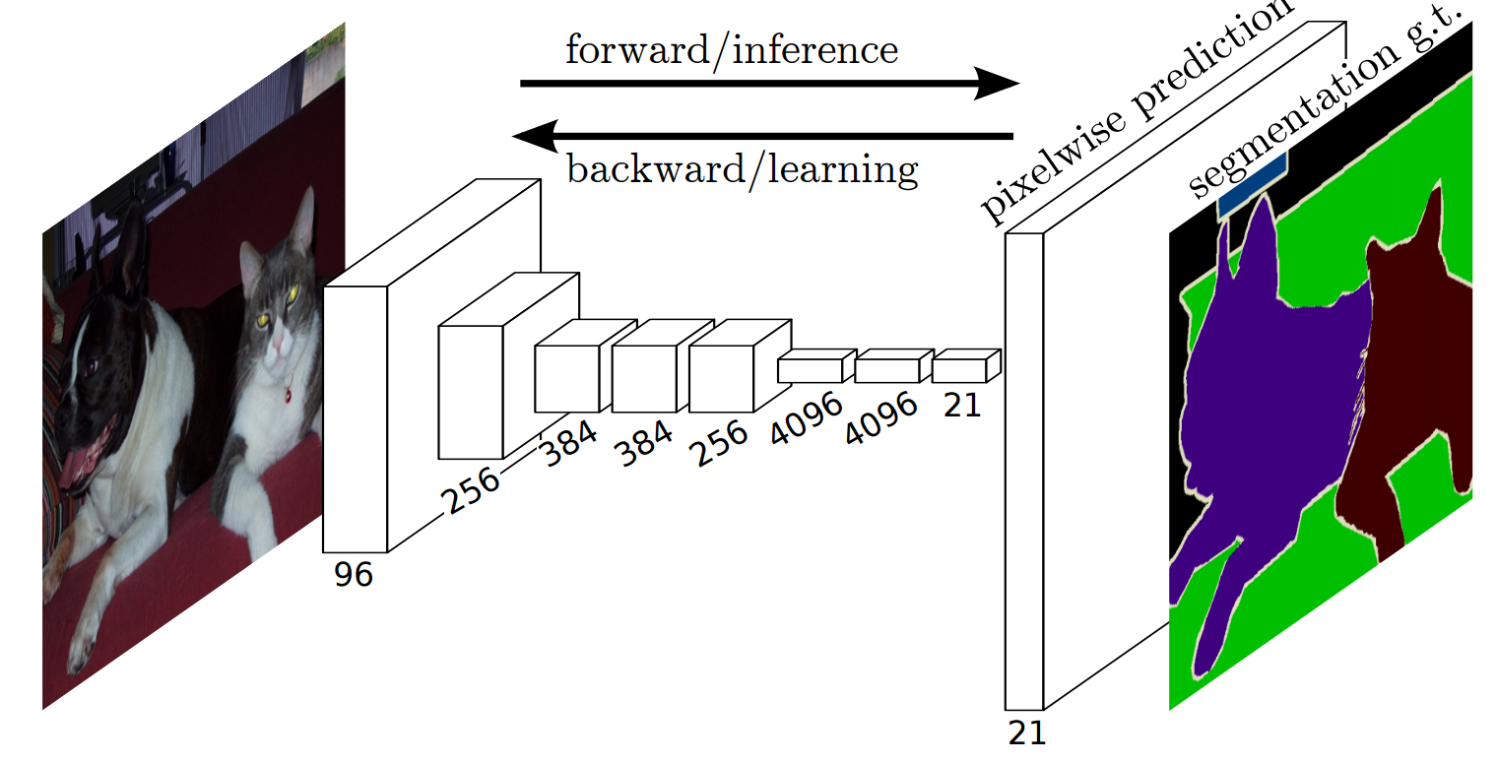
Semantic Segmentation - FCN
Replace FC layers with conv – “sliding window” classification
Long, Shelhamer and Darrell Fully convolutional networks for semantic segmentation (CVPR 2015)

Slide 45
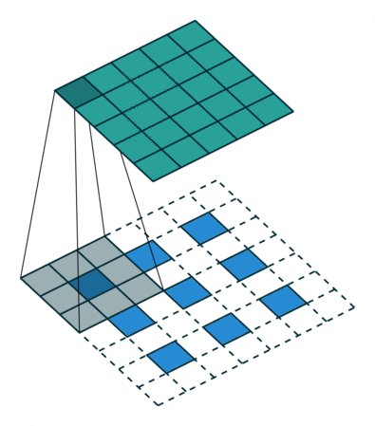
“Deconvolution” / Transposed Convolution
In depth: here

Slide 46
Semantic Segmentation - FCN
Replace FC layers with conv – “sliding window” classification
Long, Shelhamer and Darrell Fully convolutional networks for semantic segmentation (CVPR 2015)

Slide 47
Semantic Segmentation - FCN

Slide 48
“Deconvolution” / Transposed Convolution
In depth: here

Slide 49
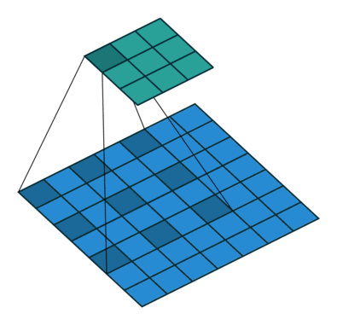
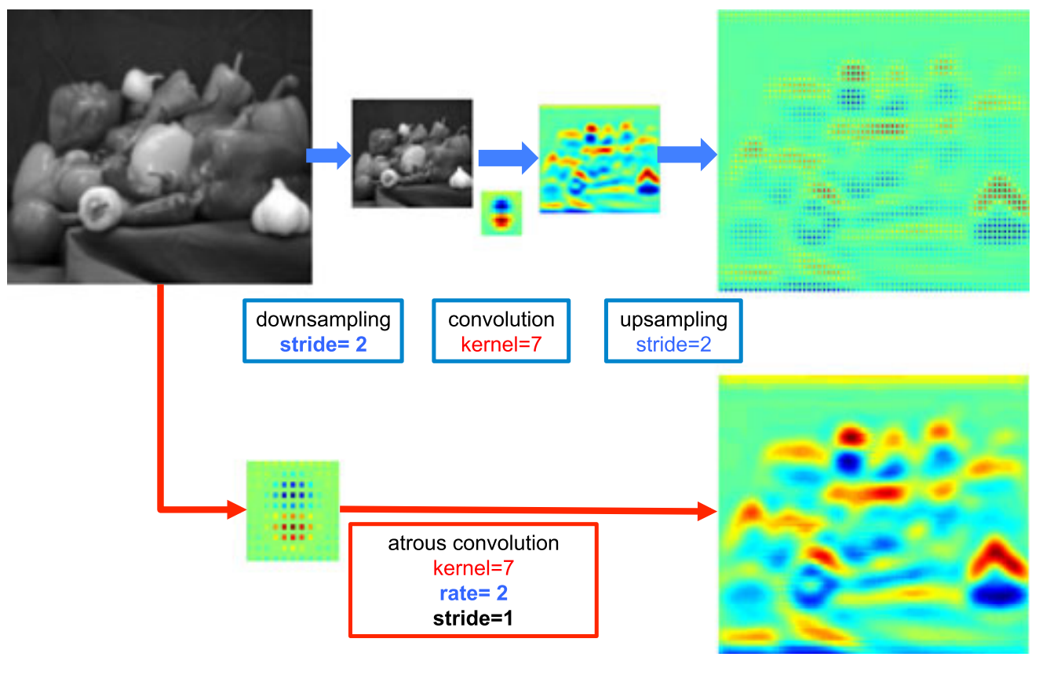
DeepLab: Atrous Convolution
Chen, Papandreou, Kokkinos, Murphy and Yuille Deeplab: Semantic image segmentation with deep convolutional nets, atrous convolution, and fully connected CRFs (PAMI 2018)
$$y\left[i\right]=\sum_{k=1}^{K}{x\left[i+r⋅k\right]⋅w\left[k\right]}$$

Slide 50
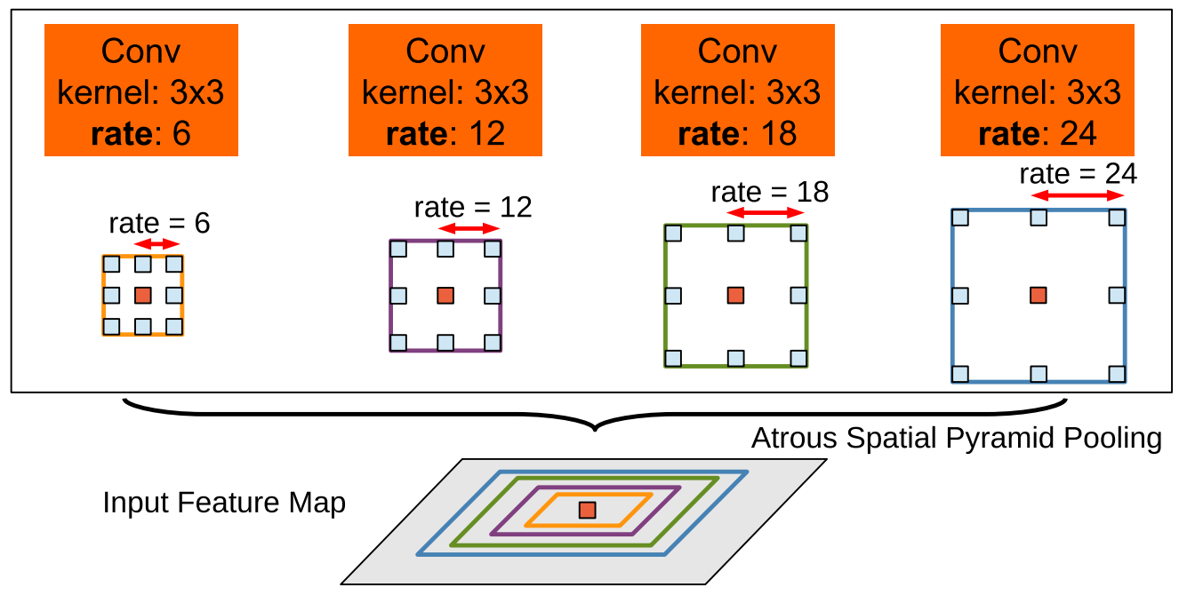
DeepLab: Atrous Convolution
Chen, Papandreou, Kokkinos, Murphy and Yuille Deeplab: Semantic image segmentation with deep convolutional nets, atrous convolution, and fully connected CRFs (PAMI 2018)

Slide 51
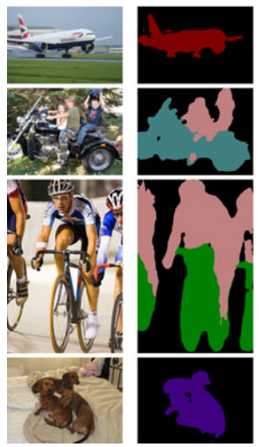
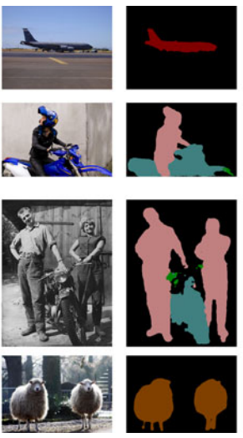
DeepLab: Atrous Convolution
Trade stride/pooling with “dilation” of kernel
Increase receptive field without increase in parameters/operations

Slide 52
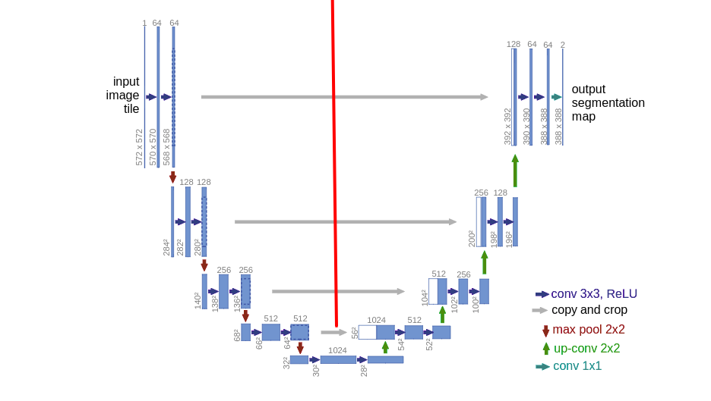
Semantic Segmentation – U-net
Olaf, Fischer and Brox U-net: Convolutional networks for biomedical image segmentation (2015)

Slide 53
Semantic Segmentation – U-net
Olaf, Fischer and Brox U-net: Convolutional networks for biomedical image segmentation (2015)

Slide 54
Semantic Segmentation
Resolution vs. Semantic information
FCN: using “deconv”
DeepLab: dilated convolution + simple interpolation
U-net: skip connections

Slide 55
Instance Segmentation

Slide 56
Mask R-CNN
He, Gkioxari, Dollar and Girshick “Mask R-CNN” (ICCV 2017)
RPN
backbone
Class / BG
BBox
Mask

Slide 57
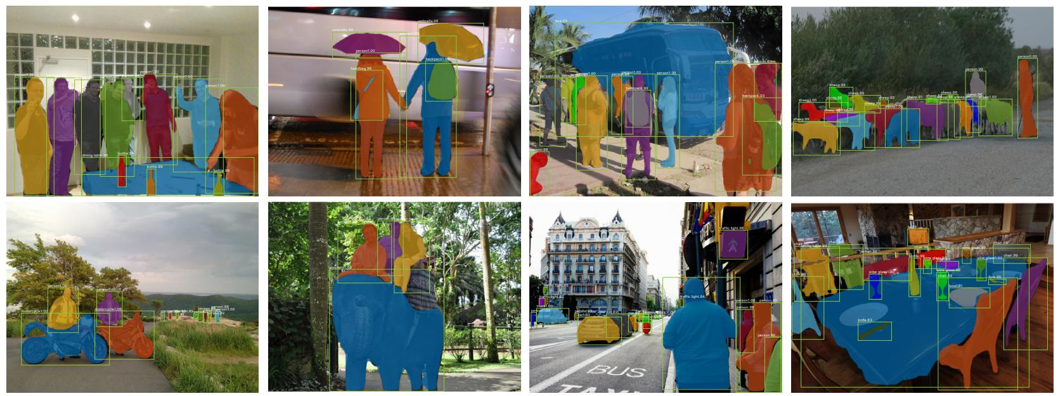
Mask R-CNN
He, Gkioxari, Dollar and Girshick “Mask R-CNN” (ICCV 2017)

Slide 58
Assignment #5 – Deep Image Prior
Ulyanov, Vedaldi and Lempitsky "Deep image prior" (CVPR 2018)
noise
Deep Convolutional Network

Slide 59
Assignment #5 – Deep Image Prior
Ulyanov, Vedaldi and Lempitsky "Deep image prior" (CVPR 2018)
Given noisy image
Deep Convolutional Network
$$𝓛$$
noise
“ideal” predictor
Specific DNN
Approximation error

Slide 60
Assignment #5 – Deep Image Prior
Ulyanov, Vedaldi and Lempitsky "Deep image prior" (CVPR 2018)
Given noisy image
Deep Convolutional Network
$$𝓛$$
noise
“ideal” predictor
Specific DNN
Approximation error

Slide 61
Assignment #5 – Deep Image Prior
Ulyanov, Vedaldi and Lempitsky "Deep image prior" (CVPR 2018)
Given noisy image
Deep Convolutional Network
$$𝓛$$
noise
Bottleneck and up-sampling
Multi-resolution: “Image pyramids”
Convolutions – “translation invariance”

Slide 62
Assignment #5 – Deep Image Prior
Ulyanov, Vedaldi and Lempitsky "Deep image prior" (CVPR 2018)
Goals:
Easy and fast “hands-on”
Design you own architecture
See the effect of optimizers/loss
Tweak hyper parameters learning rate/number of iterations

Slide 63
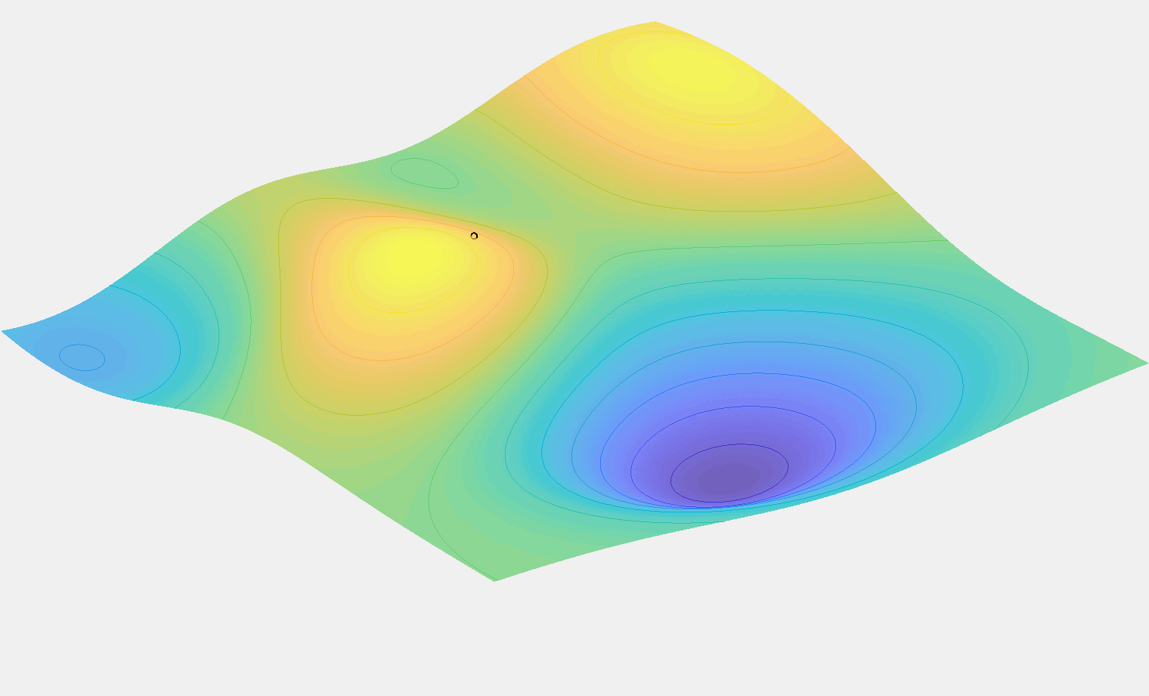
Deep Learning for Computer Vision
Machine learning: “example based” programming
Deep nets as versatile parametric models
End-to-end training using SGD
Overfitting: data augmentation / regularization
Design considerations, e.g.: receptive field
Image classification
Object detection
Semantic segmentation

Slide 64
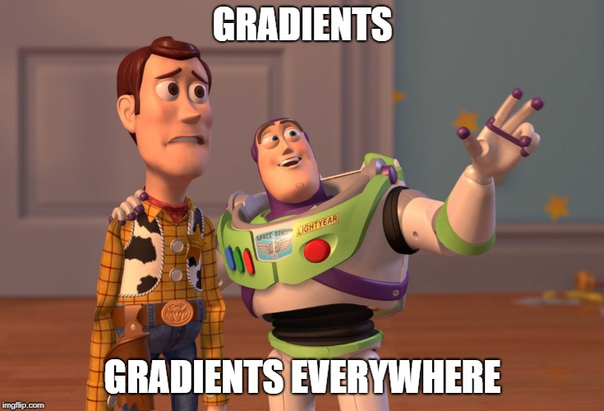
If you were to remember only one thing…

