Slide 1
Motion Estimation
Uses of Motion
3D shape reconstruction
Segment objects based on motion cues
Recognize events and activities
Image/video enhancement
Track objects
• Correct for camera jitter (stabilization)
• Align images (mosaics)
• Efficient video representations
Video compression (e.g., MPEG2)
Special effects
…

Slide 2
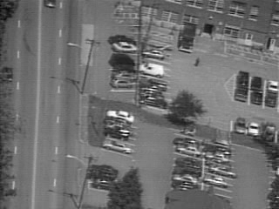
Motion Estimation
What affects the induced image motion?
Camera motion
Object motion
Scene structure

Slide 3
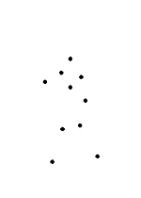
Motion Estimation
Even “poor” motion data can evoke a strong percept

Slide 4
Motion Estimation
Even “poor” motion data can evoke a strong percept

Slide 5

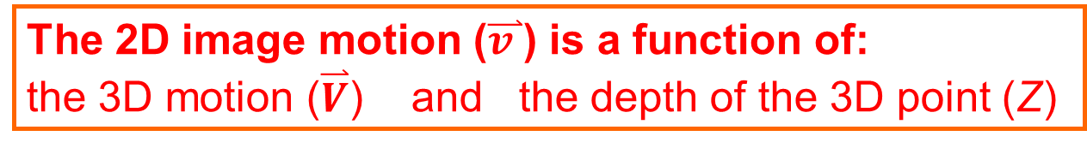




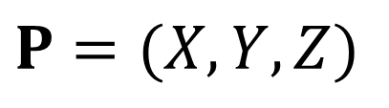

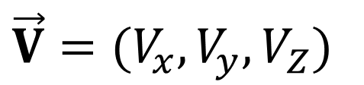
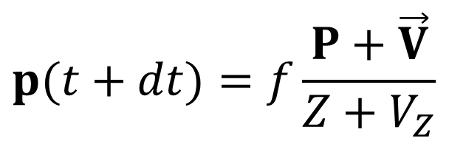
Motion field
$$P(t+dt)$$
$$\overset{⃑}{V}$$
$$\vec{V}=(V_{x},V_{y},V_{Z})$$
$$P(t)$$
$$P=(X,Y,Z)$$
$$p(t+dt)=f\frac{P+\vec{V}}{Z+V_{Z}}$$
$$\overset{⃑}{v }$$
$$p(t+dt)$$
$$p(t)$$
The 2D image motion ($\overset{⃑}{v }$) is a function of:
the 3D motion ($\overset{⃑}{V}$) and the depth of the 3D point (Z)

Slide 6
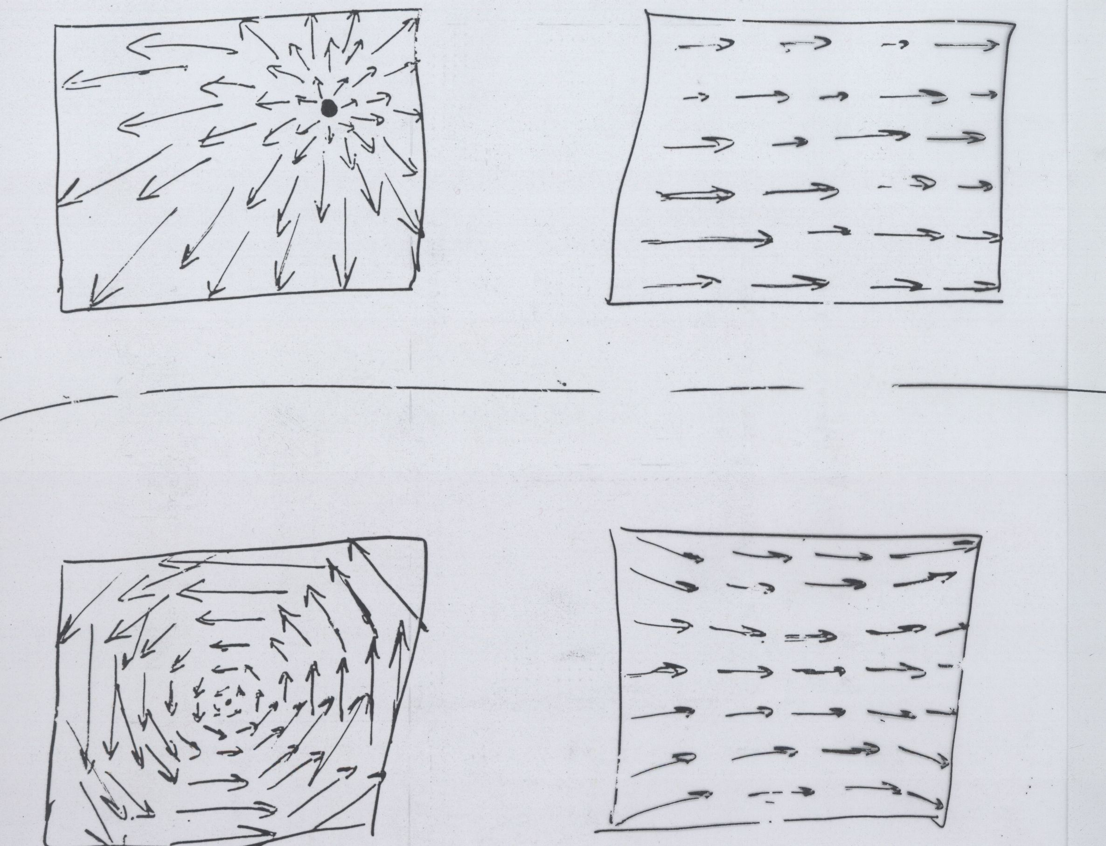
Example Flow Fields
Is this the FoE
(Focus of Expansion =Epipole)
or the
Optical axis ???
Possible ambiguity between zoom and forward translation
Possible ambiguity between sideways translation and rotation
This lesson – estimation of general 2D flow-fields
Next lesson – constrained by global parametric transformations

Slide 7
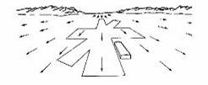
Optical Flow

Slide 8



The Aperture Problem
So how much information is there locally…?
Notes:
So what does it mean “motion consistency of small patches”?
Consider for example the following 4 patches.
They all have different patterns of intensities (and seem to have different motions).
Yet, they have been induced by the same global motion.
Therefore, we would like our measure to capture that they are motion consistent.
While these 4 intensity patterns cannot result from the same motion,
therefore we would like our measure to tell us they are inconsistent.
Once again, we want to do than purely based on the intensities of those patches, without estimating their motions.

Slide 9
The Aperture Problem
Not enough info in local regions
Copyright, 1996 © Dale Carnegie & Associates, Inc.

Slide 10
The Aperture Problem
Not enough info in local regions
Copyright, 1996 © Dale Carnegie & Associates, Inc.

Slide 11
The Aperture Problem
Copyright, 1996 © Dale Carnegie & Associates, Inc.

Slide 12
The Aperture Problem
Information is propagated from regions with high certainty (e.g., corners) to regions with low certainty.
Copyright, 1996 © Dale Carnegie & Associates, Inc.

Slide 13
Such info propagation can cause optical illusions…
Illusory corners
Notes:
So what does it mean “motion consistency of small patches”?
Consider for example the following 4 patches.
They all have different patterns of intensities (and seem to have different motions).
Yet, they have been induced by the same global motion.
Therefore, we would like our measure to capture that they are motion consistent.
While these 4 intensity patterns cannot result from the same motion,
therefore we would like our measure to tell us they are inconsistent.
Once again, we want to do than purely based on the intensities of those patches, without estimating their motions.

Slide 14
1. Gradient-based (differential) methods
(Horn &Schunk, Lucase & Kanade)
2. Region-based methods
(Correlation, SSD, Normalized correlation)
Direct (intensity-based) Methods
(Dense matches)
Feature-based Methods
(Sparse matches)

Slide 15
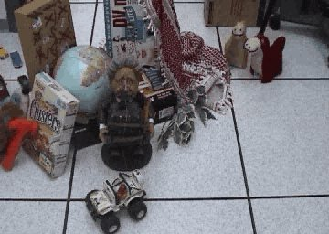
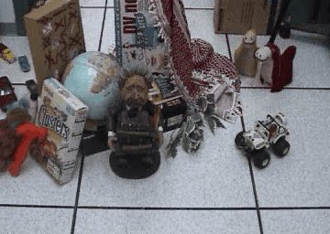
Brightness Constancy Assumption
Image I
(taken at time t+1)
Image J
(taken at time t)

Slide 16
The Brightness Constancy Constraint
Brightness Constancy Equation:
Linearizing (assuming small (u,v)):

Slide 17
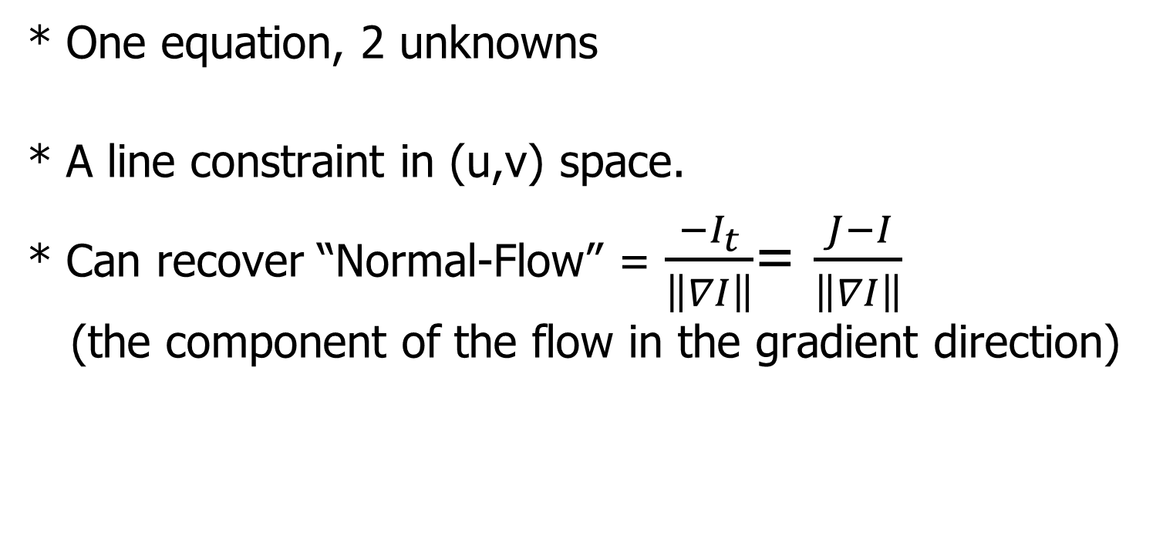
Observations:
* One equation, 2 unknowns
* A line constraint in (u,v) space.
* Can recover “Normal-Flow” = $\frac{{−I}_{t}}{\left\|∇I\right\|}$= $\frac{J−I}{\left\|∇I\right\|}$
(the component of the flow in the gradient direction)
Need additional constraints…

Slide 18
Horn and Schunk (1981)
Add global smoothness term
Error in brightness constancy equation
Smoothness error
Minimize:
Solve by using calculus of variations

Slide 19
Horn and Schunk (1981)
Minimize:
Inherent problems:
* Smoothness assumption wrong at motion/depth discontinuities
➔ over-smoothing of the flow field.
* How is Lambda determined…?

Slide 20
Lucas-Kanade (1981)
Assume a single displacement (u,v) for all pixels within a small window (e.g., 5x5)
Geometrically -- Intersection of multiple line constraints
Algebraically -- Solve a set of linear equations
Minimize E(u,v):

Slide 21
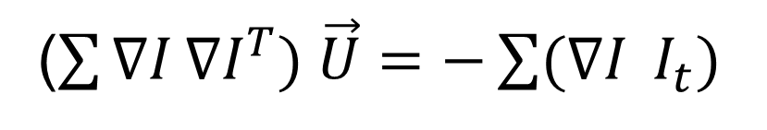
Lucas-Kanade (1981)
Minimize E(u,v):
Differentiating w.r.t u and v and equating to 0:
($\sum{∇I}∇I^{T}) \vec{U}=−\sum{(∇I} I_{t})$
Solve for (u,v)
[ Repeat this process for each and every pixel in the image ]

Slide 22
Singularites
Where in the image will this matrix be invertible and where not…?

Slide 23
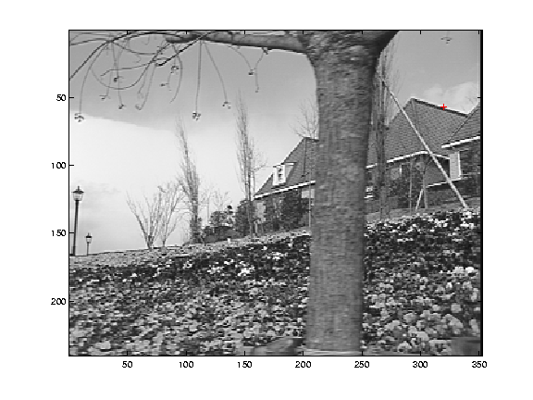
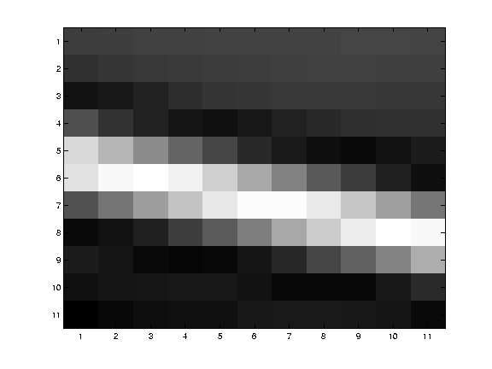
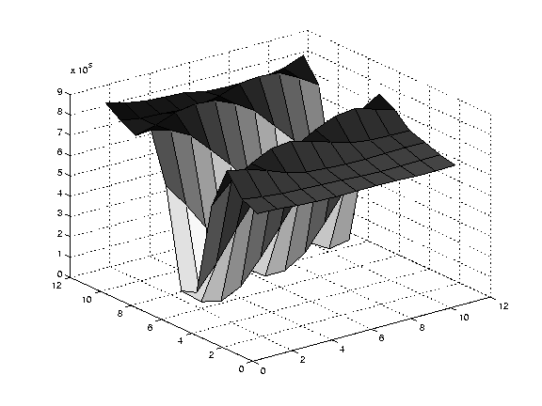
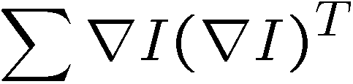
Edge
large gradients, all in the same direction
large λ₁, small λ₂

Slide 24
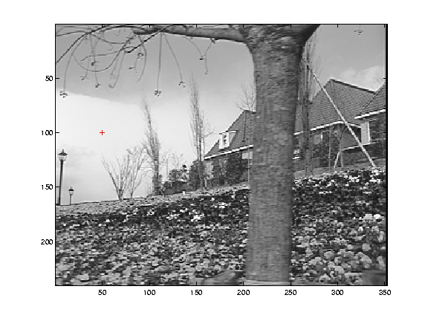
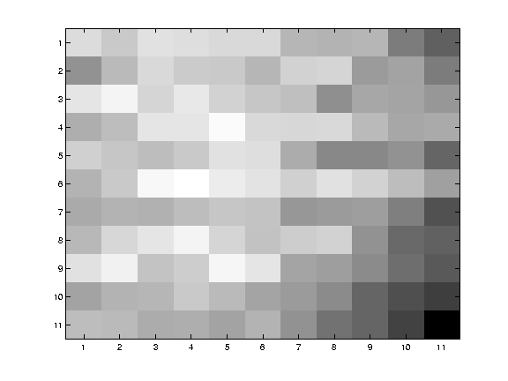
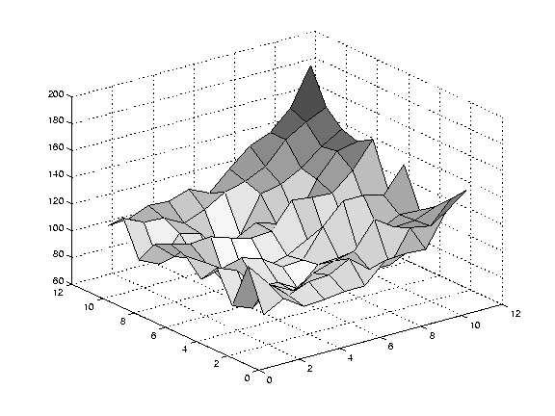
Low texture region
gradients have small magnitude
small λ₁, small λ₂

Slide 25
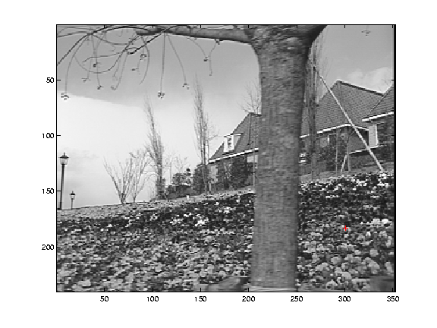
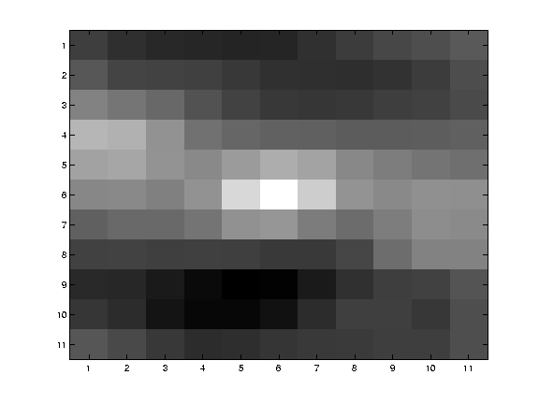
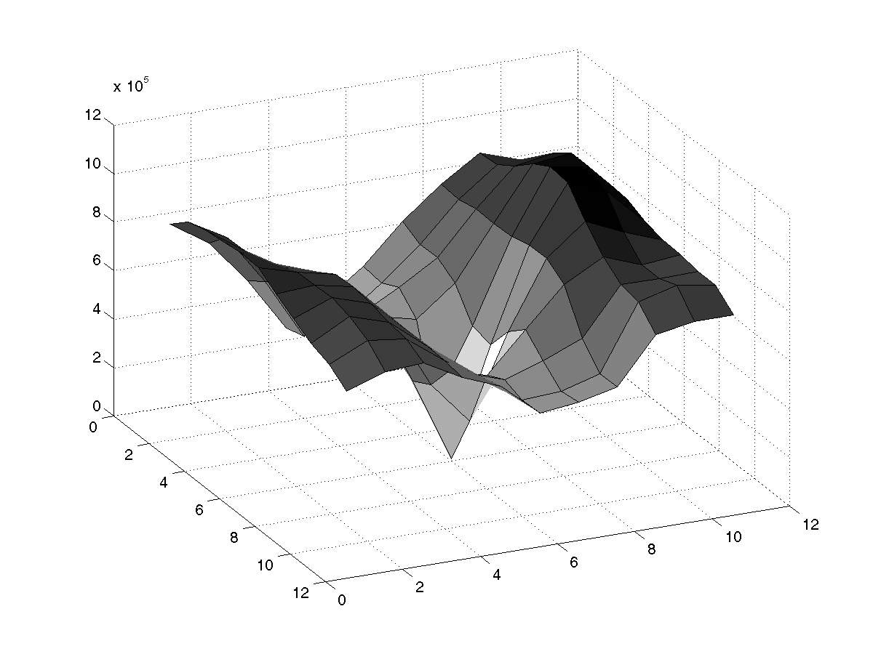
High textured region
large gradients in multiple directions
large λ₁, large λ₂

Slide 26
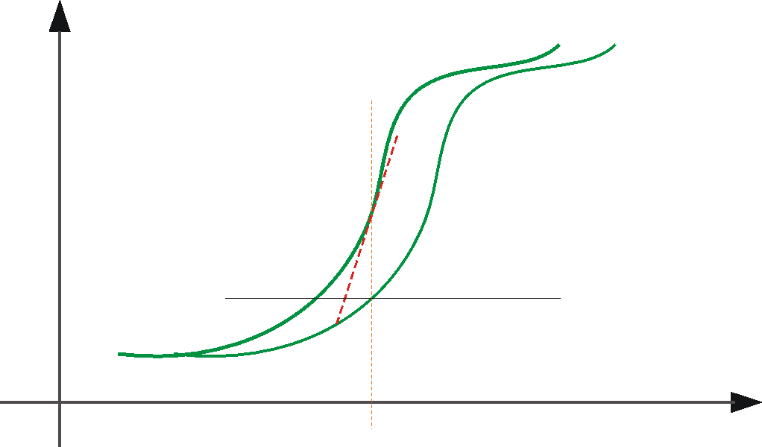





➔ iterate & warp
Linearization approximation
estimate update
Initial guess:
Estimate:
x₀
x

Slide 27
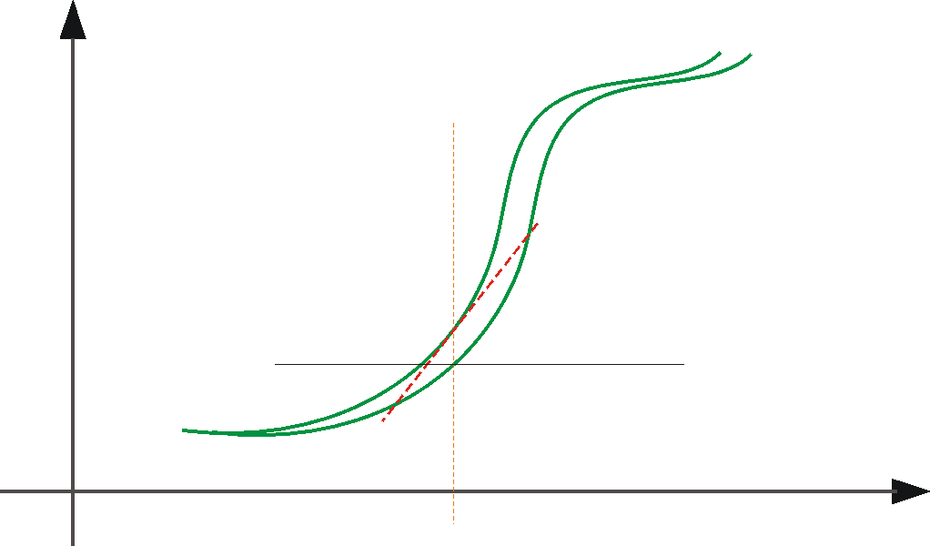



Linearization approximation
➔ iterate & warp
+
estimate update
Initial guess:
Estimate:
x₀
x

Slide 28
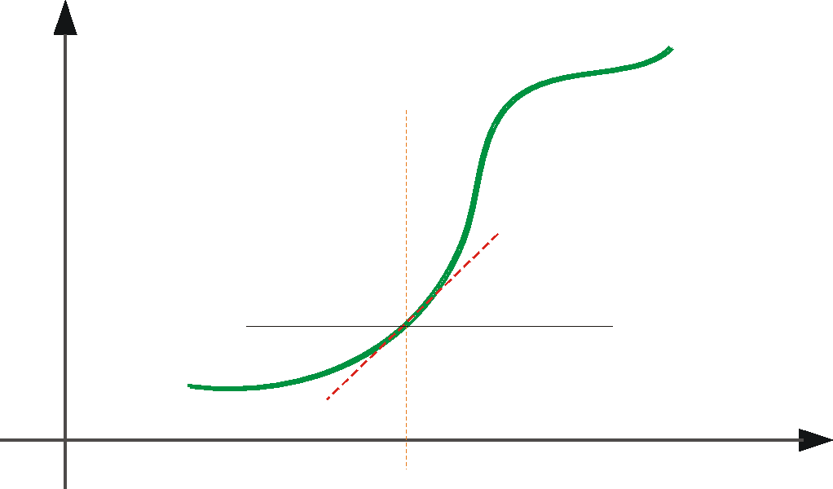



Linearization approximation
➔ iterate & warp
+
estimate update
Initial guess:
Estimate:
Initial guess:
Estimate:
x₀
x

Slide 29
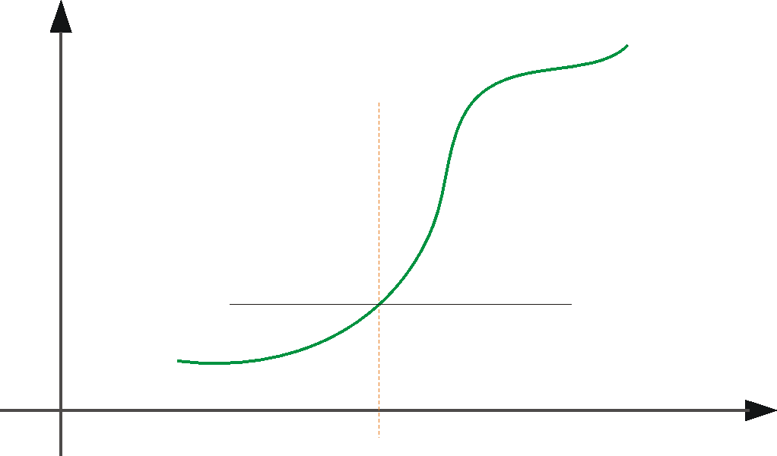

Linearization approximation
➔ iterate & warp
+
x₀
x

Slide 30
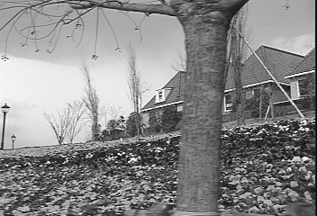
Revisiting the small motion assumption
Is this motion small enough?
  Probably not—it’s much larger than one pixel
  (2nd order terms dominate)
  How might we solve this problem?

Slide 31



Coarse-to-Fine Estimation
Advantages: (i) Larger displacements. (ii) Speedup.
(iii) Information from multiple window sizes.
$$\vec{u}$$
refine
iterate
u=1.25 pixels
+
$$\vec{u}$$
u=2.5 pixels
$$Δ\vec{u}$$
==> small u and v ...
u=5 pixels
image J
u=10 pixels
image J
image I
image I
Pyramid of image J
Pyramid of image I

Slide 32
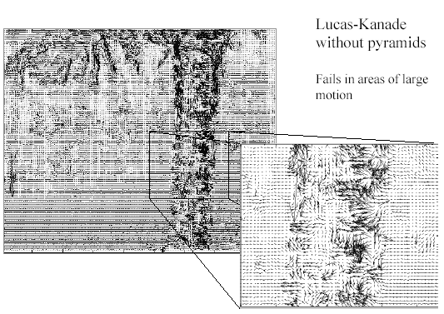
Optical Flow Results

Slide 33
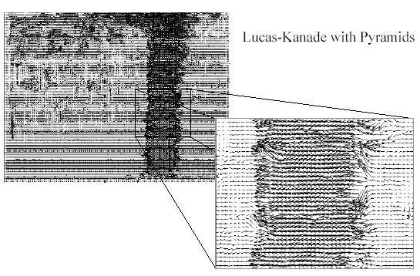
Optical Flow Results

Slide 34
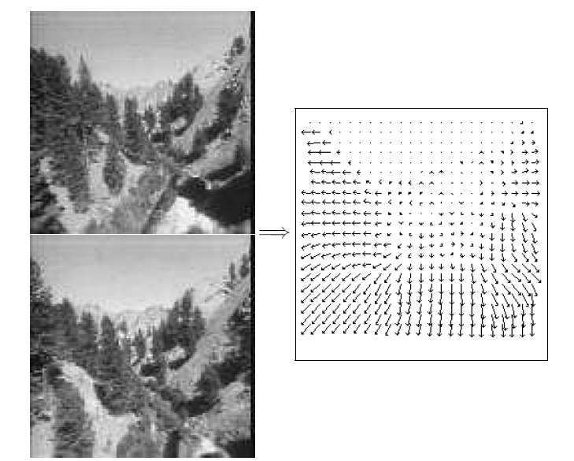
Optical Flow Results
Images taken from a helicopter flying through a canyon
Computed optical flow
[Black & Anandan]
Length of flow vectors inversely proportional to depth Z of the
3D point
Points closer to the camera move faster across the image plane

Slide 35
Lucas-Kanade (1981)
Inherent problems:
* Still smooths motion discontinuities
(but unlike Horn & Schunk, does not propagate smoothness across the entire image)
* Local singularities (due to the aperture problem)
Maybe increase the aperture (window) size…?
But no longer a single motion…
➔ Global parametric motion estimation – next week.

Slide 36
Motion Estimation Approaches
1. Direct methods
  Directly recover image motion at each pixel from spatio-temporal image brightness variations.
  Dense motion fields, but sensitive to appearance variations.
  Suitable for recovering small displacements – e.g., in video (where frame-to-frame motion is typically small).
2. Feature-based methods (e.g., SIFT + Ransac)
    Extract visual features (corners, textured areas) and match them across images.
    Sparse motion fields, but more robust to intensity variations.
    Suitable when image motion is large (e.g., 10s of pixels).

Slide 37

Motion Magnification
Wu, Rubinstein, Shih, Guttag, Durand, Freeman
“Eulerian Video Magnification for Revealing Subtle Changes in the World”, SIGGRAPH 2012
Source video: ..\Course_Intro_2014_2015\baby.mp4
Result: ..\Course_Intro_2014_2015\baby-iir-r1-0.4-r2-0.05-alpha-10-lambda_c-16-chromAtn-0.1.mp4
Paper + videos can be found on:
http://people.csail.mit.edu/mrub/vidmag

Slide 38
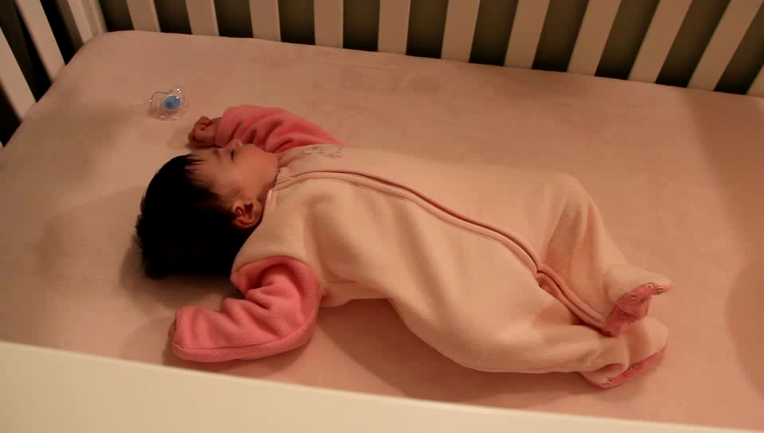
Motion Magnification
Input video:

Slide 39

Motion Magnification
Output video (Motion Magnified):

Slide 40
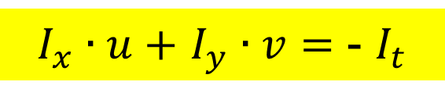
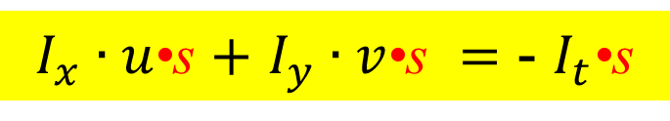
Motion Magnification
Could compute optical flow and magnify it
But…
very complicated (motions are almost invisible)
Alternatively:
$I_{x}∙u+$ $I_{y}∙v=$ - $I_{t}$
$I_{x}∙u\text{•}\text{s}$ $+$ $I_{y}∙v\text{•}\text{s} =$ - $I_{t}$•s

Slide 41
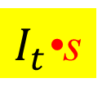
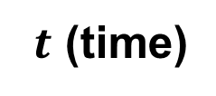

Motion Magnification
What is equivalent to?
$I_{t}$•s
$$I(x,y)$$
The brightness of pixel (x,y) over time:
$t$ (time)
This is equivalent to keeping the same temporal frequencies,
but magnifying their amplitude (i.e., increase the coefficient of the temporal frequency in the Temporal Fourier Transform).
➔ We can do this selectively to specific temporal frequencies
(e.g., a range of frequencies of expected heart rates).

Slide 42
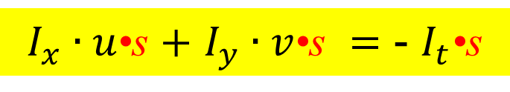
Motion Magnification
What is equivalent to?
$I_{t}$•s
$$I(x,y)$$
$t$ (time)
$I_{x}∙u\text{•}\text{s}$ $+$ $I_{y}∙v\text{•}\text{s} =$ - $I_{t}$•s
But this approximation holds only for small u•s and v•s
Apply to coarse pyramid levels to generate larger motions
➔

Slide 43
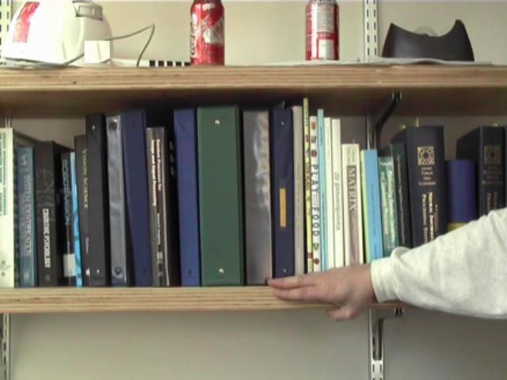
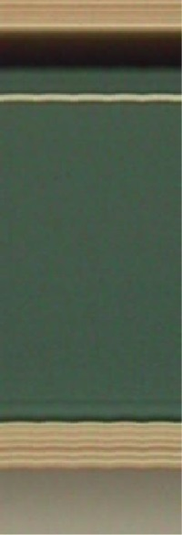
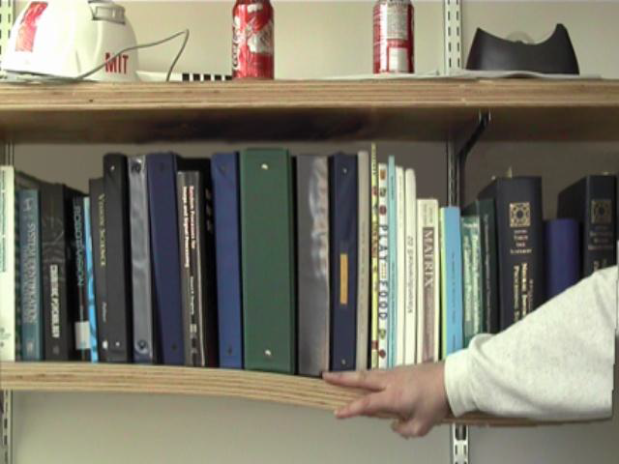
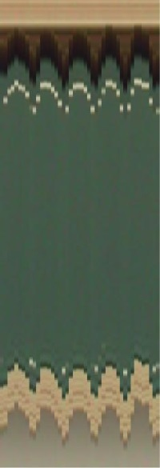
Original
Original
time
Time-Magnified
Time-Magnified
time

Slide 44
Motion Magnification
Paper + videos can be found on:
http://people.csail.mit.edu/mrub/vidmag
EVM_NSFSciVis2012.mov
Copyright, 1996 © Dale Carnegie & Associates, Inc.

Slide 45
Motion Magnification
Paper + videos can be found on:
http://people.csail.mit.edu/mrub/vidmag
vidmag.mov

