Slide 1
The Brightness Constraint
Brightness Constancy Equation:
Linearizing (assuming small (u,v)):
Where:
I
=
I
(
x
,
y
)
−
J
(
x
,
y
)
Each pixel provides 1 equation in 2 unknowns (u,v).
t
Insufficient info.
Another constraint: Global Motion Model Constraint

Slide 2
The 2D/3D Dichotomy
➔ Requires prior model selection
3D Camera motion
+
3D Scene structure
+
Independent motions
Image motion =
Camera induced motion
+ =
Independent motions
2D techniques
3D techniques
Do not model “3D scenes”
Singularities in “2D scenes”
Notes:
2

Slide 3
The 2D/3D Dichotomy
In the uncalibrated case (unknown calibration matrix K)
➔ Cannot recover 3D rotation or Plane parameters either
(cannot tell the difference between a planar H and KR)
The only part with 3D depth information
When cannot recover any 3D info?
Planar scene:

Slide 4
Global Motion Models
* 2D models always provide dense correspondences.
* 2D Models are easier to
estimate than 3D models
(much fewer unknowns ➔
numerically more stable).
➔ Relevant for:
*Airborne video (distant scene) * Remote Surveillance (distant scene) * Camera on tripod (pure Zoom/Rotation)
2D Models:
2D Similarity
2D Affine
Homography (2D projective transformation)
3D Models:
3D Rotation + 3D Translation + Depth
Essential/Fundamental Matrix
Plane+Parallax
➔ Relevant when camera is translating, scene is near, and non-planar.

Slide 5
Example: Affine Motion
Substituting into the B.C. Equation:
Each pixel provides 1 linear constraint in 6 global unknowns
Least Square Minimization (over all pixels):
(minimum 6 pixels necessary)
Every pixel contributes ➔ Confidence-weighted regression

Slide 6
Example: Affine Motion
Differentiating w.r.t. a1 , …, a6 and equating to zero
➔ 6 linear equations in 6 unknowns:
Summation is over all the pixels in the image!

Slide 7
Coarse-to-Fine Estimation
Parameter propagation:
u=1.25 pixels
warp
J^{w}
refine
+
u=2.5 pixels
==> small u and v ...
u=5 pixels
image J
u=10 pixels
image J
image I
image I
Pyramid of image J
Pyramid of image I

Slide 8
Other 2D Motion Models
2D Projective – planar motion
(Homography H)

Slide 9
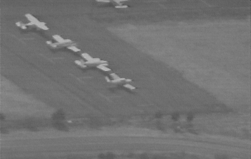
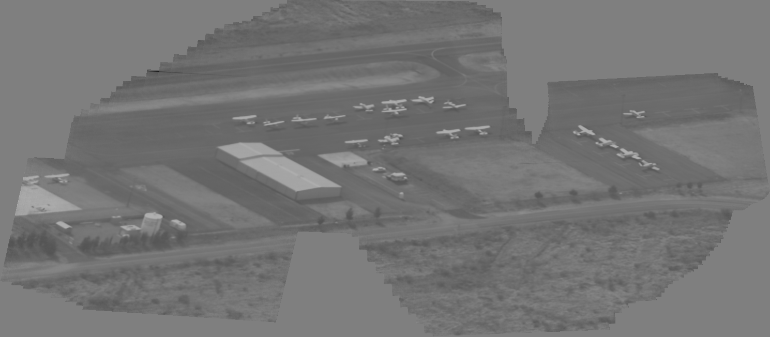
Panoramic Mosaic Image
Original video clip
Alignment accuracy (between a pair of frames): error < 0.1 pixel
Generated Mosaic image

Slide 10
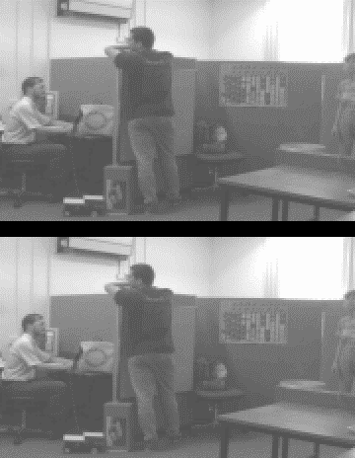
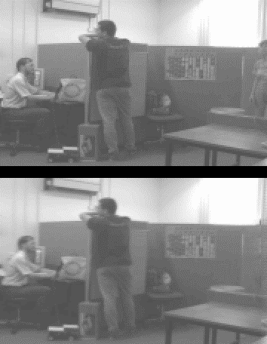
Video Removal
Original
Original
Outliers
Synthesized

Slide 11
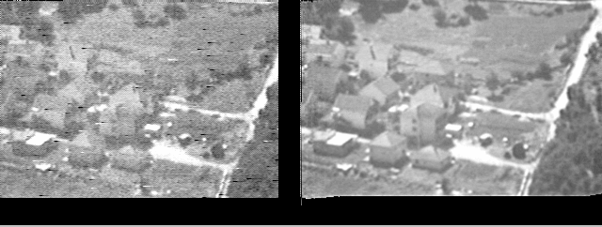
Video Enhancement
ORIGINAL
ENHANCED

Slide 12
Direct Methods:
Methods for motion and/or shape estimation, which recover the unknown parameters directly from image intensities.
➔ Error measure based on dense image quantities (Confidence-weighted regression; Exploits all available information)
Feature-based Methods: Methods for motion and/or shape estimation based on feature matches (e.g., SIFT, HOG).
➔ Error measure based on sparse distinct features (Features matches + RANSAC + Parameter estimation)

Slide 13
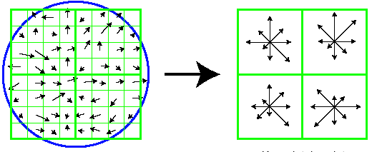
Example: The SIFT Descriptor
Compute gradient orientation histograms of several small windows (128 values for each point)
Normalize the descriptor to make it invariant to intensity change
To add Scale & Rotation invariance: Determine local scale (by maximizing DoG in scale and in space), local orientation as the dominant gradient direction.
Image gradients
The descriptor (4x4 array of 8-bin histograms)
Compute descriptors in each image Find descriptors matches across images ➔ Estimate transformation between the pair of images.
In case of multiple motions: Use RANSAC (Random Sampling and Consensus) to compute Affine-transformation / Homography / Essential-Matrix / etc.
D.Lowe. “Distinctive Image Features from Scale-Invariant Keypoints”. IJCV 2004

Slide 14
Benefits of Direct Methods
High subpixel accuracy.
Simultaneously estimate matches + transformation
➔ Do not need distinct features for image alignment:
Strong locking property.

Slide 15
Limitations of Direct Methods
Limited search range (up to ~10% of the image size).
Brightness constancy assumption.

Slide 16
DEMO:
Video Indexing and Editing
Exercise 4: Image alignment
(will be posted on Jan. 22)
Keep reference image the same (i.e., unwarp target image)
➔ Estimate derivatives only once per pyramid level.
Avoid repeated warping of the target image
➔ Compose transformations and unwarp target image only.

Slide 17
The 2D/3D Dichotomy
Source of dichotomy: Camera-centric models (R,T,Z)
Camera motion
+
Scene structure
+
Independent motions
Camera induced motion =
+
Independent motions =
Image motion =
2D techniques
3D techniques
Do not model “3D scenes”
Singularities in “2D scenes”

Slide 18
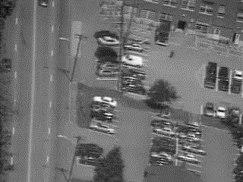
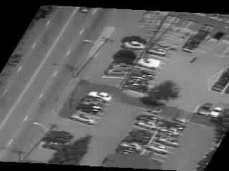
The Plane+Parallax Decomposition
Move from CAMERA-centric to a SCENE-centric model
Original Sequence
Plane-Stabilized Sequence
The residual parallax lies on a radial (epipolar) field:
epipole
h
h
h

Slide 19
Benefits of the P+P Decomposition
1. Reduces the search space:
Eliminates effects of rotation
Eliminates changes in camera calibration parameters / zoom
Camera parameters: Need to estimate only the epipole.
(i.e., 2 unknowns)
Image displacements: Constrained to lie on radial lines
(i.e., reduces to a 1D search problem)
➔ A result of aligning an existing structure in the image.

Slide 20
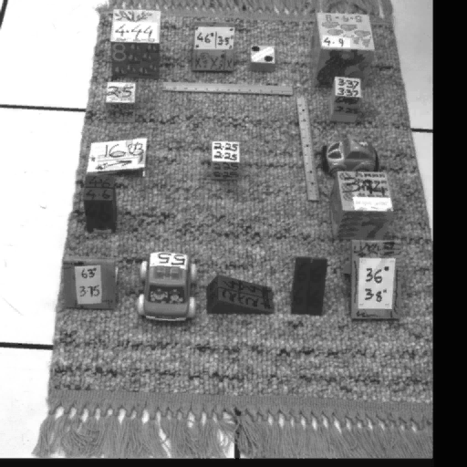
Benefits of the P+P Decomposition
2. Scene-Centered Representation:
Translation or pure rotation ???
Focus on relevant portion of info
Remove global component which dilutes information !

Slide 21

Benefits of the P+P Decomposition
2. Scene-Centered Representation:
Shape = Fluctuations relative to a planar surface in the scene
STAB_RUG SEQ

Slide 22
Benefits of the P+P Decomposition
2. Scene-Centered Representation:
Shape = Fluctuations relative to a planar surface in the scene
Height vs. Depth (e.g., obstacle avoidance)
Appropriate units for shape
A compact representation
- fewer bits, progressive encoding
total distance [97..103]
camera
center
scene
global (100)
component
local [-3..+3]
component

Slide 23
Benefits of the P+P Decomposition
3. Stratified 2D-3D Representation:
Start with 2D estimation (homography).
3D info builds on top of 2D info.
Avoids a-priori model selection.

Slide 24
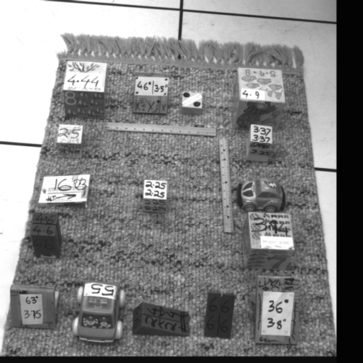
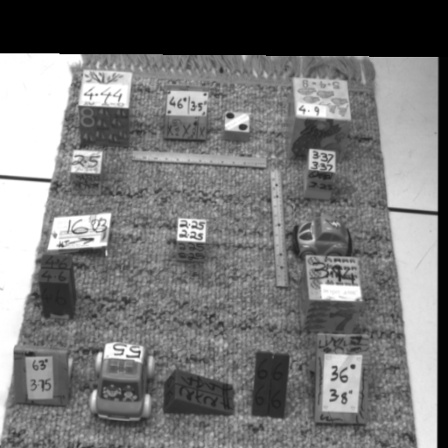
Dense 3D Reconstruction (Plane+Parallax)
Original sequence
Plane-aligned sequence
Recovered shape
Notes:
Epipolar geometry in this case reduces to estimating the epipoles. Everything else is captured by the homography.

Slide 25
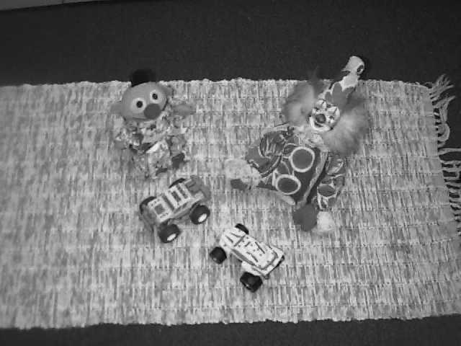
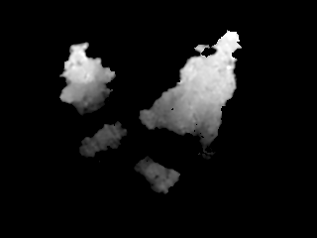
Dense 3D Reconstruction (Plane+Parallax)
Original
sequence
Plane-aligned
sequence
Recovered shape

Slide 26
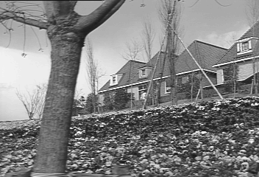
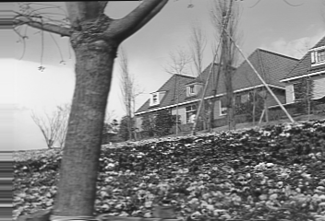

Dense 3D Reconstruction (Plane+Parallax)
Original sequence
Plane-aligned
sequence
Recovered shape
Notes:
Epipolar geometry in this case reduces to estimating the epipoles. Everything else is captured by the homography.

Slide 27
P+P Correspondence Estimation
1. Eliminating Aperture Problem
Brightness Constancy constraint
p
Epipolar line
epipole
The intersection of the two line constraints
uniquely defines the displacement.

Slide 28
Multi-Frame vs. 2-Frame Estimation
1. Eliminating Aperture Problem
Brightness Constancy constraint
p
another
epipole
Epipolar line
other epipolar line
epipole
The other epipole resolves the ambiguity !
The two line constraints are parallel
==> do NOT intersect

Slide 29
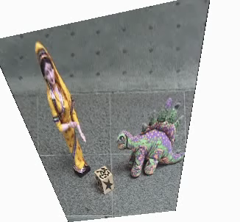
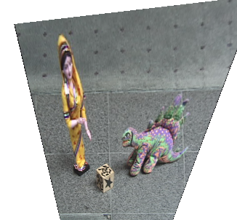
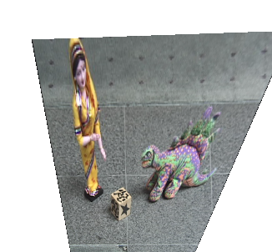

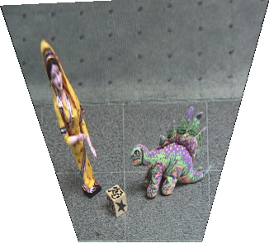
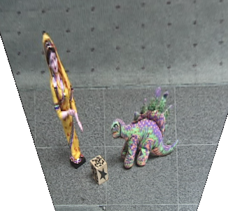
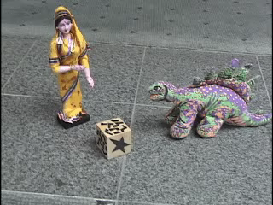
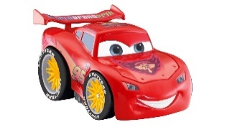
What about moving objects…?
Dual epipole
Parallax Geometry of Pairs of Points [ Irani & Anandan, ECCV’96 ]

