Slide 1
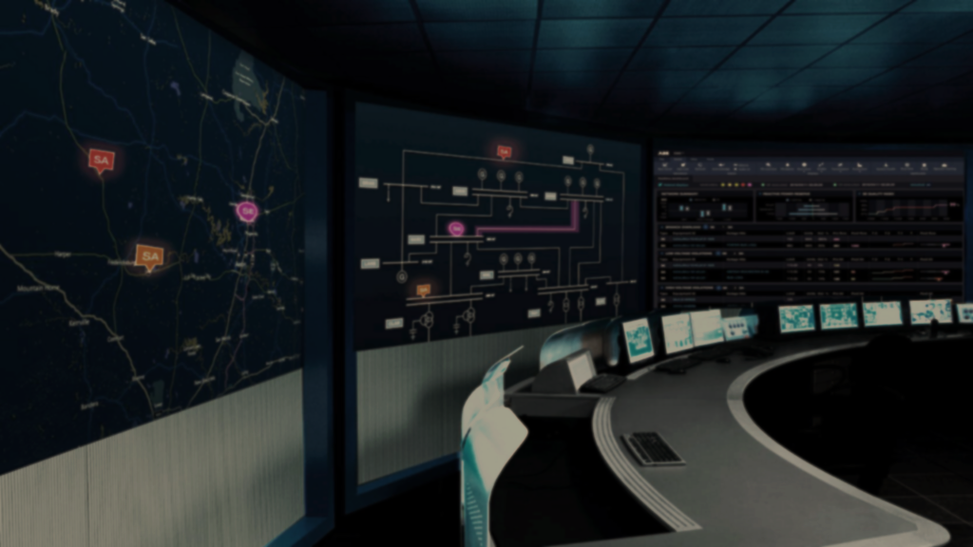

Final Exam Review
Dr. Thomas H. Morris
Electrical and Computer Engineering Department
University of Alabama in Huntsville
tommy.morris@uah.edu
Tommy Morris
Eminent Scholar and Professor, Electrical and Computer Engineering
Director, Center for Cybersecurity Research and Education
University of Alabama in Huntsville

Slide 2

Logistics
Exam Date: University dependent
  UAH: Friday, April 30
Exam Time: University dependent
  UAH: 300-5:30pm, Central
Where: University dependent
  UAH – Canvas Quiz w/Lockdown Browser

Slide 3
UAH: Installing Respondus Lockdown Browser
Before March 3 take the following practice quiz to install the Respondus Lockdown Browser.
  Lockdown Browser Install Quiz- Requires Respondus LockDown Browser”
This is a practice quiz with one question.
There is no credit for this quiz.
This quiz is available now and will be available for the rest of the semester.
You can take the quiz multiple times (if you change computers).

Slide 4
Topics
Lecture - Topics include all material presented in lecture after March 1 – written and verbal.
  ICS Vulnerabilities
  Network Attacks
  STRIDE
  Reconnaissance
  Injection Attacks
  DOS
  MITM
  Network Defense
  Risk and Threat
Exercises – material from lab exercises is fair game for the exam.
However, exam questions were made from the lecture content.

Slide 5
Number of questions
There will be approximate 40 questions.
This may vary by university.

Slide 6
Question Types
Multiple choice
True/False
Multiple answer
The exam will be automatically graded. However, the questions are new and the key may require some corrections by your faculty member.
Your grade may be adjusted based on key corrections.

